Slide 1

Introductory Statistics
Module 8:
Introduction to Sampling Distributions

Slide 2

Affirmations
I chose to move forward every day, growing and learning as I go!
I am capable of being a great student
I don’t need to be anyone else but me

Slide 3
Learning Goals
Deepen your understanding and form connections within these skills:
1 Describe a population and sample of interest
2 Use technology to find sample statistics from a sampling distribution
3 Use technology to create a sampling distribution of a sample proportion given n and p
4 Calculate the mean and standard deviation for a sampling distribution of a sample proportion
5 Recognize the difference between the standard deviation and the standard error of a sample proportion
6 Find the sample size needed for a sampling distribution to have a desired standard deviation
7 Check the conditions for normal approximation of a sampling distribution of a sample proportion
8 Use the normal distribution to calculate probabilities and percentiles from a sampling distribution

Slide 4

2020 November General Election Turnout Rates (1)
The 2020 November presidential election in the United States had one of the highest voter turnout rates in recent history.
Why do you think that is?
What proportion of voters do you think voted in the 2020 November presidential election?
Notes:
https://www.electproject.org/2020g

Slide 5
2020 November General Election Turnout Rates (2)
The voting-eligible population represents an estimate of persons eligible to vote regardless of voter registration status in an election and is constructed by modifying the voting-age population.
It is reported that 66.6% of the voting-eligible population voted for a candidate for president.
Is the value 66.6% a parameter or a statistic?
Explain your reasoning.
Notes:
https://www.electproject.org/2020g

Slide 6

Recall terms
The population is the entire collection of individuals or objects that you want to learn about.
A parameter describes a characteristic of a population.
A sample is a part of the population that is selected for study.
A statistic describes a characteristic of a sample.

Slide 7
2020 November General Election Turnout Rates (3)
Claim: If you take a simple random sample of 1,000 individuals from the U.S. voting-eligible population and ask each individual whether they voted in the 2020 November presidential election, 666 of them will answer yes.
What do you think of this claim?
Is it true? Is it false?
Why?
Notes:
https://www.electproject.org/2020g

Slide 8

Let’s collect data!
How many people in your class are considered voting-eligible individuals during 2020 election?
What is the proportion of the the voting-eligible population voted for a candidate for president in the 2020 election in your class?

Slide 9

Random Sample
Suppose you plan to take a simple random sample of 30 individuals from the U.S. voting-eligible population and ask each individual whether they voted in the 2020 November presidential election.
1 Do you think it is likely for your sample proportion to be 0.6? Explain.
2 Do you think it is likely for your sample proportion to be 0.3? Explain.

Slide 10

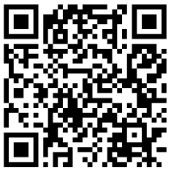
Let’s Simulate!
Simulate 5 different samples of 30.
What are the sample proportions?
Are they the same?
Are they the same as the claimed proportion?
Recall:
It is reported that 66.6% of the voting-eligible population voted for a candidate for president.

Slide 11

Let’s Simulate! (again)
Simulate 100 different samples of 30.
What is the mean of the sample proportions?
What is the standard deviation of the sample proportions?
Discussion:
Why do we want to draw 100 samples?
What is the purpose of obtaining the sampling distribution of a sample proportion?

Slide 12

Let’s Simulate! (again… and again)
Simulate 1,000 different samples of 30.
What is the mean of the sample proportions? Interpret this value.
What is the standard deviation of the sample proportions? Interpret this value.
Are these values the same as the values you found using 100 simulated samples?
Approximate:
Use the 1,000 simulated samples to approximate the proportion of the simulated samples with a sample proportion of 0.6.
Interpret this value.

Slide 13
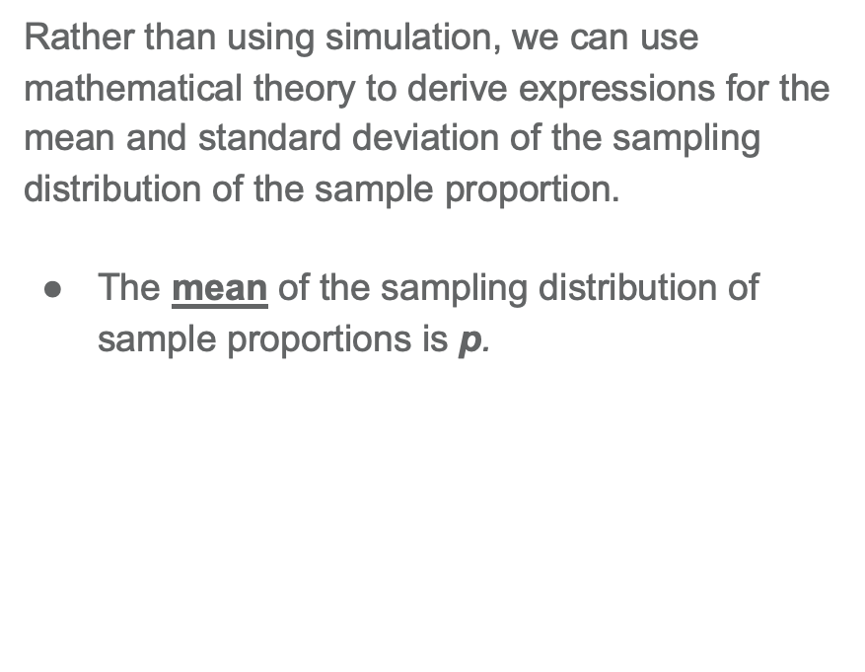
Key Takeaway (1)
Rather than using simulation, we can use mathematical theory to derive expressions for the mean and standard deviation of the sampling distribution of the sample proportion.
The mean of the sampling distribution of sample proportions is p.
The standard deviation of the sampling distribution of sample proportions is
$$\sqrt{\frac{p\left(1−p\right)}{n}}$$

Slide 14
2020 November General Election Turnout Rates (4)
It is reported that 66.6% of the voting-eligible population voted for a candidate for president. We plan to take samples of 30 individuals from the U.S. voting-eligible population.
Calculate the mean and standard deviation of the sampling distribution of a sample proportion using the mathematical formula.
How does the mean and standard deviation values compare to the values generated from the simulation?
Notes:
https://www.electproject.org/2020g

Slide 15
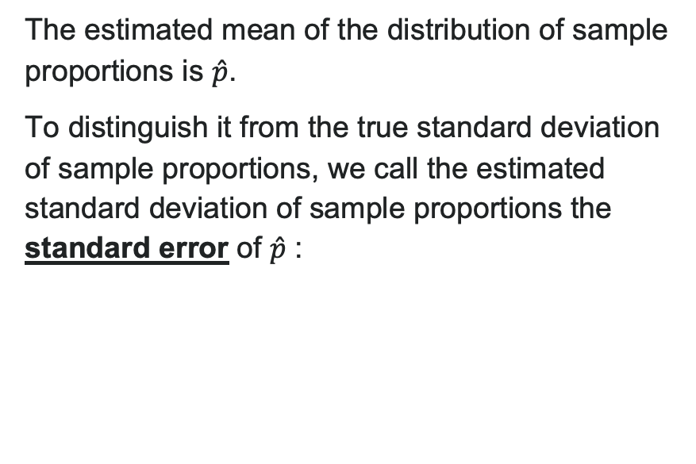
Key Takeaway (2)
The estimated mean of the distribution of sample proportions is $\hat{p}$.
To distinguish it from the true standard deviation of sample proportions, we call the estimated standard deviation of sample proportions the standard error of $\hat{p}$ :
Standard Error: $SE=\sqrt{\frac{\hat{p}\left(1−\hat{p}\right)}{n}}$

Slide 16
What is the Sampling Distribution of the Sample Proportion?
As the number of trials gets really large, what do you notice about the sampling distribution of the sample proportion graph?
What happened to the variability of the sampling distribution as the sample size increased?
In your own words, explain the Central Limit Theorem (CLT) for the sampling distribution of the sample proportion.
Notes:
CLT: As the sample size gets larger, the distribution of the sample proportion will become closer to a normal distribution.

Slide 17
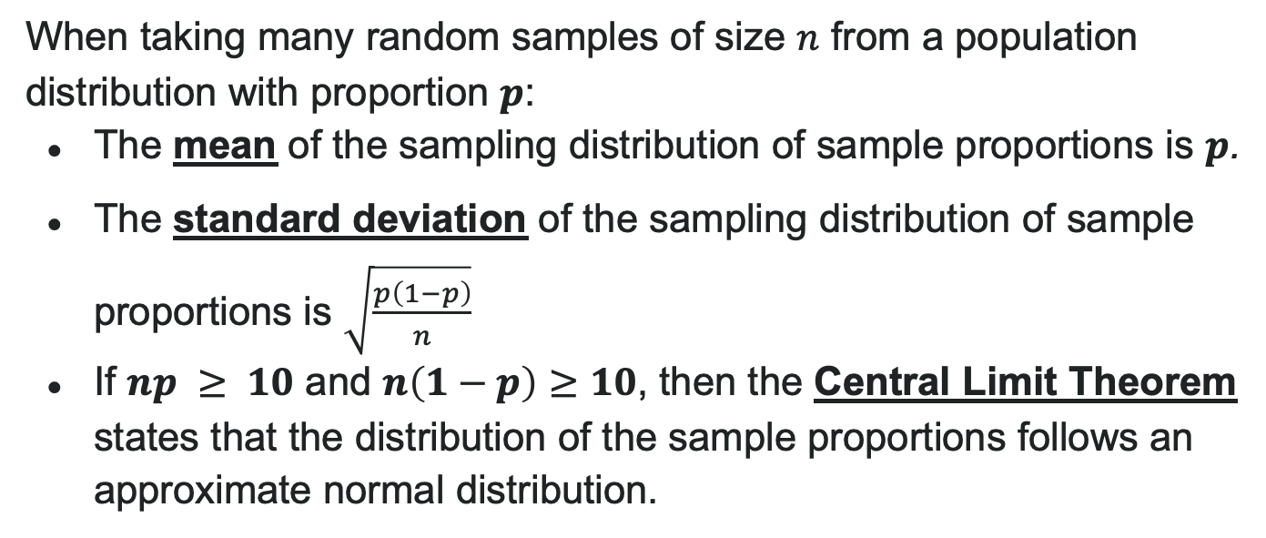
Sampling Distribution of the Sample Proportion
When taking many random samples of size $n$ from a population distribution with proportion $p$:
The mean of the sampling distribution of sample proportions is $p$.
The standard deviation of the sampling distribution of sample proportions is $\sqrt{\frac{p\left(1−p\right)}{n}}$
If $np ≥ 10$ and $n\left(1−p\right)≥10$, then the Central Limit Theorem states that the distribution of the sample proportions follows an approximate normal distribution.

Slide 18

2020 November General Election Turnout Rates (5)
It is reported that 66.6% of the voting-eligible population voted for a candidate for president.
Verify that we can model the distribution of sample proportions from random samples of 30 voting-eligible individuals with a normal distribution.
Notes:
https://www.electproject.org/2020g

Slide 19
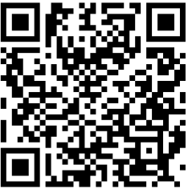
2020 November General Election Turnout Rates (6)
Use the Normal Distribution tool to complete the following sentence:
If the true proportion of the voter turnout rates is 66.6%, then in approximately 95% of all random samples of 30 voting-eligible individuals, the sample proportion who voted would fall between ________ and ________.
Notes:
https://www.electproject.org/2020g

Slide 20

2020 November General Election Turnout Rates (7)
Consider your answers to the fill-in-the-blanks question. Does this data provide strong evidence that the percentage of voting-eligible individuals who did vote in the 2020 presidential election is more than the national average of 70%? Explain.

Slide 21
2020 November General Election Turnout Rates (8)
We would like to do a follow-up study but would like the standard deviation of the sample proportion to be no higher than 0.01. Recall that it is reported that 66.6% of the voting-eligible population voted for a candidate for president. How many individuals would we need to ensure that the standard deviation of sample proportions is at most 0.01?

Slide 22

Reflection
What is a sampling distribution for a sample proportion?
How can we use the sampling distribution to make an inference?
What is the Central Limit Theorem and why is it important?
What does it mean to make an inference using data?

