Slide 1

Introductory Statistics
Module 7:
The Normal Distribution

Slide 2

Affirmations
I will handle whatever happens, like I always do
I am well-organized and plan my days efficiently
People see the good in me and I see the good in them

Slide 3
Learning Goals
Deepen your understanding and form connections within these skills:
1 Understand the concept of a probability distribution and its role in describing the behavior of a random variable
2 Describe the characteristics of probability distributions
3 Understand the properties and the characteristics of a normal distribution and its importance in statistical analysis
4 Explain how changing the mean and standard deviation will change the shape of a normal curve
5 Understand the properties and the characteristics of the standard normal distribution
6 Calculate probabilities and percentiles using normal distribution and z-scores with technology

Slide 4

Key Takeaway (1)
Probability model (probability distribution) includes all possible outcomes of a chance experiment and the probabilities associated with those outcomes.

Slide 5
Key Takeaway (2)
The outcomes are random events.
All outcomes are assigned a probability.
The probabilities are numbers between 0 and 1.
The sum of all of the probabilities is 1.

Slide 6

Probability Distributions - Coin Toss
Break down the probabilities of getting heads or tails in a fair coin toss and create a probability distribution table for a coin toss. What are the possible outcomes, and what probabilities would you assign to each? How does this table represent the discrete probability distribution for the coin toss?
Discuss different ways to visually represent the probabilities of a coin toss. Would you use a bar chart, pie chart, or another visualization method? How does this visual representation enhance understanding?

Slide 7
Key Takeaway (3)
A discrete probability distribution is a type of probability distribution that shows all possible values of a discrete random variable (countable or finite outcomes) along with the probabilities associated with those outcomes.

Slide 8

Let’s discuss probability distributions!
Brainstorm other situations where discrete probability distributions might be relevant.
How can the principles learned from the coin toss example be applied to more complex scenarios?

Slide 9
Probability Distributions - Height of Adults
Imagine you are a researcher studying the height of adult individuals in a large population. You collect height data from a representative sample and are interested in understanding the distribution of heights within the population.
Discuss the characteristics of the distribution in the context of adult heights.

Slide 10
Key Takeaway (4)
A continuous probability distribution is a probability distribution for a continuous random variable (an infinite and uncountable random variable).

Slide 11
Probability Distributions - Height of Adults cont.
Imagine you are a researcher studying the height of adult individuals in a large population. You collect height data from a representative sample and are interested in understanding the distribution of heights within the population.
Create a visual representation of the distribution of adult heights. How might you represent the heights on a graph, and what insights can be gained from the graph?

Slide 12
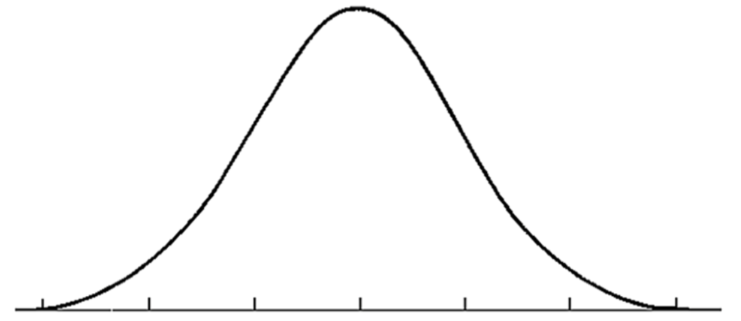
Key Takeaway (5)
A normal distribution is a mathematical model with a smooth bell-shaped curve to describe the bell-shaped data distributions.
It is a continuous random variable.
Centered at the mean.
Bell-shaped.

Slide 13
Key Takeaway (6)
A normal distribution with a mean (μ) = 0 and a standard deviation (σ) = 1 is called the standard normal (z) distribution.

Slide 14


Let’s explore!
Change the Mean!
Increase the mean from 0 to a few different positive values
Decrease the mean from 0 to a few different negative values
How does changing the mean impact the central tendency of the distribution?
What implications does this shift have for the interpretation of data? Discuss the corresponding changes in the shape and location of the probability distribution curve.

Slide 15
Let’s explore!... more
Change the Standard Deviation!
Increase the mean from 1 to a few larger values
Decrease the mean from 1 to a few smaller values
Examine the concept that adjusting the standard deviation results in the stretching or compressing of the entire probability distribution curve.
How does varying the standard deviation impact the spread or dispersion of data?
What visual and interpretative changes occur in the curve as a result?

Slide 16
ESG Score (1)
Investors are becoming increasingly more concerned with the environmental and social impact of the companies with which they associate. Several rating agencies have taken on the task of assessing these investment companies by evaluating each with an environmental, social, and governance (ESG) score. These scores are based on many factors, including carbon footprint, labor practices, board diversity, etc. Many agencies use a scale of 0 - 100 points.

Slide 17
Let’s discuss ESG!
What are ESG scores, and how are they used to assess the sustainability and ethical practices of companies?
What are the key components of ESG—and how do they relate to each other?
Why is there a growing focus on ESG factors in investment and corporate decision-making?
How do ESG scores encourage companies to adopt responsible and sustainable business practices?
What impact can ESG initiatives have on a company's reputation and competitiveness?

Slide 18
ESG Score (2)
Assume the distribution of the ESG scores is approximately normal with a mean of 74 and a standard deviation of 8 points.
Find the probability that a randomly selected company received a score greater than 81.

Slide 19
ESG Score (3)
Assume the distribution of the ESG scores is approximately normal with a mean of 74 and a standard deviation of 8 points.
Companies with a score of less than 50 are considered to be performing poorly.
Find the probability that a randomly selected company received a score less than 50.

Slide 20
ESG Score (4)
Assume the distribution of the ESG scores is approximately normal with a mean of 74 and a standard deviation of 8 points.
Find the probability that a randomly selected company receives a score between 65 and 80.

Slide 21
ESG Score (5)
Assume the distribution of the ESG scores is approximately normal with a mean of 74 and a standard deviation of 8 points.
What score does a company at the 25th percentile have?

Slide 22
ESG Score (6)
Assume the distribution of the ESG scores is approximately normal with a mean of 74 and a standard deviation of 8 points.
In order to be in the top 10%, what score does a company need?

Slide 23

Let’s discuss!
Discuss the implications of the assumed normal distribution of ESG scores for investors and companies.
How does the mean of 74 and standard deviation of 8 points provide insights into the central tendency and variability of these scores?

Slide 24
Let’s discuss! cont.
Consider the significance of a normal distribution in this context, particularly in terms of understanding the relative performance of companies.
Discuss potential scenarios or strategies investors might consider based on the given distribution parameters, and how companies might interpret their ESG scores in relation to the broader market.

Slide 25

Reflection
What aspects of probability distributions do you find most challenging, and why?
How would you explain the concept of a probability distribution to someone who is new to the topic?
Discuss situations where data may not follow a normal distribution. Explore the implications of working with non-normally distributed data.
Explore the relationship between the standard deviation and the shape of the normal distribution curve.

