Slide 1

Introductory Statistics
Module 6:
Probability

Slide 2

Affirmations
I do not give up, I find solutions
I continually improve my time management skills
I am building my future

Slide 3
Learning Goals (1)
Deepen your understanding and form connections within these skills:
1 Define and calculate the probability in a chance experiment
2 Recognize the differences between theoretical and empirical probability
3 Calculate and interpret probabilities of simple and compound events
4 Understand the concept of mutually exclusive events
5 Describe and find conditional probabilities
6 Understand the concept of independent events

Slide 4

Extracurricular Activities
What clubs, sports, or activities are you a part of?
What are the personal and academic advantages of these extracurricular activities?
How can participation in certain extracurricular activities help students develop skills and experiences that are valuable for future careers?
Are extracurricular activities accessible and inclusive to all students, regardless of their background, abilities, or socioeconomic status?
How can schools and organizations ensure that a diverse range of students can participate?
Notes:
https://www.electproject.org/2020g

Slide 5

Key Takeaway (1)
Probability is a measure that is associated with how certain we are of outcomes of a particular experiment or activity.

Slide 6
Speech and Debate Team – probability
Your school’s speech and debate team has 16 student members - 6 seniors, 4 juniors, 4 sophomores, and 2 freshmen.
Suppose a member is chosen at random to represent the school on an all-state speech and debate committee.
In terms of probability, which grade level is the most likely to be chosen to represent the school?
Notes:
https://www.electproject.org/2020g

Slide 7
Key Takeaway (2)
The sample space of a chance experiment is the collection of all possible outcomes for the experiment.
The uppercase letter S is typically used to denote the sample space.

Slide 8
Speech and Debate Team – sample space
Your school’s speech and debate team has 16 student members - 6 seniors, 4 juniors, 4 sophomores, and 2 freshmen.
Suppose a member is chosen at random to represent the school on an all-state speech and debate committee.
What is the sample space?
Notes:
https://www.electproject.org/2020g

Slide 9
Key Takeaway (3)
Theoretical probability is the probability that an event will happen based on pure mathematics, not by carrying out an experiment.
When the outcomes of the sample space are equally likely, the probability of an event is the number of outcomes in the event divided by the number of possible outcomes in the sample space.

Slide 10
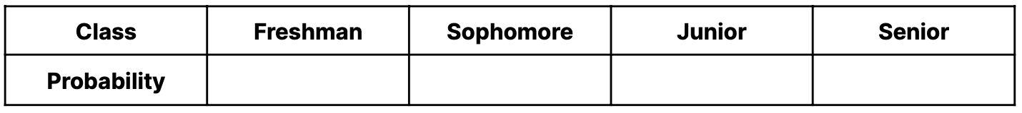
Speech and Debate Team – distribution table
Your school’s speech and debate team has 16 student members - 6 seniors, 4 juniors, 4 sophomores, and 2 freshmen.
Suppose a member is chosen at random to represent the school on an all-state speech and debate committee.
Fill out the probability distribution table below.
Notes:
https://www.electproject.org/2020g

Slide 11
Speech and Debate Team – finding probabilities
Your school’s speech and debate team has 16 student members - 6 seniors, 4 juniors, 4 sophomores, and 2 freshmen.
Suppose a member is chosen at random to represent the school on an all-state speech and debate committee.
Fill the following probabilities:
Find the probability that the randomly selected student is a senior.
Find the probability that the randomly selected student is an underclassman (freshman or sophomore).
Notes:
https://www.electproject.org/2020g

Slide 12
Key Takeaway (4)
“OR” Events
An outcome is in the event A OR B if the outcome is in A or is in B or is in both A and B.
P(A or B) = P(A ∪ B) = the relative frequency of either event A or B (or both) must happen in the outcome.

Slide 13
Speech and Debate Team – probability of NOT
Your school’s speech and debate team has 16 student members - 6 seniors, 4 juniors, 4 sophomores, and 2 freshmen.
Suppose a member is chosen at random to represent the school on an all-state speech and debate committee.
Find the probability that a randomly selected student is NOT a junior.
Notes:
https://www.electproject.org/2020g

Slide 14
Key Takeaway (5)
Complement of an Event
The complement of event A is denoted A′ (read “A prime”) or A^{c} (read “A complement”).
The complement of the event A consists of all outcomes that are NOT in A.
P(A) + P(not A) = 1 or P(A) + P(A′) = 1

Slide 15

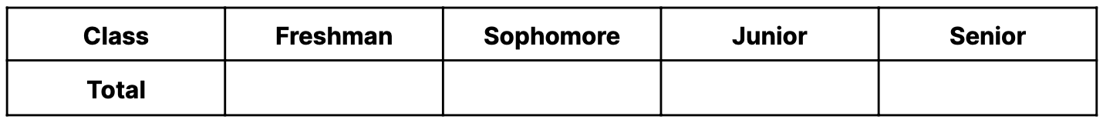
Let’s collect data!
Your school’s speech and debate team has 16 student members - 6 seniors, 4 juniors, 4 sophomores, and 2 freshmen.
In each group, on 16 slips of paper write each of the students’ classes, one per slip. Place all slips in a hat or bag. Draw a slip from the bag and record the class in the table below. Put the slip back in the bag and repeat this 10 times. Record the tally.

Slide 16
Let’s collect data! cont.
Your school’s speech and debate team has 16 student members - 6 seniors, 4 juniors, 4 sophomores, and 2 freshmen.
Combine your tallies and all of your classmates together below.
Using the table above, create the probability distribution table for the experiment.

Slide 17

Let’s discuss!
When you are collecting your samples using the experiment, what do you notice about the experimental (empirical) probability of randomly selecting a senior?
Compare this to your answer to your previous answer. Why might these be different?

Slide 18
Key Takeaway (6)
The probability estimated from a chance experiment is called an empirical probability.

Slide 19

Reflection – calculating probabilities
Can I articulate the fundamental concepts of probability, such as sample space, events, and outcomes?
Do I understand the difference between empirical and theoretical probability?
How comfortable am I with using the complement rule?
Why is learning to calculate probabilities important? How might this be helpful in a real-world scenario?

Slide 20
Chess Tournament
At a recent high school chess tournament, participants recorded whether or not they had the first move as well as if they won or lost the game.
How might having the first move in a chess game impact the player's overall strategy and likelihood of winning?
Notes:
https://www.electproject.org/2020g

Slide 21

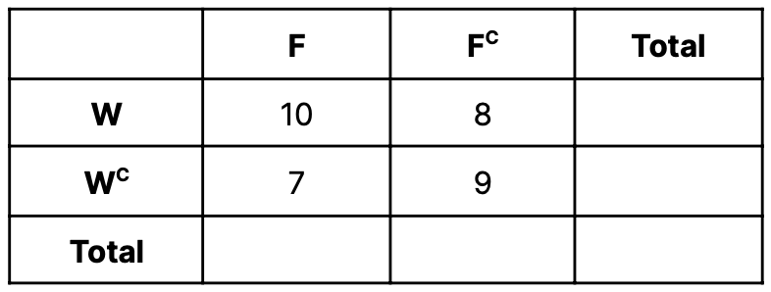
Let’s calculate probabilities! (1)
In the table below, F represents those who had the first move and W represents those who won. Suppose a student is selected at random.
Find P(F) and P(F^{C}).
Is it possible for one student to have the first move and not have the first move in a chess match? What do you call these types of events?

Slide 22

Key Takeaway (7)
Mutually Exclusive Events
If event A and event B are mutually exclusive, then
P(A or B) = P(A∪B) = P(A) + P(B)

Slide 23
Let’s calculate probabilities! (2)
In the table below, F represents those who had the first move and W represents those who won. Suppose a student is selected at random.
Find the probability that the student did not win.
Find the probability that the student had the first move and did not win.

Slide 24
Key Takeaway (8)
“AND” Events
AND (∩) means that both events must happen.
P(A and B) = P(A∩B) = the relative frequency of events A and B must happen in the same outcome.

Slide 25
Let’s calculate probabilities! (3)
In the table below, F represents those who had the first move and W represents those who won. Suppose a student is selected at random.
Find the probability that the student had the first move or won.
Important Note: Do not double count the frequency when both event A and B occurs.

Slide 26
Key Takeaway (9)
A conditional probability is calculated based on the assumption that one event has already occurred.
Conditional probabilities restrict the total.
The new total is indicated after the word “given” in the question.
The conditional probability of A given B is written P(A given B) or P(A|B).
P(A given B) is the probability that event A will occur given that the event B has already occurred.

Slide 27
Let’s calculate probabilities! (4)
In the table below, F represents those who had the first move and W represents those who won. Suppose a student is selected at random.
Find the probability that a randomly selected student won given that they had the first move.

Slide 28
Let’s calculate probabilities! (5)
In the table below, F represents those who had the first move and W represents those who won. Suppose a student is selected at random.
Find the probability that a randomly selected student had the first move given that they won.

Slide 29
Key Takeaway (10)
Independent Events
Events A and B are independent if
P(A given B)=P(A)
Alternatively: Two events are independent if
P(A and B)=P(A)×P(B)

Slide 30
Let’s calculate probabilities! (6)
In the table below, F represents those who had the first move and W represents those who won. Suppose a student is selected at random.
What does it mean for two events to be independent? Are the events F and W independent? How would you know?

Slide 31
Reflection – probability strategies
Considering the data on having the first move and winning, what strategies do you think chess players might employ when they have the first move? How might different players approach the game based on this information?
Do I feel confident in choosing the right probability rule for different types of problems?
What topics related to probability would I like to explore further?

