Slide 1

Introductory Statistics
Module 5:
Modeling and Analysis of Bivariate Data

Slide 2

Affirmations
I choose to see obstacles as opportunities
I embrace growth and learning
I am a good learner

Slide 3
Learning Goals (1)
Deepen your understanding and form connections within these skills:
1 Answer questions from a scatterplot
2 Describe the trend of bivariate data
3 Calculate the correlation coefficient and explain what it means

Slide 4

Movie Ratings
When deciding if you want to watch a movie, do you rely more on what professional movie critics think about a movie or what other regular moviegoers think about a movie?
Notes:
Time estimate: 2 minutes
Whole group discussion
Answers will vary.
Sample answer: I usually rely on what regular moviegoers think because I care more about what will be entertaining rather than the technical qualities of the movie.

Slide 5

Recall variables
The Explanatory Variable is used to predict the Response Variable
The Explanatory Variable is used to calculate the Response Variable
The Explanatory Variable is used to determine the Response Variable
Notes:
Time estimate: 1 minute

Slide 6

What are the explanatory and response variables?
Rotten Tomatoes (rottentomatoes.com) is an American review-aggregation website for film and television. On this website, movie critics write reviews and regular moviegoers submit ratings (1–5 stars) for movies and TV shows.
Sampling from 125 movies from the website, we have obtained the following variables:
tomatometer: The “Tomatometer” score calculated as the percentage of professional movie and TV critics who write a positive review for the movie.
audience_score: The percentage of the general public (regular moviegoers) who rate the movie 3.5 stars or higher (out of 5 stars).
Notes:
Time estimate: 1 minute
audience_score: Response variable
tomatometer: Explanatory variable
Since the objective is to use the Tomatometer score to predict how the general audience will rate the movie, the Tomatometer score is the explanatory variable.

Slide 7
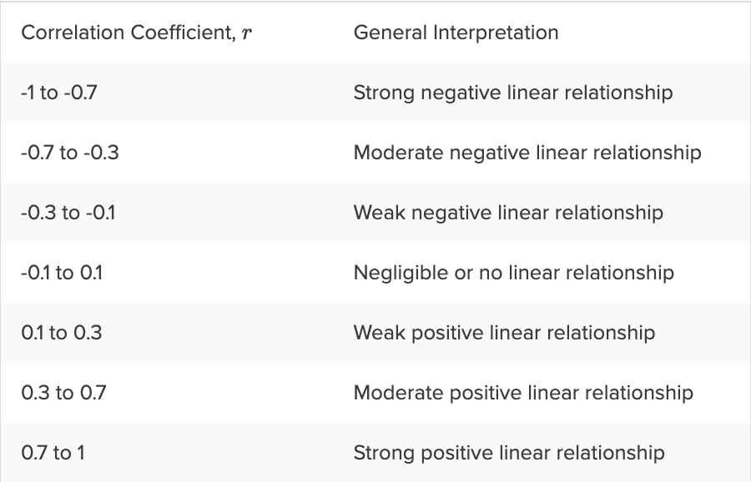

Recall $r$
The correlation coefficient (r) is a numerical measure that measures the strength and direction of a linear relationship between two quantitative variables.
Notes:
Time estimate: 1 minute

Slide 8

Use the
"Movie Ratings"
data set and its scatterplot to answer the questions on the next slide
Notes:
Time estimate: 2 minutes
Time to get the scatterplot and explain directions

Slide 9
Data set: “Movie Ratings” (1)
Create the scatterplot.
What is the correlation coefficient?
Describe the relationship between the Tomatometer and audience scores.
Notes:
Time estimate: 10 minutes
r= 0.697
There is a positive, moderately strong linear relationship between the Tomatometer score and the audience score.

Slide 10
Learning Goals (2)
Deepen your understanding and form connections within these skills:
4 Recognize when a linear regression model will fit a given data set
5 Use technology to create scatterplots, find the line of best fit, and find the correlation coefficient
6 Find the estimated slope and y-intercept for a linear regression model
7 Use the line of best fit to predict values

Slide 11
Recall LSR
Least Squares Regression (LSR) Analysis is
a method we will use to make predictions about missing observations or future observations in bivariate data
Can also be described as linear modeling, where we determine the equation of a line of best fit to make predictions based on an existing dataset.
Notes:
Time estimate: 1 minute

Slide 12
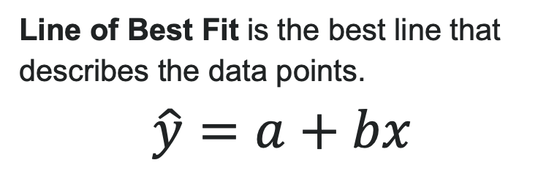
Recall line of best fit
Line of Best Fit is the best line that describes the data points.
$$\hat{y}=a+bx$$
Notes:
Time estimate: 1 minute

Slide 13
Data set: “Movie Ratings” (2)
Use the statistical tool to calculate the line of best fit.
audience_score = _____ + ______ x Tomatometer
Interpret the slope of the line of best fit in context of the problem.
Interpret the y-intercept in context of the problem. Does this value even makes sense?
Notes:
Time estimate: 10 minutes
audience_score= 35.465 + 0.479 ∙ tomatometer

Slide 14
Data set: “Movie Ratings” (3)
You and your friends want to watch a movie, and you're considering five movies recommended by your peers. You have the Tomatometer score for each movie, but you want to get an idea of how a regular movie goer might enjoy the movie to help you decide.
To help figure this out, you decide to use your line of best fit to predict what the audience score is based on the Tomatometer score.
Notes:
Time estimate: <1 minutes

Slide 15
Data set: “Movie Ratings” (4)
Movie | Tomatometer | Predicted Audience Score
Aladdin (2019) | 57
Fantastic Four | 9
Parasite | 98
The Grinch | 58
Avengers: Age of Ultron | 75
Chaos Walking | 22
Notes:
Time estimate: 5 minutes
audience_score= 35.465 + 0.479 ∙ tomatometer

Slide 16
Extrapolation:
Using the model to predict for values of the explanatory variable far outside the range in our data
Notes:
Time estimate: 1 minute

Slide 17
Data set: “Movie Ratings” (5)
For which movie would making a prediction be considered an extrapolation?
If we used the line of best fit from the "Movie Ratings" data set to calculate predicted audience scores, for which Tomatometer scores would the estimates be considered extrapolation?
Based on the predicted audience scores, which movie will you and your friends watch?
Notes:
Time estimate: 3 minutes
Fantastic Four; the minimum Tomatometer score in the data is 20.
The lowest Tomatometer score is 20, so it would be extrapolation to make predictions for movies with really low Tomatometer scores (i.e., movies that got close to all negative reviews).
Parasite, since it has the highest predicted audience score

Slide 18
Data set: “Movie Ratings” (6)
Movie | Tomatometer | Actual Audience Score
Aladdin (2019) | 57 | 94
Parasite | 98 | 90
The Grinch | 58 | 50
Avengers: Age of Ultron | 75 | 83
Chaos Walking | 22 | 72
Did the line of best fit overpredict or underpredict the audience score for your movie? Are these results surprising? Explain.
Notes:
Time estimate: 5 minutes
audience_score= 35.465 + 0.479 ∙ tomatometer

Slide 19
Learning Goals (3)
Deepen your understanding and form connections within these skills:
8 Describe how the slope, shape of the data, and the coefficient of determination are connected
9 Find R² and explain what it means
10 Describe the connection between the residual and the position of a data point relative to the line of best fit
11 Create and use a residual plot to identify influential points and assess the regression model
12 Determine the reliability of predictions from the line of best fit using the residuals and standard error of the residuals

Slide 20
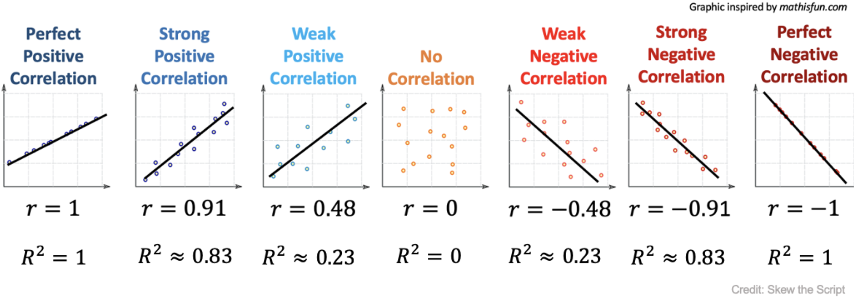

Recall $r^{2}$
Coefficient of Determination (r² or R²) is the proportion of the variation in the response variable that can be explained by its linear relationship with the explanatory variable
Written as a decimal or a percentage between 0-100%
Notes:
Time estimate: 2 minutes

Slide 21

Data set: “Movie Ratings” (7)
What is its coefficient of determination?
What does it measure?
Write a sentence to describe what this value represents.
Notes:
Time estimate: 10 minutes

Slide 22
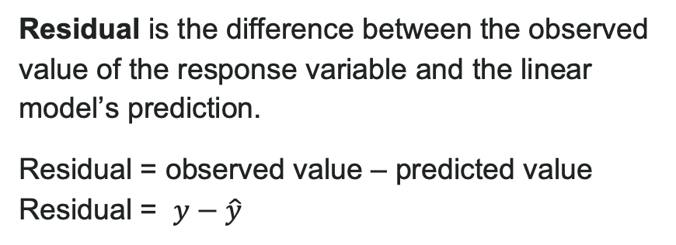
Recall residual
Residual is the difference between the observed value of the response variable and the linear model’s prediction.
Residual = observed value – predicted value
Residual = $y−\hat{y}$
Notes:
Time estimate: 2 minutes
Teacher has time to read the slides, answer questions, and maybe explain in their own words.

Slide 23
Recall residual standard error
Residual Standard Error is a measure of the variability in the residuals. It is the typical error we expect in predictions using the line of best fit.
A large residual standard error indicates there is a lot of spread in the scatter of the points around the line of best fit and thus more variability in the residuals.
If all the data points fit perfectly on the line, the line is a perfect fit for the data and residual standard error = 0.
This scenario almost never occurs in practice!
Notes:
Time estimate: 2 minutes

Slide 24
Data set: “Movie Ratings” (8)
Assess the fit of the line based on its residual standard deviation/error.
Use the statistical software to calculate the residual standard error/deviation.
Based on the residual standard error, would you recommend using this line of best fit to predict the audience score for a movie based on the Tomatometer? Explain.
Notes:
Time estimate: 5 minutes

Slide 25
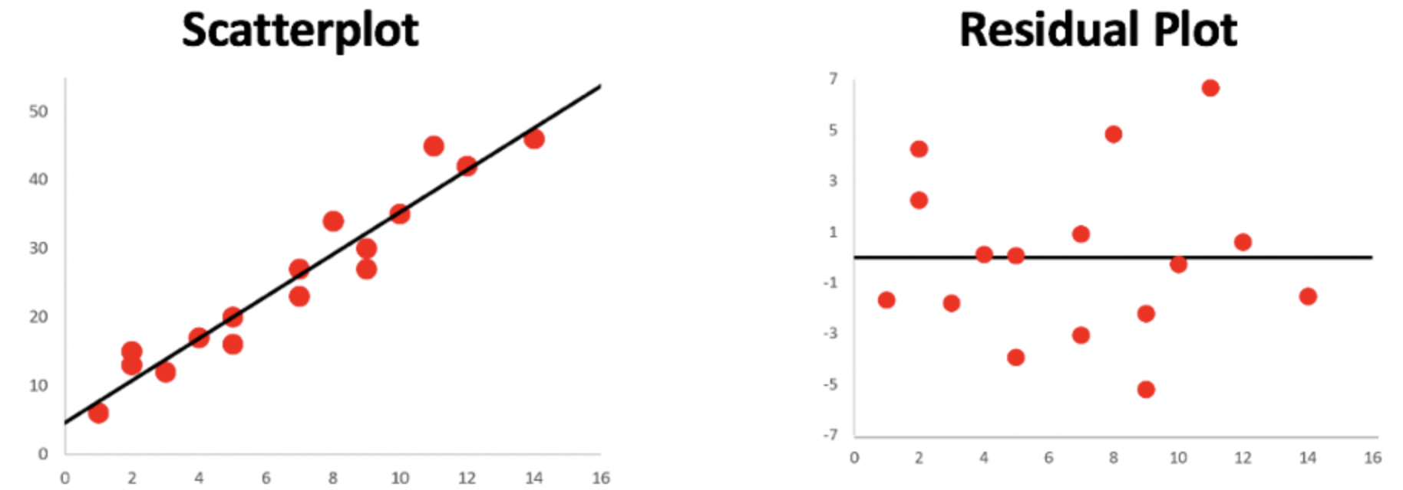
Recall residual plots
Residual plots emphasize the residual values in our model.
The following scatterplot and corresponding residual plot show that our linear regression model is appropriate: the residual values appear to be randomly scattered across the x-values, with no clear patterns or changes in variability.
Notes:
Time estimate: 2 minutes

Slide 26
Data set: “Movie Ratings” (9)
Assess the fit of the line based on its residual plot.
Create the residual plot in the statistical tool for the data set to help us assess the reasonableness of our linear model.
Is there any reason to question if a linear model is appropriate? Explain.
Notes:
Time estimate: 5 minutes

Slide 27

Great job today!!!

