Slide 1

Introductory Statistics
Module 4:
Describing Data Numerically

Slide 2

Affirmations
Every wrong answer is an opportunity to learn
I am excited to learn today
I deserve happiness.

Slide 3
Learning Goals (1)
Deepen your understanding and form connections within these skills:
1 Name and compare the measures of center
2 Find and use measures of center to explain the typical value
3 Name the features of the distribution of a dataset
4 Describe the connection between the shape and measures of center

Slide 4


Recall mean
The mean of the data set (also known as the average) represents the central tendency for symmetrical distributions.
The median (or middle value) of a data set represents the central tendency for skewed distributions.
$μ$ - population mean

Slide 5

Activity: Understanding Average

Slide 6
Am I Average?
Example:
“How old is the average college student?”
“What percent of college students are the average age?”

Slide 7

Let’s Brainstorm!
Create a list of questions about the average value of something, and then a question to test the average.
Example
“How old is the average college student?”
“What percent of college students are the average age?”

Slide 8

Test the Average
Choose a question, or two, to look up on the internet. 1 Is the average misleading why or why not?
2 Describe the data found to answer the question. Is the data skewed? In what direction? Does the data contain outliers?

Slide 9

Questions to Review
1 Use the summary statistics to interpret the mean and median peak chart ranking for a Beyonce single released in the U.S.
2 What measure of center should be used to describe the typical ranking of a Beyonce song and why?
Notes:
Sample answer
Median: Half of Beyonce’s singles rank 28 or higher and half rank below 29
Mean: The average peak chart ranking is 33rd

Slide 10
Learning Goals (2)
Deepen your understanding and form connections within these skills:
5 Read information from a boxplot and make conclusions
6 Compare boxplots
7 Use histograms and dotplots to describe differences in variability
8 Calculate the standard deviation and then explain what it means
9 Calculate z-scores to explain the location of data points
10 Compare observations using z-scores and the Empirical Rule

Slide 11
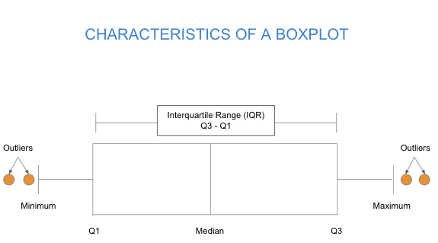

Recall boxplots
A boxplot is a graphical visualization of a quantitative variable that shows median, spread, skew, and outliers by illustrating a set of numbers (minimum, Q1, median, Q3, and maximum) called the five-number summary.
The interquartile range (sometimes denoted as IQR) is the difference between the quartiles calculated as Q3–Q1.

Slide 12

Recall outliers
An outlier is a data point that is far from the majority of the data.
Upper outliers are above the majority and lower outliers are below the majority
The 1.5(IQR) rule can be used to classify data points as outliers
Lower fence: Q1-1.5(IQR)
Upper fence: Q3+1.5(IQR)

Slide 13
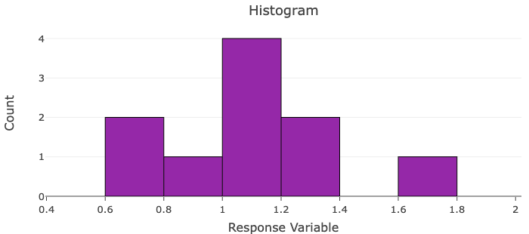
Questions to Review (1)
The histogram displays the earnings (in billions) for the top grossing Disney animated film for each year from 2010 to 2019
3 Does the data appear to have an outlier?
4 Use the 1.5(IQR) method to determine if there are any outliers.
1.07, 0.67, 0.88, 1.29, 0.66, 1.16, 1.03, 1.03, 1.24, 1.66

Slide 14
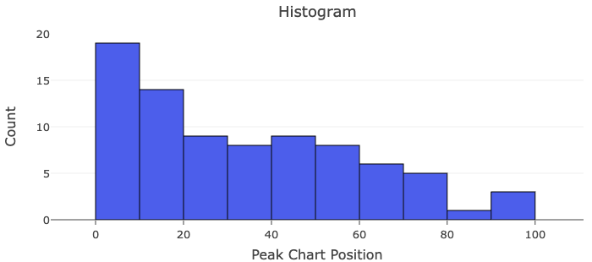
Questions to Review (2)
5 The histogram displays the peak chart position for every single released by Beyonce in the U.S. Note that songs that did not chart were removed from the dataset.
Sketch a boxplot that would display the same data as in the histogram.
Source: https://en.wikipedia.org/wiki/Beyonc%C3%A9_singles_discography

Slide 15
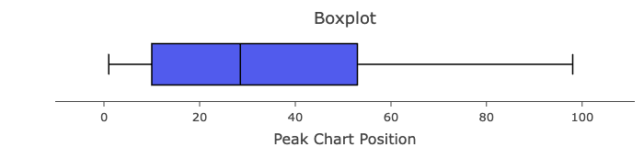
Questions to Review (3)
5 Solution:
Source: https://en.wikipedia.org/wiki/Beyonc%C3%A9_singles_discography

Slide 16

Recall spread
The range, IQR, and standard deviation can be used to describe the spread of a data set.
Range = maximum - minimum
IQR = Q3 - Q1
Standard deviation - average distance from the mean
Standard deviation will be calculated using technology and is represented as

Slide 17

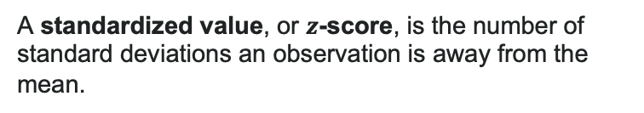

Recall z-score
A standardized value, or $z$-score, is the number of standard deviations an observation is away from the mean.
$$z=\frac{x−μ}{σ}= \frac{\text{Observed} \text{Valu}e−m\text{ean}}{\text{standard} \text{deviation}}$$
Z-scores give us a way to compare values in different distributions
For a normal distribution
68% of data are within 1 deviation of the mean
95% of the data are within 2 deviations of the mean
99.7% of the data are within 3 deviations of the mean

Slide 18

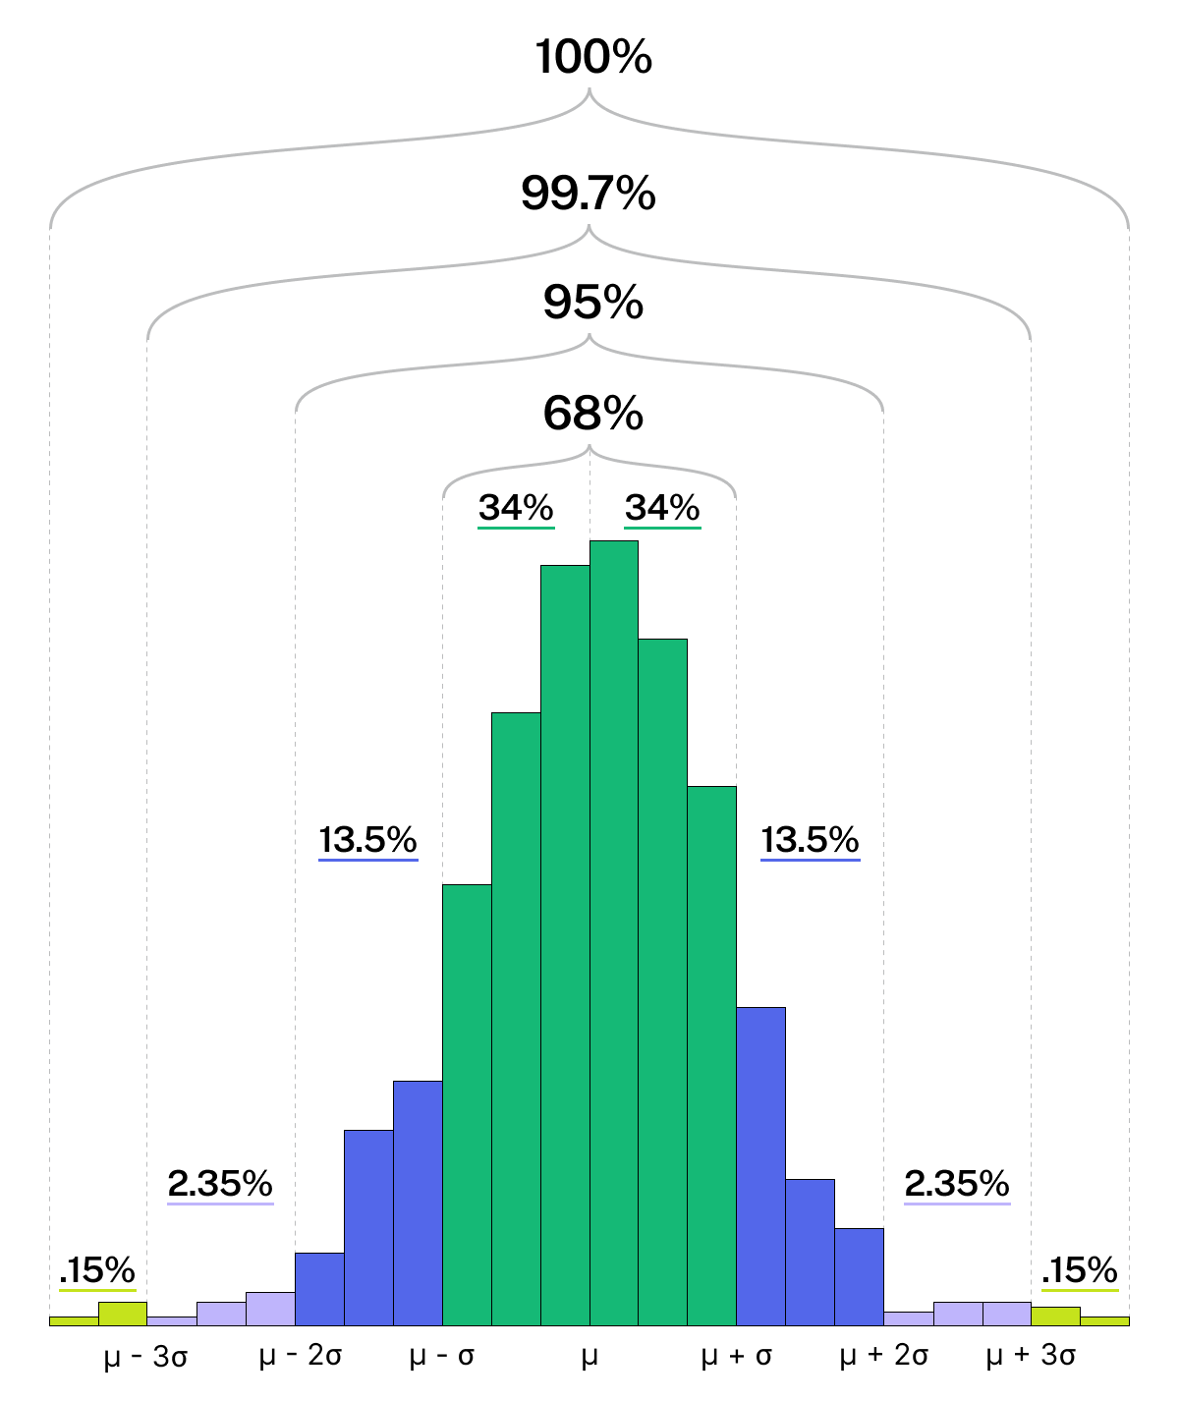
Recall
The Empirical Rule gives an estimate of the proportion of data within 1, 2, and 3 deviations from the mean

