Slide 1

Introductory Statistics
Module 3:
Describing Data Graphically

Slide 2

Affirmations
I can ask for help.
I embrace growth and learning.
I have good ideas.

Slide 3
Learning Goals (1)
Deepen your understanding and form connections within these skills:
1 Create frequency tables, bar graphs, and pie charts
2 Answer questions using information from data displays
3 Create side-by-side and stacked bar graphs from technology
4 Use side-by-side and stacked bar graphs to compare groups

Slide 4

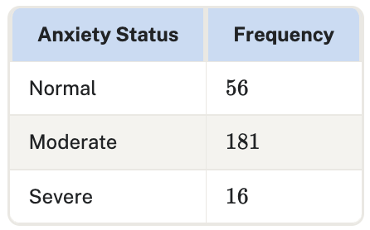
Key Takeaway (1)
A frequency table lists the different categories of data and the number of observations (the frequency) of each unique value.
The relative frequency of a category is the proportion of observations for that category. Relative frequency can be expressed as a fraction, decimal, or percentage.

Slide 5
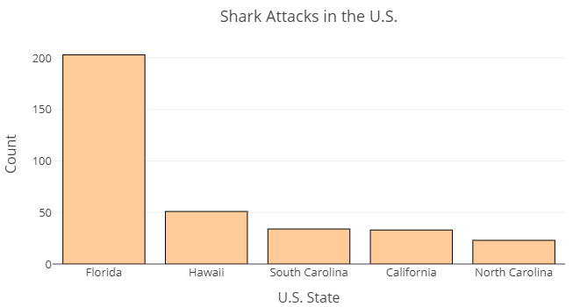
Key Takeaway (2)
A bar graph can be used to display frequencies or relative frequencies. Each bar represents a category listed along the x-axis while the y-axis represents the frequencies or relative frequency.

Slide 6

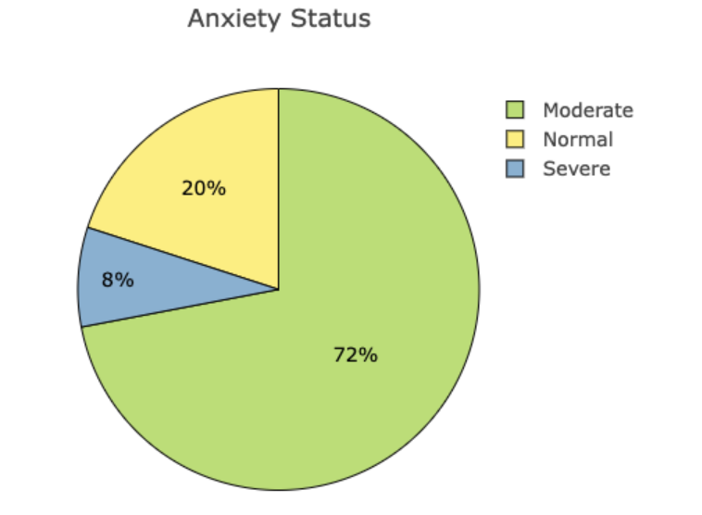
Key Takeaway (3)
A pie chart displays the relative frequencies of data and will always add up to 100%

Slide 7

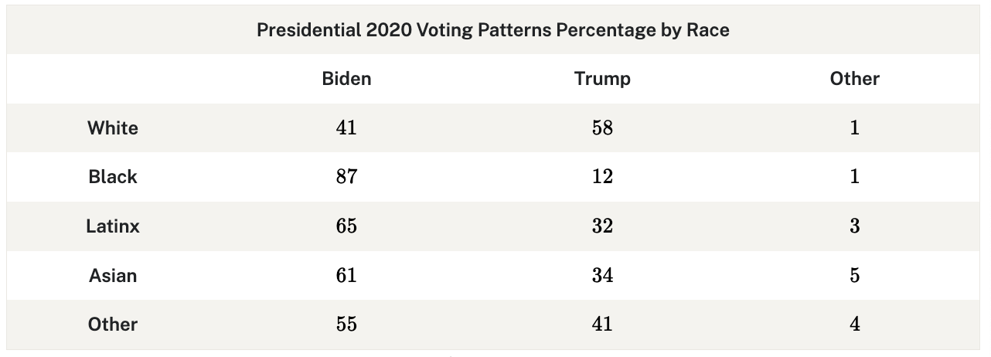
Key Takeaway (4)
A two-way table or contingency table displays the results of two categorical variables at the same time.

Slide 8

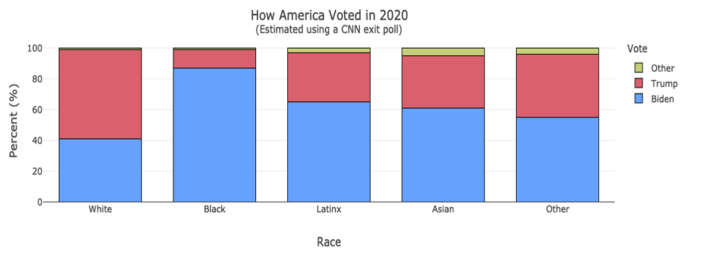
Key Takeaway (5)
Two categorical variables can also be displayed in a side-by-side bar graph or a stacked bar graph.

Slide 9

Activity: Language and First-Generation College Students
What does it mean to be a first-generation college student?
Are first-generation college students more likely to have a first language other than English?

Slide 10

Questions
1 What are the groups of interest and variables of interest for this question?
2 Use the stats tool to create both a side by side bar graph and a stacked bar graph to display the data.

Slide 11

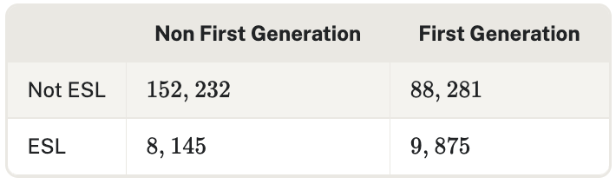
Questions continued
3 Use the stats tool to create both a side by side bar graph and a stacked bar graph to display the data.
National survey data from the Community College Survey of Student Engagement (CCSSE) 2020 Cohort.
Note: The first language status in the CCSSE survey is measured by: "Enrolled in English course taught specifically for students whose first language is not English (ESL, ESOL)."

Slide 12

Discussion
What are the advantages and disadvantages of each bar graph?
What other questions could we investigate regarding first-generation college students?

Slide 13
Learning Goals (2)
Deepen your understanding and form connections within these skills:
5 Create graphs that display quantitative data
6 Explain the differences between different graphs displaying the same quantitative data
7 Describe the graph of a data set using its shape, center, and outliers
8 Compare data sets by describing their shapes, centers, spreads, and outliers

Slide 14
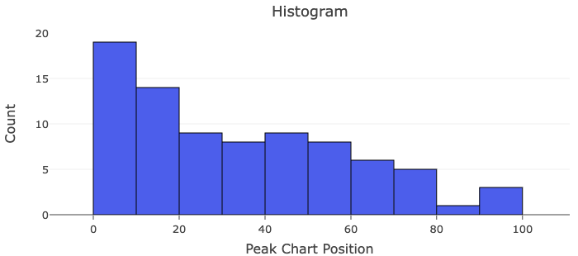
Key Takeaway (6)
Histograms group quantitative data into “bins”. These graphs are best for large datasets.
There are no gaps between bars of a histogram unless that bin has no data in it.

Slide 15

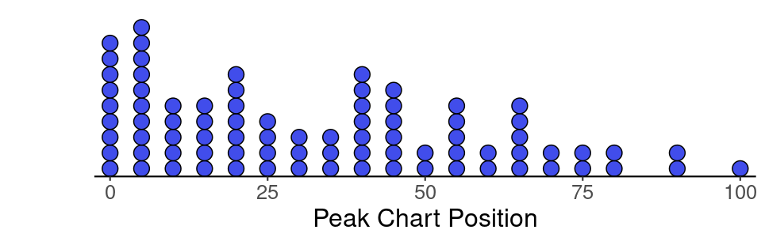
Key Takeaway (7)
Dotplots display each individual data point as a dot (or X). Datasets without a large number of repeated values or too large of a range may not be easy to interpret on a dotplot.

Slide 16
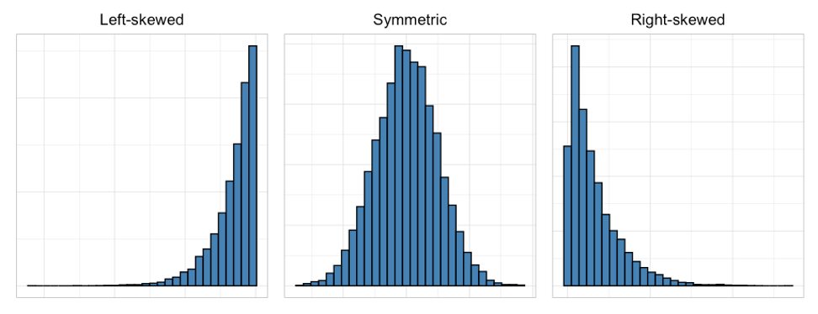
Key Takeaway (8)
Distributions of quantitative data are described by their shape, center, spread, and outliers.
Center - describes the middle (or typical) value of the dataset
Spread - described by the range or variability of the data
Outliers - data points far from the rest that often influence the statistical results

Slide 17

Activity: Favorite Movie Runtime
In 2021, the average length of the top 10 highest-grossing movies in the United States and Canada amounted to 130.9 minutes (or two hours and 10 minutes). This figure is 17% higher than the average recorded in 1990 – 111.8 minutes (or one hour and 51 minutes).
What are the lengths of your favorite movies?

Slide 18

Activity: Favorite Movie Runtime Cont.
Go to https:www.imbdb.com and find the length (in minutes) of your favorite movies.
As a group, collect the runtimes of a sample of 30 or more movies.

Slide 19


Let’s Graph It!
Use the stats tool to make either a histogram or a dotplot that displays the movie runtimes.
Discussion:
How would you describe the distribution?
What observations are the same between the dotplot and the histogram? What observations were different?

Slide 20
So what did you find?
Answer each question, then indicate if the answer can be found in the dotplot, the histogram, or both.
1 What were the longest and shortest movies?
2 How many movies were between 1-2 hours?
3 How many movies were exactly 2 hours long?
4 Based on this data, is it more likely for a movie to be around 90 minutes or 110 minutes?
5 Identify and describe any outliers.

Slide 21

Let’s Dig Deeper
Do runtimes vary noticeably based on the genre and target audience of the movie?
Are the top movies in this decade longer than top movies in previous decades?

Slide 22

Questions to Review
1 Describe the type of data displayed in bar graphs, pie charts, histograms, and dotplots.
2 When would a histogram be a better display for data? When would a dotplot be a better display?
3 A pie chart displays the same information as…
A bar graph
A side-by-side bar graph, or
A stacked bar graph

Slide 23
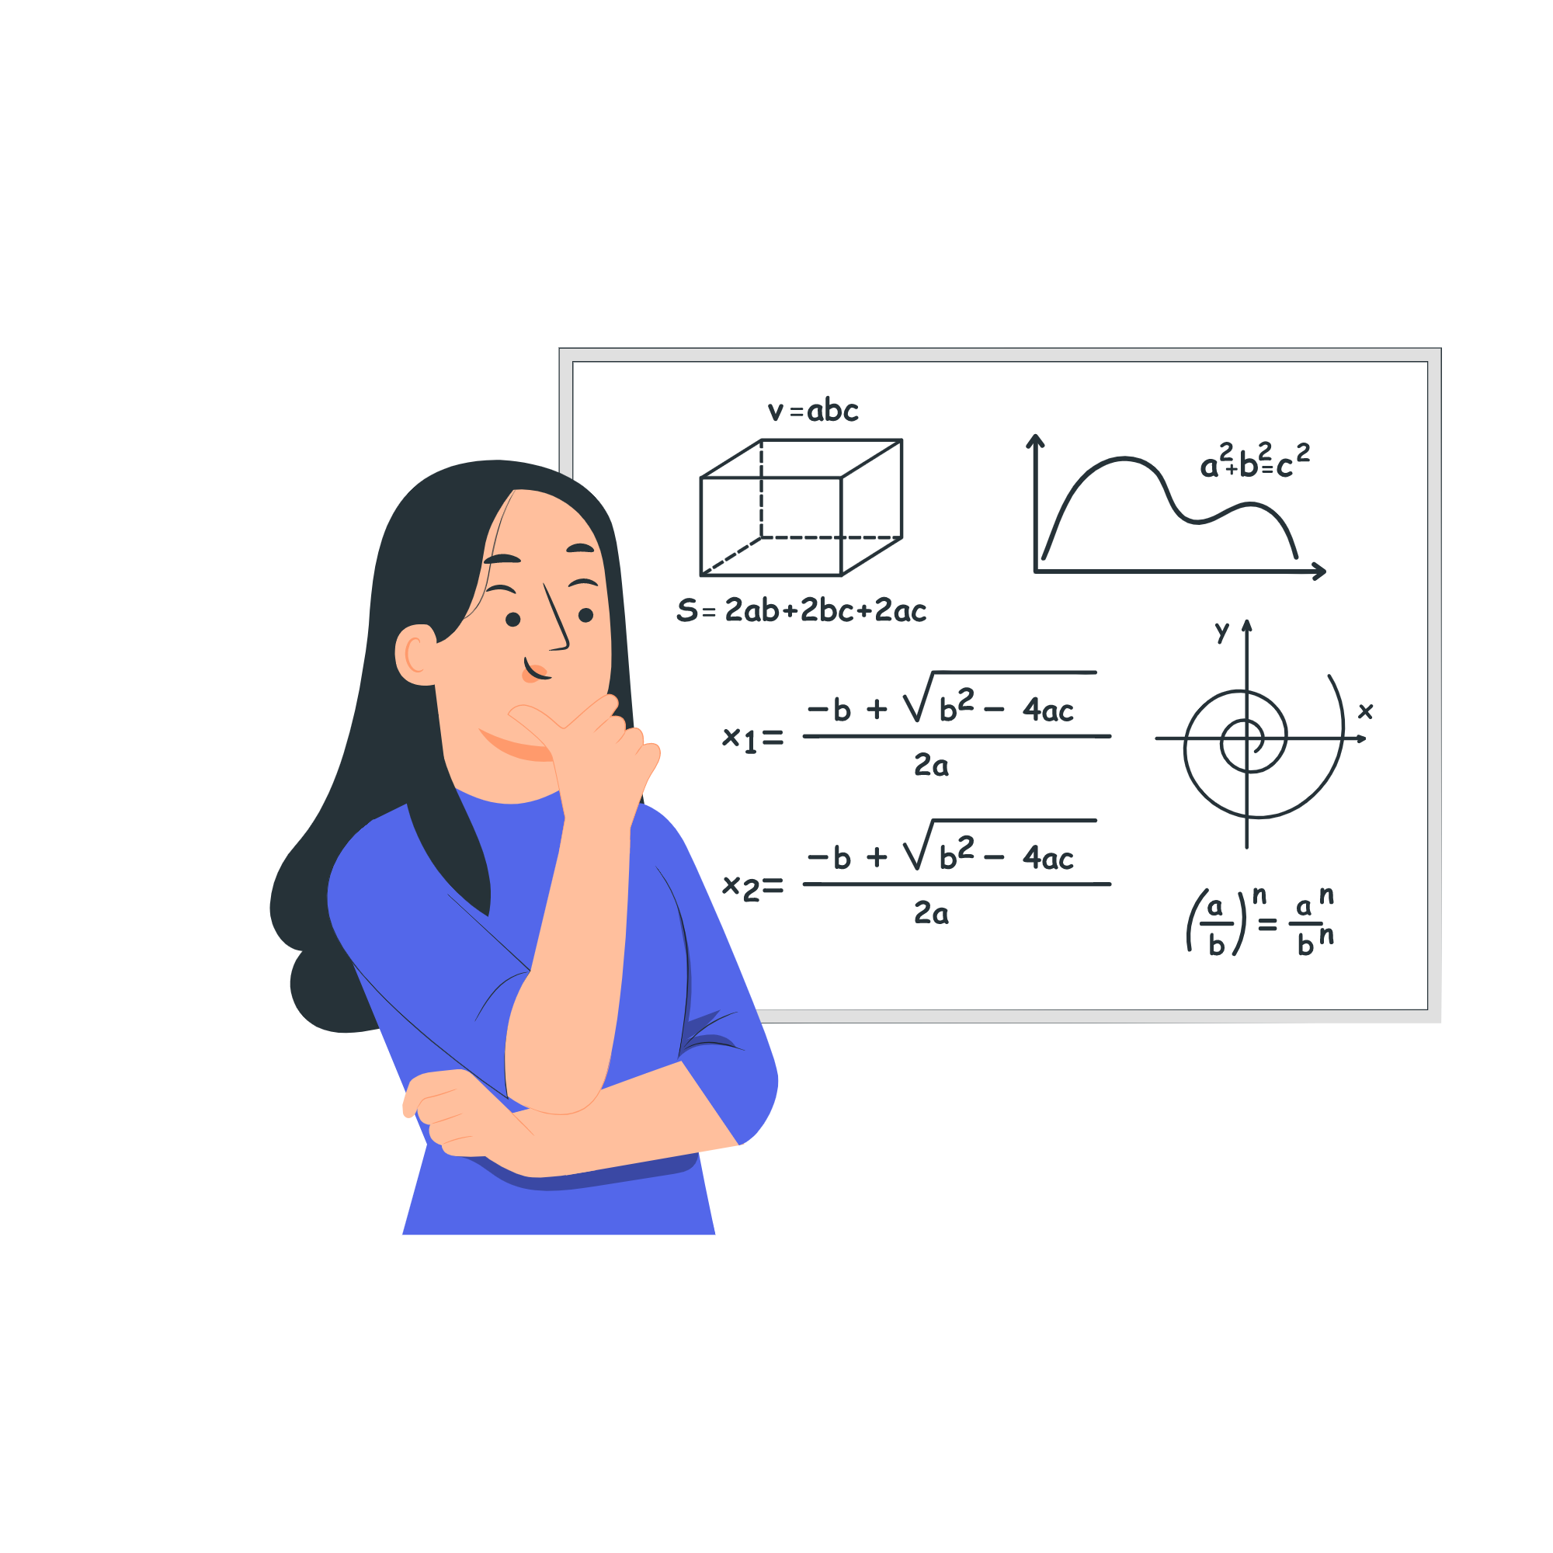
Questions to Review, cont.
4 The histogram displays the peak chart position for every single released by Beyonce in the U.S. Note that songs that did not chart were removed from the dataset.
Describe the shape, center, spread, and outliers.
Source: https://en.wikipedia.org/wiki/Beyonc%C3%A9_singles_discography

