Slide 1

Introductory Statistics
Module 2:
Statistical Studies

Slide 2

Affirmations
It is okay to have questions
I am open to learning new things
My time is valuable

Slide 3
Learning Goals (1)
Deepen your understanding and form connections within these skills:
1 Recognize observational studies and list the components
2 Describe confounding factors that may influence association
3 Identify the key components of experimental design
4 Review an experiment and explain if has been designed well
5 Use randomized block design to create a hypothetical experiment

Slide 4

Recall: Observational Studies
In an observational study a researcher will observe an outcome without interfering.
Due to lack of control, observational studies are at risk of confounding biases.
A confounding variable is a variable that influences variables in the study and was not accounted for.

Slide 5
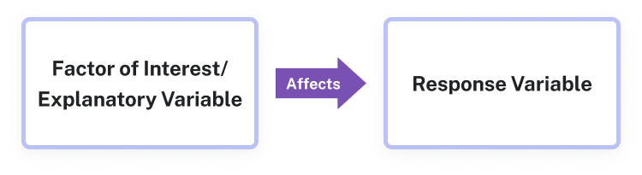
Recall: Variable
The explanatory variable is the independent variable that is controlled by the researcher.
The response variable is the dependent variable that allows the researcher to compare the outcomes of the experiment.

Slide 6
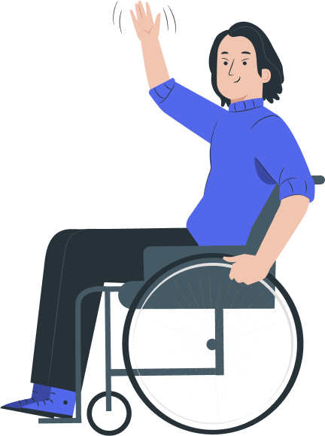

Recall:

Slide 7
Recall: Blinding
Blinding is the nondisclosure of the treatment an experimental unit is receiving as to preserve the power
A double-blind experiment is one in which both the subjects and the researchers who have contact with the subjects do not know which subjects receive treatment.

Slide 8
Recall: Blocking
Blocking is used when the sample may have a known nuisance factor that might affect the outcome of the experiment. A block is a group of objects that share a similar characteristic.

Slide 9

Testing Beliefs
What are ideas you have heard used in your community that are accepted to be true?
Examples:
Beans make you fart
If you shave then your hair will grow back thicker
Sleeping with an onion in your socks will cure a cold faster
Notes:
This is Activity/Project #1 in the Instructor Guide

Slide 10
Experimental Design Activity
Choose a belief and design an experiment that can be used to test it. Your experiment should be plausible, but will not actually be completed.
What are the explanatory and response variables?
Who is your target population?
How will a representative sample be selected?

Slide 11
Good Experimental Design
Choose a belief and design an experiment that can be used to test it. Your experiment should be plausible, but will not actually be completed.
Will your experiment include blocking?
What are the treatments? How will participants be assigned?
What are the potential nuisance factors?

Slide 12
Does Your Experiment Include?
1
Randomization
2
Replication
3
Control

Slide 13

Questions to Review (1)
An experiment was conducted to investigate the impact of regular exercise on stress reduction. Participants self-assessed their current stress levels and were separated into two groups: high stress level and low stress level. Then, participants in each group were assigned one of three conditions: no exercise, exercise three days per week for 20 minutes, and exercise one day per week for one hour. At the end of each week, the participants stress levels were recorded.
1 Identify the explanatory and response variables, experimental units, blocks, treatments and treatment groups

Slide 14
Questions to Review (2)
An experiment was conducted to investigate the impact of regular exercise on stress reduction. Participants self-assessed their current stress levels and were separated into two groups: high stress level and low stress level. Then, participants in each group were assigned one of three conditions: no exercise, exercise three days per week for 20 minutes, and exercise one day per week for one hour. At the end of each week, the participants stress levels were recorded.
2 Explain how the experiment could use randomization, replication, control, and blinding.
Notes:
The participants are randomly assigned to a treatment, with a large enough sample participating the needs of replication would be met, having the control group that does not exercise as well as the blocks evidence control and it would not be possible for blinding to be included because the participants will know which exercise treatment they’ve received.

Slide 15
Learning Goals (2)
Deepen your understanding and form connections within these skills:
6 Find information from graphical displays used in media
7 Recognize when a graph is misleading

Slide 16
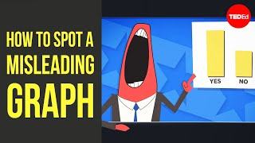
Misleading Data Visualizations

Slide 17
What’s Wrong?
Discuss with your group what is misleading about each data visualization.
Then, choose one graph to “correct”

Slide 18
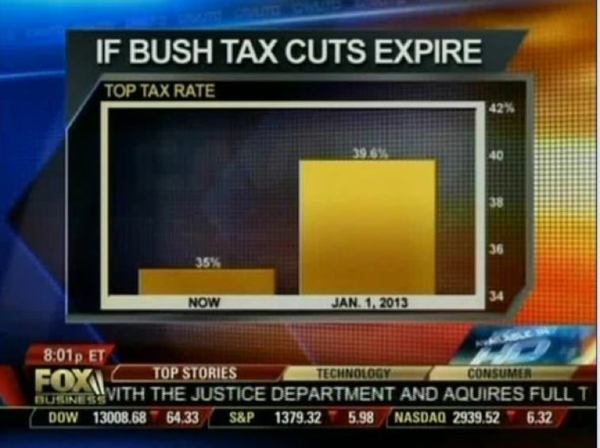
Graph #1

Slide 19
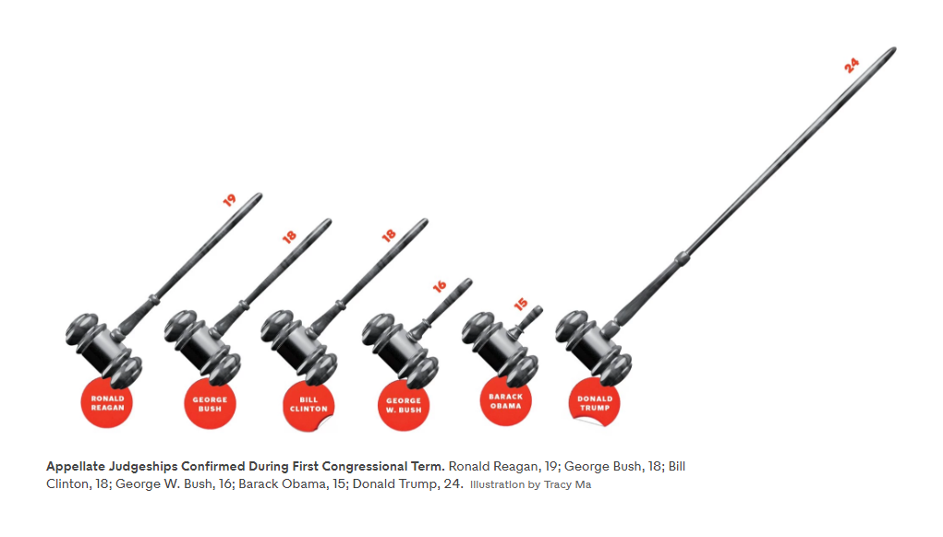
Graph #2

Slide 20
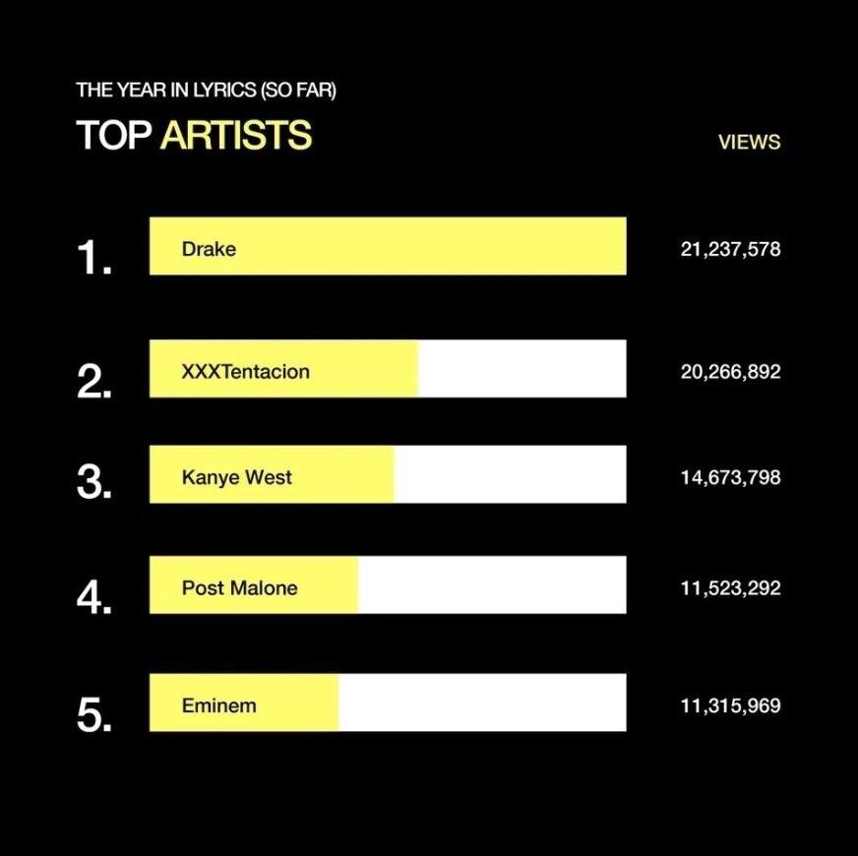
Graph #3

Slide 21
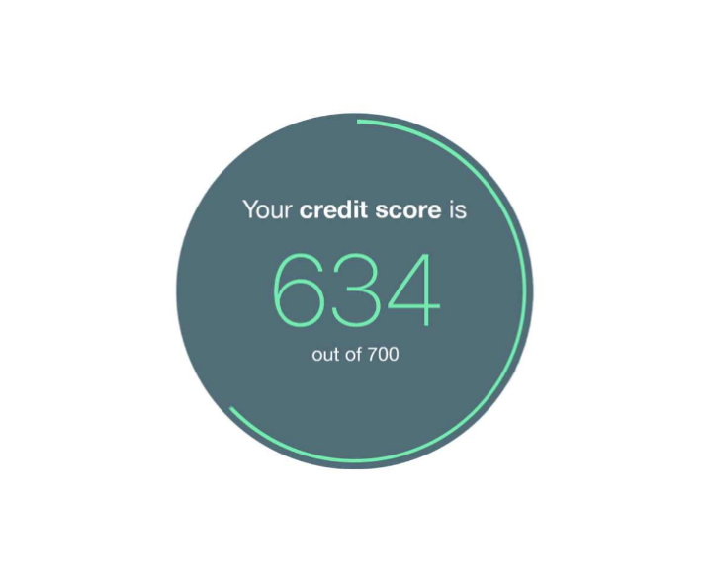
Graph #4

Slide 22
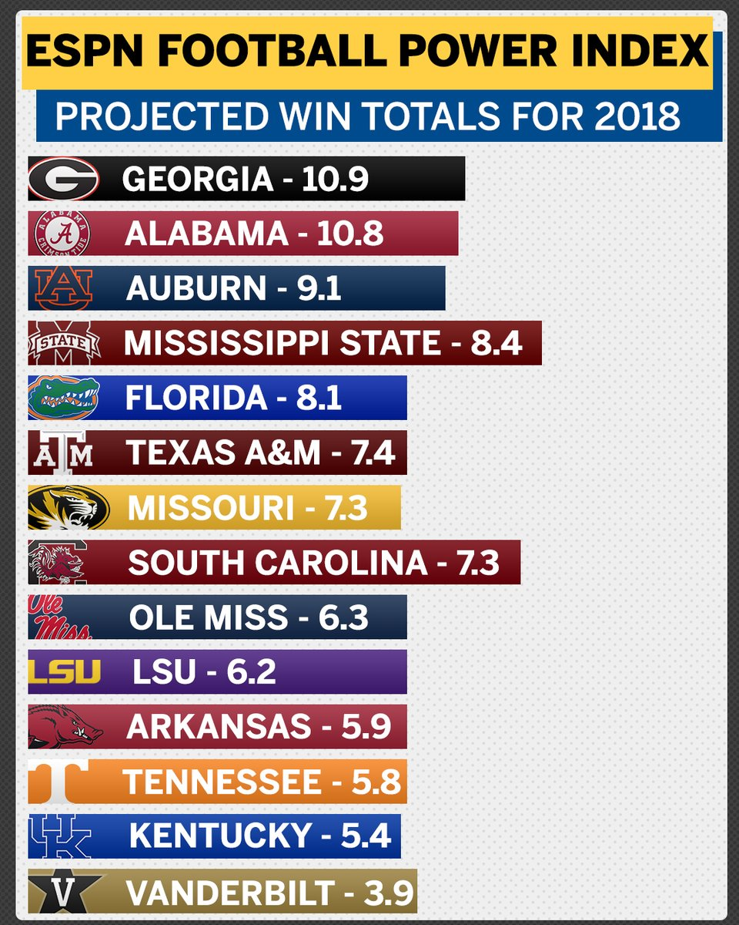
Graph #5

Slide 23

Reflection
Explain the importance of scale for both the x-axis and y-axis
How can color be used to share information in a data visualization? What are the risks of using color?

