Slide 1

Introductory Statistics
Module 1:
Thinking Statistically and Collecting Data

Slide 2

Affirmations
I am intelligent and capable.
It is okay to make mistakes. What matters is what I learn from them.
If I don’t understand something at first, that does not make me less smart.

Slide 3
Learning Goals 1
Thinking Statistical and Statistical Questions
1 List the steps of the statistical investigative process
2 Create questions that can be answered with statistics
3 Name and classify variables by type
4 Identify the observational unit of a statistical study
5 Name the population, sample, parameter and statistic

Slide 4
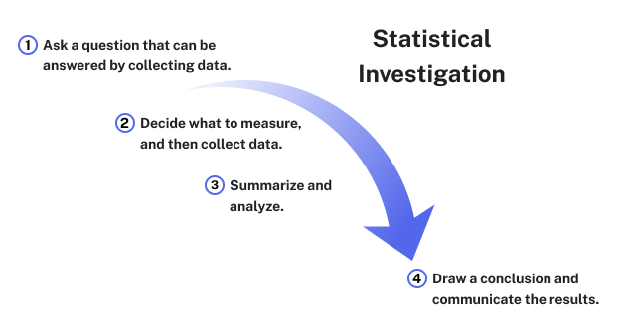

Recall
Statistics is a science that deals with the collection, analysis and interpretation, and presentation of data.

Slide 5
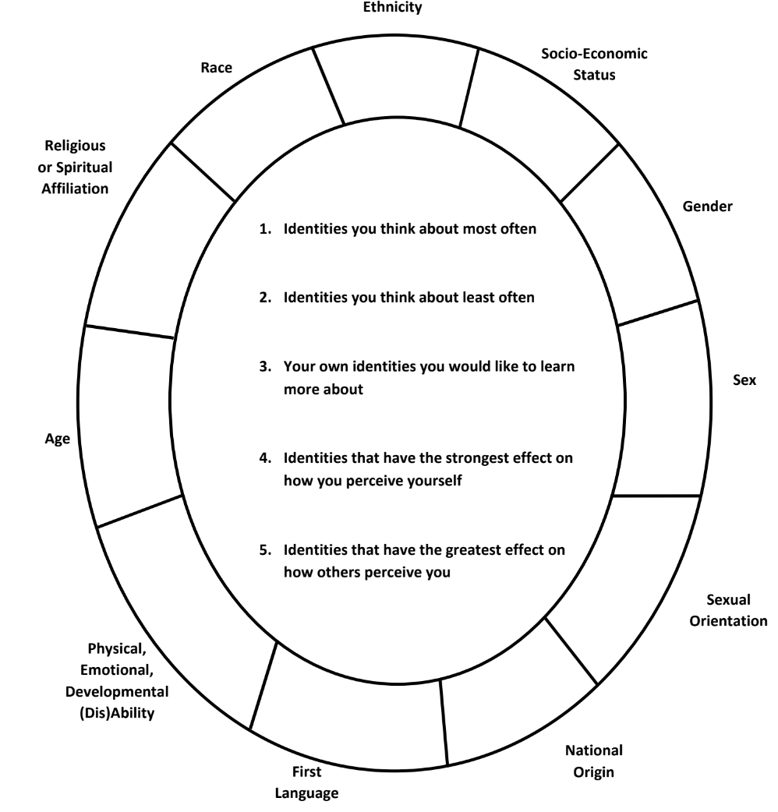

Your Social Identity
For the purpose of this self-examination please identify the memberships you claim or those ascribed to you.
Then, consider the five questions in the center of the circle.
Finally, which identities may play a role in your college success?
Notes:
Activity #1 in the Instructor Guide

Slide 6

Data Collection
Consider if data were collected anonymously from the social identity wheel.
Design one statistical question that could be analyzed using the data.
List one example of categorical and one example of quantitative data
If data came from this class, what would the population be?
Notes:
Continuation of Activity #1 in the Instructor Guide

Slide 7
Questions to Review
1 What is the difference between a population and a sample?
2 What are the characteristics of a good statistical question?
3 What is the difference between categorical and quantitative variables?

Slide 8
Recall Statistical Questions
Statistics is an investigative process that can allow us to answer questions about our world. We need to consider what makes a good statistical question and how we can match appropriate data with those statistical questions.
Two key qualities of a statistical question are:
There is not an exact answer and the question anticipates variability.

Slide 9
Review Questions
1 What is an observational unit?
2 What is the difference between a parameter and a statistic?

Slide 10
Learning Goals 2
Sampling Methods and Bias
6 Select a simple random sample to estimate a parameter
7 Identify different sampling methods to select a random sample
8 Recognize bias in sampling

Slide 11
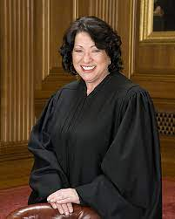
The Power of Words
The following is an excerpt of a speech given by Supreme Court Justice Sonia Sotomayor given at the University of California at Berkeley on October 6, 2001.
Notes:
This is the Activity #3 in the Instructor Guide: Sampling Words

Slide 12
From Justice Sonia Sotomayer Part 1
For me, a very special part of my being Latina is the mucho platos de arroz, gandoles y pernir—rice, beans, and pork—that I have eaten at countless family holidays and special events. My Latina identity also includes, because of my particularly adventurous taste buds, morcilla—pig intestines, patitas de cerdo con garbanzo—pigs' feet with beans, and la lengua y orejas de cuchifrito—pigs' tongue and ears. I bet the Mexican-Americans in this room are thinking that Puerto Ricans have unusual food tastes. Some of us, like me, do. Part of my Latina identity is the sound of merengue at all our family parties and the heart-wrenching Spanish love songs that we enjoy. It is the memory of Saturday afternoon at the movies with my aunt and cousins watching Cantinflas, who is not Puerto Rican, but who was an icon Spanish comedian on par with Abbot and Costello of my generation. My Latina soul was nourished as I visited and played at my grandmother's house with my cousins and extended family. They were my friends as I grew up. Being a Latina child was watching the adults playing dominos on Saturday night and us kids playing loteria, bingo, with my grandmother calling out the numbers which we marked on our cards with chick peas.

Slide 13
From Justice Sonia Sotomayer Part 2
Now, does any one of these things make me a Latina? Obviously not because each of our Caribbean and Latin American communities has their own unique food and different traditions at the holidays. I only learned about tacos in college from my Mexican-American roommate. Being a Latina in America also does not mean speaking Spanish. I happen to speak it fairly well. But my brother, only three years younger, like too many of us educated here, barely speaks it. Most of us born and bred here, speak it very poorly.
If I had pursued my career in my undergraduate history major, I would likely provide you with a very academic description of what being a Latino or Latina means. For example, I could define Latinos as those peoples and cultures populated or colonized by Spain who maintained or adopted Spanish or Spanish Creole as their language of communication. You can tell that I have been very well educated. That antiseptic description however, does not really explain the appeal of morcilla—pig's intestine—to an American-born child. It does not provide an adequate explanation of why individuals like us, many of whom are born in this completely different American culture, still identify so strongly with those communities in which our parents were born and raised.

Slide 14
Justice Sotomayor's Speech
Suppose you want to select a sample of 10 words from the speech excerpt and analyze the average word length.
How would you select the 10 words?
How would you describe the population, sample, and variable of interest?
Notes:
Activity #3 in the Instructor Guide: Sampling Words

Slide 15
Pulling a Sample
3. Select 10 words from the speech and record the length of each word.
4. What is the average word length of your chosen words? Is this average a parameter or a statistic? Explain.
5. Create a dot plot of the different word length averages found bny students in the class. How would you describe a typical sample mean?
Notes:
Activity #3 in the Instructor Guide: Sampling Words

Slide 16
Random Number Generator
6. Now, use the random number generator to select a random sample of words from the excerpt.
7. What is the average word length of the randomly chosen words? Is this average a parameter or a statistic? Explain.
8. Create a dot plot of at least 30 randomly generated sample means. How does this compare to the dotplot from before?

Slide 17
The True Average
The true average word length of all 431 words in Justice Sotomayor's speech is 4.68 letters.
9. Is this a parameter or statistic?
10. How does this value compare to the two sample means we found in the activity?

Slide 18

Reflection
What makes a sample representative of a population?
Do you feel your method of sampling led to a representative sample?
Do you feel the random number generator led to a more representative sample?

Slide 19
Discussion
Do unbiased sampling methods guarantee representative samples?

Slide 20
Review
Describe how each of the following sampling methods could be used to pull a random sample of 5 students from class.
Simple random sampling
Stratified sampling
Cluster sampling
Systematic sampling
Convenience sampling

Slide 21
Recall Sampling Bias
Sampling bias is created when a sample is collected from a population and some members of the population are not as likely to be chosen as others.
We want to consider four main sources of bias when sampling:
Undercoverage, Non-response, Response bias, Voluntary response bias

Slide 22
Make it Biased
The college wants to survey the current work status of the student body.
Discuss ways that the college could gather data that would introduce each of the four types of bias:
undercoverage
non-response
response
voluntary response

