Slide 1

Introductory Statistics
Module 15:
Inferences Concerning Regression Models

Slide 2

Affirmations
I matter
I can do hard things
I am getting better and better every day

Slide 3
Learning Goals
Deepen your understanding and form connections within these skills:
1 Perform a test for significance of slope and interpret the results
2 Check the conditions that are necessary to perform a test for significance of slope
3 Understand what is measured by SSRegression, SSResiduals, and SSTotal in a regression context
4 Discuss the factors that affect the value of F-statistics in a regression context
5 Find and interpret the confidence interval for the mean response
6 Find and interpret the prediction interval for the mean response
7 Identify whether a confidence interval or a prediction interval is more appropriate in context of the problem
8 Decide which transformation to use for the different type of datasets and analyze the results

Slide 4

How many calories is in a drink?
How many calories is in the beverage you typically drink?
Where do calories come from in drinks?
How do you figure out calories in alcohol?
Do alcohol calories count the same as food calories?

Slide 5
Can we determine the calories in a beer?
Can we calculate how many calories is in a 12 fluid ounces beer based on its Alcoholic Content (aka ABV)?
Note: Alcohol by volume (ABV) is a metric used to determine the alcohol content in an alcoholic beverage. The measurement shows what percentage of the beverage’s total volume is pure alcohol.

Slide 6
How do the calories compare?
A 12 ounce Bud Light, Guinness Draught, and Michelob Ultra has a 4.20% Alcoholic Content.
Do you think they have the same number of calories? Why or why not?

Slide 7

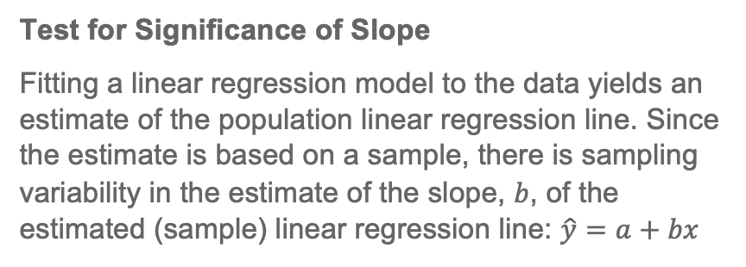

Key Takeaway (1)
Test for Significance of Slope
Fitting a linear regression model to the data yields an estimate of the population linear regression line. Since the estimate is based on a sample, there is sampling variability in the estimate of the slope, $b$, of the estimated (sample) linear regression line: $\hat{y}=a+bx$
Population Linear Regression Line:
$$y=α+β_{1}x$$
The slope, $b$, is calculated using the sample data and is an estimate of $β_{1}$

Slide 8
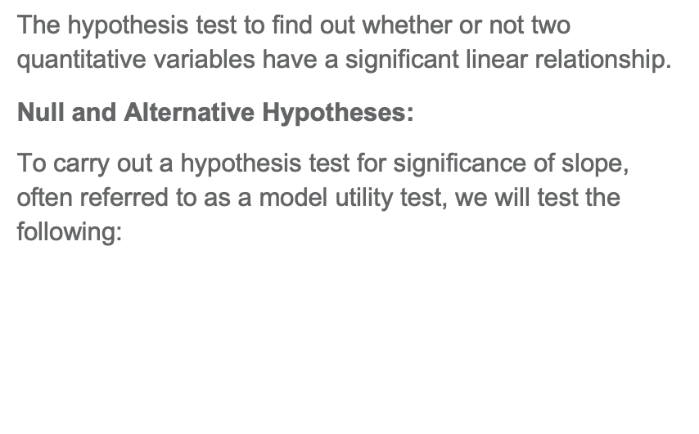
Key Takeaway (2)
The hypothesis test to find out whether or not two quantitative variables have a significant linear relationship.
Null and Alternative Hypotheses:
To carry out a hypothesis test for significance of slope, often referred to as a model utility test, we will test the following:
$$H_{0}:β_{1}=0 \\ H_{A}:β_{1}≠0$$

Slide 9
Key Takeaway (3)
Conditions Test for Significance of Slope
A random sample of data
A linear trend
No obvious trends in the residual plot

Slide 10

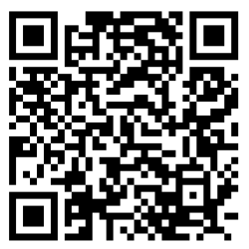
Let’s Analyze! (1)
Data Set:
Select Beer Alcohol and Calories in the statistical tool.
Or access it in: https://www.beer100.com/beer-calories/
Data Description:
The dataset has 227 observations of domestic and imported beers.
The data shown is for a 12 ounce serving.
Breweries occasionally change their recipes, so the values might differ from the label.

Slide 11
Let’s Analyze! (2)
Data Set:
Select Beer Alcohol and Calories in the statistical tool.
Or access it in: https://www.beer100.com/beer-calories/
We would like to know if there is a linear relationship between the calories in a 12 fluid ounces beer and its ABV.
Use the scatterplot to describe the relationship between the calories in a 12 fluid ounces beer and its ABV.

Slide 12
Let’s Analyze! (3)
Data Set:
Select Beer Alcohol and Calories in the statistical tool.
Or access it in: https://www.beer100.com/beer-calories/
We would like to know if there is a linear relationship between the calories in a 12 fluid ounces beer and its ABV.
State its null and alternative hypothesis.

Slide 13
Let’s Analyze! (4)
Data Set:
Select Beer Alcohol and Calories in the statistical tool.
Or access it in: https://www.beer100.com/beer-calories/
We would like to know if there is a linear relationship between the calories in a 12 fluid ounces beer and its ABV.
To carry out a hypothesis test for the significance of slope, determine whether the conditions for fitting a linear regression line have been met.

Slide 14
Let’s Analyze! (5)
Data Set:
Select Beer Alcohol and Calories in the statistical tool.
Or access it in: https://www.beer100.com/beer-calories/
At the 5% significance level, carry out a hypothesis test for the significance of slope to determine whether there is convincing evidence to conclude that there is a useful linear relationship between the calories in a 12 fluid ounces beer and its ABV.

Slide 15

Key Takeaway (4)
ANOVA for Regression
An ANOVA is a way to “partition” the variation in the data. In other words, it divides the total variation into two parts: the part that is explained by the regression model (SSRegression) and the part that remains unexplained (SSResiduals).
SSTotal = SSRegression + SSResiduals

Slide 16
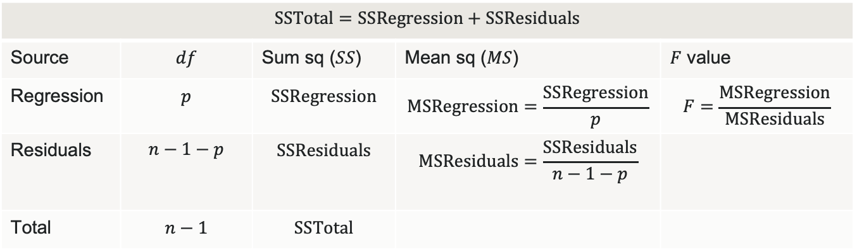

ANOVA Table
$$\text{SSTotal}=\text{SSRegression}+\text{SSResiduals}$$
Source | $$df$$ | Sum sq ($SS$) | Mean sq ($MS$) | $F$ value
Regression | $$p$$ | $$\text{SSRegression}$$ | $$\text{MSRegression}=\frac{\text{SSRegression}}{p}$$ | $$F=\frac{\text{MSRegression}}{\text{MSResiduals}}$$
Residuals | $$n−1−p$$ | $$\text{SSResiduals}$$ | $$\text{MSResiduals}=\frac{\text{SSResiduals}}{n−1−p}$$
Total | $$n−1$$ | $$\text{SSTotal}$$
$$R^{2}=\frac{\text{variation} \text{explained}}{\text{total} \text{variation}}=\frac{\text{SSRegression}}{\text{SSTotal}}=1−\frac{\text{SSResiduals}}{\text{SSTotal}}$$

Slide 17

Let’s Discuss Our Findings!
Data Set:
Beer Alcohol and Calories
Report the value of SSTotal, SSRegression, and SSResiduals.
What does SSTotal, SSRegression, and SSResiduals measure?

Slide 18

Let’s Analyze Our Findings!
An ANOVA F-test can be used to test the population slope for simple linear regression.
Use the statistical tool to calculate a P-value that measures the evidence of an association between the calories in a 12 fluid ounces beer and its ABV.
At the α= 0.05 significance level, does the data provide sufficient evidence of an association between the calories in a 12 fluid ounces beer and its ABV?
State your conclusion in context.
Data Set:
Beer Alcohol and Calories

Slide 19

Key Takeaway (5)
Confidence and Prediction Intervals
Confidence interval for the mean response: This interval gives us a range of plausible values of the mean response for a subset of the population with a value of the explanatory variable equal to x₀.
Prediction interval for an individual response: This interval gives us a range of plausible values of the response for an individual observation that has a value of the explanatory variable equal to x₀.

Slide 20

Let’s Analyze! (6)
Data Set:
Select Beer Alcohol and Calories in the statistical tool.
Use the linear regression statistical tool to calculate the equation for the line of best fit.
Write the equation using contextualized variable names.

Slide 21
Let’s Analyze! (7)
Data Set:
Select Beer Alcohol and Calories in the statistical tool.
Use the linear regression statistical tool to calculate the equation for the line of best fit.
Interpret the slope in the context of the data.

Slide 22
Let’s Analyze! (8)
Data Set:
Select Beer Alcohol and Calories in the statistical tool.
Use the linear regression statistical tool to calculate the equation for the line of best fit.
Create a plot of the residual vs. the fitted values.
Based on this plot, is the linear regression equation a reasonable fit for these data? Explain.

Slide 23
Let’s Analyze! (9)
Data Set:
Select Beer Alcohol and Calories in the statistical tool.
Use the linear regression statistical tool to calculate the equation for the line of best fit.
What is the predicted number of calories in a 12 fluid ounces beer with a 4.20% Alcohol Content?

Slide 24
Let’s Analyze! (10)
Data Set:
Select Beer Alcohol and Calories in the statistical tool.
Use the statistical tool to calculate a 95% confidence interval for the mean number of calories in a 12 fluid ounces beer with a 4.20% Alcohol Content.
What is the center of the interval? What is the margin of error?
Interpret the interval in the context of the data.

Slide 25
Let’s Analyze! (11)
Data Set:
Select Beer Alcohol and Calories in the statistical tool.
Use the statistical tool to calculate a 95% predicted interval for the mean number of calories in a 12 fluid ounces beer with a 4.20% Alcohol Content.
What is the center of the interval? What is the margin of error?
Interpret the interval in the context of the data.

Slide 26

Let’s discuss!
Compare the confidence interval and the prediction interval.
How do the centers of the intervals compare? Is this what you would expect? Explain.
How do the margins of error of the intervals compare? Is this what you would expected? Explain.

Slide 27
Let’s discuss it more!
Create analysis questions that should use:
A confidence interval for the mean response.
A prediction interval for an individual response.

Slide 28

Reflection
How does understanding the significance of the slope contribute to interpreting the relationship between variables in a regression model?
What is the purpose of using ANOVA in the context of regression analysis? How does ANOVA help assess the overall significance of a regression model with multiple predictors?
When might you choose to use a prediction interval instead of a confidence interval, and why?
How do these concepts enhance your ability to draw meaningful conclusions from regression models in various contexts?

