Slide 1

Precalculus
Module 8:
Exponential and Logarithmic Equations

Slide 2
Affirmations
I deserve the time it takes to understand new concepts.
I am capable of creative solutions and original ideas.
I can adapt my strategies when something isn’t working.

Slide 3
Learning Goals: Logarithmic Properties
Deepen your understanding and form connections within these skills:
1 Expand logarithmic expressions
2 Condense logarithmic expressions
3 Use the change-of-base formula for logarithms

Slide 4

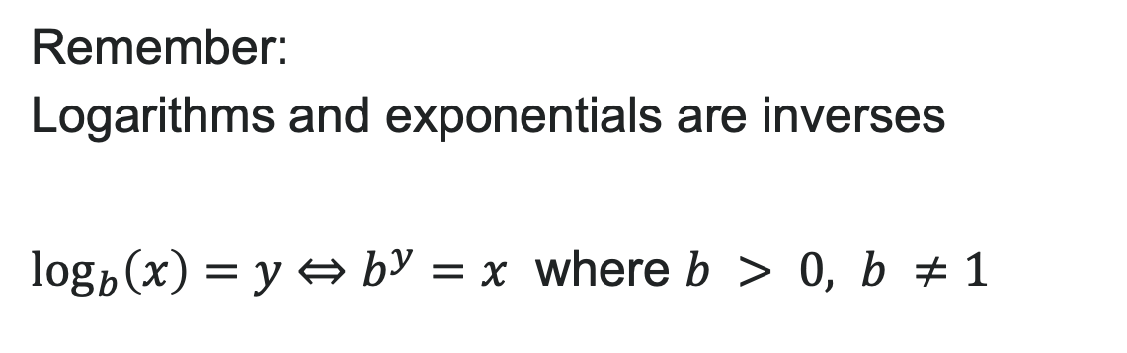
Recall: Logarithms and Exponentials
Remember:
Logarithms and exponentials are inverses
$\log_{b}\left(x\right)=y⇔b^{y}=x$ where $b > 0, b ≠1$

Slide 5
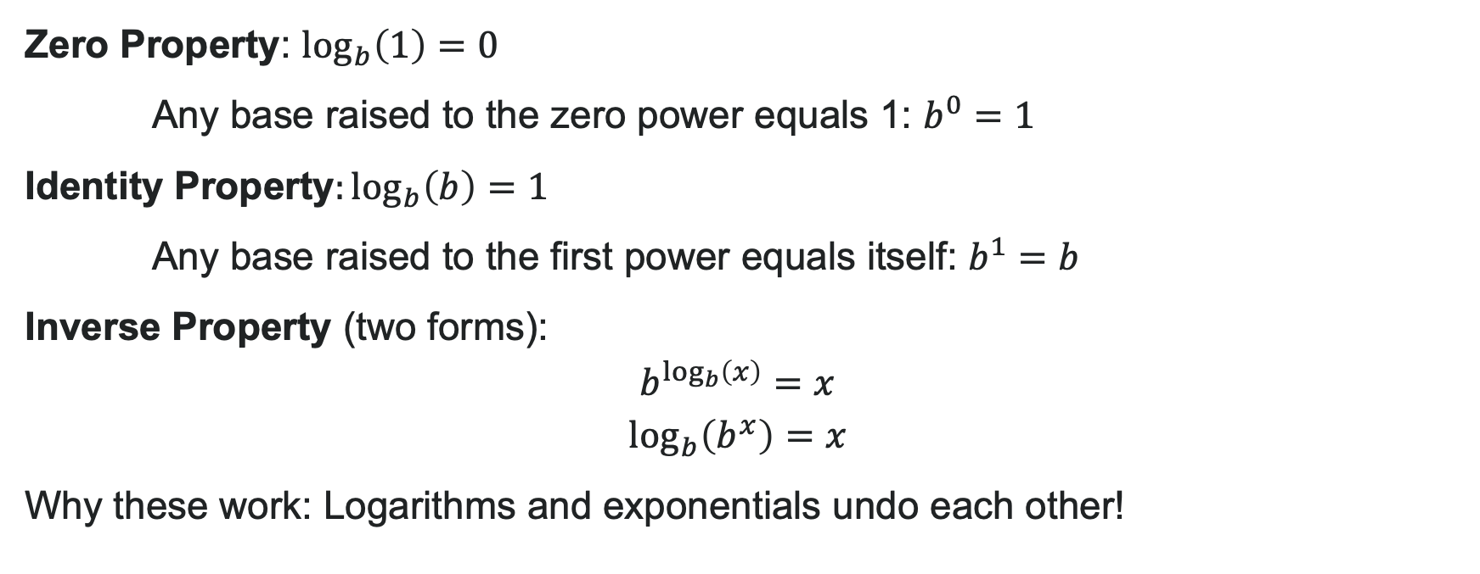
Basic Properties of Logarithms
Zero Property: $\log_{b}\left(1\right)=0$
Any base raised to the zero power equals 1: $b^{0}=1$
Identity Property$:\log_{b}\left(b\right)=1$
Any base raised to the first power equals itself: $b^{1}=b$
Inverse Property (two forms):
Why these work: Logarithms and exponentials undo each other!

Slide 6
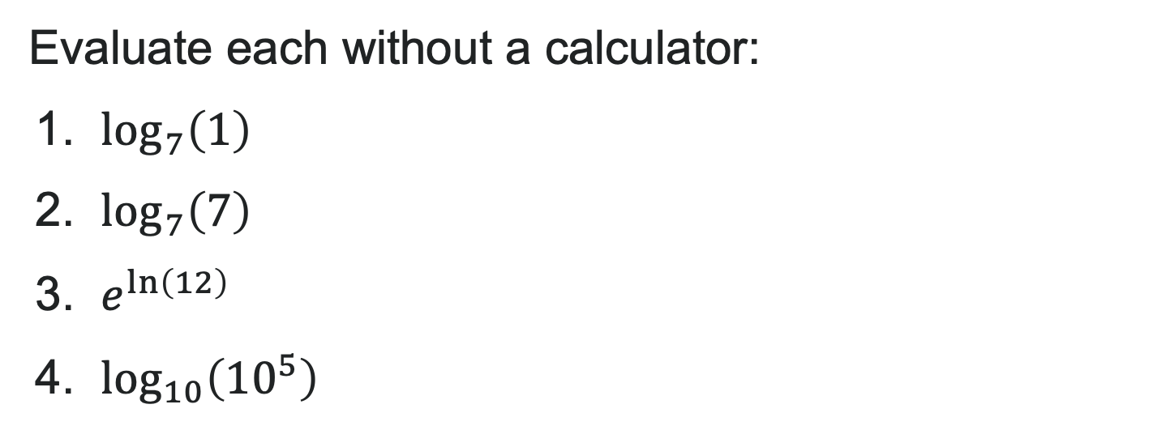
Try It: Properties of Logarithms
Evaluate each without a calculator:
1. $\log_{7}\left(1\right)$
2. $\log_{7}\left(7\right)$
3. $e^{\ln\left(12\right)}$
4. $\log_{10}\left({10}^{5}\right)$
Notes:
Answer:
0
1
12
5

Slide 7
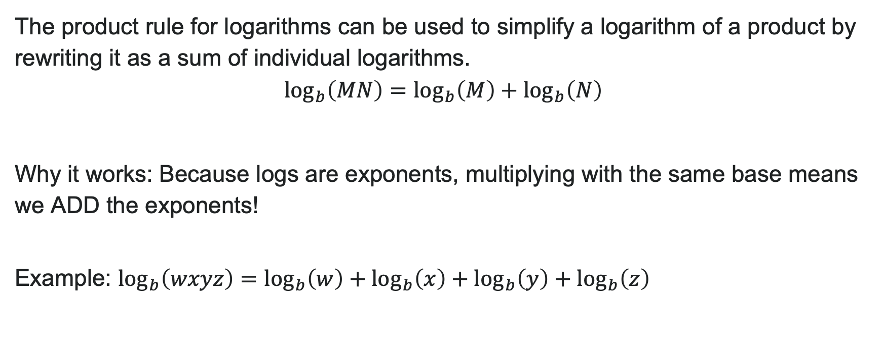
The Product Rule for Logarithms
The product rule for logarithms can be used to simplify a logarithm of a product by rewriting it as a sum of individual logarithms.
$$\log_{b}\left(MN\right)=\log_{b}\left(M\right)+\log_{b}\left(N\right)$$
Why it works: Because logs are exponents, multiplying with the same base means we ADD the exponents!
Example: $\log_{b}\left(wxyz\right)=\log_{b}\left(w\right)+\log_{b}\left(x\right)+\log_{b}\left(y\right)+\log_{b}\left(z\right)$

Slide 8
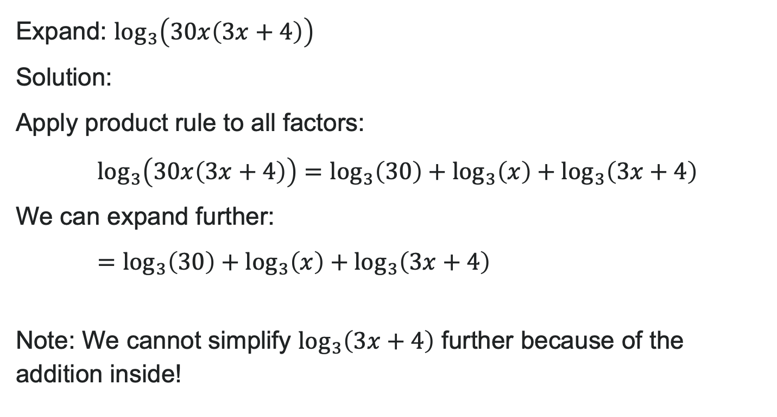
Example: Using the Product Rule
Expand: $\log_{3}\left(30x\left(3x+4\right)\right)$
Solution:
Apply product rule to all factors:
$\log_{3}\left(30x\left(3x+4\right)\right)=\log_{3}\left(30\right)+\log_{3}\left(x\right)+\log_{3}\left(3x+4\right)$
We can expand further:
$=\log_{3}\left(30\right)+\log_{3}\left(x\right)+\log_{3}\left(3x+4\right)$
Note: We cannot simplify $\log_{3}\left(3x+4\right)$ further because of the addition inside!

Slide 9
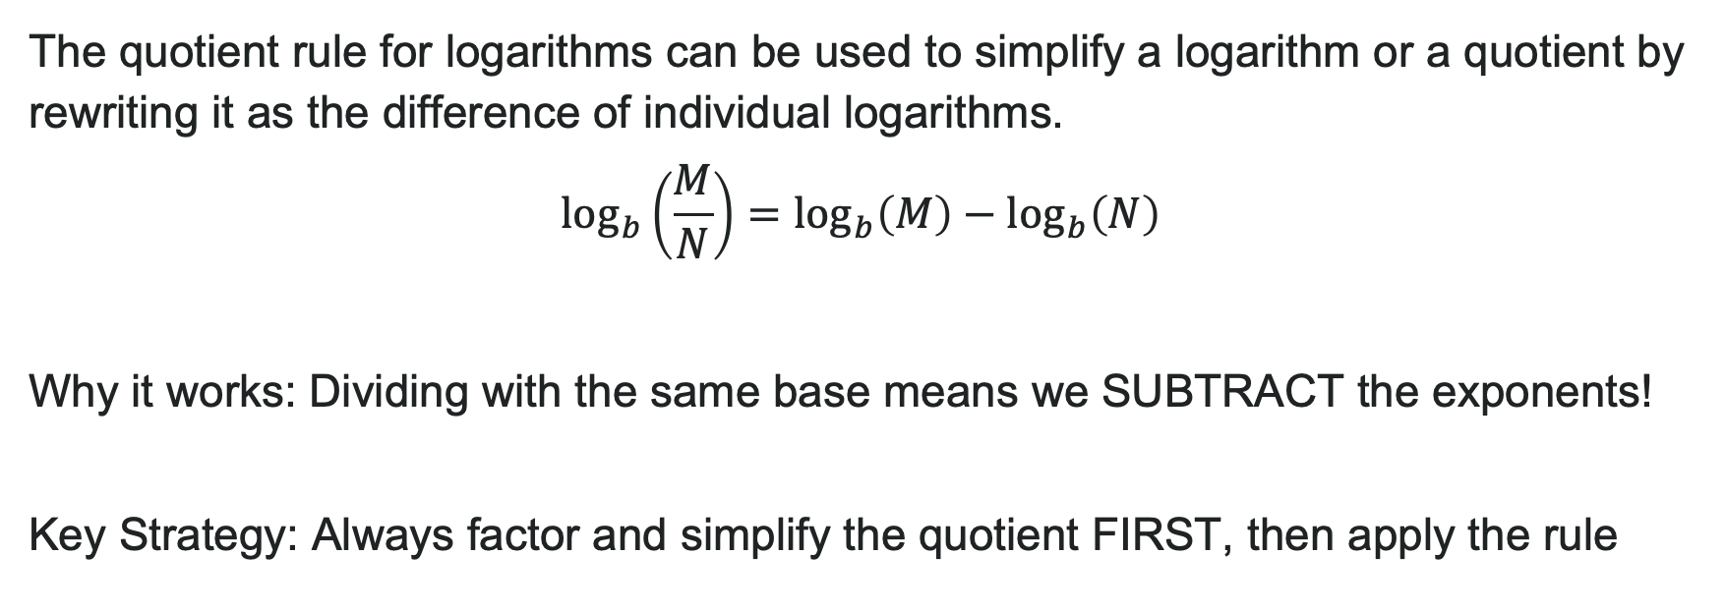
The Quotient Rule for Logarithms
The quotient rule for logarithms can be used to simplify a logarithm or a quotient by rewriting it as the difference of individual logarithms.
$$\log_{b}\left(\frac{M}{N}\right)=\log_{b}\left(M\right)−\log_{b}\left(N\right)$$
Why it works: Dividing with the same base means we SUBTRACT the exponents!
Key Strategy: Always factor and simplify the quotient FIRST, then apply the rule

Slide 10
How to: Use the Quotient Rule for Log
Steps:
Express the argument in lowest terms by factoring the numerator and denominator and canceling common terms.
Write the equivalent expression by subtracting the logarithm of the denominator from the logarithm of the numerator.
Check to see that each term is fully expanded. If not, apply the product rule for logarithms to expand completely.

Slide 11

Try It: Product and Quotient Rules
Expand completely:
1. $\log_{5}\left(7xy\right)$
2. $\log\left(\frac{x^{2}}{100}\right)$
Notes:
Answer:
\log_5(7) + \log_5(x) + \log_5(y)
\log(x^2) - \log(100) = 2\log(x) - 2

Slide 12
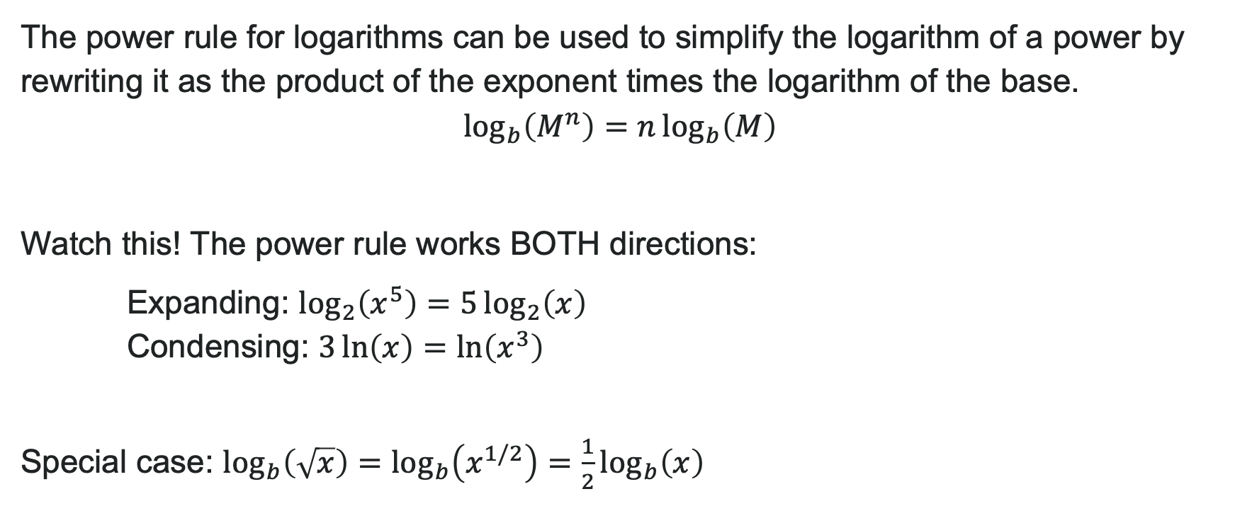
The Power Rule for Logarithms
The power rule for logarithms can be used to simplify the logarithm of a power by rewriting it as the product of the exponent times the logarithm of the base.
$$\log_{b}\left(M^{n}\right)=n\log_{b}\left(M\right)$$
Watch this! The power rule works BOTH directions:
Expanding: $\log_{2}\left(x^{5}\right)=5\log_{2}\left(x\right)$
Condensing: $3\ln\left(x\right)=\ln\left(x^{3}\right)$
Special case: $\log_{b}\left(\sqrt{x}\right)=\log_{b}\left(x^{1/2}\right)=\frac{1}{2}\log_{b}\left(x\right)$

Slide 13

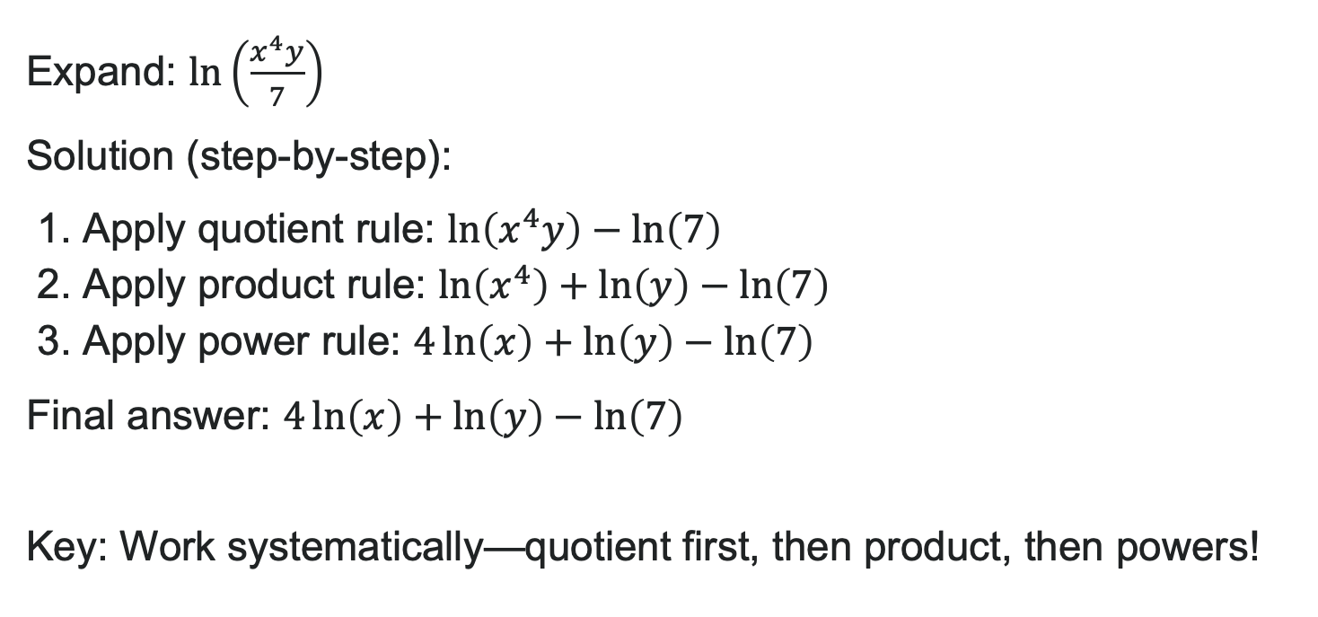
Example: Expanding with All Three Rules
Expand: $\ln\left(\frac{x^{4}y}{7}\right)$
Solution (step-by-step):
1. Apply quotient rule: $\ln\left(x^{4}y\right)−\ln\left(7\right)$
2. Apply product rule: $\ln\left(x^{4}\right)+\ln\left(y\right)−\ln\left(7\right)$
3. Apply power rule: $4\ln\left(x\right)+\ln\left(y\right)−\ln\left(7\right)$
Final answer: $4\ln\left(x\right)+\ln\left(y\right)−\ln\left(7\right)$
Key: Work systematically—quotient first, then product, then powers!

Slide 14
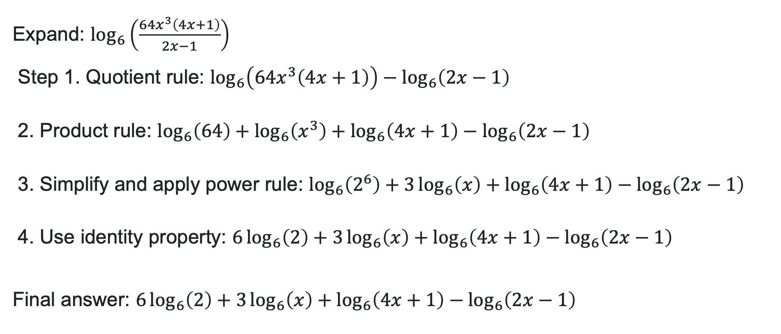
Example: Complex Expansion
Expand: $\log_{6}\left(\frac{64x^{3}\left(4x+1\right)}{2x−1}\right)$
Step 1. Quotient rule: $\log_{6}\left(64x^{3}\left(4x+1\right)\right)−\log_{6}\left(2x−1\right)$
2. Product rule: $\log_{6}\left(64\right)+\log_{6}\left(x^{3}\right)+\log_{6}\left(4x+1\right)−\log_{6}\left(2x−1\right)$
3. Simplify and apply power rule: $\log_{6}\left(2^{6}\right)+3\log_{6}\left(x\right)+\log_{6}\left(4x+1\right)−\log_{6}\left(2x−1\right)$
4. Use identity property: $6\log_{6}\left(2\right)+3\log_{6}\left(x\right)+\log_{6}\left(4x+1\right)−\log_{6}\left(2x−1\right)$
Final answer: $6\log_{6}\left(2\right)+3\log_{6}\left(x\right)+\log_{6}\left(4x+1\right)−\log_{6}\left(2x−1\right)$

Slide 15

Try It: Condensing Logarithms
Expand completely:
1. $\log_{2}\left(\frac{8x^{2}}{\sqrt{x+1}}\right)$
2. $\ln\left(\frac{e^{3}x}{y^{2}}\right)$
Notes:
Answer:
3 + 2\log_2(x) - \frac{1}{2}\log_2(x+1)
3 + \ln(x) - 2\ln(y)

Slide 16
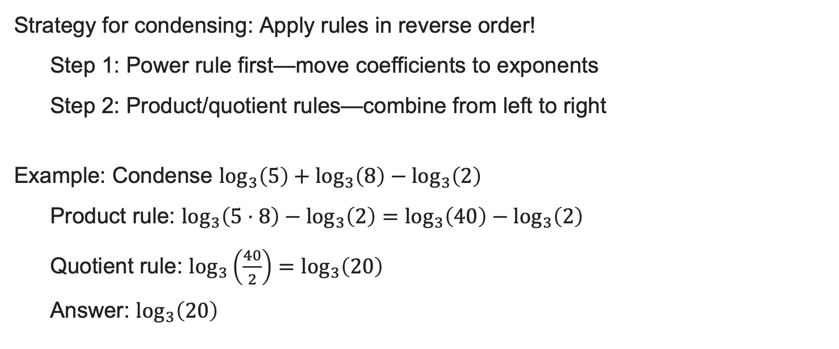
Condensing Logarithms
Strategy for condensing: Apply rules in reverse order!
Step 1: Power rule first—move coefficients to exponents
Step 2: Product/quotient rules—combine from left to right
Example: Condense $\log_{3}\left(5\right)+\log_{3}\left(8\right)−\log_{3}\left(2\right)$
Product rule: $\log_{3}\left(5⋅8\right)−\log_{3}\left(2\right)=\log_{3}\left(40\right)−\log_{3}\left(2\right)$
Quotient rule: $\log_{3}\left(\frac{40}{2}\right)=\log_{3}\left(20\right)$
Answer: $\log_{3}\left(20\right)$

Slide 17
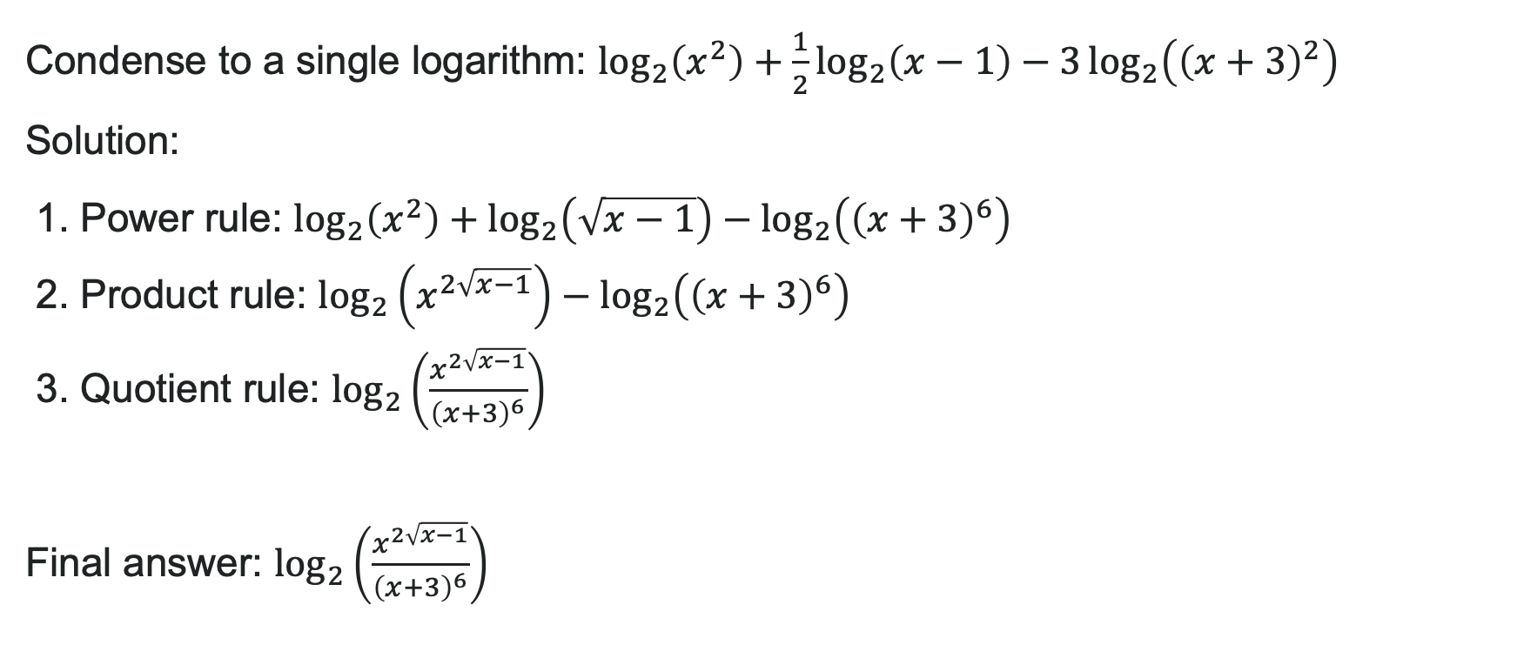
Example: Condensing with Powers
Condense to a single logarithm: $\log_{2}\left(x^{2}\right)+\frac{1}{2}\log_{2}\left(x−1\right)−3\log_{2}\left({\left(x+3\right)}^{2}\right)$
Solution:
1. Power rule: $\log_{2}\left(x^{2}\right)+\log_{2}\left(\sqrt{x−1}\right)−\log_{2}\left({\left(x+3\right)}^{6}\right)$
2. Product rule: $\log_{2}\left(x^{2\sqrt{x−1}}\right)−\log_{2}\left({\left(x+3\right)}^{6}\right)$
3. Quotient rule: $\log_{2}\left(\frac{x^{2\sqrt{x−1}}}{{\left(x+3\right)}^{6}}\right)$
Final answer: $\log_{2}\left(\frac{x^{2\sqrt{x−1}}}{{\left(x+3\right)}^{6}}\right)$

Slide 18
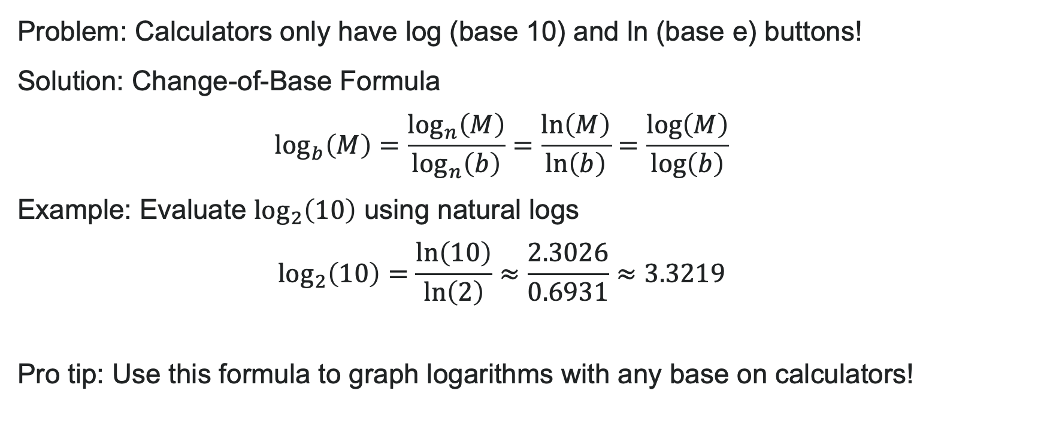
The Change-of-Base Formula
Problem: Calculators only have log (base 10) and ln (base e) buttons!
Solution: Change-of-Base Formula
$$\log_{b}\left(M\right)=\frac{\log_{n}\left(M\right)}{\log_{n}\left(b\right)}=\frac{\ln\left(M\right)}{\ln\left(b\right)}=\frac{\log\left(M\right)}{\log\left(b\right)}$$
Example: Evaluate $\log_{2}\left(10\right)$ using natural logs
$$\log_{2}\left(10\right)=\frac{\ln\left(10\right)}{\ln\left(2\right)}≈\frac{2.3026}{0.6931}≈3.3219$$
Pro tip: Use this formula to graph logarithms with any base on calculators!

Slide 19
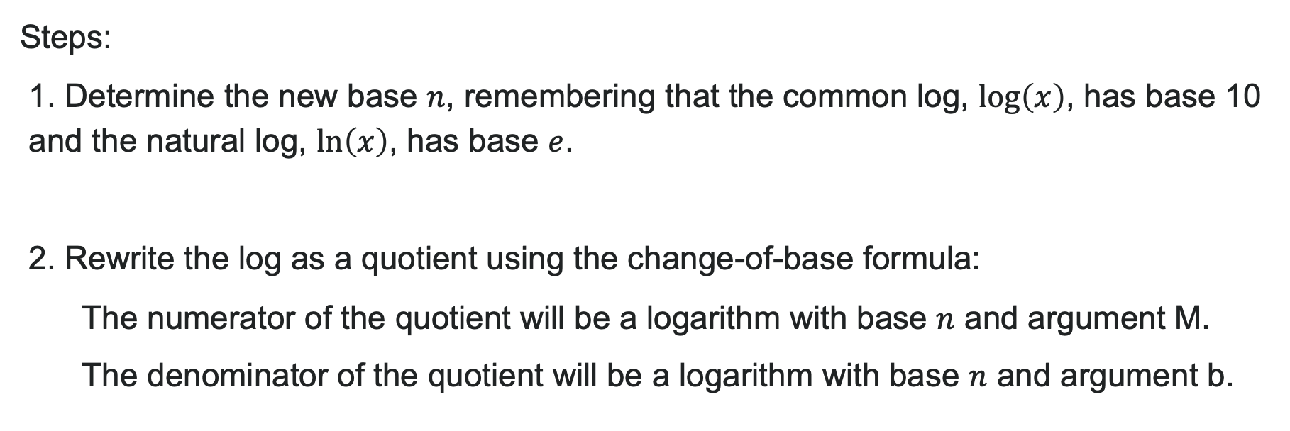
How to: Use the Change of Base Formula
Steps:
1. Determine the new base $n$, remembering that the common log, $\log\left(x\right)$, has base 10 and the natural log, $\ln\left(x\right)$, has base $e$.
2. Rewrite the log as a quotient using the change-of-base formula:
The numerator of the quotient will be a logarithm with base $n$ and argument M.
The denominator of the quotient will be a logarithm with base $n$ and argument b.

Slide 20
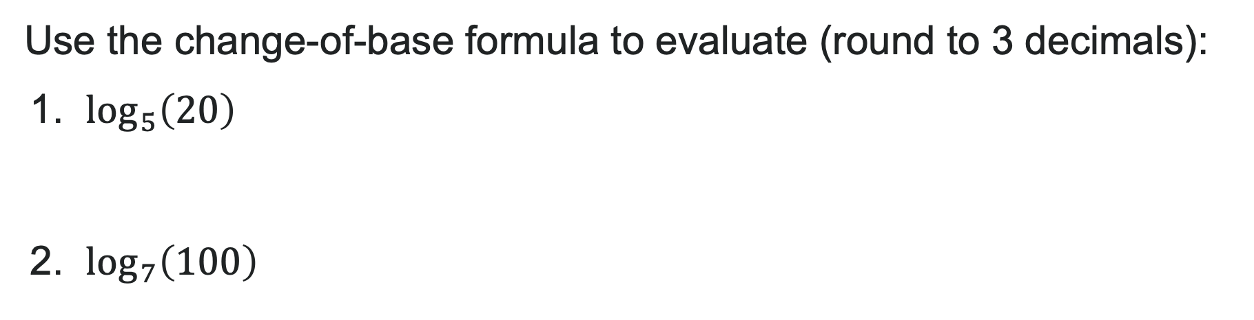
Try It!
Use the change-of-base formula to evaluate (round to 3 decimals):
1. $\log_{5}\left(20\right)$
2. $\log_{7}\left(100\right)$
Notes:
Answer:
1.861
2.367

Slide 21
Learning Goals: Exponential and Logarithmic Equations
Deepen your understanding and form connections within these skills:
1 Use like bases to solve exponential equations
2 Use logarithms to solve exponential equations
3 Solve logarithmic equations
4 Solve applied problems involving exponential and logarithmic equations

Slide 22
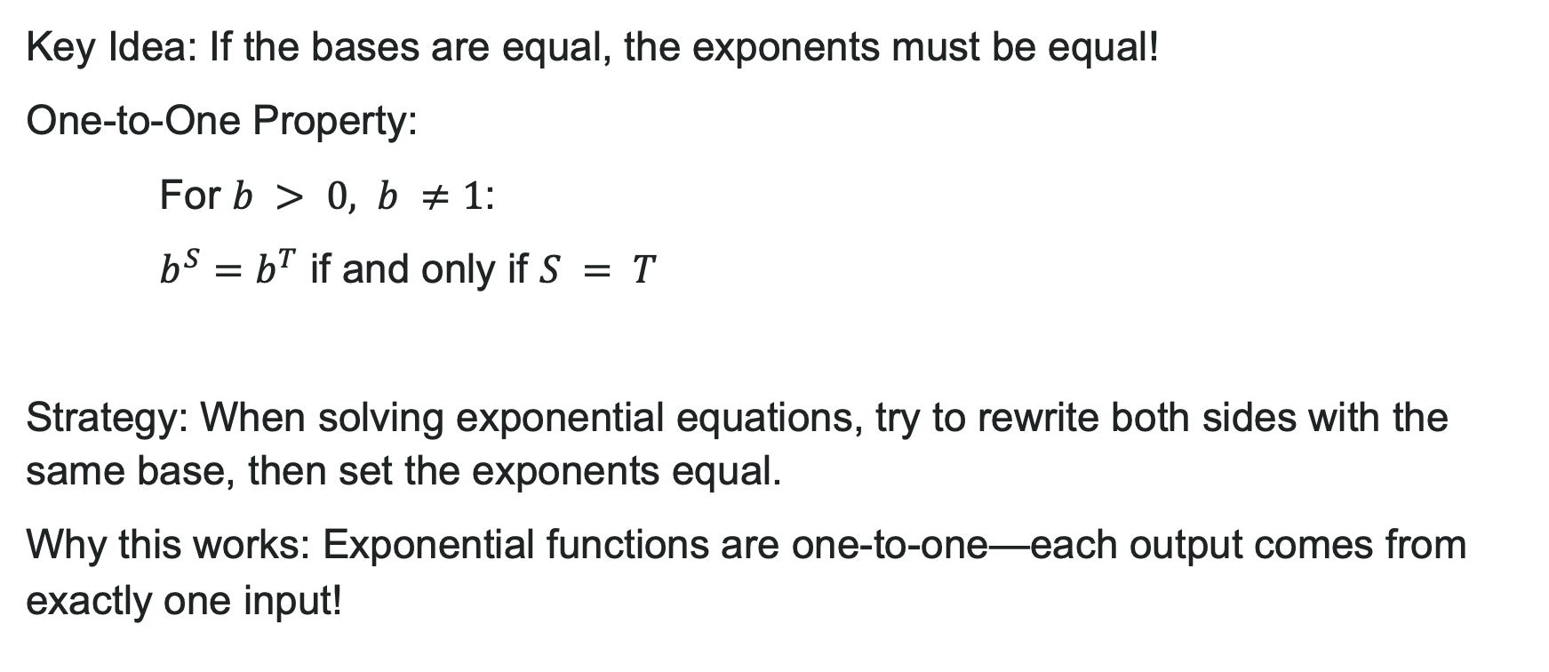
The One-to-One Property of Exponentials
Key Idea: If the bases are equal, the exponents must be equal!
One-to-One Property:
For $b > 0, b ≠1$:
$b^{S}=b^{T}$ if and only if $S = T$
Strategy: When solving exponential equations, try to rewrite both sides with the same base, then set the exponents equal.
Why this works: Exponential functions are one-to-one—each output comes from exactly one input!

Slide 23
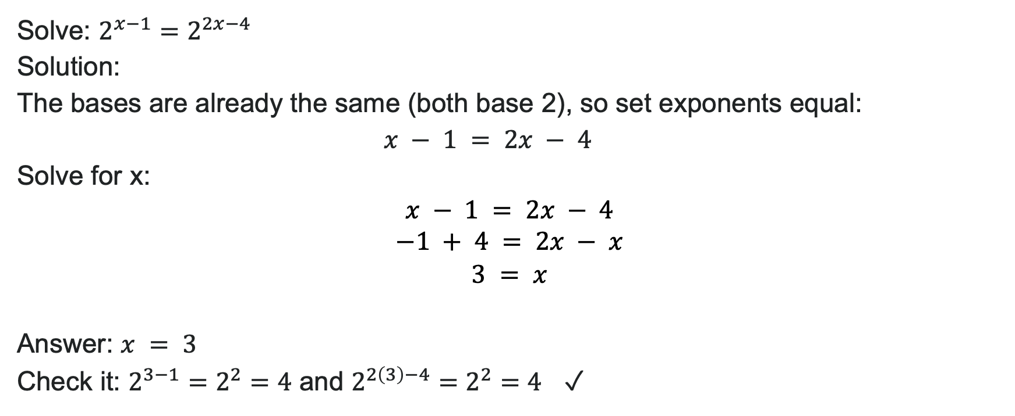
Example: Same Base Already Present
Solve: $2^{x−1}=2^{2x−4}$
Solution:
The bases are already the same (both base 2), so set exponents equal:
$$x − 1 = 2x − 4$$
Solve for x:
$$x − 1 = 2x − 4 \\ −1 + 4 = 2x − x \\ 3 = x$$
Answer: $x = 3$
Check it: $2^{3−1}=2^{2}=4$ and $2^{2\left(3\right)−4}=2^{2}=4$ ✓

Slide 24
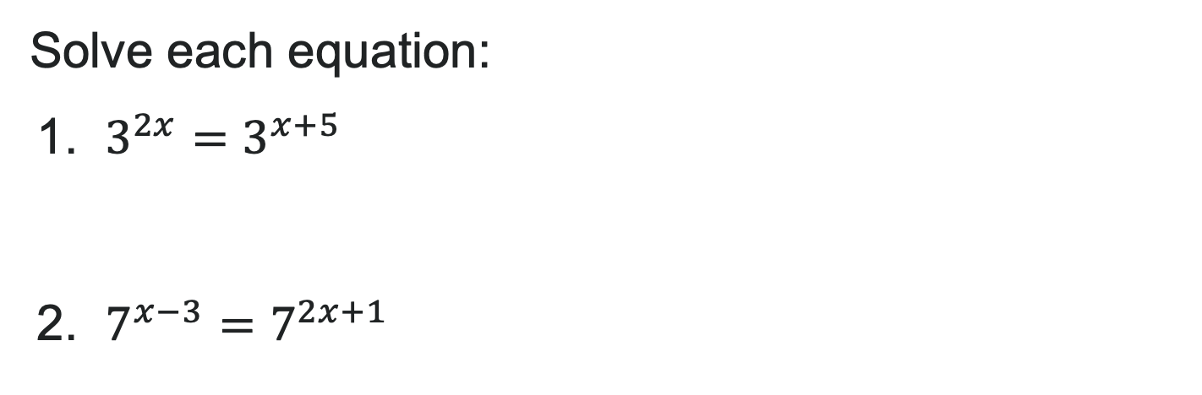
Try It: Same Base Equations
Solve each equation:
1. $3^{2x}=3^{x+5}$
2. $7^{x−3}=7^{2x+1}$
Notes:
Answer:
x = 5
x = -4

Slide 25
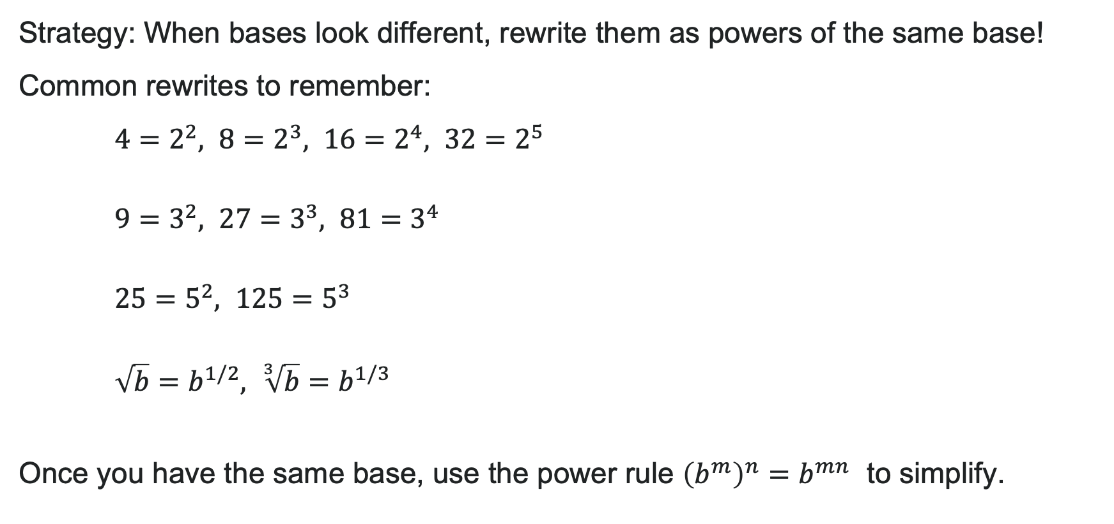
Rewriting with a Common Base
Strategy: When bases look different, rewrite them as powers of the same base!
Common rewrites to remember:
$4=2^{2}, 8=2^{3}, 16=2^{4}, 32=2^{5}$
$9=3^{2}, 27=3^{3}, 81=3^{4}$
$25=5^{2}, 125=5^{3}$
$\sqrt{b}=b^{1/2}, \sqrt[3]{b}=b^{1/3}$
Once you have the same base, use the power rule ${\left(b^{m}\right)}^{n}=b^{mn}$ to simplify.

Slide 26
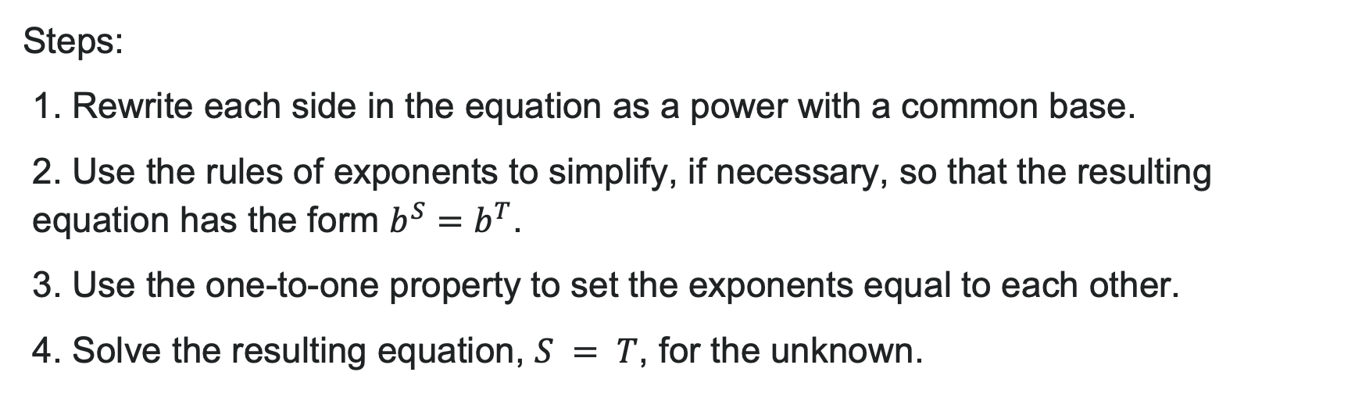
How to: Use the One-to-One Property
Steps:
1. Rewrite each side in the equation as a power with a common base.
2. Use the rules of exponents to simplify, if necessary, so that the resulting equation has the form $b^{S}=b^{T}$.
3. Use the one-to-one property to set the exponents equal to each other.
4. Solve the resulting equation, $S = T$, for the unknown.

Slide 27
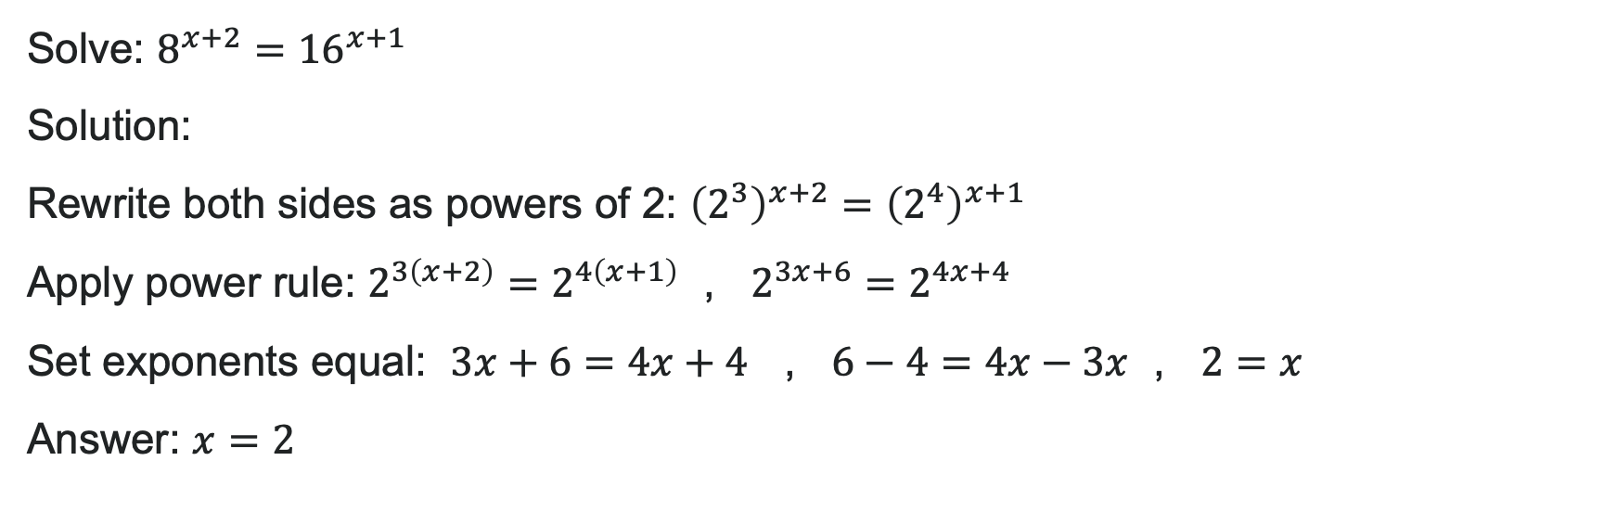
Example: Finding a Common Base
Solve: $8^{x+2}={16}^{x+1}$
Solution:
Rewrite both sides as powers of 2: ${\left(2^{3}\right)}^{x+2}={\left(2^{4}\right)}^{x+1}$
Apply power rule: $2^{3\left(x+2\right)}=2^{4\left(x+1\right)}$ , $2^{3x+6}=2^{4x+4}$
Set exponents equal: $3x+6=4x+4$ , $6−4=4x−3x$ , $2=x$
Answer: $x=2$

Slide 28
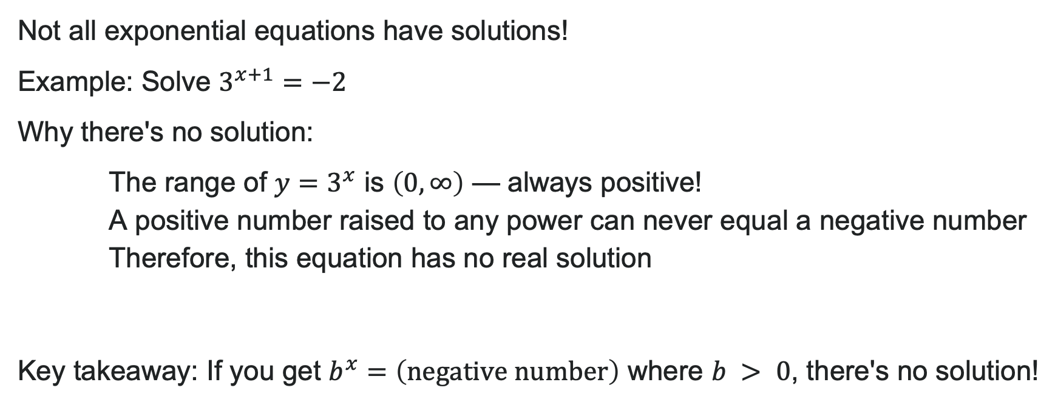
Watch Out! No Solution Cases
Not all exponential equations have solutions!
Example: Solve $3^{x+1}=−2$
Why there's no solution:
The range of $y=3^{x}$ is $\left(0,∞\right)$ — always positive!
A positive number raised to any power can never equal a negative number
Therefore, this equation has no real solution
Key takeaway: If you get $b^{x}=\left(\text{negative} \text{number}\right)$ where $b > 0$, there's no solution!

Slide 29
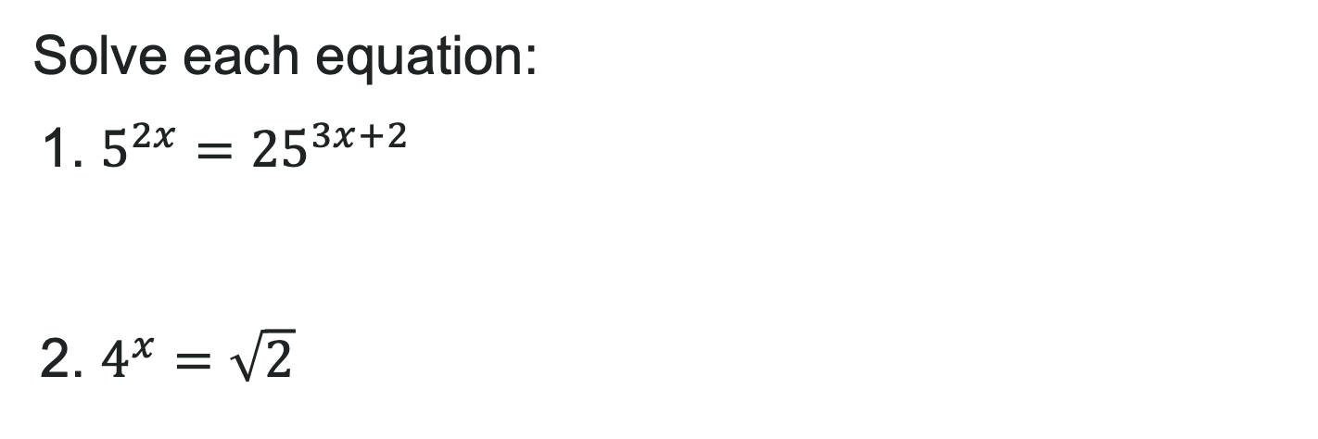
Try It: Rewriting with Common Bases
Solve each equation:
1. $5^{2x}={25}^{3x+2}$
2. $4^{x}=\sqrt{2}$
Notes:
Answer:
x = -1
x = \frac{1}{4}

Slide 30
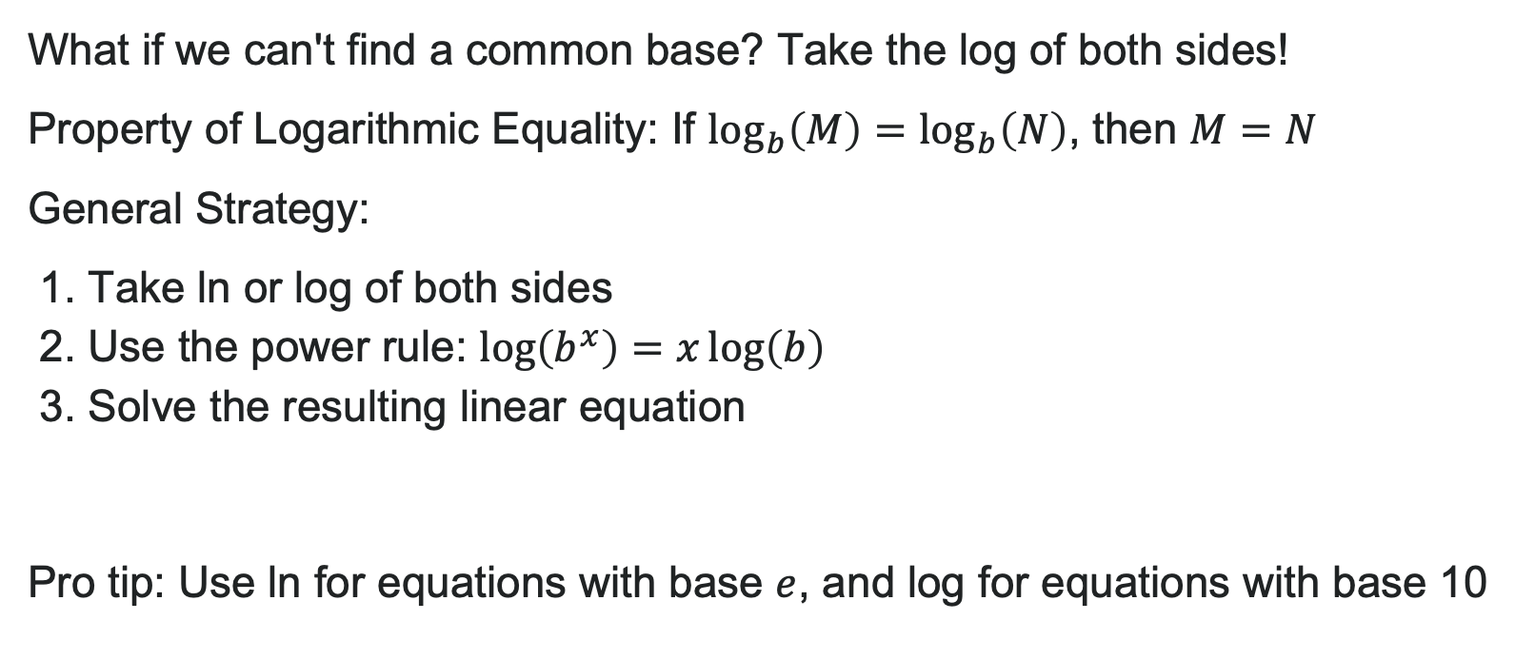
Property of Logarithmic Equality
What if we can't find a common base? Take the log of both sides!
Property of Logarithmic Equality: If $\log_{b}\left(M\right)=\log_{b}\left(N\right)$, then $M=N$
General Strategy:
1. Take ln or log of both sides
2. Use the power rule: $\log\left(b^{x}\right)=x\log\left(b\right)$
3. Solve the resulting linear equation
Pro tip: Use ln for equations with base $e$, and log for equations with base 10

Slide 31
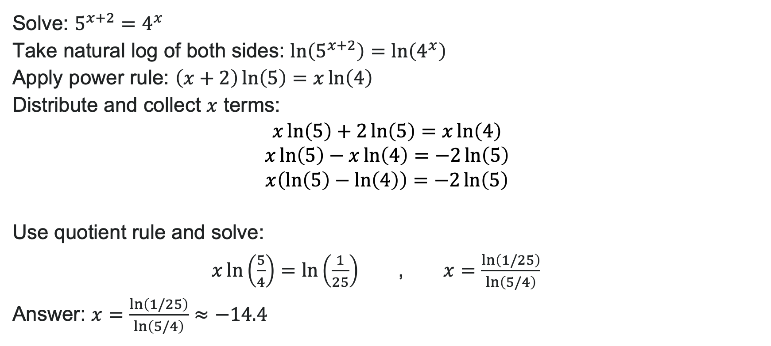
Example: Taking Logs of Both Sides
Solve: $5^{x+2}=4^{x}$
Take natural log of both sides: $\ln\left(5^{x+2}\right)=\ln\left(4^{x}\right)$
Apply power rule: $\left(x+2\right)\ln\left(5\right)=x\ln\left(4\right)$
Distribute and collect $x$ terms:
$$x\ln\left(5\right)+2\ln\left(5\right)=x\ln\left(4\right) \\ x\ln\left(5\right)−x\ln\left(4\right)=−2\ln\left(5\right) \\ x\left(\ln\left(5\right)−\ln\left(4\right)\right)=−2\ln\left(5\right)$$
Use quotient rule and solve:
$x\ln\left(\frac{5}{4}\right)=\ln\left(\frac{1}{25}\right)$ , $x=\frac{\ln\left(1/25\right)}{\ln\left(5/4\right)}$
Answer: $x=\frac{\ln\left(1/25\right)}{\ln\left(5/4\right)}≈−14.4$

Slide 32
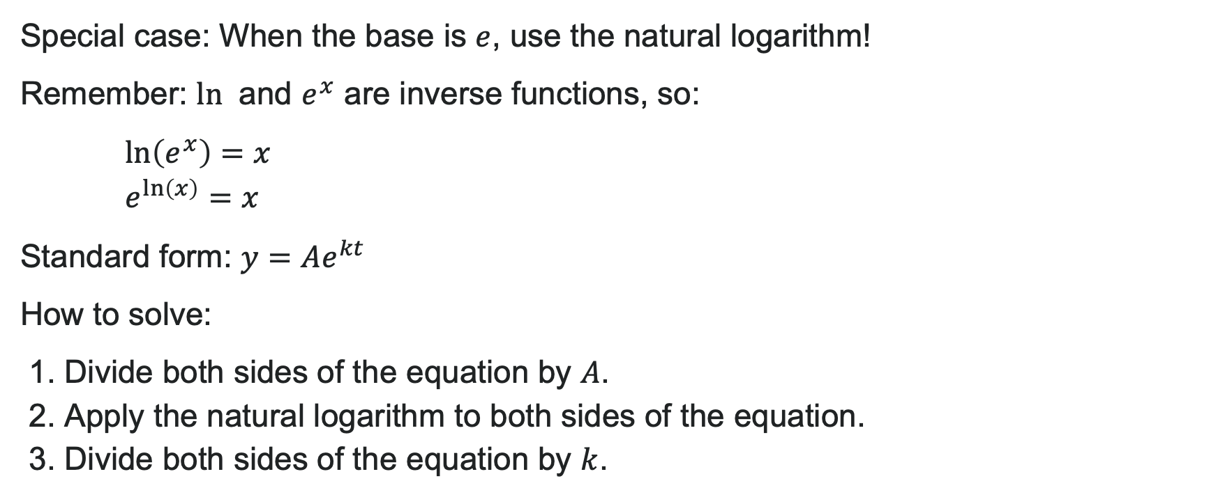
Equations with Base e
Special case: When the base is $e$, use the natural logarithm!
Remember: $ln⁡$ and $e^{x}$ are inverse functions, so:
$\ln\left(e^{x}\right)=x$
$e^{\ln\left(x\right)}=x$
Standard form: $y=Ae^{kt}$
How to solve:
1. Divide both sides of the equation by $A$.
2. Apply the natural logarithm to both sides of the equation.
3. Divide both sides of the equation by $k$.

Slide 33


Example: Solving with Base e
Solve: $100=20e^{2t}$
Solution:
Divide by 20: $5=e^{2t}$
Take natural log of both sides:
$\ln\left(5\right)=\ln\left(e^{2t}\right)$
$\ln\left(5\right)=2t$
Solve for t: $t=\frac{\ln\left(5\right)}{2}$
Answer: $t=\frac{\ln\left(5\right)}{2}≈0.805$
Alternative form: $t=\ln\left(\sqrt{5}\right)$

Slide 34
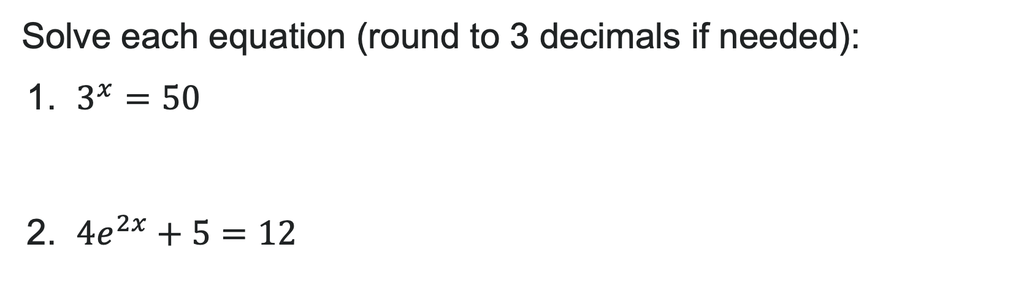
Try It: Exponential Equations with Logs
Solve each equation (round to 3 decimals if needed):
1. $3^{x}=50$
2. $4e^{2x}+5=12$
Notes:
Answer:
x = \frac{\ln(50)}{\ln(3)} \approx 3.561
x = \frac{1}{2}\ln\left(\frac{7}{4}\right) \approx 0.280

Slide 35
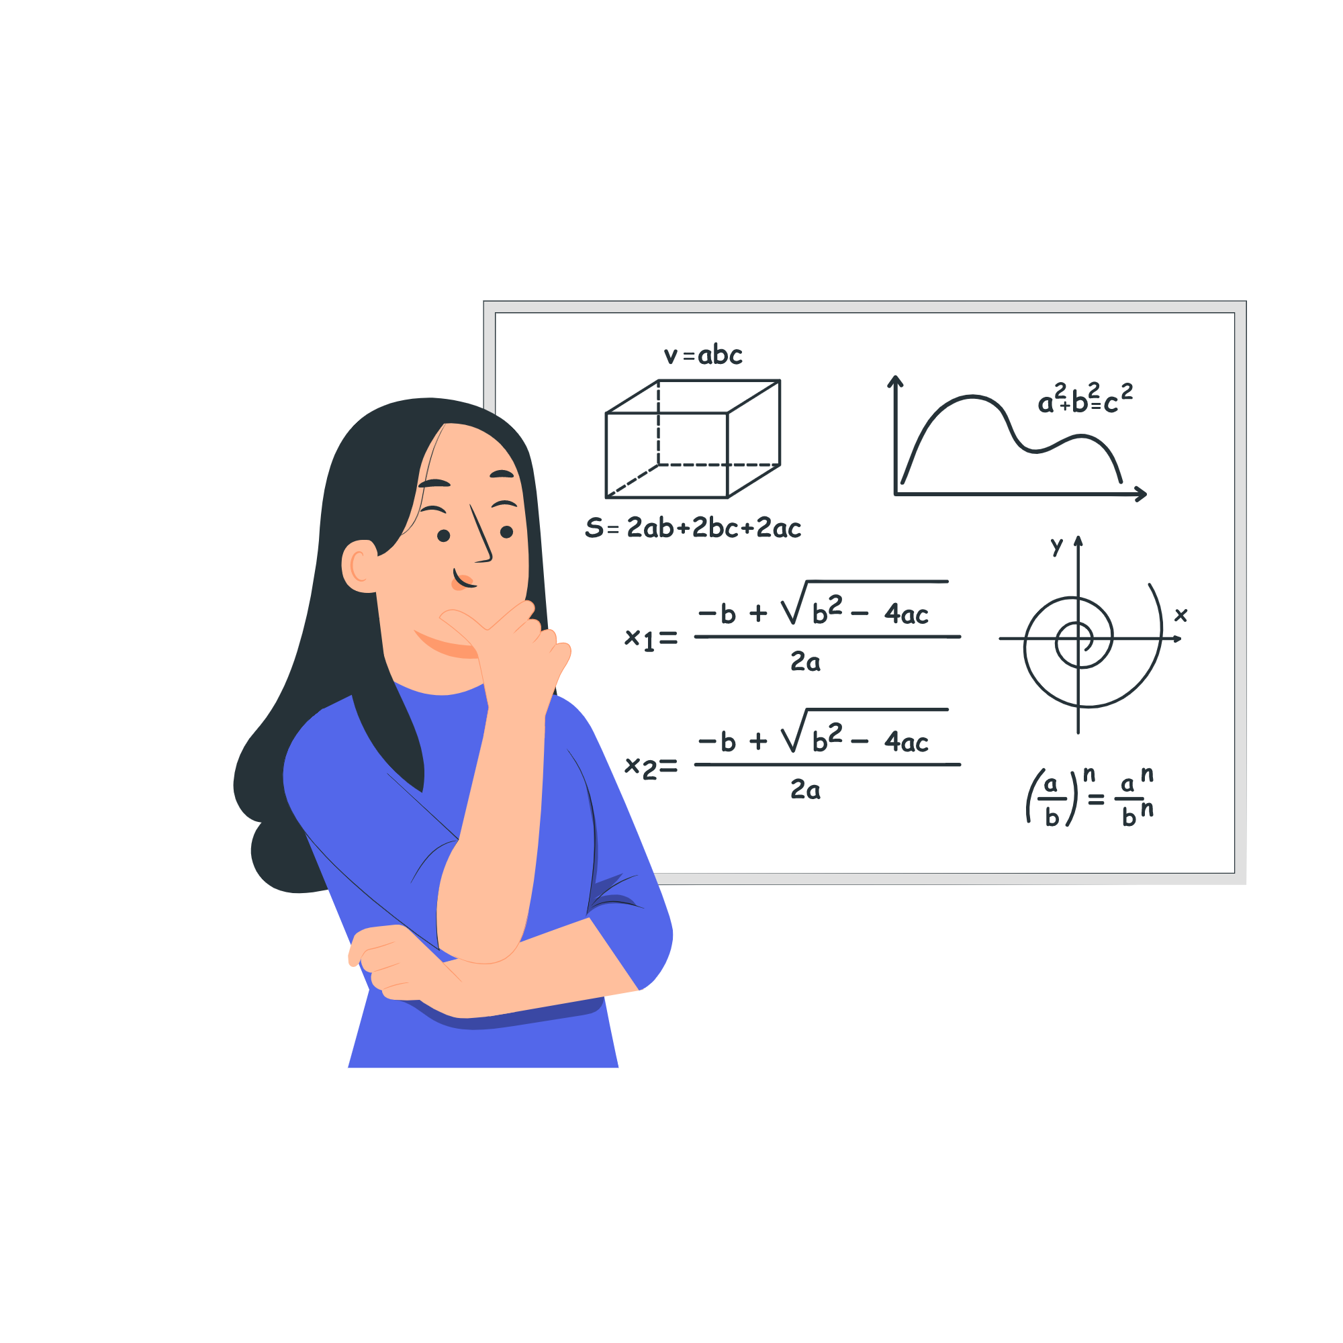
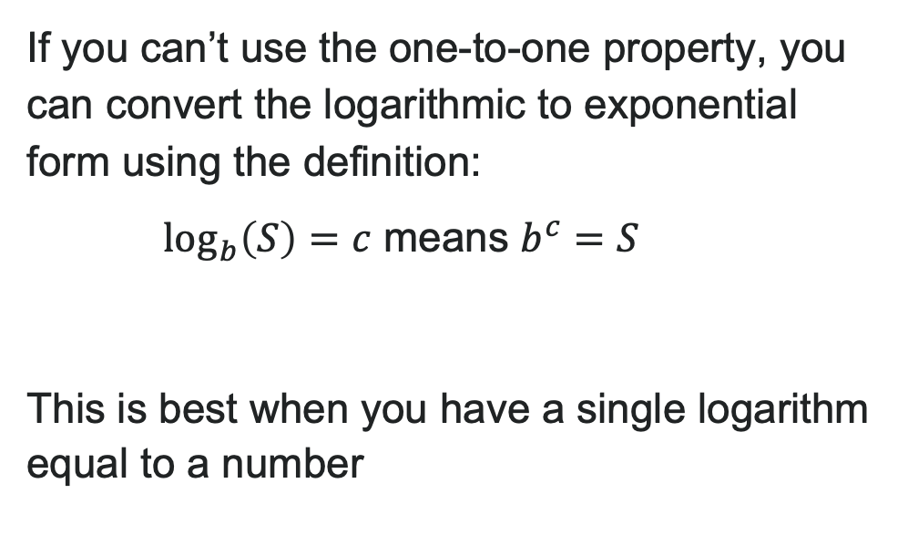
Definition of a Logarithm
If you can’t use the one-to-one property, you can convert the logarithmic to exponential form using the definition:
$\log_{b}\left(S\right)=c$ means $b^{c}=S$
This is best when you have a single logarithm equal to a number

Slide 36
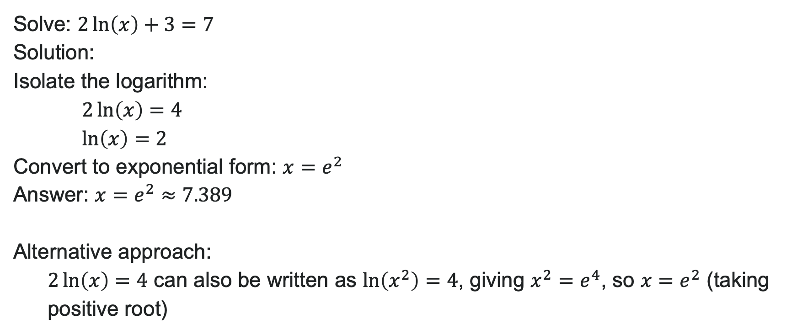
Example: Using the Definition
Solve: $2\ln\left(x\right)+3=7$
Solution:
Isolate the logarithm:
$2\ln\left(x\right)=4$
$\ln\left(x\right)=2$
Convert to exponential form: $x=e^{2}$
Answer: $x=e^{2}≈7.389$
Alternative approach:
$2\ln\left(x\right)=4$ can also be written as $\ln\left(x^{2}\right)=4$, giving $x^{2}=e^{4}$, so $x=e^{2}$ (taking positive root)

Slide 37
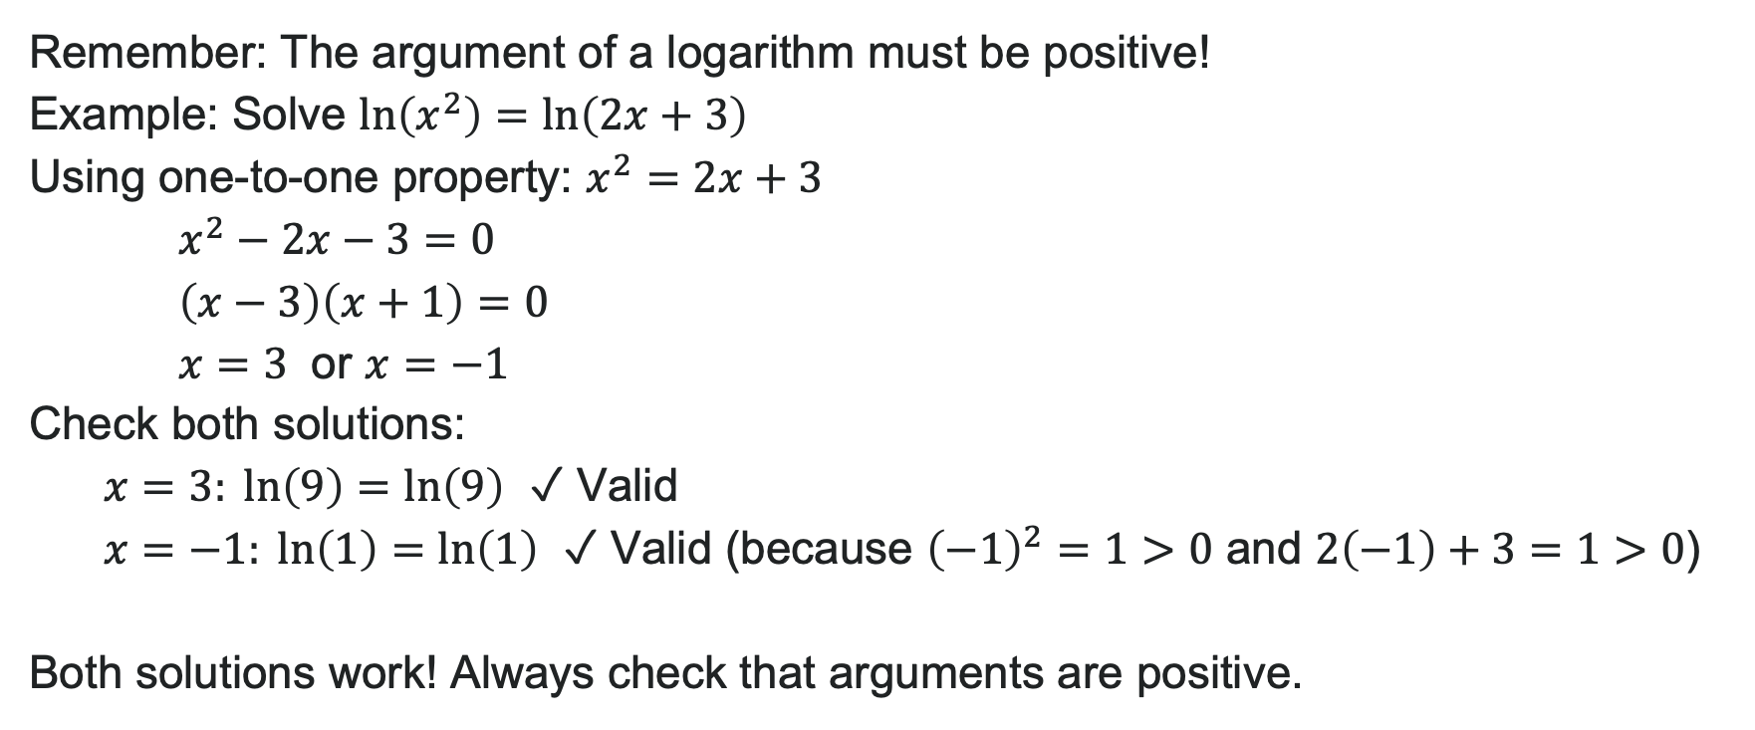
Extraneous Solutions: Be Careful!
Remember: The argument of a logarithm must be positive!
Example: Solve $\ln\left(x^{2}\right)=\ln\left(2x+3\right)$
Using one-to-one property: $x^{2}=2x+3$
$x^{2}−2x−3=0$
$\left(x−3\right)\left(x+1\right)=0$
$x=3$ or $x=−1$
Check both solutions:
$x=3: \ln\left(9\right)=\ln\left(9\right)$ ✓ Valid
$x=−1:\ln\left(1\right)=\ln\left(1\right)$ ✓ Valid (because ${\left(−1\right)}^{2}=1>0$ and $2\left(−1\right)+3=1>0$)
Both solutions work! Always check that arguments are positive.

Slide 38
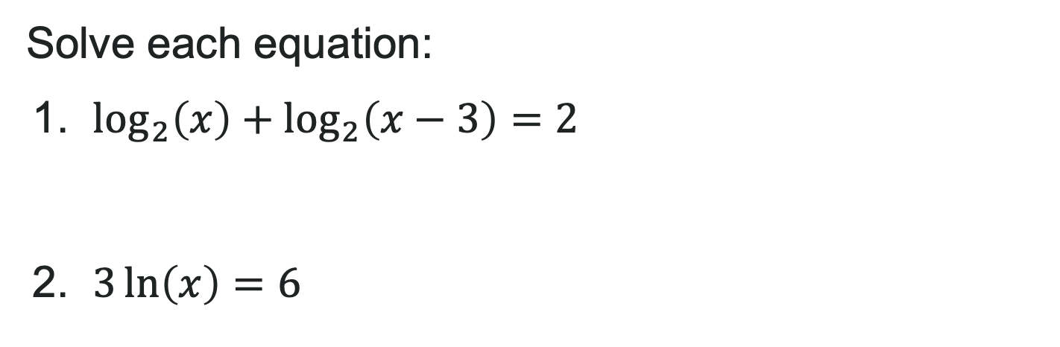
Try It: Logarithmic Equations
Solve each equation:
1. $\log_{2}\left(x\right)+\log_{2}\left(x−3\right)=2$
2. $3\ln\left(x\right)=6$
Notes:
Answer:
x = 4 (Note: x = -1 is extraneous because \log_2(-1) and \log_2(-4) are undefined)
x = e^2 \approx 7.389

Slide 39
Learning Goals: Exponential and Logarithmic Models
Deepen your understanding and form connections within these skills:
1 Model exponential growth and decay
2 Use Newton’s Law of Cooling
3 Use logistic-growth models

Slide 40
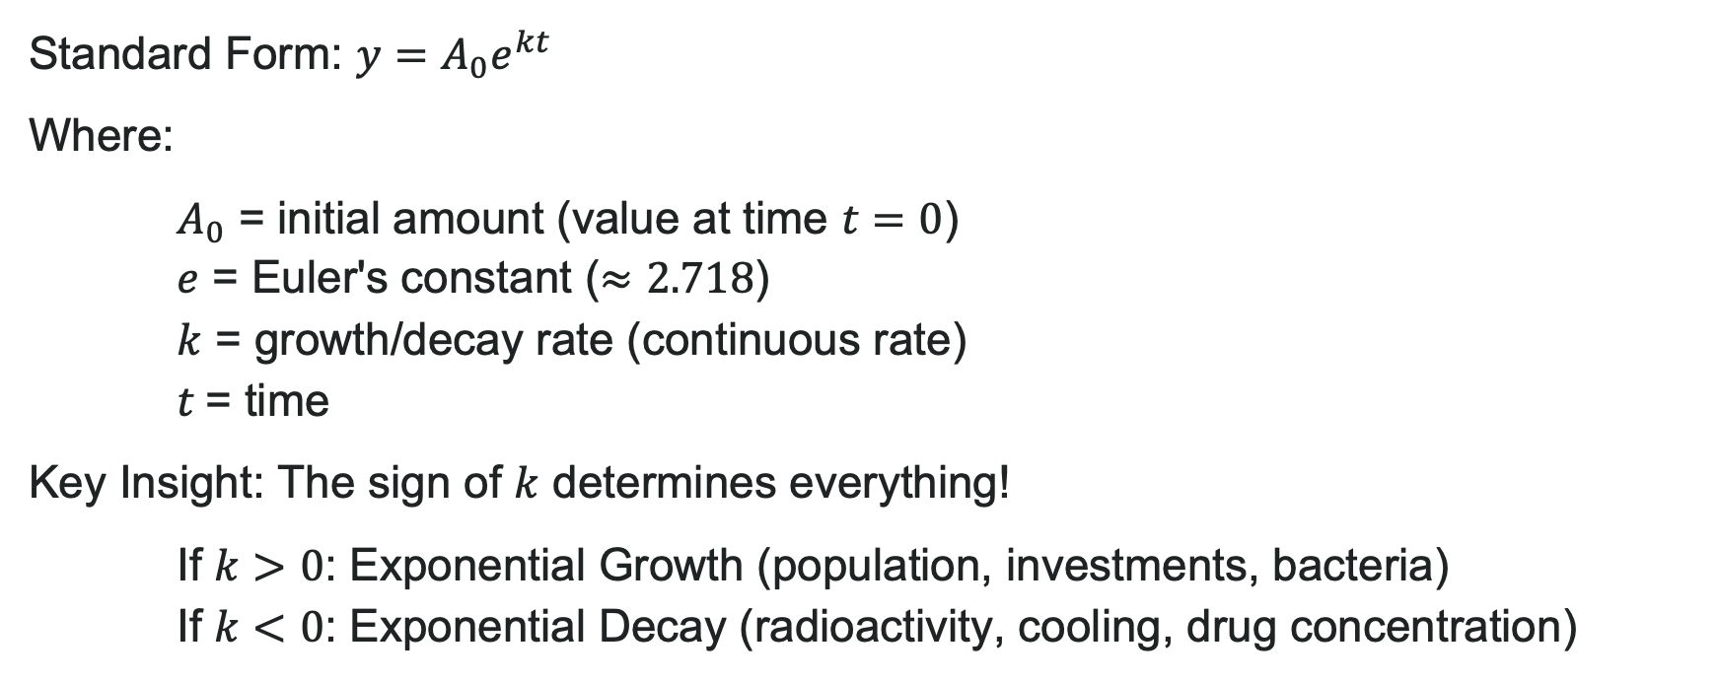
Exponential Growth and Decay
Standard Form: $y=A_{0}e^{kt}$
Where:
$A_{0}$ = initial amount (value at time $t=0$)
$e$ = Euler's constant ($≈2.718$)
$k$ = growth/decay rate (continuous rate)
$t$= time
Key Insight: The sign of $k$ determines everything!
If $k>0$: Exponential Growth (population, investments, bacteria)
If $k<0$: Exponential Decay (radioactivity, cooling, drug concentration)

Slide 41
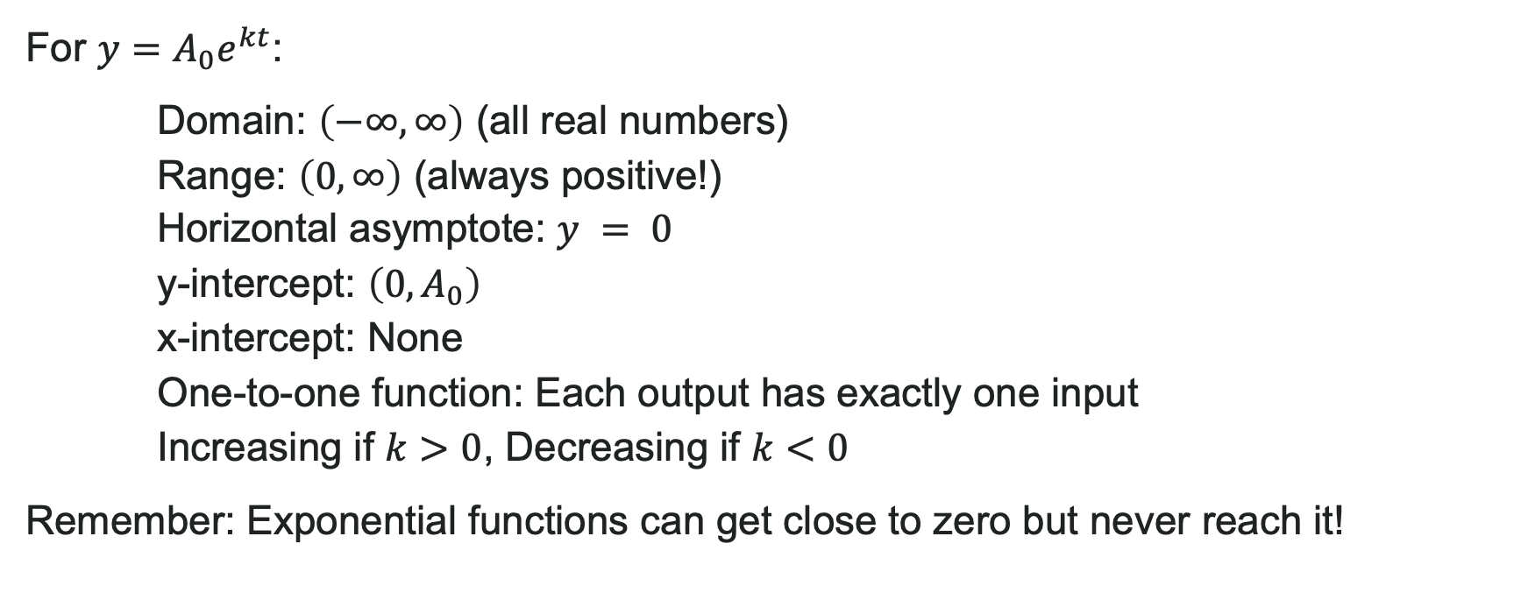
Characteristics of Exponential Functions
For $y=A_{0}e^{kt}$:
Domain: $\left(−∞,∞\right)$ (all real numbers)
Range: $\left(0,∞\right)$ (always positive!)
Horizontal asymptote: $y = 0$
y-intercept: $\left(0,A_{0}\right)$
x-intercept: None
One-to-one function: Each output has exactly one input
Increasing if $k>0$, Decreasing if $k<0$
Remember: Exponential functions can get close to zero but never reach it!

Slide 42
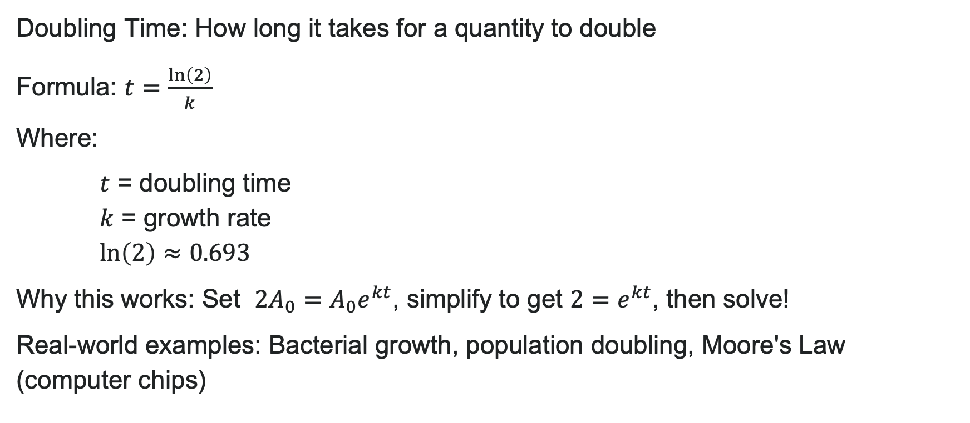
Exponential Growth: Doubling Time
Doubling Time: How long it takes for a quantity to double
Formula: $t=\frac{\ln\left(2\right)}{k}$
Where:
$t$ = doubling time
$k$ = growth rate
$\ln\left(2\right)≈0.693$
Why this works: Set $2A_{0}=A_{0}e^{kt}$, simplify to get $2=e^{kt}$, then solve!
Real-world examples: Bacterial growth, population doubling, Moore's Law (computer chips)

Slide 43
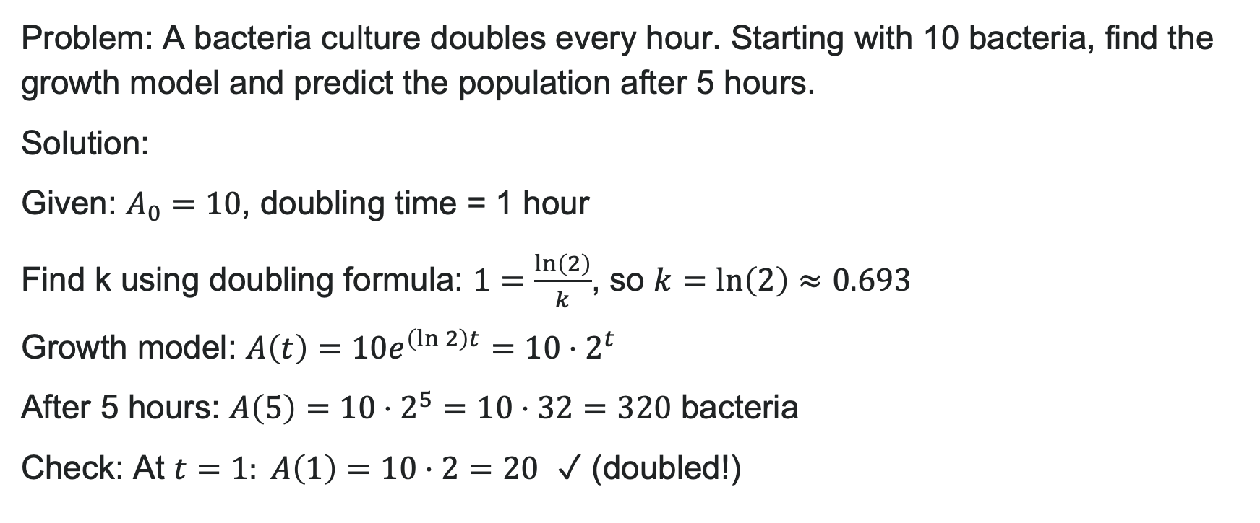
Example: Bacteria Growth with Doubling
Problem: A bacteria culture doubles every hour. Starting with 10 bacteria, find the growth model and predict the population after 5 hours.
Solution:
Given: $A_{0}=10$, doubling time = 1 hour
Find k using doubling formula: $1=\frac{\ln\left(2\right)}{k}$, so $k=\ln\left(2\right)≈0.693$
Growth model: $A\left(t\right)=10e^{\left(\ln{2}\right)t}=10⋅2^{t}$
After 5 hours: $A\left(5\right)=10⋅2^{5}=10⋅32=320$ bacteria
Check: At $t=1: A\left(1\right)=10⋅2=20$ ✓ (doubled!)

Slide 44
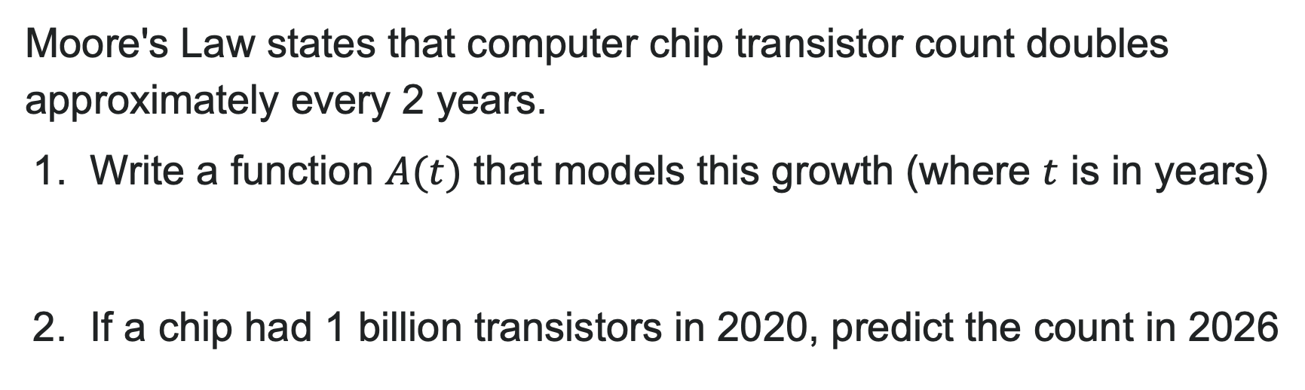
Try It: Exponential Growth
Moore's Law states that computer chip transistor count doubles approximately every 2 years.
1. Write a function $A(t)$ that models this growth (where $t$ is in years)
2. If a chip had 1 billion transistors in 2020, predict the count in 2026
Notes:
Answer:
k = \frac{\ln(2)}{2}, so A(t) = A_0 e^{\frac{\ln(2)}{2}t}
t = 6 years, so A(6) = 1 \times 10^9 \cdot 2^3 = 8 billion transistors

Slide 45
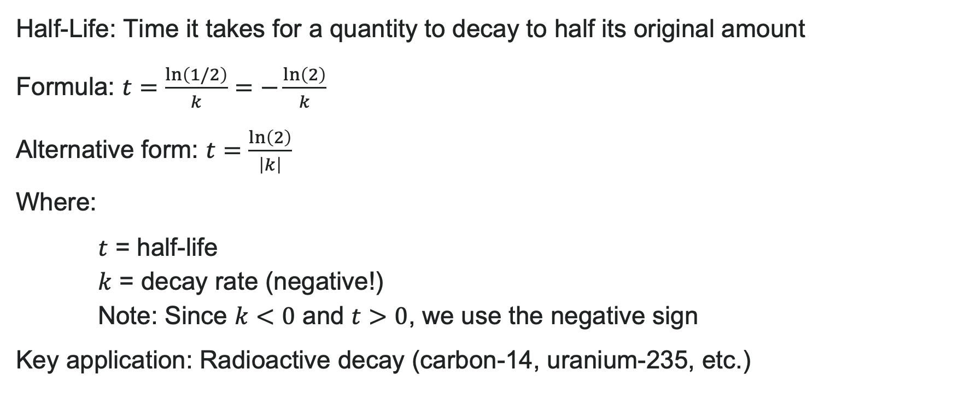
Exponential Decay: Half-Life
Half-Life: Time it takes for a quantity to decay to half its original amount
Formula: $t=\frac{\ln\left(1/2\right)}{k}=−\frac{\ln\left(2\right)}{k}$
Alternative form: $t=\frac{\ln\left(2\right)}{\left|k\right|}$
Where:
$t$ = half-life
$k$ = decay rate (negative!)
Note: Since $k<0$ and $t>0$, we use the negative sign
Key application: Radioactive decay (carbon-14, uranium-235, etc.)

Slide 46

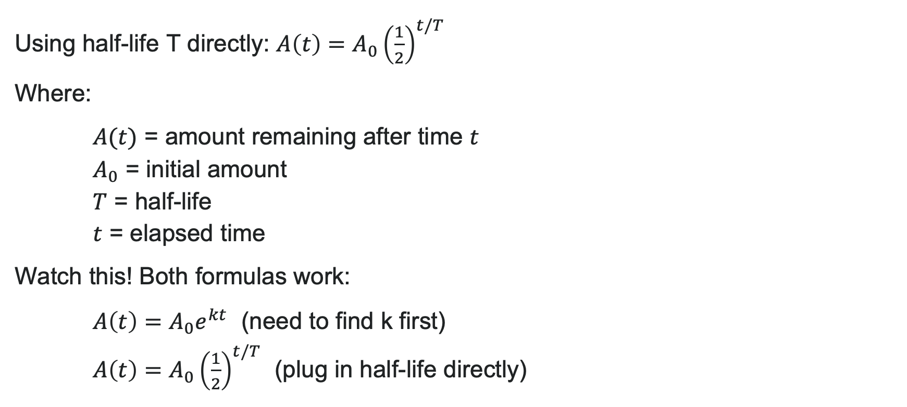
Radioactive Decay Formula
Using half-life T directly: $A\left(t\right)=A_{0}{\left(\frac{1}{2}\right)}^{t/T}$
Where:
$A(t)$ = amount remaining after time $t$
$A_{0}$ = initial amount
$T$ = half-life
$t$ = elapsed time
Watch this! Both formulas work:
$A\left(t\right)=A_{0}e^{kt}$ (need to find k first)
$A\left(t\right)=A_{0}{\left(\frac{1}{2}\right)}^{t/T}$ (plug in half-life directly)

Slide 47
Try It: Half-Life Calculations
Cobalt-60 has a half-life of 5.3 years.
1. Write the decay function for a 100-gram sample
2. How much remains after 10 years?
3. When will only 25 grams remain?
Notes:
Answer:
A(t) = 100 \left(\frac{1}{2}\right)^{t/5.3} or A(t) = 100e^{\frac{\ln(0.5)}{5.3}t}
A(10) = 100(1/2)^{10/5.3} \approx 27.4 grams
25 = 100(1/2)^{t/5.3}, so t = 5.3 \times \frac{\ln(0.25)}{\ln(0.5)} = 10.6 years

Slide 48
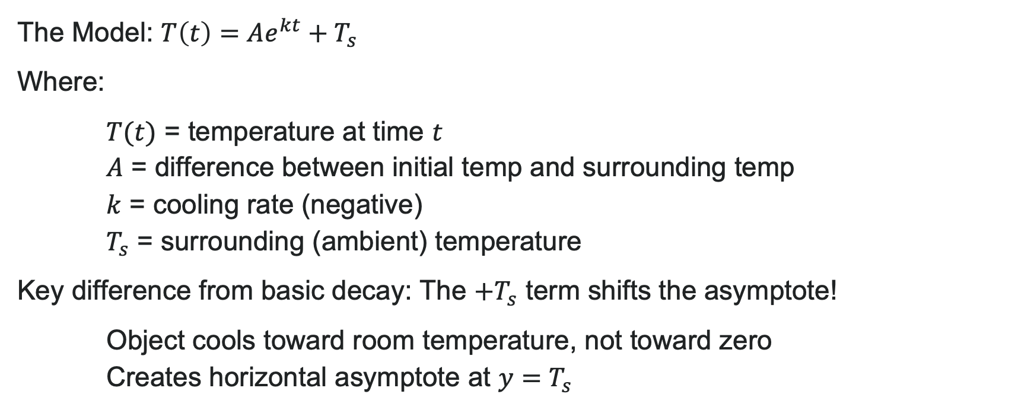
Newton’s Law of Cooling
The Model: $T\left(t\right)=Ae^{kt}+T_{s}$
Where:
$T(t)$ = temperature at time $t$
$A$ = difference between initial temp and surrounding temp
$k$ = cooling rate (negative)
$T_{s}$ = surrounding (ambient) temperature
Key difference from basic decay: The $+T_{s}$ term shifts the asymptote!
Object cools toward room temperature, not toward zero
Creates horizontal asymptote at $y=T_{s}$

Slide 49
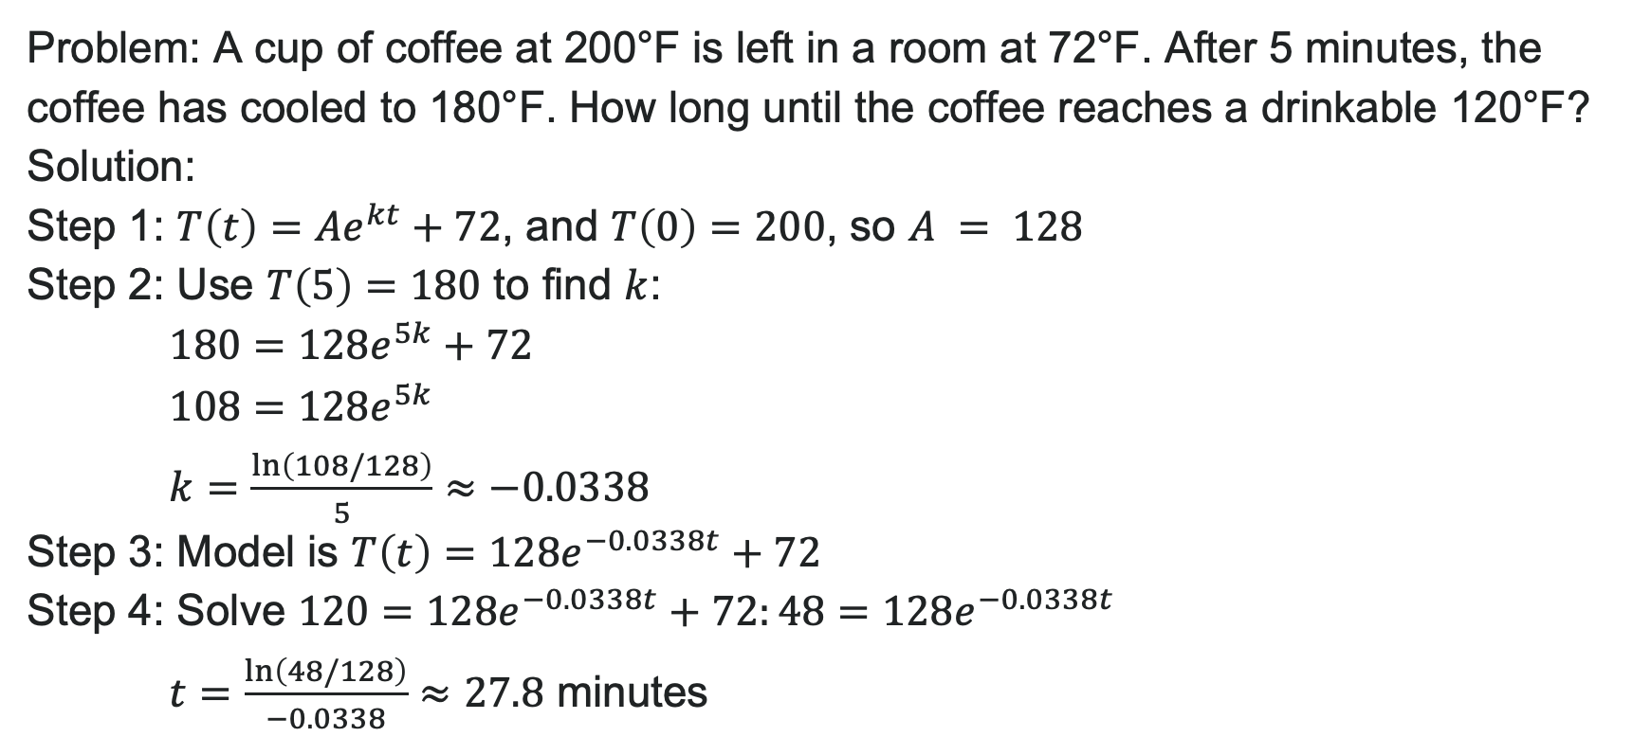
Example: Cooling Coffee
Problem: A cup of coffee at 200°F is left in a room at 72°F. After 5 minutes, the coffee has cooled to 180°F. How long until the coffee reaches a drinkable 120°F?
Solution:
Step 1: $T\left(t\right)=Ae^{kt}+72$, and $T\left(0\right)=200$, so $A = 128$
Step 2: Use $T\left(5\right)=180$ to find $k$:
$180=128e^{5k}+72$
$108=128e^{5k}$
$k=\frac{\ln\left(108/128\right)}{5}≈−0.0338$
Step 3: Model is $T\left(t\right)=128e^{−0.0338t}+72$
Step 4: Solve $120=128e^{−0.0338t}+72:48=128e^{−0.0338t}$
$t=\frac{\ln\left(48/128\right)}{−0.0338}≈27.8$ minutes
Answer: About 28 minutes until the coffee is drinkable (cool enough to enjoy safely!)

Slide 50
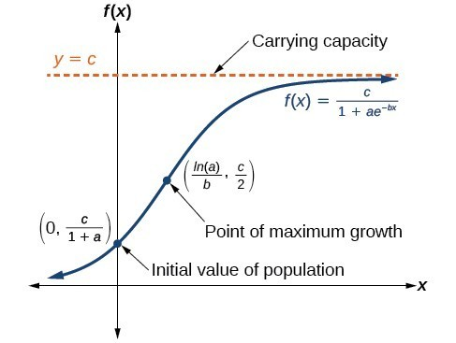
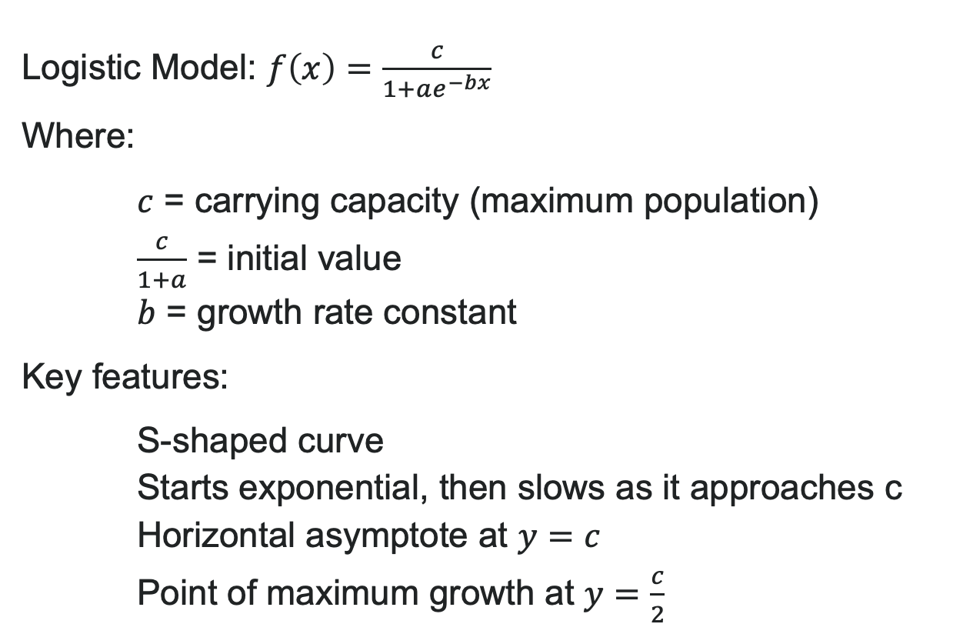
Logistic Growth
Logistic Model: $f\left(x\right)=\frac{c}{1+ae^{−bx}}$
Where:
$c$ = carrying capacity (maximum population)
$\frac{c}{1+a}$ = initial value
$b$ = growth rate constant
Key features:
S-shaped curve
Starts exponential, then slows as it approaches c
Horizontal asymptote at $y=c$
Point of maximum growth at $y=\frac{c}{2}$
Exponential growth can't continue forever—populations hit limits!

Slide 51
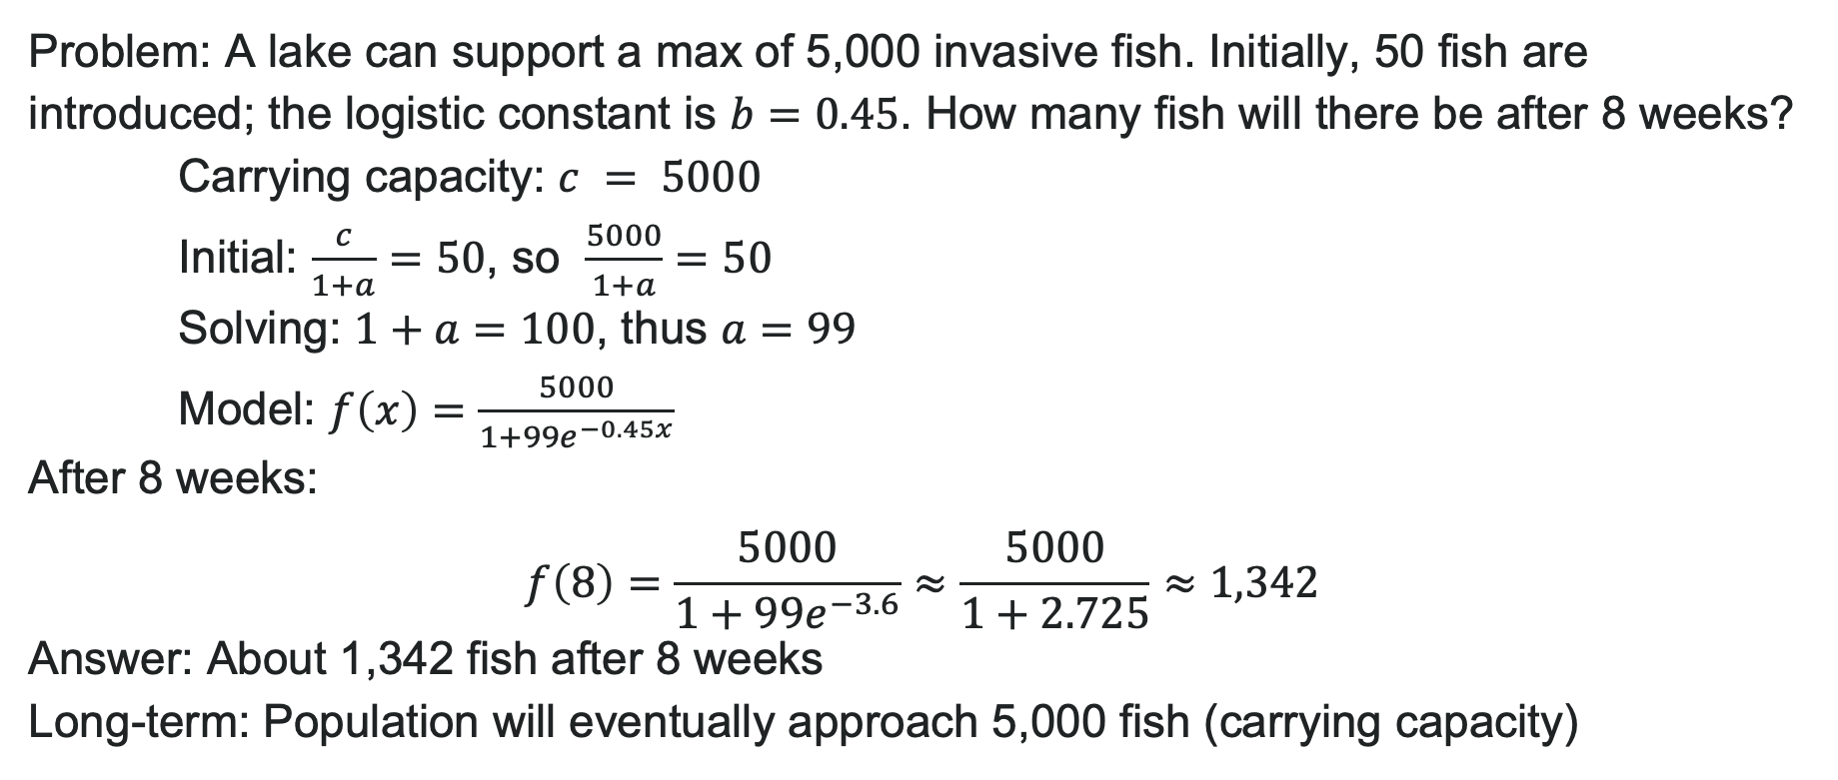
Example: Invasive Species Spread
Problem: A lake can support a max of 5,000 invasive fish. Initially, 50 fish are introduced; the logistic constant is $b=0.45$. How many fish will there be after 8 weeks?
Carrying capacity: $c = 5000$
Initial: $\frac{c}{1+a}=50$, so $\frac{5000}{1+a}=50$
Solving: $1+a=100$, thus $a=99$
Model: $f\left(x\right)=\frac{5000}{1+99e^{−0.45x}}$
After 8 weeks:
$$f\left(8\right)=\frac{5000}{1+99e^{−3.6}}≈\frac{5000}{1+2.725}≈1,342$$
Answer: About 1,342 fish after 8 weeks
Long-term: Population will eventually approach 5,000 fish (carrying capacity)

Slide 52
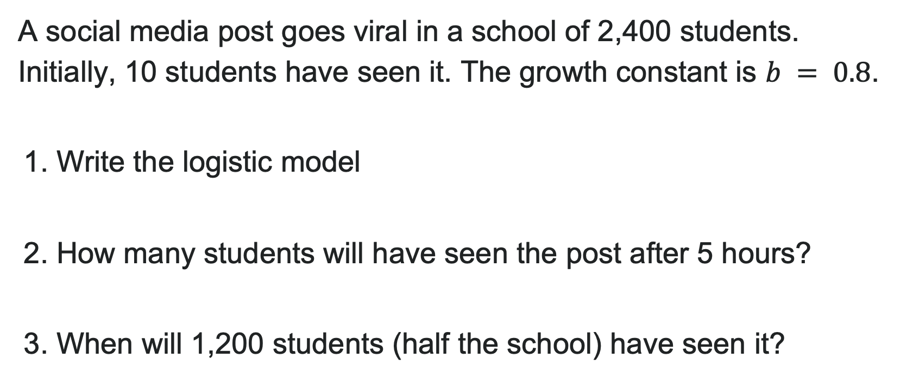
Try It: Logistic Growth Application
A social media post goes viral in a school of 2,400 students. Initially, 10 students have seen it. The growth constant is $b = 0.8$.
1. Write the logistic model
2. How many students will have seen the post after 5 hours?
3. When will 1,200 students (half the school) have seen it?
Notes:
Answer:
c = 2400, \frac{2400}{1+a} = 10 so a = 239. Model: f(x) = \frac{2400}{1 + 239e^{-0.8x}}
f(5) = \frac{2400}{1 + 239e^{-4}} \approx 515 students
Half of 2400 is 1200, which occurs at x = \frac{\ln(a)}{b} = \frac{\ln(239)}{0.8} \approx 6.88 hours

Slide 53
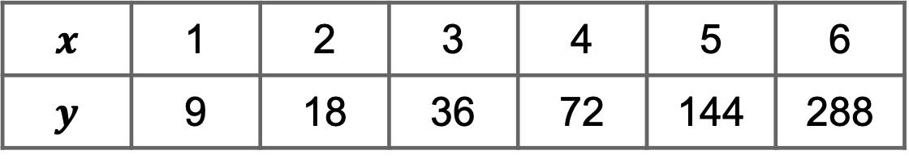
Try It: Choosing the Right Model
Look at the data pattern and choose: Linear, Exponential, Logarithmic, or Logistic?
$$x$$ | 1 | 2 | 3 | 4 | 5 | 6
$$y$$ | 9 | 18 | 36 | 72 | 144 | 288
Hint: Check if the data doubles at regular intervals!
Notes:
Answer: Exponential growth. Pattern shows doubling: each y-value is 2× the previous.
Model: y = 9 \cdot 2^{x-1} or y = 4.5 \cdot 2^x or y = 4.5e^{(\ln 2)x}

Slide 54
Learning Goals: Fitting Exponential Models to Data
Deepen your understanding and form connections within these skills:
1 Build an exponential model from data
2 Build a logarithmic model from data
3 Build a logistic model from data

Slide 55
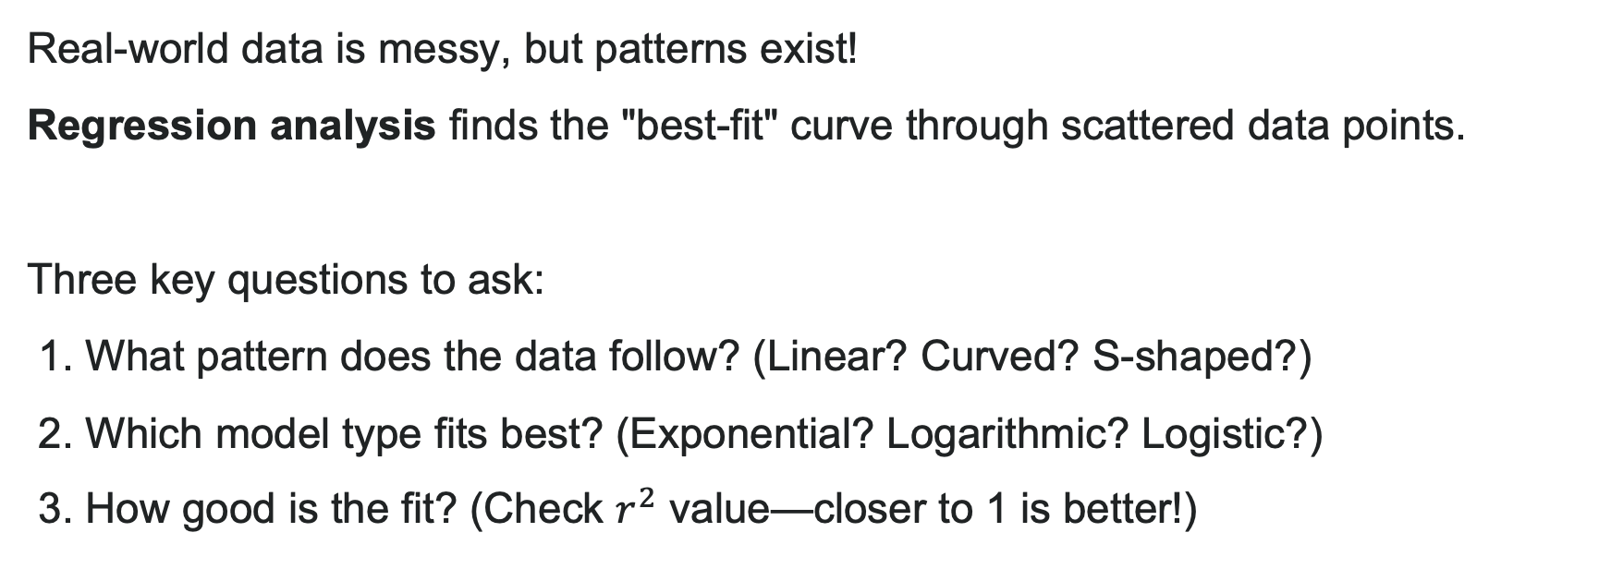
Regression: From Data to Models
Real-world data is messy, but patterns exist!
Regression analysis finds the "best-fit" curve through scattered data points.
Three key questions to ask:
1. What pattern does the data follow? (Linear? Curved? S-shaped?)
2. Which model type fits best? (Exponential? Logarithmic? Logistic?)
3. How good is the fit? (Check $r^{2}$ value—closer to 1 is better!)

Slide 56
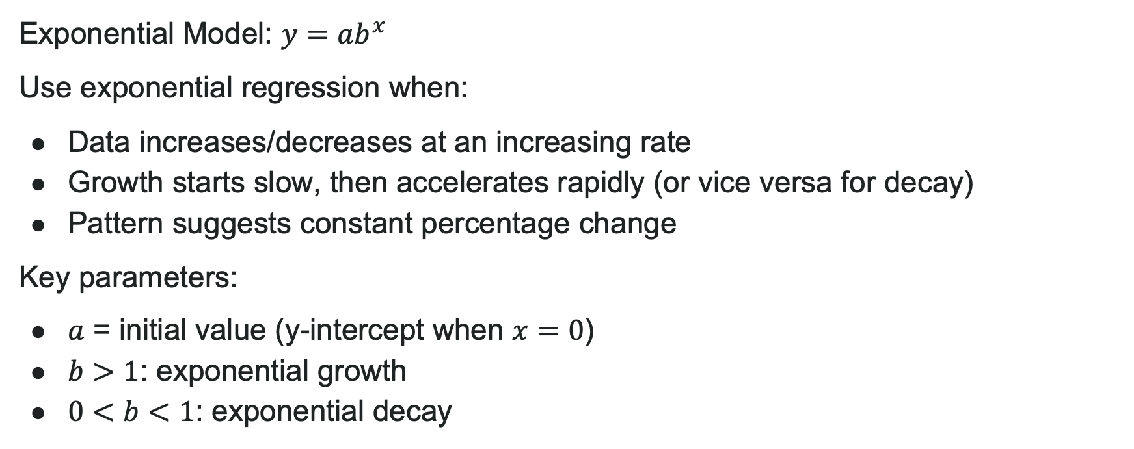
When to Use Exponential Regression
Exponential Model: $y=ab^{x}$
Use exponential regression when:
Data increases/decreases at an increasing rate
Growth starts slow, then accelerates rapidly (or vice versa for decay)
Pattern suggests constant percentage change
Key parameters:
$a$ = initial value (y-intercept when $x=0$)
$b>1$: exponential growth
$0<b<1$: exponential decay
Real-world examples: Compound interest, viral spread, radioactive decay, bacterial growth

Slide 57


Exponential Regression with a Calculator
Step 1: Enter data (STAT → EDIT)
Put x-values in L1
Put y-values in L2
Step 2: Create scatter plot (STATPLOT)
Verify the data curves upward or downward
Step 3: Perform regression (STAT → CALC → ExpReg)
Calculator returns values for $a$ and $b$
Check $r^{2}$ (closer to 1 = better fit)
Step 4: Graph the model with data to verify fit
Pro tip: Always plot first—let your eyes guide your choice!

Slide 58


Example: App Downloads
Problem: A tech company tracks new app downloads per week after launch:
Week ($x$) | 1 | 2 | 3 | 4 | 5 | 6
Downloads (1000s) | 2.1 | 4.3 | 8.9 | 17.8 | 35.2 | 71.5
Find an exponential model and predict downloads in week 8.
Solution:
Enter data and perform ExpReg → $y=1.04⋅{\left(2.01\right)}^{x}$
For week 8: $y=1.04{\left(2.01\right)}^{8}≈287.3$
Answer: About 287,000 downloads in week 8
Analysis: $b=2.01>1$ confirms exponential growth. Downloads roughly double each week!

Slide 59

Try It: Exponential Regression
A savings account earns compound interest. The balance over 5 years:
Year ($x$) | 0 | 1 | 2 | 3 | 4 | 5
Balance ($) | 5000 | 5250 | 5513 | 5789 | 6078 | 6382
1. Find an exponential regression model
2. Predict the balance after 10 years
3. What is the approximate annual growth rate?
Notes:
Answer:
y \approx 5000(1.05)^x (exact values may vary slightly)
y(10) = 5000(1.05)^{10} \approx 8144 dollars
About 5% per year (since b \approx 1.05)

Slide 60

When to Use Logarithmic Regression
Logarithmic Model: $y=a+b\ln\left(x\right)$
Use logarithmic regression when:
Data increases/decreases rapidly at first, then levels off
Growth/decay rate slows over time
Curve is concave down (for positive data)
Key parameters:
$a$ = y-value when $x=1$ (since $\ln\left(1\right)=0$)
$b>0$: model is increasing
$b<0$: model is decreasing
Real-world examples: Learning curves, diminishing returns, pH levels, sound intensity

Slide 61

Logarithmic Regression with a Calculator
1. Use the STAT then EDIT menu to enter given data.
a. Clear any existing data from the lists.
b. List the input values in the L1 column.
c. List the output values in the L2 column.
2. Graph and observe a scatter plot of the data using the STATPLOT feature.
a. Use ZOOM [9] to adjust axes to fit the data.
b. Verify the data follow a logarithmic pattern.
3. Find the equation that models the data.
a. Select "LnReg" from the STAT then CALC menu.
b. Use the values returned for $a$ and $b$ to record the model, $y=a+b\ln\left(x\right)$.
4. Graph the model in the same window as the scatterplot to verify it is a good fit for the data.

Slide 62


Example: Learning a New Skill
Problem: Students learn vocabulary words over time. Average words mastered:
Week ($x$) | 1 | 2 | 3 | 4 | 5 | 6 | 7 | 8
Words ($y$) | 15 | 23 | 28 | 32 | 35 | 37 | 39 | 40
Find a logarithmic model and predict words mastered after 12 weeks.
Solution:
Enter data and perform LnReg → $y=15.2+10.8\ln\left(x\right)$
For week 12: $y=15.2+10.8\ln\left(12\right)≈42.0$
Answer: About 42 words after 12 weeks
Analysis: $b = 10.8 > 0$ confirms growth
But notice it's slowing down—classic logarithmic pattern!

Slide 63
Try It: Logarithmic Regression
A new medication's effectiveness (% pain relief) over hours:
Hour (x) | 1 | 2 | 3 | 4 | 5 | 6 | 7 | 8
Relief (%) | 20 | 32 | 39 | 44 | 47 | 50 | 52 | 53
1. Find a logarithmic regression model
2. Predict pain relief after 10 hours
3. Why does a logarithmic model make sense here?
Notes:
Answer:
y \approx 20.3 + 15.7\ln(x) (values may vary)
y(10) = 20.3 + 15.7\ln(10) \approx 56.4%
Medication works quickly at first, then effect levels off as it approaches maximum effectiveness

Slide 64

Comparing Exponential vs. Logarithmic
How to tell them apart visually:
Exponential ($y=ab^{x}$):
Always concave up (curves upward)
No upper bound—grows without limit
Rate of change increases over time
Logarithmic ($y=a+b\ln\left(x\right)$):
Always concave down (curves downward)
Increases but slows down significantly
Approaches a horizontal behavior (though no asymptote)
Quick test: Draw a line between two data points. If most points are above the line, think logarithmic. If below, think exponential.

Slide 65

When to Use Logistic Regression
Logistic Model: $y=\frac{c}{1+ae^{−bx}}$
Use logistic regression when:
Data shows S-shaped curve
Growth starts exponential, then slows to approach a limit
There's a clear carrying capacity or maximum value
Key parameters:
$c$ = carrying capacity (upper limit)
$\frac{c}{1+a}$ = initial value
$b$ = growth rate
Point of maximum growth at $y=\frac{c}{2}$
Real-world examples: Population with limited resources, disease spread, product adoption

Slide 66

Logistic Regression with a Calculator
1. Use the STAT then EDIT menu to enter given data.
a. Clear any existing data from the lists.
b. List the input values in the L1 column.
c. List the output values in the L2 column.
2. Graph and observe a scatter plot of the data using the STATPLOT feature.
a. Use ZOOM [9] to adjust axes to fit the data.
b. Verify the data follow a logistic pattern.
3. Find the equation that models the data.
a. Select "Logistic" from the STAT then CALC menu.
b. Use the values returned for $a$, $b$, and $c$ to record the model, $y=\frac{c}{1+ae^{−bx}}$.
4. Graph the model in the same window as the scatterplot to verify it is a good fit for the data.

Slide 67

Try It: Logistic Regression
A social media platform tracks user growth (millions):
Month ($x$) | 0 | 2 | 4 | 6 | 8 | 10 | 12 | 14
Users (M) | 0.5 | 2.1 | 7.8 | 22.4 | 45.3 | 68.2 | 82.1 | 89.5
1. Find a logistic regression model
2. What is the predicted maximum user base?
3. When will the platform reach 50 million users?
Notes:
Answer:
y \approx \frac{95}{1 + 180e^{-0.55x}} (values vary by calculator/tool)
Carrying capacity c \approx 95 million users
Solve 50 = \frac{95}{1+180e^{-0.55x}} → x \approx 8.3 months

Slide 68
Before we finish up…
2
Next steps…..
3
Reminders about student hours, upcoming deadlines, campus activities ….
1
Questions…..

Slide 69

Attributions
Illustrations are from Storyset
Authored by: Lumen Learning. License: CC BY: Attribution

