Slide 1
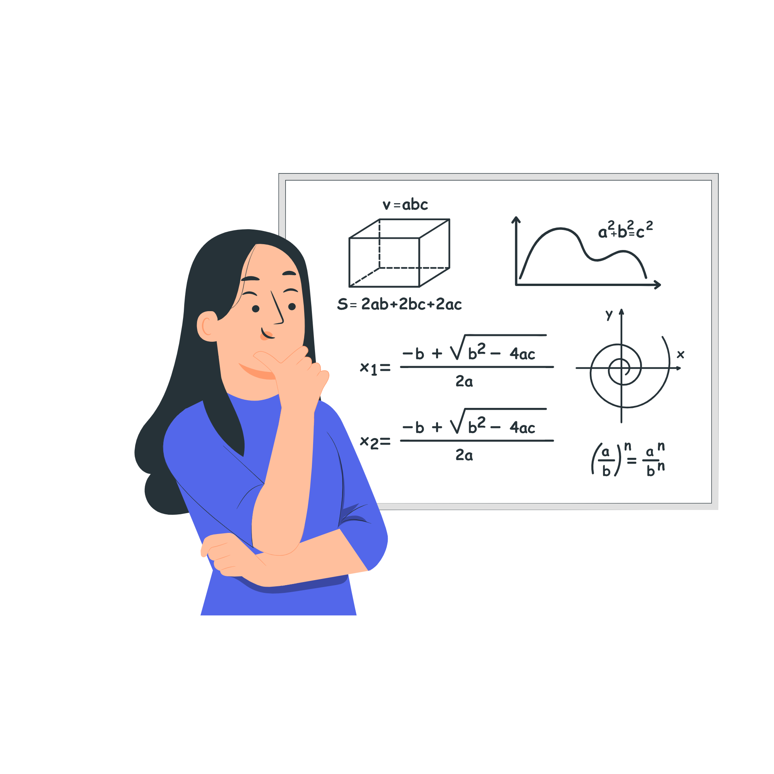
Precalculus
Module 7:
Exponential and Logarithmic Functions

Slide 2
Affirmations
I am capable of connecting ideas and seeing patterns.
I celebrate every bit of progress I make.
I embrace challenges because they help me improve.

Slide 3
Learning Goals: Graphs of Exponential Functions
Deepen your understanding and form connections within these skills:
1 Graph exponential functions
2 Graph exponential functions using transformations

Slide 4

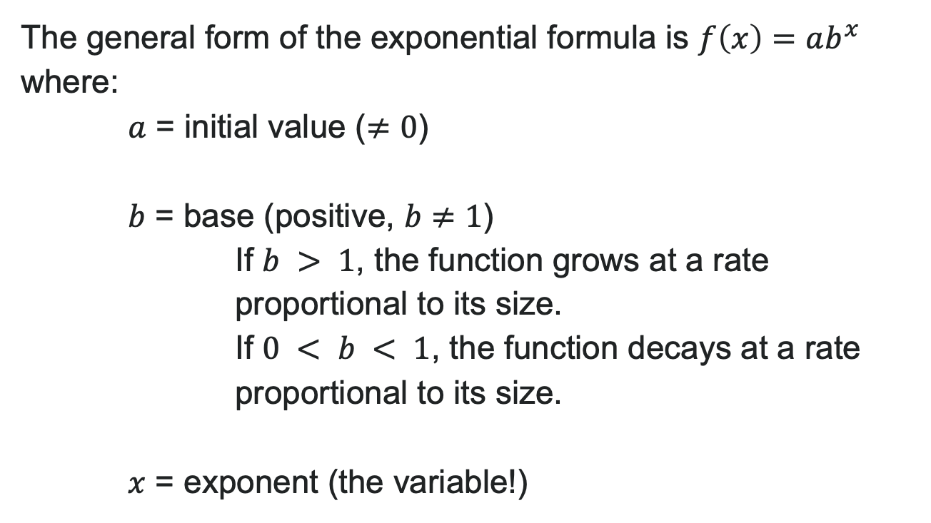
What is an Exponential Function?
The general form of the exponential formula is $f\left(x\right)=ab^{x}$
where:
$a$ = initial value ($≠0$)
$b$ = base (positive, $b≠1$)
If $b > 1$, the function grows at a rate proportional to its size.
If $0 < b < 1$, the function decays at a rate proportional to its size.
$x$ = exponent (the variable!)

Slide 5

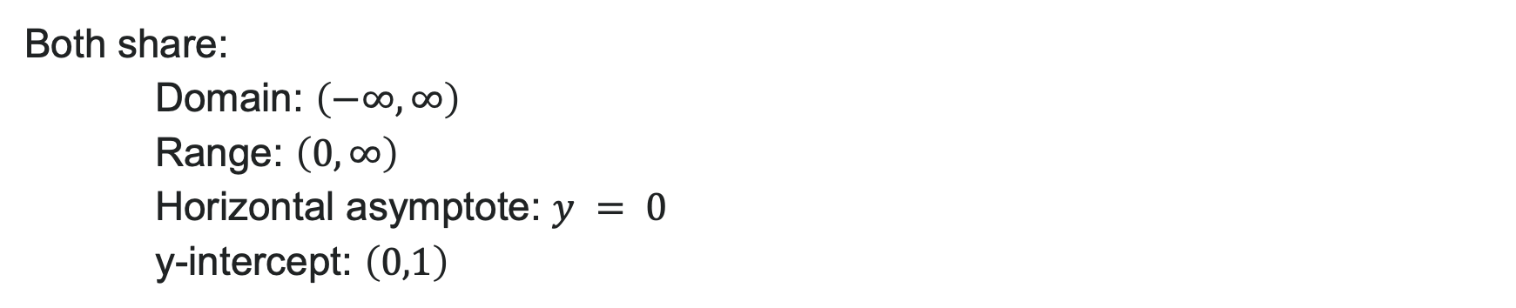
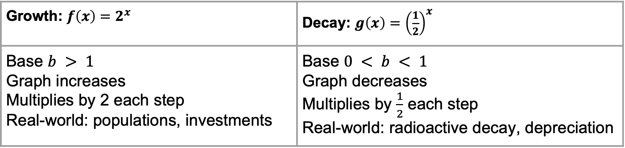
Exponential Growth vs. Decay
Growth: $f\left(x\right)=2^{x}$ | Decay: $g\left(x\right)={\left(\frac{1}{2}\right)}^{x}$
Base $b > 1$ Graph increases Multiplies by 2 each step Real-world: populations, investments | Base $0 < b < 1$ Graph decreases Multiplies by $\frac{1}{2}$ each step Real-world: radioactive decay, depreciation
Both share:
Domain: $\left(−∞,∞\right)$
Range: $\left(0,∞\right)$
Horizontal asymptote: $y = 0$
y-intercept: $\left(0,1\right)$

Slide 6
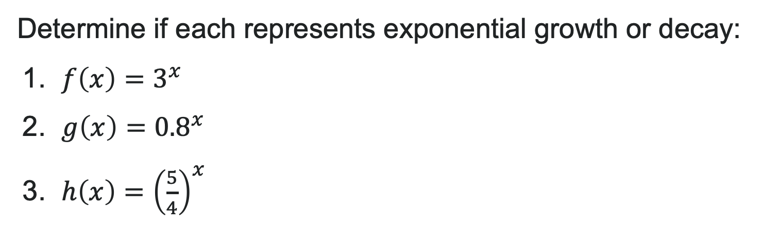
Try It: Growth or Decay?
Determine if each represents exponential growth or decay:
1. $f\left(x\right)=3^{x}$
2. $g\left(x\right)={0.8}^{x}$
3. $h\left(x\right)={\left(\frac{5}{4}\right)}^{x}$
Notes:
Answer:
Growth (base 3 > 1)
Decay (base 0.8 < 1)
Growth (base \frac{5}{4} = 1.25 > 1)

Slide 7
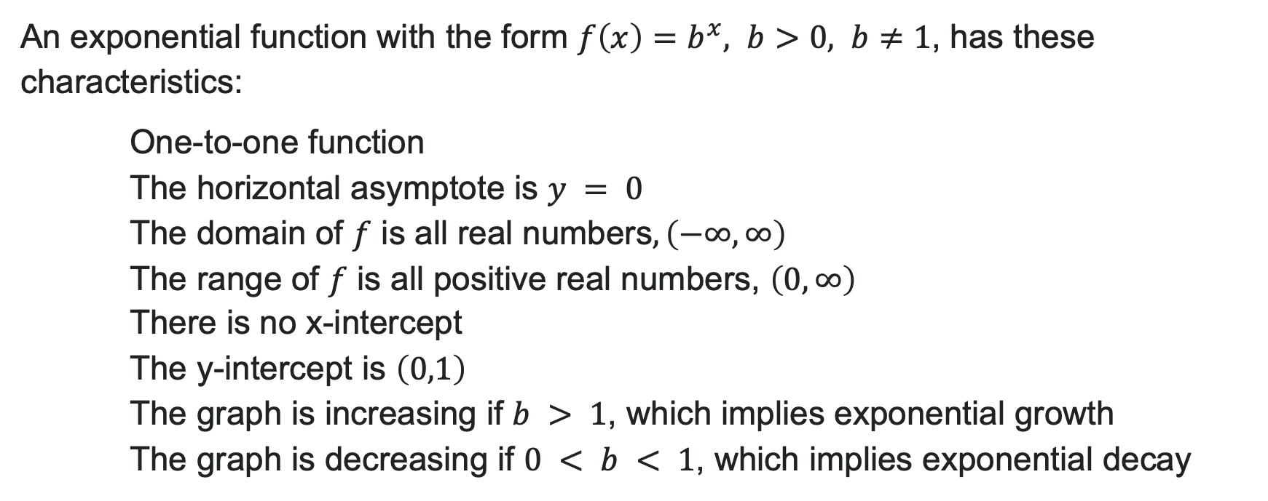
Characteristics of Exponential Functions
An exponential function with the form $f\left(x\right)=b^{x}, b>0, b≠1$, has these characteristics:
One-to-one function
The horizontal asymptote is $y = 0$
The domain of $f$ is all real numbers$,\left(−∞,∞\right)$
The range of $f$ is all positive real numbers, $\left(0,∞\right)$
There is no x-intercept
The y-intercept is $\left(0,1\right)$
The graph is increasing if $b > 1$, which implies exponential growth
The graph is decreasing if $0 < b < 1$, which implies exponential decay

Slide 8
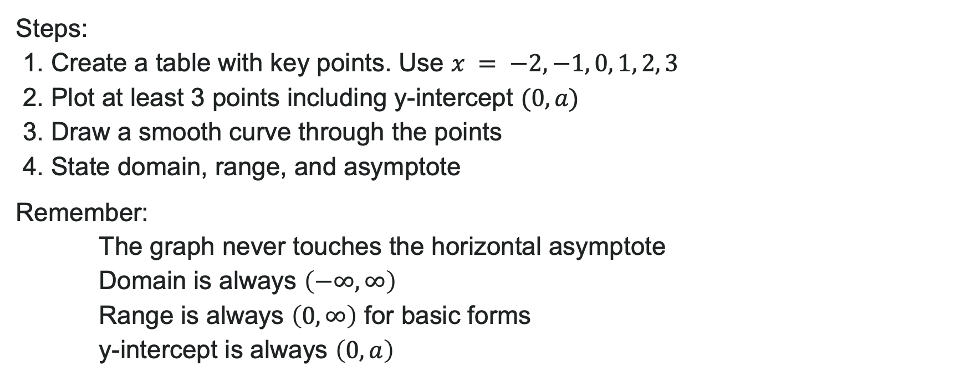
How to: Graph Exponential Functions
Steps:
1. Create a table with key points. Use $x = −2, −1, 0, 1, 2, 3$
2. Plot at least 3 points including y-intercept $(0, a)$
3. Draw a smooth curve through the points
4. State domain, range, and asymptote
Remember:
The graph never touches the horizontal asymptote
Domain is always $\left(−∞,∞\right)$
Range is always $\left(0,∞\right)$ for basic forms
y-intercept is always $\left(0,a\right)$

Slide 9
Try It: Graph an Exponential Function
Graph $f\left(x\right)=3^{x}$. State the domain, range, and asymptote.
Notes:
Answer: Table: x = -1: f(x) = \frac{1}{3}; x = 0: f(x) = 1; x = 1: f(x) = 3; x = 2: f(x) = 9
Domain: (-\infty, \infty)
Range: (0, \infty)
Horizontal asymptote: y = 0
Graph is increasing

Slide 10
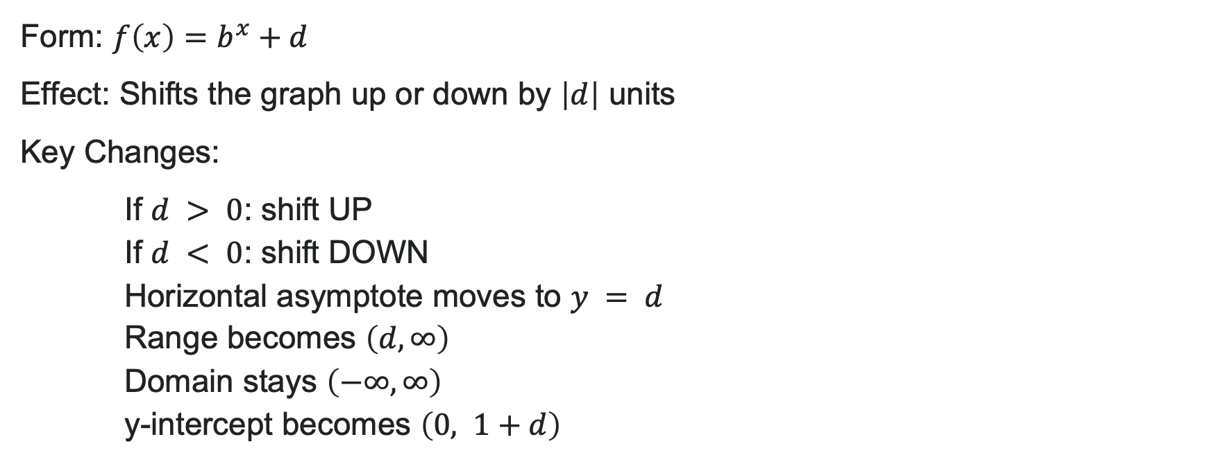

Transformations: Vertical Shifts
Form: $f\left(x\right)=b^{x}+d$
Effect: Shifts the graph up or down by $\left|d\right|$ units
Key Changes:
If $d > 0$: shift UP
If $d < 0$: shift DOWN
Horizontal asymptote moves to $y = d$
Range becomes $\left(d,∞\right)$
Domain stays $\left(−∞,∞\right)$
y-intercept becomes $\left(0, 1+d\right)$
Example: $f\left(x\right)=2^{x}+3$
Shifts $2^{x}$ up 3 units
New asymptote: $y = 3$
New range: $\left(3,∞\right)$

Slide 11
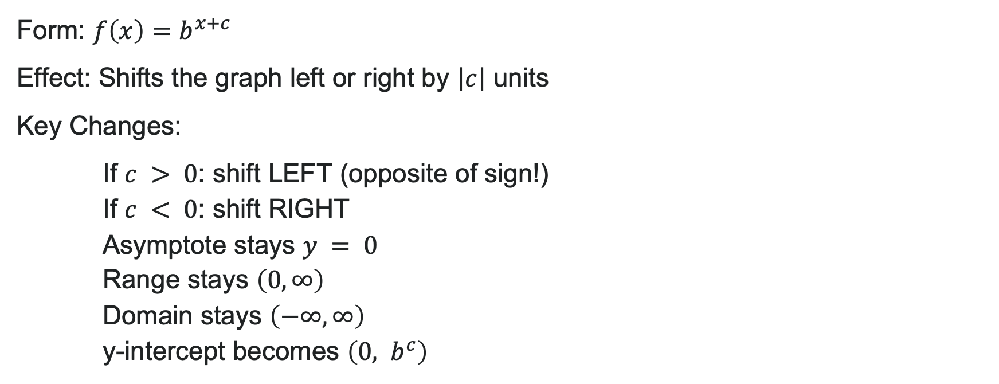

Transformations: Horizontal Shifts
Form: $f\left(x\right)=b^{x+c}$
Effect: Shifts the graph left or right by $\left|c\right|$ units
Key Changes:
If $c > 0$: shift LEFT (opposite of sign!)
If $c < 0$: shift RIGHT
Asymptote stays $y = 0$
Range stays $\left(0,∞\right)$
Domain stays $\left(−∞,∞\right)$
y-intercept becomes $\left(0, b^{c}\right)$
Example$:f\left(x\right)=2^{x−3}$
Shifts $2^{x}$ right 3 units
New y-intercept: $\left(0,2^{−3}\right)$ = $\left(0,\frac{1}{8}\right)$

Slide 12


Example: Multiple Transformations
Problem: Graph $f\left(x\right)=2^{x+1}−3$
Solution: Start with parent: $f\left(x\right)=2^{x}$
Apply transformations:
Shift LEFT 1 unit (because +1 in exponent)
Shift DOWN 3 units
Key features:
Horizontal asymptote: $y = −3$
y-intercept: $\left(0,2^{1}−3\right)=\left(0,−1\right)$
Domain: $\left(−∞,∞\right)$
Range: $\left(−3,∞\right)$

Slide 13
Try It: Transformations
Describe the transformations and sketch $f\left(x\right)=3^{x−2}+1$.
Notes:
Answer: Right 2 units, up 1 unit
Horizontal asymptote: y = 1
y-intercept: (0, 3^{-2} + 1) = (0, \frac{10}{9})
Domain: (-\infty, \infty)
Range: (1, \infty)

Slide 14
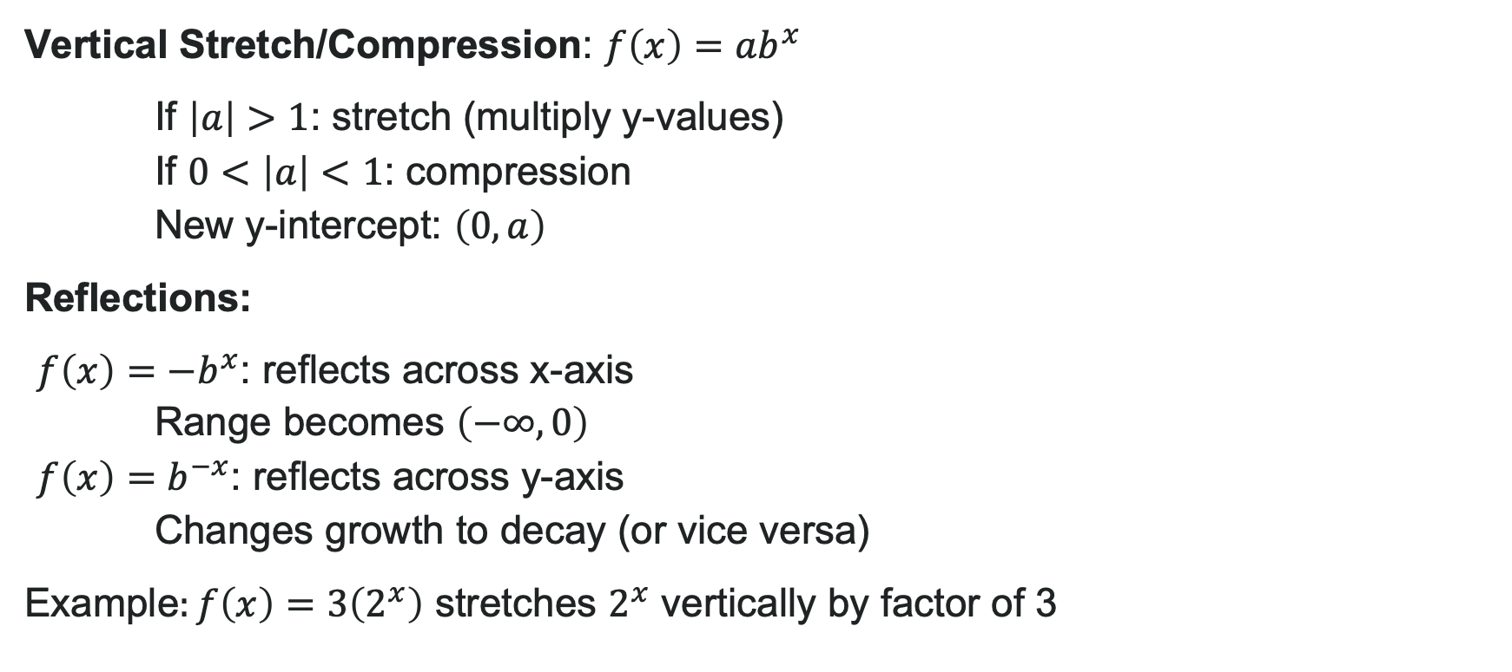
Stretches and Reflections
Vertical Stretch/Compression: $f\left(x\right)=ab^{x}$
If $\left|a\right|>1$: stretch (multiply y-values)
If $0<\left|a\right|<1$: compression
New y-intercept: $\left(0,a\right)$
Reflections:
$f\left(x\right)=−b^{x}$: reflects across x-axis Range becomes $\left(−∞,0\right)$
$f\left(x\right)=b^{−x}$: reflects across y-axis Changes growth to decay (or vice versa)
Example$:f\left(x\right)=3\left(2^{x}\right)$ stretches $2^{x}$ vertically by factor of 3

Slide 15
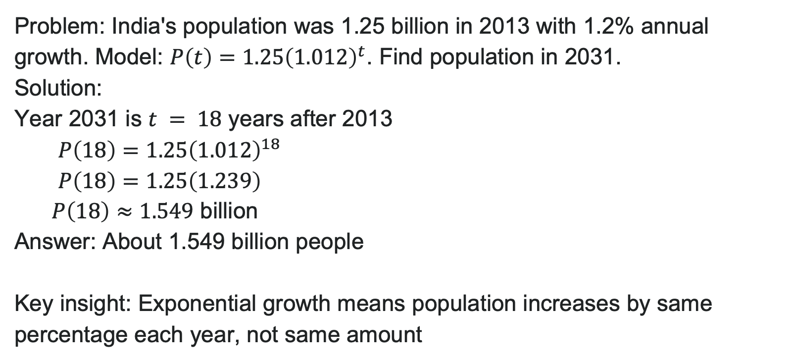
Example: Population Growth
Problem: India's population was 1.25 billion in 2013 with 1.2% annual growth. Model: $P\left(t\right)=1.25{\left(1.012\right)}^{t}$. Find population in 2031.
Solution:
Year 2031 is $t = 18$ years after 2013
$P\left(18\right)=1.25{\left(1.012\right)}^{18}$
$P\left(18\right)=1.25\left(1.239\right)$
billion
Answer: About 1.549 billion people
Key insight: Exponential growth means population increases by same percentage each year, not same amount

Slide 16
Learning Goals: Exponential Functions
Deepen your understanding and form connections within these skills:
1 Evaluate exponential functions
2 Find the equation of an exponential function
3 Use compound interest formulas

Slide 17
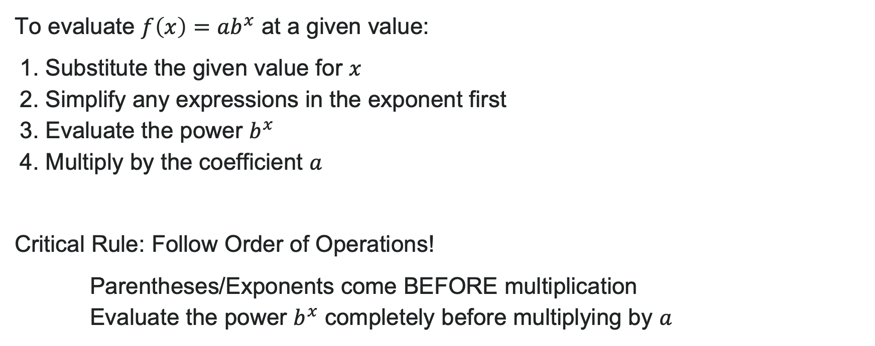
Evaluating Exponential Functions
To evaluate $f\left(x\right)=ab^{x}$ at a given value:
1. Substitute the given value for $x$
2. Simplify any expressions in the exponent first
3. Evaluate the power $b^{x}$
4. Multiply by the coefficient $a$
Critical Rule: Follow Order of Operations!
Parentheses/Exponents come BEFORE multiplication
Evaluate the power $b^{x}$ completely before multiplying by $a$

Slide 18

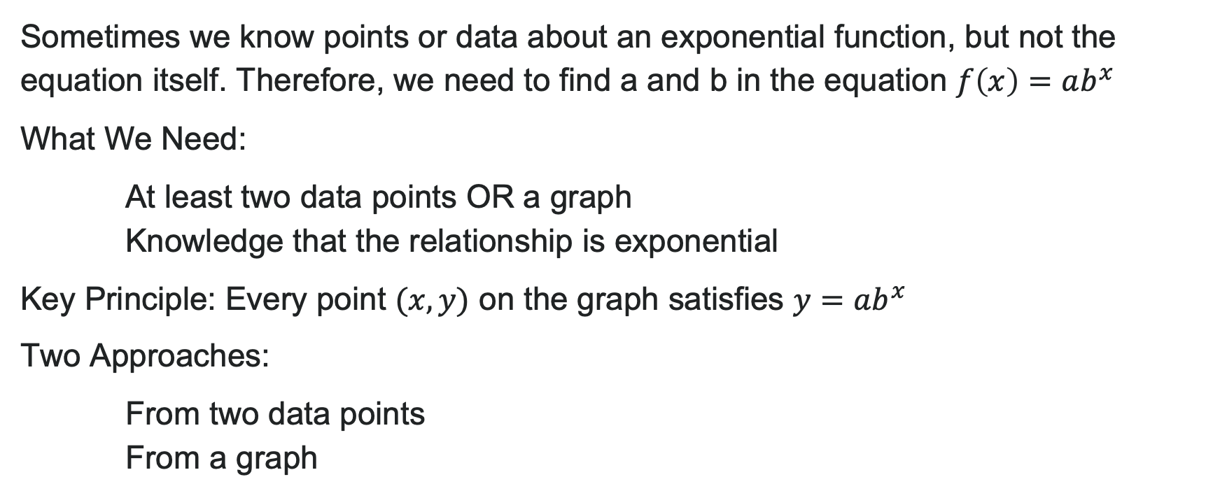
Finding Exponential Functions from Data
Sometimes we know points or data about an exponential function, but not the equation itself. Therefore, we need to find a and b in the equation $f\left(x\right)=ab^{x}$
What We Need:
At least two data points OR a graph
Knowledge that the relationship is exponential
Key Principle: Every point $(x, y)$ on the graph satisfies $y=ab^{x}$
Two Approaches:
From two data points
From a graph

Slide 19
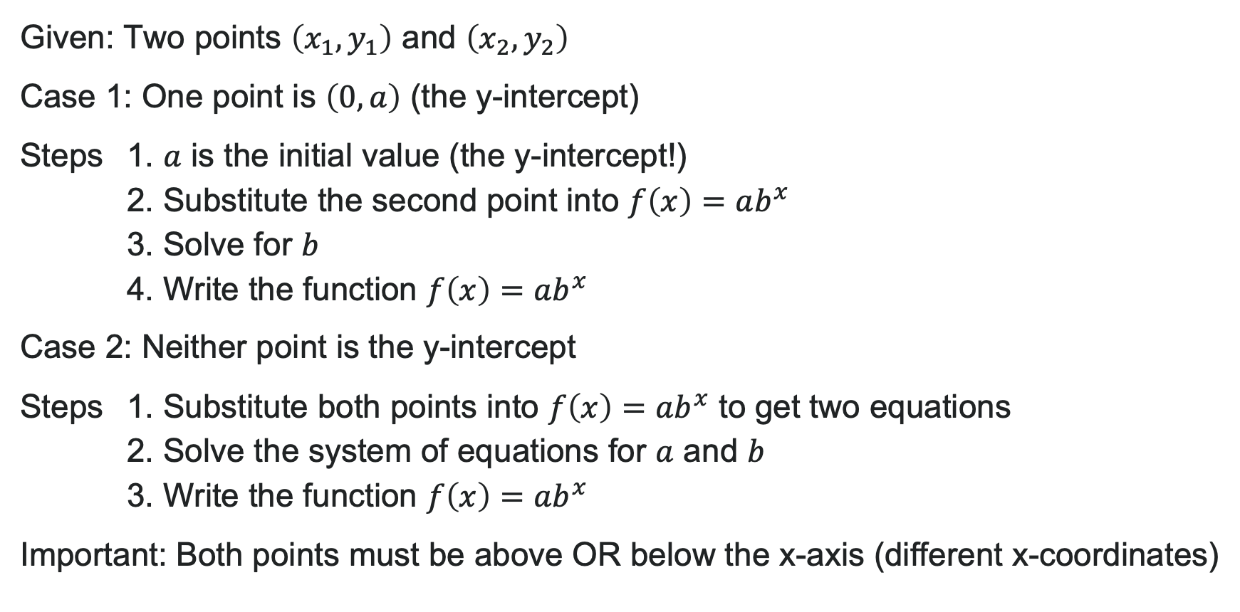
Write an Exponential Model from Two Points
Given: Two points $\left(x_{1},y_{1}\right)$ and $\left(x_{2},y_{2}\right)$
Case 1: One point is $\left(0,a\right)$ (the y-intercept)
Steps 1. $a$ is the initial value (the y-intercept!)
2. Substitute the second point into $f\left(x\right)=ab^{x}$
3. Solve for $b$
4. Write the function $f\left(x\right)=ab^{x}$
Case 2: Neither point is the y-intercept
Steps 1. Substitute both points into $f\left(x\right)=ab^{x}$ to get two equations
2. Solve the system of equations for $a$ and $b$
3. Write the function $f\left(x\right)=ab^{x}$
Important: Both points must be above OR below the x-axis (different x-coordinates)

Slide 20
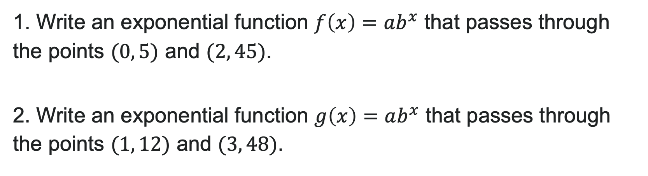
Try It: Write Exponential Model from Two Points
1. Write an exponential function $f\left(x\right)=ab^{x}$ that passes through the points $(0, 5)$ and $(2, 45)$.
2. Write an exponential function $g\left(x\right)=ab^{x}$ that passes through the points $(1, 12)$ and $(3, 48)$.
Notes:
Answer:
Point (0, 5) gives a = 5. Substitute (2, 45): 45 = 5b^2 → b^2 = 9 → b = 3.
Answer: f(x) = 5(3)^x
Set up system: 12 = ab^1 and 48 = ab^3. Divide second by first: \frac{48}{12} = \frac{ab^3}{ab} → 4 = b^2 → b = 2.
Substitute back: 12 = a(2) → a = 6.
Answer: g(x) = 6(2)^x

Slide 21

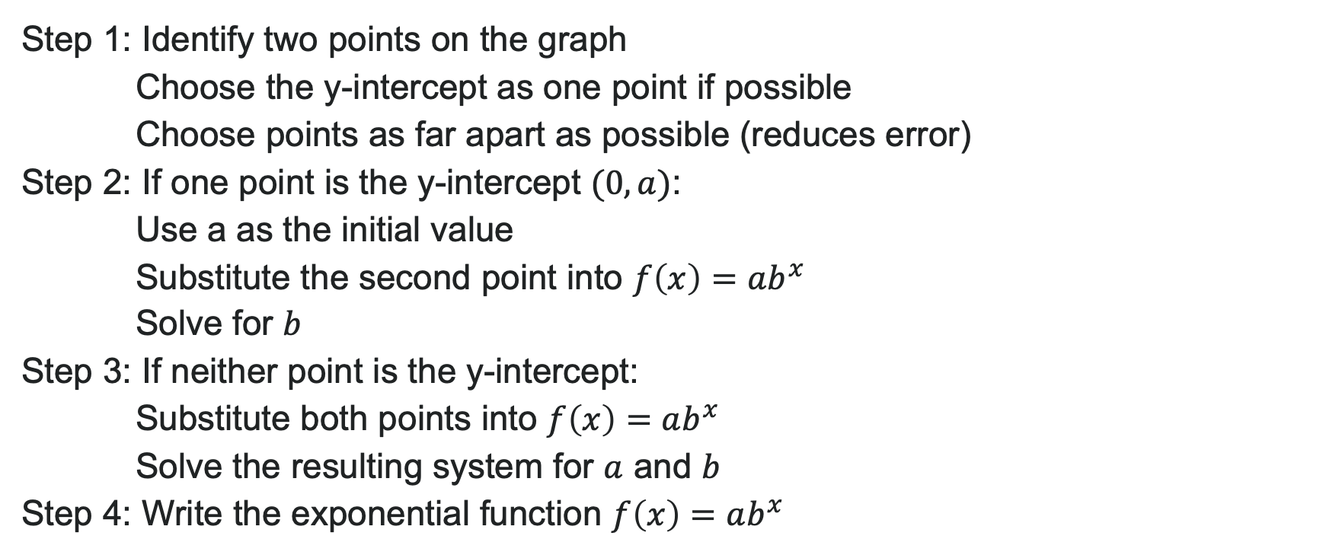
Write an Exponential Function from a Graph
Step 1: Identify two points on the graph
Choose the y-intercept as one point if possible
Choose points as far apart as possible (reduces error)
Step 2: If one point is the y-intercept $(0, a)$:
Use a as the initial value
Substitute the second point into $f\left(x\right)=ab^{x}$
Solve for $b$
Step 3: If neither point is the y-intercept:
Substitute both points into $f\left(x\right)=ab^{x}$
Solve the resulting system for $a$ and $b$
Step 4: Write the exponential function $f\left(x\right)=ab^{x}$

Slide 22
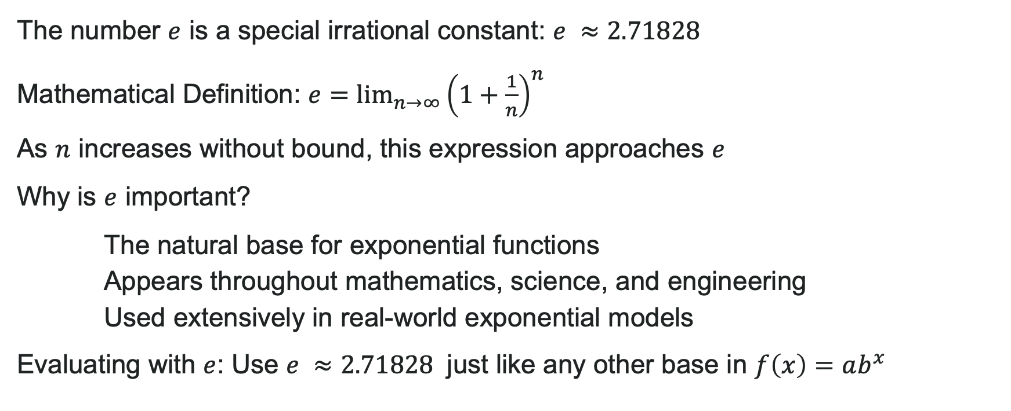
Exponential Functions with Base e
The number $e$ is a special irrational constant: $e ≈2.71828$
Mathematical Definition: $e=\lim_{n→∞}{{\left(1+\frac{1}{n}\right)}^{n}}$
As $n$ increases without bound, this expression approaches $e$
Why is $e$ important?
The natural base for exponential functions
Appears throughout mathematics, science, and engineering
Used extensively in real-world exponential models
Evaluating with $e$: Use $e ≈2.71828$ just like any other base in $f\left(x\right)=ab^{x}$

Slide 23
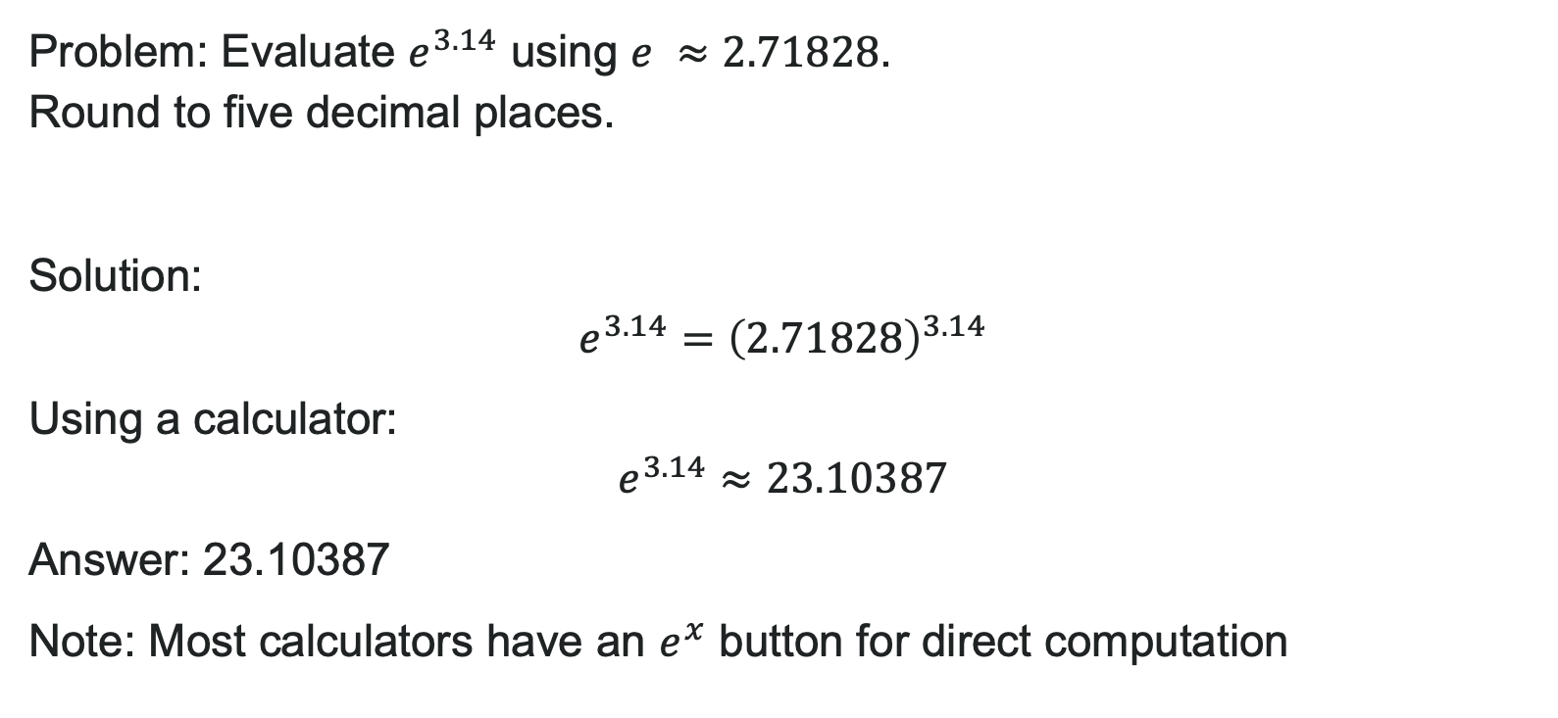
Example: Evaluating with Base e
Problem: Evaluate $e^{3.14}$ using $e ≈2.71828$.
Round to five decimal places.
Solution:
$e^{3.14}={\left(2.71828\right)}^{3.14}$
Using a calculator:
$e^{3.14}≈23.10387$
Answer: 23.10387
Note: Most calculators have an $e^{x}$ button for direct computation

Slide 24
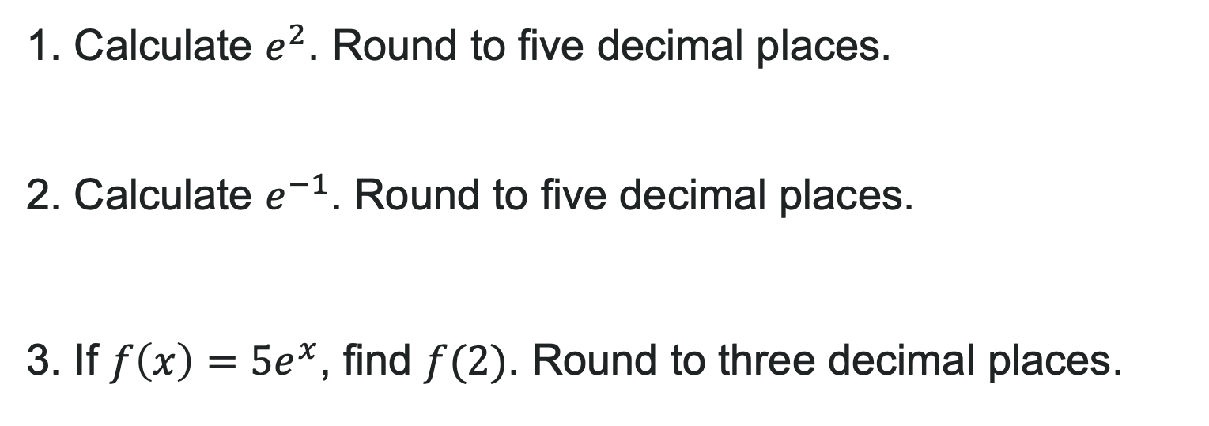
Try It: Evaluate with Base e
1. Calculate $e^{2}$. Round to five decimal places.
2. Calculate $e^{−1}$. Round to five decimal places.
3. If $f\left(x\right)=5e^{x}$, find $f(2)$. Round to three decimal places.
Notes:
Answer:
e^2 \approx 7.38906
e^{-1} \approx 0.36788
f(2) = 5e^2 = 5(7.38906) \approx 36.945

Slide 25
Learning Goals: Logarithmic Functions
Deepen your understanding and form connections within these skills:
1 Convert between logarithmic to exponential form
2 Evaluate logarithms
3 Use common and natural logarithms

Slide 26
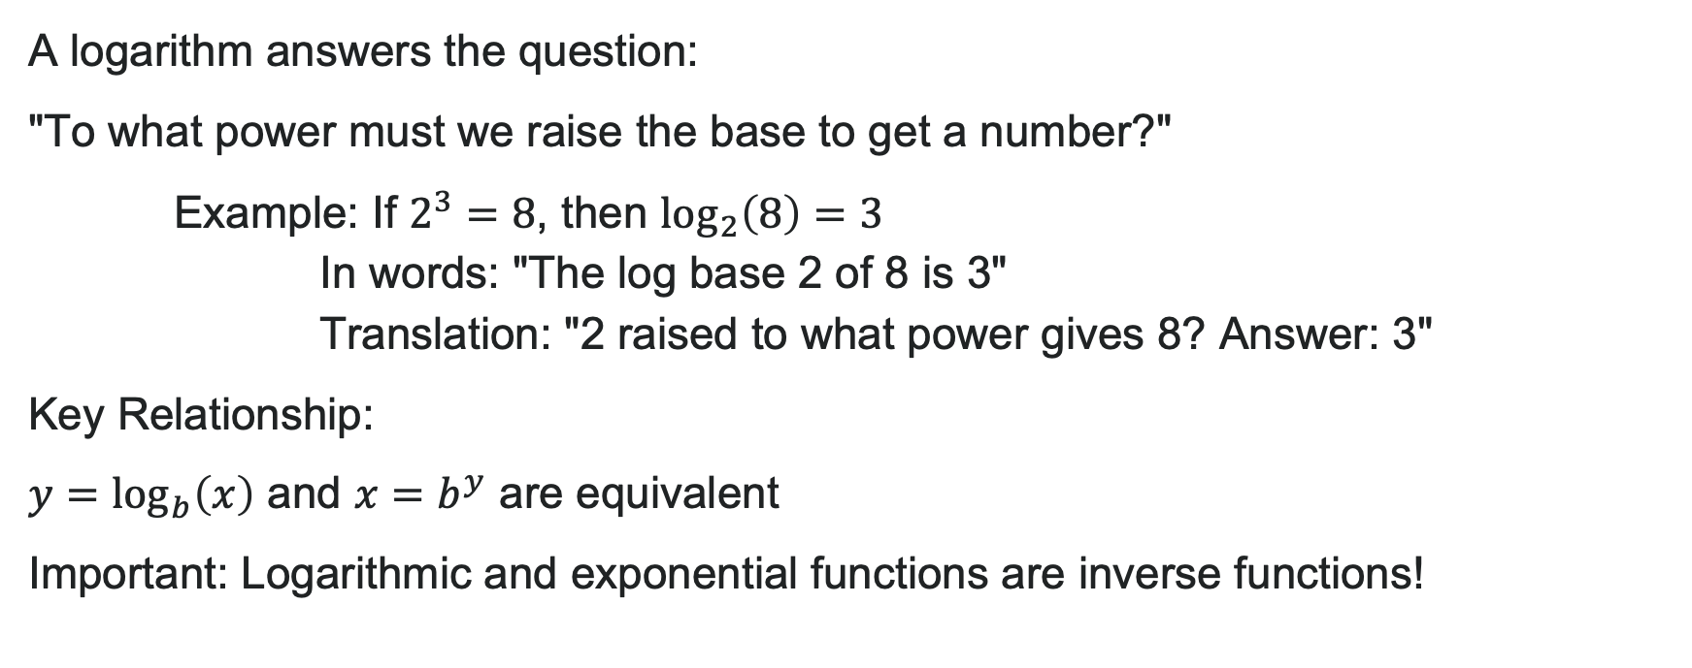
What is a Logarithm?
A logarithm answers the question:
"To what power must we raise the base to get a number?"
Example: If $2^{3}=8$, then $\log_{2}\left(8\right)=3$
In words: "The log base 2 of 8 is 3"
Translation: "2 raised to what power gives 8? Answer: 3"
Key Relationship:
$y=\log_{b}\left(x\right)$ and $x=b^{y}$ are equivalent
Important: Logarithmic and exponential functions are inverse functions!

Slide 27
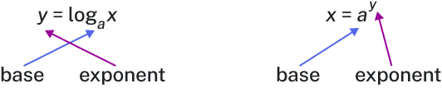
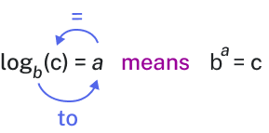
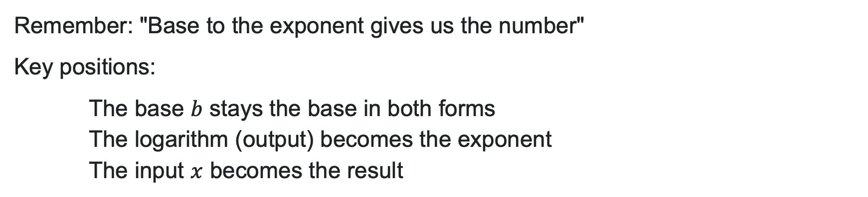
Converting Between Forms
Remember: "Base to the exponent gives us the number"
Key positions:
The base $b$ stays the base in both forms
The logarithm (output) becomes the exponent
The input $x$ becomes the result

Slide 28

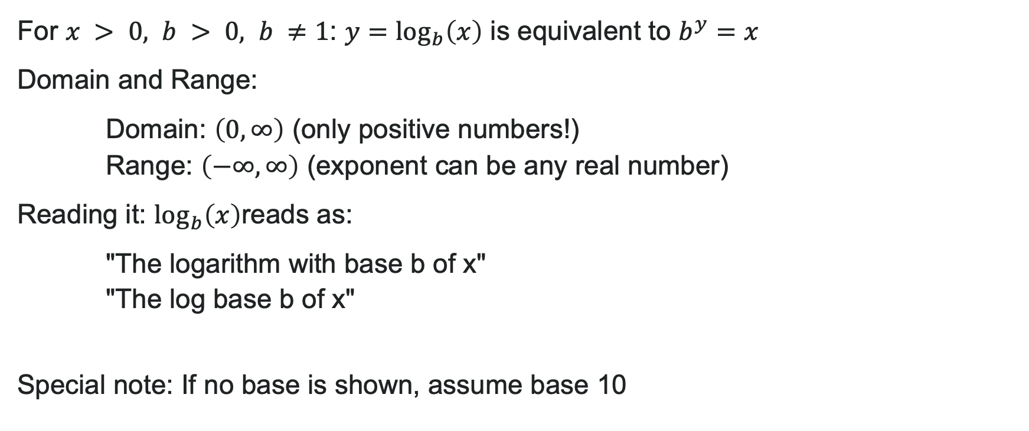
Logarithmic Functions
For $x > 0, b > 0, b ≠1$: $y=\log_{b}\left(x\right)$ is equivalent to $b^{y}=x$
Domain and Range:
Domain: $\left(0,∞\right)$ (only positive numbers!)
Range: $\left(−∞,∞\right)$ (exponent can be any real number)
Reading it: $\log_{b}\left(x\right)$reads as:
"The logarithm with base b of x"
"The log base b of x"
Special note: If no base is shown, assume base 10

Slide 29

How To: Convert Log to Exponential
Given: $\log_{b}\left(x\right)=y$
1. Identify $b$, $y$, and $x$
2. Rewrite as $b^{y}=x$
Examples:
$\log_{6}\left(\sqrt{6}\right)=\frac{1}{2}$ → $6^{\frac{1}{2}}=\sqrt{6}$
$\log_{3}\left(9\right)=2$ → $3^{2}=9$
Remember: The log equals the exponent!

Slide 30
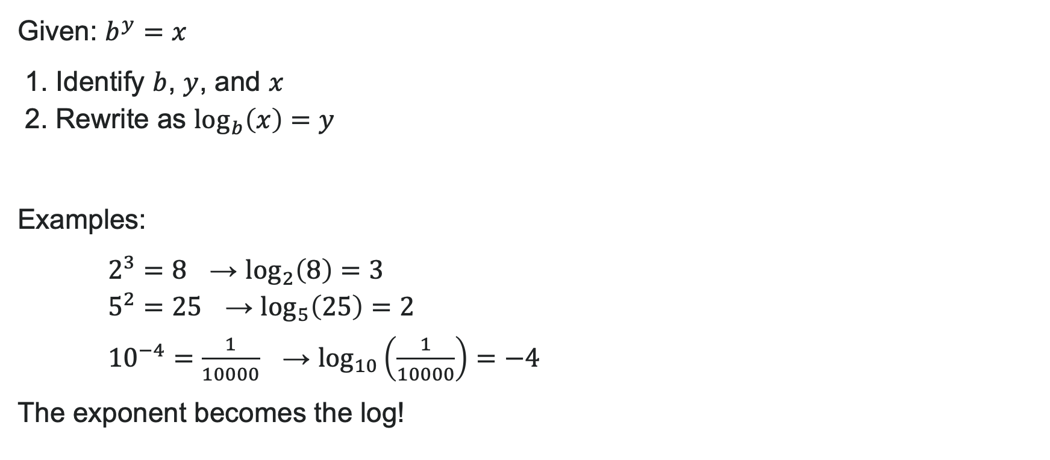
How to: Converting Exponential to Log
Given: $b^{y}=x$
1. Identify $b$, $y$, and $x$
2. Rewrite as $\log_{b}\left(x\right)=y$
Examples:
$2^{3}=8$ → $\log_{2}\left(8\right)=3$
$5^{2}=25$ → $\log_{5}\left(25\right)=2$
${10}^{−4}=\frac{1}{10000}$ → $\log_{10}\left(\frac{1}{10000}\right)=−4$
The exponent becomes the log!

Slide 31
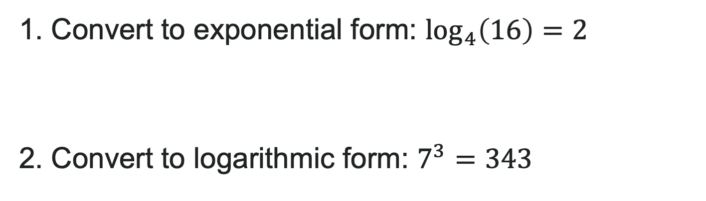
Try It!
1. Convert to exponential form: $\log_{4}\left(16\right)=2$
2. Convert to logarithmic form: $7^{3}=343$
Notes:
Answer:
4^2 = 16
\log_7(343) = 3

Slide 32
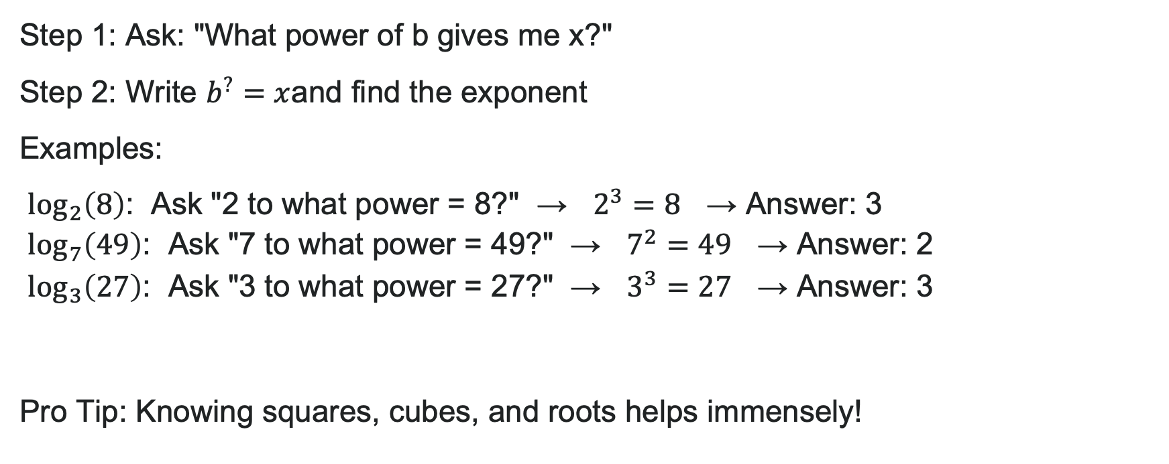
How to: Evaluating Logarithms Mentally
Step 1: Ask: "What power of b gives me x?"
Step 2: Write $b^{?}=x$and find the exponent
Examples:
$\log_{2}\left(8\right)$: Ask "2 to what power = 8?" → $2^{3}=8$ → Answer: 3
$\log_{7}\left(49\right)$: Ask "7 to what power = 49?" → $7^{2}=49$ → Answer: 2
$\log_{3}\left(27\right)$: Ask "3 to what power = 27?" → $3^{3}=27$ → Answer: 3
Pro Tip: Knowing squares, cubes, and roots helps immensely!

Slide 33


Example: Mental Evaluation
Problem 1: Solve $y=\log_{4}\left(64\right)$
Solution: Rewrite in exponential form: $4^{y}=64$
Ask: "4 to what power = 64?"
$4^{3}=64$ Answer: y = 3
Problem 2: Evaluate $y=\log_{3}\left(\frac{1}{27}\right)$
Solution: Rewrite: $3^{y}=\frac{1}{27}$
We know $3^{3}=27$, so $3^{−3}=\frac{1}{27}$
Answer: $y = −3$

Slide 34

Try It: Evaluating Logarithms Mentally
Evaluate without a calculator:
1. $\log_{5}\left(125\right)$
2. $\log_{2}\left(\frac{1}{16}\right)$
3. $\log_{9}\left(81\right)$
Notes:
Answer:
5^3 = 125, so \log_5(125) = 3
2^4 = 16, so 2^{-4} = \frac{1}{16}, thus \log_2(\frac{1}{16}) = -4
9^2 = 81, so \log_9(81) = 2

Slide 35
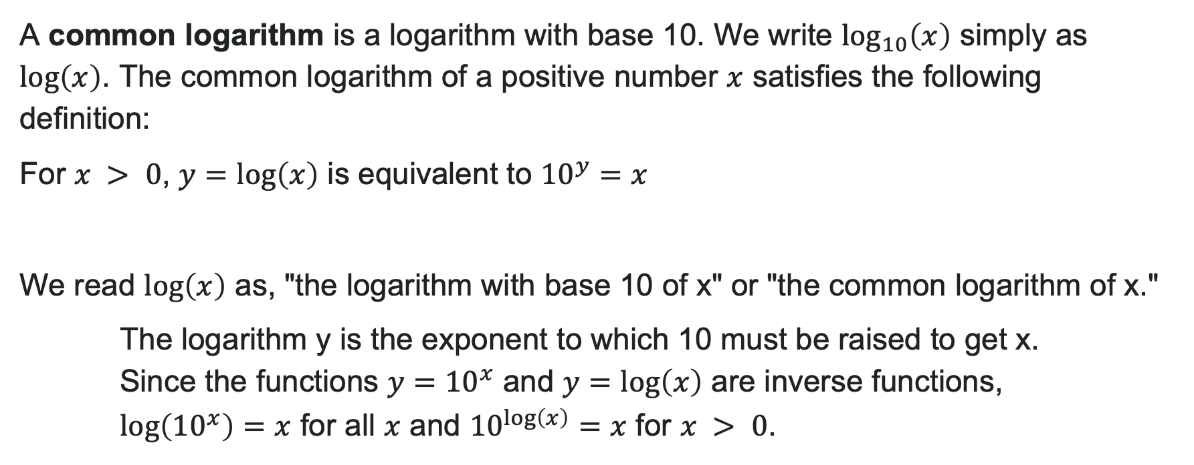
Common Logarithms (Base 10)
A common logarithm is a logarithm with base 10. We write $\log_{10}\left(x\right)$ simply as $\log\left(x\right)$. The common logarithm of a positive number $x$ satisfies the following definition:
For $x > 0$, $y=\log\left(x\right)$ is equivalent to ${10}^{y}=x$
We read $\log\left(x\right)$ as, "the logarithm with base 10 of x" or "the common logarithm of x."
The logarithm y is the exponent to which 10 must be raised to get x.
Since the functions $y={10}^{x}$ and $y=\log\left(x\right)$ are inverse functions, $\log\left({10}^{x}\right)=x$ for all $x$ and ${10}^{\log\left(x\right)}=x$ for $x > 0$.

Slide 36
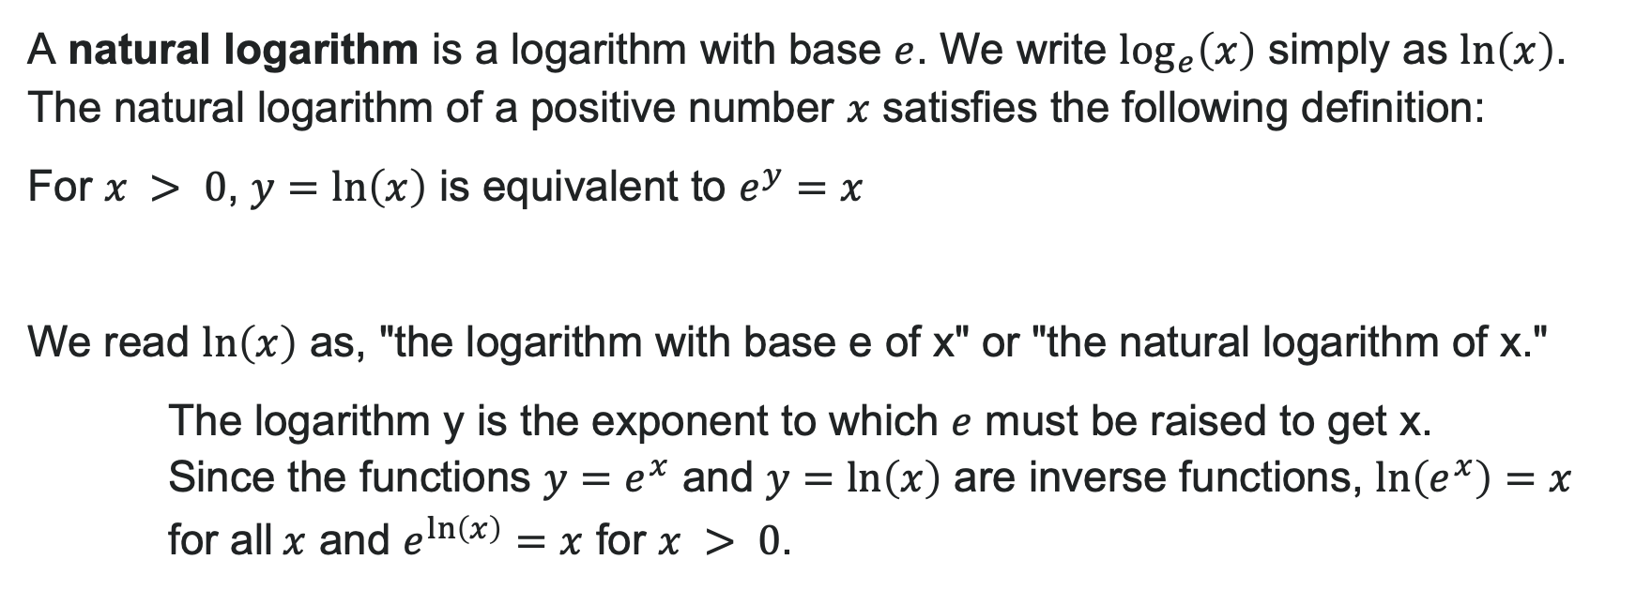
Natural Logarithms (Base e)
A natural logarithm is a logarithm with base $e$. We write $\log_{e}\left(x\right)$ simply as $\ln\left(x\right)$. The natural logarithm of a positive number $x$ satisfies the following definition:
For $x > 0$, $y=\ln\left(x\right)$ is equivalent to $e^{y}=x$
We read $\ln\left(x\right)$ as, "the logarithm with base e of x" or "the natural logarithm of x."
The logarithm y is the exponent to which $e$ must be raised to get x.
Since the functions $y=e^{x}$ and $y=\ln\left(x\right)$ are inverse functions, $\ln\left(e^{x}\right)=x$ for all$x$ and $e^{\ln\left(x\right)}=x$ for $x > 0$.

Slide 37
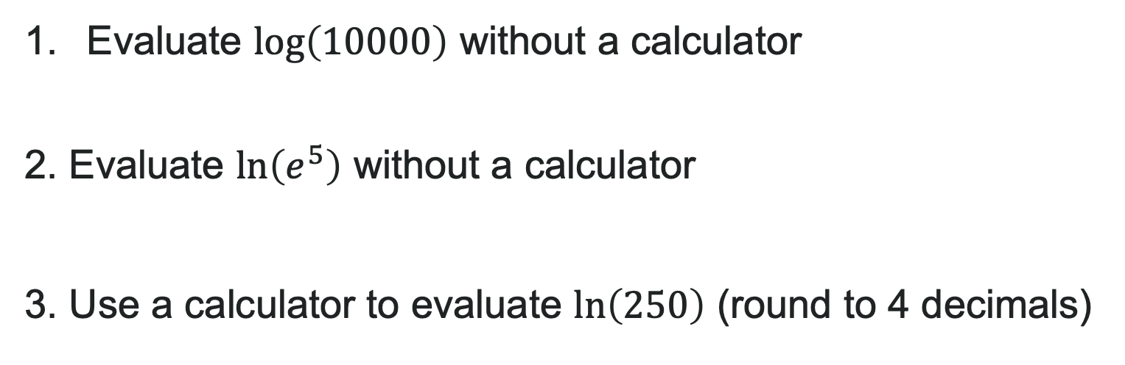
Try It: Common and Natural Logs
Evaluate $\log\left(10000\right)$ without a calculator
2. Evaluate $\ln\left(e^{5}\right)$ without a calculator
3. Use a calculator to evaluate $\ln\left(250\right)$ (round to 4 decimals)
Notes:
Answer:
\log(10000) = 4 because 10^4 = 10000
\ln(e^5) = 5 (inverse property)
\ln(250) \approx 5.5215

Slide 38
Learning Goals: Graphs of Logarithmic Functions
Deepen your understanding and form connections within these skills:
1 Identify the domain of a logarithmic function
2 Graph logarithmic functions

Slide 39
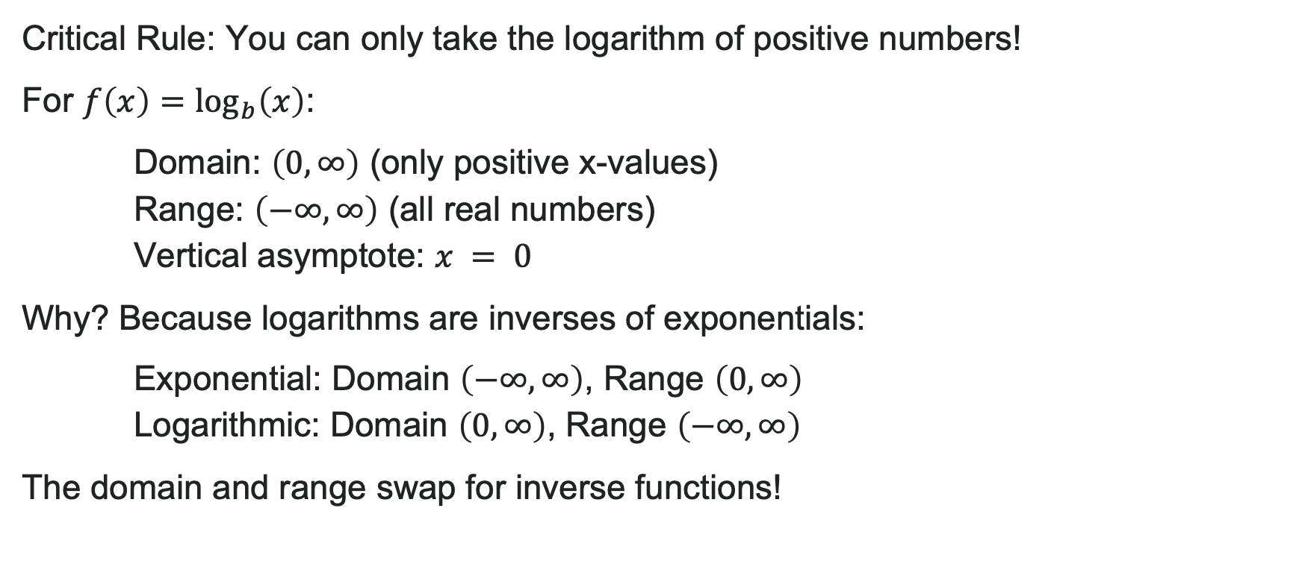
Domain of Logarithmic Functions
Critical Rule: You can only take the logarithm of positive numbers!
For $f\left(x\right)=\log_{b}\left(x\right)$:
Domain: $\left(0,∞\right)$ (only positive x-values)
Range: $\left(−∞,∞\right)$ (all real numbers)
Vertical asymptote: $x = 0$
Why? Because logarithms are inverses of exponentials:
Exponential: Domain $\left(−∞,∞\right)$, Range $\left(0,∞\right)$
Logarithmic: Domain $\left(0,∞\right)$, Range $\left(−∞,∞\right)$
The domain and range swap for inverse functions!

Slide 40

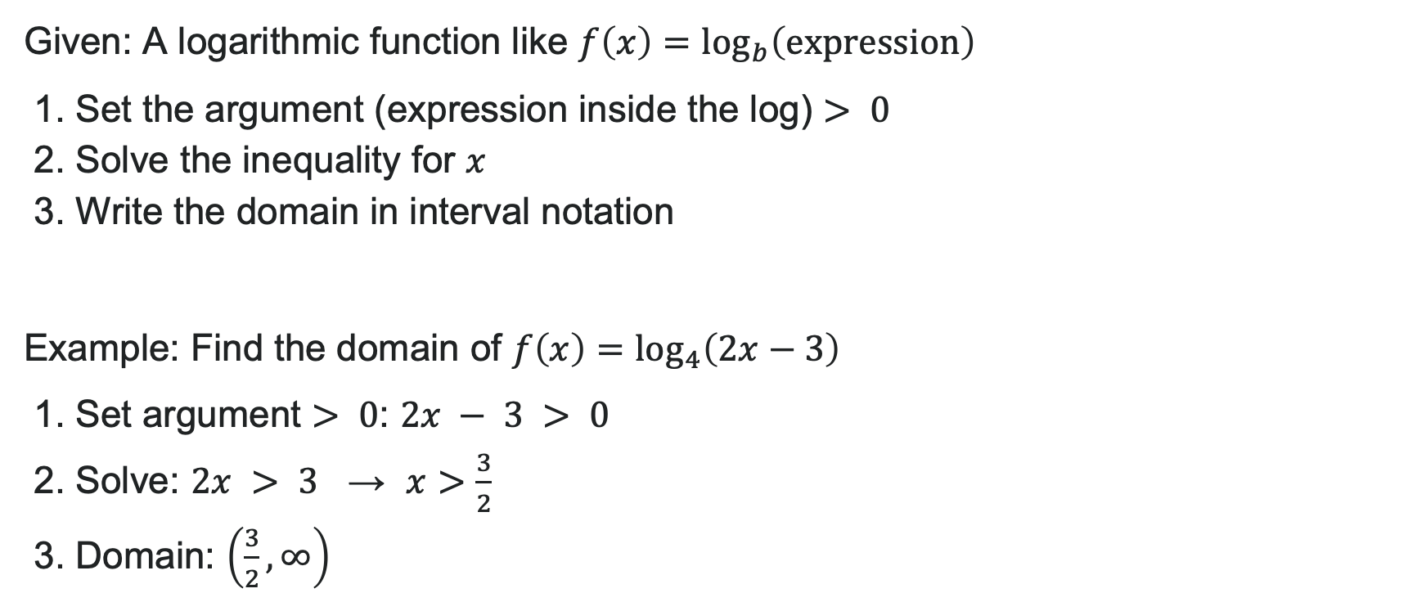
How To: Find the Domain
Given: A logarithmic function like $f\left(x\right)=\log_{b}\left(\text{expression}\right)$
1. Set the argument (expression inside the log) $> 0$
2. Solve the inequality for $x$
3. Write the domain in interval notation
Example: Find the domain of $f\left(x\right)=\log_{4}\left(2x−3\right)$
1. Set argument $> 0$: $2x − 3 > 0$
2. Solve: $2x > 3$ → $x>\frac{3}{2}$
3. Domain: $\left(\frac{3}{2},∞\right)$

Slide 41
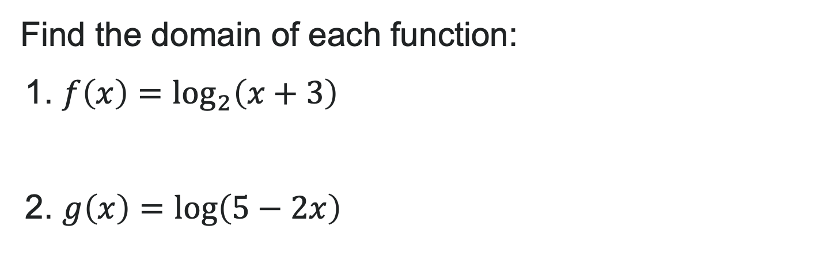
Try It: Find the Domain
Find the domain of each function:
1. $f\left(x\right)=\log_{2}\left(x+3\right)$
2. $g\left(x\right)=\log\left(5−2x\right)$
Notes:
Answer:
Set x + 3 > 0 → x > -3. Domain: (-3, \infty)
Set 5 - 2x > 0 → -2x > -5 → x < \frac{5}{2}. Domain: (-\infty, \frac{5}{2})

Slide 42
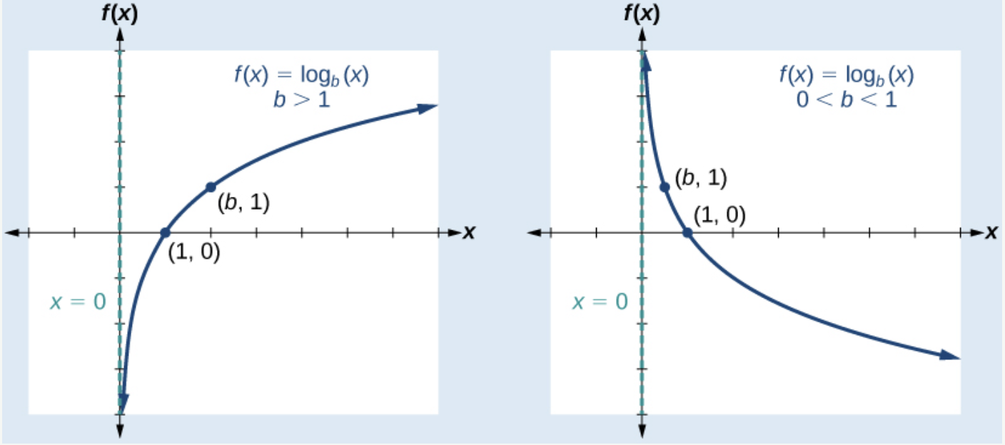

Characteristics of $f\left(x\right)=\log_{b}\left(x\right)$
For $b > 0, b ≠1$:
Vertical asymptote: $x = 0$
Domain: $\left(0,∞\right)$
Range: $\left(−∞,∞\right)$
x-intercept: $\left(1,0\right)$ (always!)
Key point: $\left(b,1\right)$
No y-intercept
Behavior:
Increasing if $b > 1$
Decreasing if $0 < b < 1$
Notes:
Inverse Relationship: \log_b(x) and b^x are reflections across y = x

Slide 43
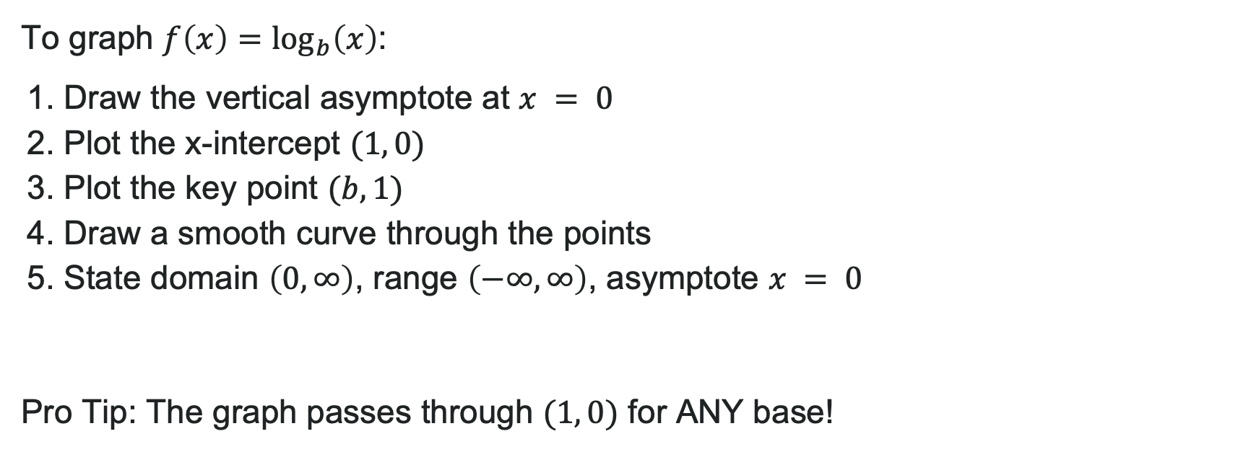
How to: Graph the Parent Function
To graph $f\left(x\right)=\log_{b}\left(x\right)$:
1. Draw the vertical asymptote at $x = 0$
2. Plot the x-intercept $(1, 0)$
3. Plot the key point $(b, 1)$
4. Draw a smooth curve through the points
5. State domain $\left(0,∞\right)$, range $\left(−∞,∞\right)$, asymptote $x = 0$
Pro Tip: The graph passes through $(1, 0)$ for ANY base!

Slide 44


Example: Graph Parent Function
Graph $f\left(x\right)=\log_{5}\left(x\right)$
Solution: Base: $b=5>1$ → function is increasing
Key features:
Vertical asymptote: $x = 0$
x-intercept: $(1, 0)$
Key point: $(5, 1)$
Domain: $\left(0,∞\right)$
Range: $\left(−∞,∞\right)$

Slide 45
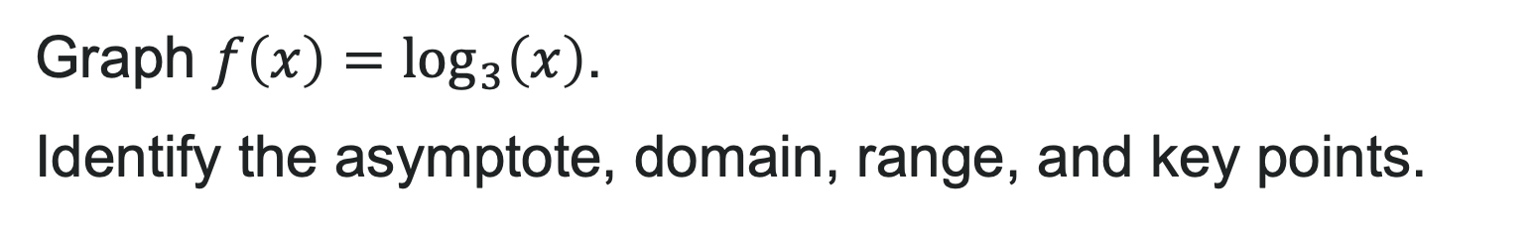
Try It: Graph a Log Function
Graph $f\left(x\right)=\log_{3}\left(x\right)$.
Identify the asymptote, domain, range, and key points.
Notes:
Answer: Vertical asymptote: x = 0
x-intercept: (1, 0)
Key point: (3, 1)
Domain: (0, \infty)
Range: (-\infty, \infty)
Function is increasing (base > 1)

Slide 46
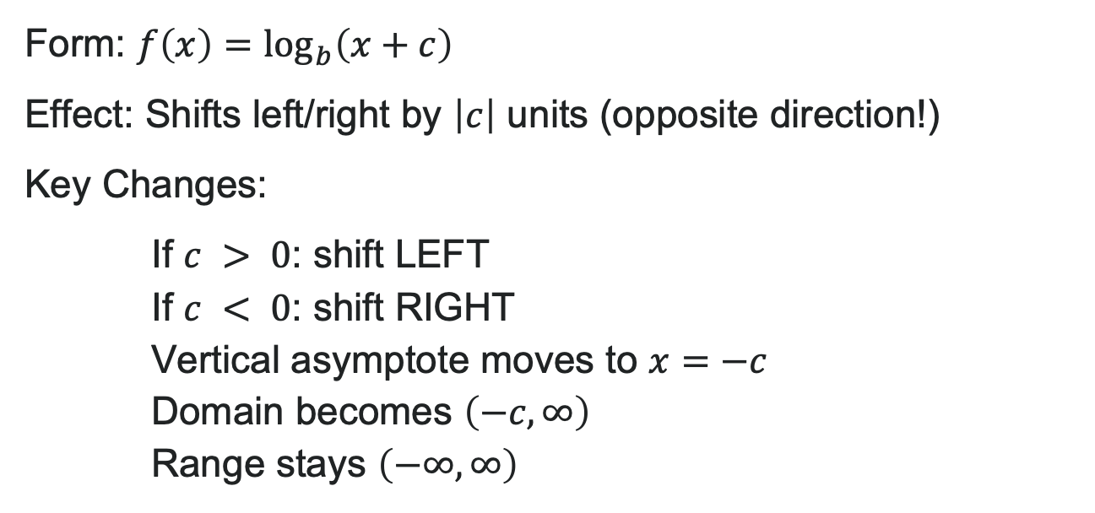
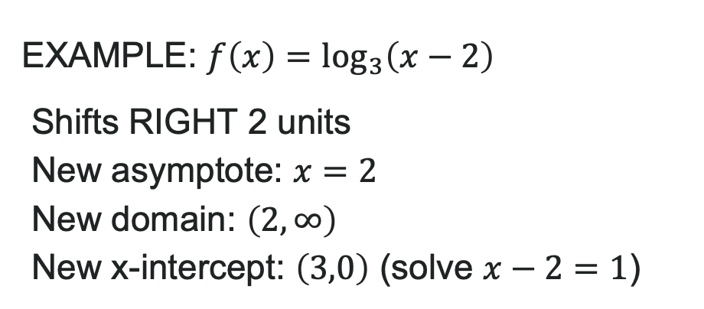
Exponential Transformations: Horizontal Shifts
Form: $f\left(x\right)=\log_{b}\left(x+c\right)$
Effect: Shifts left/right by $\left|c\right|$ units (opposite direction!)
Key Changes:
If $c > 0$: shift LEFT
If $c < 0$: shift RIGHT
Vertical asymptote moves to $x=−c$
Domain becomes $\left(−c,∞\right)$
Range stays $\left(−∞,∞\right)$
EXAMPLE: $f\left(x\right)=\log_{3}\left(x−2\right)$
Shifts RIGHT 2 units
New asymptote: $x=2$
New domain: $\left(2,∞\right)$
New x-intercept: $\left(3,0\right)$ (solve $x−2=1$)

Slide 47
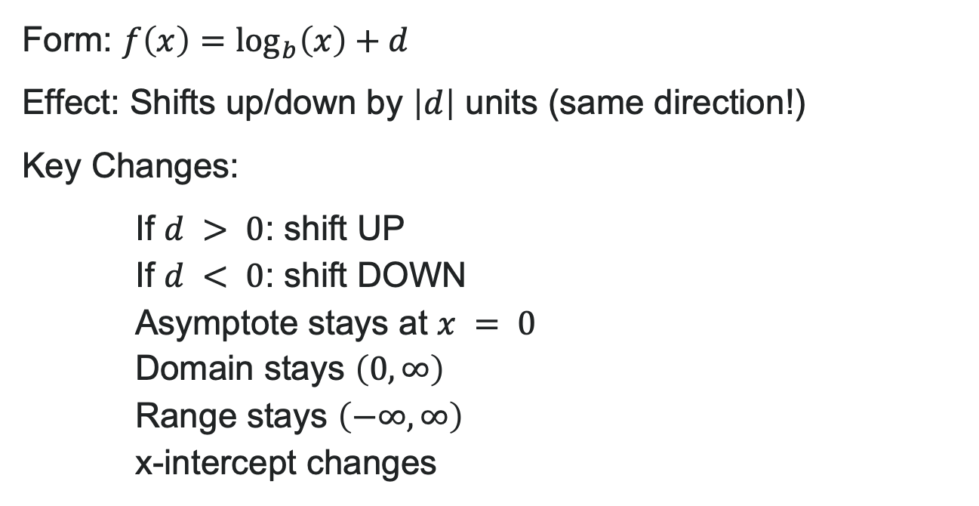
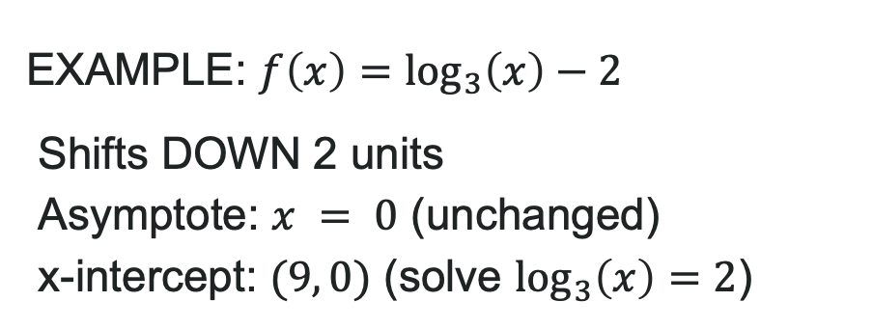
Exponential Transformations: Vertical Shifts
Form: $f\left(x\right)=\log_{b}\left(x\right)+d$
Effect: Shifts up/down by $\left|d\right|$ units (same direction!)
Key Changes:
If $d > 0$: shift UP
If $d < 0$: shift DOWN
Asymptote stays at $x = 0$
Domain stays $\left(0,∞\right)$
Range stays $\left(−∞,∞\right)$
x-intercept changes
EXAMPLE: $f\left(x\right)=\log_{3}\left(x\right)−2$
Shifts DOWN 2 units
Asymptote: $x = 0$ (unchanged)
x-intercept: $(9, 0)$ (solve $\log_{3}\left(x\right)=2$)

Slide 48

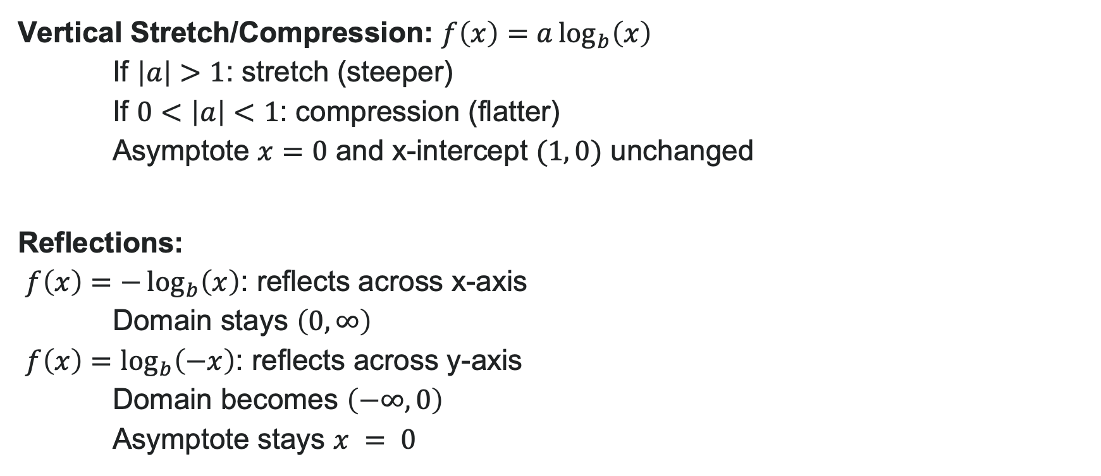
Exponential Stretches and Reflections
Vertical Stretch/Compression: $f\left(x\right)=a\log_{b}\left(x\right)$
If $\left|a\right|>1$: stretch (steeper)
If $0<\left|a\right|<1$: compression (flatter)
Asymptote $x=0$ and x-intercept $(1, 0)$ unchanged
Reflections:
$f\left(x\right)=−\log_{b}\left(x\right)$: reflects across x-axis Domain stays $\left(0,∞\right)$
$f\left(x\right)=\log_{b}\left(−x\right)$: reflects across y-axis Domain becomes $\left(−∞,0\right)$
Asymptote stays $x = 0$

Slide 49
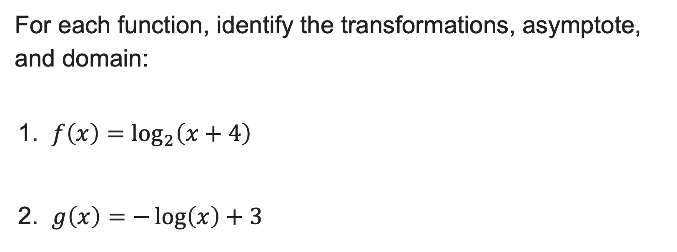
Try It: Exponential Transformations
For each function, identify the transformations, asymptote, and domain:
1. $f\left(x\right)=\log_{2}\left(x+4\right)$
2. $g\left(x\right)=−\log\left(x\right)+3$
Notes:
Answer:
Left 4 units; Asymptote: x = -4; Domain: (-4, \infty)
Reflection across x-axis, up 3 units; Asymptote: x = 0; Domain: (0, \infty)

Slide 50
Before we finish up…
2
Next steps…..
3
Reminders about student hours, upcoming deadlines, campus activities ….
1
Questions…..

Slide 51

Attributions
Illustrations are from Storyset
Authored by: Lumen Learning. License: CC BY: Attribution

