Slide 1

Precalculus
Module 6:
Rational Functions

Slide 2
Affirmations
I am proud of the resilience I show in my learning.
I listen to understand, not just to respond.
Every math skill I learn builds a stronger foundation.

Slide 3
Learning Goals: Rational Functions
Deepen your understanding and form connections within these skills:
1 Utilize arrow notation to specify the behavior of rational functions
2 Find the domains of rational functions
3 Identify vertical and horizontal asymptotes
4 Identify slant asymptotes
5 Graph rational functions

Slide 4
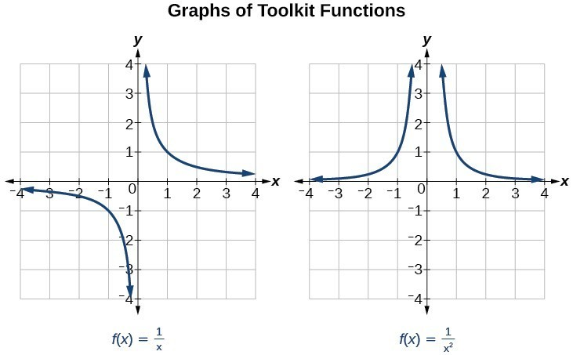
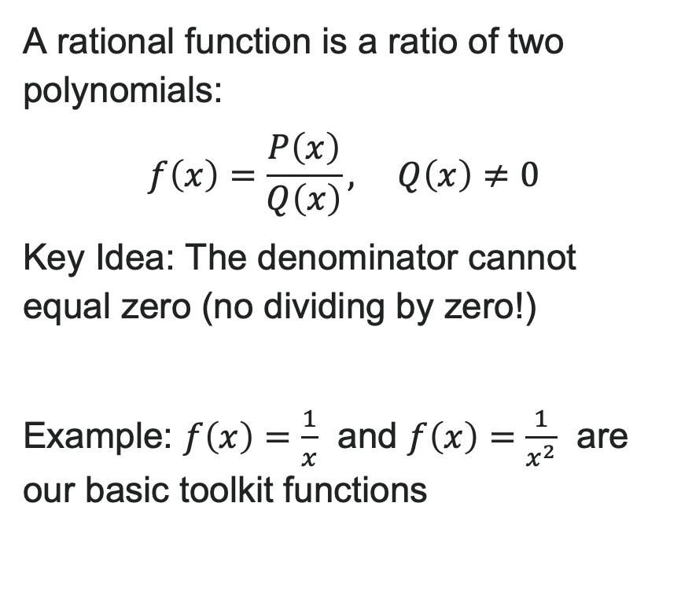
What is a Rational Function?
A rational function is a ratio of two polynomials:
$f\left(x\right)=\frac{P\left(x\right)}{Q\left(x\right)}, Q\left(x\right)≠0$
Key Idea: The denominator cannot equal zero (no dividing by zero!)
Example: $f\left(x\right)=\frac{1}{x}$ and $f\left(x\right)=\frac{1}{x^{2}}$ are our basic toolkit functions

Slide 5

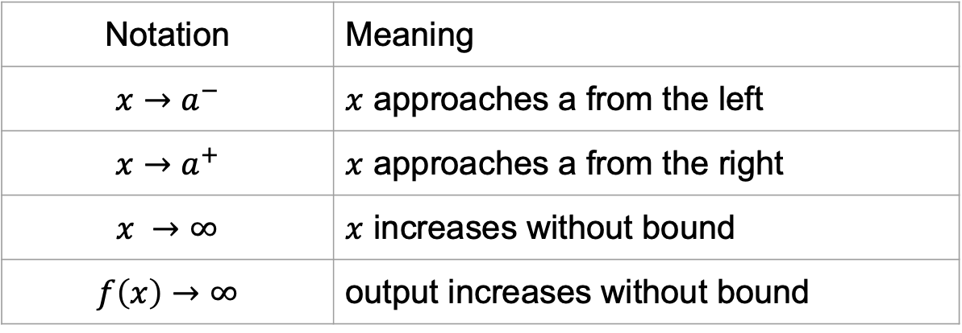
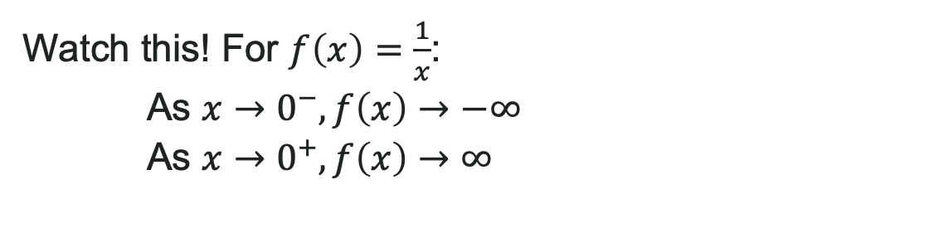
Arrow Notation
We use arrow notation to describe where functions are headed:
Notation | Meaning
$$x→a^{−}$$ | $x$ approaches a from the left
$$x→a^{+}$$ | $x$ approaches a from the right
$$x →∞$$ | $x$ increases without bound
$$f\left(x\right)→∞$$ | output increases without bound
Watch this! For $f\left(x\right)=\frac{1}{x}$:
As $x→0^{−},f\left(x\right)→−∞$
As $x→0^{+},f\left(x\right)→∞$

Slide 6

Try It: Arrow Notation
Use arrow notation to describe $f\left(x\right)=\frac{1}{x−2}+3$ as:
1. $x→2^{−}$
2. $x→2^{+}$
3. $x →−∞$
4. $x →∞$
Notes:
Answer:
As x \to 2^-, f(x) \to -\infty
As x \to 2^+, f(x) \to \infty
As x \to -\infty, f(x) \to 3
As x \to \infty, f(x) \to 3

Slide 7
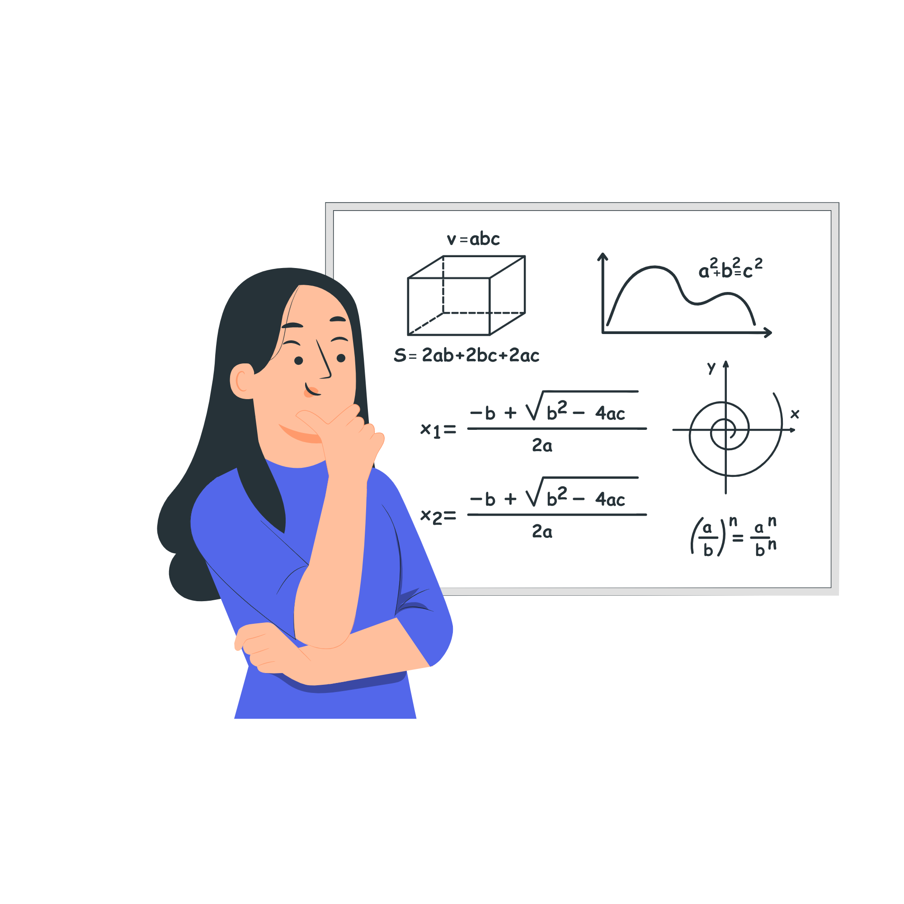
Finding the Domain of Rational Functions
The domain of a rational function includes all real numbers except those that cause the denominator to equal zero.
How to find the domain:
Set the denominator equal to zero.
Solve to find the values of the variable that cause the denominator to equal zero.
The domain contains all real numbers except those found in Step 2.

Slide 8

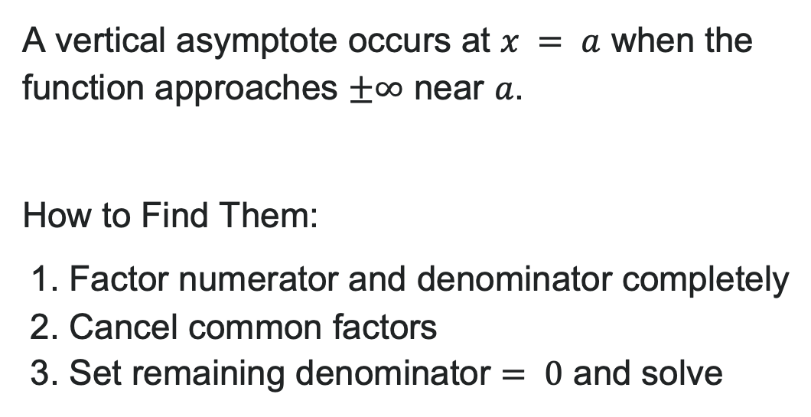
Vertical Asymptotes
A vertical asymptote occurs at $x = a$ when the function approaches $±∞$ near $a$.
How to Find Them:
1. Factor numerator and denominator completely
2. Cancel common factors
3. Set remaining denominator $= 0$ and solve

Slide 9
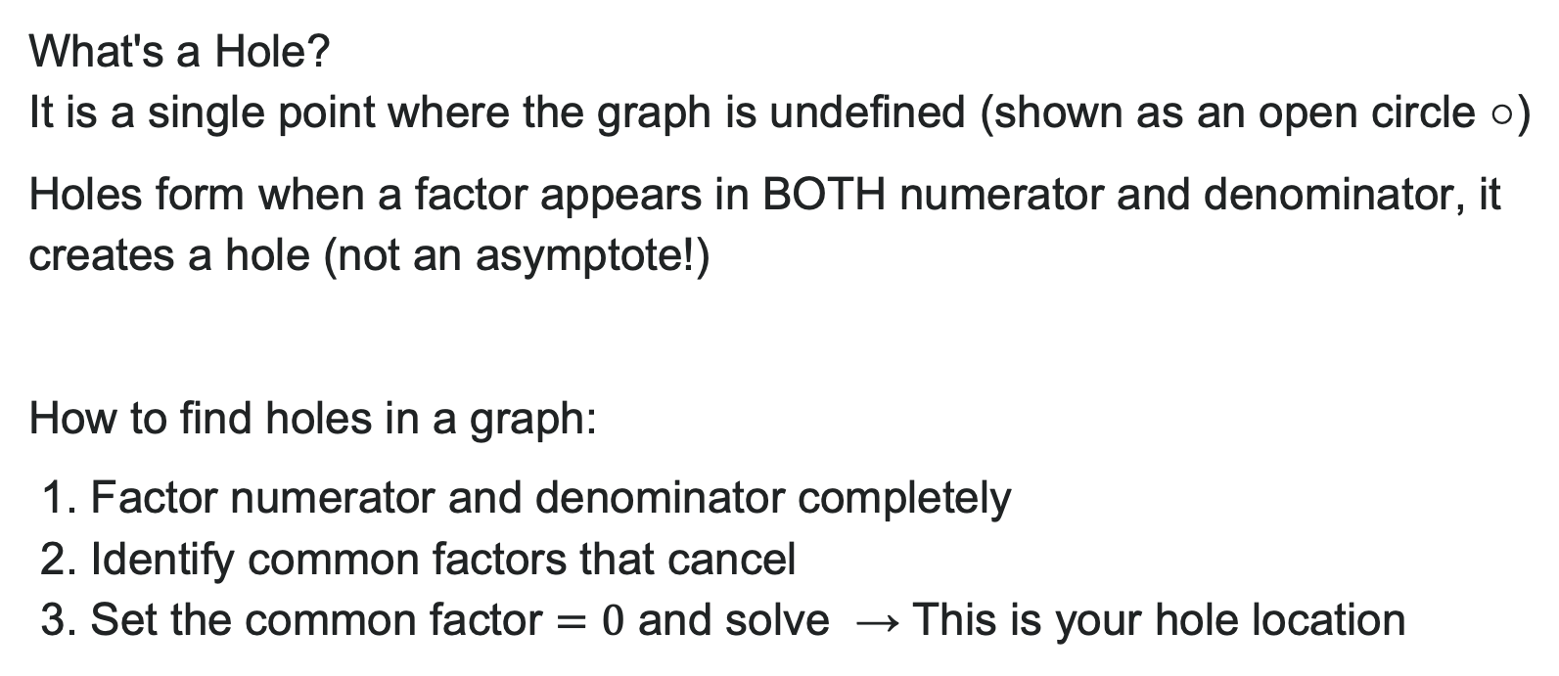
Removable Discontinuities (Holes)
What's a Hole?
It is a single point where the graph is undefined (shown as an open circle ○)
Holes form when a factor appears in BOTH numerator and denominator, it creates a hole (not an asymptote!)
How to find holes in a graph:
1. Factor numerator and denominator completely
2. Identify common factors that cancel
3. Set the common factor $=0$ and solve → This is your hole location

Slide 10
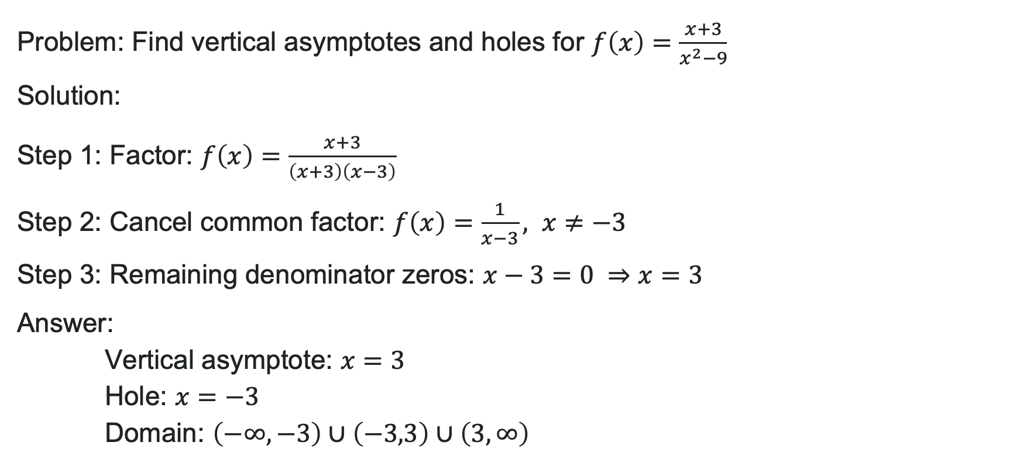
Example: Vertical Asymptotes and Holes
Problem: Find vertical asymptotes and holes for $f\left(x\right)=\frac{x+3}{x^{2}−9}$
Solution:
Step 1: Factor: $f\left(x\right)=\frac{x+3}{\left(x+3\right)\left(x−3\right)}$
Step 2: Cancel common factor: $f\left(x\right)=\frac{1}{x−3}, x≠−3$
Step 3: Remaining denominator zeros: $x−3=0 ⇒x=3$
Answer:
Vertical asymptote: $x=3$
Hole: $x=−3$
Domain: $\left(−∞,−3\right)∪\left(−3,3\right)∪\left(3,∞\right)$

Slide 11

Try It: Vertical Asymptotes
Find all vertical asymptotes and holes for:
$$g\left(x\right)=\frac{x^{2}−4}{x^{2}+x−6}$$
Notes:
Answer: Factor: g(x) = \frac{(x-2)(x+2)}{(x+3)(x-2)}
After canceling (x-2): g(x) = \frac{x+2}{x+3}, x \neq 2
Vertical asymptote: x = -3
Hole: x = 2

Slide 12
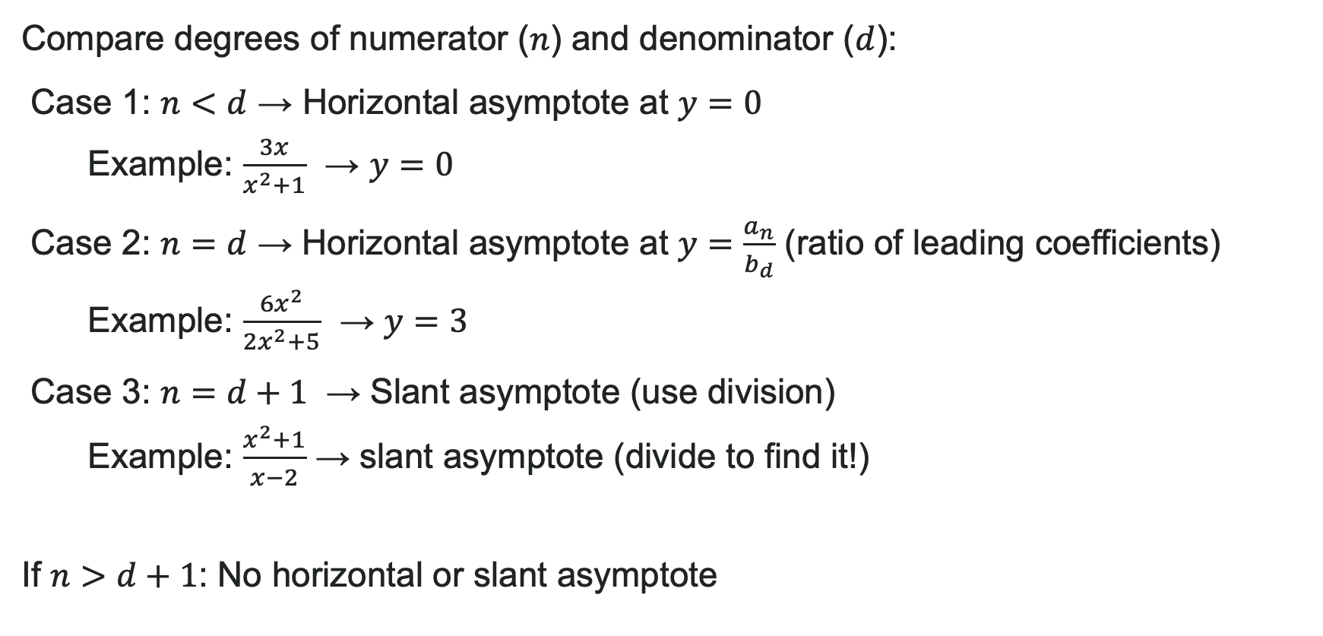
End Behavior and Horizontal Asymptotes
Compare degrees of numerator ($n$) and denominator ($d$):
Case 1: $n<d$ → Horizontal asymptote at $y=0$
  Example: $\frac{3x}{x^{2}+1}$ → $y=0$
Case 2: $n=d$ → Horizontal asymptote at $y=\frac{a_{n}}{b_{d}}$ (ratio of leading coefficients)
  Example: $\frac{6x^{2}}{2x^{2}+5}$ → $y=3$
Case 3: $n=d+1$ → Slant asymptote (use division)
  Example: $\frac{x^{2}+1}{x−2}$ → slant asymptote (divide to find it!)
If $n>d+1$: No horizontal or slant asymptote

Slide 13
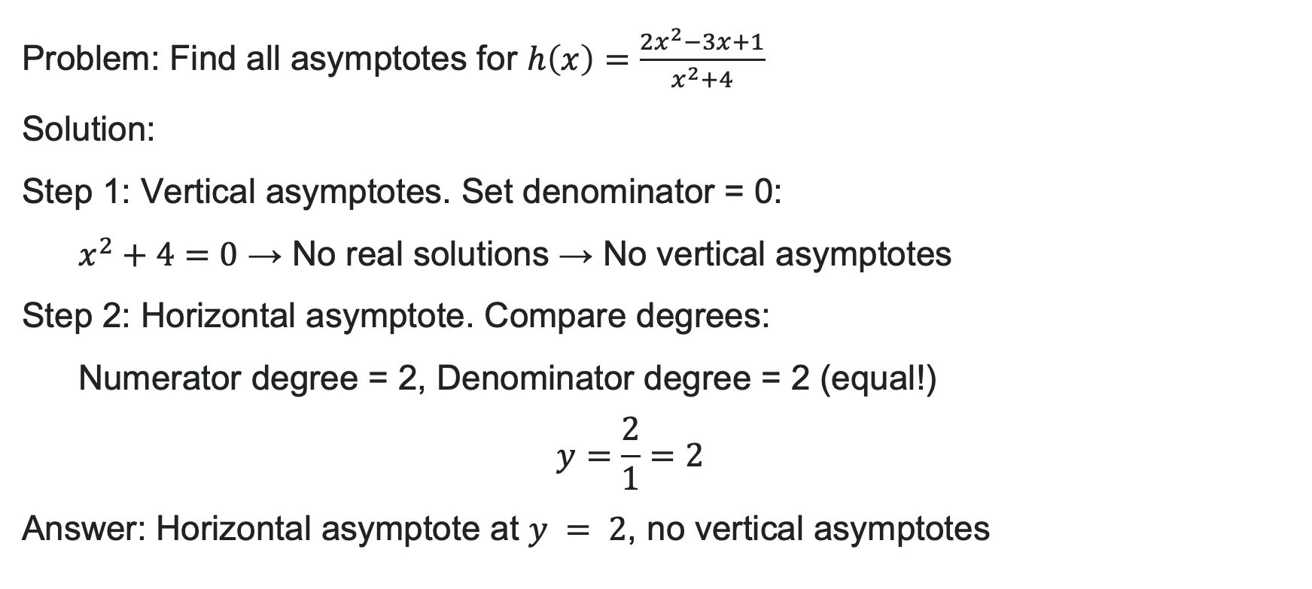
Example: Horizontal and Slant Asymptotes
Problem: Find all asymptotes for $h\left(x\right)=\frac{2x^{2}−3x+1}{x^{2}+4}$
Solution:
Step 1: Vertical asymptotes. Set denominator = 0:
$x^{2}+4=0$ → No real solutions → No vertical asymptotes
Step 2: Horizontal asymptote. Compare degrees:
Numerator degree = 2, Denominator degree = 2 (equal!)
$y=\frac{2}{1}=2$
Answer: Horizontal asymptote at $y = 2$, no vertical asymptotes

Slide 14

Try It: Identify All Asymptotes
Find all asymptotes for:
1. $f\left(x\right)=\frac{x^{2}+3x}{x^{3}−1}$
2. $g\left(x\right)=\frac{2x^{3}+x}{x^{2}−9}$
Notes:
Answer:
Vertical asymptote: x = 1; Horizontal asymptote: y = 0 (degree numerator < degree denominator)
Vertical asymptotes: x = -3, x = 3; Slant asymptote (divide to find): y = 2x

Slide 15
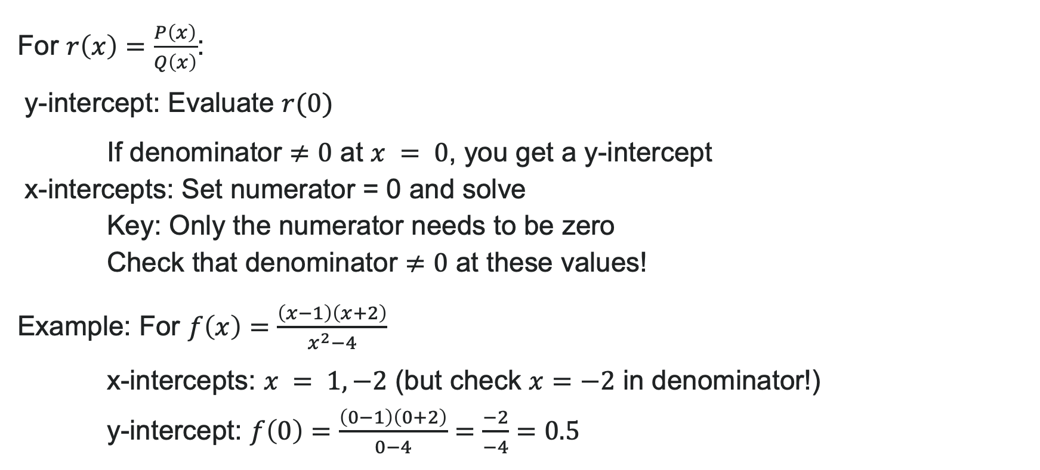
Finding Intercepts
For $r\left(x\right)=\frac{P\left(x\right)}{Q\left(x\right)}$:
y-intercept: Evaluate $r(0)$
If denominator $≠0$ at $x = 0$, you get a y-intercept
x-intercepts: Set numerator = 0 and solve
Key: Only the numerator needs to be zero
Check that denominator $≠0$ at these values!
Example: For $f\left(x\right)=\frac{\left(x−1\right)\left(x+2\right)}{x^{2}−4}$
x-intercepts: $x = 1, −2$ (but check $x=−2$ in denominator!)
y-intercept: $f\left(0\right)=\frac{\left(0−1\right)\left(0+2\right)}{0−4}=\frac{−2}{−4}=0.5$

Slide 16
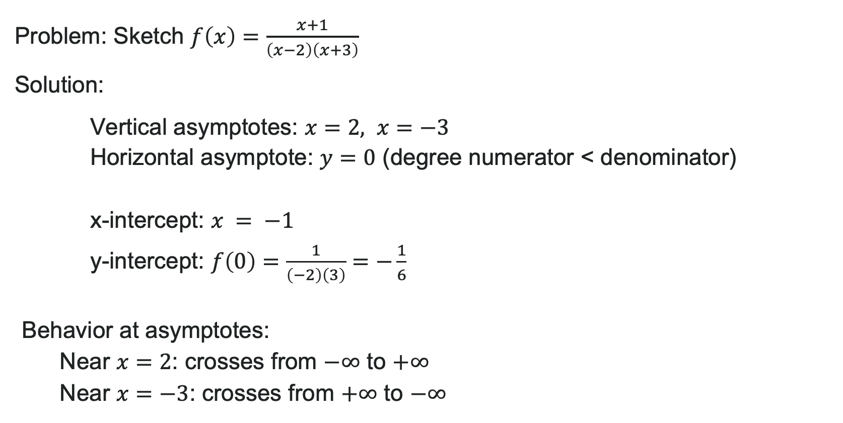
Example: Complete Graph Analysis
Problem: Sketch $f\left(x\right)=\frac{x+1}{\left(x−2\right)\left(x+3\right)}$
Solution:
Vertical asymptotes: $x=2, x=−3$
Horizontal asymptote: $y=0$ (degree numerator < denominator)
x-intercept: $x = −1$
y-intercept: $f\left(0\right)=\frac{1}{\left(−2\right)\left(3\right)}=−\frac{1}{6}$
Behavior at asymptotes:
Near $x=2$: crosses from $−∞$ to $+∞$
Near $x=−3$: crosses from $+∞$ to $−∞$

Slide 17
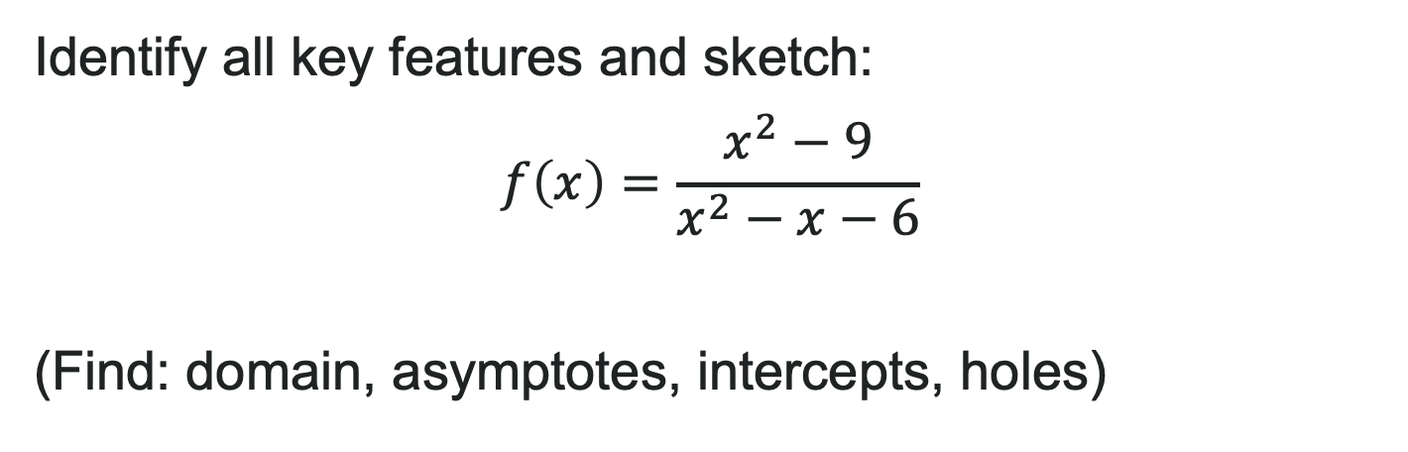
Try It: Your Turn to Graph
Identify all key features and sketch:
$$f\left(x\right)=\frac{x^{2}−9}{x^{2}−x−6}$$
(Find: domain, asymptotes, intercepts, holes)
Notes:
Answer: Factor: f(x) = \frac{(x-3)(x+3)}{(x-3)(x+2)} → Cancels to \frac{x+3}{x+2}, x \neq 3 Vertical asymptote: x = -2 Hole: x = 3 Horizontal asymptote: y = 1 x-intercept: x = -3 y-intercept: f(0) = \frac{9}{-6} = -1.5

Slide 18
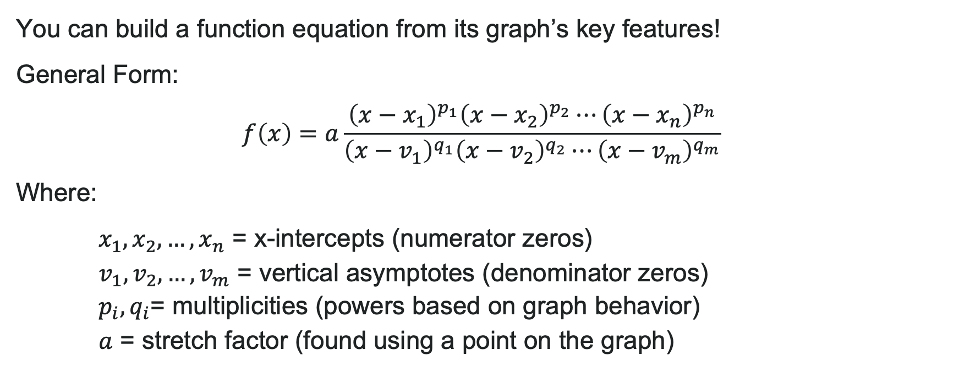
Writing Rational Functions from Graphs
You can build a function equation from its graph’s key features!
General Form:
$f\left(x\right)=a\frac{{\left(x−x_{1}\right)}^{p_{1}}{\left(x−x_{2}\right)}^{p_{2}}⋯{\left(x−x_{n}\right)}^{p_{n}}}{{\left(x−v_{1}\right)}^{q_{1}}{\left(x−v_{2}\right)}^{q_{2}}⋯{\left(x−v_{m}\right)}^{q_{m}}}$
Where:
$x_{1},x_{2},…,x_{n}$ = x-intercepts (numerator zeros)
$v_{1},v_{2},…,v_{m}$ = vertical asymptotes (denominator zeros)
$p_{i},q_{i}$= multiplicities (powers based on graph behavior)
$a$ = stretch factor (found using a point on the graph)

Slide 19

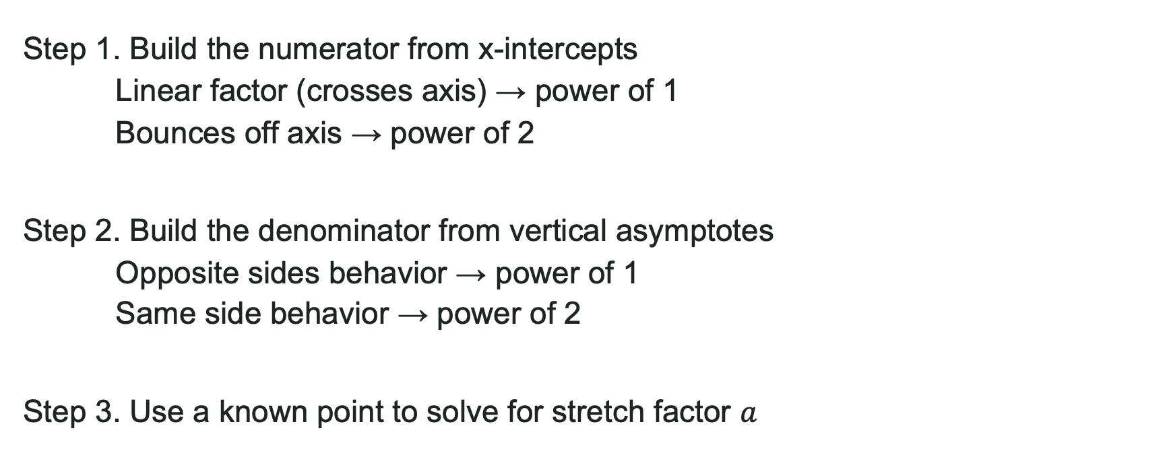
How to: Write a Rational Equation from a Graph
Step 1. Build the numerator from x-intercepts
Linear factor (crosses axis) → power of 1
Bounces off axis → power of 2
Step 2. Build the denominator from vertical asymptotes
Opposite sides behavior → power of 1
Same side behavior → power of 2
Step 3. Use a known point to solve for stretch factor $a$

Slide 20
Learning Goals: Applications of Rational Functions
Deepen your understanding and form connections within these skills:
1 Solve applied problems involving rational functions
2 Solve rational inequalities

Slide 21

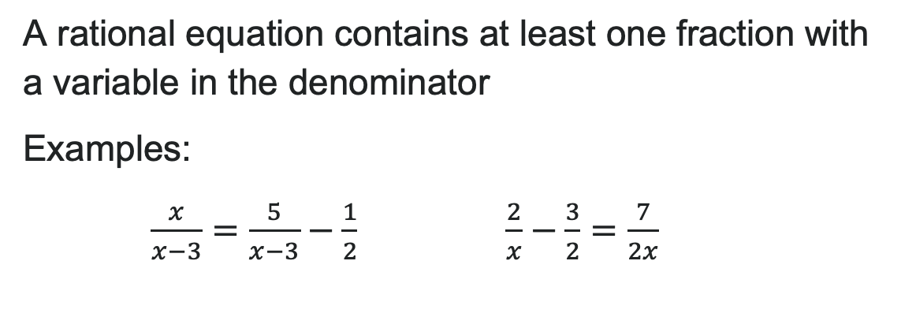
Recall: Rational Equations
A rational equation contains at least one fraction with a variable in the denominator
Examples:
$\frac{x}{x−3}=\frac{5}{x−3}−\frac{1}{2}$ $\frac{2}{x}−\frac{3}{2}=\frac{7}{2x}$

Slide 22
Solving Rational Equations: LCD Method
The strategy: multiply by the least common denominator (LCD) to eliminate all denominators! Steps:
Factor all denominators
Find excluded values (where denominators = 0)
Find the LCD
Multiply the entire equation by the LCD
Solve the resulting equation
Check your solution against excluded values
Pro Tip: Leave the LCD factored—it makes canceling easier!

Slide 23
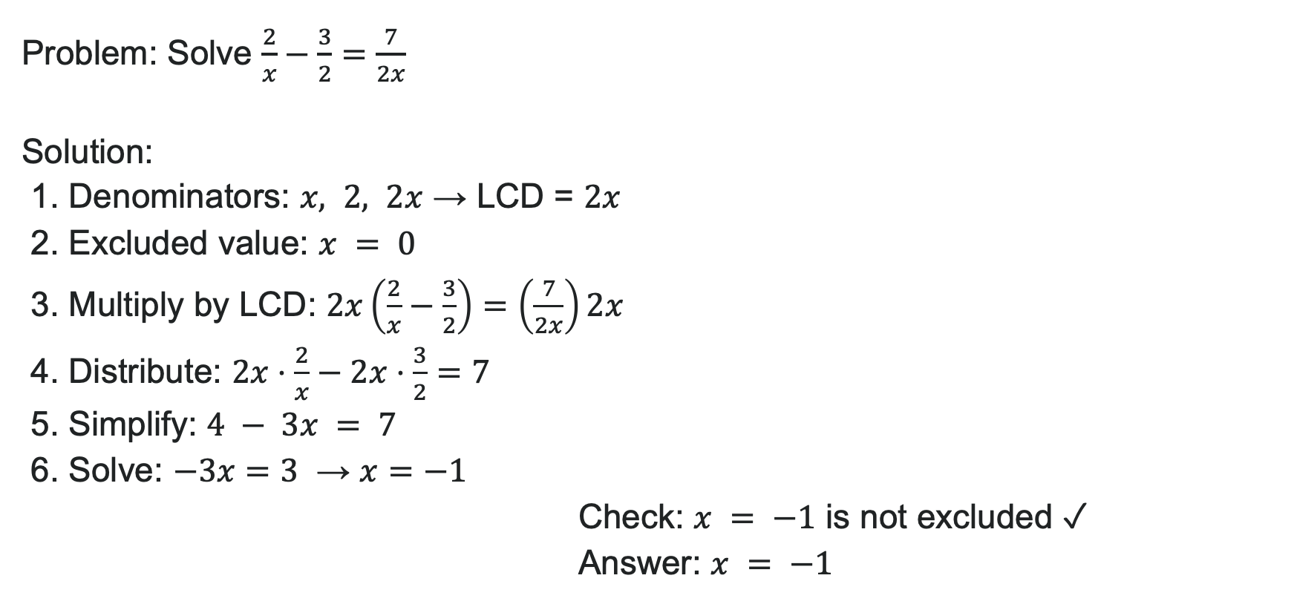
Example: Solving a Rational Equation
Problem: Solve $\frac{2}{x}−\frac{3}{2}=\frac{7}{2x}$
Solution:
1. Denominators: $x, 2, 2x$ → LCD = $2x$
2. Excluded value: $x = 0$
3. Multiply by LCD: $2x\left(\frac{2}{x}−\frac{3}{2}\right)=\left(\frac{7}{2x}\right)2x$
4. Distribute: $2x⋅\frac{2}{x}−2x⋅\frac{3}{2}=7$
5. Simplify: $4 − 3x = 7$
6. Solve: $−3x=3$ → $x=−1$
Check: $x = −1$ is not excluded ✓
Answer: $x = −1$

Slide 24

Try It: Solve a Rational Equation
Solve and state excluded values:
$$\frac{1}{x}=\frac{1}{10}−\frac{3}{4x}$$
Notes:
Solution: LCD = 20x, Excluded value: x = 0 Multiply by 20x: 20 = 2x - 15 Solve: 2x = 35 → x = \frac{35}{2} Answer: x = \frac{35}{2}, excluded value is x = 0

Slide 25
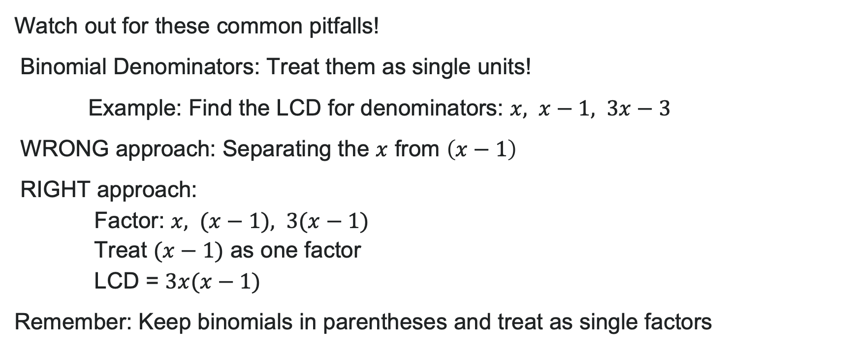
Common LCD Mistakes
Watch out for these common pitfalls!
Binomial Denominators: Treat them as single units!
Example: Find the LCD for denominators: $x, x−1, 3x−3$
WRONG approach: Separating the $x$ from $\left(x−1\right)$
RIGHT approach:
    Factor: $x, (x−1), 3(x−1)$
    Treat $(x−1)$ as one factor
    LCD = $3x(x−1)$
Remember: Keep binomials in parentheses and treat as single factors

Slide 26
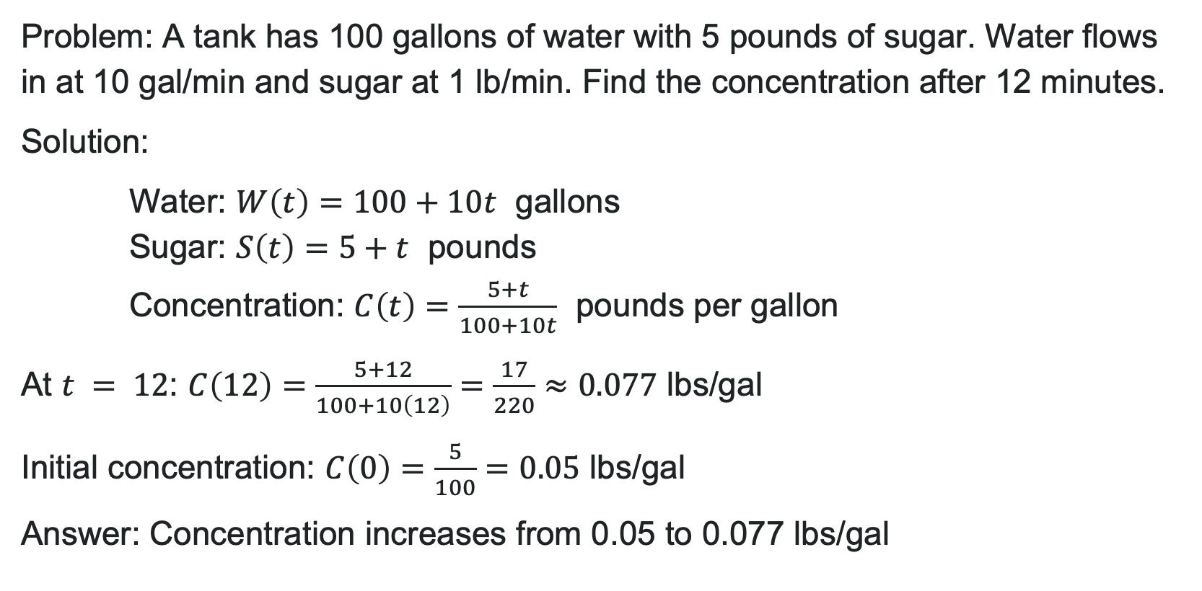
Real-World Example: Concentration
Problem: A tank has 100 gallons of water with 5 pounds of sugar. Water flows in at 10 gal/min and sugar at 1 lb/min. Find the concentration after 12 minutes.
Solution:
Water: $W\left(t\right)=100+10t$ gallons
Sugar: $S\left(t\right)=5+t$ pounds
Concentration: $C\left(t\right)=\frac{5+t}{100+10t}$ pounds per gallon
At $t = 12$: $C\left(12\right)=\frac{5+12}{100+10\left(12\right)}=\frac{17}{220}≈0.077$ lbs/gal
Initial concentration: $C\left(0\right)=\frac{5}{100}=0.05$ lbs/gal
Answer: Concentration increases from 0.05 to 0.077 lbs/gal

Slide 27
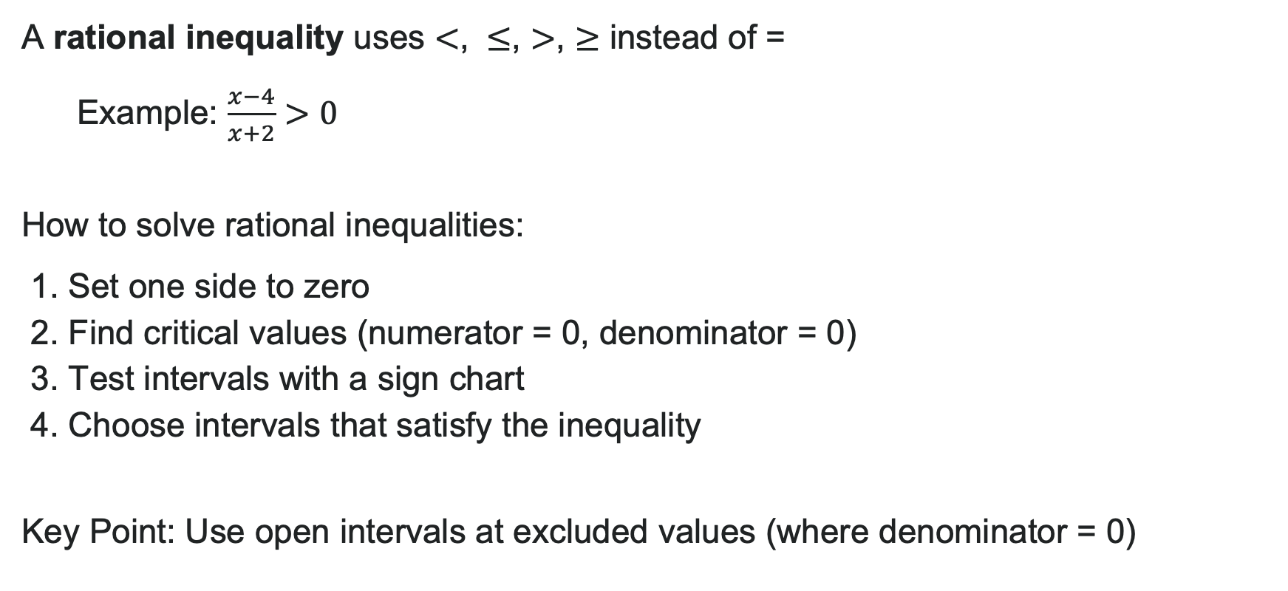
Rational Inequalities
A rational inequality uses $<$, $≤$, $>$, $≥$ instead of =
Example: $\frac{x−4}{x+2}>0$
How to solve rational inequalities:
1. Set one side to zero
2. Find critical values (numerator = 0, denominator = 0)
3. Test intervals with a sign chart
4. Choose intervals that satisfy the inequality
Key Point: Use open intervals at excluded values (where denominator = 0)

Slide 28
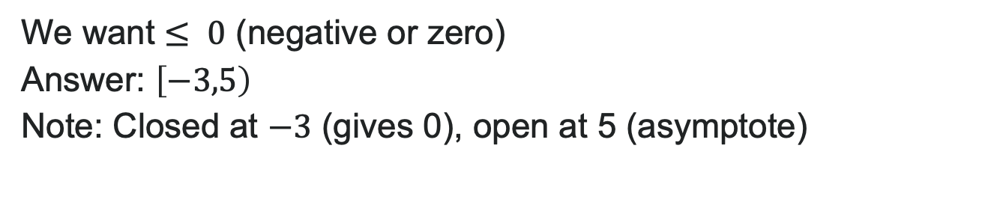
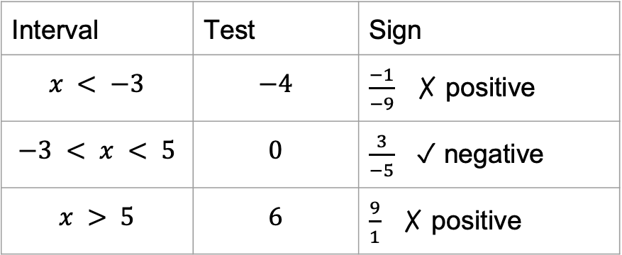
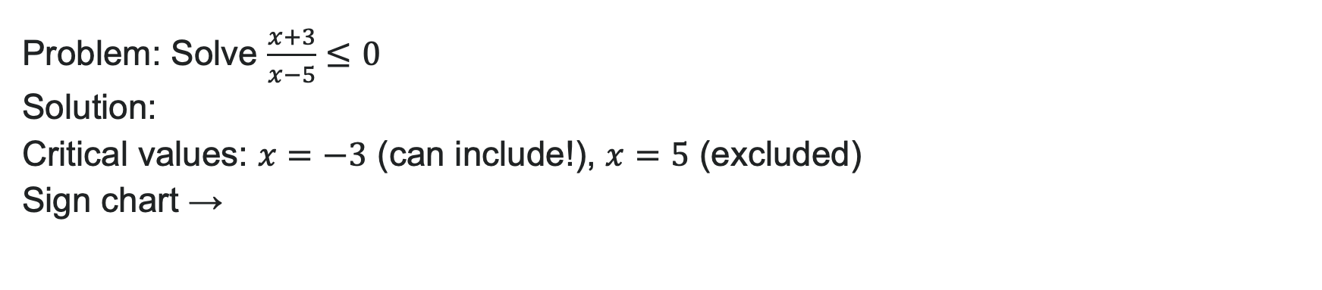
Example: Inequality with $≤$
Problem: Solve $\frac{x+3}{x−5}≤0$
Solution:
Critical values: $x=−3$ (can include!), $x=5$ (excluded)
Sign chart →
Interval | Test | Sign
$$x < −3$$ | $$−4$$ | $\frac{−1}{−9}$ ✗ positive
$$−3 < x < 5$$ | $$0$$ | $\frac{3}{−5}$ ✓ negative
$$x > 5$$ | $$6$$ | $\frac{9}{1}$ ✗ positive
We want $≤ 0$ (negative or zero)
Answer: $\left[−3,5\right)$
Note: Closed at $−3$ (gives 0), open at 5 (asymptote)

Slide 29
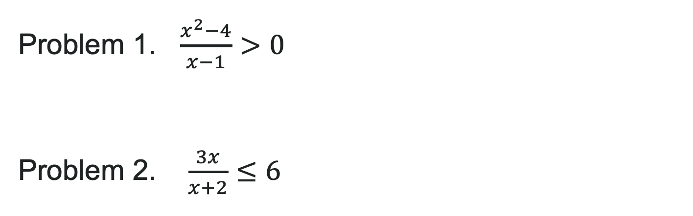
Try It: Inequalities
Problem 1. $\frac{x^{2}−4}{x−1}>0$
Problem 2. $\frac{3x}{x+2}≤6$
Notes:
Answer:
Critical values: x = -2, 2 (numerator), x = 1 (excluded) Test intervals: Solution is (-\infty, -2) \cup (1, 2) \cup (2, \infty)
Rewrite as \frac{3x}{x+2} - 6 \leq 0 → \frac{3x - 6(x+2)}{x+2} \leq 0 → \frac{-3x-12}{x+2} \leq 0 Critical: x = -4, x = -2 (excluded). Solution: (-\infty, -4] \cup (-2, \infty)

Slide 30
Learning Goals: Variation
Deepen your understanding and form connections within these skills:
1 Solve direct variation problems
2 Solve inverse variation problems
3 Solve problems involving joint variation

Slide 31

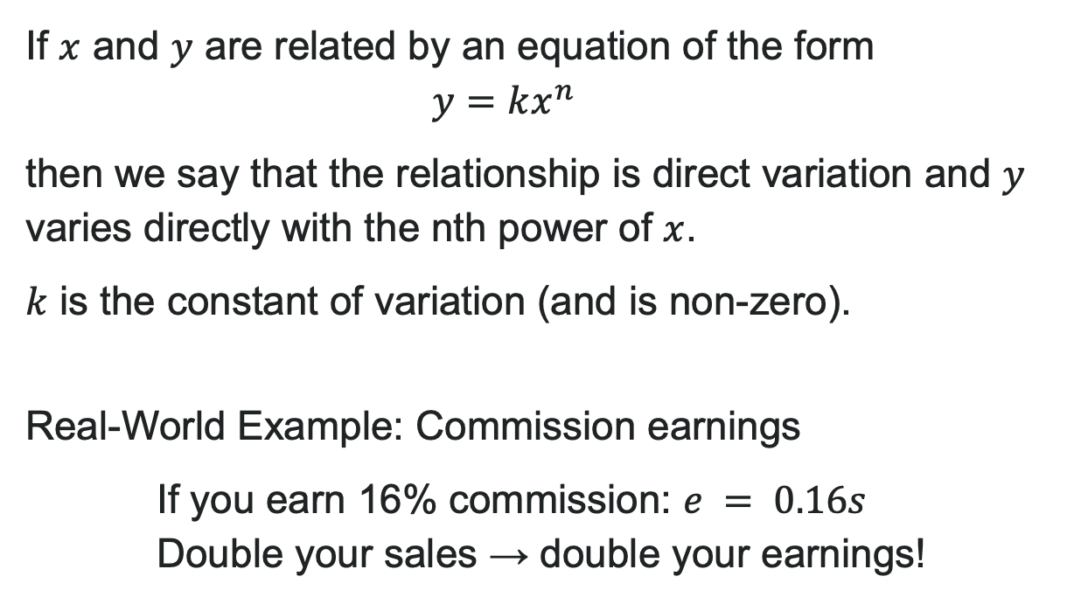
Direct Variation
If $x$ and $y$ are related by an equation of the form
$$y=kx^{n}$$
then we say that the relationship is direct variation and $y$ varies directly with the nth power of $x$.
$k$ is the constant of variation (and is non-zero).
Real-World Example: Commission earnings
If you earn 16% commission: $e = 0.16s$
Double your sales → double your earnings!

Slide 32
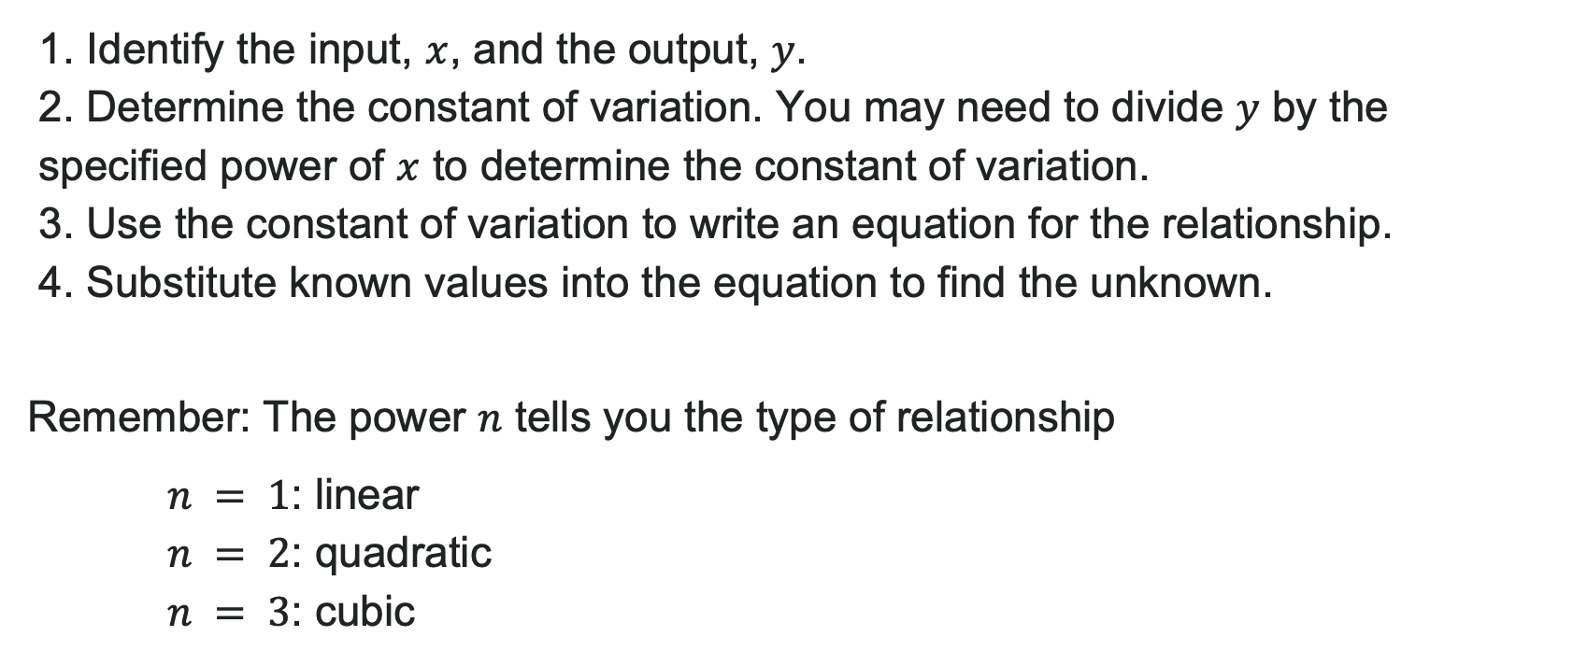
How to: Solve Direct Variation Problems
1. Identify the input, $x$, and the output, $y$.
2. Determine the constant of variation. You may need to divide $y$ by the specified power of $x$ to determine the constant of variation.
3. Use the constant of variation to write an equation for the relationship.
4. Substitute known values into the equation to find the unknown.
Remember: The power $n$ tells you the type of relationship
$n = 1$: linear
$n = 2$: quadratic
$n = 3$: cubic

Slide 33
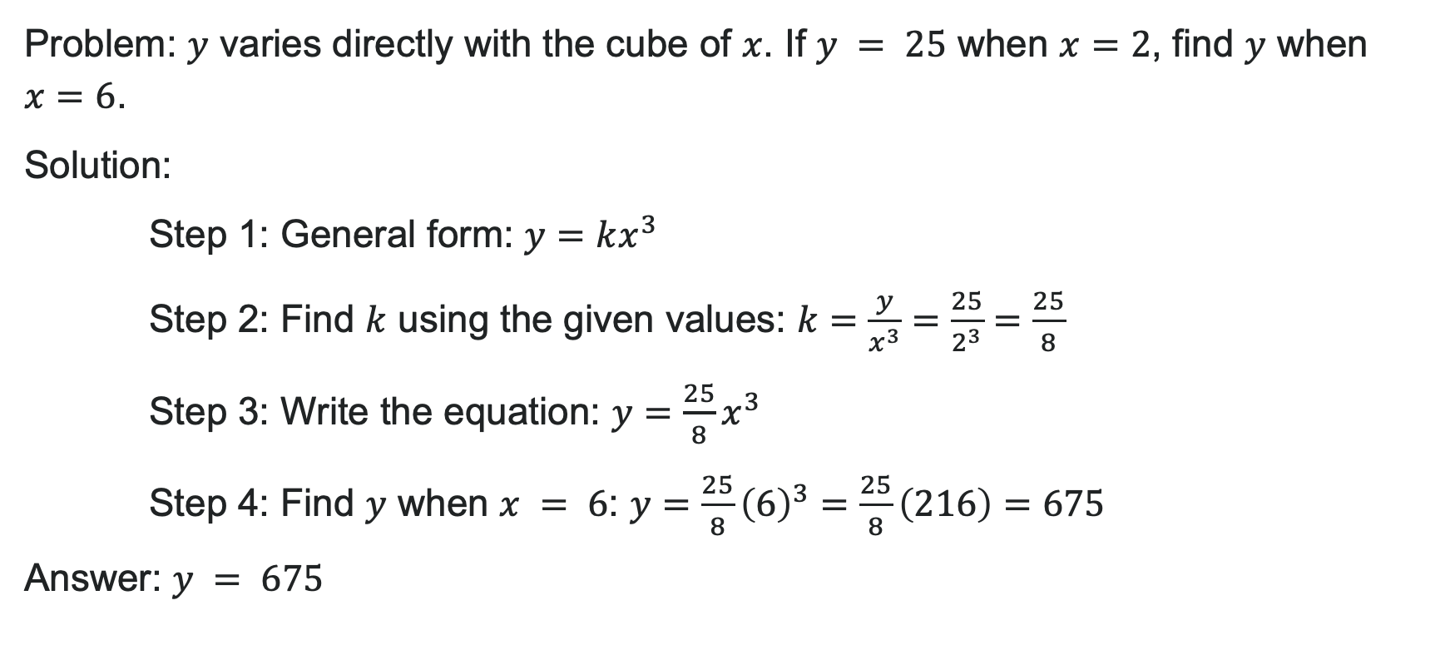
Example: Direct Variation
Problem: $y$ varies directly with the cube of $x$. If $y = 25$ when $x=2$, find $y$ when $x=6$.
Solution:
Step 1: General form: $y=kx^{3}$
Step 2: Find $k$ using the given values: $k=\frac{y}{x^{3}}=\frac{25}{2^{3}}=\frac{25}{8}$
Step 3: Write the equation: $y=\frac{25}{8}x^{3}$
Step 4: Find $y$ when $x = 6$: $y=\frac{25}{8}{\left(6\right)}^{3}=\frac{25}{8}\left(216\right)=675$
Answer: $y = 675$

Slide 34
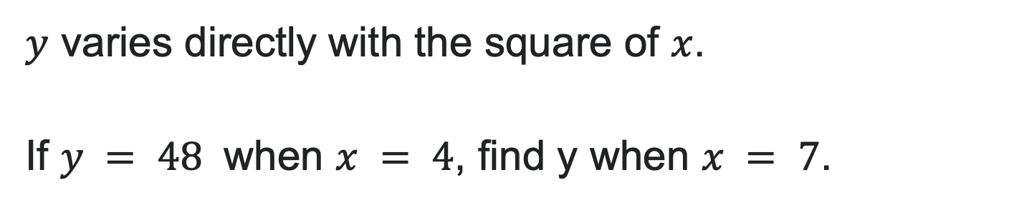
Try It: Direct Variation
$y$ varies directly with the square of $x$.
If $y = 48$ when $x = 4$, find y when $x = 7$.
Notes:
Solution: k = \frac{y}{x^2} = \frac{48}{16} = 3
Equation: y = 3x^2
When x = 7: y = 3(49) = 147
Answer: y = 147

Slide 35
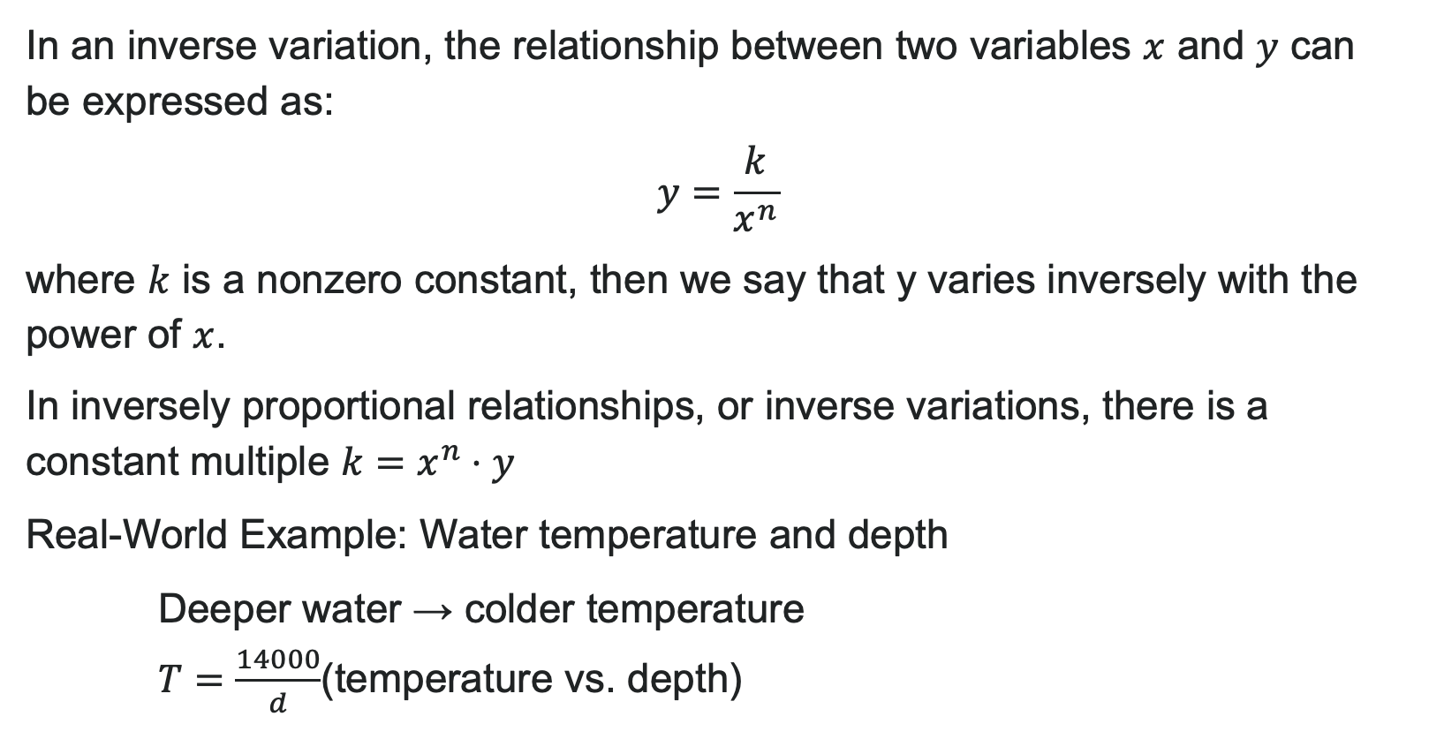
Inverse Variation
In an inverse variation, the relationship between two variables $x$ and $y$ can be expressed as:
$y=\frac{k}{x^{n}}$
where $k$ is a nonzero constant, then we say that y varies inversely with the power of $x$.
In inversely proportional relationships, or inverse variations, there is a constant multiple $k=x^{n}⋅y$
Real-World Example: Water temperature and depth
Deeper water → colder temperature
$T=\frac{14000}{d}$(temperature vs. depth)

Slide 36

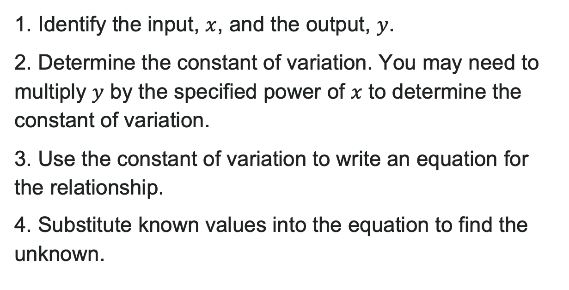
How to: Solve Inverse Variation Problem
1. Identify the input, $x$, and the output, $y$.
2. Determine the constant of variation. You may need to multiply $y$ by the specified power of $x$ to determine the constant of variation.
3. Use the constant of variation to write an equation for the relationship.
4. Substitute known values into the equation to find the unknown.

Slide 37
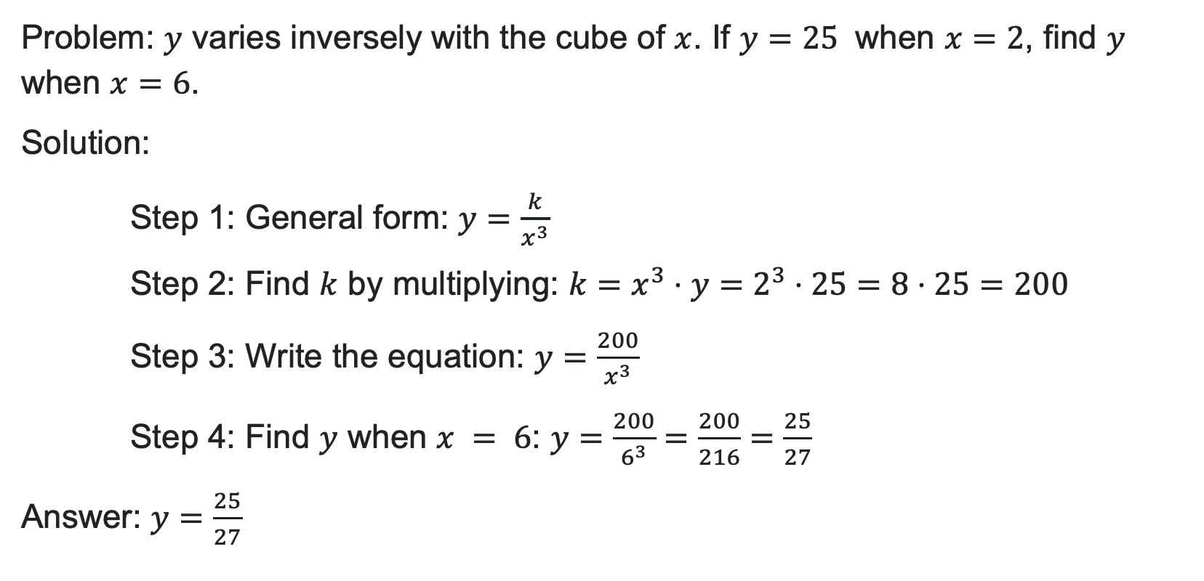
Example: Inverse Variation
Problem: $y$ varies inversely with the cube of $x$. If $y=25$ when $x=2$, find $y$ when $x=6$.
Solution:
Step 1: General form: $y=\frac{k}{x^{3}}$
Step 2: Find $k$ by multiplying: $k=x^{3}⋅y=2^{3}⋅25=8⋅25=200$
Step 3: Write the equation: $y=\frac{200}{x^{3}}$
Step 4: Find $y$ when $x = 6$: $y=\frac{200}{6^{3}}=\frac{200}{216}=\frac{25}{27}$
Answer: $y=\frac{25}{27}$

Slide 38
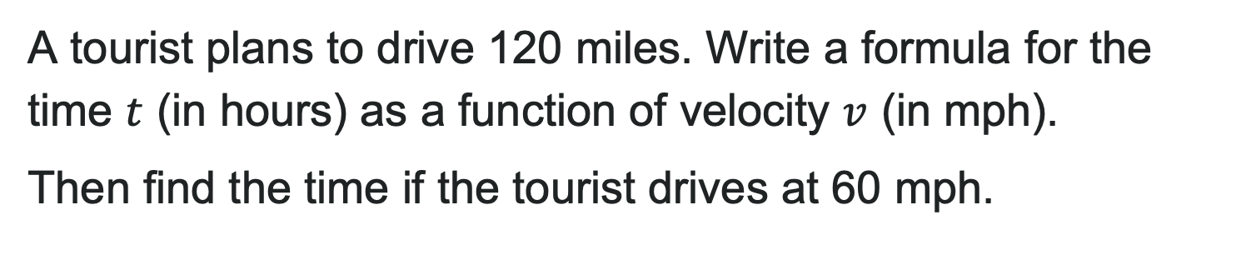
Try It: Inverse Variation
A tourist plans to drive 120 miles. Write a formula for the time $t$ (in hours) as a function of velocity $v$ (in mph).
Then find the time if the tourist drives at 60 mph.
Notes:
Solution: Using distance = velocity × time: vt = 120
Solve for time: t = \frac{120}{v}
When v = 60: t = \frac{120}{60} = 2 hours
Answer: t(v) = \frac{120}{v}; at 60 mph, it takes 2 hours

Slide 39
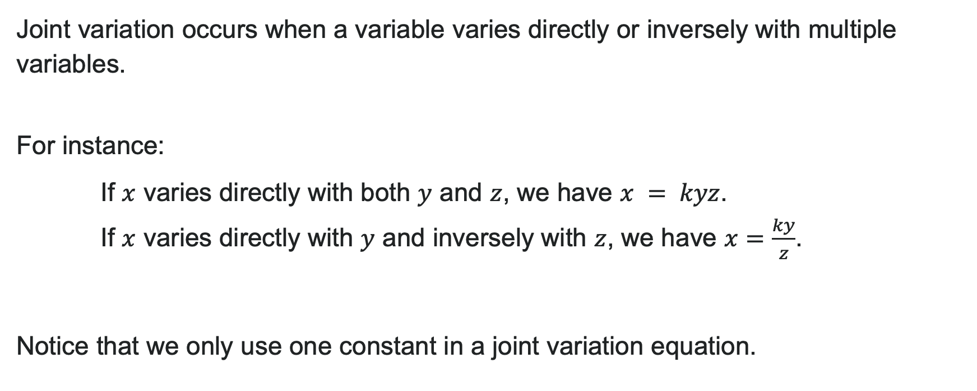
Joint Variation
Joint variation occurs when a variable varies directly or inversely with multiple variables.
For instance:
If $x$ varies directly with both $y$ and $z$, we have $x = kyz$.
If $x$ varies directly with $y$ and inversely with $z$, we have $x=\frac{ky}{z}$.
Notice that we only use one constant in a joint variation equation.

Slide 40
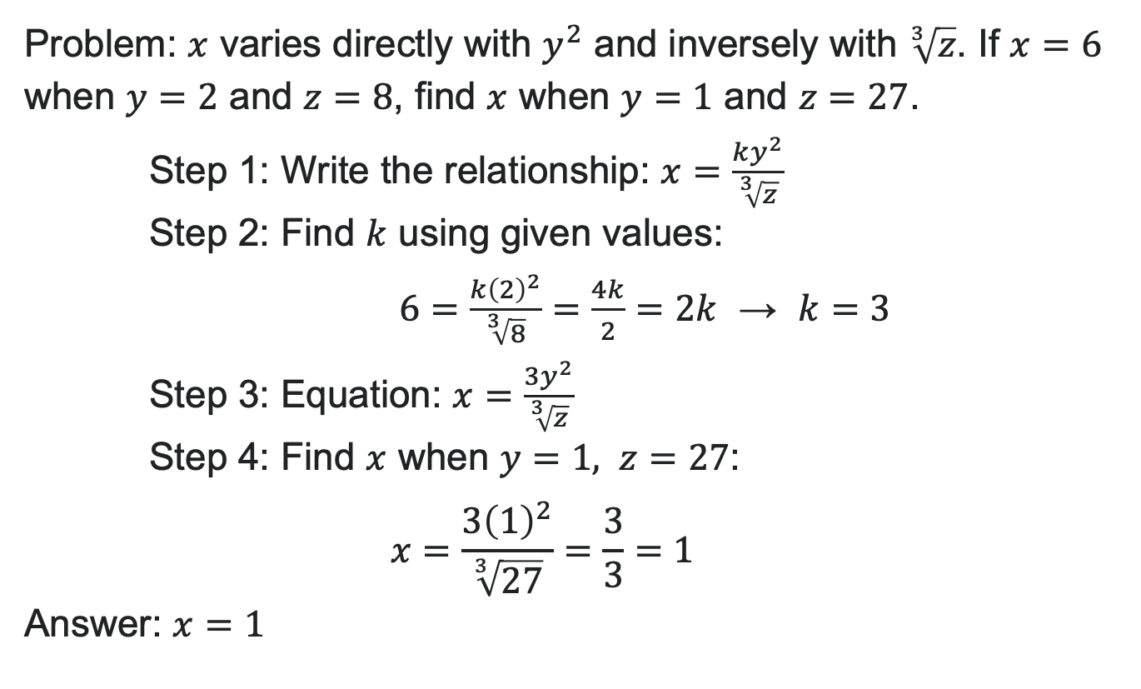
Example: Joint Variation
Problem: $x$ varies directly with $y^{2}$ and inversely with $\sqrt[3]{z}$. If $x=6$ when $y=2$ and $z=8$, find $x$ when $y=1$ and $z=27$.
Step 1: Write the relationship: $x=\frac{ky^{2}}{\sqrt[3]{z}}$
Step 2: Find $k$ using given values:
$6=\frac{k{\left(2\right)}^{2}}{\sqrt[3]{8}}=\frac{4k}{2}=2k$ → $k=3$
Step 3: Equation: $x=\frac{3y^{2}}{\sqrt[3]{z}}$
Step 4: Find $x$ when $y=1, z=27$:
$x=\frac{3{\left(1\right)}^{2}}{\sqrt[3]{27}}=\frac{3}{3}=1$
Answer: $x=1$

Slide 41
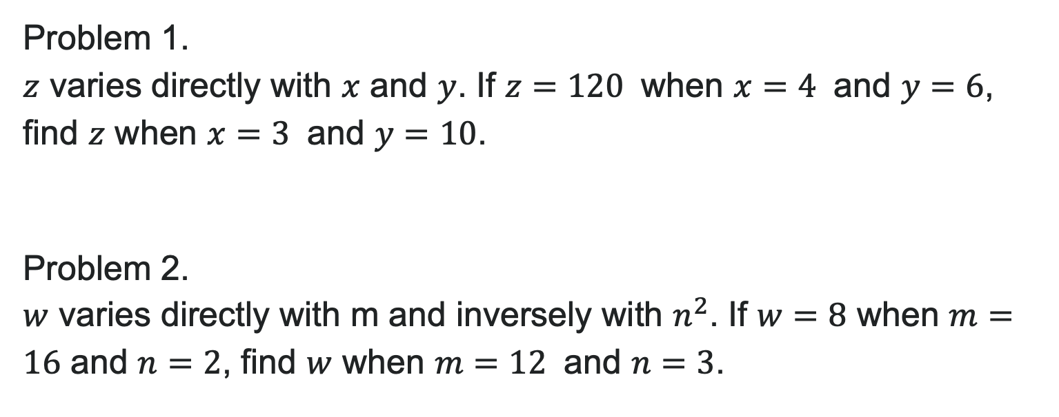
Try It: Joint Variation
Problem 1.
$z$ varies directly with $x$ and $y$. If $z=120$ when $x=4$ and $y=6$, find $z$ when $x=3$ and $y=10$.
Problem 2.
$w$ varies directly with m and inversely with $n^{2}$. If $w=8$ when $m=16$ and $n=2$, find $w$ when $m=12$ and $n=3$.
Notes:
Answer:
z = kxy: 120 = k(4)(6) → k = 5; When x = 3, y = 10: z = 5(3)(10) = 150
w = \frac{km}{n^2}: 8 = \frac{k(16)}{4} → k = 2; When m = 12, n = 3: w = \frac{2(12)}{9} = \frac{8}{3}

Slide 42
Before we finish up…
2
Next steps…..
3
Reminders about student hours, upcoming deadlines, campus activities ….
1
Questions…..

Slide 43

Attributions
Illustrations are from Storyset
Authored by: Lumen Learning. License: CC BY: Attribution

