Slide 1

Precalculus
Module 5:
Polynomial Equations

Slide 2
Affirmations
I am consistent, capable, and committed to my goals.
I am open to learning from people with different perspectives.
I can reframe math challenges as opportunities to grow.

Slide 3
Learning Goals: Dividing Polynomials
Deepen your understanding and form connections within these skills:
1 Use long division to divide polynomials.
2 Use synthetic division to divide polynomials.
3 Evaluate a polynomial using the Remainder Theorem.

Slide 4

Why Divide Polynomials?
Dividing polynomials helps us factor complex expressions
Finding factors reveals the zeros of polynomials
These zeros are essential for accurate graphing
Remember: All those factored polynomials we graphed? We got there through division!

Slide 5

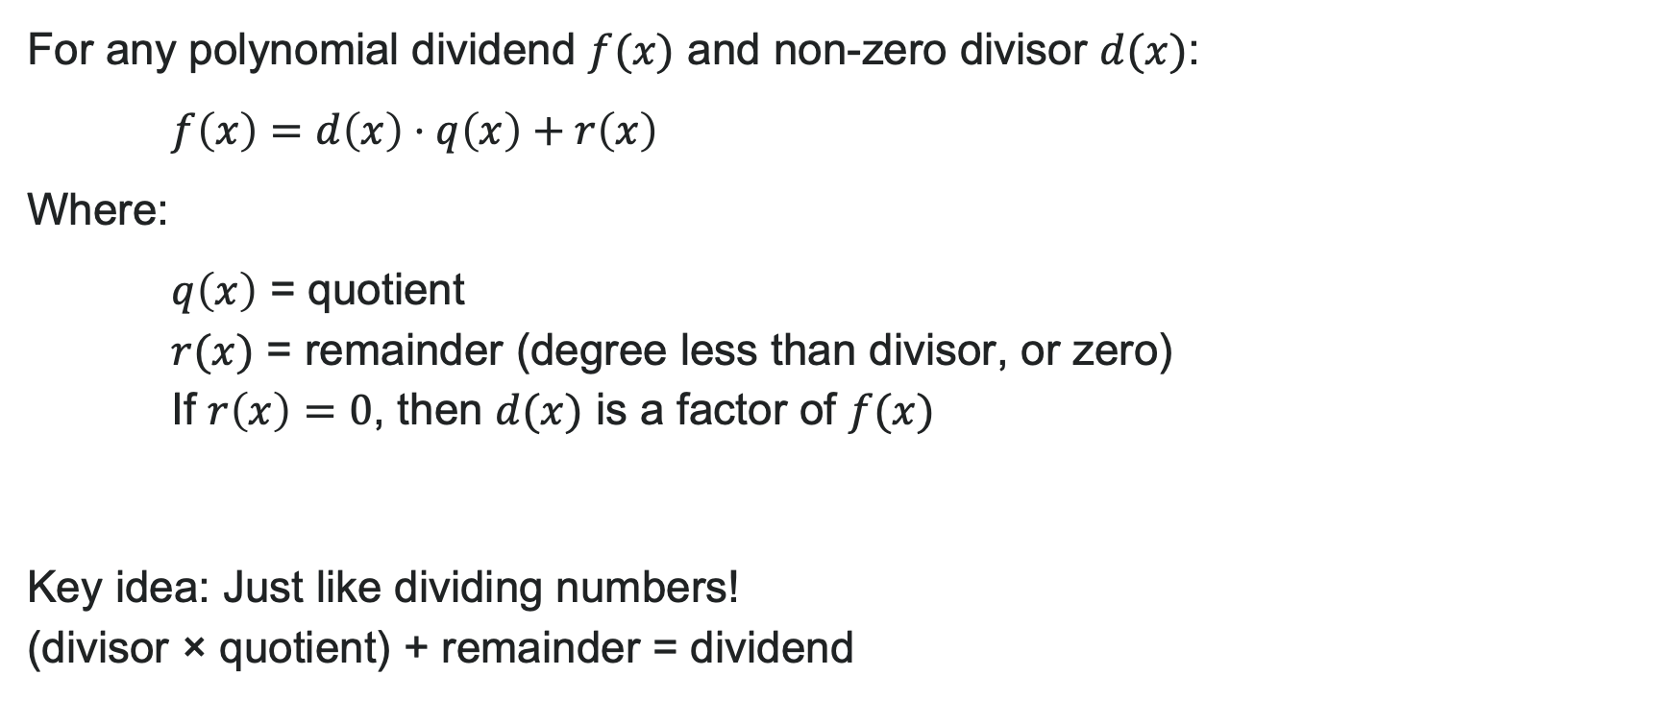
The Division Algorithm
For any polynomial dividend $f(x)$ and non-zero divisor $d(x)$:
$f\left(x\right)=d\left(x\right)⋅q\left(x\right)+r\left(x\right)$
Where:
$q\left(x\right)$ = quotient
$r(x)$ = remainder (degree less than divisor, or zero)
If $r\left(x\right)=0$, then $d(x)$ is a factor of $f(x)$
Key idea: Just like dividing numbers! (divisor × quotient) + remainder = dividend

Slide 6
How to: Polynomial Long Division
The steps (similar to numerical long division):
Set up the division problem (dividend inside, divisor outside)
Divide leading terms to get first quotient term
Multiply divisor by that term, write below
Subtract and bring down next term
Repeat until done
Express any non-zero remainder as a fraction
Think of it as: "How many times does the divisor fit into each term?"

Slide 7
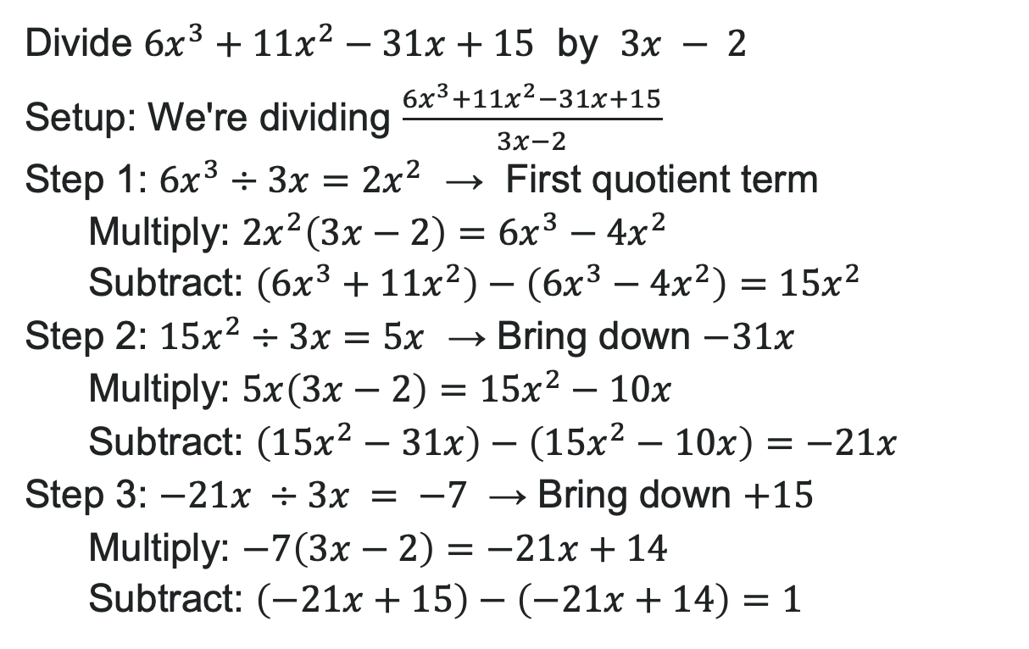
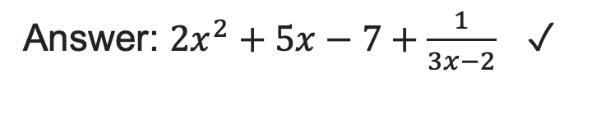
Example: Polynomial Long Division
Divide $6x^{3}+11x^{2}−31x+15$ by $3x − 2$
Setup: We're dividing $\frac{6x^{3}+11x^{2}−31x+15}{3x−2}$
Step 1: $6x^{3}÷3x=2x^{2}$ → First quotient term
Multiply: $2x^{2}\left(3x−2\right)=6x^{3}−4x^{2}$
Subtract: $\left(6x^{3}+11x^{2}\right)−\left(6x^{3}−4x^{2}\right)=15x^{2}$
Step 2: $15x^{2}÷3x=5x$ → Bring down $−31x$
Multiply: $5x\left(3x−2\right)=15x^{2}−10x$
Subtract: $\left(15x^{2}−31x\right)−\left(15x^{2}−10x\right)=−21x$
Step 3: $−21x ÷3x = −7$ → Bring down $+15$
Multiply: $−7\left(3x−2\right)=−21x+14$
Subtract: $\left(−21x+15\right)−\left(−21x+14\right)=1$
Answer: $2x^{2}+5x−7+\frac{1}{3x−2}$ ✓

Slide 8

Try It: Polynomial Long Division
Divide $2x^{3}+5x^{2}−x−6$ by $x+2$
(Work this out on paper - use the same steps we just practiced!)
Notes:
Answer: 2x^2 + x - 3
(Remainder is 0, so x + 2 is a factor)

Slide 9
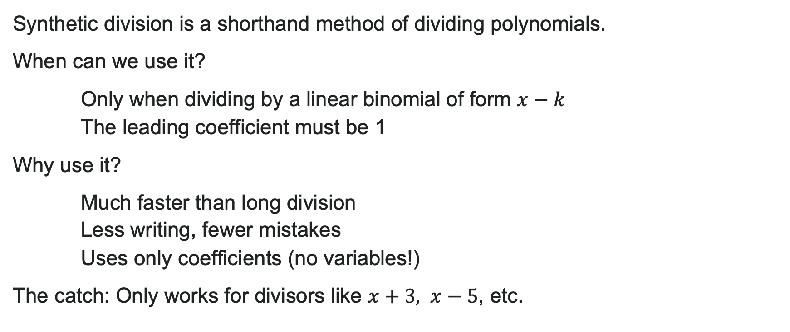
Synthetic Division
Synthetic division is a shorthand method of dividing polynomials.
When can we use it?
Only when dividing by a linear binomial of form $x−k$
The leading coefficient must be 1
Why use it?
Much faster than long division
Less writing, fewer mistakes
Uses only coefficients (no variables!)
The catch: Only works for divisors like $x+3, x−5$, etc.

Slide 10

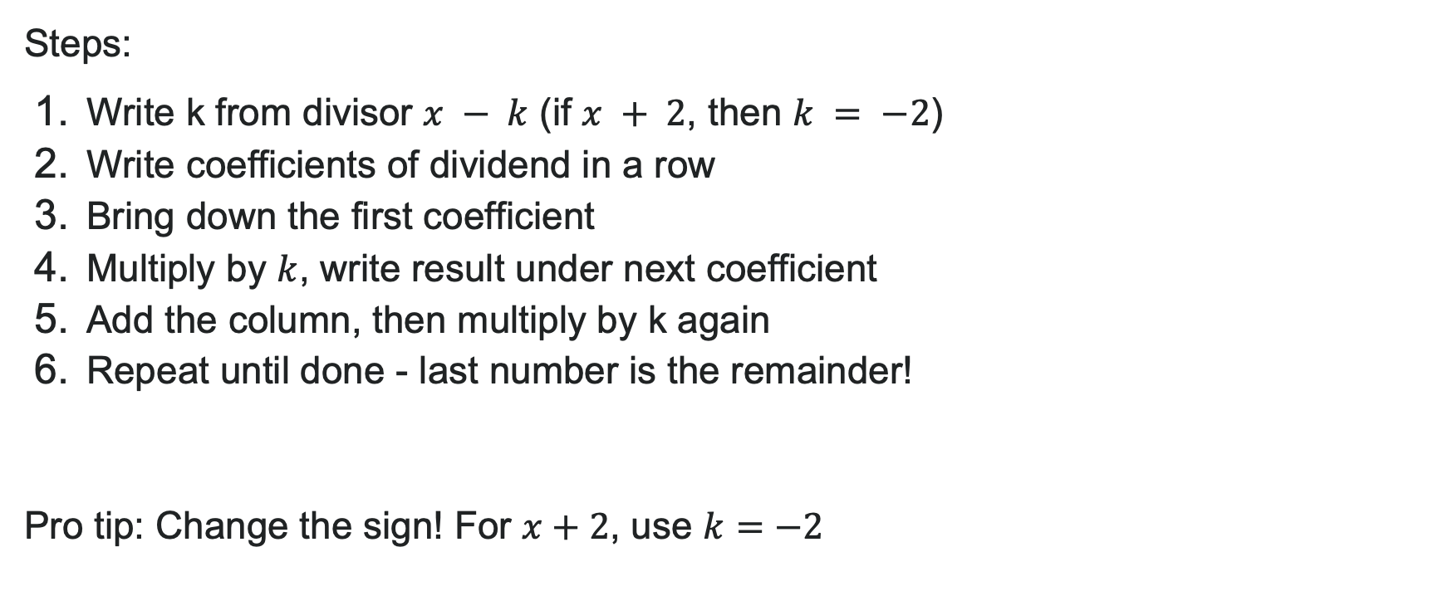
How to: Synthetic Division
Steps:
Write k from divisor $x − k$ (if $x + 2$, then $k = −2$)
Write coefficients of dividend in a row
Bring down the first coefficient
Multiply by $k$, write result under next coefficient
Add the column, then multiply by k again
Repeat until done - last number is the remainder!
Pro tip: Change the sign! For $x+2$, use $k=−2$

Slide 11
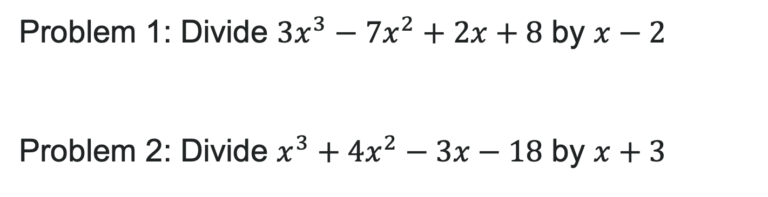
Try It: Synthetic Division
Problem 1: Divide $3x^{3}−7x^{2}+2x+8$ by $x−2$
Problem 2: Divide $x^{3}+4x^{2}−3x−18$ by $x+3$
Notes:
Problem 1 Answer: 3x^2 - x with remainder 8, so 3x^2 - x + \frac{8}{x-2}
Problem 2 Answer: x^2 + x - 6 with remainder 0 (so x + 3 is a factor)

Slide 12
Learning Goals: Complex Numbers
Deepen your understanding and form connections within these skills:
1 Express square roots of negative numbers as multiples of i
2 Plot complex numbers on the complex plane
3 Add, subtract, and multiply complex numbers
4 Rationalize complex denominators

Slide 13
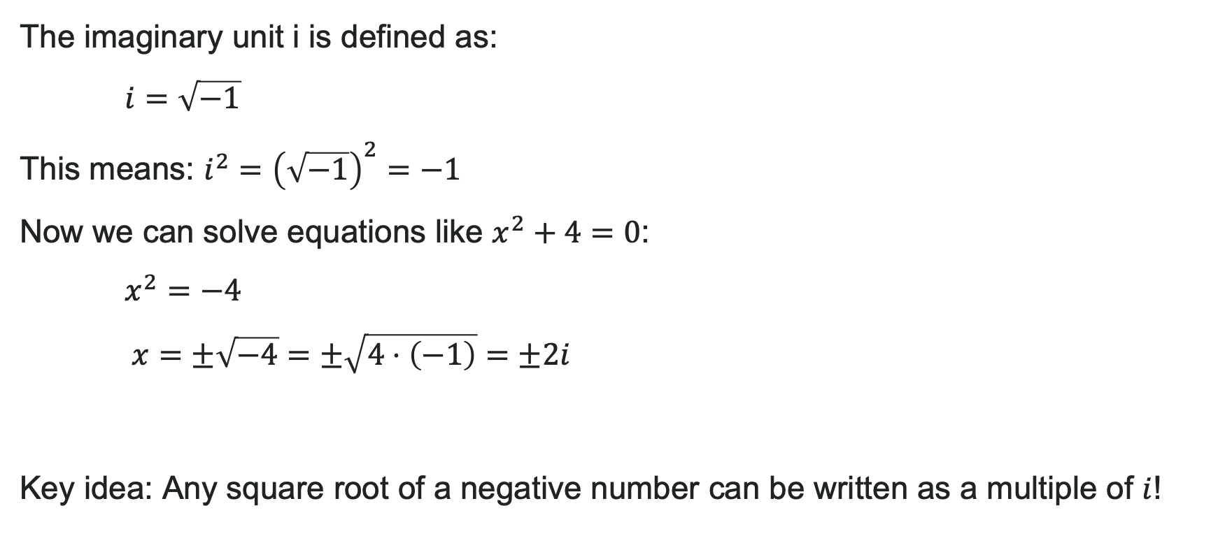
Meet i: The Imaginary Unit
The imaginary unit i is defined as:
$i=\sqrt{−1}$
This means: $i^{2}={\left(\sqrt{−1}\right)}^{2}=−1$
Now we can solve equations like $x^{2}+4=0$:
$x^{2}=−4$
$x=±\sqrt{−4}=±\sqrt{4⋅\left(−1\right)}=±2i$
Key idea: Any square root of a negative number can be written as a multiple of $i$!

Slide 14
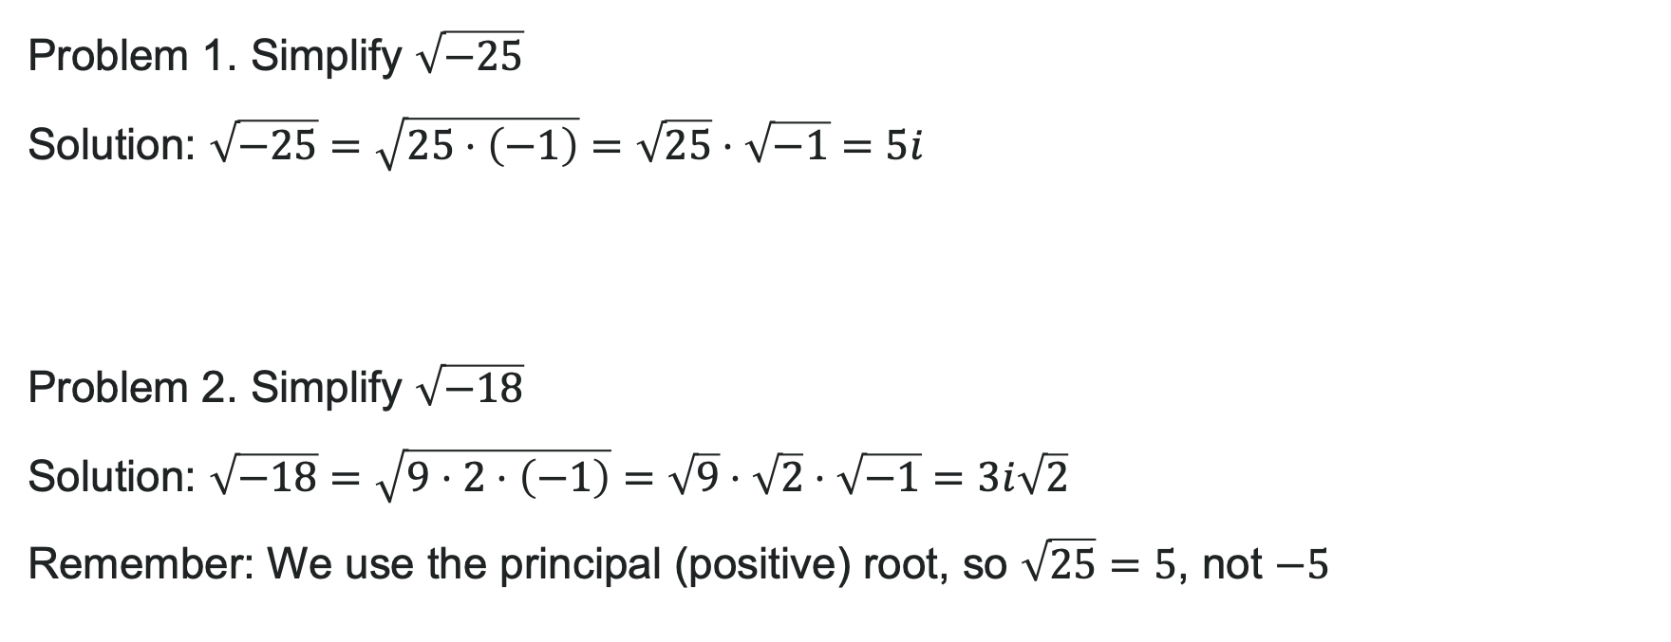
Examples: Simplifying Square Roots
Problem 1. Simplify $\sqrt{−25}$
Solution: $\sqrt{−25}=\sqrt{25⋅\left(−1\right)}=\sqrt{25}⋅\sqrt{−1}=5i$
Problem 2. Simplify $\sqrt{−18}$
Solution: $\sqrt{−18}=\sqrt{9⋅2⋅\left(−1\right)}=\sqrt{9}⋅\sqrt{2}⋅\sqrt{−1}=3i\sqrt{2}$
Remember: We use the principal (positive) root, so $\sqrt{25}=5$, not $−5$

Slide 15

Try It: Imaginary Numbers
Problem 1: Simplify $\sqrt{−49}$
Problem 2: Simplify $\sqrt{−32}$
Notes:
Problem 1 Answer: 7i
Problem 2 Answer: 4i\sqrt{2} (since \sqrt{32} = \sqrt{16 \cdot 2} = 4\sqrt{2})

Slide 16


Complex Numbers
A complex number has the form: $z=a+bi$
Where:
$a$ = real part (a real number)
$b$ = imaginary part (coefficient of $i$, also real)
$bi$ = imaginary term
Examples:
$5+2i$ → real part: 5, imaginary part: 2
$3−7i$ → real part: 3, imaginary part: -7
$4i$ → real part: 0, imaginary part: 4
$6$ → real part: 6, imaginary part: 0

Slide 17
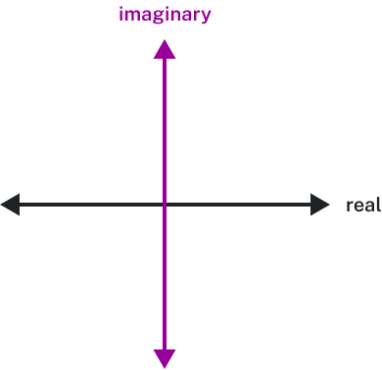
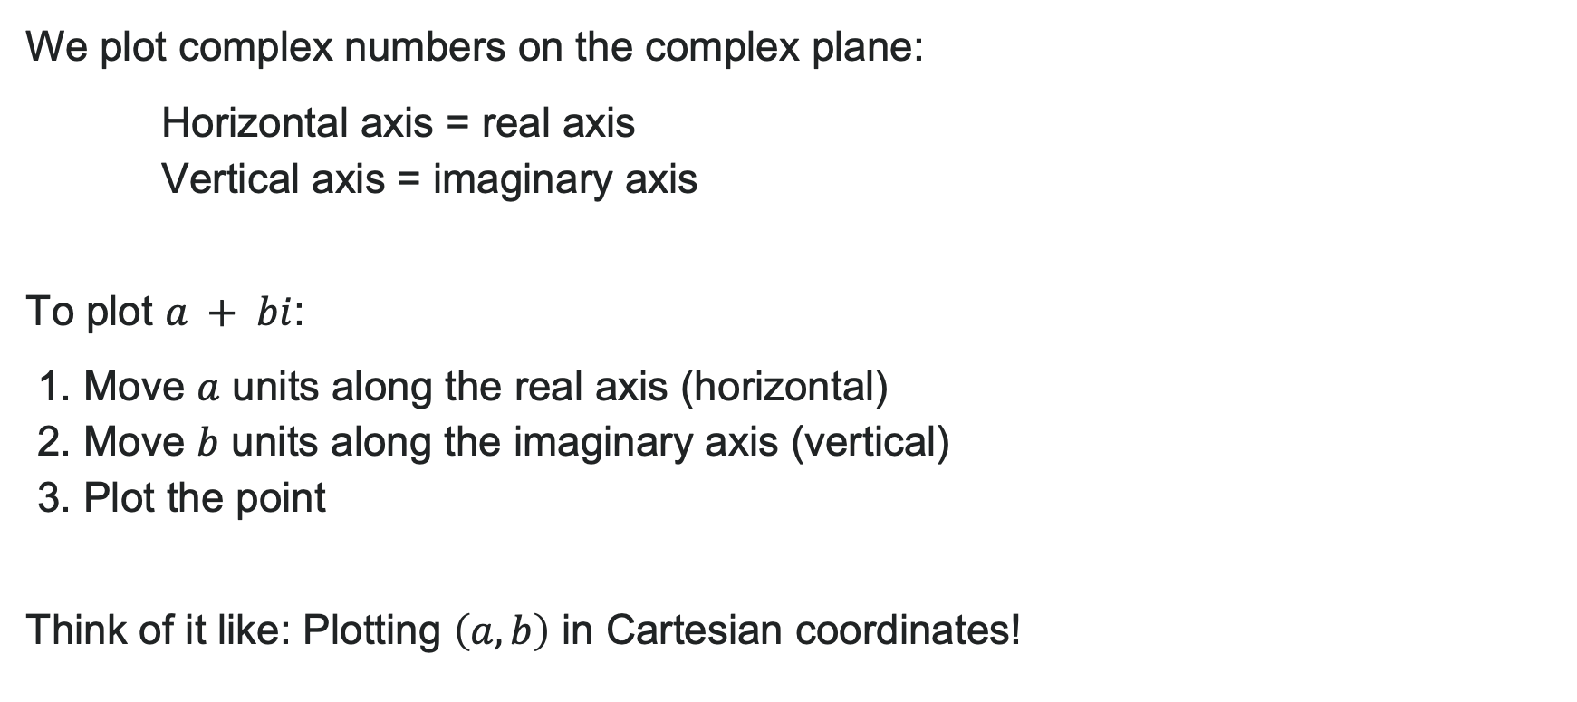
The Complex Plane
We plot complex numbers on the complex plane:
Horizontal axis = real axis
Vertical axis = imaginary axis
To plot $a + bi$:
1. Move $a$ units along the real axis (horizontal)
2. Move $b$ units along the imaginary axis (vertical)
3. Plot the point
Think of it like: Plotting $\left(a,b\right)$ in Cartesian coordinates!

Slide 18

Try It: Plotting Complex Numbers
Plot these complex numbers:
1. $2+3i$
2. $−4+i$
3. $−1−2i$
Notes:
Answers:
2 + 3i → Point at (2, 3)
-4 + i → Point at (-4, 1)
-1 - 2i → Point at (-1, -2)

Slide 19
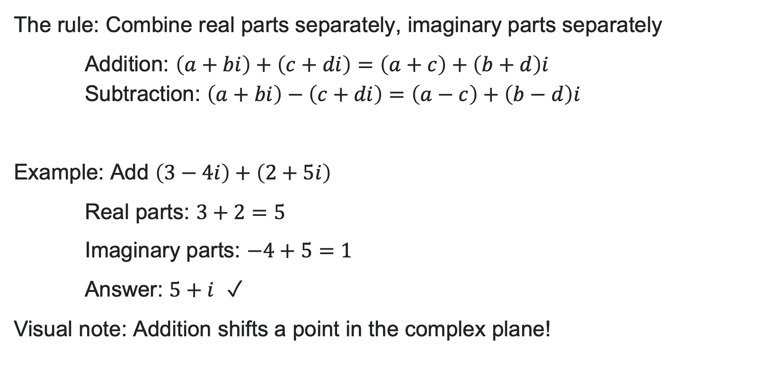
Adding and Subtracting Complex Numbers
The rule: Combine real parts separately, imaginary parts separately
Addition: $\left(a+bi\right)+\left(c+di\right)=\left(a+c\right)+\left(b+d\right)i$
Subtraction: $\left(a+bi\right)−\left(c+di\right)=\left(a−c\right)+\left(b−d\right)i$
Example: Add $\left(3−4i\right)+\left(2+5i\right)$
Real parts: $3+2=5$
Imaginary parts: $−4+5=1$
Answer: $5+i$ ✓
Visual note: Addition shifts a point in the complex plane!

Slide 20

Try It: Adding & Subtracting
Problem 1: $\left(6+2i\right)+\left(−3+4i\right)$
Problem 2: $\left(5−3i\right)−\left(2+i\right)$
Notes:
Problem 1 Answer: 3 + 6i
Problem 2 Answer: 3 - 4i

Slide 21
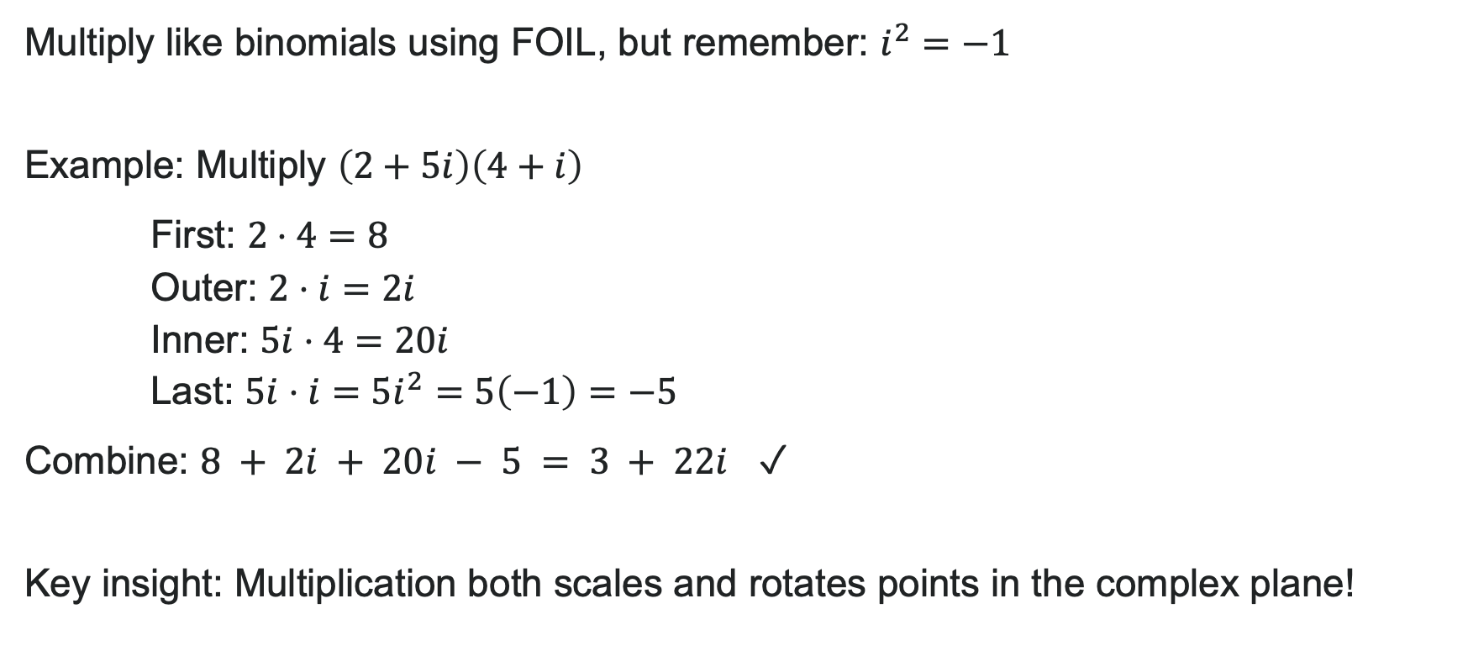
Multiplying Complex Numbers
Multiply like binomials using FOIL, but remember: $i^{2}=−1$
Example: Multiply $\left(2+5i\right)\left(4+i\right)$
First: $2⋅4=8$
Outer: $2⋅i=2i$
Inner: $5i⋅4=20i$
Last: $5i⋅i=5i^{2}=5\left(−1\right)=−5$
Combine: $8 + 2i + 20i − 5 = 3 + 22i$ ✓
Key insight: Multiplication both scales and rotates points in the complex plane!

Slide 22
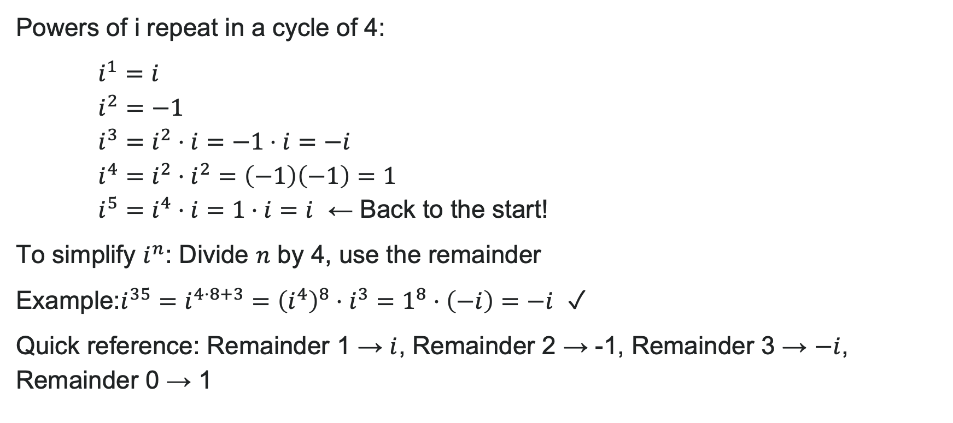
Simplifying Powers of i
Powers of i repeat in a cycle of 4:
$i^{1}=i$
$i^{2}=−1$
$i^{3}=i^{2}⋅i=−1⋅i=−i$
$i^{4}=i^{2}⋅i^{2}=\left(−1\right)\left(−1\right)=1$
$i^{5}=i^{4}⋅i=1⋅i=i$ ← Back to the start!
To simplify $i^{n}$: Divide $n$ by 4, use the remainder
Example:$i^{35}=i^{4⋅8+3}={\left(i^{4}\right)}^{8}⋅i^{3}=1^{8}⋅\left(−i\right)=−i$ ✓
Quick reference: Remainder 1 → $i$, Remainder 2 → -1, Remainder 3 → $−i$, Remainder 0 → 1

Slide 23
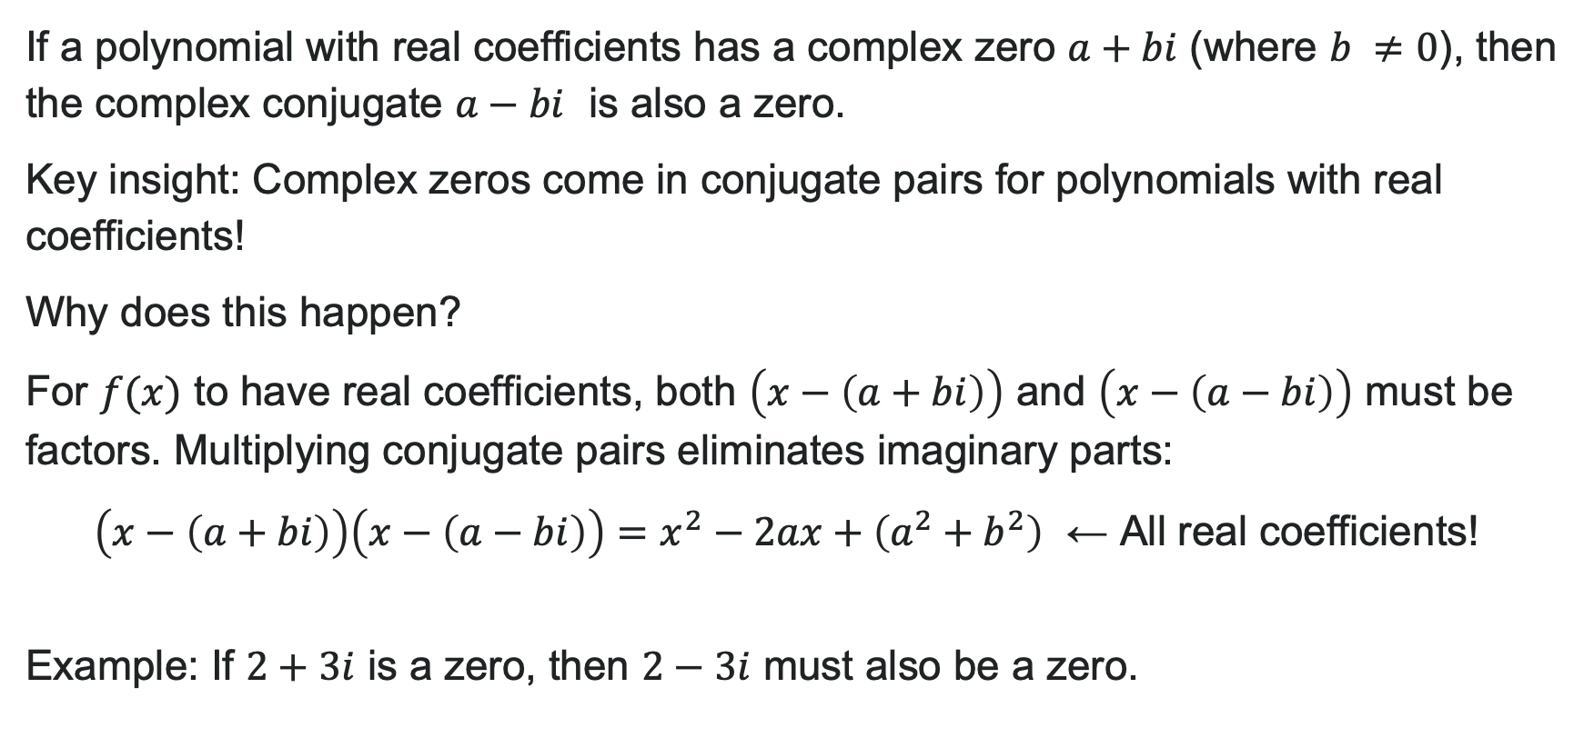
The Complex Conjugate
If a polynomial with real coefficients has a complex zero $a+bi$ (where $b ≠0$), then the complex conjugate $a−bi$ is also a zero.
Key insight: Complex zeros come in conjugate pairs for polynomials with real coefficients!
Why does this happen?
For $f(x)$ to have real coefficients, both $\left(x−\left(a+bi\right)\right)$ and $\left(x−\left(a−bi\right)\right)$ must be factors. Multiplying conjugate pairs eliminates imaginary parts:
$\left(x−\left(a+bi\right)\right)\left(x−\left(a−bi\right)\right)=x^{2}−2ax+\left(a^{2}+b^{2}\right)$ ← All real coefficients!
Example: If $2+3i$ is a zero, then $2−3i$ must also be a zero.

Slide 24
How to: Divide Complex Numbers
Steps:
Write the division problem as a fraction.
Determine the complex conjugate of the denominator.
Multiply the numerator and denominator of the fraction by the complex conjugate of the denominator.
Simplify.

Slide 25
Learning Goals: Zeros of Polynomial Functions
Deepen your understanding and form connections within these skills:
1 Use the Factor Theorem to solve a polynomial equation
1 Use the Rational Zero Theorem to find rational zeros
1 Find zeros of a polynomial function
1 Use the Linear Factorization Theorem to find polynomials with given zeros
1 Solve real-world applications of polynomial equations

Slide 26
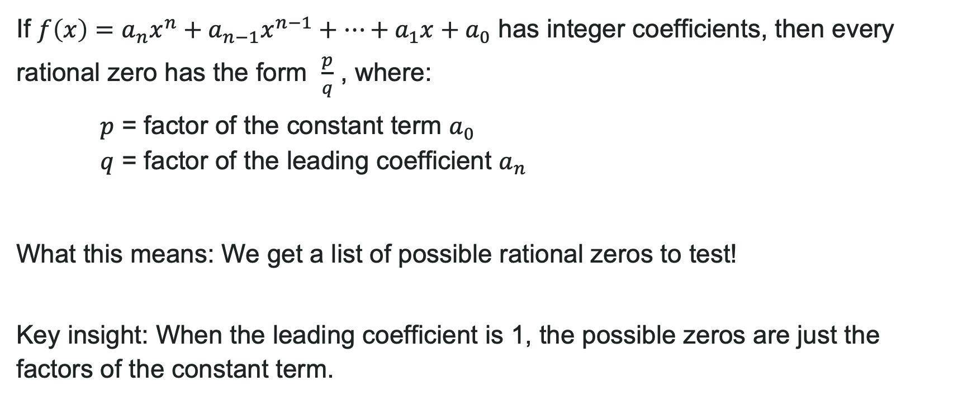
The Rational Zero Theorem
If $f\left(x\right)=a_{n}x^{n}+a_{n−1}x^{n−1}+⋯+a_{1}x+a_{0}$ has integer coefficients, then every rational zero has the form $\frac{p}{q}$ , where:
$p$ = factor of the constant term $a_{0}$
$q$ = factor of the leading coefficient $a_{n}$
What this means: We get a list of possible rational zeros to test!
Key insight: When the leading coefficient is 1, the possible zeros are just the factors of the constant term.

Slide 27
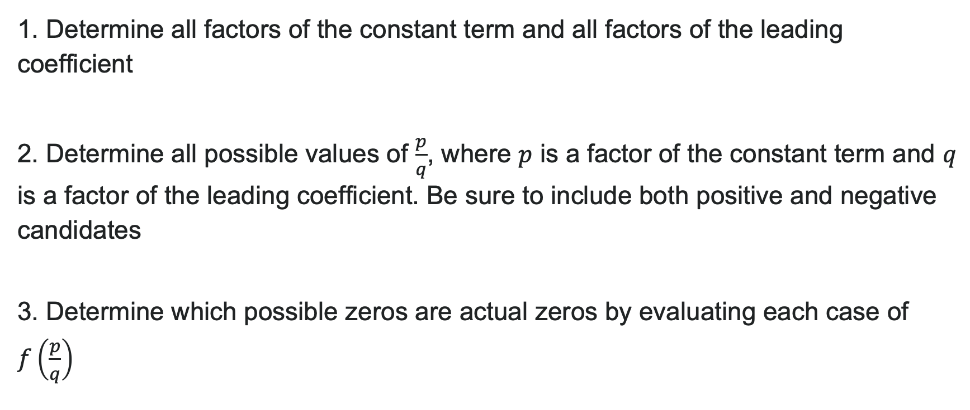
How to: Use the Rational Zero Theorem
1. Determine all factors of the constant term and all factors of the leading coefficient
2. Determine all possible values of $\frac{p}{q}$, where $p$ is a factor of the constant term and $q$ is a factor of the leading coefficient. Be sure to include both positive and negative candidates
3. Determine which possible zeros are actual zeros by evaluating each case of $f\left(\frac{p}{q}\right)$

Slide 28
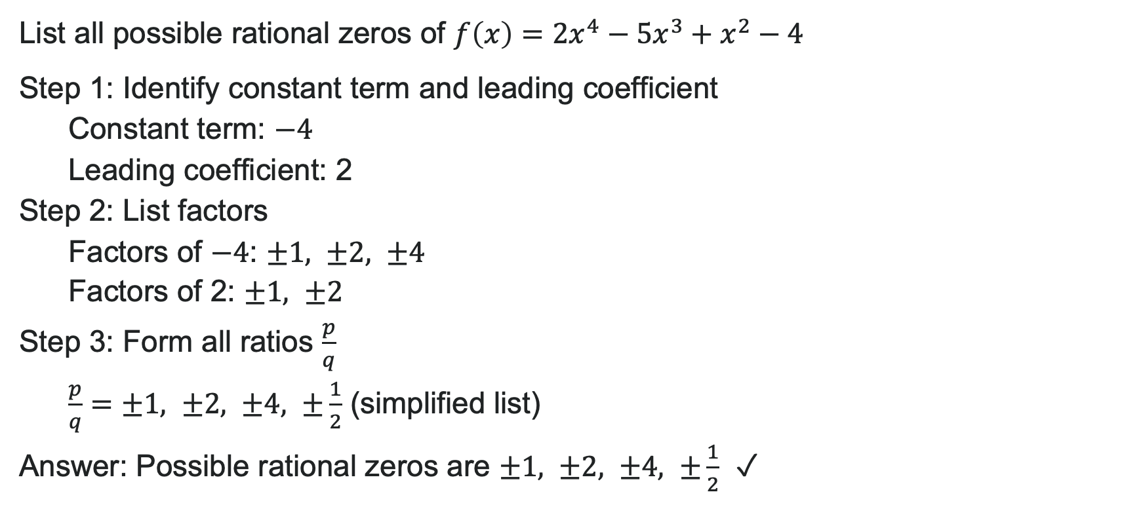
Example: Finding All Rational Zeros
List all possible rational zeros of $f\left(x\right)=2x^{4}−5x^{3}+x^{2}−4$
Step 1: Identify constant term and leading coefficient
Constant term: $−4$
Leading coefficient: 2
Step 2: List factors
Factors of $−4$: $±1, ±2, ±4$
Factors of 2: $±1, ±2$
Step 3: Form all ratios
(simplified list)
Answer: Possible rational zeros are $±1, ±2, ±4, ±\frac{1}{2}$ ✓

Slide 29
Try It: List Possible Zeros
List all possible rational zeros of $f\left(x\right)=3x^{3}−8x^{2}+5x−6$
Notes:
Answer: \pm 1, \pm 2, \pm 3, \pm 6, \pm \frac{1}{3}, \pm \frac{2}{3}
(Factors of -6: \pm 1, \pm 2, \pm 3, \pm 6; Factors of 3: \pm 1, \pm 3)

Slide 30
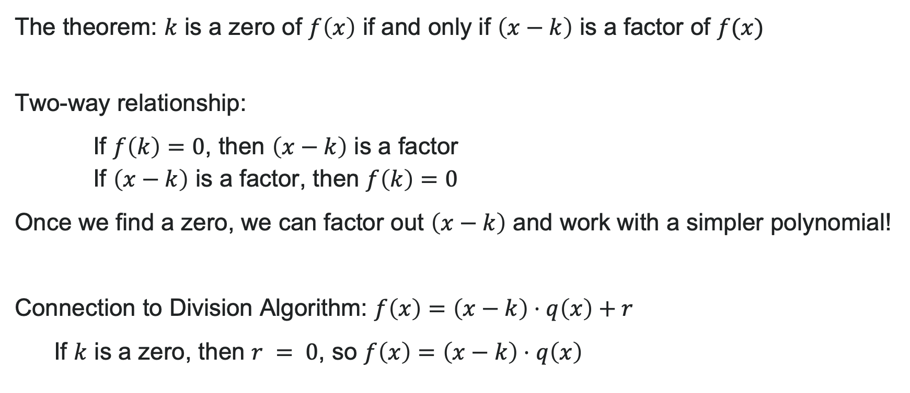
The Factor Theorem
The theorem: $k$ is a zero of $f\left(x\right)$ if and only if $\left(x−k\right)$ is a factor of $f(x)$
Two-way relationship:
If $f\left(k\right)=0$, then $\left(x−k\right)$ is a factor
If $\left(x−k\right)$ is a factor, then $f\left(k\right)=0$
Once we find a zero, we can factor out $\left(x−k\right)$ and work with a simpler polynomial!
Connection to Division Algorithm: $f\left(x\right)=\left(x−k\right)⋅q\left(x\right)+r$
If $k$ is a zero, then $r = 0$, so $f\left(x\right)=\left(x−k\right)⋅q\left(x\right)$

Slide 31

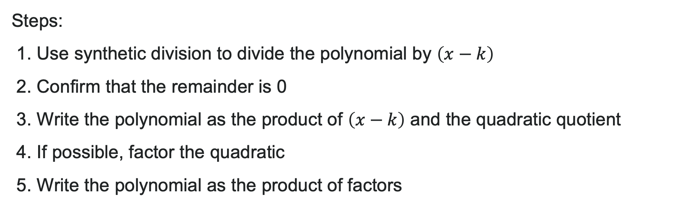
How to: Use the Factor Theorem
Steps:
1. Use synthetic division to divide the polynomial by $\left(x−k\right)$
2. Confirm that the remainder is 0
3. Write the polynomial as the product of $\left(x−k\right)$ and the quadratic quotient
4. If possible, factor the quadratic
5. Write the polynomial as the product of factors

Slide 32
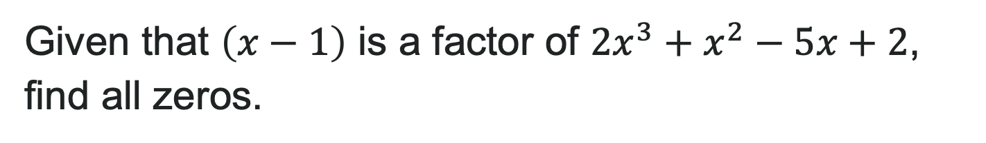
Try It: Use the Factor Theorem
Given that $\left(x−1\right)$ is a factor of $2x^{3}+x^{2}−5x+2$, find all zeros.
Notes:
Answer: Zeros are 1, -2, \frac{1}{2}
(Synthetic division gives 2x^2 + 3x - 2, which factors as (2x - 1)(x + 2))

Slide 33
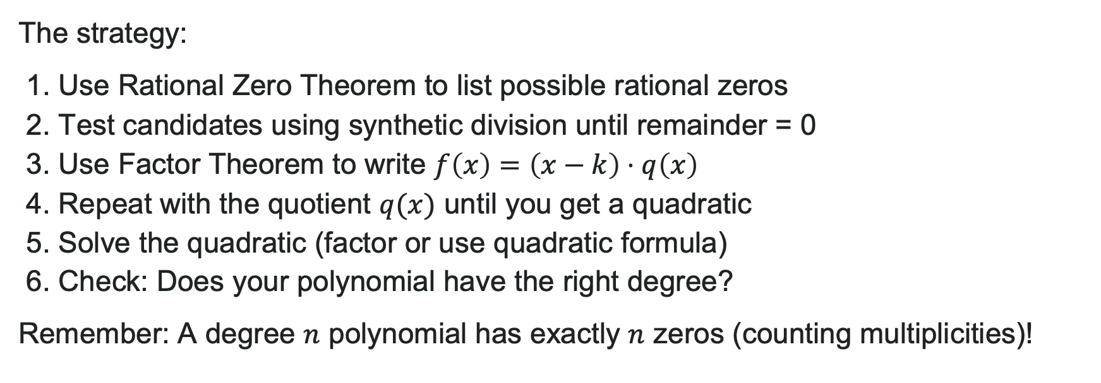
Finding All Zeros
The strategy:
1. Use Rational Zero Theorem to list possible rational zeros
2. Test candidates using synthetic division until remainder = 0
3. Use Factor Theorem to write $f\left(x\right)=\left(x−k\right)⋅q\left(x\right)$
4. Repeat with the quotient $q(x)$ until you get a quadratic
5. Solve the quadratic (factor or use quadratic formula)
6. Check: Does your polynomial have the right degree?
Remember: A degree $n$ polynomial has exactly $n$ zeros (counting multiplicities)!

Slide 34
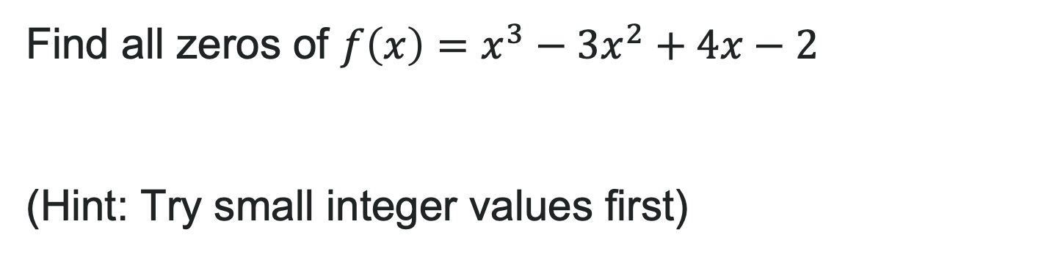
Try It: Find All Zeros
Find all zeros of $f\left(x\right)=x^{3}−3x^{2}+4x−2$
(Hint: Try small integer values first)
Notes:
Answer: Zeros are 1, 1 + i, 1 - i
(Testing x = 1 works; synthetic division gives x^2 - 2x + 2; use quadratic formula: x = \frac{2 \pm \sqrt{-4}}{2} = 1 \pm i)

Slide 35
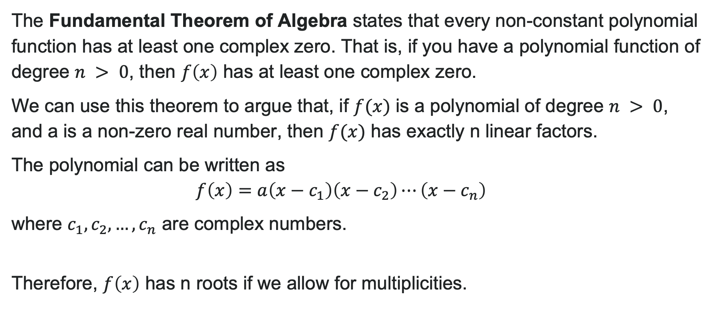
The Fundamental Theorem of Algebra
The Fundamental Theorem of Algebra states that every non-constant polynomial function has at least one complex zero. That is, if you have a polynomial function of degree $n > 0$, then $f\left(x\right)$ has at least one complex zero.
We can use this theorem to argue that, if $f(x)$ is a polynomial of degree $n > 0$, and a is a non-zero real number, then $f(x)$ has exactly n linear factors.
The polynomial can be written as
$f\left(x\right)=a\left(x−c_{1}\right)\left(x−c_{2}\right)⋯\left(x−c_{n}\right)$
where $c_{1},c_{2},…,c_{n}$ are complex numbers.
Therefore, $f\left(x\right)$ has n roots if we allow for multiplicities.

Slide 36
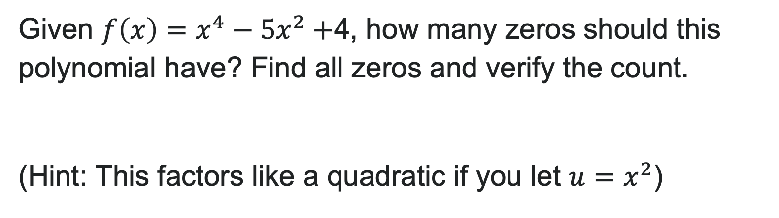
Try It: Using the Fundamental Theorem
Given $f\left(x\right)=x^{4}−5x^{2}+$4, how many zeros should this polynomial have? Find all zeros and verify the count.
(Hint: This factors like a quadratic if you let $u=x^{2}$)
Notes:
Answer: Should have 4 zeros (degree 4 polynomial)
Let u = x^2: u^2 - 5u + 4 = (u - 1)(u - 4) = (x^2 - 1)(x^2 - 4) = (x - 1)(x + 1)(x - 2)(x + 2)
Zeros: 1, -1, 2, -2 (exactly 4 zeros, all with multiplicity 1) ✓

Slide 37
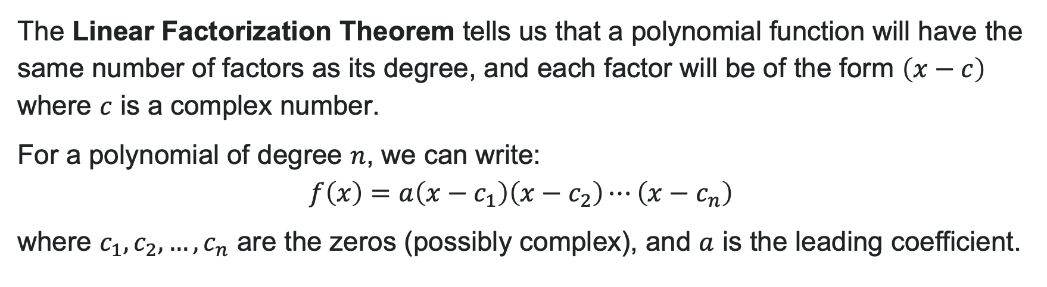
Linear Factorization Theorem
The Linear Factorization Theorem tells us that a polynomial function will have the same number of factors as its degree, and each factor will be of the form $\left(x−c\right)$ where $c$ is a complex number.
For a polynomial of degree $n$, we can write:
$f\left(x\right)=a\left(x−c_{1}\right)\left(x−c_{2}\right)⋯\left(x−c_{n}\right)$
where $c_{1},c_{2},…,c_{n}$ are the zeros (possibly complex), and $a$ is the leading coefficient.

Slide 38
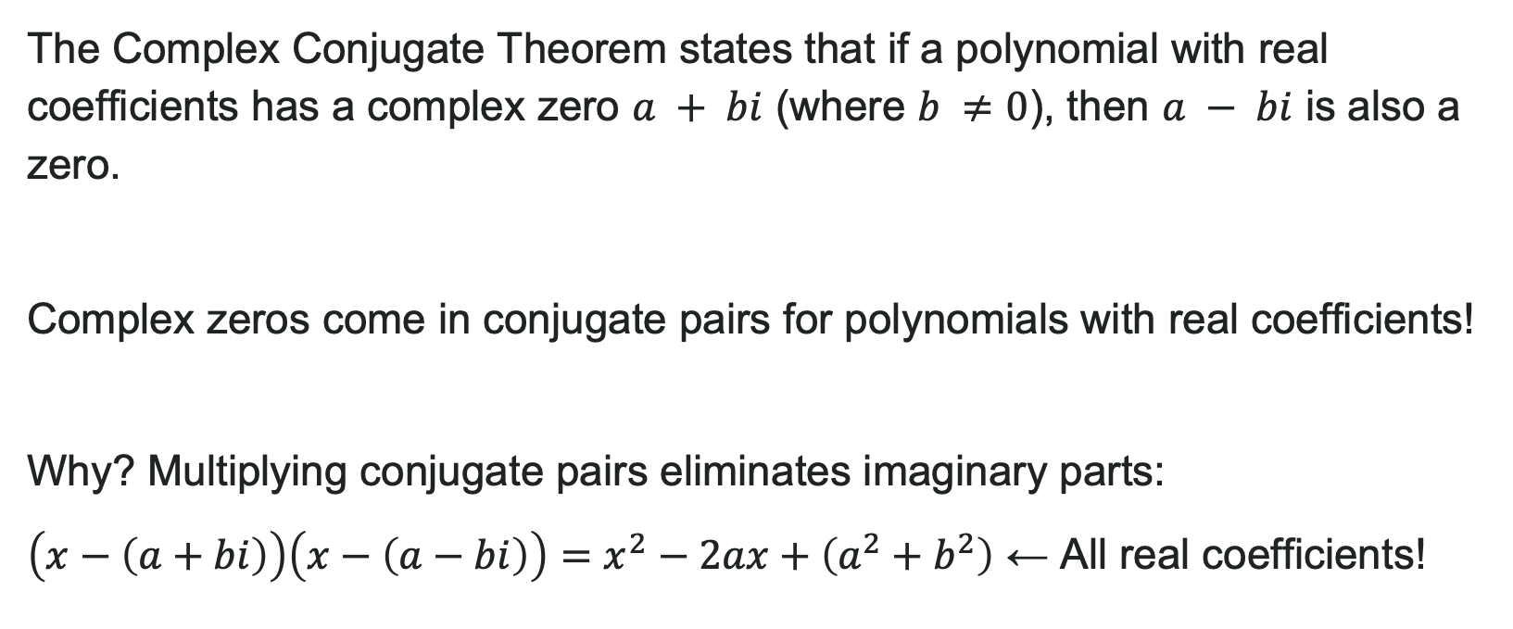
Complex Conjugate Theorem
The Complex Conjugate Theorem states that if a polynomial with real coefficients has a complex zero $a + bi$ (where $b ≠0$), then $a − bi$ is also a zero.
Complex zeros come in conjugate pairs for polynomials with real coefficients!
Why? Multiplying conjugate pairs eliminates imaginary parts:
$\left(x−\left(a+bi\right)\right)\left(x−\left(a−bi\right)\right)=x^{2}−2ax+\left(a^{2}+b^{2}\right)$ ← All real coefficients!

Slide 39
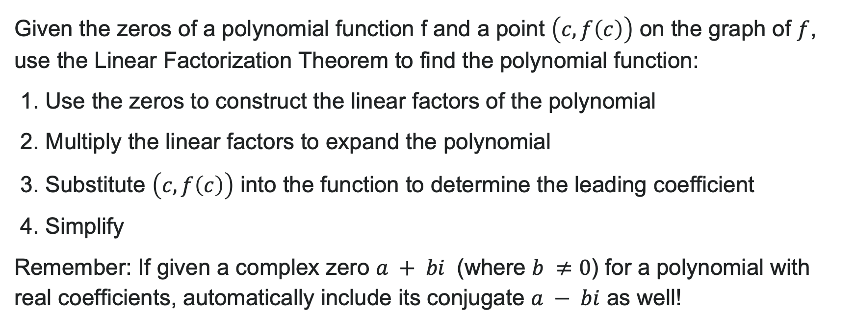
How to: Find a Polynomial from Given Zeros
Given the zeros of a polynomial function f and a point $\left(c,f\left(c\right)\right)$ on the graph of $f$, use the Linear Factorization Theorem to find the polynomial function:
1. Use the zeros to construct the linear factors of the polynomial
2. Multiply the linear factors to expand the polynomial
3. Substitute $\left(c,f\left(c\right)\right)$ into the function to determine the leading coefficient
4. Simplify
Remember: If given a complex zero $a + bi$ (where $b ≠0$) for a polynomial with real coefficients, automatically include its conjugate $a − bi$ as well!

Slide 40
Learning Goals: Polynomial Equations and Inequalities
Deepen your understanding and form connections within these skills:
1 Solve polynomial inequalities
2 Find the inverse of invertible polynomial functions
3 Restrict the domain to find the inverse of a polynomial function

Slide 41
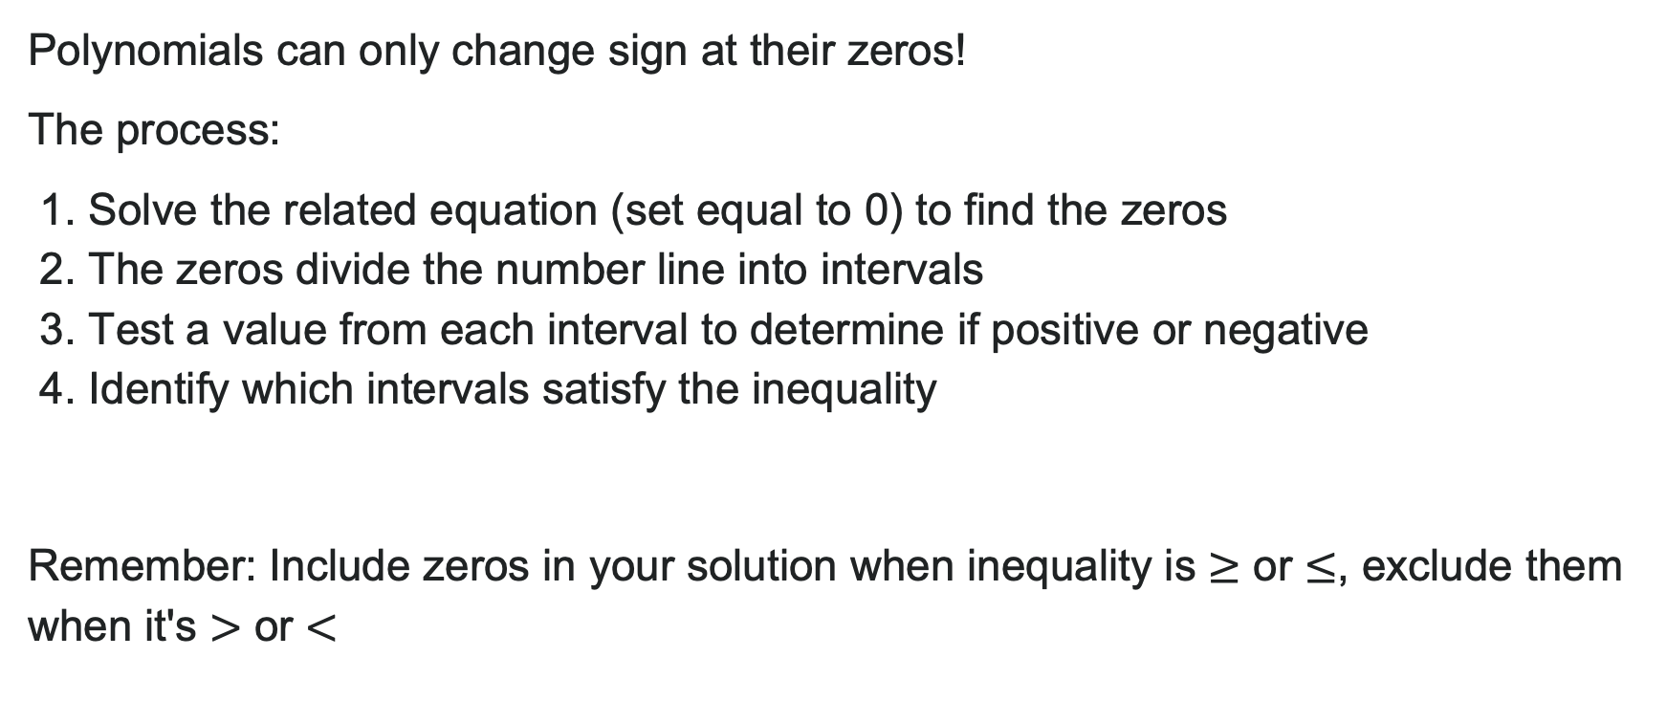
Solving Polynomial Inequalities
Polynomials can only change sign at their zeros!
The process:
1. Solve the related equation (set equal to 0) to find the zeros
2. The zeros divide the number line into intervals
3. Test a value from each interval to determine if positive or negative
4. Identify which intervals satisfy the inequality
Remember: Include zeros in your solution when inequality is $≥$ or $≤$, exclude them when it's $>$ or $<$

Slide 42
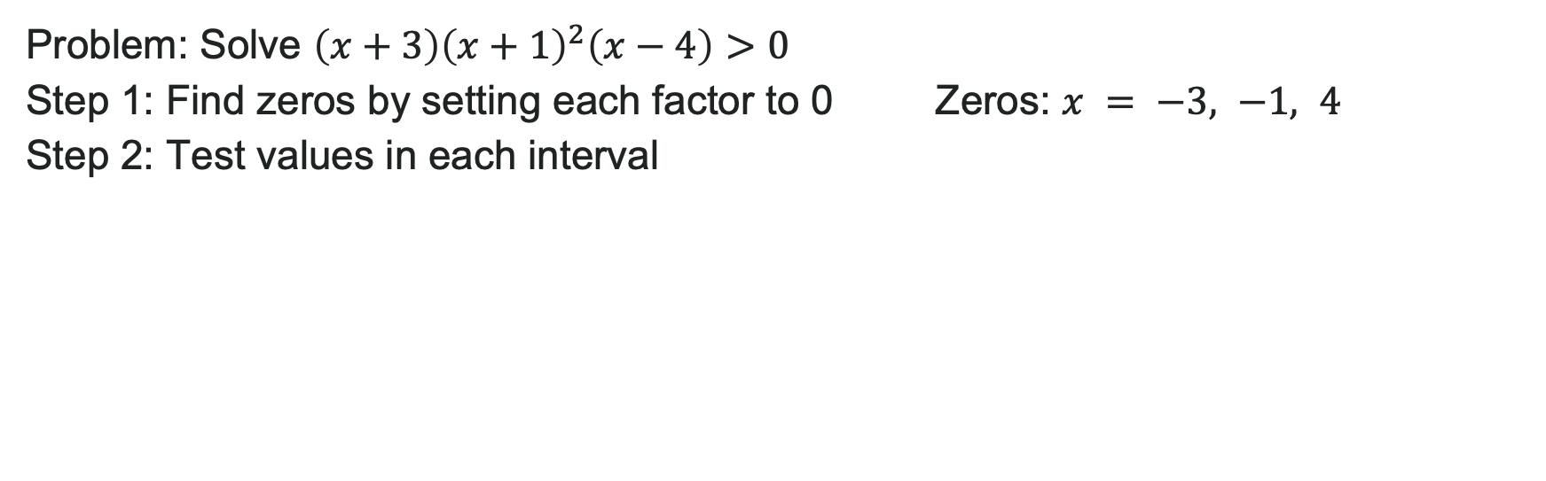
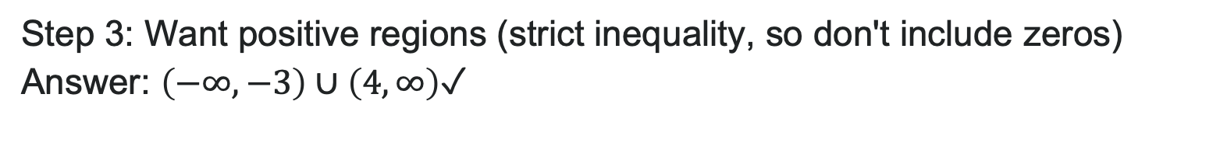
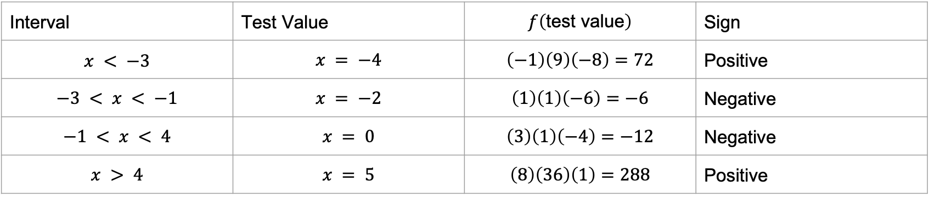
Example: Polynomial Inequality
Problem: Solve $\left(x+3\right){\left(x+1\right)}^{2}\left(x−4\right)>0$
Step 1: Find zeros by setting each factor to 0 Zeros: $x = −3, −1, 4$
Step 2: Test values in each interval
Interval | Test Value | $$f\left(\text{test} \text{value}\right)$$ | Sign
$$x < −3$$ | $$x = −4$$ | $$\left(−1\right)\left(9\right)\left(−8\right)=72$$ | Positive
$$−3 < x < −1$$ | $$x = −2$$ | $$\left(1\right)\left(1\right)\left(−6\right)=−6$$ | Negative
$$−1 < x < 4$$ | $$x = 0$$ | $$\left(3\right)\left(1\right)\left(−4\right)=−12$$ | Negative
$$x > 4$$ | $$x = 5$$ | $$\left(8\right)\left(36\right)\left(1\right)=288$$ | Positive
Step 3: Want positive regions (strict inequality, so don't include zeros)
Answer: $\left(−∞,−3\right)∪\left(4,∞\right)$ ✓

Slide 43
Try It: Solve the Inequality
Solve $\left(x−2\right)\left(x+1\right)\left(x−5\right)≤0$
Notes:
Answer: (-\infty, -1] \cup [2, 5]
Zeros at x = -1, 2, 5
Test intervals: x < -1 (negative), -1 < x < 2 (positive), 2 < x < 5 (negative), x > 5 (positive)
Want negative regions or zero, so include zeros with brackets

Slide 44
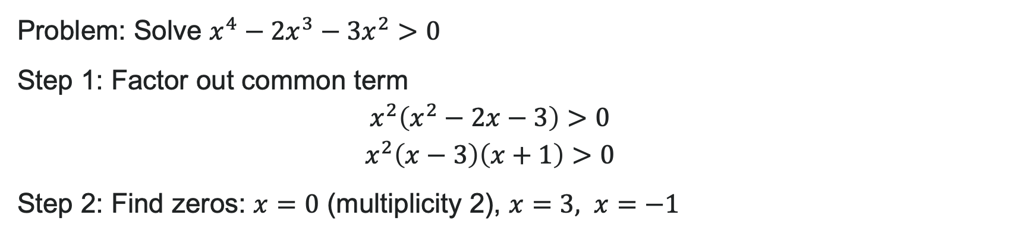
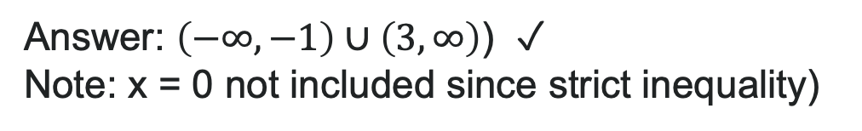
Example: Inequality Requiring Factoring
Problem: Solve $x^{4}−2x^{3}−3x^{2}>0$
Step 1: Factor out common term
Step 2: Find zeros: $x=0$ (multiplicity 2), $x=3, x=−1$
Step 3: Test intervals (see table)
Interval | Test Value | Sign
x < -1 | x = -2 | Positive
-1 < x < 0 | x = -0.5 | Negative
0 < x < 3 | x = 1 | Negative
x > 3 | x = 4 | Positive
Answer: $\left(−∞,−1\right)∪\left(3,∞\right)$ ✓ ( Note: x = 0 not included since strict inequality)

Slide 45
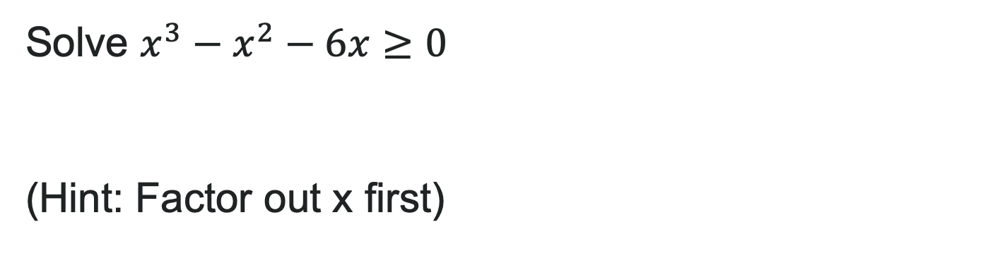
Try It: Factor and Solve Inequalities
Solve $x^{3}−x^{2}−6x≥0$
(Hint: Factor out x first)
Notes:
Answer: [-3, 0] \cup [2, \infty)
Factor: x(x^2 - x - 6) = x(x - 3)(x + 2) — correction: x(x^2 - x - 6) = x(x - 3)(x + 2) doesn't work. Should be x(x - 3)(x + 2) = x(x^2 - x - 6)... let me recalculate: x^3 - x^2 - 6x = x(x^2 - x - 6) = x(x - 3)(x + 2)
Zeros: -2, 0, 3
Test intervals, find where positive or zero: [-2, 0] \cup [3, \infty)

Slide 46
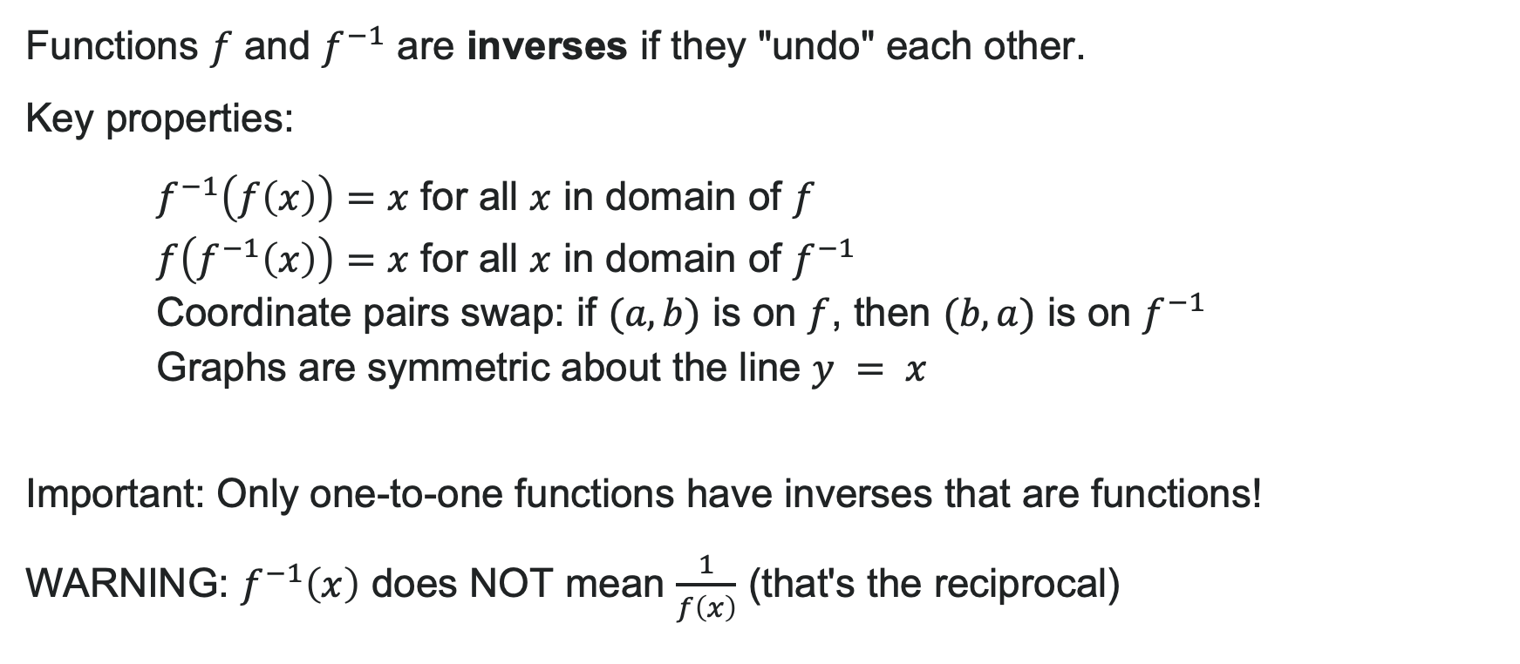
What Are Inverse Functions?
Functions $f$ and $f^{−1}$ are inverses if they "undo" each other.
Key properties:
$f^{−1}\left(f\left(x\right)\right)=x$ for all $x$ in domain of $f$
$f\left(f^{−1}\left(x\right)\right)=x$ for all $x$ in domain of $f^{−1}$
Coordinate pairs swap: if $(a, b)$ is on $f$, then $(b, a)$ is on $f^{−1}$
Graphs are symmetric about the line $y = x$
Important: Only one-to-one functions have inverses that are functions!
WARNING: $f^{−1}\left(x\right)$ does NOT mean $\frac{1}{f\left(x\right)}$ (that's the reciprocal)

Slide 47
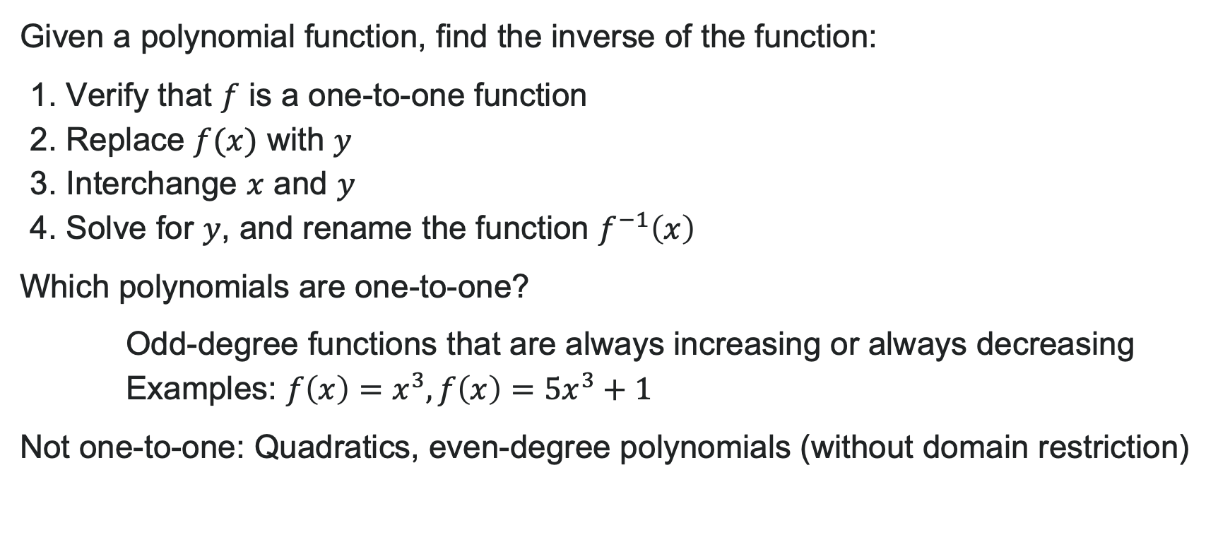
How to: Find the Inverse of a Polynomial
Given a polynomial function, find the inverse of the function:
1. Verify that $f$ is a one-to-one function
2. Replace $f(x)$ with $y$
3. Interchange $x$ and $y$
4. Solve for $y$, and rename the function $f^{−1}\left(x\right)$
Which polynomials are one-to-one?
Odd-degree functions that are always increasing or always decreasing
Examples: $f\left(x\right)=x^{3},f\left(x\right)=5x^{3}+1$
Not one-to-one: Quadratics, even-degree polynomials (without domain restriction)

Slide 48
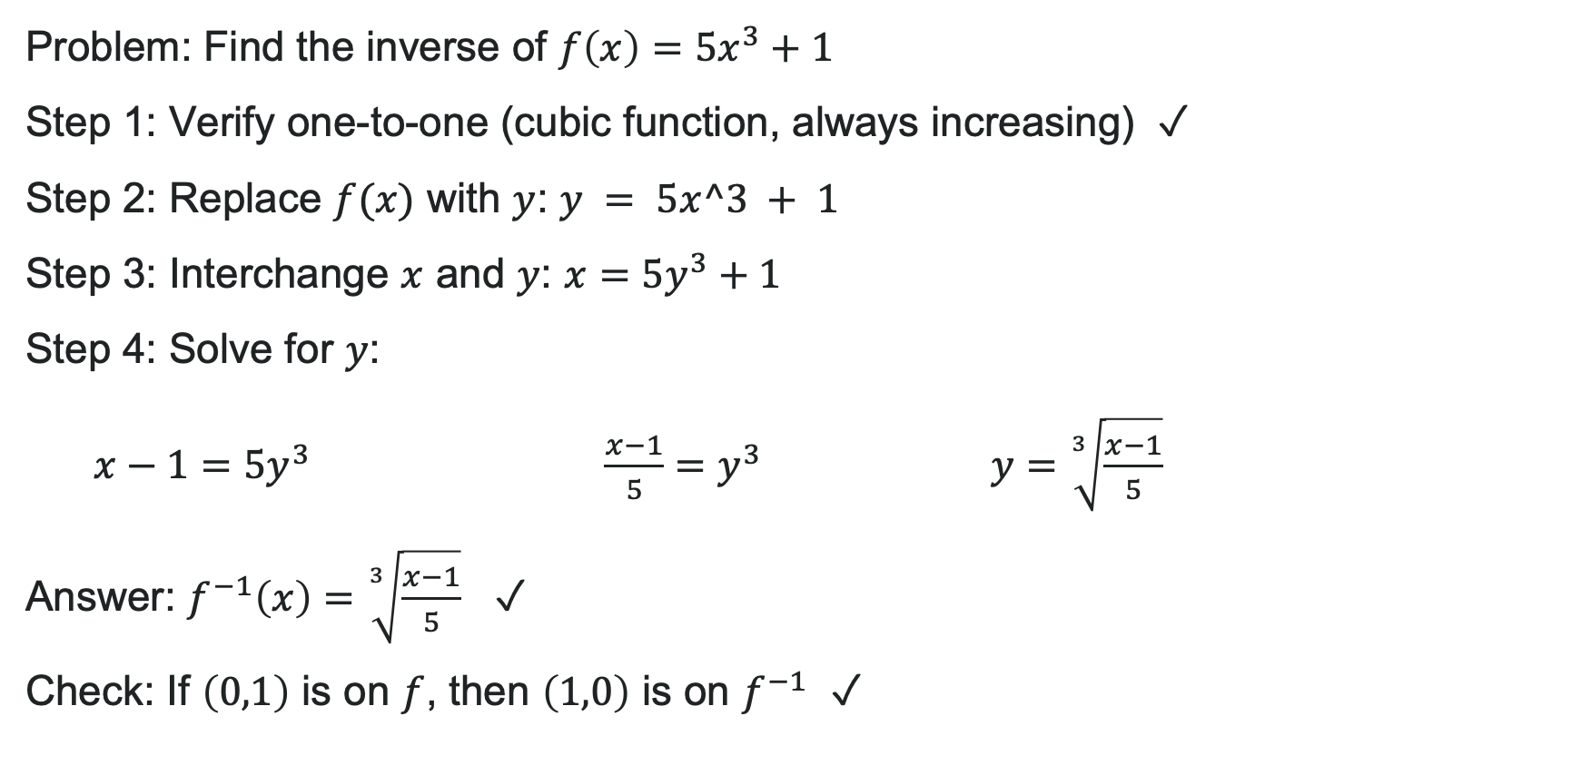
Example: Finding the Inverse Function
Problem: Find the inverse of $f\left(x\right)=5x^{3}+1$
Step 1: Verify one-to-one (cubic function, always increasing) ✓
Step 2: Replace $f(x)$ with $y$: $y = 5x^3 + 1$
Step 3: Interchange $x$ and $y$: $x=5y^{3}+1$
Step 4: Solve for $y$:
$x−1=5y^{3}$ $\frac{x−1}{5}=y^{3}$ $y=\sqrt[3]{\frac{x−1}{5}}$
Answer: $f^{−1}\left(x\right)=\sqrt[3]{\frac{x−1}{5}}$ ✓
Check: If $\left(0,1\right)$ is on $f$, then $\left(1,0\right)$ is on $f^{−1}$ ✓

Slide 49
Try It: Find an Inverse
Find the inverse of $f\left(x\right)=2x^{3}−4$
Notes:
Answer: f^{-1}(x) = \sqrt[3]{\frac{x + 4}{2}}
Steps: y = 2x^3 - 4 → x = 2y^3 - 4 → x + 4 = 2y^3 → \frac{x + 4}{2} = y^3 → y = \sqrt[3]{\frac{x + 4}{2}}

Slide 50
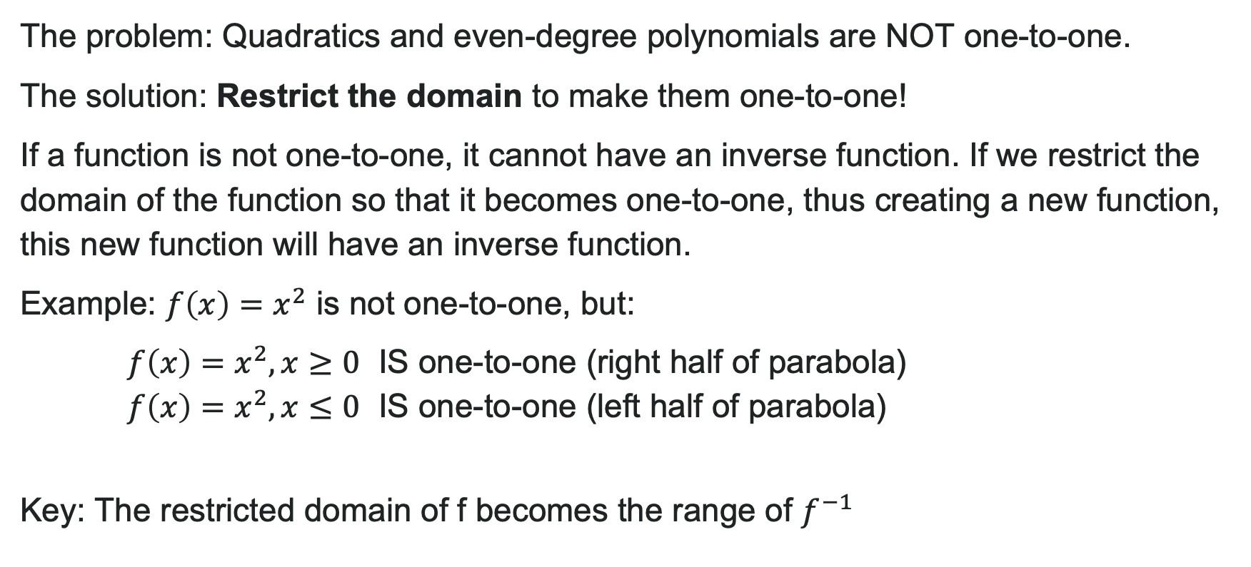
Restricting the Domain
The problem: Quadratics and even-degree polynomials are NOT one-to-one.
The solution: Restrict the domain to make them one-to-one!
If a function is not one-to-one, it cannot have an inverse function. If we restrict the domain of the function so that it becomes one-to-one, thus creating a new function, this new function will have an inverse function.
Example: $f\left(x\right)=x^{2}$ is not one-to-one, but:
$f\left(x\right)=x^{2},x≥0$ IS one-to-one (right half of parabola)
$f\left(x\right)=x^{2},x≤0$ IS one-to-one (left half of parabola)
Key: The restricted domain of f becomes the range of $f^{−1}$

Slide 51
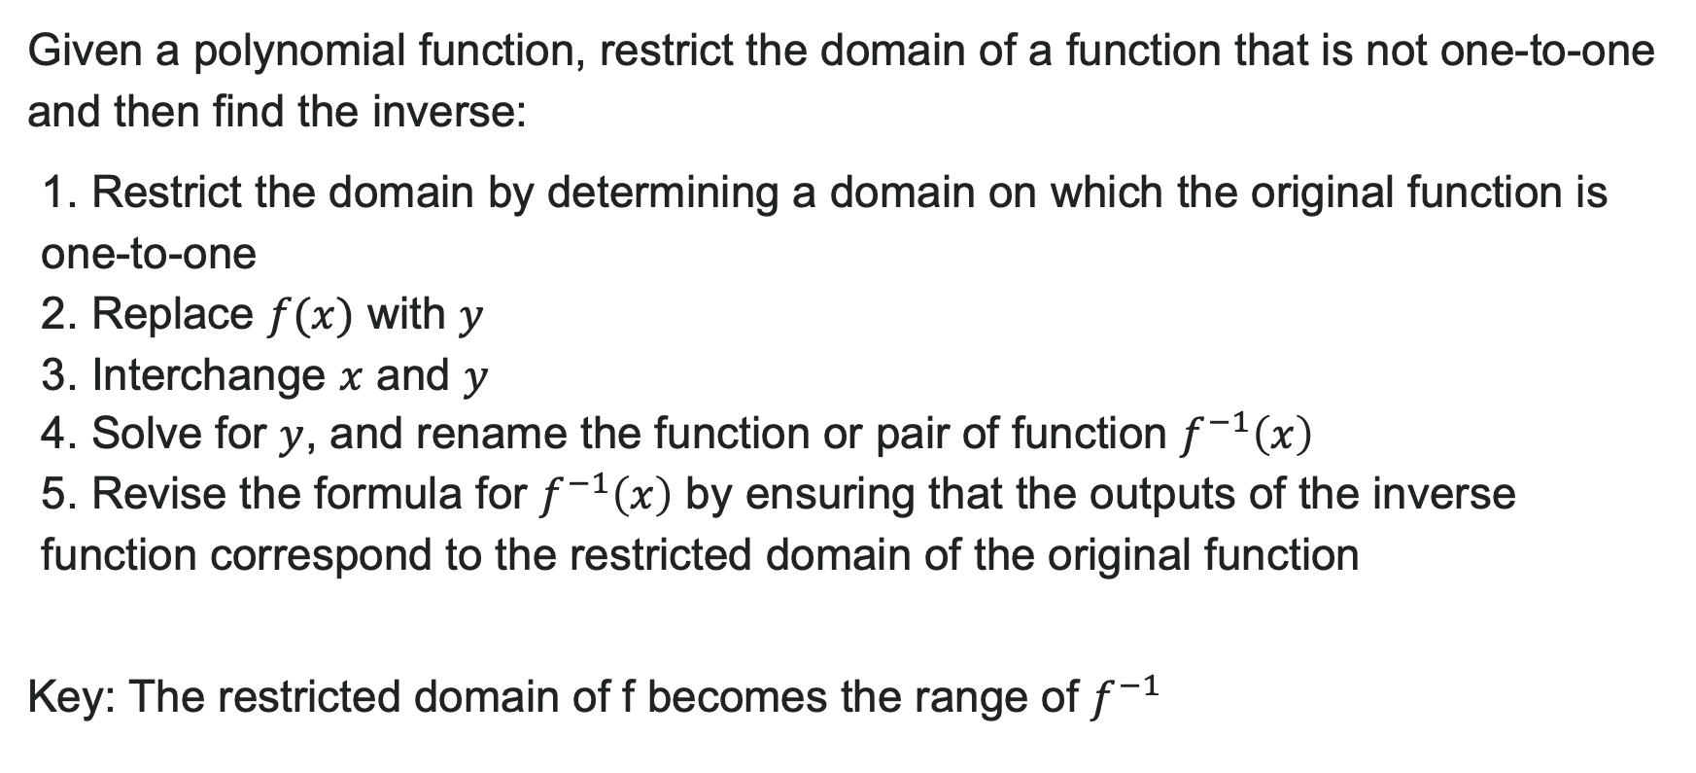
How to: Restrict the Domain
Given a polynomial function, restrict the domain of a function that is not one-to-one and then find the inverse:
1. Restrict the domain by determining a domain on which the original function is one-to-one
2. Replace $f(x)$ with $y$
3. Interchange $x$ and $y$
4. Solve for $y$, and rename the function or pair of function $f^{−1}\left(x\right)$
5. Revise the formula for $f^{−1}\left(x\right)$ by ensuring that the outputs of the inverse function correspond to the restricted domain of the original function
Key: The restricted domain of f becomes the range of $f^{−1}$

Slide 52
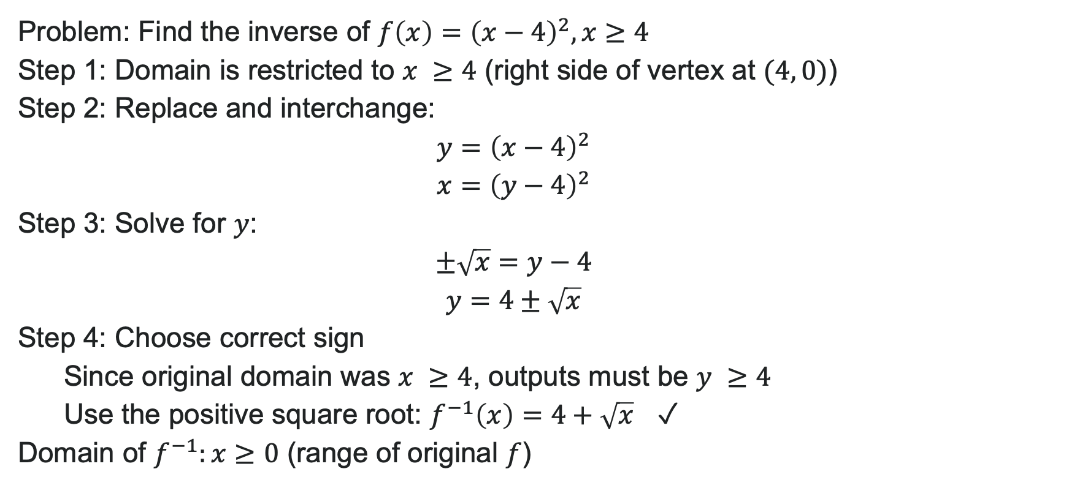
Example: Find Inverse w/ Restricted Domain
Problem: Find the inverse of $f\left(x\right)={\left(x−4\right)}^{2},x≥4$
Step 1: Domain is restricted to $x ≥4$ (right side of vertex at $(4, 0)$)
Step 2: Replace and interchange:
Step 3: Solve for $y$:
Step 4: Choose correct sign
Since original domain was $x ≥4$, outputs must be $y ≥4$
Use the positive square root: $f^{−1}\left(x\right)=4+\sqrt{x}$ ✓
Domain of $f^{−1}:x≥0$ (range of original $f$)

Slide 53
Try It: Find Inverse with Domain Restriction
Find the inverse of $f\left(x\right)={\left(x+1\right)}^{2}−3,x≥−1$
Notes:
Answer: f^{-1}(x) = -1 + \sqrt{x + 3}
Vertex at (-1, -3), domain x \geq -1 means right side
Solve: y = (x + 1)^2 - 3 → x = (y + 1)^2 - 3 → x + 3 = (y + 1)^2 → \pm\sqrt{x + 3} = y + 1
Since x \geq -1, we need y \geq -1, so use positive: f^{-1}(x) = -1 + \sqrt{x + 3}
Domain of f^{-1}: x \geq -3

Slide 54
Before we finish up…
2
Next steps…..
3
Reminders about student hours, upcoming deadlines, campus activities ….
1
Questions…..

Slide 55

Attributions
Illustrations are from Storyset
Authored by: Lumen Learning. License: CC BY: Attribution

