Slide 1

Precalculus
Module 4:
Polynomial Functions

Slide 2
Affirmations
I believe I can grow more confident in math.
I am confident asking questions when I need clarity.
I believe in my ability to succeed.

Slide 3
Learning Goals: Quadratic Functions
Deepen your understanding and form connections within these skills:
1 Identify key characteristics of parabolas from the graph
2 Understand how the graph of a parabola is related to its quadratic function
3 Draw the graph of a quadratic function
4 Solve problems involving a quadratic function’s minimum or maximum value

Slide 4
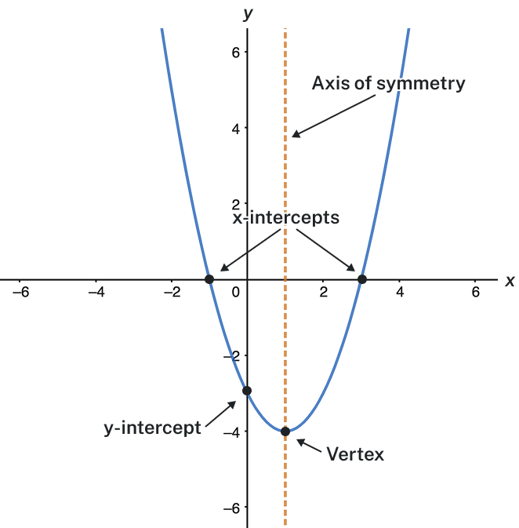
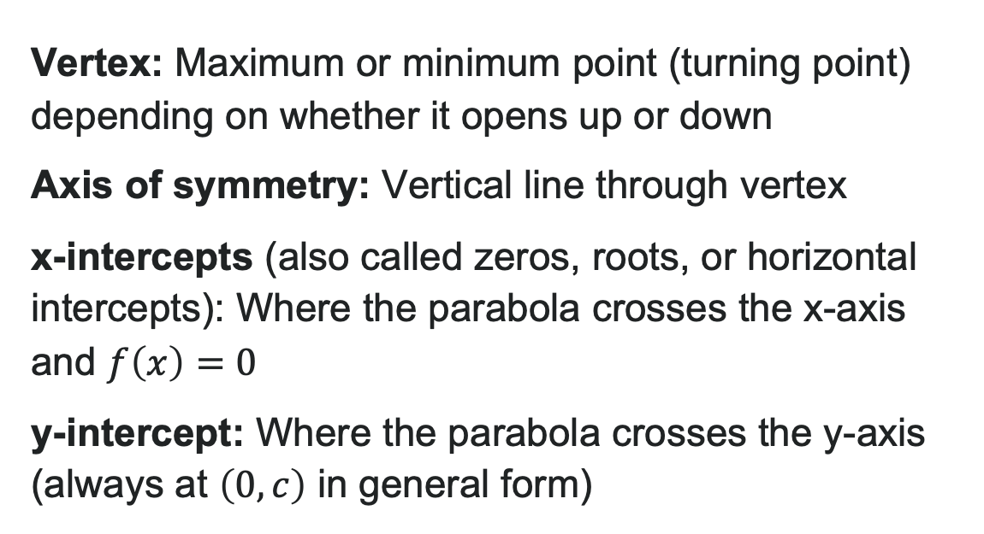
What is a Parabola?
A parabola is a U-shaped curve, graph of a quadratic function
Vertex: Maximum or minimum point (turning point) depending on whether it opens up or down
Axis of symmetry: Vertical line through vertex
x-intercepts (also called zeros, roots, or horizontal intercepts): Where the parabola crosses the x-axis and $f\left(x\right)=0$
y-intercept: Where the parabola crosses the y-axis (always at $\left(0,c\right)$ in general form)

Slide 5
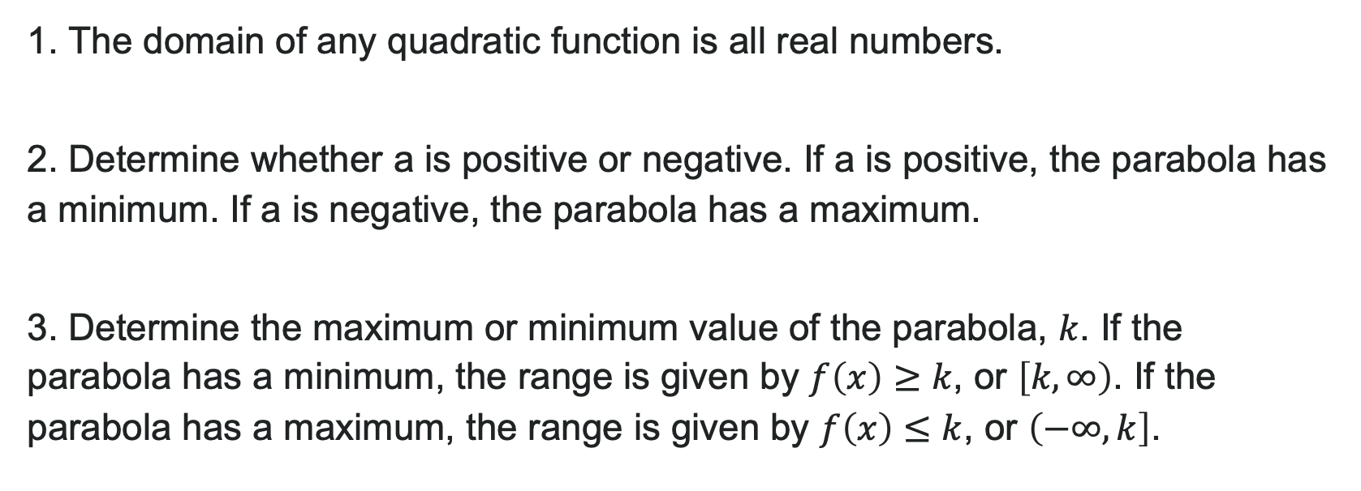
How To: Find Domain and Range of a Quadratic Equation
1. The domain of any quadratic function is all real numbers.
2. Determine whether a is positive or negative. If a is positive, the parabola has a minimum. If a is negative, the parabola has a maximum.
3. Determine the maximum or minimum value of the parabola, $k$. If the parabola has a minimum, the range is given by $f\left(x\right)≥k$, or $\left[k,∞\right)$. If the parabola has a maximum, the range is given by $f\left(x\right)≤k$, or $\left(−∞,k\right]$.

Slide 6

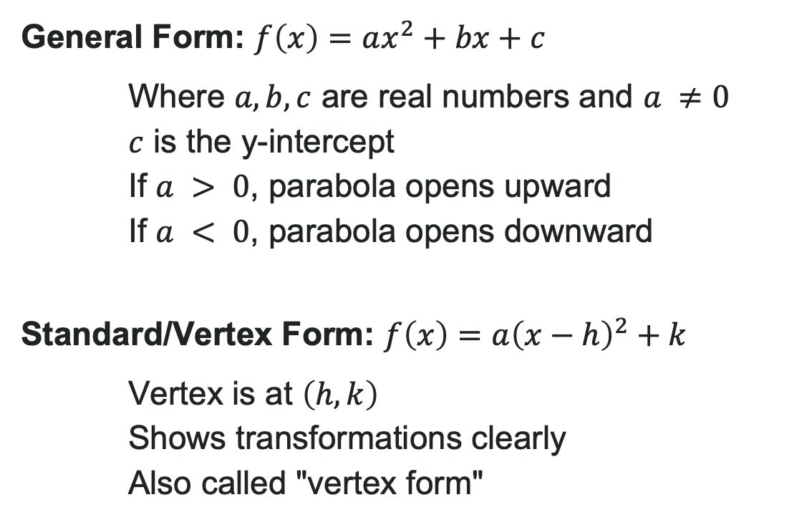
Two Forms of Quadratic Functions
General Form: $f\left(x\right)=ax^{2}+bx+c$
Where $a, b, c$ are real numbers and $a ≠0$
$c$ is the y-intercept
If $a > 0$, parabola opens upward
If $a < 0$, parabola opens downward
Standard/Vertex Form: $f\left(x\right)=a{\left(x−h\right)}^{2}+k$
Vertex is at $\left(h,k\right)$
Shows transformations clearly
Also called "vertex form"

Slide 7
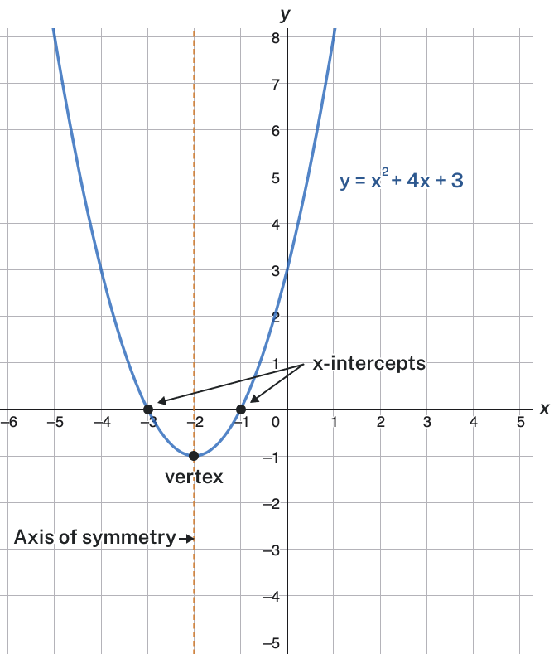
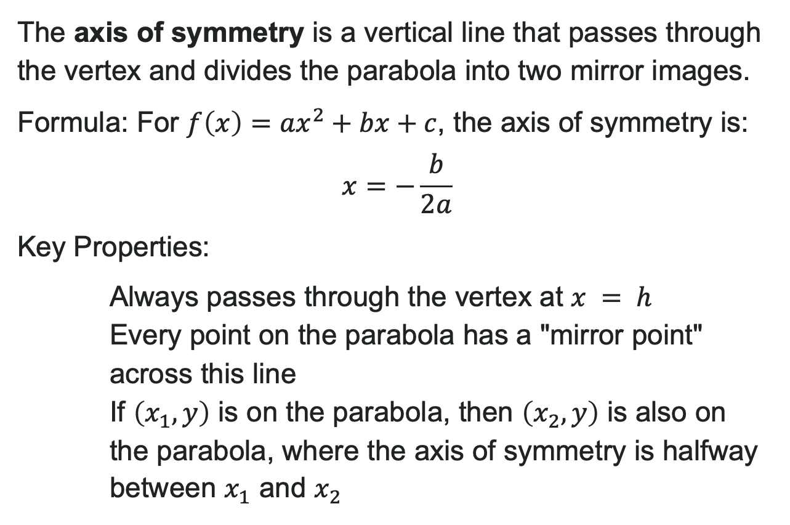
The Axis of Symmetry
The axis of symmetry is a vertical line that passes through the vertex and divides the parabola into two mirror images.
Formula: For $f\left(x\right)=ax^{2}+bx+c$, the axis of symmetry is:
$$x=−\frac{b}{2a}$$
Key Properties:
Always passes through the vertex at $x = h$
Every point on the parabola has a "mirror point" across this line
If $\left(x_{1},y\right)$ is on the parabola, then $\left(x_{2},y\right)$ is also on the parabola, where the axis of symmetry is halfway between $x_{1}$ and $x_{2}$

Slide 8

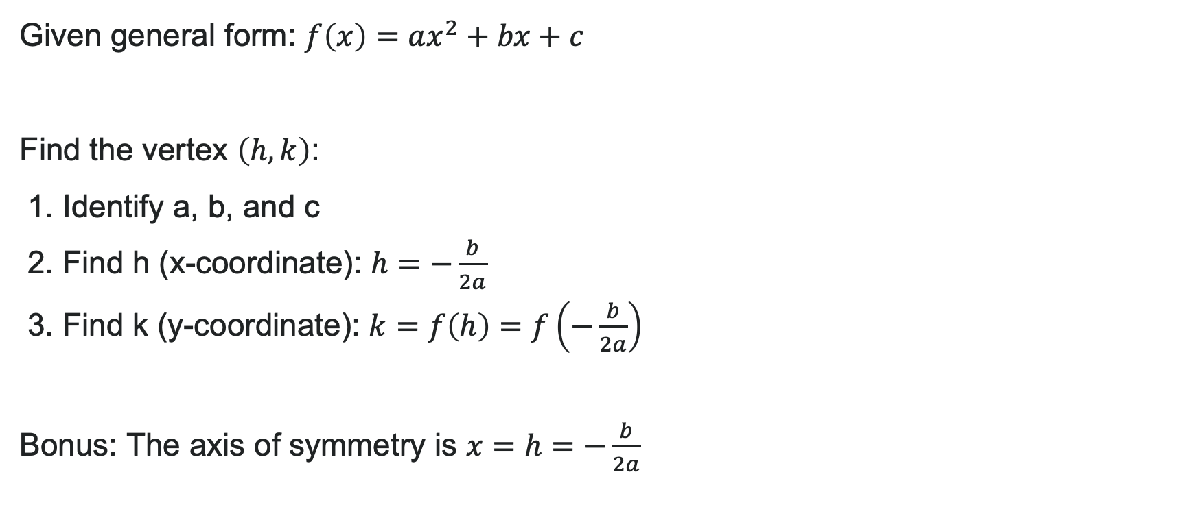
How to: Find the Vertex from General Form
Given general form: $f\left(x\right)=ax^{2}+bx+c$
Find the vertex $\left(h,k\right)$:
1. Identify a, b, and c
2. Find h (x-coordinate): $h=−\frac{b}{2a}$
3. Find k (y-coordinate): $k=f\left(h\right)=f\left(−\frac{b}{2a}\right)$
Bonus: The axis of symmetry is $x=h=−\frac{b}{2a}$

Slide 9
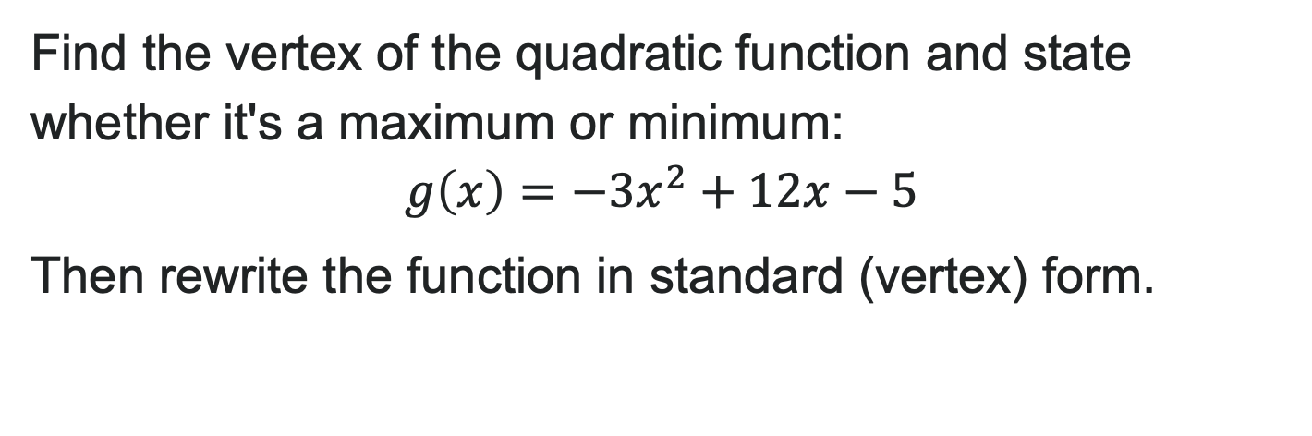
Try It: Analyzing a Quadratic Equation
Find the vertex of the quadratic function and state whether it's a maximum or minimum:
$$g\left(x\right)=−3x^{2}+12x−5$$
Then rewrite the function in standard (vertex) form.
Notes:
Answer: a = -3, b = 12, c = -5
h = -\frac{12}{2(-3)} = -\frac{12}{-6} = 2
k = g(2) = -3(2)^2 + 12(2) - 5 = -12 + 24 - 5 = 7
Vertex: (2, 7)
This is a maximum since a = -3 < 0
Standard form: g(x) = -3(x - 2)^2 + 7

Slide 10
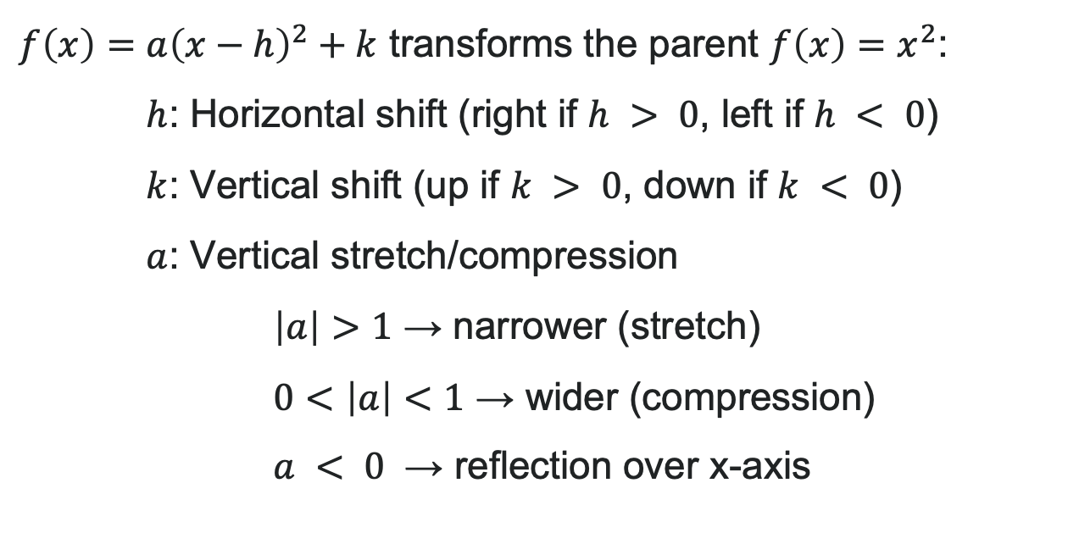
Transforming Parabolas with Standard Form
$f\left(x\right)=a{\left(x−h\right)}^{2}+k$ transforms the parent $f\left(x\right)=x^{2}$:
$h$: Horizontal shift (right if $h > 0$, left if $h < 0$)
$k$: Vertical shift (up if $k > 0$, down if $k < 0$)
$a$: Vertical stretch/compression
$\left|a\right|>1$ → narrower (stretch)
$0<\left|a\right|<1$ → wider (compression)
$a < 0$ → reflection over x-axis

Slide 11
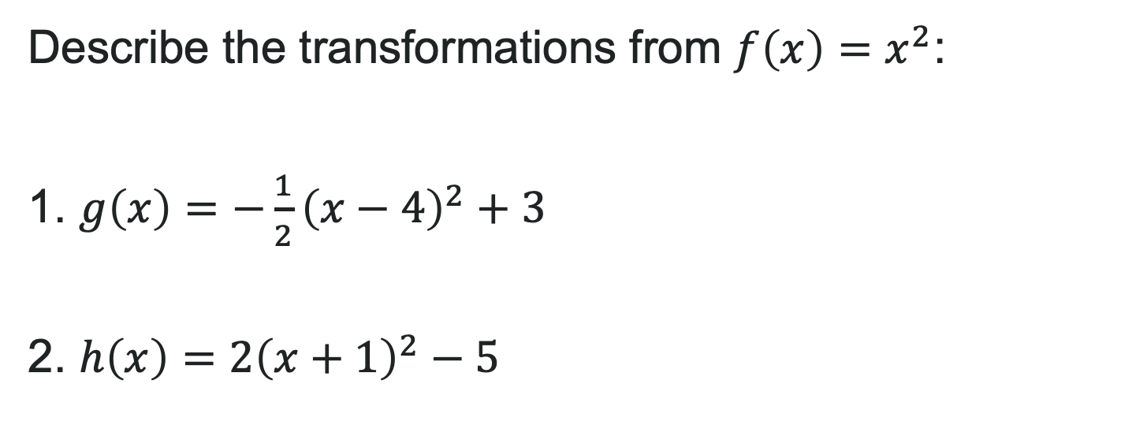
Try It: Standard Form Transformations
Describe the transformations from $f\left(x\right)=x^{2}$:
1. $g\left(x\right)=−\frac{1}{2}{\left(x−4\right)}^{2}+3$
2. $h\left(x\right)=2{\left(x+1\right)}^{2}−5$
Notes:
Answer:
a) Right 4, up 3, wider (compressed by 1/2), opens down
b) Left 1, down 5, narrower (stretched by 2), opens up

Slide 12

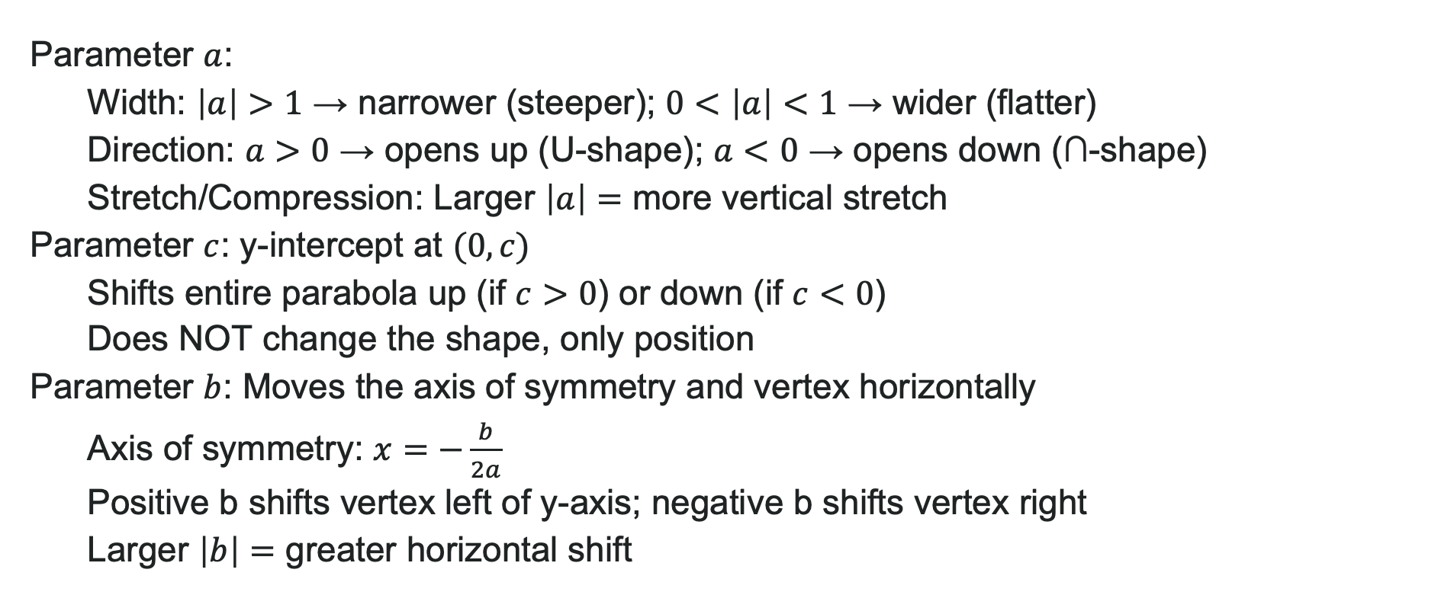
Transforming Parabolas with General Form
In $f\left(x\right)=ax^{2}+bx+c$:
Parameter $a$:
Width: $\left|a\right|>1$ → narrower (steeper); $0<\left|a\right|<1$ → wider (flatter)
Direction: $a>0$ → opens up (U-shape); $a<0$ → opens down (∩-shape)
Stretch/Compression: Larger $\left|a\right|=$ more vertical stretch
Parameter $c$: y-intercept at $(0, c)$
Shifts entire parabola up (if $c>0$) or down (if $c<0$)
Does NOT change the shape, only position
Parameter $b$: Moves the axis of symmetry and vertex horizontally
Axis of symmetry: $x=−\frac{b}{2a}$ Positive b shifts vertex left of y-axis; negative b shifts vertex right
Larger $\left|b\right|=$ greater horizontal shift

Slide 13
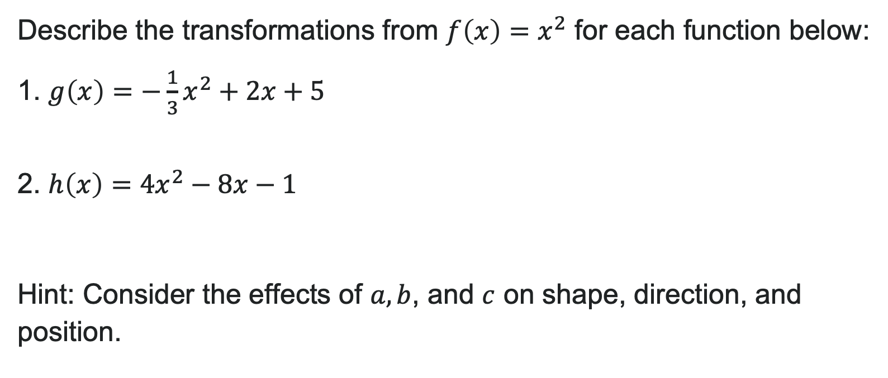
Try It: General Form Transformations
Describe the transformations from $f\left(x\right)=x^{2}$ for each function below:
1. $g\left(x\right)=−\frac{1}{3}x^{2}+2x+5$
2. $h\left(x\right)=4x^{2}−8x−1$
Hint: Consider the effects of $a, b$, and $c$ on shape, direction, and position.
Notes:
Answer:
a) a = -\frac{1}{3}, b = 2, c = 5
Vertical compression by factor of \frac{1}{3} (wider parabola)
Reflection over x-axis (opens down)
Vertical shift up 5 units (y-intercept at (0, 5))
Horizontal shift: axis of symmetry at x = 3 (vertex shifted right and adjusted by b)
b) a = 4, b = -8, c = -1
Vertical stretch by factor of 4 (narrower parabola)
Opens up (no reflection)
Vertical shift down 1 unit (y-intercept at (0, -1))
Horizontal shift: axis of symmetry at x = 1 (vertex shifted right and adjusted by b)

Slide 14
Learning Goals: Polynomial Functions
Deepen your understanding and form connections within these skills:
1 Identify the degree and leading coefficient of polynomial functions
2 Identify end behavior of polynomial functions
3 Identify intercepts of factored polynomial functions

Slide 15
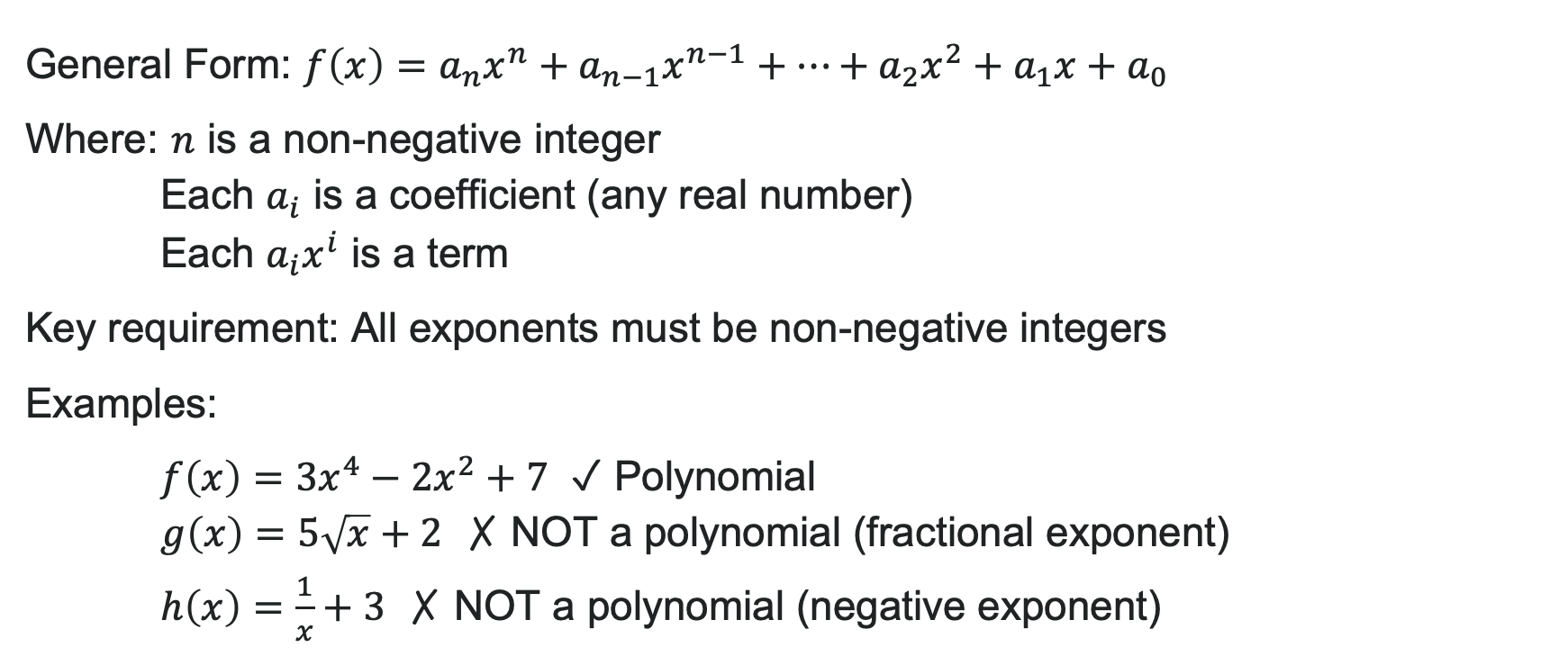
What is a Polynomial Function?
General Form: $f\left(x\right)=a_{n}x^{n}+a_{n−1}x^{n−1}+⋯+a_{2}x^{2}+a_{1}x+a_{0}$
Where: $n$ is a non-negative integer
Each $a_{i}$ is a coefficient (any real number)
Each $a_{i}x^{i}$ is a term
Key requirement: All exponents must be non-negative integers
Examples:
$f\left(x\right)=3x^{4}−2x^{2}+7$ ✓ Polynomial
$g\left(x\right)=5\sqrt{x}+2$ ✗ NOT a polynomial (fractional exponent)
$h\left(x\right)=\frac{1}{x}+3$ ✗ NOT a polynomial (negative exponent)

Slide 16
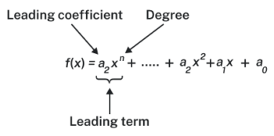
Degree and Leading Coefficient
Degree: The highest power of the variable in the polynomial
Leading Term: The term with the highest degree
Leading Coefficient: The coefficient of the leading term

Slide 17
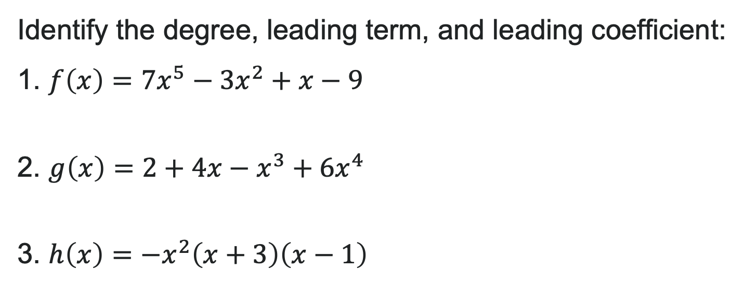
Try It: Degree and Leading Coefficient
Identify the degree, leading term, and leading coefficient:
1. $f\left(x\right)=7x^{5}−3x^{2}+x−9$
2. $g\left(x\right)=2+4x−x^{3}+6x^{4}$
3. $h\left(x\right)=−x^{2}\left(x+3\right)\left(x−1\right)$
Notes:
Answer:
a) Degree: 5, Leading term: 7x^5, Leading coefficient: 7
b) First rewrite in standard form: g(x) = 6x^4 - x^3 + 4x + 2
Degree: 4, Leading term: 6x^4, Leading coefficient: 6
c) Find leading term by multiplying first terms: -x^2 \cdot x \cdot x = -x^4
Degree: 4, Leading term: -x^4, Leading coefficient: -1

Slide 18
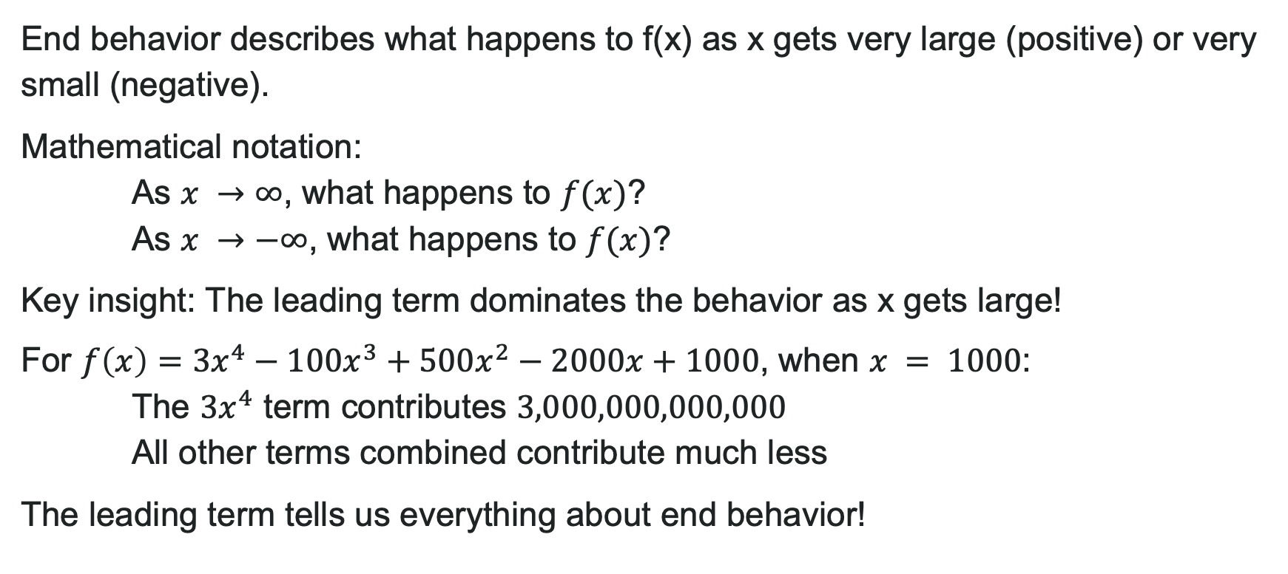
What is End Behavior?
End behavior describes what happens to f(x) as x gets very large (positive) or very small (negative).
Mathematical notation:
As $x →∞$, what happens to $f(x)$?
As $x →−∞$, what happens to $f(x)$?
Key insight: The leading term dominates the behavior as x gets large!
For $f\left(x\right)=3x^{4}−100x^{3}+500x^{2}−2000x+1000$, when $x = 1000$:
The $3x^{4}$ term contributes $3,000,000,000,000$
All other terms combined contribute much less
The leading term tells us everything about end behavior!

Slide 19

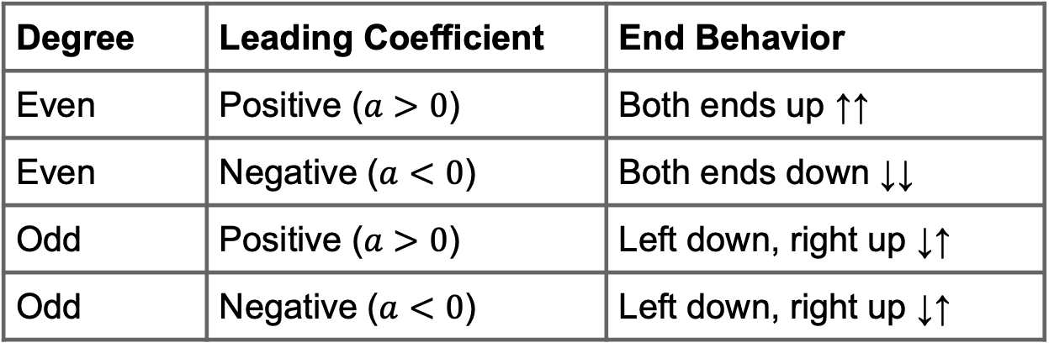
Determining End Behavior
End behavior depends on two things:
1. Degree (even or odd?)
2. Leading coefficient (positive or negative?)
Degree | Leading Coefficient | End Behavior
Even | Positive ($a>0$) | Both ends up ↑↑
Even | Negative ($a<0$) | Both ends down ↓↓
Odd | Positive ($a>0$) | Left down, right up ↓↑
Odd | Negative ($a<0$) | Left down, right up ↓↑

Slide 20
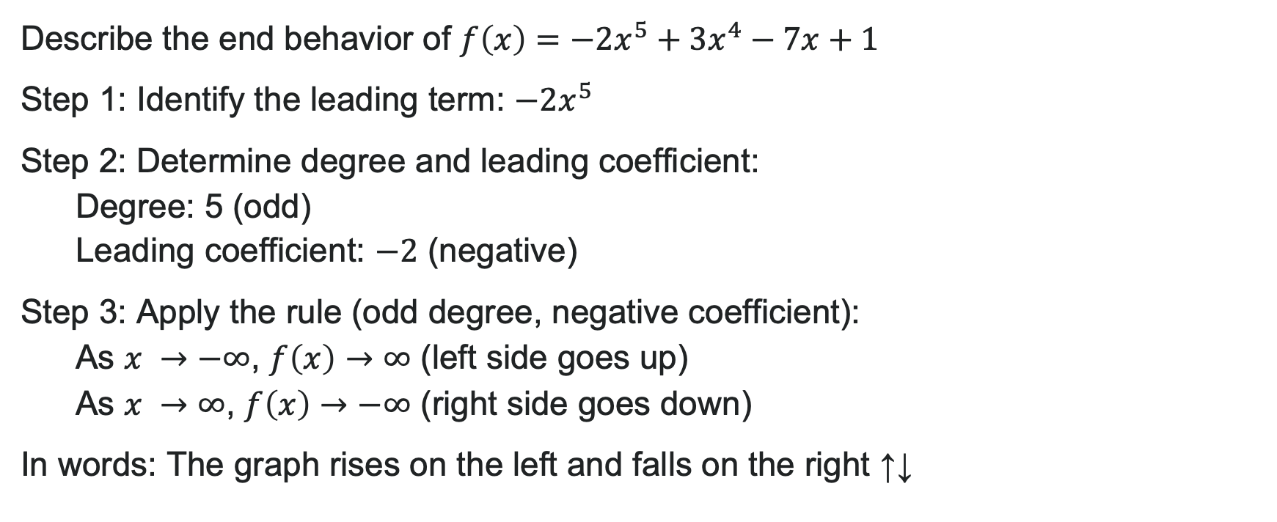
Example: Describing End Behavior
Describe the end behavior of $f\left(x\right)=−2x^{5}+3x^{4}−7x+1$
Step 1: Identify the leading term: $−2x^{5}$
Step 2: Determine degree and leading coefficient:
Degree: 5 (odd)
Leading coefficient: $−2$ (negative)
Step 3: Apply the rule (odd degree, negative coefficient):
As $x →−∞$, $f\left(x\right)→∞$ (left side goes up)
As $x →∞$, $f\left(x\right)→−∞$ (right side goes down)
In words: The graph rises on the left and falls on the right ↑↓

Slide 21
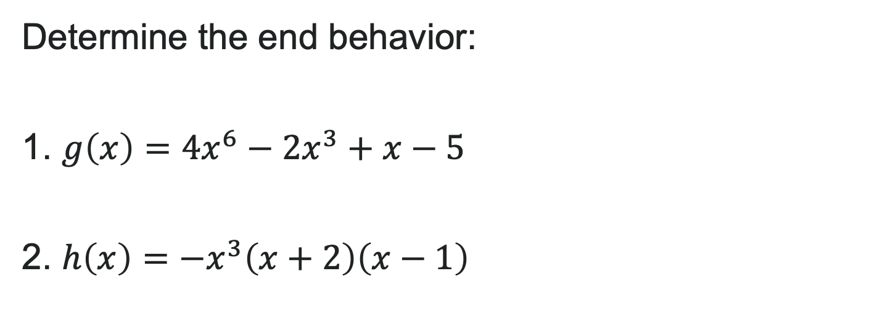
Try It: Determining End Behavior
Determine the end behavior:
1. $g\left(x\right)=4x^{6}−2x^{3}+x−5$
2. $h\left(x\right)=−x^{3}\left(x+2\right)\left(x−1\right)$
Notes:
Answer:
a) Leading term: 4x^6
Degree: 6 (even), Leading coefficient: 4 (positive)
As x \to -\infty, f(x) \to \infty
As x \to \infty, f(x) \to \infty
Both ends up ↑↑
b) Leading term: -x^3 \cdot x \cdot x = -x^5
Degree: 5 (odd), Leading coefficient: -1 (negative)
As x \to -\infty, f(x) \to \infty
As x \to \infty, f(x) \to -\infty
Left up, right down ↑↓

Slide 22
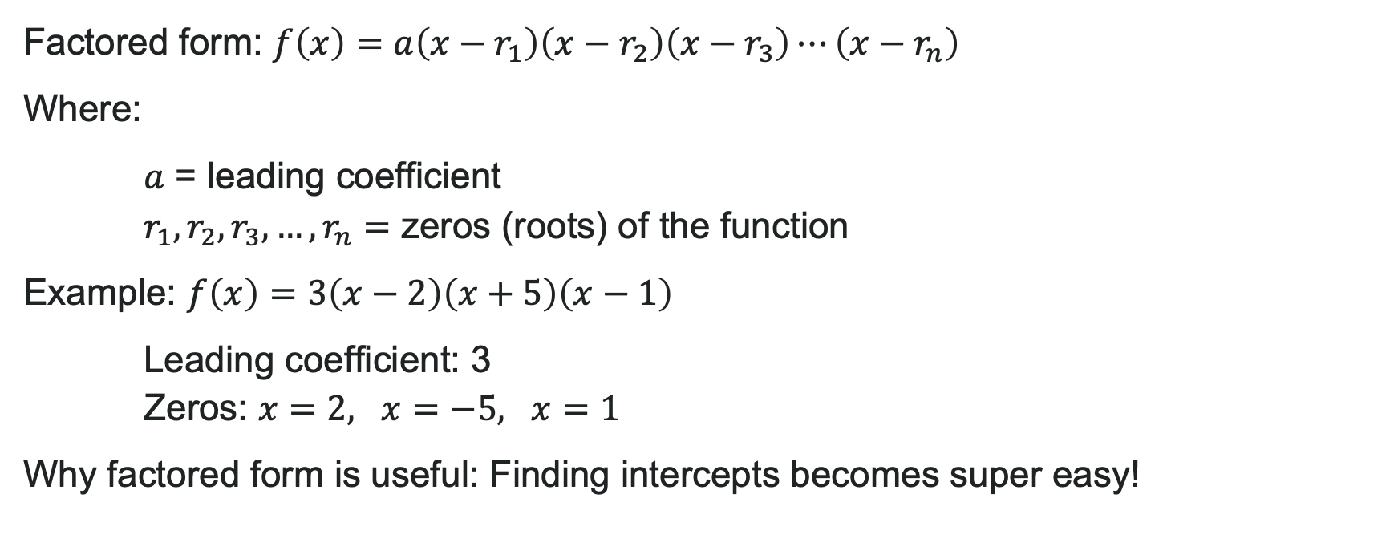
Factored Form of Polynomials
Factored form: $f\left(x\right)=a\left(x−r_{1}\right)\left(x−r_{2}\right)\left(x−r_{3}\right)⋯\left(x−r_{n}\right)$
Where:
$a$ = leading coefficient
$r_{1},r_{2},r_{3},…,r_{n}=$ zeros (roots) of the function
Example: $f\left(x\right)=3\left(x−2\right)\left(x+5\right)\left(x−1\right)$
Leading coefficient: 3
Zeros: $x=2, x=−5, x=1$
Why factored form is useful: Finding intercepts becomes super easy!

Slide 23
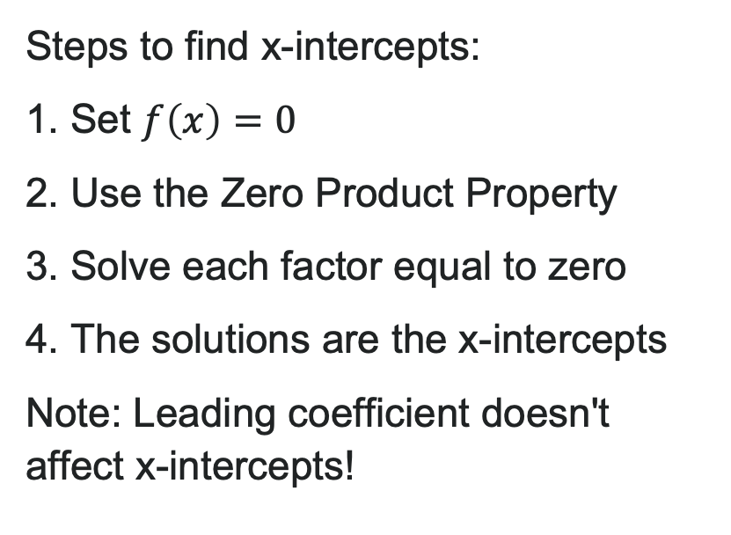
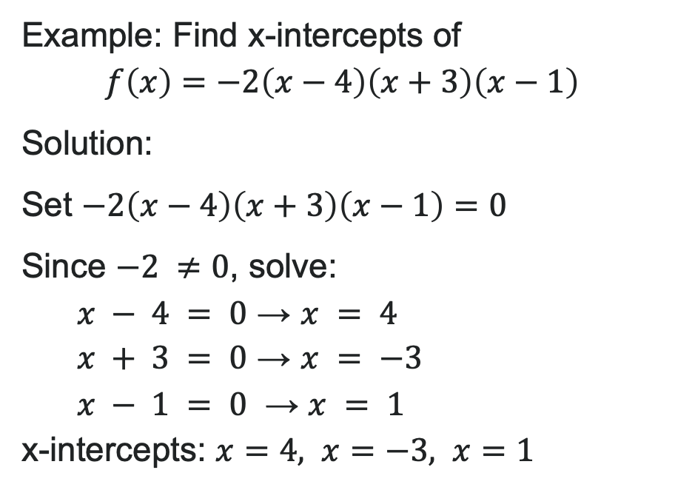
Finding x-intercepts from Factored Form
Steps to find x-intercepts:
1. Set $f\left(x\right)=0$
2. Use the Zero Product Property
3. Solve each factor equal to zero
4. The solutions are the x-intercepts
Note: Leading coefficient doesn't affect x-intercepts!
Example: Find x-intercepts of
$$f\left(x\right)=−2\left(x−4\right)\left(x+3\right)\left(x−1\right)$$
Solution:
Set $−2\left(x−4\right)\left(x+3\right)\left(x−1\right)=0$
Since $−2 ≠0$, solve:
$x − 4 = 0$ → $x = 4$
$x + 3 = 0$ → $x = −3$
$x − 1 = 0$ → $x = 1$
x-intercepts: $x=4, x=−3, x=1$

Slide 24
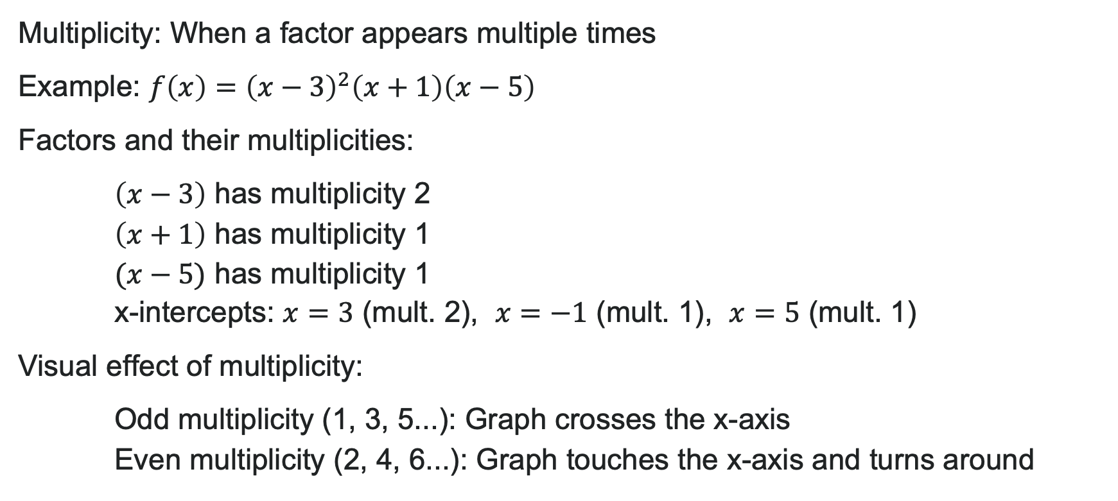
Understanding Multiplicity
Multiplicity: When a factor appears multiple times
Example: $f\left(x\right)={\left(x−3\right)}^{2}\left(x+1\right)\left(x−5\right)$
Factors and their multiplicities:
$\left(x−3\right)$ has multiplicity 2
$\left(x+1\right)$ has multiplicity 1
$(x−5)$ has multiplicity 1
x-intercepts: $x=3$ (mult. 2), $x=−1$ (mult. 1), $x=5$ (mult. 1)
Visual effect of multiplicity:
Odd multiplicity (1, 3, 5...): Graph crosses the x-axis
Even multiplicity (2, 4, 6...): Graph touches the x-axis and turns around

Slide 25
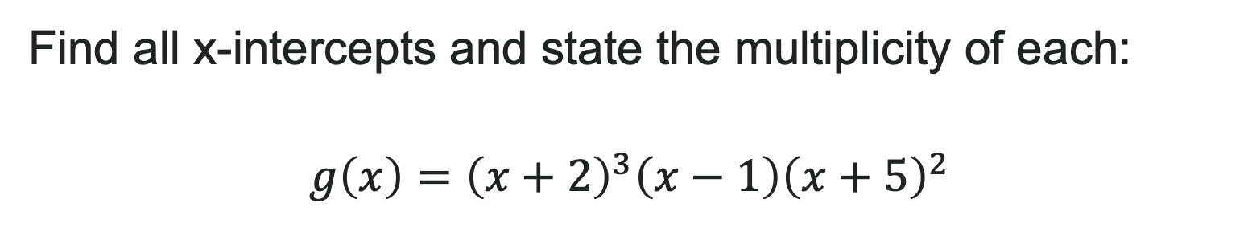
Try It: Multiplicity
Find all x-intercepts and state the multiplicity of each:
$$g\left(x\right)={\left(x+2\right)}^{3}\left(x−1\right){\left(x+5\right)}^{2}$$
Notes:
Answer:
x = -2 with multiplicity 3 (crosses)
x = 1 with multiplicity 1 (crosses)
x = -5 with multiplicity 2 (touches/bounces)

Slide 26
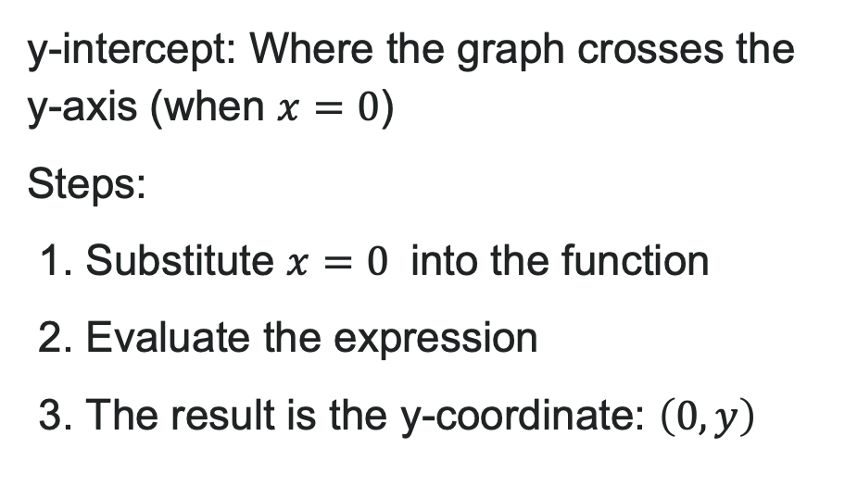
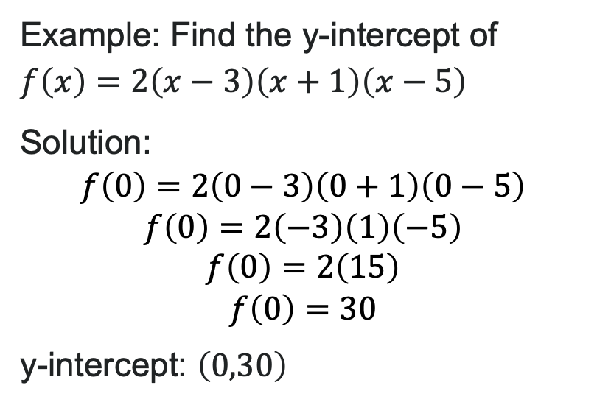
Finding y-intercepts
y-intercept: Where the graph crosses the y-axis (when $x=0$)
Steps:
1. Substitute $x=0$ into the function
2. Evaluate the expression
3. The result is the y-coordinate: $\left(0,y\right)$
Example: Find the y-intercept of $f\left(x\right)=2\left(x−3\right)\left(x+1\right)\left(x−5\right)$
Solution:
$$f\left(0\right)=2\left(0−3\right)\left(0+1\right)\left(0−5\right) \\ f\left(0\right)=2\left(−3\right)\left(1\right)\left(−5\right) \\ f\left(0\right)=2\left(15\right) \\ f\left(0\right)=30$$
y-intercept: $\left(0,30\right)$

Slide 27

Try It: Finding Intercepts
Find both the x-intercepts and y-intercept:
$$h\left(x\right)=−3\left(x−2\right){\left(x+4\right)}^{2}$$
Notes:
Answer:
x-intercepts:
x - 2 = 0 → x = 2 (multiplicity 1)
x + 4 = 0 → x = -4 (multiplicity 2)
y-intercept:
h(0) = -3(0 - 2)(0 + 4)^2 = -3(-2)(16) = -3(-32) = 96
y-intercept: (0, 96)

Slide 28
Learning Goals: Graphs of Polynomial Functions
Deepen your understanding and form connections within these skills:
1 Graph polynomial functions
2 Use the Intermediate Value Theorem
3 Write the formula for a polynomial function given its graph

Slide 29
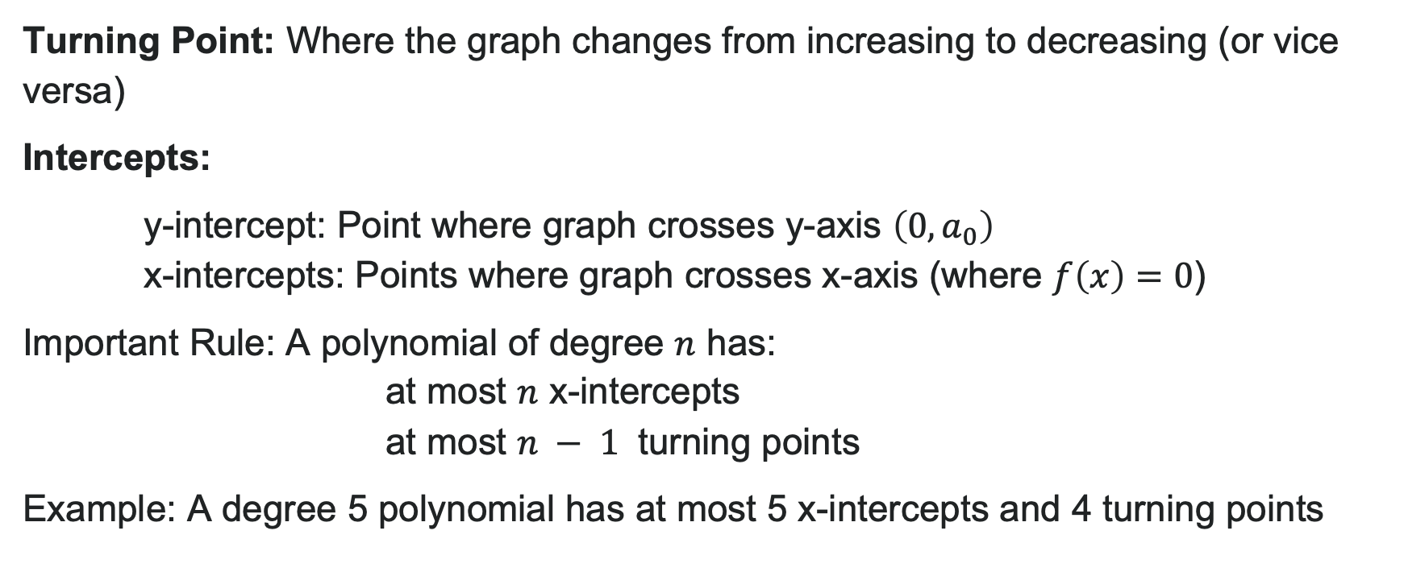
Turning Points and Intercepts of Polynomials
Turning Point: Where the graph changes from increasing to decreasing (or vice versa)
Intercepts:
y-intercept: Point where graph crosses y-axis $\left(0,a_{0}\right)$
x-intercepts: Points where graph crosses x-axis (where $f\left(x\right)=0$)
Important Rule: A polynomial of degree $n$ has:
at most $n$ x-intercepts
at most $n − 1$ turning points
Example: A degree 5 polynomial has at most 5 x-intercepts and 4 turning points

Slide 30

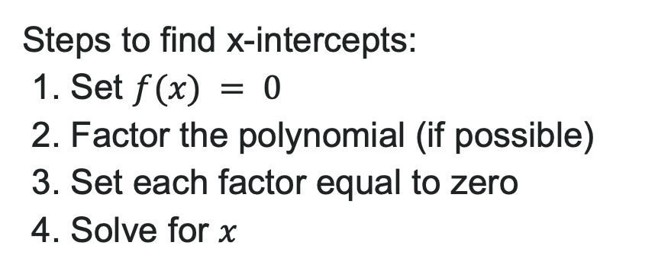
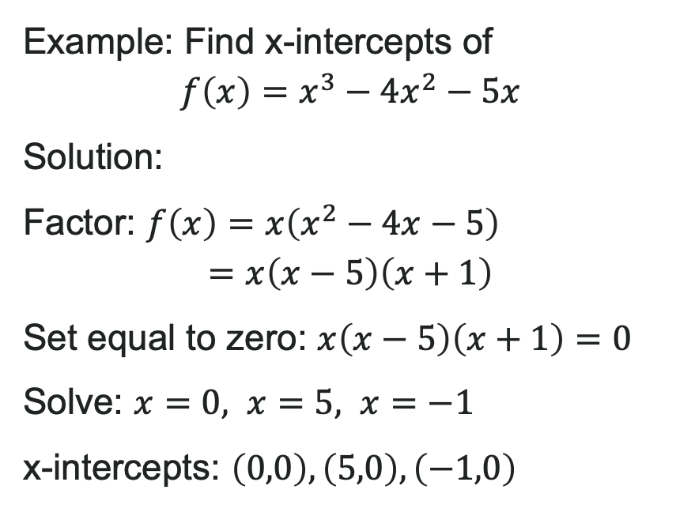
Finding x-intercepts by Factoring
Steps to find x-intercepts:
1. Set $f(x) = 0$
2. Factor the polynomial (if possible)
3. Set each factor equal to zero
4. Solve for $x$
Example: Find x-intercepts of
$$f\left(x\right)=x^{3}−4x^{2}−5x$$
Solution:
Factor: $f\left(x\right)=x\left(x^{2}−4x−5\right)$
$$=x\left(x−5\right)\left(x+1\right)$$
Set equal to zero: $x\left(x−5\right)\left(x+1\right)=0$
Solve: $x=0, x=5, x=−1$
x-intercepts: $\left(0,0\right),\left(5,0\right),\left(−1,0\right)$

Slide 31

Try It: Find Polynomial Intercepts
Find the x-intercepts and y-intercept:
$$g\left(x\right)=2x^{3}−8x^{2}−10x$$
Notes:
Answer:
x-intercepts:
Factor: g(x) = 2x(x^2 - 4x - 5) = 2x(x - 5)(x + 1)
Set equal to zero: 2x(x - 5)(x + 1) = 0
x = 0, x = 5, x = -1
x-intercepts: (0, 0), (5, 0), (-1, 0)
y-intercept:
g(0) = 0
y-intercept: (0, 0)

Slide 32
Graphical Behavior of Polynomials at x-intercepts
Multiplicity: The number of times a factor appears in factored form
Graph Behavior at x-intercepts:
Odd Multiplicity (1, 3, 5, ...):
Graph crosses the x-axis
Linear (mult. 1): straight through
Cubic (mult. 3): flattens then crosses (S-curve)
Even Multiplicity (2, 4, 6, ...):
Graph touches x-axis and bounces back
Quadratic (mult. 2): U-shaped bounce
Higher even: flatter bounce
Sum of all multiplicities = degree of polynomial
Notes:
Key: Sum of all multiplicities = degree of polynomial

Slide 33
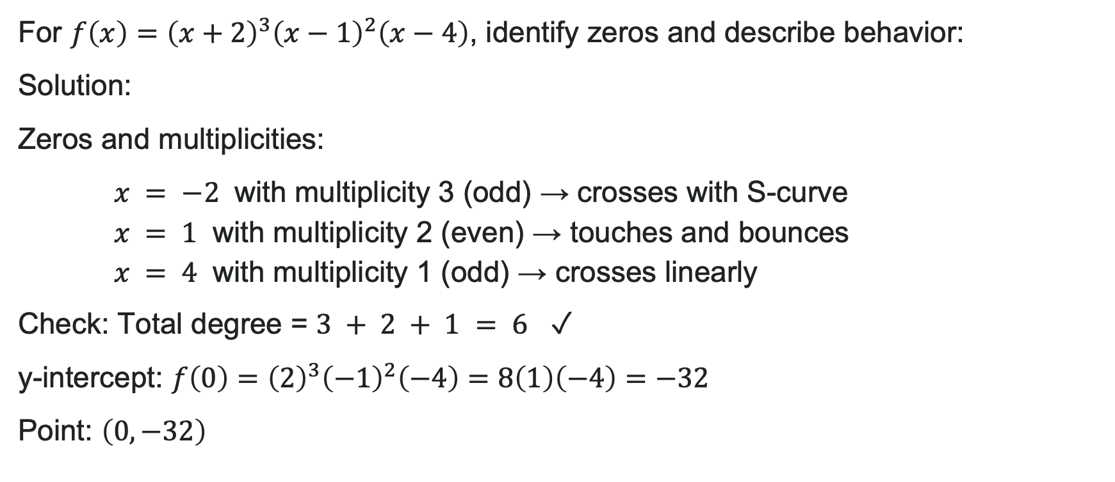
Example: Analyze Multiplicity
For $f\left(x\right)={\left(x+2\right)}^{3}{\left(x−1\right)}^{2}\left(x−4\right)$, identify zeros and describe behavior:
Solution:
Zeros and multiplicities:
$x = −2$ with multiplicity 3 (odd) → crosses with S-curve
$x = 1$ with multiplicity 2 (even) → touches and bounces
$x = 4$ with multiplicity 1 (odd) → crosses linearly
Check: Total degree = $3 + 2 + 1 = 6$ ✓
y-intercept: $f\left(0\right)={\left(2\right)}^{3}{\left(−1\right)}^{2}\left(−4\right)=8\left(1\right)\left(−4\right)=−32$
Point: $\left(0,−32\right)$

Slide 34
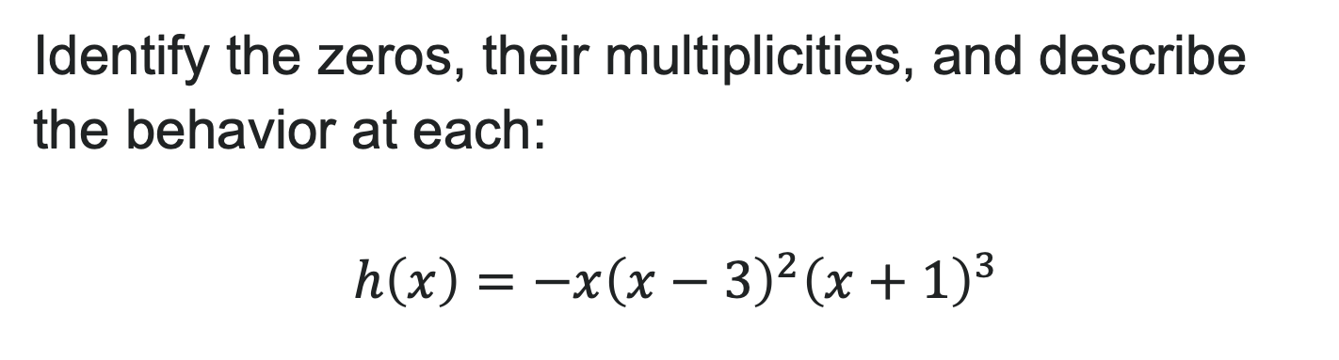
Try It: Graph Behavior and Multiplicities
Identify the zeros, their multiplicities, and describe the behavior at each:
$$h\left(x\right)=−x{\left(x−3\right)}^{2}{\left(x+1\right)}^{3}$$
Notes:
Answer:
Zeros and behavior:
x = 0 with multiplicity 1 (odd) → crosses linearly
x = 3 with multiplicity 2 (even) → touches and bounces
x = -1 with multiplicity 3 (odd) → crosses with S-curve
Degree: 1 + 2 + 3 = 6 (even)
Leading coefficient: negative (opens down on both ends)

Slide 35
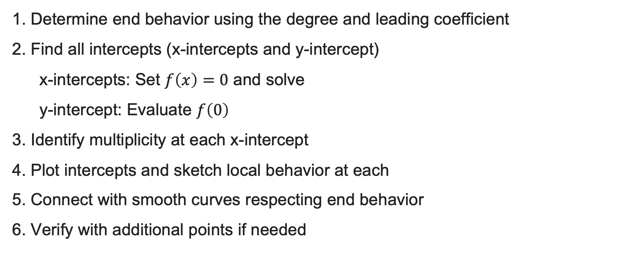
How to: Graph Polynomials by Hand
1. Determine end behavior using the degree and leading coefficient
2. Find all intercepts (x-intercepts and y-intercept)
x-intercepts: Set $f\left(x\right)=0$ and solve
y-intercept: Evaluate $f\left(0\right)$
3. Identify multiplicity at each x-intercept
4. Plot intercepts and sketch local behavior at each
5. Connect with smooth curves respecting end behavior
6. Verify with additional points if needed

Slide 36
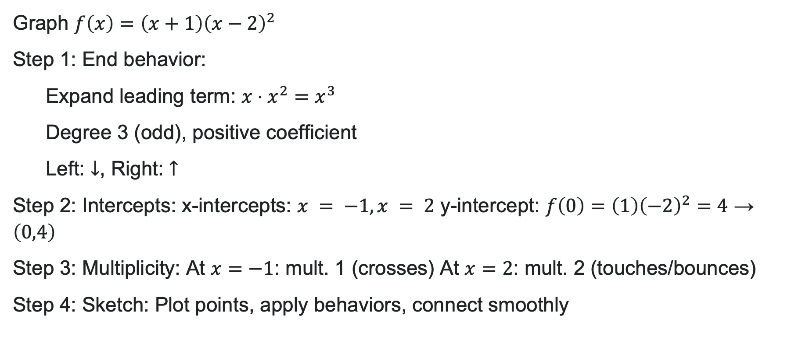
Example: Sketch the Graph
Graph $f\left(x\right)=\left(x+1\right){\left(x−2\right)}^{2}$
Step 1: End behavior:
Expand leading term: $x⋅x^{2}=x^{3}$
Degree 3 (odd), positive coefficient
Left: $↓$, Right: $↑$
Step 2: Intercepts: x-intercepts: $x = −1, x = 2$ y-intercept: $f\left(0\right)=\left(1\right){\left(−2\right)}^{2}=4$ → $\left(0,4\right)$
Step 3: Multiplicity: At $x=−1$: mult. 1 (crosses) At $x=2$: mult. 2 (touches/bounces)
Step 4: Sketch: Plot points, apply behaviors, connect smoothly

Slide 37
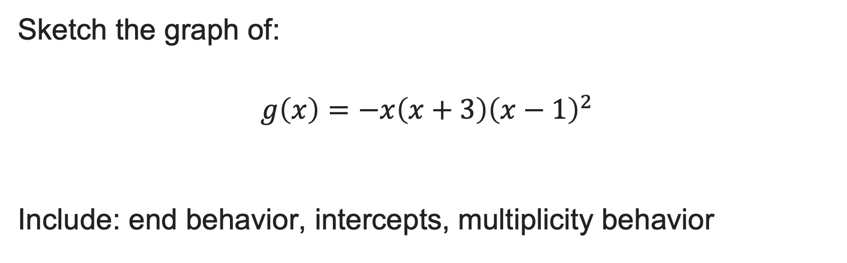
Try It: Draw a Polynomial
Sketch the graph of:
$$g\left(x\right)=−x\left(x+3\right){\left(x−1\right)}^{2}$$
Include: end behavior, intercepts, multiplicity behavior
Notes:
Answer:
End behavior: Degree 4 (even), negative leading coefficient → both ends down ↓↓
x-intercepts: x = 0 (mult. 1, crosses), x = -3 (mult. 1, crosses), x = 1 (mult. 2, touches)
y-intercept: g(0) = 0
Sketch: Start high on left, cross at -3, cross at 0 going up, touch and bounce at 1, end down on right

Slide 38
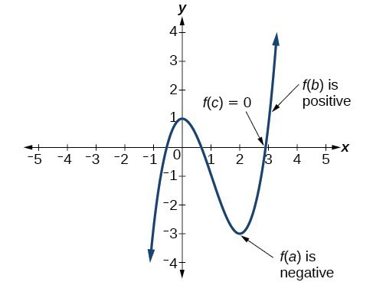
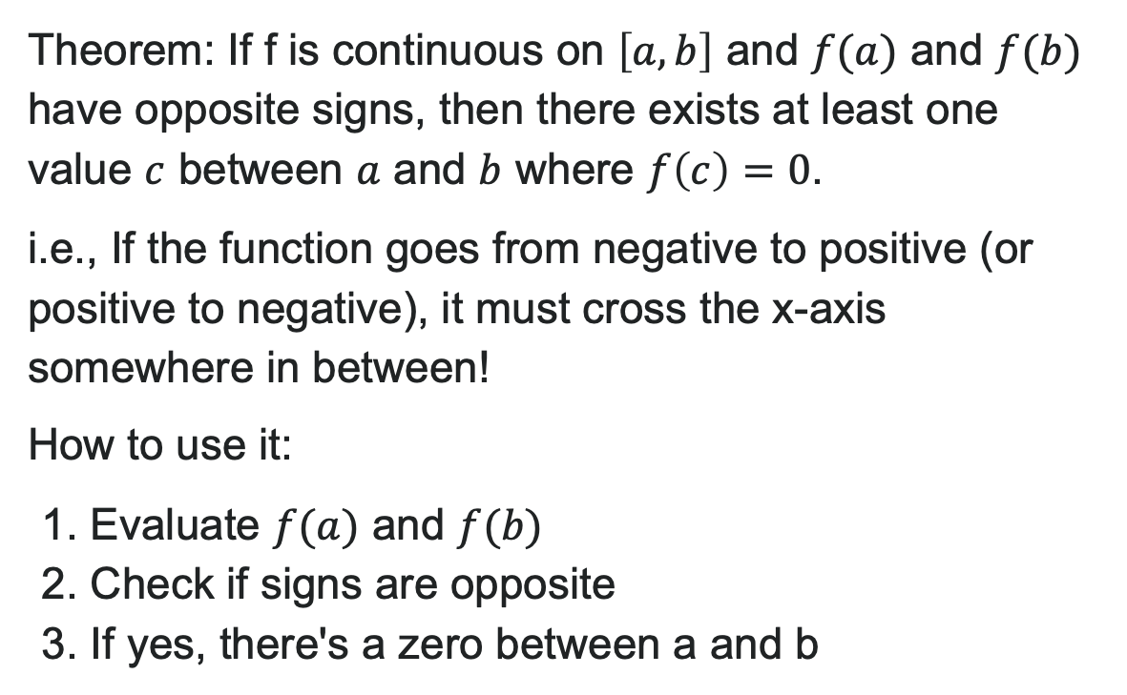
The Intermediate Value Theorem (IVT)
Theorem: If f is continuous on $\left[a,b\right]$ and $f(a)$ and $f(b)$ have opposite signs, then there exists at least one value $c$ between $a$ and $b$ where $f\left(c\right)=0$.
i.e., If the function goes from negative to positive (or positive to negative), it must cross the x-axis somewhere in between!
How to use it:
1. Evaluate $f(a)$ and $f(b)$
2. Check if signs are opposite
3. If yes, there's a zero between a and b

Slide 39
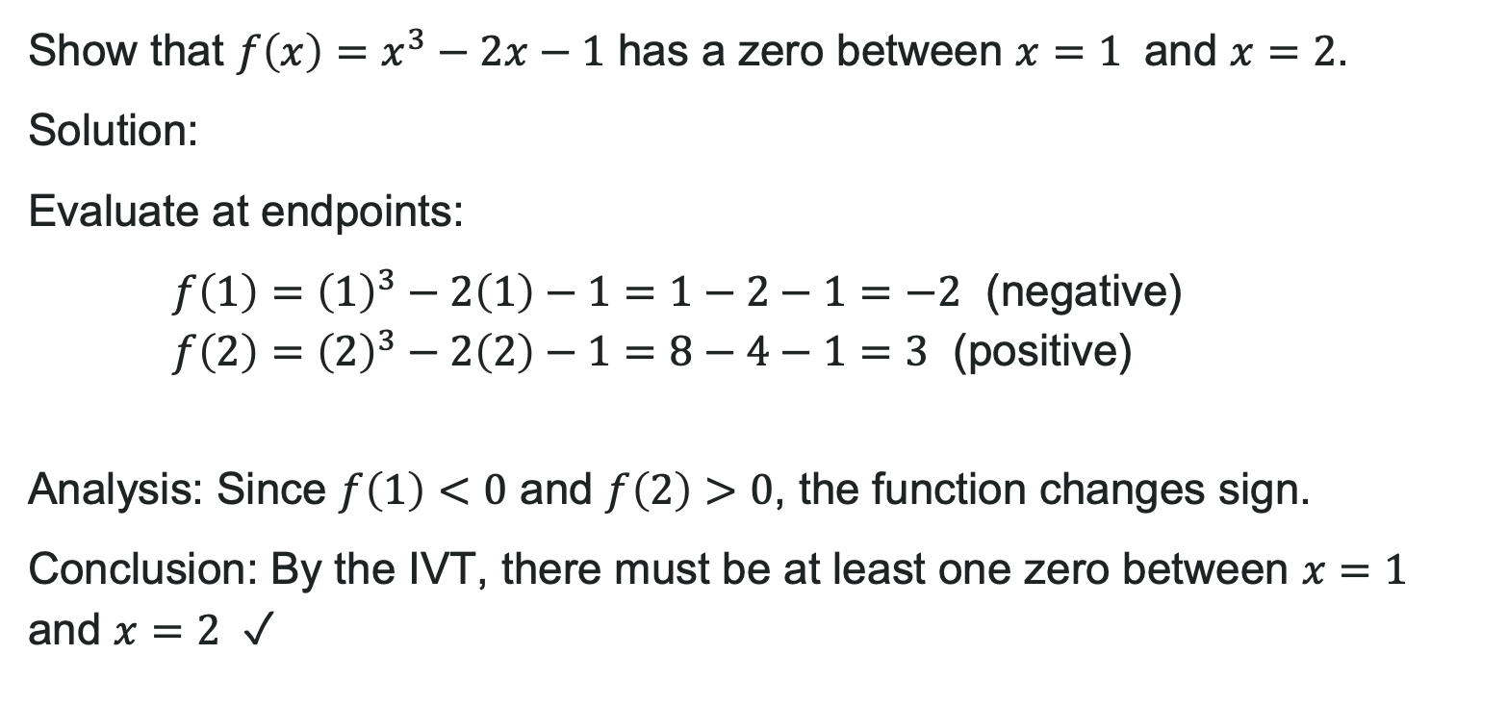
Example: Apply the IVT
Show that $f\left(x\right)=x^{3}−2x−1$ has a zero between $x=1$ and $x=2$.
Solution:
Evaluate at endpoints:
$f\left(1\right)={\left(1\right)}^{3}−2\left(1\right)−1=1−2−1=−2$ (negative)
$f\left(2\right)={\left(2\right)}^{3}−2\left(2\right)−1=8−4−1=3$ (positive)
Analysis: Since $f\left(1\right)<0$ and $f\left(2\right)>0$, the function changes sign.
Conclusion: By the IVT, there must be at least one zero between $x=1$ and $x=2$ ✓

Slide 40
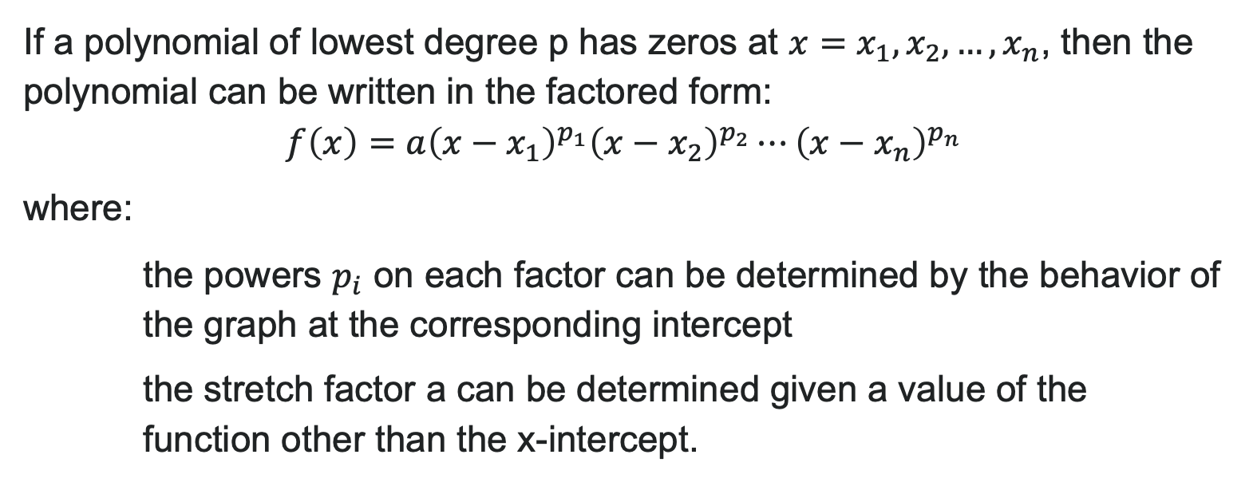
More Complex Factored Form
If a polynomial of lowest degree p has zeros at $x=x_{1},x_{2},…,x_{n}$, then the polynomial can be written in the factored form:
$$f\left(x\right)=a{\left(x−x_{1}\right)}^{p_{1}}{\left(x−x_{2}\right)}^{p_{2}}⋯{\left(x−x_{n}\right)}^{p_{n}}$$
where:
the powers $p_{i}$ on each factor can be determined by the behavior of the graph at the corresponding intercept
the stretch factor a can be determined given a value of the function other than the x-intercept.

Slide 41
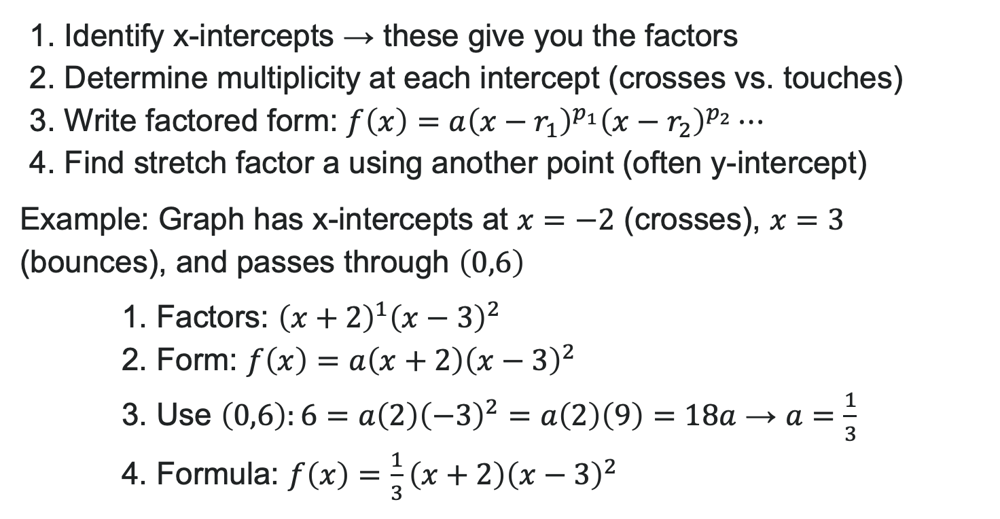
How to: Write a Formula from a Graph
1. Identify x-intercepts → these give you the factors
2. Determine multiplicity at each intercept (crosses vs. touches)
3. Write factored form: $f\left(x\right)=a{\left(x−r_{1}\right)}^{p_{1}}{\left(x−r_{2}\right)}^{p_{2}}⋯$
4. Find stretch factor a using another point (often y-intercept)
Example: Graph has x-intercepts at $x=−2$ (crosses), $x=3$ (bounces), and passes through $\left(0,6\right)$
1. Factors: ${\left(x+2\right)}^{1}{\left(x−3\right)}^{2}$
2. Form: $f\left(x\right)=a\left(x+2\right){\left(x−3\right)}^{2}$
3. Use $\left(0,6\right):6=a\left(2\right){\left(−3\right)}^{2}=a\left(2\right)\left(9\right)=18a$ → $a=\frac{1}{3}$
4. Formula: $f\left(x\right)=\frac{1}{3}\left(x+2\right){\left(x−3\right)}^{2}$

Slide 42
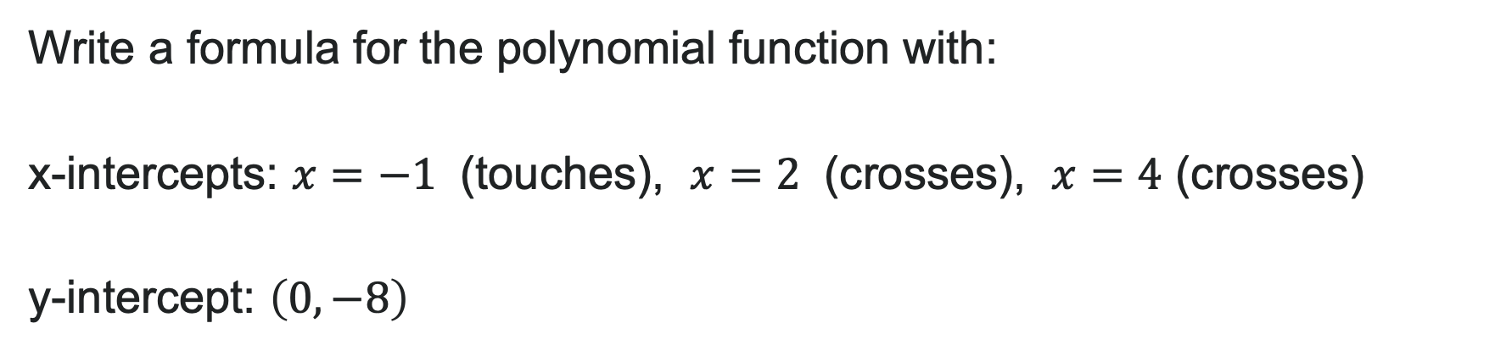
Try It: Polynomial Formula
Write a formula for the polynomial function with: x-intercepts: $x=−1$ (touches), $x=2$ (crosses), $x=4$ (crosses)
y-intercept: $\left(0,−8\right)$
Notes:
Solution: Step 1 - Factors:
x = -1 touches → (x + 1)^2
x = 2 crosses → (x - 2)
x = 4 crosses → (x - 4)
Step 2 - General form: f(x) = a(x + 1)^2(x - 2)(x - 4)
Step 3 - Find a: -8 = a(0 + 1)^2(0 - 2)(0 - 4) -8 = a(1)(-2)(-4) = 8a a = -1
Answer: f(x) = -(x + 1)^2(x - 2)(x - 4)

Slide 43
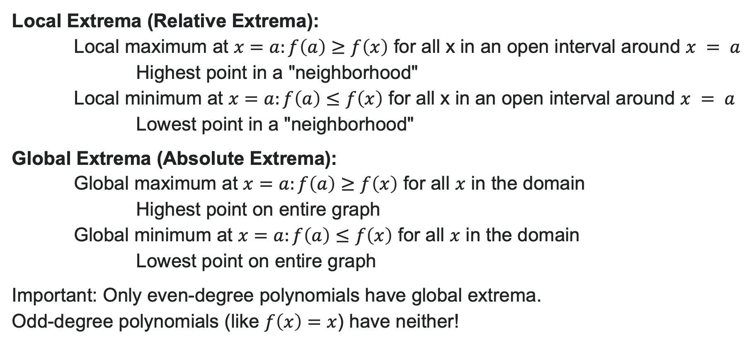
Local and Global Extrema
Local Extrema (Relative Extrema):
Local maximum at $x=a:f\left(a\right)≥f\left(x\right)$ for all x in an open interval around $x = a$
Highest point in a "neighborhood"
Local minimum at $x=a:f\left(a\right)≤f\left(x\right)$ for all x in an open interval around $x = a$
Lowest point in a "neighborhood"
Global Extrema (Absolute Extrema):
Global maximum at $x=a:f\left(a\right)≥f\left(x\right)$ for all $x$ in the domain
Highest point on entire graph
Global minimum at $x=a:f\left(a\right)≤f\left(x\right)$ for all $x$ in the domain
Lowest point on entire graph
Important: Only even-degree polynomials have global extrema. Odd-degree polynomials (like $f\left(x\right)=x$) have neither!

Slide 44
Before we finish up…
2
Next steps…..
3
Reminders about student hours, upcoming deadlines, campus activities ….
1
Questions…..

Slide 45

Attributions
Illustrations are from Storyset
Authored by: Lumen Learning. License: CC BY: Attribution

