Slide 1

Precalculus
Module 3:
Linear Functions

Slide 2
Affirmations
I am learning to balance study and relaxation.
I am proud of myself for showing up, even on hard days.
I am patient with myself as I work through tough problems.

Slide 3
Learning Goals: Graphs of Linear Functions
Deepen your understanding and form connections within these skills:
1 Make a table of values and use it to graph a linear function
2 Find and understand the slope and intercepts of a linear graph
3 Look at a graph and write the equation of the line shown

Slide 4

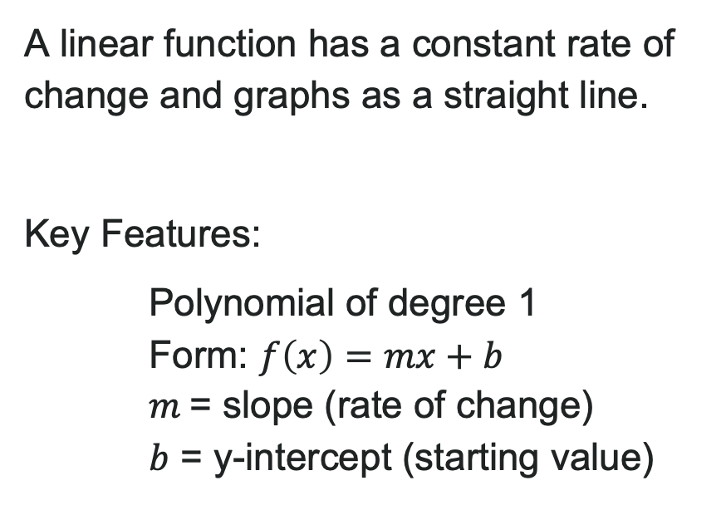
What is a Linear Function?
A linear function has a constant rate of change and graphs as a straight line.
Key Features:
Polynomial of degree 1
Form: $f\left(x\right)=mx+b$
$m$= slope (rate of change)
$b$ = y-intercept (starting value)

Slide 5
Representing Linear Functions
Linear functions can be described in words by stating how the output changes with respect to the input.
For example: "The train's distance from the station equals its constant speed multiplied by time, plus its starting distance of 250 meters."
Another way to represent a linear function: use a table of values!
Key Pattern to Look For:
When x-values increase by a consistent amount...
The y-values change by a constant amount
This constant change = the slope (rate of change)

Slide 6
Graphing by Plotting Points
How to Graph a Linear Function:
1. Choose a minimum of two input values.
2. Evaluate the function at each input value.
3. Use the resulting output values to identify coordinate pairs.
4. Plot the coordinate pairs on a grid.
5. Draw a line through the points.
Pro Tip: If your equation has a fraction, choose x-values that are multiples of the denominator!

Slide 7
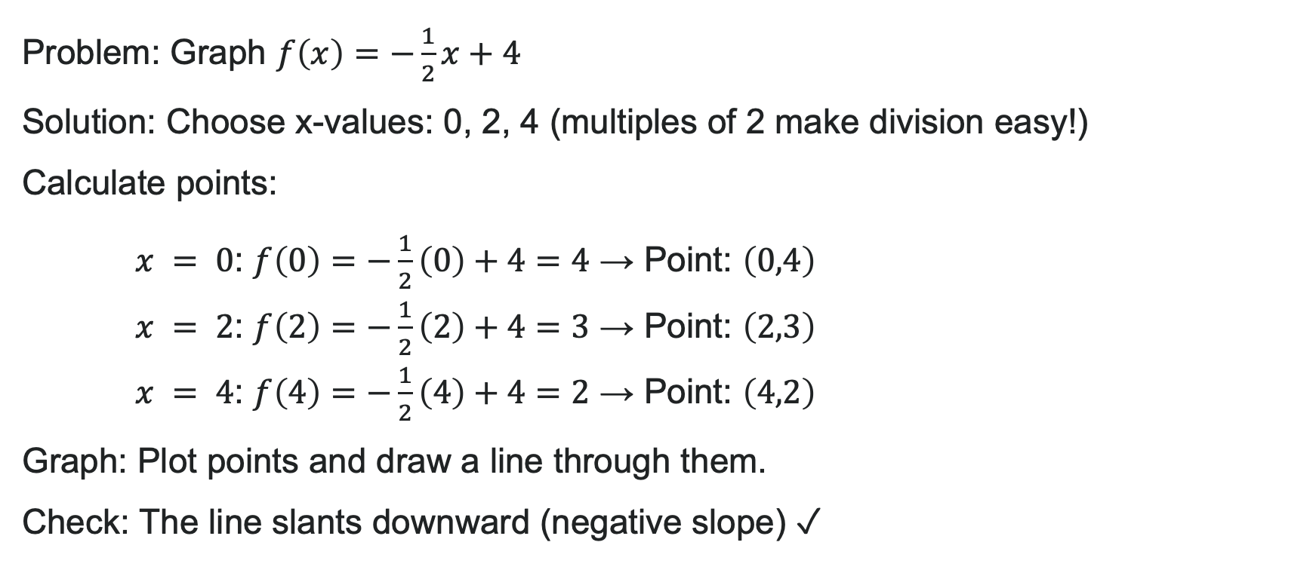
Example: Graph by Plotting Points
Problem: Graph $f\left(x\right)=−\frac{1}{2}x+4$
Solution: Choose x-values: 0, 2, 4 (multiples of 2 make division easy!)
Calculate points:
$x = 0$: $f\left(0\right)=−\frac{1}{2}\left(0\right)+4=4$ → Point: $\left(0,4\right)$
$x = 2$: $f\left(2\right)=−\frac{1}{2}\left(2\right)+4=3$ → Point: $\left(2,3\right)$
$x = 4$: $f\left(4\right)=−\frac{1}{2}\left(4\right)+4=2$ → Point: $\left(4,2\right)$
Graph: Plot points and draw a line through them.
Check: The line slants downward (negative slope) ✓

Slide 8
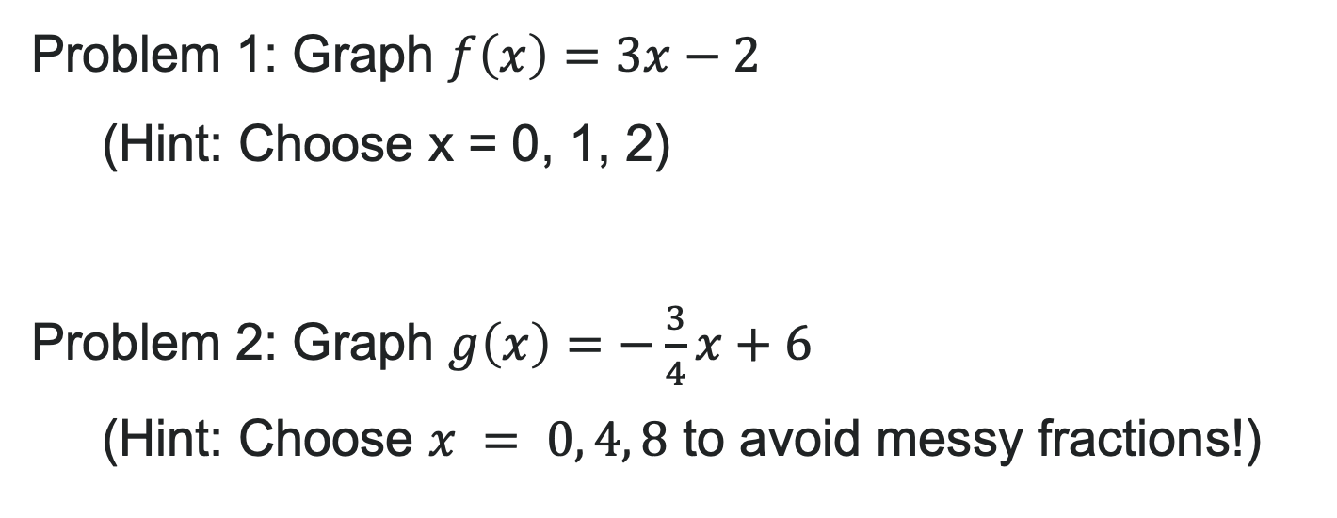
Try It: Graph by Plotting Points
Problem 1: Graph $f\left(x\right)=3x−2$
(Hint: Choose x = 0, 1, 2)
Problem 2: Graph $g\left(x\right)=−\frac{3}{4}x+6$
(Hint: Choose $x = 0, 4, 8$ to avoid messy fractions!)
Notes:
Problem 1 Answer:
Points: (0, -2), (1, 1), (2, 4) — line slopes upward steeply (slope = 3)
Problem 2 Answer:
Points: (0, 6), (4, 3), (8, 0) — line slopes downward, y-intercept at 6

Slide 9
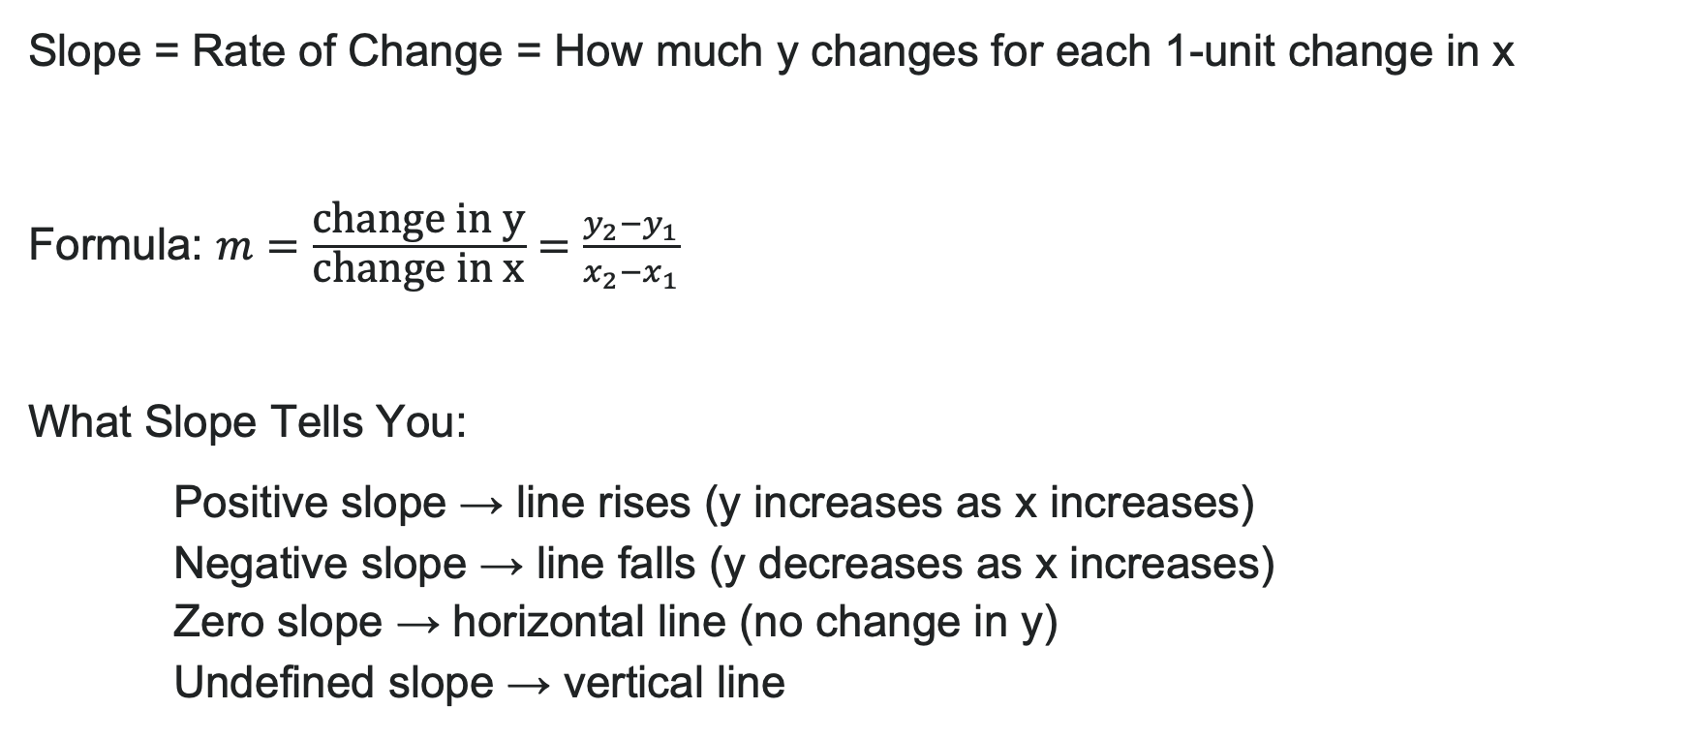
Understanding Slope
Slope = Rate of Change = How much y changes for each 1-unit change in x
Formula: $m=\frac{\text{change} \text{in} \text{y}}{\text{change} \text{in} \text{x}}=\frac{y_{2}−y_{1}}{x_{2}−x_{1}}$
What Slope Tells You:
Positive slope → line rises (y increases as x increases)
Negative slope → line falls (y decreases as x increases)
Zero slope → horizontal line (no change in y)
Undefined slope → vertical line

Slide 10
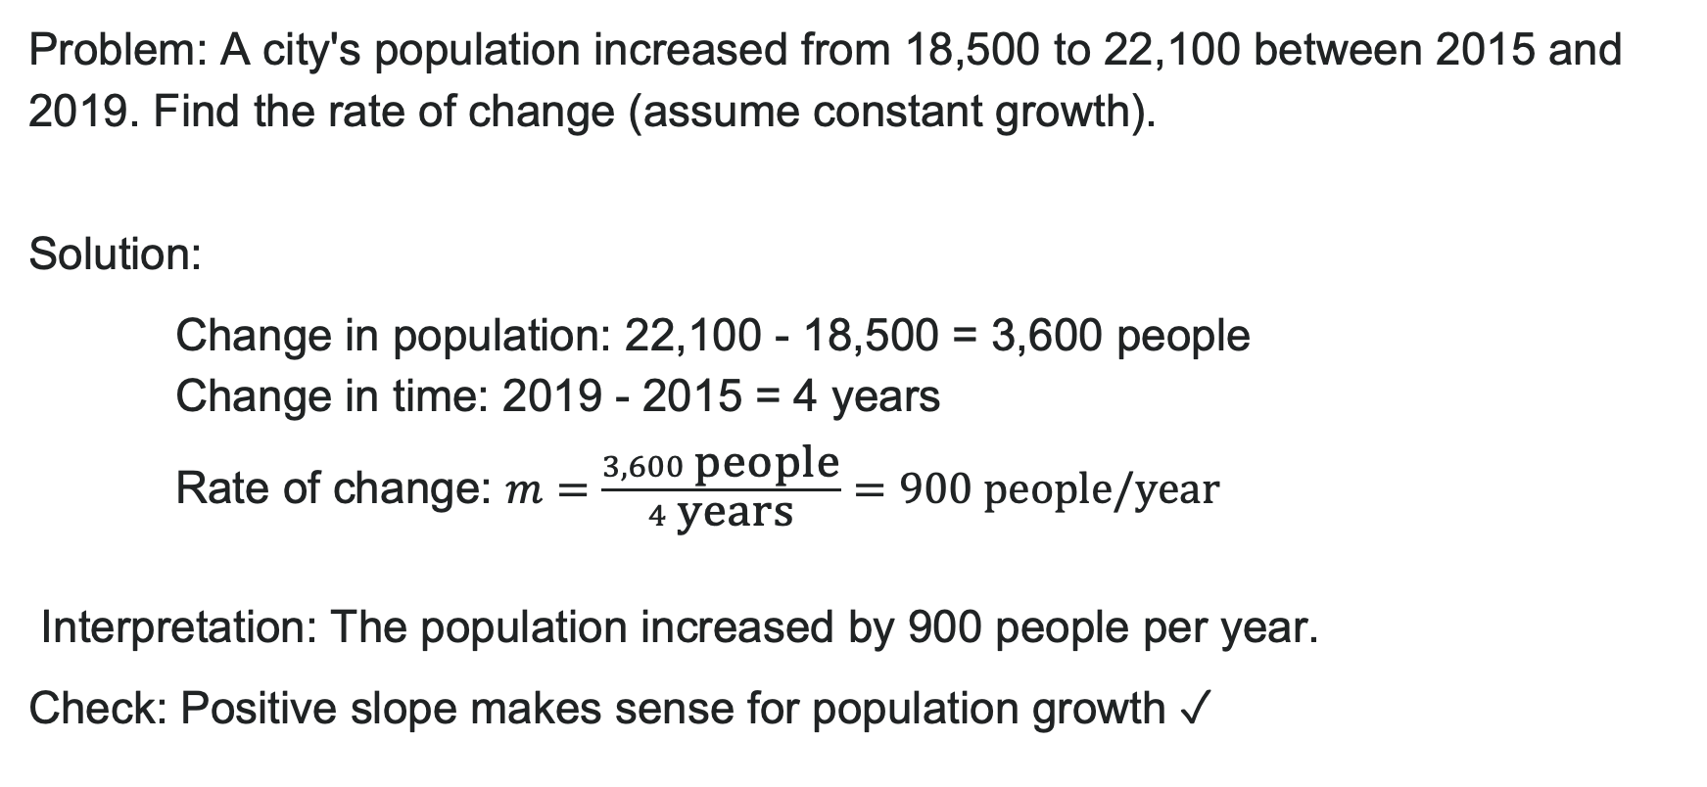
Example: Finding Rate of Change
Problem: A city's population increased from 18,500 to 22,100 between 2015 and 2019. Find the rate of change (assume constant growth).
Solution:
Change in population: 22,100 - 18,500 = 3,600 people
Change in time: 2019 - 2015 = 4 years
Rate of change: $m=\frac{3,600 \text{people}}{4 \text{years}}=900 \text{people}\text{/}\text{year}$
Interpretation: The population increased by 900 people per year.
Check: Positive slope makes sense for population growth ✓

Slide 11
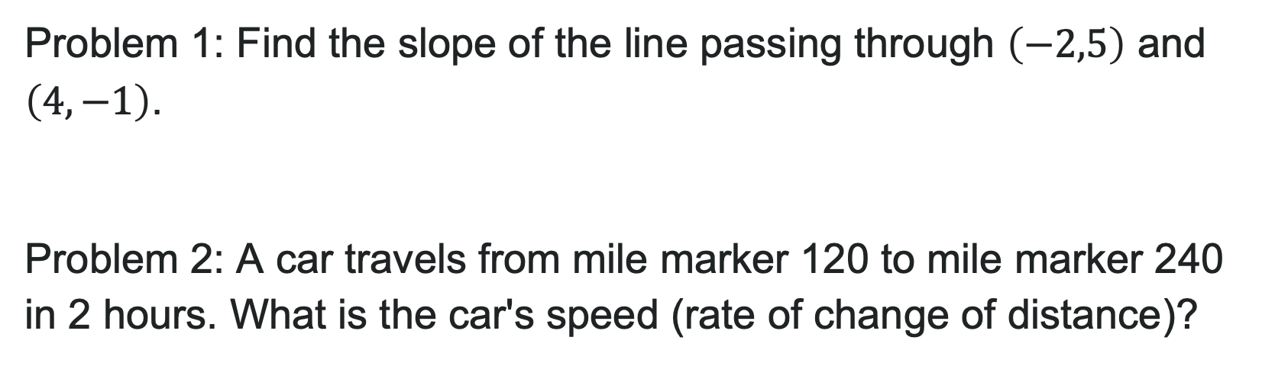
Try It: Calculate Slope
Problem 1: Find the slope of the line passing through $\left(−2,5\right)$ and $\left(4,−1\right)$.
Problem 2: A car travels from mile marker 120 to mile marker 240 in 2 hours. What is the car's speed (rate of change of distance)?
Notes:
Problem 1 Answer: m = \frac{-1 - 5}{4 - (-2)} = \frac{-6}{6} = -1
Problem 2 Answer: \frac{240 - 120}{2} = \frac{120 \text{ miles}}{2 \text{ hours}} = 60 \text{ mph}

Slide 12
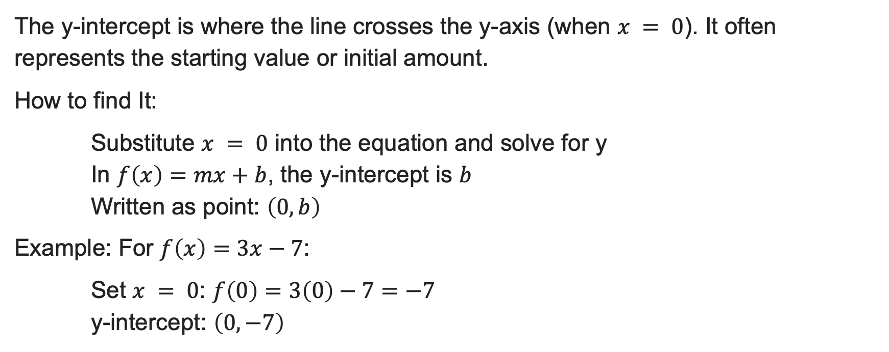
Finding the y-intercept
The y-intercept is where the line crosses the y-axis (when $x = 0$). It often represents the starting value or initial amount.
How to find It:
Substitute $x = 0$ into the equation and solve for y
In $f\left(x\right)=mx+b$, the y-intercept is $b$
Written as point: $\left(0,b\right)$
Example: For $f\left(x\right)=3x−7$:
Set $x = 0$: $f\left(0\right)=3\left(0\right)−7=−7$
y-intercept: $\left(0,−7\right)$

Slide 13
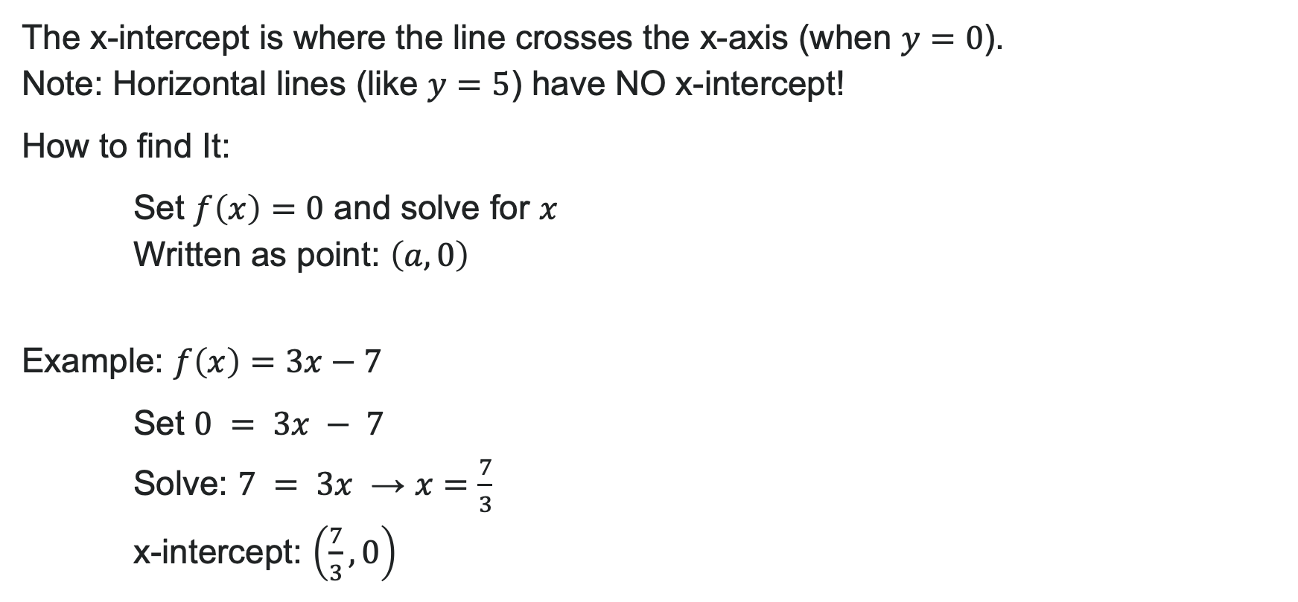
Finding the x-intercept
The x-intercept is where the line crosses the x-axis (when $y=0$).
Note: Horizontal lines (like $y=5$) have NO x-intercept!
How to find It:
Set $f\left(x\right)=0$ and solve for $x$
Written as point: $\left(a,0\right)$
Example: $f\left(x\right)=3x−7$
Set $0 = 3x − 7$
Solve: $7 = 3x$ → $x=\frac{7}{3}$
x-intercept: $\left(\frac{7}{3},0\right)$

Slide 14
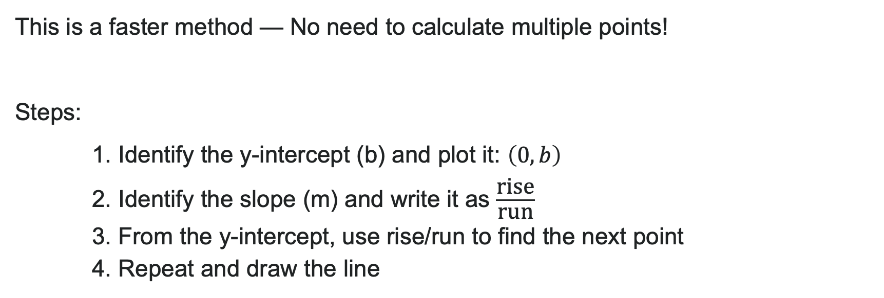
Graph Using Slope & y-intercept
This is a faster method — No need to calculate multiple points!
Steps:
1. Identify the y-intercept (b) and plot it: $\left(0,b\right)$
2. Identify the slope (m) and write it as $\frac{\text{rise}}{\text{run}}$
3. From the y-intercept, use rise/run to find the next point
4. Repeat and draw the line

Slide 15
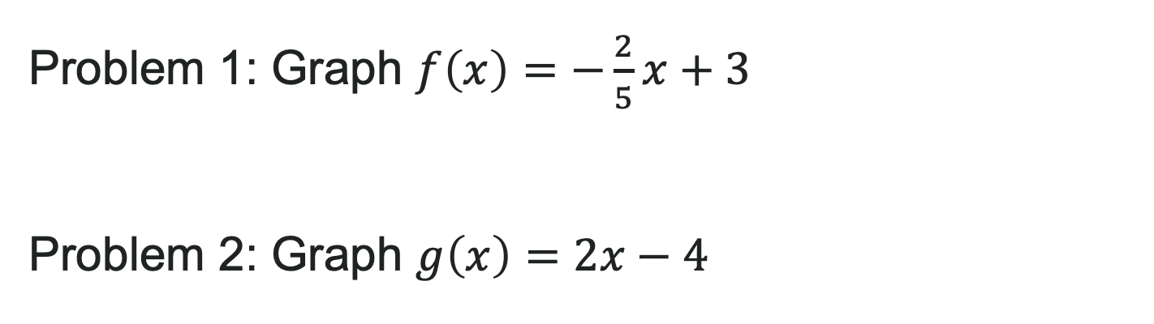
Try It: Graph Using Slope & y-intercept
Problem 1: Graph $f\left(x\right)=−\frac{2}{5}x+3$
Problem 2: Graph $g\left(x\right)=2x−4$
Notes:
Problem 1 Answer: Y-int: (0, 3), Slope: -\frac{2}{5} (down 2, right 5), passes through (5, 1)
Problem 2 Answer: Y-int: (0, -4), Slope: 2 = \frac{2}{1} (up 2, right 1), passes through (1, -2), (2, 0)

Slide 16
Learning Goals: Linear Functions
Deepen your understanding and form connections within these skills:
1 Write the equation of a line given a point and a slope, two points, or a table of values
2 Graph a linear function from any version of its equation
3 Graph and write the equations of horizontal and vertical lines
4 Write the equation of a line parallel or perpendicular to a given line

Slide 17
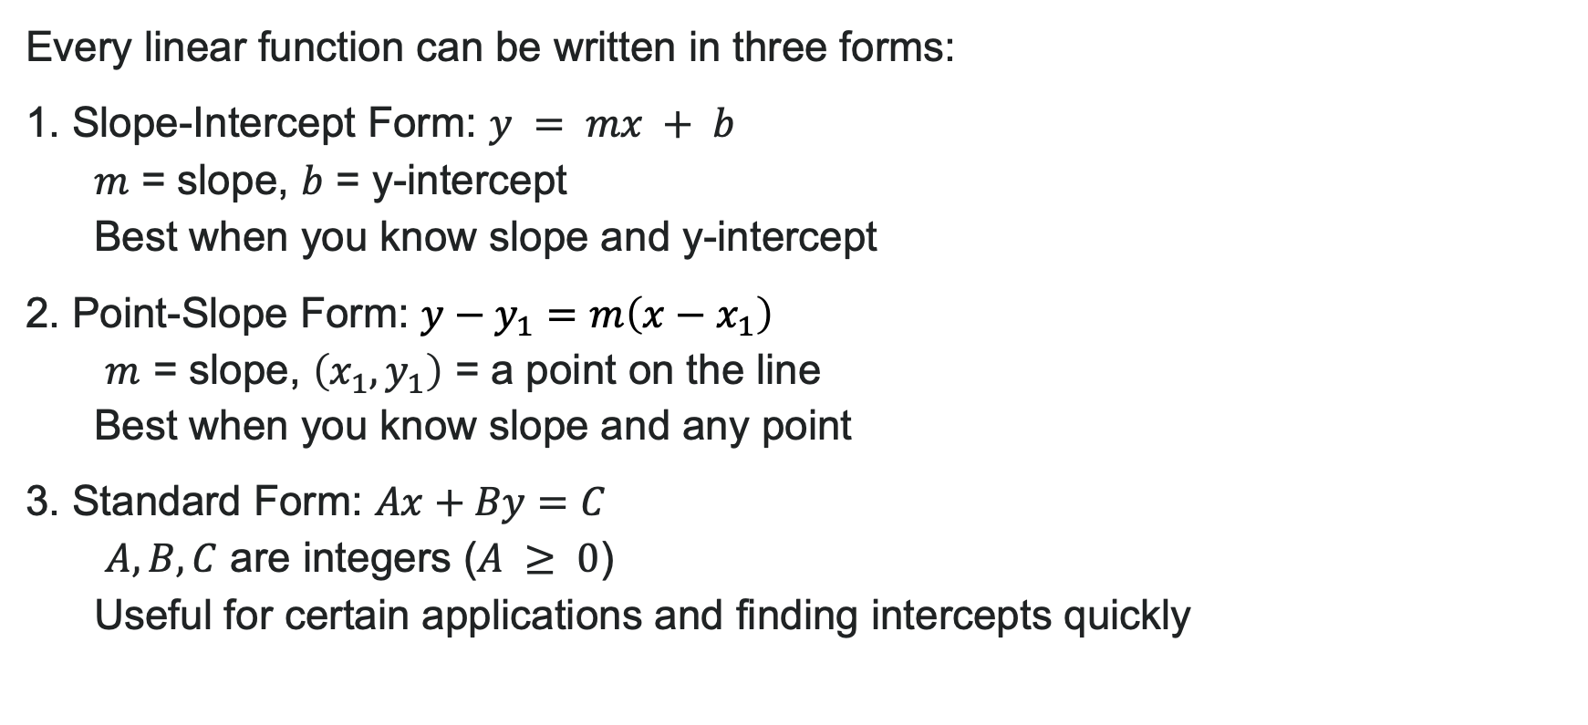
Three Forms of Linear Equations
Every linear function can be written in three forms:
1. Slope-Intercept Form: $y = mx + b$
$m$ = slope, $b$ = y-intercept
Best when you know slope and y-intercept
2. Point-Slope Form: $y−y_{1}=m\left(x−x_{1}\right)$
$m$ = slope, $\left(x_{1},y_{1}\right)$ = a point on the line
Best when you know slope and any point
3. Standard Form: $Ax+By=C$
$A,B,C$ are integers ($A ≥ 0$)
Useful for certain applications and finding intercepts quickly
Notes:
Key Idea: These all describe the SAME line, just written differently!

Slide 18
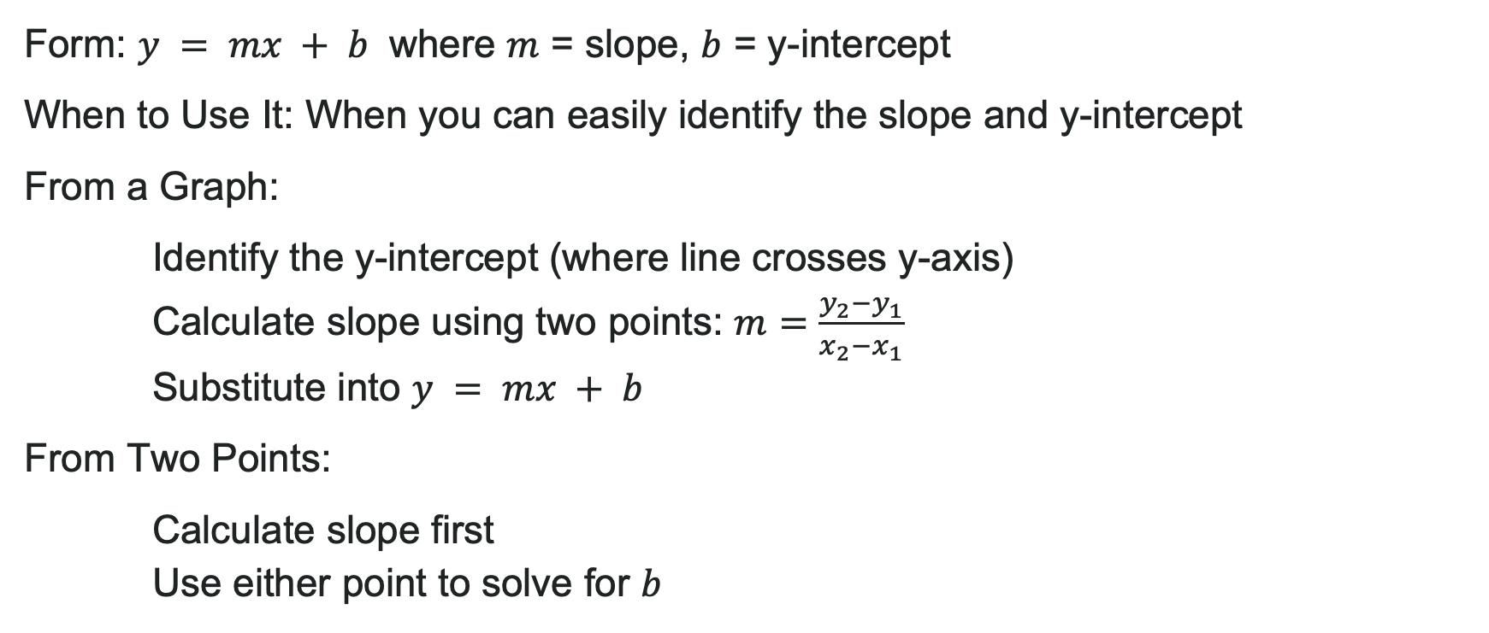
Writing Equations in Slope-Intercept Form
Form: $y = mx + b$ where $m$ = slope, $b$ = y-intercept
When to Use It: When you can easily identify the slope and y-intercept
From a Graph:
Identify the y-intercept (where line crosses y-axis)
Calculate slope using two points: $m=\frac{y_{2}−y_{1}}{x_{2}−x_{1}}$
Substitute into $y = mx + b$
From Two Points:
Calculate slope first
Use either point to solve for $b$

Slide 19
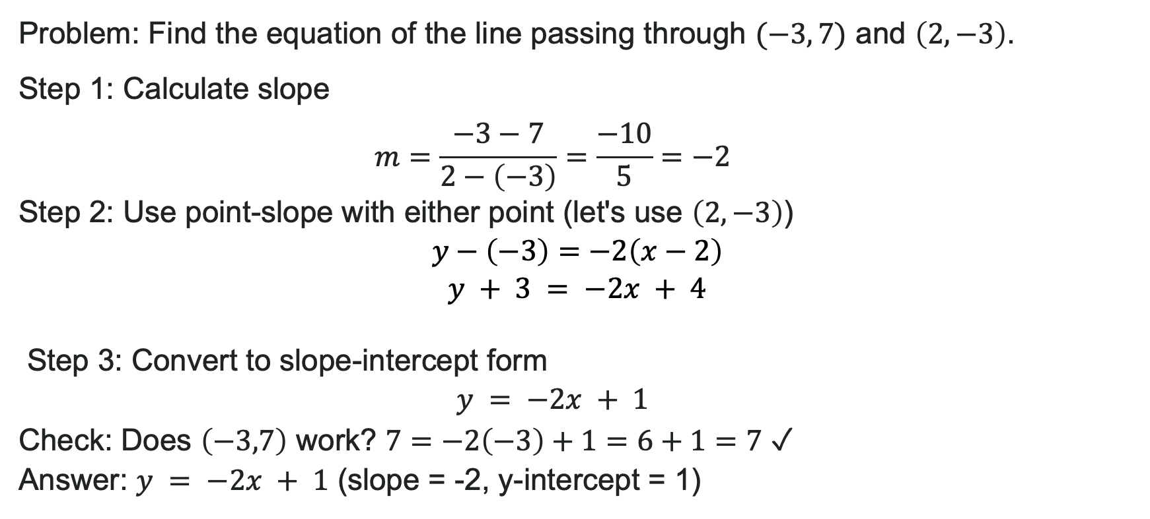
Example: Slope-Intercept Form
Problem: Find the equation of the line passing through $(−3, 7)$ and $\left(2,−3\right)$.
Step 1: Calculate slope
$$m=\frac{−3−7}{2−\left(−3\right)}=\frac{−10}{5}=−2$$
Step 2: Use point-slope with either point (let's use $\left(2,−3\right)$)
$$y−\left(−3\right)=−2\left(x−2\right) \\ y + 3 = −2x + 4$$
Step 3: Convert to slope-intercept form
$$y = −2x + 1$$
Check: Does $\left(−3,7\right)$ work? $7=−2\left(−3\right)+1=6+1=7$ ✓
Answer: $y = −2x + 1$ (slope = -2, y-intercept = 1)

Slide 20
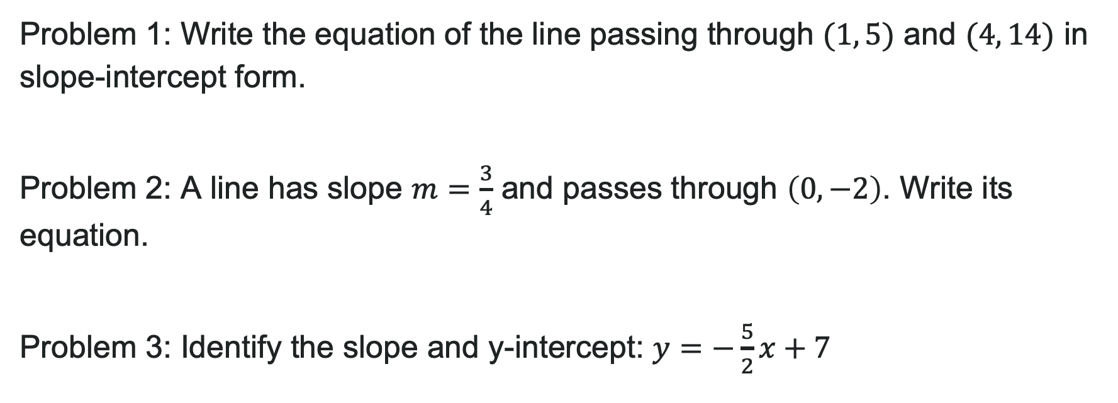
Try It: Slope-Intercept Form
Problem 1: Write the equation of the line passing through $(1, 5)$ and $(4, 14)$ in slope-intercept form.
Problem 2: A line has slope $m=\frac{3}{4}$ and passes through $\left(0,−2\right)$. Write its equation.
Problem 3: Identify the slope and y-intercept: $y=−\frac{5}{2}x+7$
Notes:
Problem 1 Answer: m = \frac{14-5}{4-1} = \frac{9}{3} = 3; using (1,5): y - 5 = 3(x-1) → y = 3x + 2
Problem 2 Answer: Since it passes through y-intercept, y = \frac{3}{4}x - 2
Problem 3 Answer: Slope = -\frac{5}{2}, y-intercept = (0, 7)

Slide 21
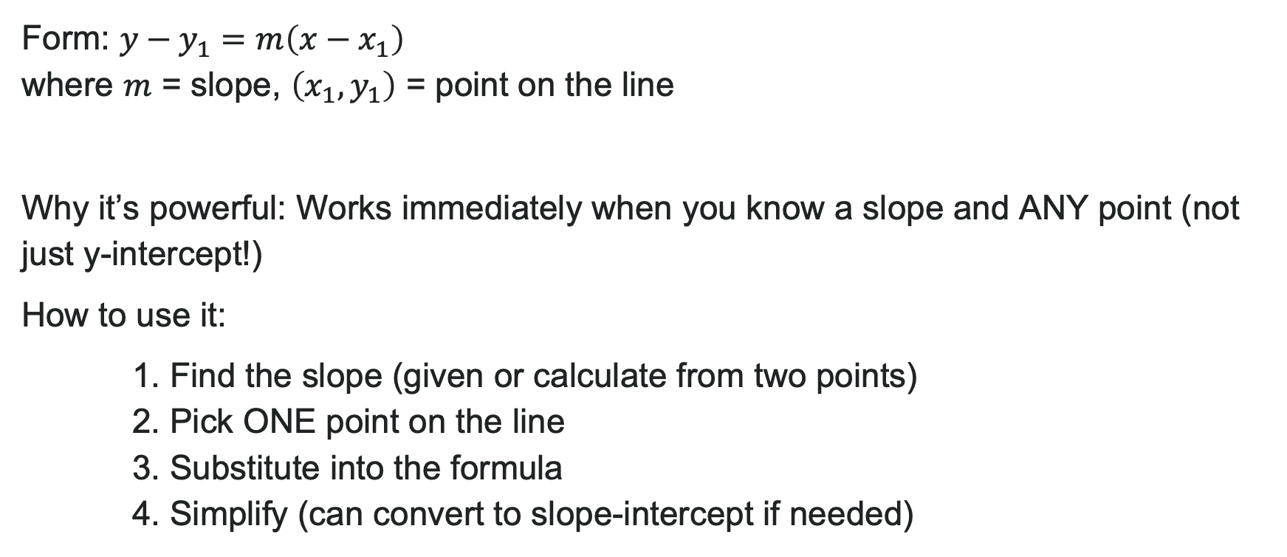
Point-Slope Form
Form: $y−y_{1}=m\left(x−x_{1}\right)$
where $m$ = slope, $\left(x_{1},y_{1}\right)$ = point on the line
Why it’s powerful: Works immediately when you know a slope and ANY point (not just y-intercept!)
How to use it:
1. Find the slope (given or calculate from two points)
2. Pick ONE point on the line
3. Substitute into the formula
4. Simplify (can convert to slope-intercept if needed)

Slide 22
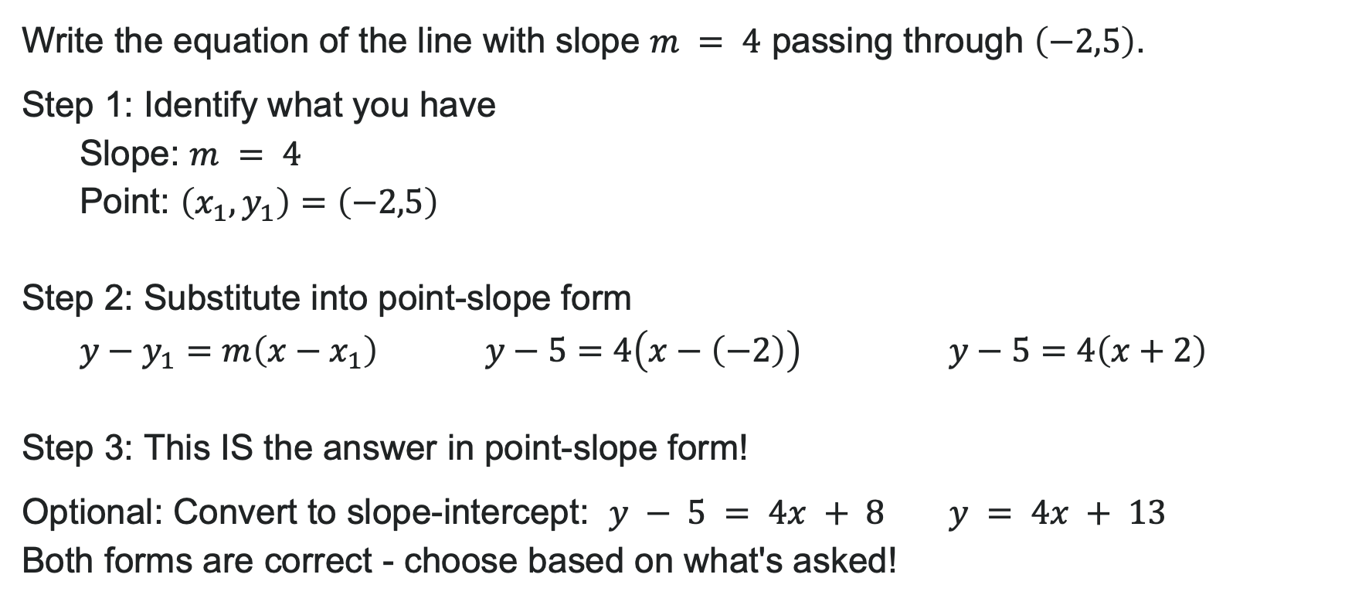
Example: Using Point-Slope Form
Write the equation of the line with slope $m = 4$ passing through $\left(−2,5\right)$.
Step 1: Identify what you have
Slope: $m = 4$
Point: $\left(x_{1},y_{1}\right)=\left(−2,5\right)$
Step 2: Substitute into point-slope form
$y−y_{1}=m\left(x−x_{1}\right)$ $y−5=4\left(x−\left(−2\right)\right)$ $y−5=4\left(x+2\right)$
Step 3: This IS the answer in point-slope form!
Optional: Convert to slope-intercept: $y − 5 = 4x + 8$ $y = 4x + 13$
Both forms are correct - choose based on what's asked!

Slide 23
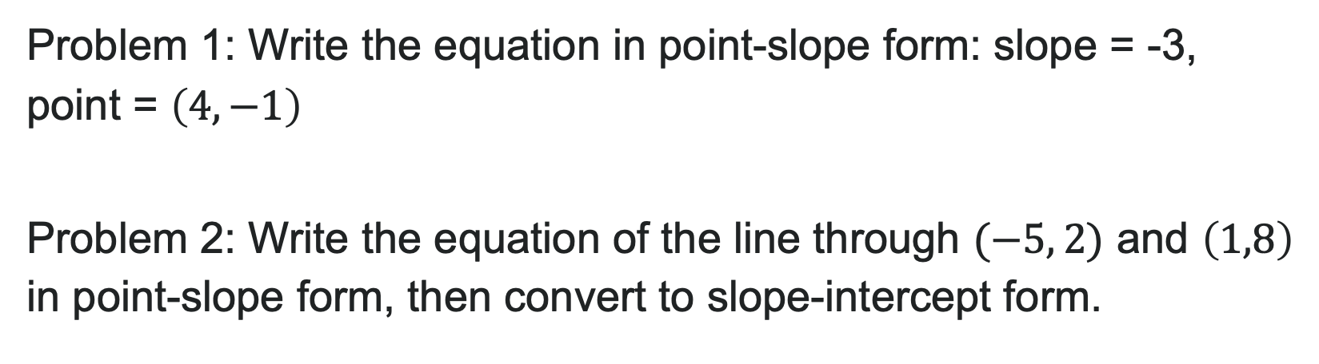
Try It: Point-Slope Form
Problem 1: Write the equation in point-slope form: slope = -3, point = $\left(4,−1\right)$
Problem 2: Write the equation of the line through $(−5, 2)$ and $\left(1,8\right)$ in point-slope form, then convert to slope-intercept form.
Notes:
Problem 1 Answer: y - (-1) = -3(x - 4) or y + 1 = -3(x - 4) Problem 2 Answer: m = \frac{8-2}{1-(-5)} = \frac{6}{6} = 1; Point-slope: y - 2 = 1(x + 5) or y - 8 = 1(x - 1); Slope-intercept: y = x + 7

Slide 24

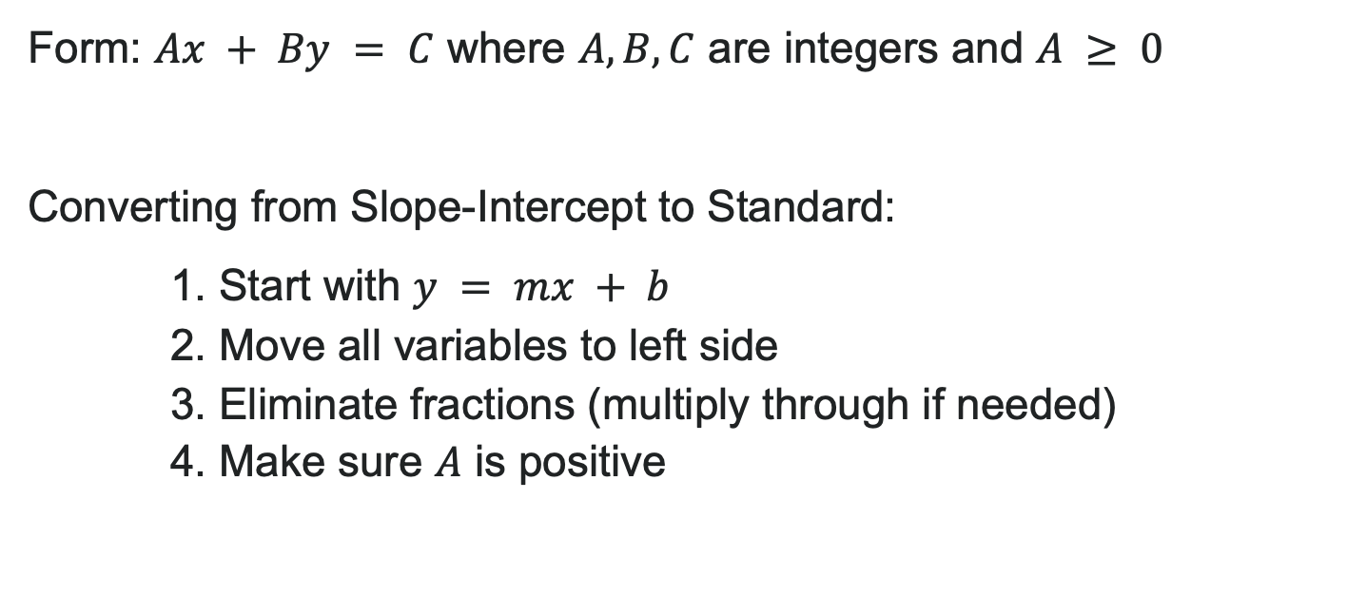
Standard Form of a Line
Form: $Ax + By = C$ where $A, B, C$ are integers and $A ≥ 0$
Converting from Slope-Intercept to Standard:
1. Start with $y = mx + b$
2. Move all variables to left side
3. Eliminate fractions (multiply through if needed)
4. Make sure $A$ is positive

Slide 25
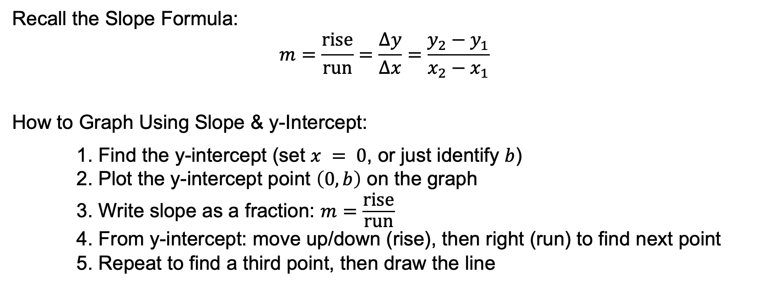
Graphing a Linear Function Using y-intercept and Slope
Recall the Slope Formula:
$$m=\frac{\text{rise}}{\text{run}}=\frac{Δy}{Δx}=\frac{y_{2}−y_{1}}{x_{2}−x_{1}}$$
How to Graph Using Slope & y-Intercept:
1. Find the y-intercept (set $x = 0$, or just identify $b$)
2. Plot the y-intercept point $\left(0,b\right)$ on the graph
3. Write slope as a fraction: $m=\frac{\text{rise}}{\text{run}}$
4. From y-intercept: move up/down (rise), then right (run) to find next point
5. Repeat to find a third point, then draw the line

Slide 26

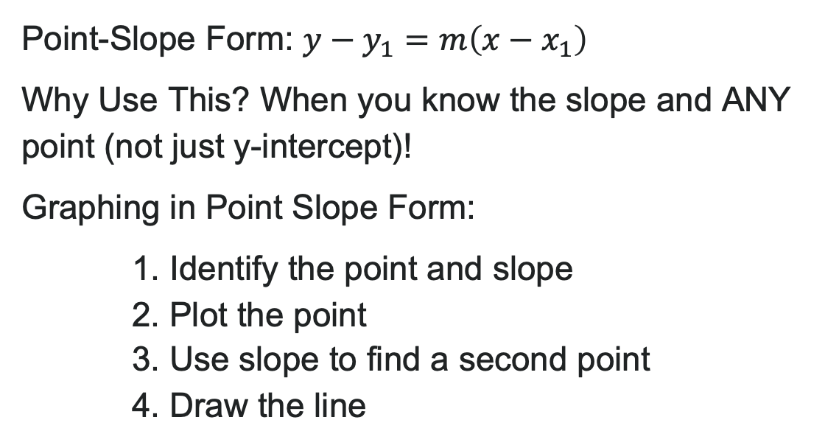
Graphing Lines in Point-Slope Form
Point-Slope Form: $y−y_{1}=m\left(x−x_{1}\right)$
Why Use This? When you know the slope and ANY point (not just y-intercept)!
Graphing in Point Slope Form:
1. Identify the point and slope
2. Plot the point
3. Use slope to find a second point
4. Draw the line

Slide 27
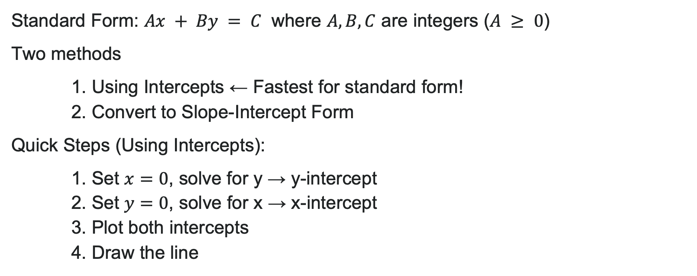
Graphing Lines in Standard Form
Standard Form: $Ax + By = C$ where $A, B, C$ are integers ($A ≥ 0$)
Two methods
1. Using Intercepts ← Fastest for standard form!
2. Convert to Slope-Intercept Form
Quick Steps (Using Intercepts):
1. Set $x=0$, solve for y → y-intercept
2. Set $y=0$, solve for x → x-intercept
3. Plot both intercepts
4. Draw the line

Slide 28
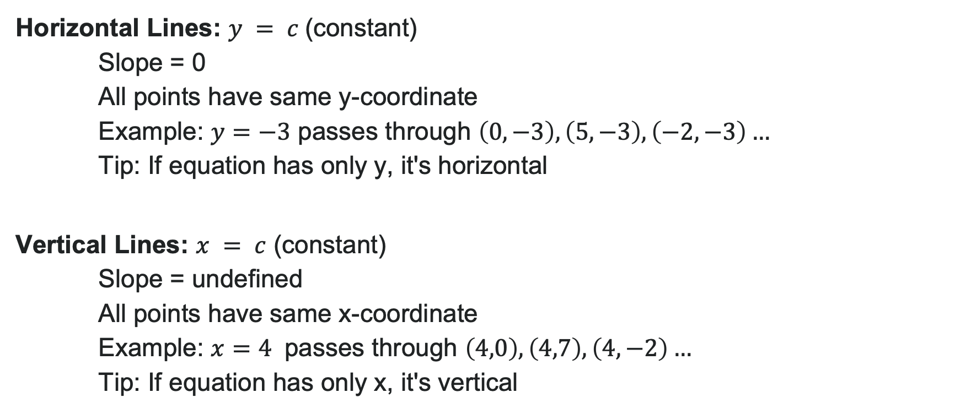
Special Cases: Horizontal & Vertical Lines
Horizontal Lines: $y = c$(constant)
Slope = 0
All points have same y-coordinate
Example: $y=−3$ passes through $\left(0,−3\right),\left(5,−3\right),\left(−2,−3\right)…$
Tip: If equation has only y, it's horizontal
Vertical Lines: $x = c$ (constant)
Slope = undefined
All points have same x-coordinate
Example: $x=4$ passes through $\left(4,0\right),\left(4,7\right),\left(4,−2\right)…$
Tip: If equation has only x, it's vertical

Slide 29
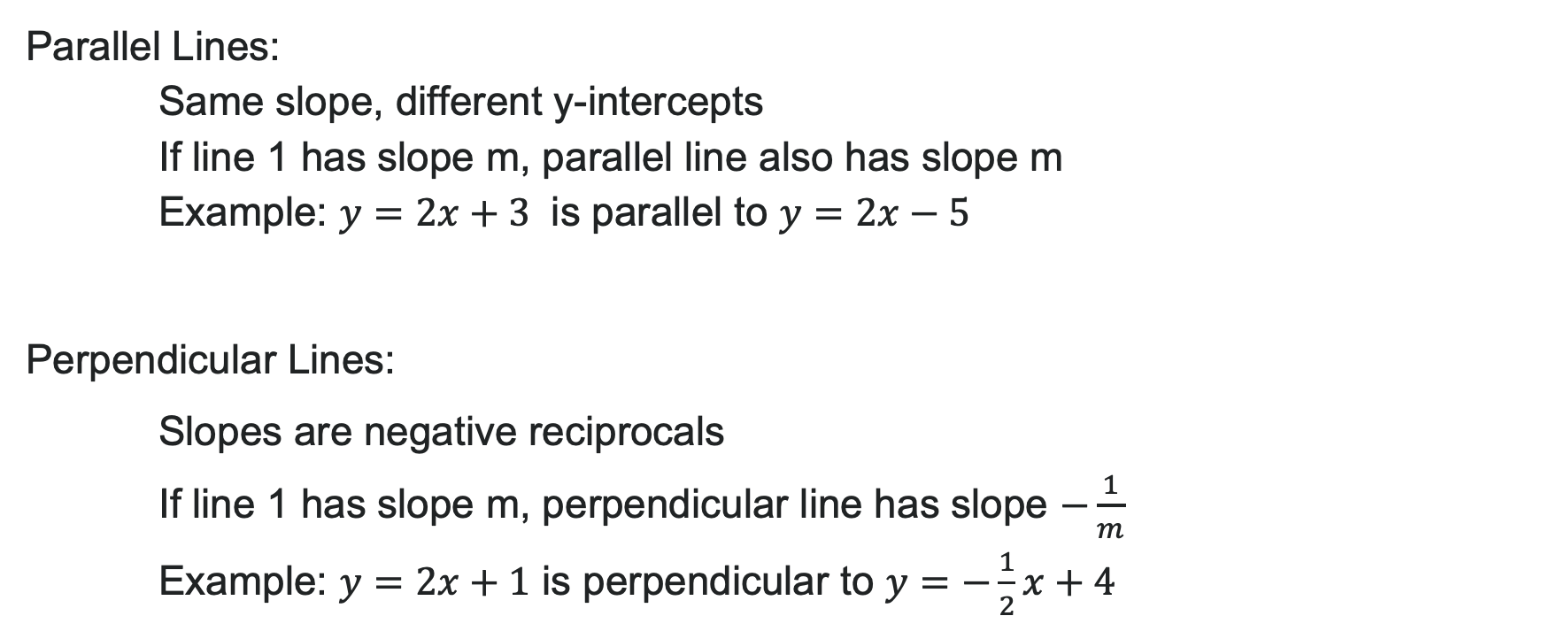
Parallel & Perpendicular Lines
Parallel Lines:
Same slope, different y-intercepts
If line 1 has slope m, parallel line also has slope m
Example: $y=2x+3$ is parallel to $y=2x−5$
Perpendicular Lines:
Slopes are negative reciprocals
If line 1 has slope m, perpendicular line has slope $−\frac{1}{m}$
Example: $y=2x+1$ is perpendicular to $y=−\frac{1}{2}x+4$

Slide 30
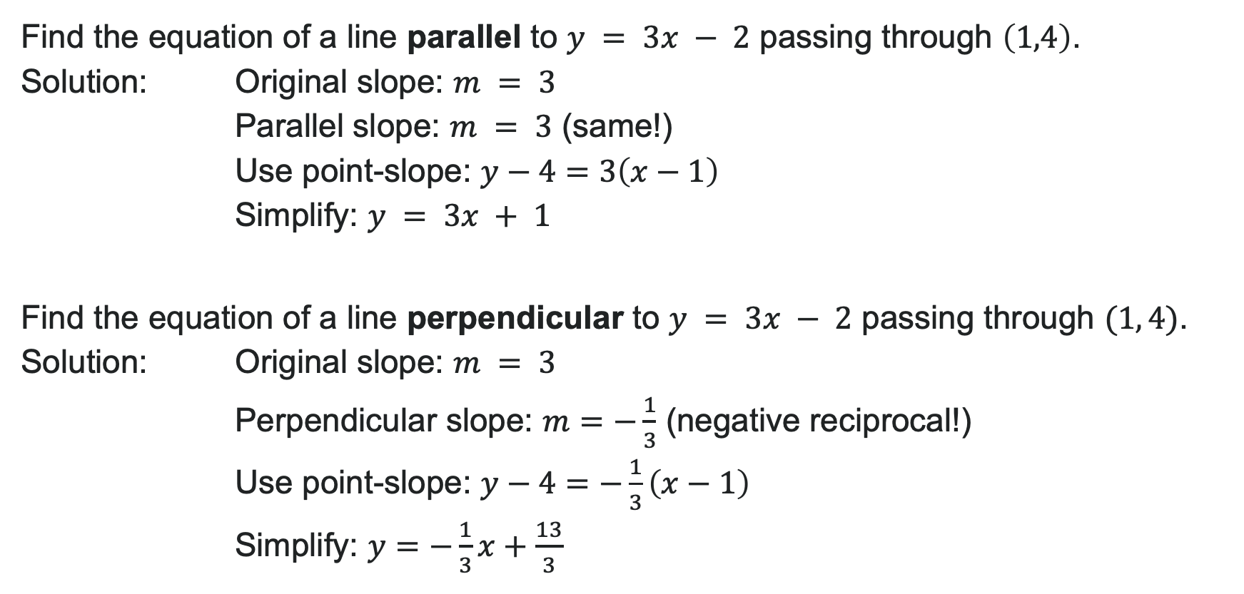
Example: Parallel & Perpendicular
Find the equation of a line parallel to $y = 3x − 2$ passing through $\left(1,4\right)$.
Solution: Original slope: $m = 3$
Parallel slope: $m = 3$ (same!)
Use point-slope: $y−4=3\left(x−1\right)$
Simplify: $y = 3x + 1$
Find the equation of a line perpendicular to $y = 3x − 2$ passing through $(1, 4)$.
Solution: Original slope: $m = 3$
Perpendicular slope: $m=−\frac{1}{3}$ (negative reciprocal!)
Use point-slope: $y−4=−\frac{1}{3}\left(x−1\right)$
Simplify: $y=−\frac{1}{3}x+\frac{13}{3}$

Slide 31
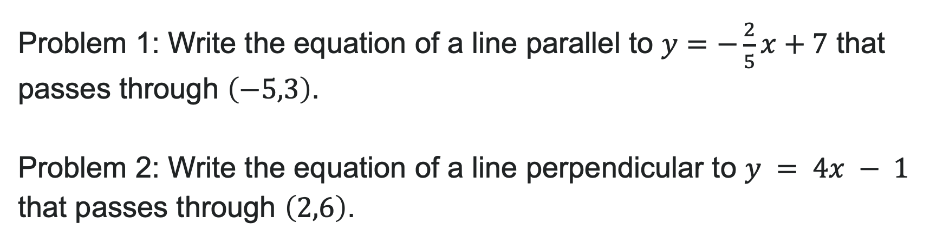
Try It: Parallel and Perpendicular Equations
Problem 1: Write the equation of a line parallel to $y=−\frac{2}{5}x+7$ that passes through $\left(−5,3\right)$.
Problem 2: Write the equation of a line perpendicular to $y = 4x − 1$ that passes through $\left(2,6\right)$.
Notes:
Problem 1 Answer: Parallel slope = -\frac{2}{5}; y - 3 = -\frac{2}{5}(x + 5) → y = -\frac{2}{5}x + 1
Problem 2 Answer: Perpendicular slope = -\frac{1}{4}; y - 6 = -\frac{1}{4}(x - 2) → y = -\frac{1}{4}x + \frac{13}{2}

Slide 32
Learning Goals: Linear Models
Deepen your understanding and form connections within these skills:
1 Write a linear equation given a scenario
2 Make a scatter plot using data points and describe any patterns
3 Find a line that best fits the data in a scatter plot
4 Use a line of best fit to make predictions based on data

Slide 33
The Modeling Process
When do we use linear models? Problems with constant rate of change
The Strategy (8 Steps):
Identify changing quantities and define variables
Find initial values and rates of change (slope!)
Determine what you're trying to find
Plan your solution pathway
Write the linear function
Solve or evaluate the function
Check if your answer makes sense
Communicate your result with units and context

Slide 34
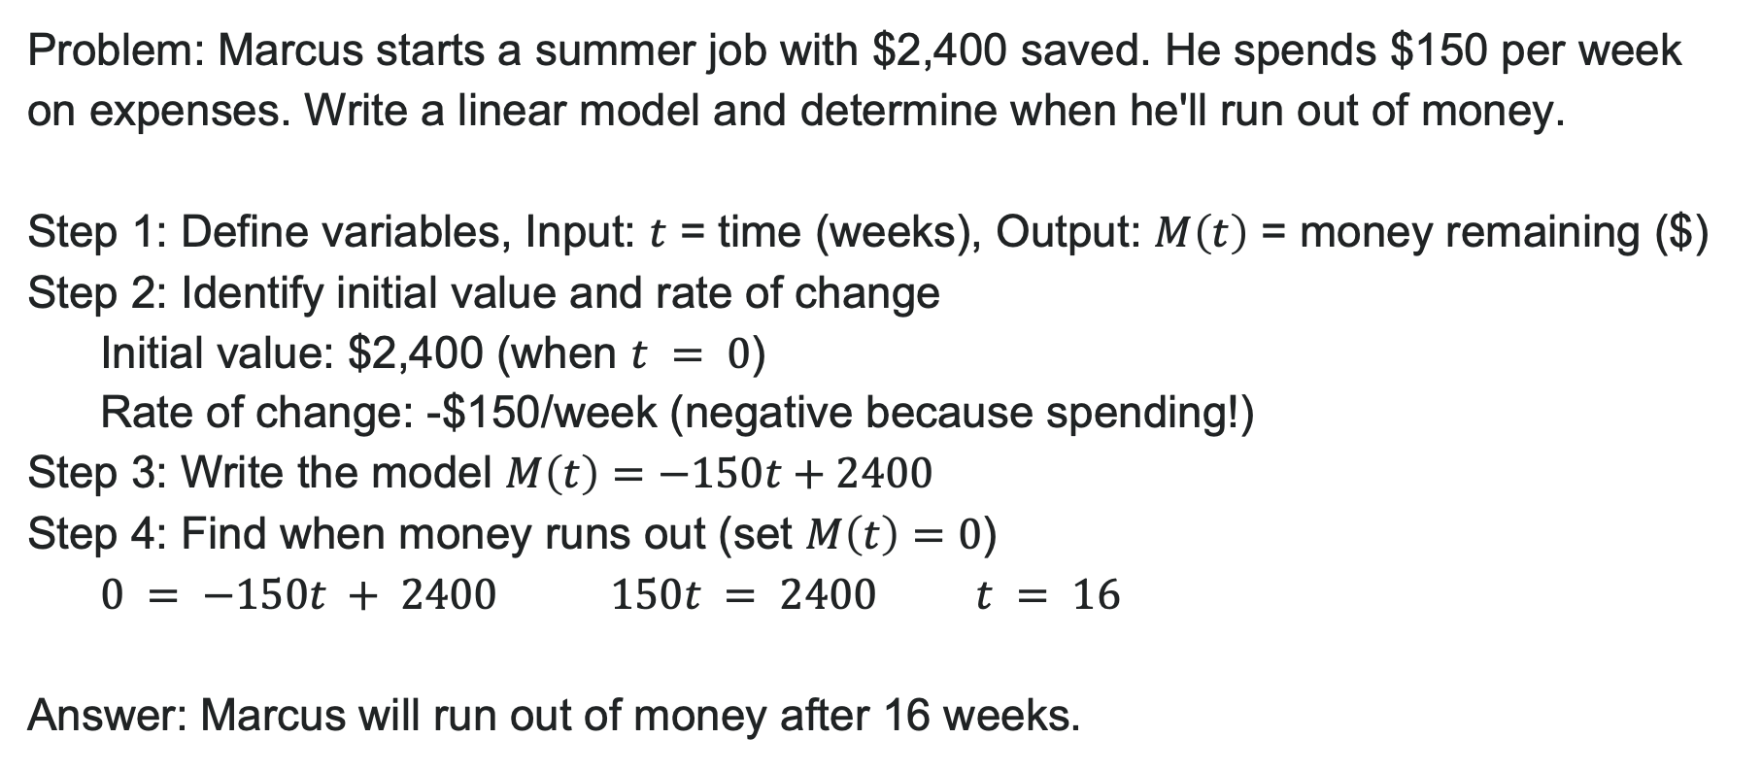
Example: Modeling a Budget
Problem: Marcus starts a summer job with $2,400 saved. He spends $150 per week on expenses. Write a linear model and determine when he'll run out of money.
Step 1: Define variables, Input: $t$ = time (weeks), Output: $M\left(t\right)$ = money remaining ($)
Step 2: Identify initial value and rate of change
Initial value: $2,400 (when $t = 0$)
Rate of change: -$150/week (negative because spending!)
Step 3: Write the model $M\left(t\right)=−150t+2400$
Step 4: Find when money runs out (set $M\left(t\right)=0$)
$0 = −150t + 2400$ $150t = 2400$ $t = 16$
Answer: Marcus will run out of money after 16 weeks.

Slide 35
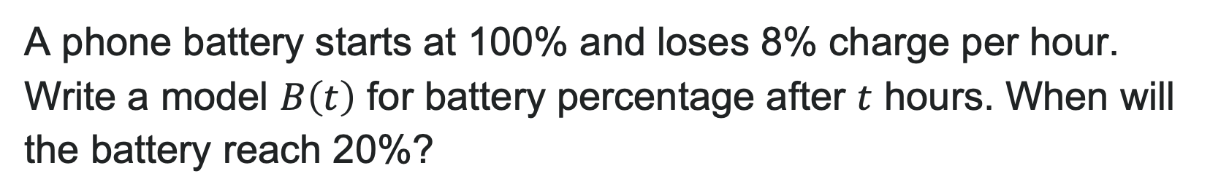
Try It: Model With a Linear Function
A phone battery starts at 100% and loses 8% charge per hour. Write a model $B\left(t\right)$ for battery percentage after $t$ hours. When will the battery reach 20%?
Notes:
Answer: B(t) = -8t + 100; Set 20 = -8t + 100 → 8t = 80 → t = 10 hours

Slide 36
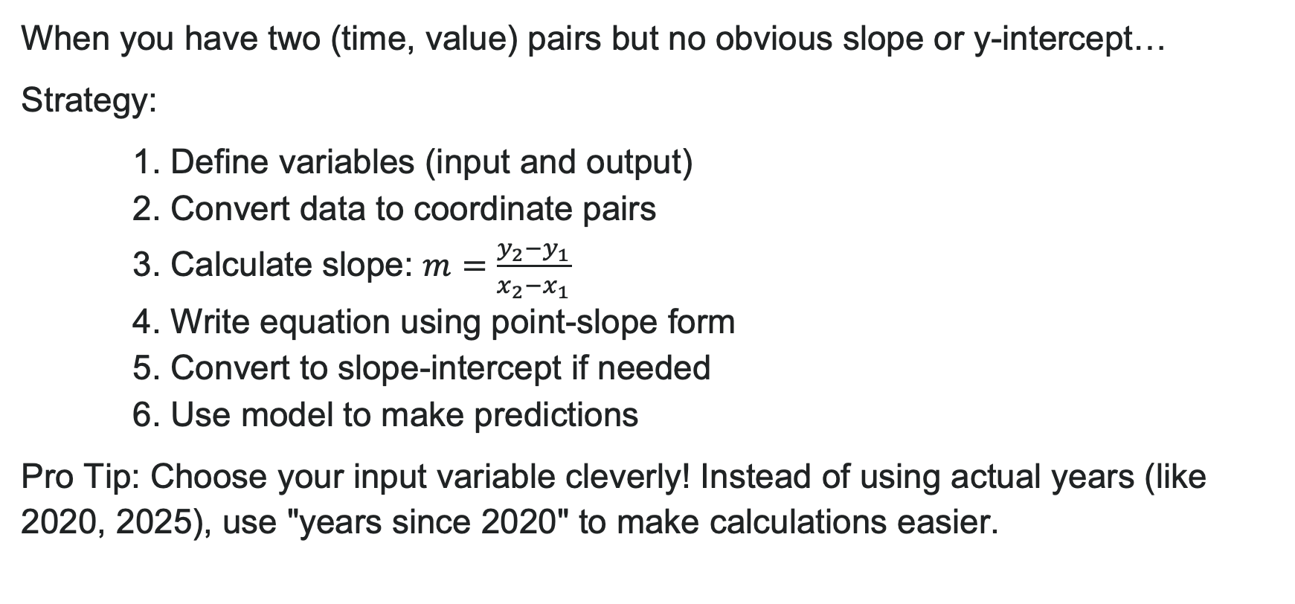
Building Models from Two Data Points
When you have two (time, value) pairs but no obvious slope or y-intercept…
Strategy:
1. Define variables (input and output)
2. Convert data to coordinate pairs
3. Calculate slope: $m=\frac{y_{2}−y_{1}}{x_{2}−x_{1}}$
4. Write equation using point-slope form
5. Convert to slope-intercept if needed
6. Use model to make predictions
Pro Tip: Choose your input variable cleverly! Instead of using actual years (like 2020, 2025), use "years since 2020" to make calculations easier.

Slide 37
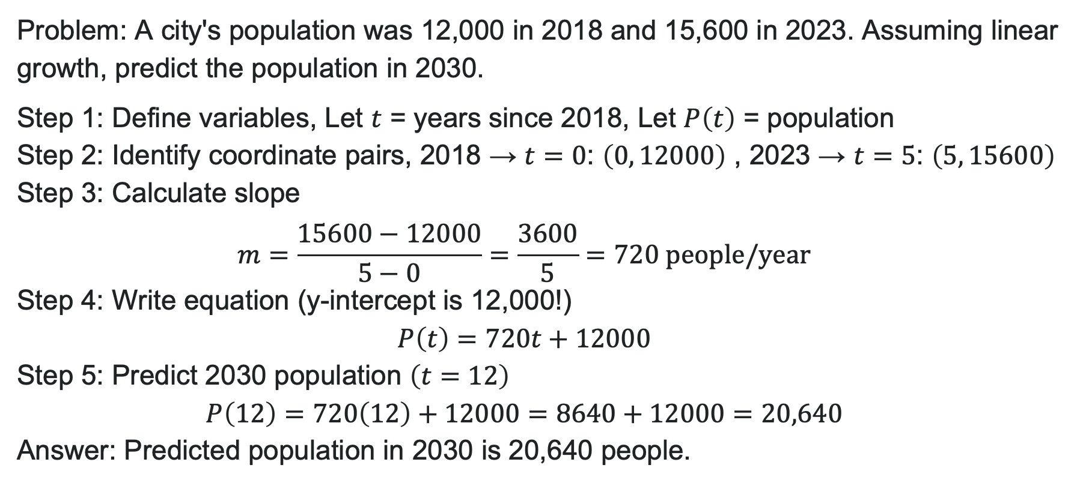
Example: Modeling Population Growth
Problem: A city's population was 12,000 in 2018 and 15,600 in 2023. Assuming linear growth, predict the population in 2030.
Step 1: Define variables, Let $t$ = years since 2018, Let $P\left(t\right)$ = population
Step 2: Identify coordinate pairs, 2018 → $t=0$: $\left(0, 12000\right)$ , 2023 → $t=5$: $\left(5, 15600\right)$
Step 3: Calculate slope
$$m=\frac{15600−12000}{5−0}=\frac{3600}{5}=720 \text{people}\text{/}\text{year}$$
Step 4: Write equation (y-intercept is 12,000!)
$$P\left(t\right)=720t+12000$$
Step 5: Predict 2030 population $\left(t=12\right)$
$$P\left(12\right)=720\left(12\right)+12000=8640+12000=20,640$$
Answer: Predicted population in 2030 is 20,640 people.

Slide 38
Modeling with Diagrams
When to Use Diagrams: Problems involving distances, geometric shapes, or spatial relationships. A visual representation makes relationships clearer!
Key Steps:
Sketch the situation (don't worry about perfection!)
Label knowns and unknowns
Define a coordinate system if needed
Use geometry (Pythagorean Theorem, distance formula, etc.)
Write equations based on relationships

Slide 39
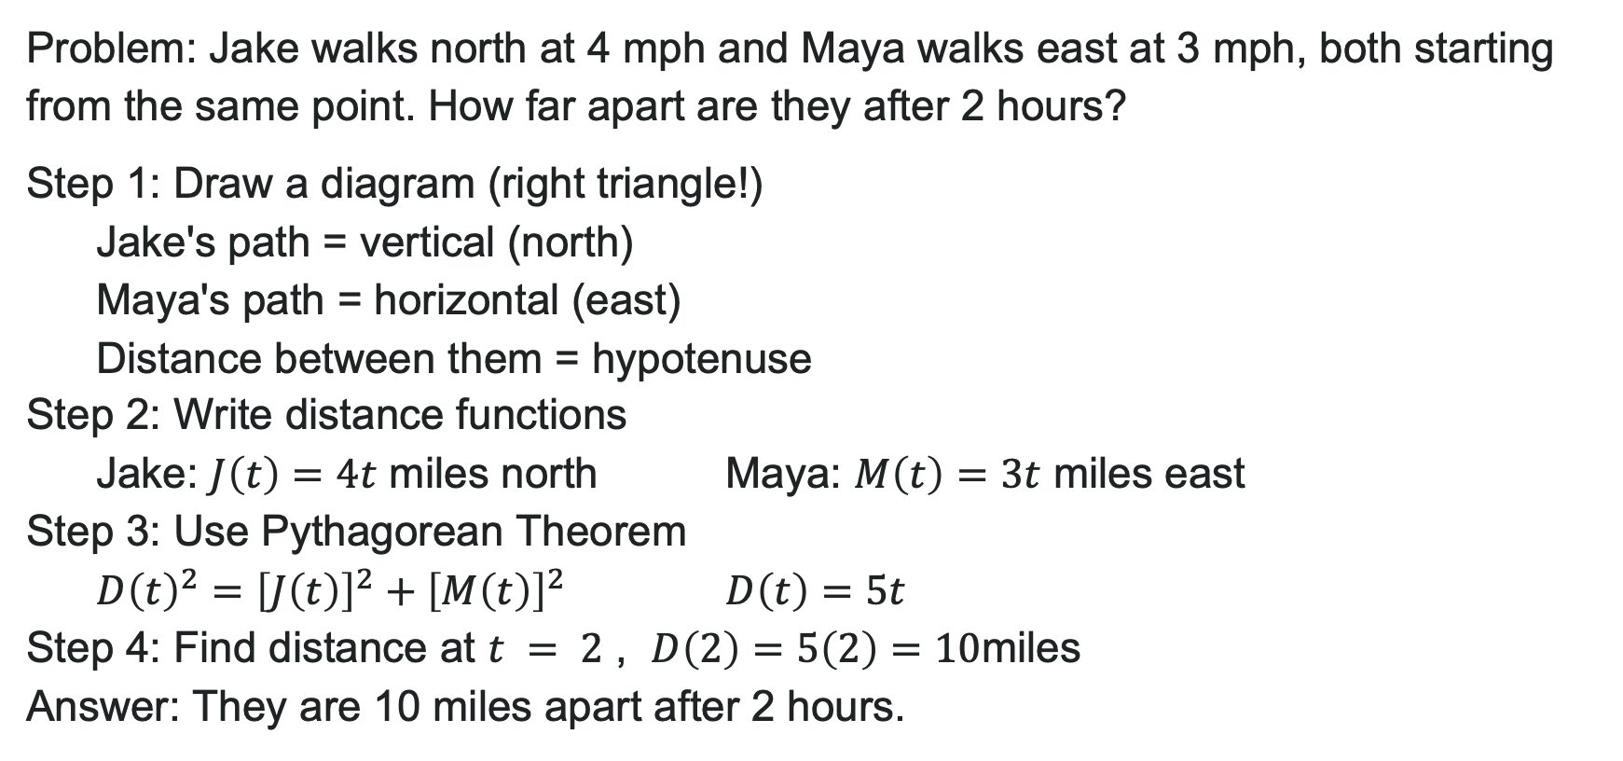
Example: Two Walkers (Using Diagrams)
Problem: Jake walks north at 4 mph and Maya walks east at 3 mph, both starting from the same point. How far apart are they after 2 hours?
Step 1: Draw a diagram (right triangle!)
Jake's path = vertical (north)
Maya's path = horizontal (east)
Distance between them = hypotenuse
Step 2: Write distance functions
Jake: $J\left(t\right)=4t$ miles north Maya: $M\left(t\right)=3t$ miles east
Step 3: Use Pythagorean Theorem
$D{\left(t\right)}^{2}={\left[J\left(t\right)\right]}^{2}+{\left[M\left(t\right)\right]}^{2}$ $D\left(t\right)=5t$
Step 4: Find distance at $t = 2$ , $D\left(2\right)=5\left(2\right)=10$miles
Answer: They are 10 miles apart after 2 hours.

Slide 40
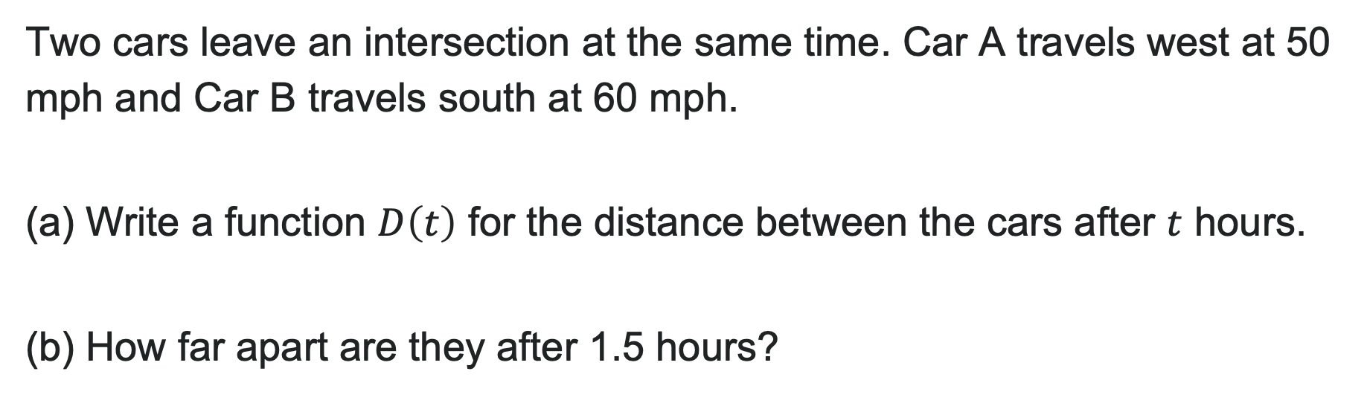
Try It: Model with Diagrams
Two cars leave an intersection at the same time. Car A travels west at 50 mph and Car B travels south at 60 mph.
(a) Write a function $D\left(t\right)$ for the distance between the cars after $t$ hours.
(b) How far apart are they after 1.5 hours?
Notes:
Answer (a): Using Pythagorean Theorem: D(t)^2 = (50t)^2 + (60t)^2 = 2500t^2 + 3600t^2 = 6100t^2 → D(t) = \sqrt{6100}t \approx 78.1t miles Answer (b): D(1.5) = 78.1(1.5) \approx 117.2 miles

Slide 41
Drawing and Interpreting Scatterplots
Scatter Plot: Graph of data points showing relationship between two variables
What to Look For:
Positive linear relationship: Points trend upward (as x ↑, y ↑)
Negative linear relationship: Points trend downward (as x ↑, y ↓)
No relationship: Points scattered randomly
Why Use Them?
Identify patterns in real data
Determine if a linear model is appropriate
Make predictions using line of best fit
Applications: Temperature vs. altitude, study time vs. grades, advertising cost vs. sales

Slide 42
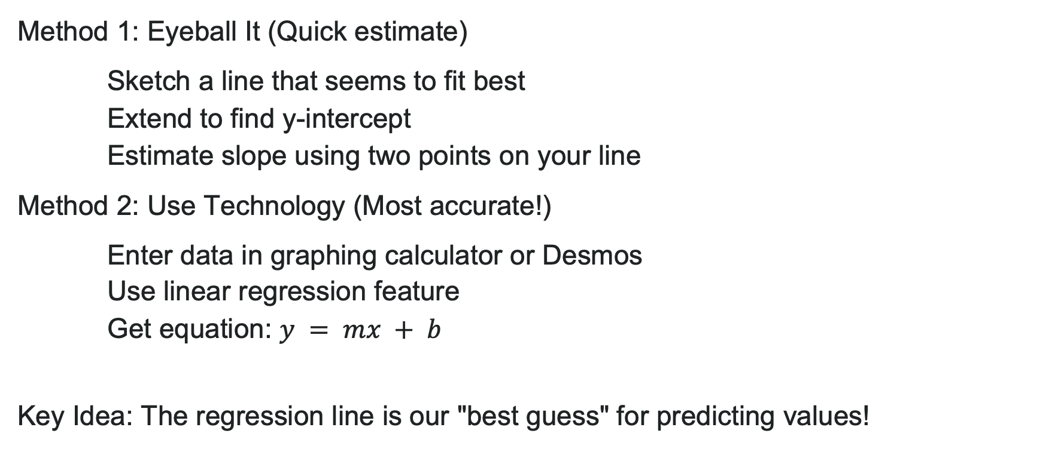
Finding the Line of Best Fit
Method 1: Eyeball It (Quick estimate)
Sketch a line that seems to fit best
Extend to find y-intercept
Estimate slope using two points on your line
Method 2: Use Technology (Most accurate!)
Enter data in graphing calculator or Desmos
Use linear regression feature
Get equation: $y = mx + b$
Key Idea: The regression line is our "best guess" for predicting values!

Slide 43
Making Predictions: Interpolation vs Extrapolation
Interpolation: Predicting within the data range
More reliable
You're staying inside known values
Extrapolation: Predicting outside the data range
Less reliable (use with caution!)
You're assuming the pattern continues
Model Breakdown: Point where the model no longer applies
Linear trends don't continue forever!
Consider real-world limits

Slide 44
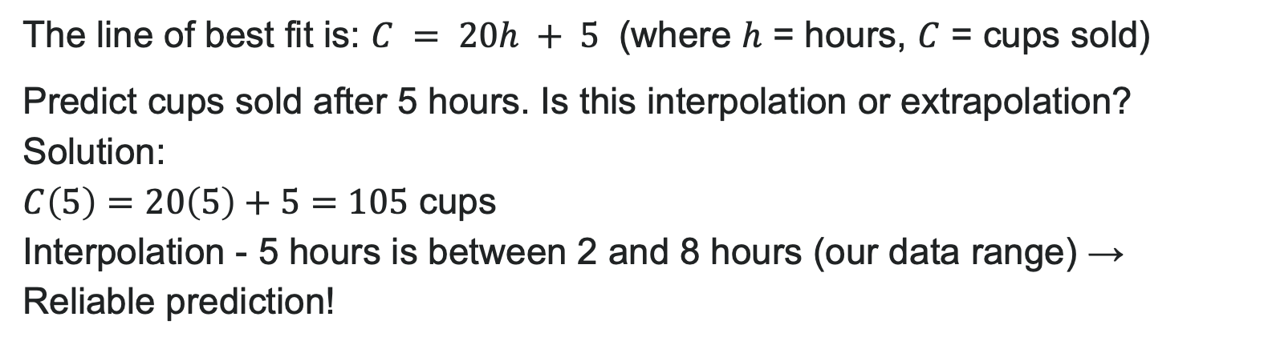
Example: Interpolation vs Extrapolation
Problem: A coffee shop tracked sales:
Hours Open | 2 | 4 | 6 | 8
Cups Sold | 45 | 85 | 125 | 165
The line of best fit is: $C = 20h + 5$ (where $h$ = hours, $C$ = cups sold)
Predict cups sold after 5 hours. Is this interpolation or extrapolation?
Solution:
$C\left(5\right)=20\left(5\right)+5=105$ cups
Interpolation - 5 hours is between 2 and 8 hours (our data range) → Reliable prediction!

Slide 45
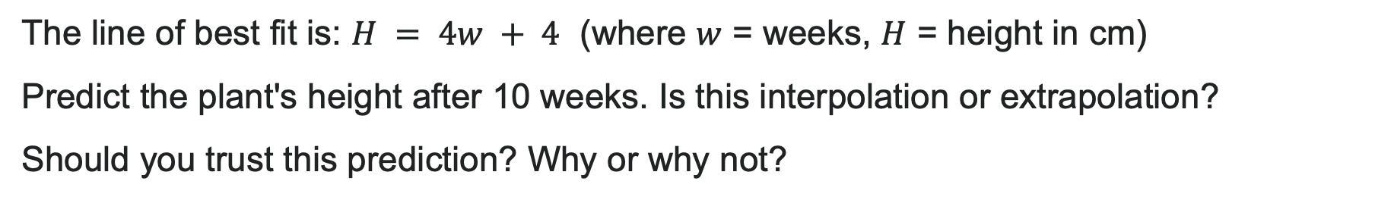
Try It: Make a Prediction
A plant's height was measured over several weeks:
Weeks | 1 | 2 | 3 | 4 | 5
Height (cm) | 8 | 12 | 16 | 20 | 24
The line of best fit is: $H = 4w + 4$ (where $w$ = weeks, $H$ = height in cm)
Predict the plant's height after 10 weeks. Is this interpolation or extrapolation?
Should you trust this prediction? Why or why not?
Notes:
Answer: H(10) = 4(10) + 4 = 40 + 4 = 44 cm; Extrapolation (10 is beyond our data range of 1-5 weeks) → Less reliable! Plant growth may slow down or stop.

Slide 46
Learning Outcomes: Absolute Value Functions
Deepen your understanding and form connections within these skills:
1 Graph absolute value functions
2 Solve equations that include absolute value symbols
3 Solve inequalities that include absolute value symbols

Slide 47
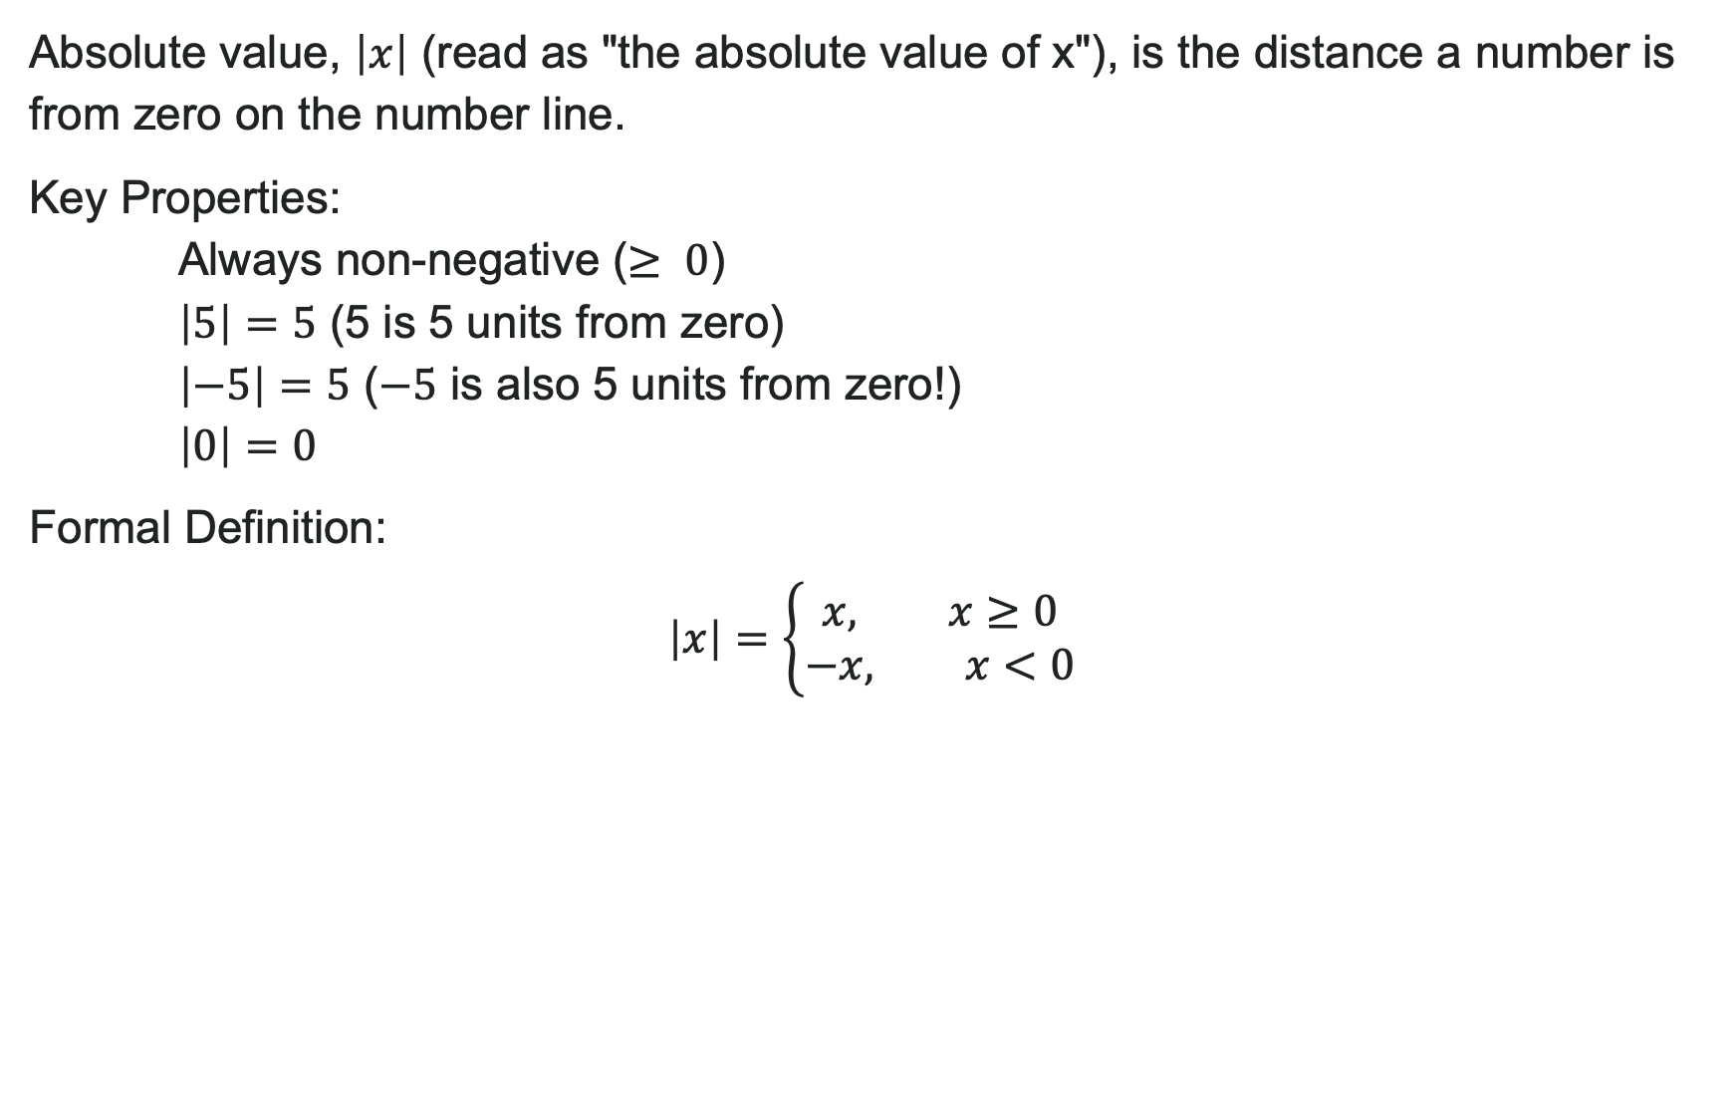
What is Absolute Value?
Absolute value, $\left|x\right|$ (read as "the absolute value of x"), is the distance a number is from zero on the number line.
Key Properties:
Always non-negative ($≥ 0$)
$\left|5\right|=5$ (5 is 5 units from zero)
$\left|−5\right|=5$ ($−5$ is also 5 units from zero!)
$\left|0\right|=0$
Formal Definition:
$$\left|x\right|=\left\{\begin{aligned}x, x≥0 \\ &−x, x<0\end{aligned}\right.$$
Notes:
Real-World Example: "Within 10 miles of home" means distance ≤ 10, whether you go north or south!

Slide 48
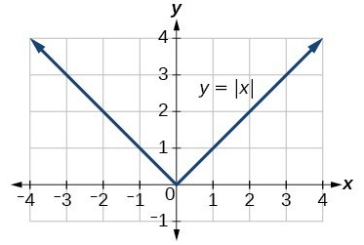
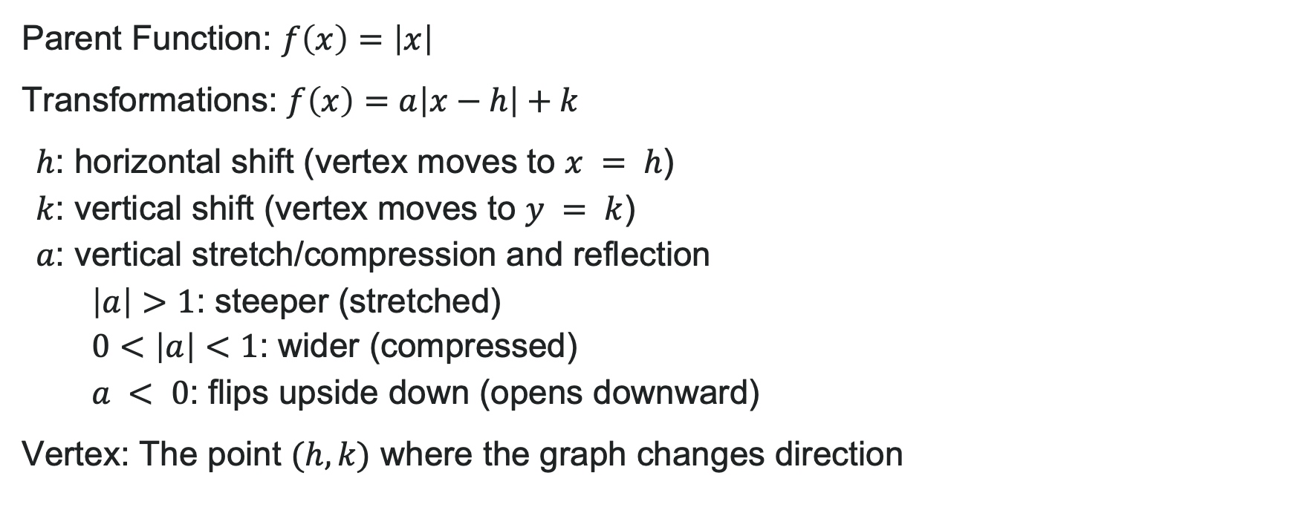

Graphing Absolute Value Functions
V-shaped graph
Vertex (corner point) at origin $(0, 0)$
Opens upward
Parent Function: $f\left(x\right)=\left|x\right|$
Transformations: $f\left(x\right)=a\left|x−h\right|+k$
$h$: horizontal shift (vertex moves to $x = h$)
$k$: vertical shift (vertex moves to $y = k$)
$a$: vertical stretch/compression and reflection
$\left|a\right|>1$: steeper (stretched)
$0<\left|a\right|<1$: wider (compressed)
$a < 0$: flips upside down (opens downward)
Vertex: The point $(h, k)$ where the graph changes direction

Slide 49
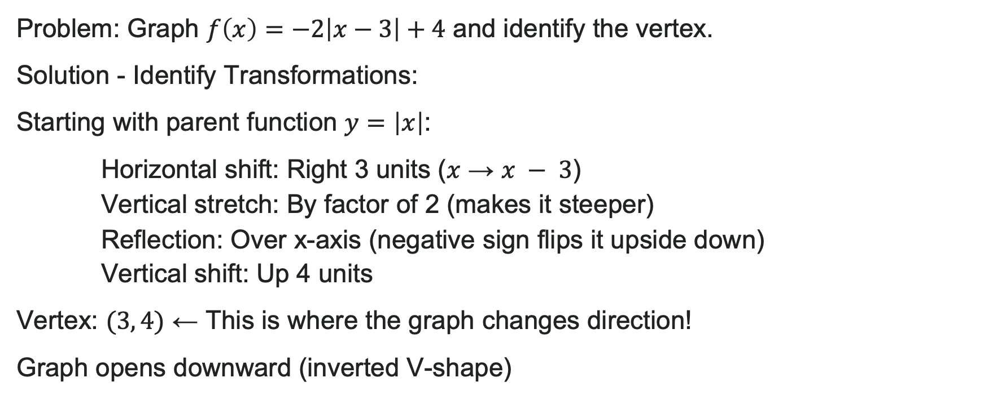
Example: Graphing Absolute Value Functions
Problem: Graph $f\left(x\right)=−2\left|x−3\right|+4$ and identify the vertex.
Solution - Identify Transformations:
Starting with parent function $y=\left|x\right|$:
Horizontal shift: Right 3 units ($x$ → $x − 3$)
Vertical stretch: By factor of 2 (makes it steeper)
Reflection: Over x-axis (negative sign flips it upside down)
Vertical shift: Up 4 units
Vertex: $(3, 4)$ ← This is where the graph changes direction!
Graph opens downward (inverted V-shape)

Slide 50
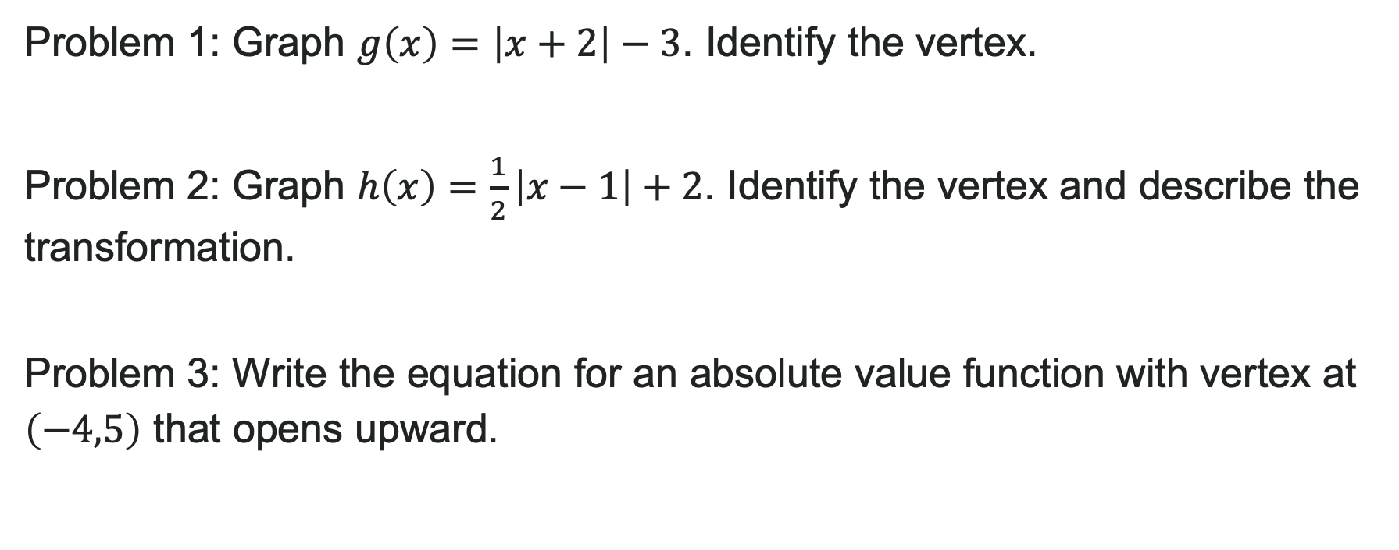
Try It: Absolute Value Graphs
Problem 1: Graph $g\left(x\right)=\left|x+2\right|−3$. Identify the vertex.
Problem 2: Graph $h\left(x\right)=\frac{1}{2}\left|x−1\right|+2$. Identify the vertex and describe the transformation.
Problem 3: Write the equation for an absolute value function with vertex at $\left(−4,5\right)$ that opens upward.
Notes:
Problem 1 Answer: Vertex: (-2, -3); shifts left 2, down 3
Problem 2 Answer: Vertex: (1, 2); shifts right 1, up 2, compressed (wider) by factor of 1/2
Problem 3 Answer: Basic form: f(x) = |x + 4| + 5 or f(x) = a|x + 4| + 5 where a > 0

Slide 51
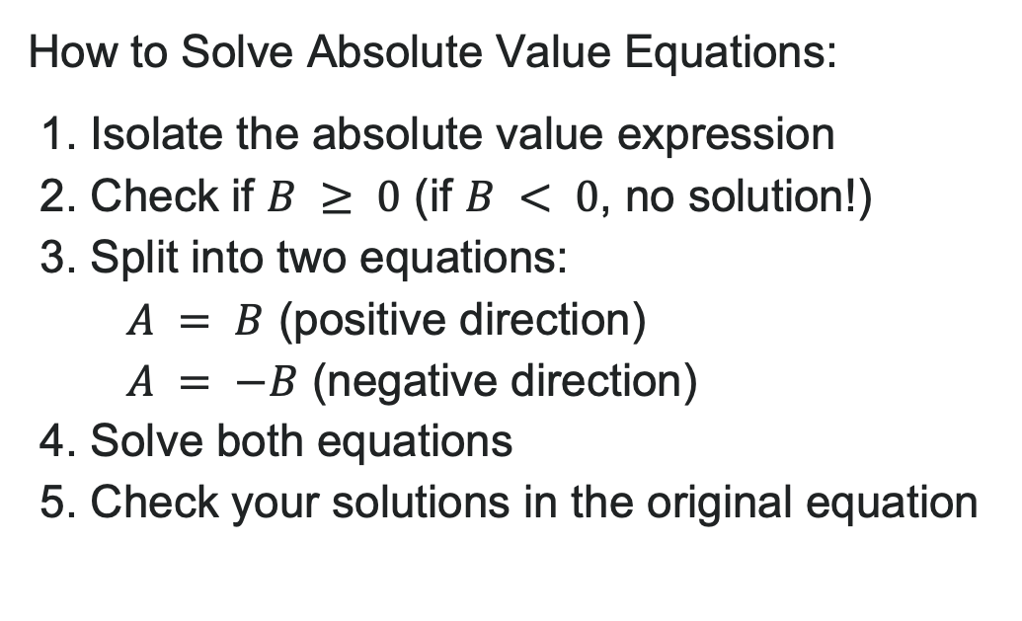
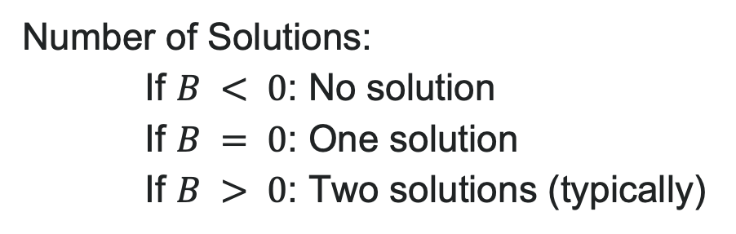
Solving Absolute Value Equations
How to Solve Absolute Value Equations:
1. Isolate the absolute value expression
2. Check if $B ≥ 0$ (if $B < 0$, no solution!)
3. Split into two equations:
$A = B$ (positive direction)
$A = −B$ (negative direction)
4. Solve both equations
5. Check your solutions in the original equation
Number of Solutions:
If $B < 0$: No solution
If $B = 0$: One solution
If $B > 0$: Two solutions (typically)

Slide 52
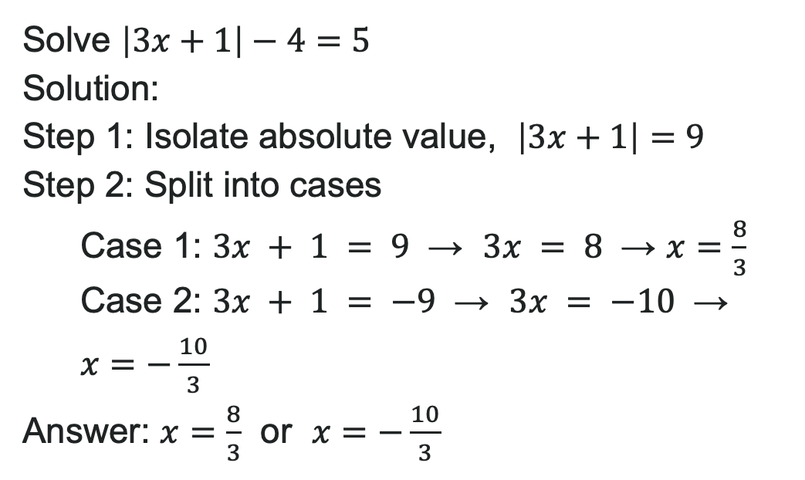
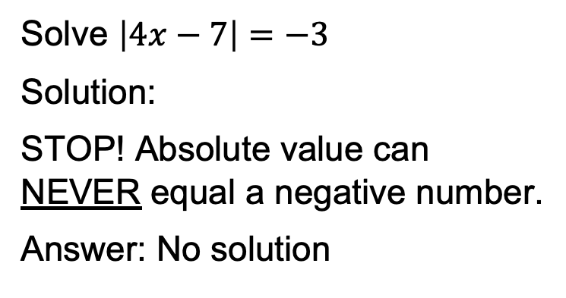
Examples: Solving Absolute Value Equations
Solve $\left|3x+1\right|−4=5$
Solution:
Step 1: Isolate absolute value, $\left|3x+1\right|=9$
Step 2: Split into cases
Case 1: $3x + 1 = 9$ → $3x = 8$ → $x=\frac{8}{3}$
Case 2: $3x + 1 = −9$ → $3x = −10$ → $x=−\frac{10}{3}$
Answer: $x=\frac{8}{3}$ or $x=−\frac{10}{3}$
Solve $\left|4x−7\right|=−3$
Solution:
STOP! Absolute value can NEVER equal a negative number.
Answer: No solution

Slide 53

Try It: Solve Absolute Value Equations
1. Solve $\left|x+3\right|=7$
2. Solve $\left|2x−1\right|+3=8$
3. Solve $\left|6x+12\right|=0$
4. Solve $\left|x−5\right|=−2$
Notes:
Problem 1 Answer: x = 4 or x = -10
Problem 2 Answer: First isolate: |2x - 1| = 5; then x = 3 or x = -2
Problem 3 Answer: 6x + 12 = 0 → x = -2 (one solution)
Problem 4 Answer: No solution (absolute value can't be negative)

Slide 54

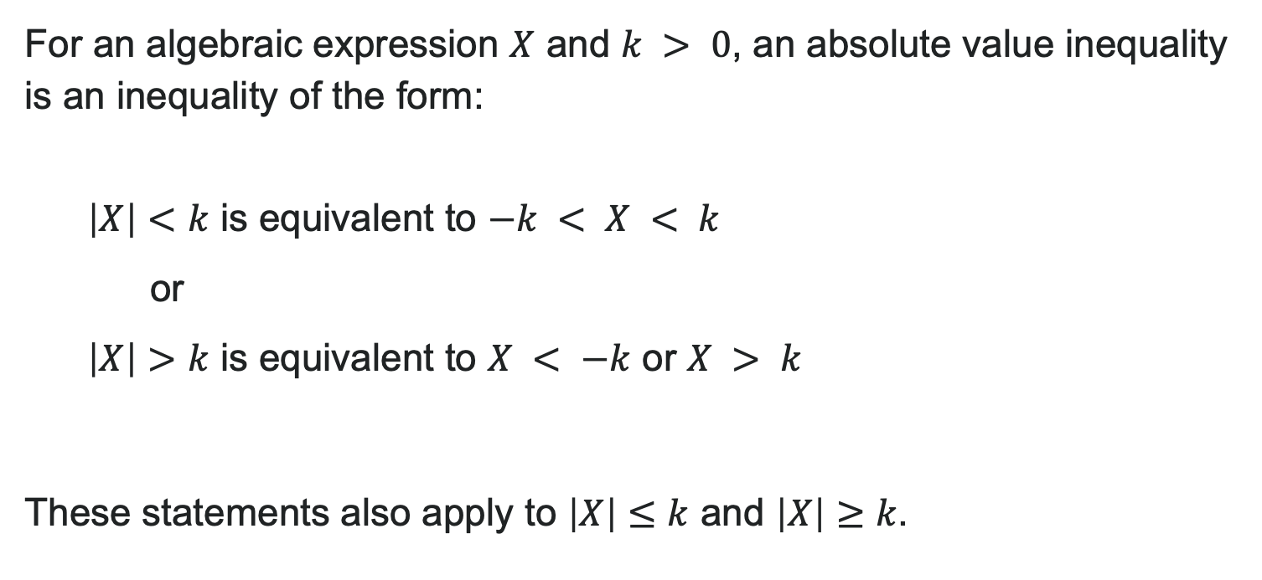
Absolute Value Inequalities
For an algebraic expression $X$ and $k > 0$, an absolute value inequality is an inequality of the form:
$\left|X\right|<k$ is equivalent to $−k < X < k$
or
$\left|X\right|>k$ is equivalent to $X < −k$ or $X > k$
These statements also apply to $\left|X\right|≤k$ and $\left|X\right|≥k$.

Slide 55
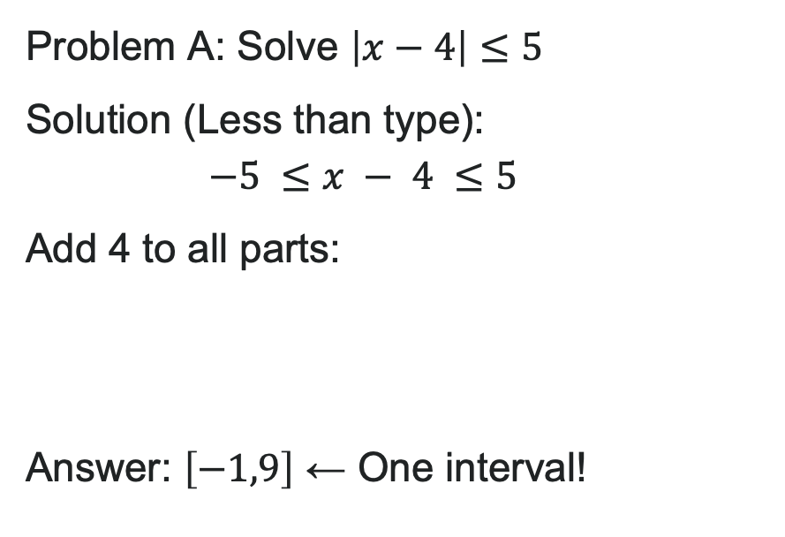
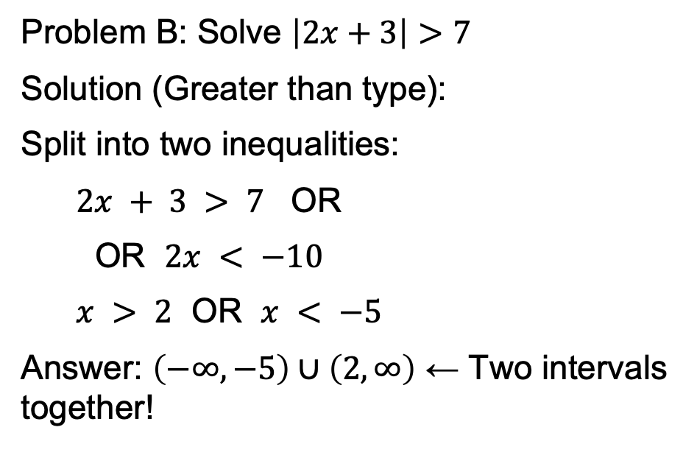
Example: Absolute Value Inequalities
Problem A: Solve $\left|x−4\right|≤5$
Solution (Less than type):
$$−5 ≤x − 4 ≤5$$
Add 4 to all parts:
Answer: $\left[−1,9\right]$ ← One interval!
Problem B: Solve $\left|2x+3\right|>7$
Solution (Greater than type):
Split into two inequalities:
$2x + 3 > 7$ OR
OR $2x < −10$
$x > 2$ OR $x < −5$
Answer: $\left(−∞,−5\right)∪\left(2,∞\right)$ ← Two intervals together!

Slide 56
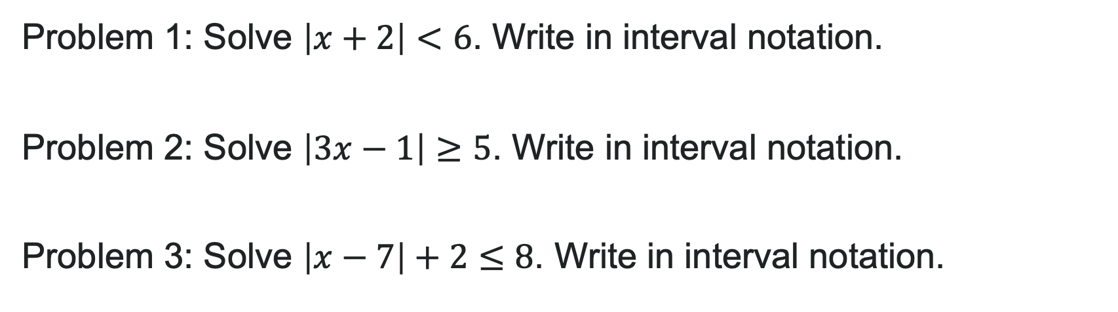
Try It: Interval Notation Solutions
Problem 1: Solve $\left|x+2\right|<6$. Write in interval notation.
Problem 2: Solve $\left|3x−1\right|≥5$. Write in interval notation.
Problem 3: Solve $\left|x−7\right|+2≤8$. Write in interval notation.
Notes:
Problem 1 Answer: -6 < x + 2 < 6 → -8 < x < 4 → (-8, 4)
Problem 2 Answer: 3x - 1 \geq 5 or 3x - 1 \leq -5 → x \geq 2 or x \leq -\frac{4}{3} → (-\infty, -\frac{4}{3}] \cup [2, \infty)
Problem 3 Answer: First isolate: |x - 7| \leq 6 → -6 \leq x - 7 \leq 6 → 1 \leq x \leq 13 → [1, 13]

Slide 57
Before we finish up…
1
Questions…..
2
Next steps…..
3
Reminders about student hours, upcoming deadlines, campus activities ….

Slide 58

Attributions
Illustrations are from Storyset
Authored by: Lumen Learning. License: CC BY: Attribution

