Slide 1

Precalculus
Module 2:
Working with Functions

Slide 2
Affirmations
I am capable of breaking math problems into manageable steps.
I learn from others and share what I know.
I remind myself that grades do not define my worth.

Slide 3
Learning Goals: Composition of Functions
Deepen your understanding and form connections within these skills:
1 Add, subtract, multiply, and divide functions
2 Plug one function into another and evaluate it
3 Find the domain of a composite function

Slide 4
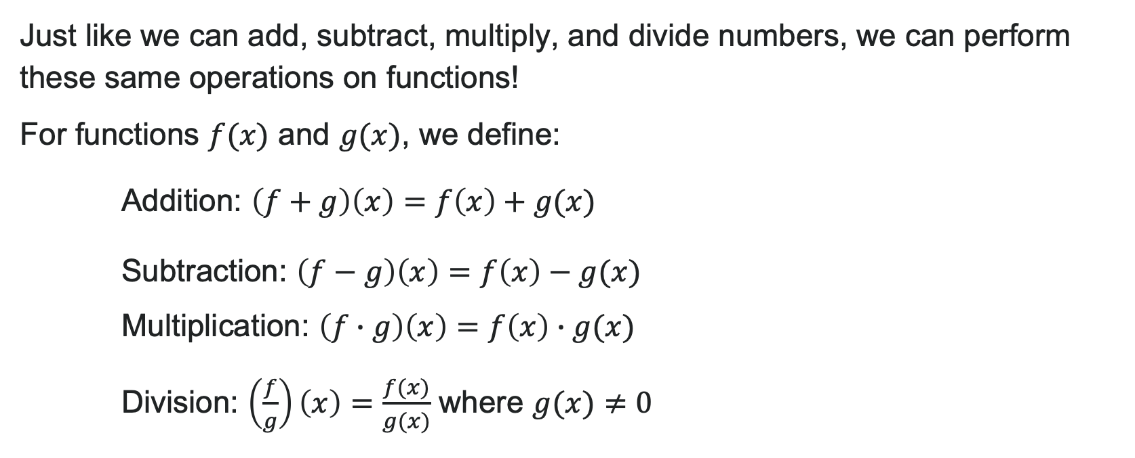
Algebraic Operations on Functions
Just like we can add, subtract, multiply, and divide numbers, we can perform these same operations on functions!
For functions $f(x)$ and $g(x)$, we define:
Addition: $\left(f+g\right)\left(x\right)=f\left(x\right)+g(x)$
Subtraction: $\left(f−g\right)\left(x\right)=f\left(x\right)−g(x)$
Multiplication: $\left(f∙g\right)\left(x\right)=f\left(x\right)∙g(x)$
Division: $\left(\frac{f}{g}\right)\left(x\right)=\frac{f(x)}{g(x)}$ where $g(x)≠0$

Slide 5
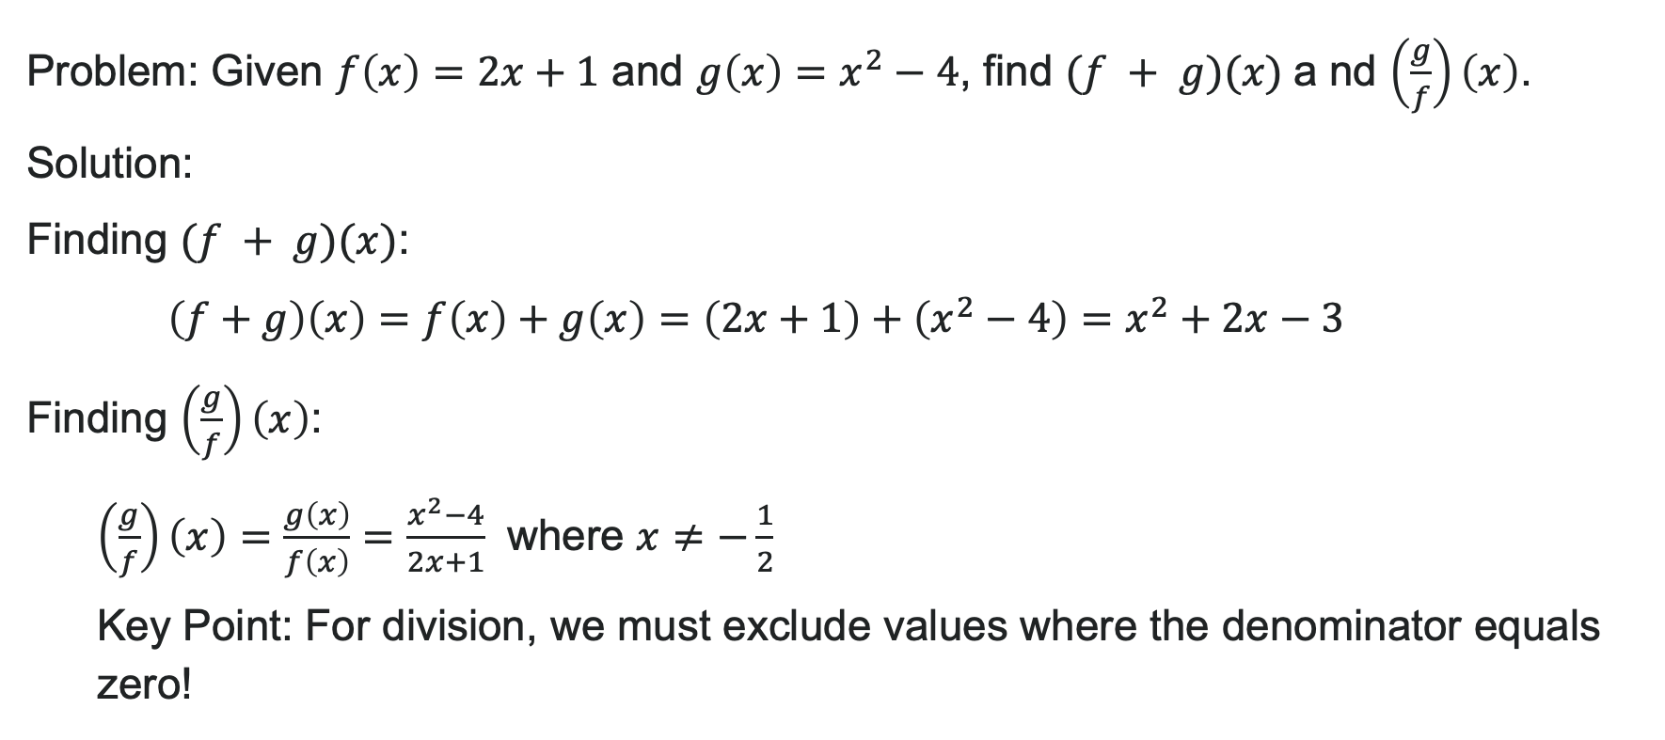
Example: Combining Functions
Problem: Given $f\left(x\right)=2x+1$ and $g\left(x\right)=x^{2}−4$, find $(f + g)(x)$a nd $\left(\frac{g}{f}\right)\left(x\right)$.
Solution:
Finding $(f + g)(x)$:
$\left(f+g\right)\left(x\right)=f\left(x\right)+g\left(x\right)=\left(2x+1\right)+\left(x^{2}−4\right)=x^{2}+2x−3$
Finding $\left(\frac{g}{f}\right)\left(x\right)$:
$\left(\frac{g}{f}\right)\left(x\right)=\frac{g\left(x\right)}{f\left(x\right)}=\frac{x^{2}−4}{2x+1}$ where $x≠−\frac{1}{2}$
Key Point: For division, we must exclude values where the denominator equals zero!

Slide 6
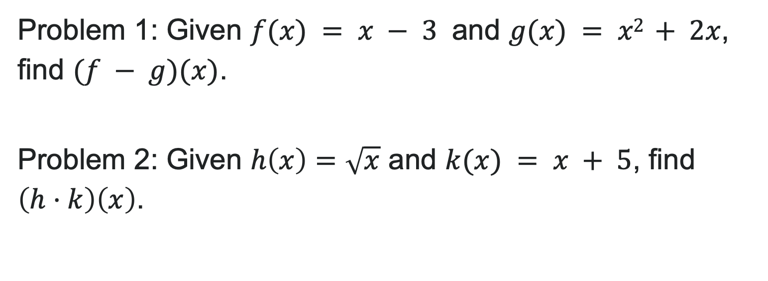
Try It: Operations on Functions
Problem 1: Given $f(x) = x − 3$ and $g(x) = x2 + 2x$, find $(f − g)(x)$.
Problem 2: Given $h\left(x\right)=\sqrt{x}$ and $k(x) = x + 5$, find $\left(h⋅k\right)\left(x\right)$.
Notes:
Answer 1: (f - g)(x) = -x^2 - x - 3
Answer 2: (h \cdot k)(x) = (x + 5)\sqrt{x}

Slide 7
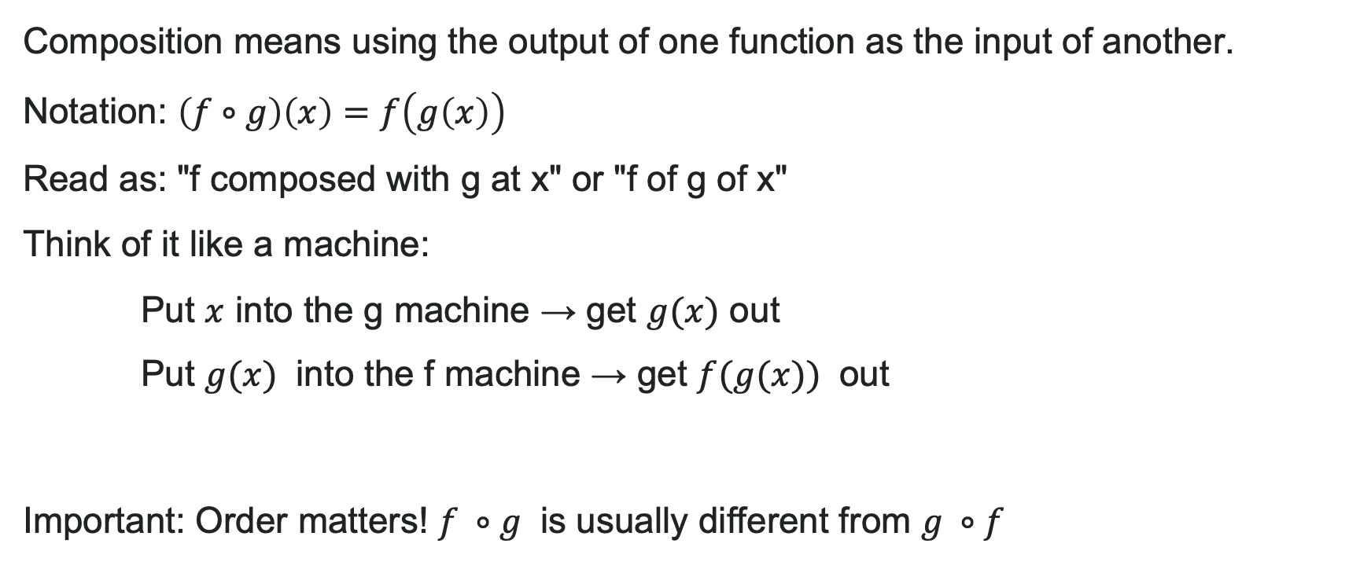
What is Function Composition?
Composition means using the output of one function as the input of another.
Notation: $\left(f∘g\right)\left(x\right)=f\left(g\left(x\right)\right)$
Read as: "f composed with g at x" or "f of g of x"
Think of it like a machine:
Put $x$ into the g machine → get $g(x)$ out
Put $g(x)$ into the f machine → get $f(g(x))$ out
Important: Order matters! $f ∘g$ is usually different from $g ∘f$

Slide 8
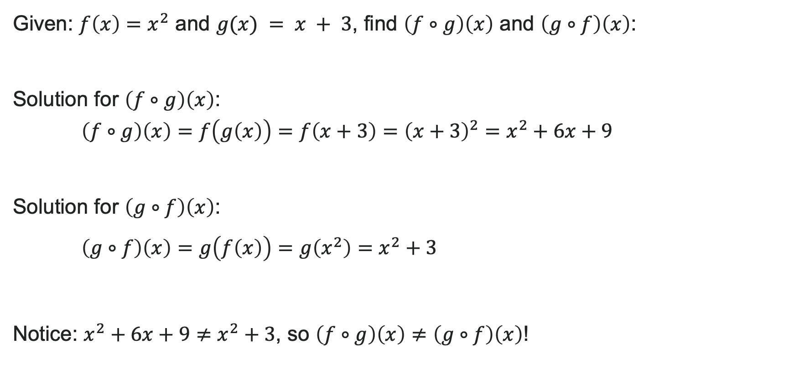
Example 2: Order Matters in Composition!
Given: $f\left(x\right)=x^{2}$ and $g(x) = x + 3$, find $\left(f∘g\right)\left(x\right)$ and $\left(g∘f\right)\left(x\right)$:
Solution for $\left(f∘g\right)\left(x\right)$: $\left(f∘g\right)\left(x\right)=f\left(g\left(x\right)\right)=f\left(x+3\right)={\left(x+3\right)}^{2}=x^{2}+6x+9$
Solution for $\left(g∘f\right)\left(x\right)$:
$\left(g∘f\right)\left(x\right)=g\left(f\left(x\right)\right)=g\left(x^{2}\right)=x^{2}+3$
Notice: $x^{2}+6x+9≠x^{2}+3$, so $\left(f∘g\right)\left(x\right)≠\left(g∘f\right)\left(x\right)$!

Slide 9
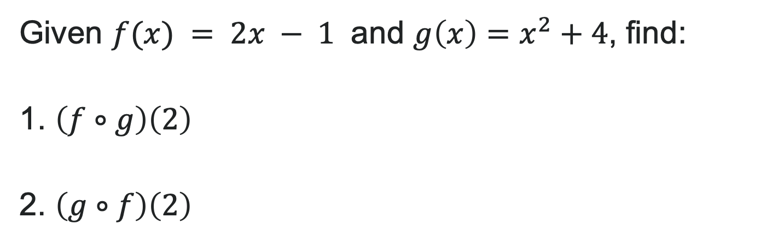
Try It: Function Composition
Given $f(x) = 2x − 1$ and $g\left(x\right)=x^{2}+4$, find:
1. $\left(f∘g\right)\left(2\right)$
2. $\left(g∘f\right)\left(2\right)$
Notes:
Answer 1: (f \circ g)(2) = f(g(2)) = f(8) = 15
Answer 2: (g \circ f)(2) = g(f(2)) = g(3) = 13

Slide 10
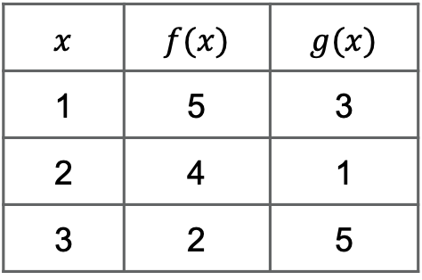
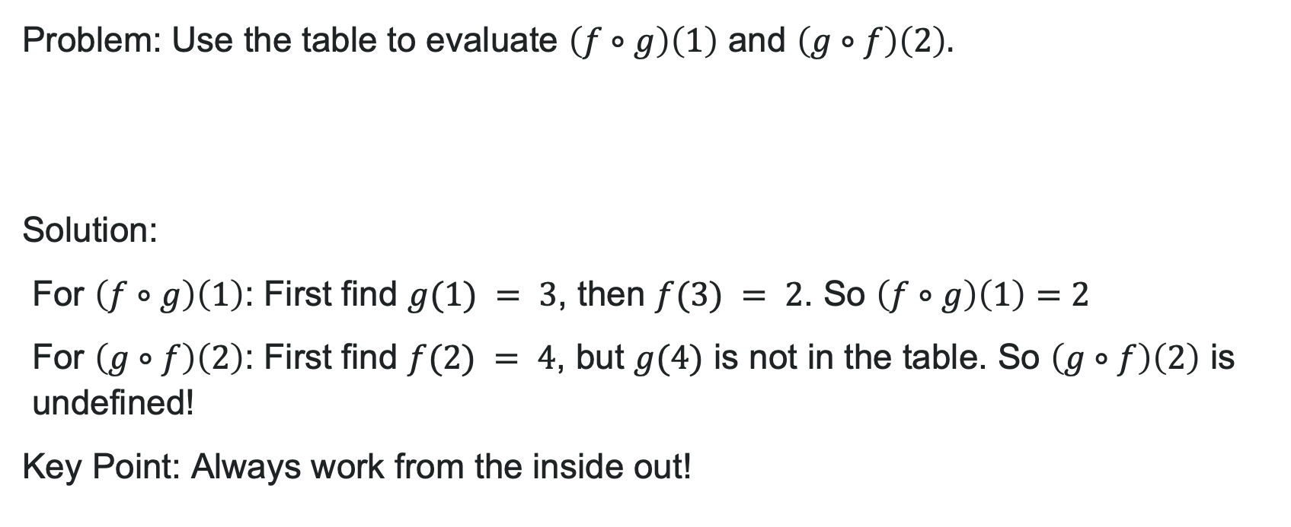
Example: Evaluating Composition Using Tables
Problem: Use the table to evaluate $\left(f∘g\right)\left(1\right)$ and $\left(g∘f\right)\left(2\right).$
Solution:
For $\left(f∘g\right)\left(1\right)$: First find $g(1) = 3$, then $f(3) = 2$. So $\left(f∘g\right)\left(1\right)=2$
For $\left(g∘f\right)\left(2\right)$: First find $f(2) = 4$, but $g(4)$ is not in the table. So $\left(g∘f\right)\left(2\right)$ is undefined!
Key Point: Always work from the inside out!
$$x$$ | $$f(x)$$ | $$g(x)$$
1 | 5 | 3
2 | 4 | 1
3 | 2 | 5

Slide 11
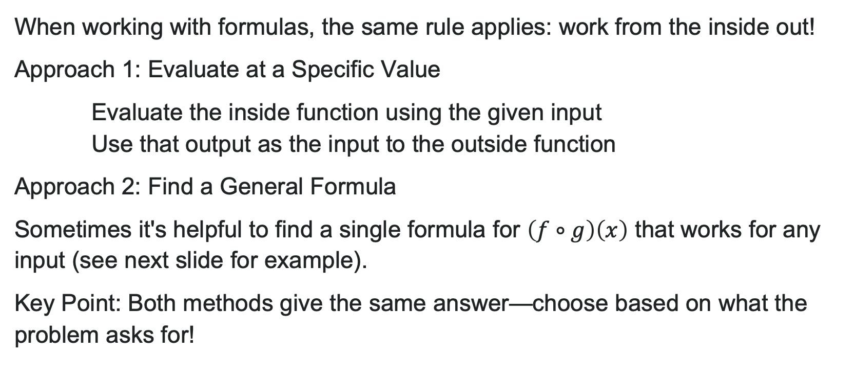
Evaluating Composite Functions from Formulas
When working with formulas, the same rule applies: work from the inside out!
Approach 1: Evaluate at a Specific Value
Evaluate the inside function using the given input
Use that output as the input to the outside function
Approach 2: Find a General Formula
Sometimes it's helpful to find a single formula for $\left(f∘g\right)\left(x\right)$ that works for any input (see next slide for example).
Key Point: Both methods give the same answer—choose based on what the problem asks for!

Slide 12
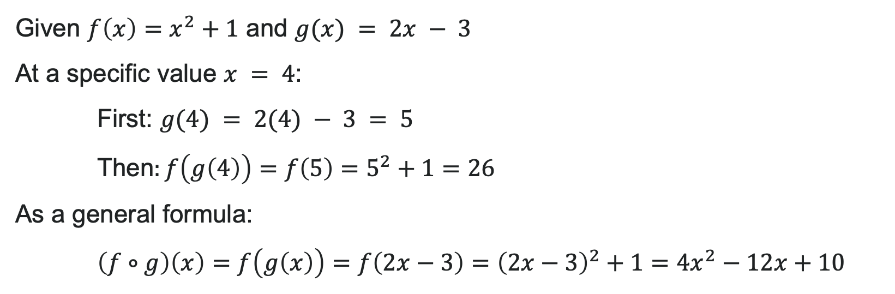
Example: Evaluating Using a General Formula
Given $f\left(x\right)=x^{2}+1$ and $g(x) = 2x − 3$
At a specific value $x = 4$:
First: $g(4) = 2(4) − 3 = 5$
Then$:f\left(g\left(4\right)\right)=f\left(5\right)=5^{2}+1=26$
As a general formula:
$\left(f∘g\right)\left(x\right)=f\left(g\left(x\right)\right)=f\left(2x−3\right)={\left(2x−3\right)}^{2}+1=4x^{2}−12x+10$

Slide 13
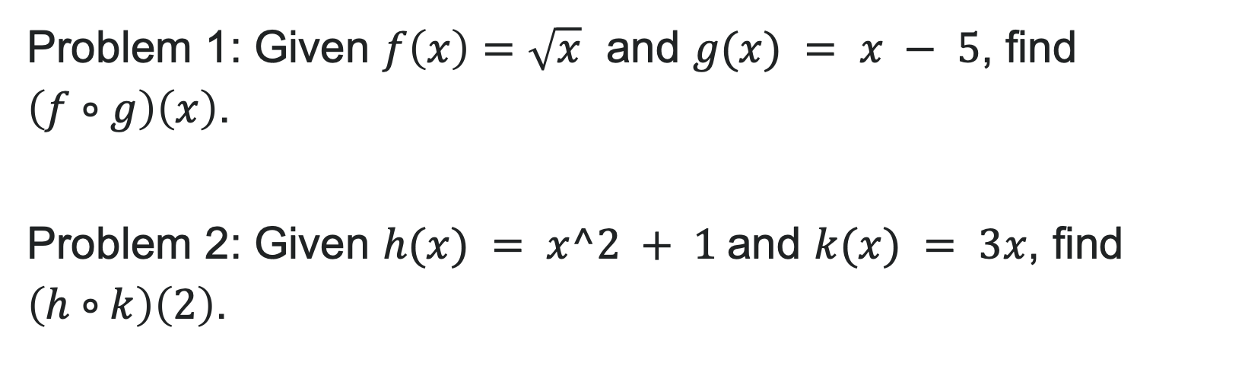
Try It: Evaluating Using a Formula
Problem 1: Given $f\left(x\right)=\sqrt{x}$ and $g(x) = x − 5$, find $\left(f∘g\right)\left(x\right)$.
Problem 2: Given $h(x) = x^2 + 1$and $k(x) = 3x$, find $\left(h∘k\right)\left(2\right)$.
Notes:
Answer 1: (f \circ g)(x) = \sqrt{x - 5} Answer 2: (h \circ k)(2) = h(6) = 37

Slide 14

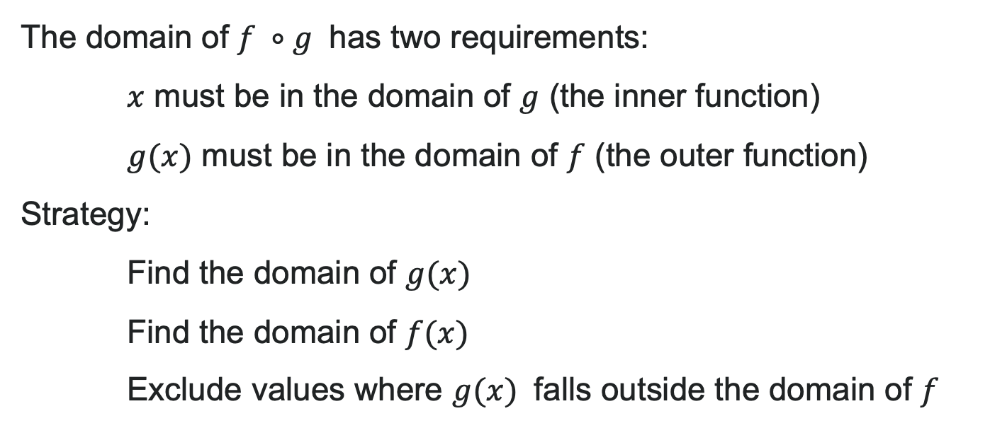
Domain of Composite Functions
The domain of $f ∘g$ has two requirements:
$x$ must be in the domain of $g$ (the inner function)
$g(x)$ must be in the domain of $f$ (the outer function)
Strategy:
Find the domain of $g(x)$
Find the domain of $f(x)$
Exclude values where $g(x)$ falls outside the domain of $f$

Slide 15
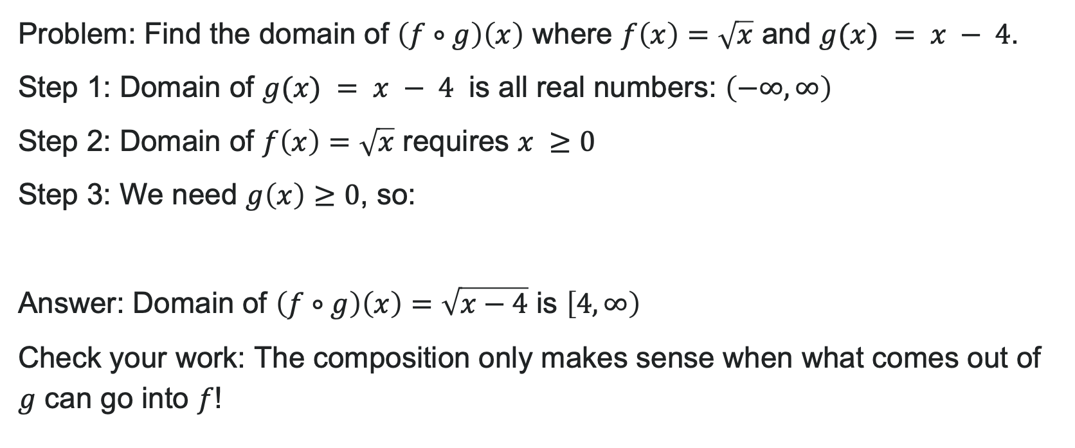
Example: Finding the Domain
Problem: Find the domain of $\left(f∘g\right)\left(x\right)$ where $f\left(x\right)=\sqrt{x}$ and $g(x) = x − 4$.
Step 1: Domain of $g(x) = x − 4$ is all real numbers: $\left(−∞,∞\right)$
Step 2: Domain of $f\left(x\right)=\sqrt{x}$ requires $x ≥0$
Step 3: We need $g\left(x\right)≥0$, so:
Answer: Domain of $\left(f∘g\right)\left(x\right)=\sqrt{x−4}$ is $\left[4,∞\right)$
Check your work: The composition only makes sense when what comes out of $g$ can go into $f$!

Slide 16
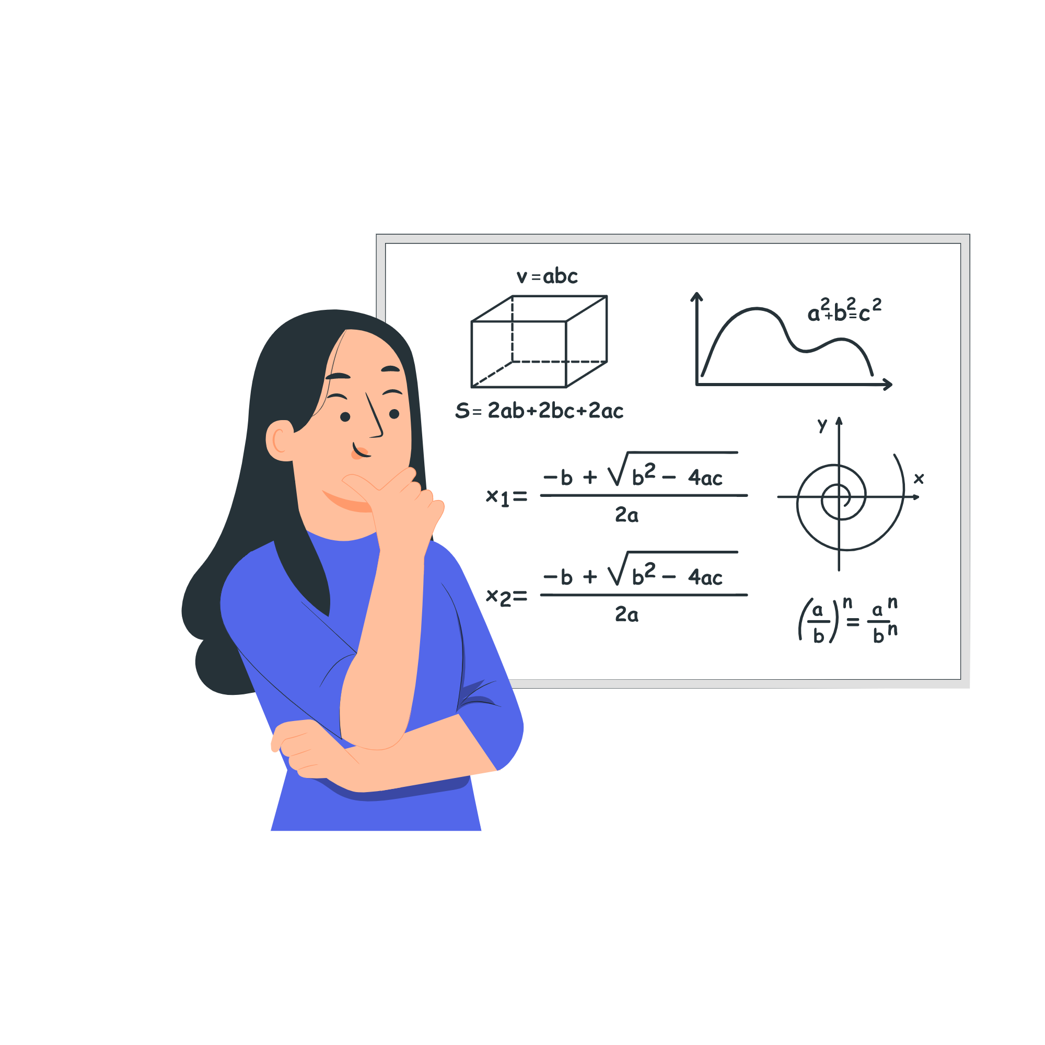
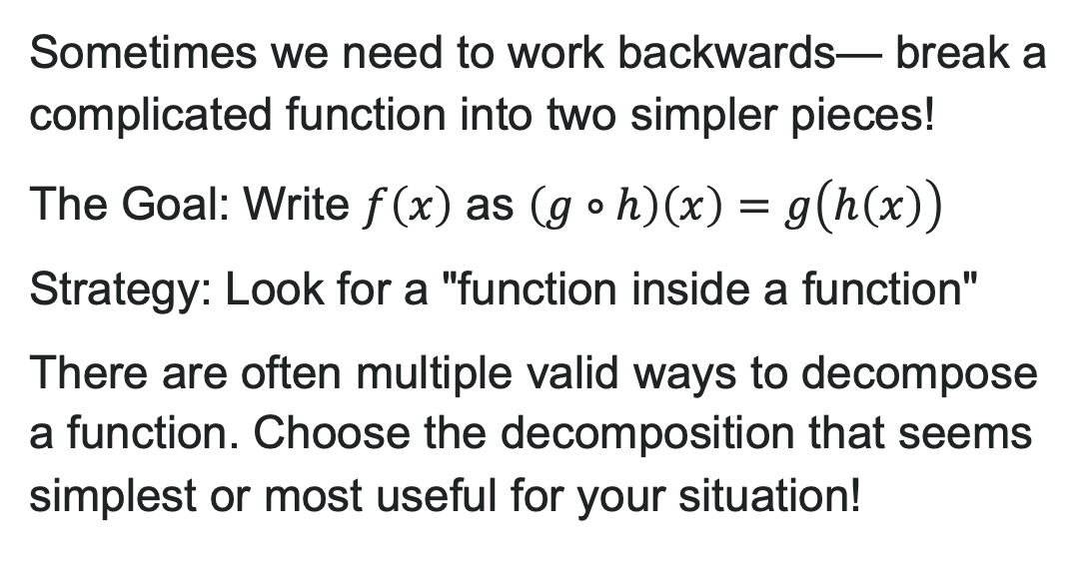
Decomposing a Composite Function
Sometimes we need to work backwards— break a complicated function into two simpler pieces!
The Goal: Write $f\left(x\right)$ as $\left(g∘h\right)\left(x\right)=g\left(h\left(x\right)\right)$
Strategy: Look for a "function inside a function"
There are often multiple valid ways to decompose a function. Choose the decomposition that seems simplest or most useful for your situation!

Slide 17
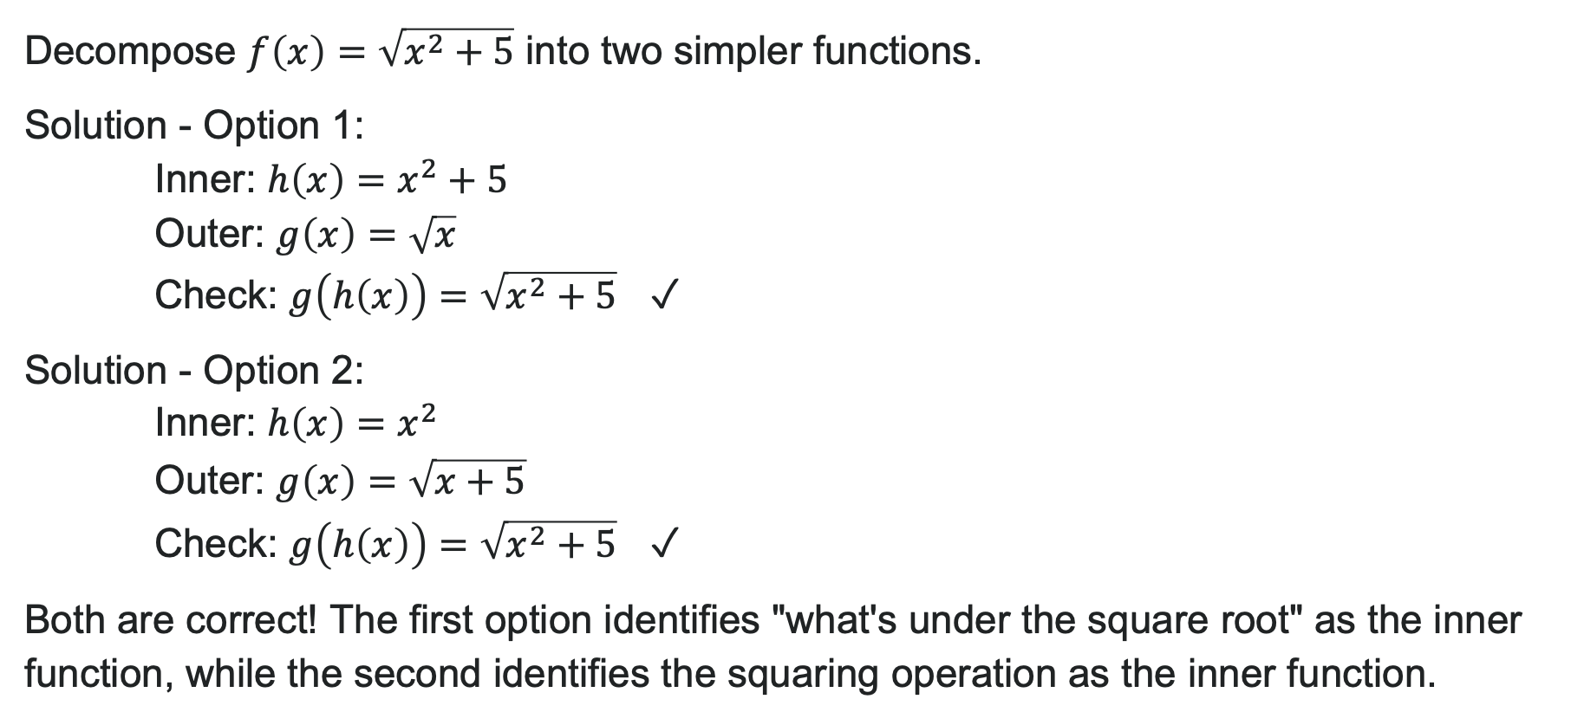
Example: Decomposing a Function
Decompose $f\left(x\right)=\sqrt{x^{2}+5}$ into two simpler functions.
Solution - Option 1:
Inner: $h\left(x\right)=x^{2}+5$
Outer: $g\left(x\right)=\sqrt{x}$
Check: $g\left(h\left(x\right)\right)=\sqrt{x^{2}+5}$ ✓
Solution - Option 2:
Inner: $h\left(x\right)=x^{2}$
Outer: $g\left(x\right)=\sqrt{x+5}$
Check: $g\left(h\left(x\right)\right)=\sqrt{x^{2}+5}$ ✓
Both are correct! The first option identifies "what's under the square root" as the inner function, while the second identifies the squaring operation as the inner function.

Slide 18
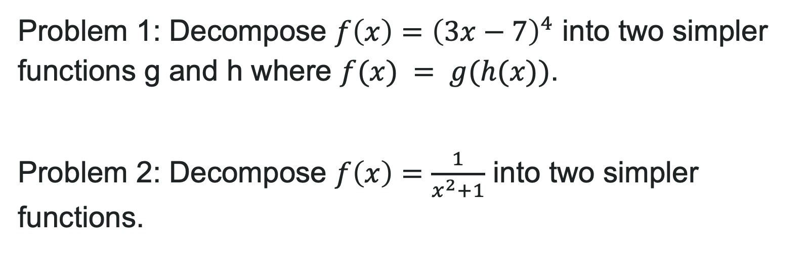
Try It: Decomposing a Function
Problem 1: Decompose $f\left(x\right)={\left(3x−7\right)}^{4}$ into two simpler functions g and h where $f(x) = g(h(x))$.
Problem 2: Decompose $f\left(x\right)=\frac{1}{x^{2}+1}$ into two simpler functions.
Notes:
Answer 1 (one possible decomposition):
h(x) = 3x - 7 and g(x) = x^4
Answer 2 (one possible decomposition):
h(x) = x^2 + 1 and g(x) = \frac{1}{x}
Note to Faculty: Accept any valid decomposition! Students may have different (but correct) answers. For example, Problem 1 could also be h(x) = 3x and g(x) = (x - 7)^4.

Slide 19
Learning Goals: Transformation of Functions
Deepen your understanding and form connections within these skills:
1 Graph functions that have been stretched, flipped, or compressed
2 Graph functions that have been shifted left, right, up, or down
3 Graph functions that have multiple transformations at once
4 Describe transformations and write an equation based on transformations

Slide 20
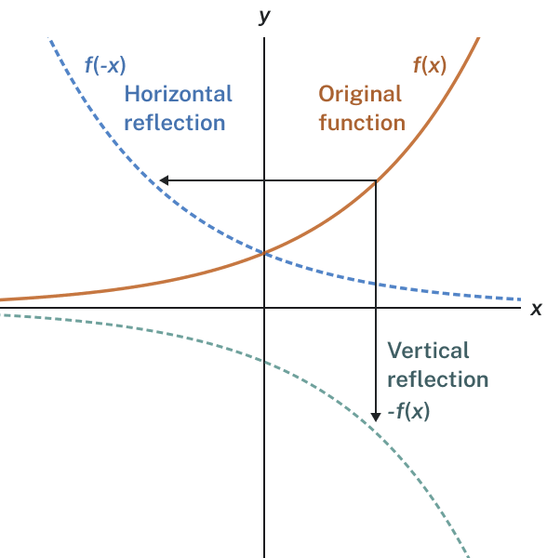
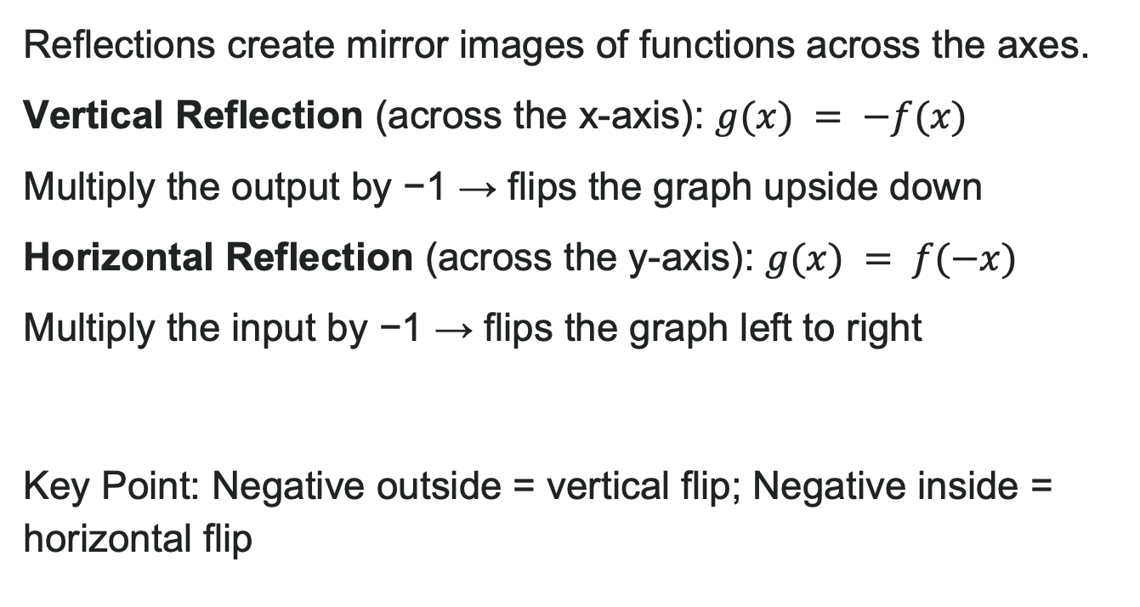
Reflections Across the Axes
Reflections create mirror images of functions across the axes.
Vertical Reflection (across the x-axis): $g(x) = −f(x)$
Multiply the output by −1 → flips the graph upside down
Horizontal Reflection (across the y-axis): $g(x) = f(−x)$
Multiply the input by −1 → flips the graph left to right
Key Point: Negative outside = vertical flip; Negative inside = horizontal flip

Slide 21

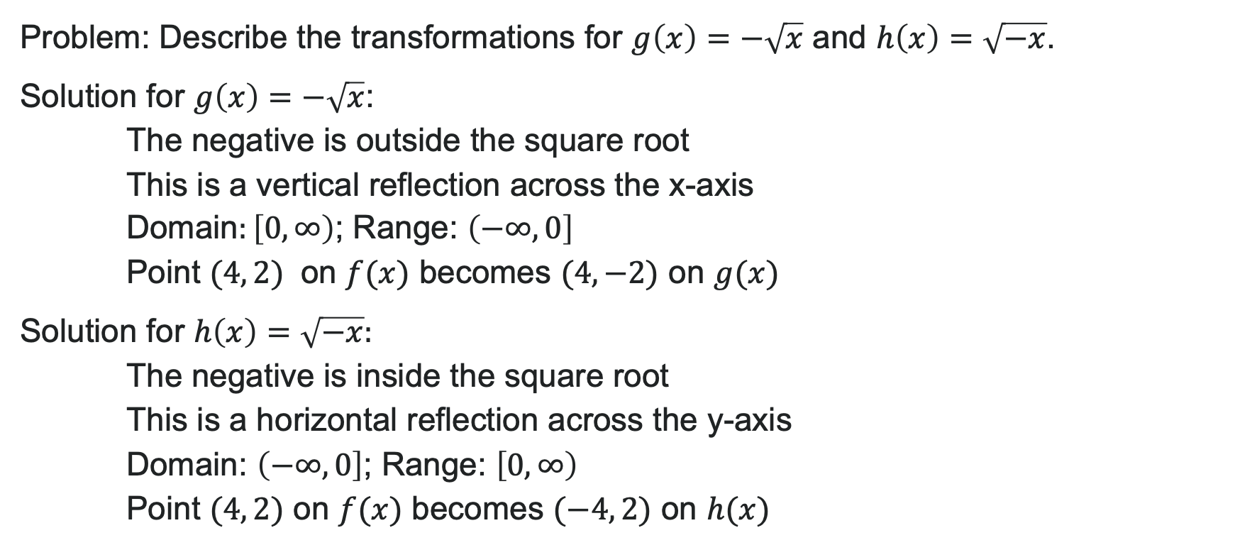
Example: Reflections
Problem: Describe the transformations for $g\left(x\right)=−\sqrt{x}$ and $h\left(x\right)=\sqrt{−x}$.
Solution for $g\left(x\right)=−\sqrt{x}$:
The negative is outside the square root
This is a vertical reflection across the x-axis
Domain$:\left[0,∞\right)$; Range: $\left(−∞,0\right]$
Point $(4, 2)$ on $f(x)$ becomes $(4, −2)$ on $g(x)$
Solution for $h\left(x\right)=\sqrt{−x}:$
The negative is inside the square root
This is a horizontal reflection across the y-axis
Domain: $\left(−∞,0\right]$; Range: $\left[0,∞\right)$
Point $(4, 2)$ on $f(x)$ becomes $(−4, 2)$ on $h(x)$

Slide 22
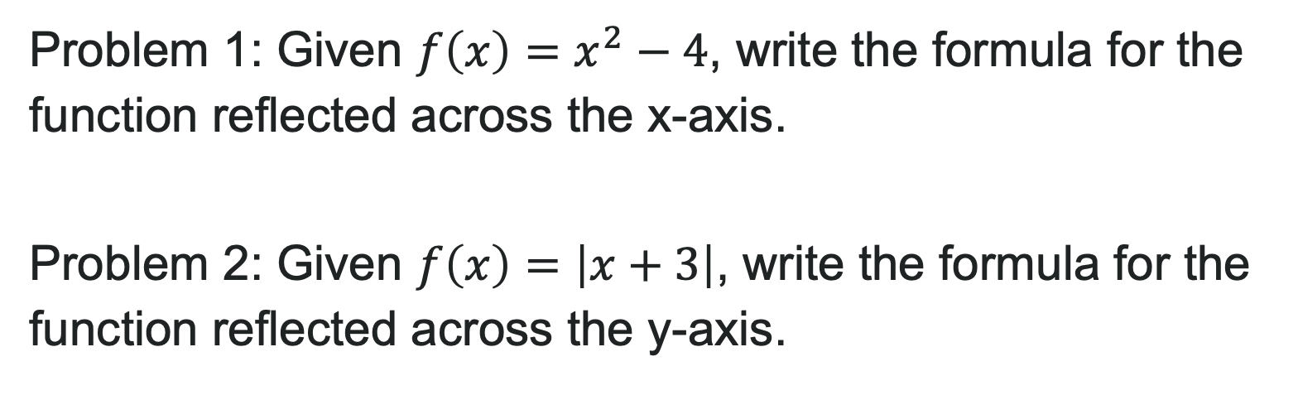
Try It: Reflections
Problem 1: Given $f\left(x\right)=x^{2}−4$, write the formula for the function reflected across the x-axis.
Problem 2: Given $f\left(x\right)=\left|x+3\right|$, write the formula for the function reflected across the y-axis.
Notes:
Answer 1: g(x) = -(x^2 - 4) = -x^2 + 4
Answer 2: h(x) = |-x + 3| = |-(x - 3)| = |x - 3|

Slide 23
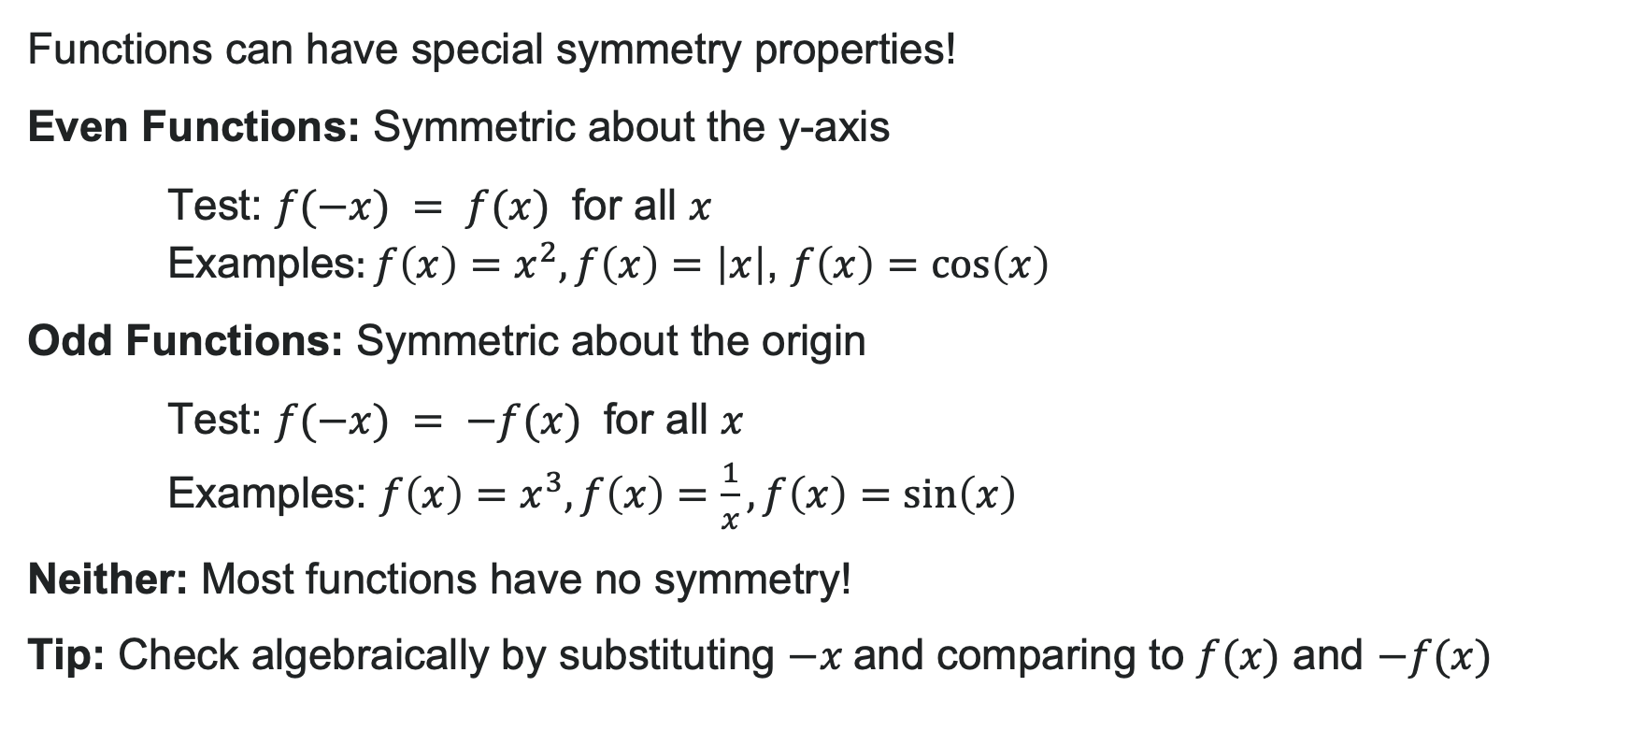
Even and Odd Functions
Functions can have special symmetry properties!
Even Functions: Symmetric about the y-axis
Test: $f(−x) = f(x)$ for all $x$
Examples$:f\left(x\right)=x^{2},f\left(x\right)=\left|x\right|$, $f\left(x\right)=\cos\left(x\right)$
Odd Functions: Symmetric about the origin
Test: $f(−x) = −f(x)$ for all $x$
Examples: $f\left(x\right)=x^{3},f\left(x\right)=\frac{1}{x}, f\left(x\right)=\sin\left(x\right)$
Neither: Most functions have no symmetry!
Tip: Check algebraically by substituting $−x$and comparing to $f(x)$ and $−f(x)$

Slide 24
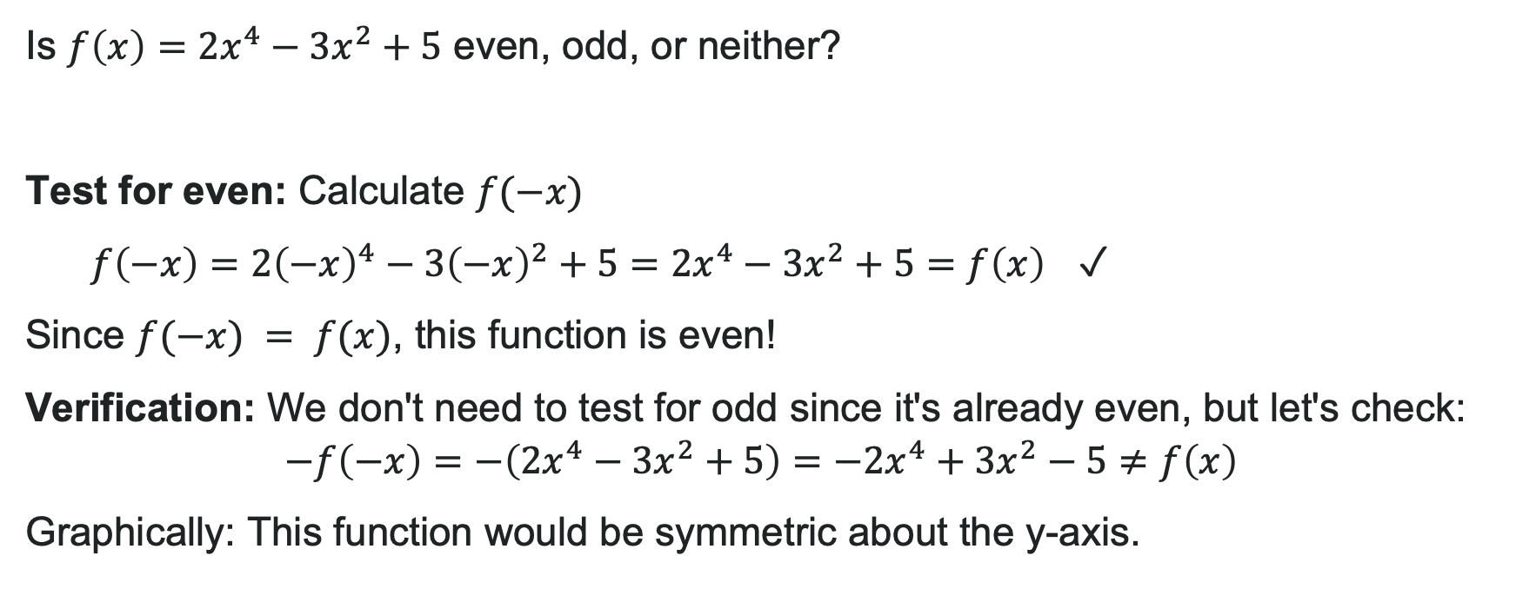
Example: Testing for Even/Odd
Is $f\left(x\right)=2x^{4}−3x^{2}+5$ even, odd, or neither?
Test for even: Calculate $f(−x)$
$f\left(−x\right)=2{\left(−x\right)}^{4}−3{\left(−x\right)}^{2}+5=2x^{4}−3x^{2}+5=f\left(x\right)$ ✓
Since $f(−x) = f(x)$, this function is even!
Verification: We don't need to test for odd since it's already even, but let's check:
$$−f\left(−x\right)=−\left(2x^{4}−3x^{2}+5\right)=−2x^{4}+3x^{2}−5≠f\left(x\right)$$
Graphically: This function would be symmetric about the y-axis.

Slide 25

Try It: Testing for Even/Odd
Determine if each function is even, odd, or neither:
1. $f\left(x\right)=x^{5}−2x$
2. $g\left(x\right)=x^{3}+x^{2}$
Notes:
Answer 1: Odd (because f(-x) = (-x)^5 - 2(-x) = -x^5 + 2x = -(x^5 - 2x) = -f(x)) Answer 2: Neither (doesn't satisfy either condition)

Slide 26

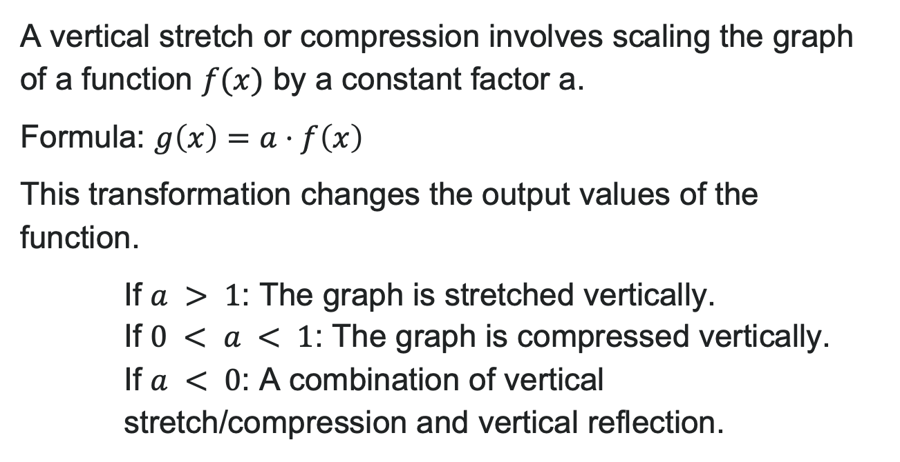
Vertical Stretches and Compressions
A vertical stretch or compression involves scaling the graph of a function $f(x)$ by a constant factor a.
Formula: $g\left(x\right)=a⋅f\left(x\right)$
This transformation changes the output values of the function.
If $a > 1$: The graph is stretched vertically.
If $0 < a < 1$: The graph is compressed vertically.
If $a < 0$: A combination of vertical stretch/compression and vertical reflection.

Slide 27
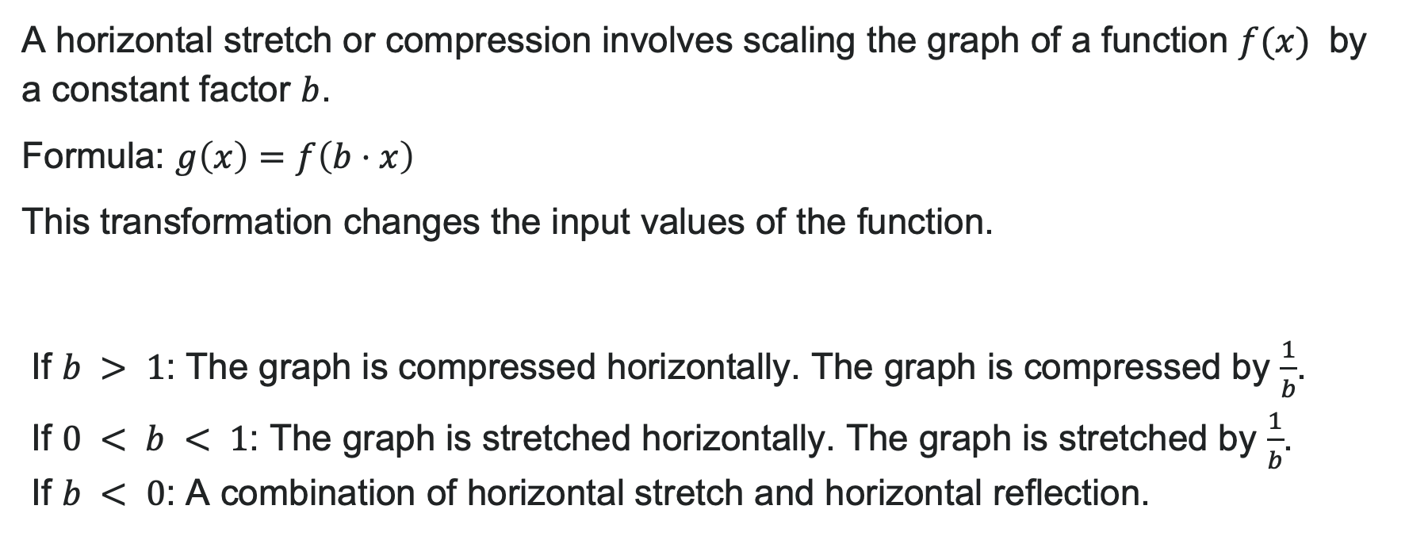
Horizontal Stretches and Compressions
A horizontal stretch or compression involves scaling the graph of a function $f(x)$ by a constant factor $b$.
Formula: $g\left(x\right)=f\left(b⋅x\right)$
This transformation changes the input values of the function.
If $b > 1$: The graph is compressed horizontally. The graph is compressed by $\frac{1}{b}$.
If $0 < b < 1$: The graph is stretched horizontally. The graph is stretched by $\frac{1}{b}$.
If $b < 0$: A combination of horizontal stretch and horizontal reflection.

Slide 28
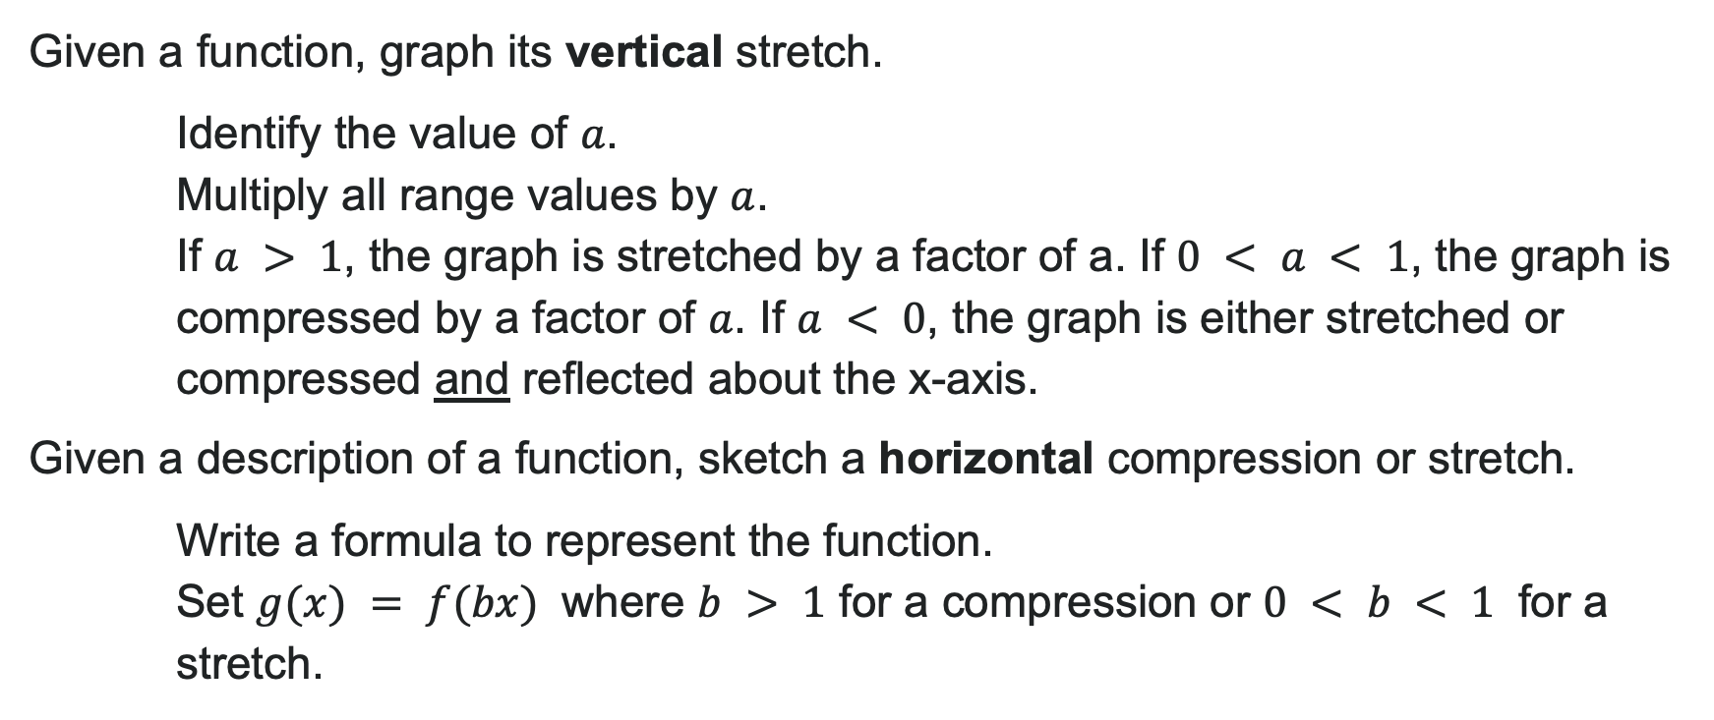
How To: Stretches and Compressions
Given a function, graph its vertical stretch.
Identify the value of $a$.
Multiply all range values by $a$.
If $a > 1$, the graph is stretched by a factor of a. If $0 < a < 1$, the graph is compressed by a factor of $a$. If $a < 0$, the graph is either stretched or compressed and reflected about the x-axis.
Given a description of a function, sketch a horizontal compression or stretch.
Write a formula to represent the function.
Set $g(x) = f(bx)$ where $b > 1$ for a compression or $0 < b < 1$ for a stretch.

Slide 29
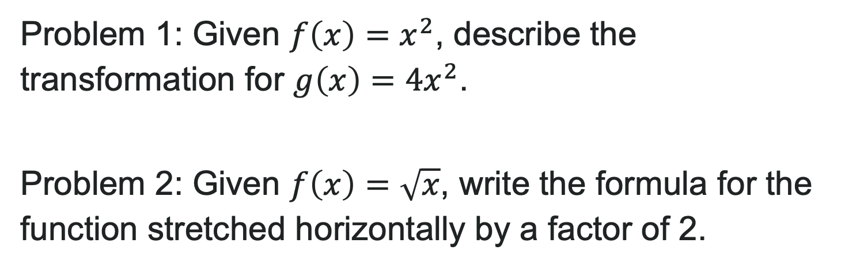
Try It: Stretches and Compressions
Problem 1: Given $f\left(x\right)=x^{2}$, describe the transformation for $g\left(x\right)=4x^{2}$.
Problem 2: Given $f\left(x\right)=\sqrt{x}$, write the formula for the function stretched horizontally by a factor of 2.
Notes:
Answer 1: Vertical stretch by a factor of 4 Answer 2: g(x) = \sqrt{\frac{1}{2}x} or g(x) = f(\frac{x}{2})

Slide 30
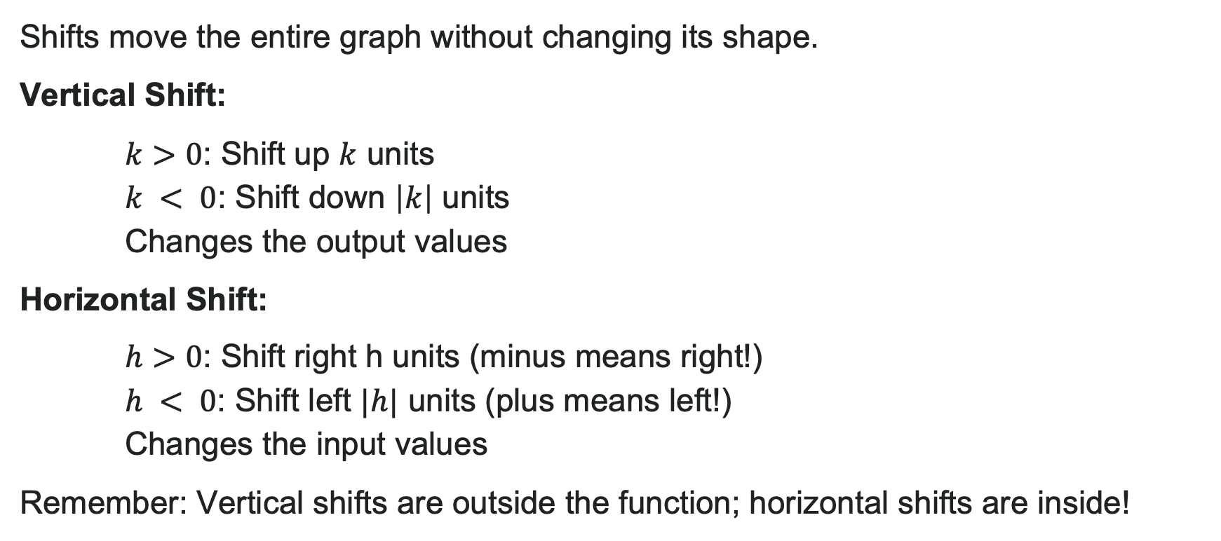
Vertical and Horizontal Shifts
Shifts move the entire graph without changing its shape.
Vertical Shift:
$k>0$: Shift up $k$ units
$k < 0$: Shift down $\left|k\right|$ units
Changes the output values
Horizontal Shift:
$h>0$: Shift right h units (minus means right!)
$h < 0$: Shift left $|h|$ units (plus means left!)
Changes the input values
Remember: Vertical shifts are outside the function; horizontal shifts are inside!

Slide 31
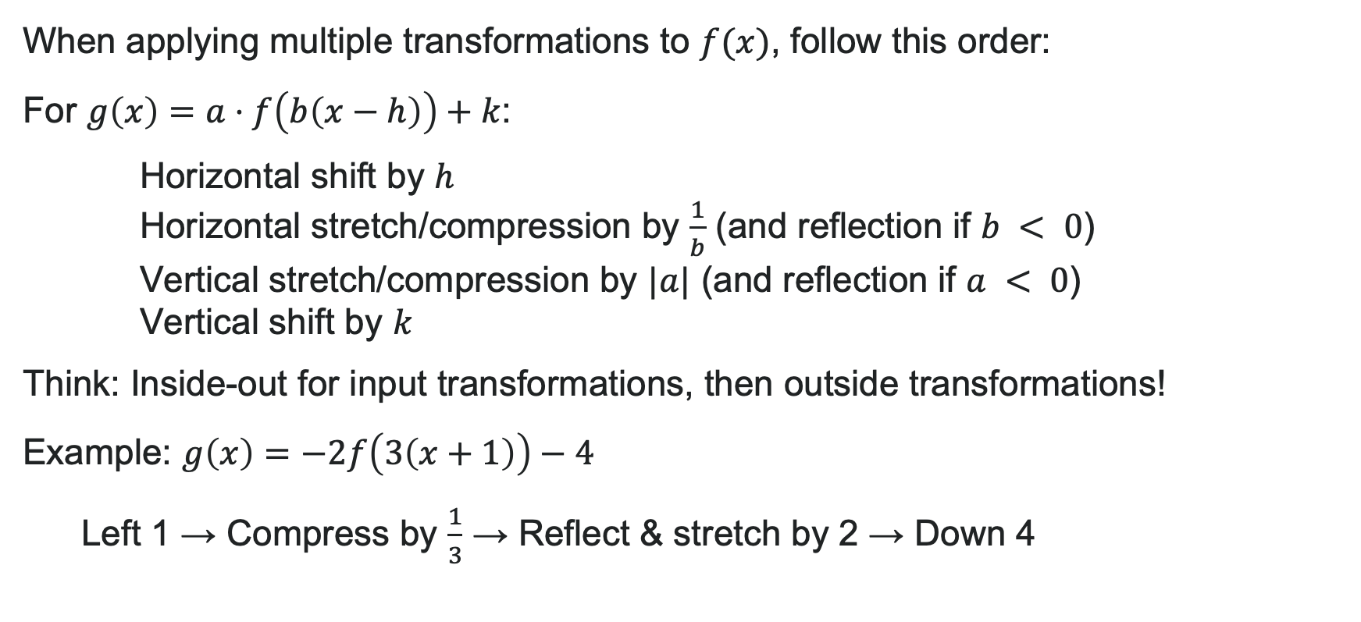
Performing a Sequence of Transformations
When applying multiple transformations to $f(x)$, follow this order:
For $g\left(x\right)=a⋅f\left(b\left(x−h\right)\right)+k$:
Horizontal shift by $h$
Horizontal stretch/compression by $\frac{1}{b}$ (and reflection if $b < 0$)
Vertical stretch/compression by $|a|$ (and reflection if $a < 0$)
Vertical shift by $k$
Think: Inside-out for input transformations, then outside transformations!
Example: $g\left(x\right)=−2f\left(3\left(x+1\right)\right)−4$
Left 1 → Compress by $\frac{1}{3}$ → Reflect & stretch by 2 → Down 4

Slide 32
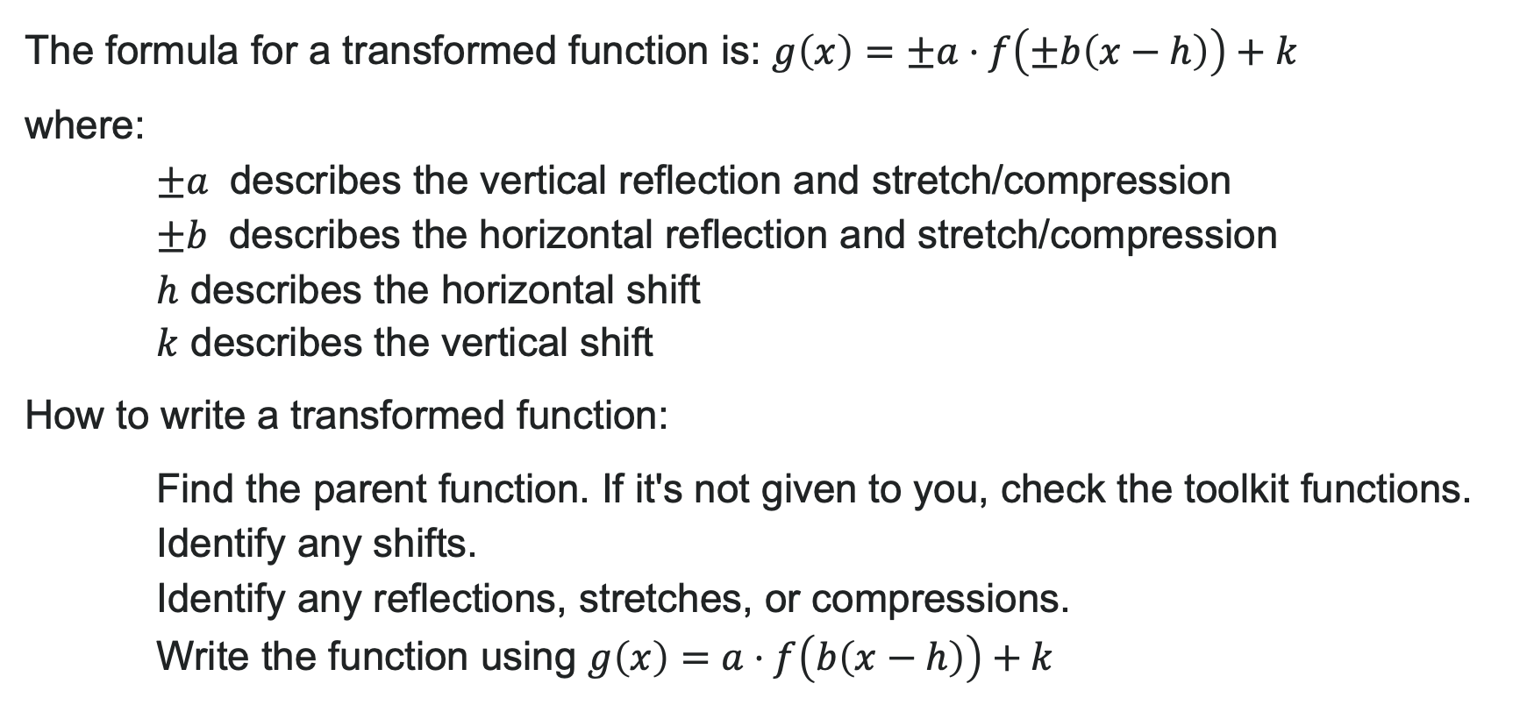
Transformed Function
The formula for a transformed function is: $g\left(x\right)=±a⋅f\left(±b\left(x−h\right)\right)+k$
where:
$±a$ describes the vertical reflection and stretch/compression
$±b$ describes the horizontal reflection and stretch/compression
$h$ describes the horizontal shift
$k$ describes the vertical shift
How to write a transformed function:
Find the parent function. If it's not given to you, check the toolkit functions.
Identify any shifts.
Identify any reflections, stretches, or compressions.
Write the function using $g\left(x\right)=a⋅f\left(b\left(x−h\right)\right)+k$

Slide 33
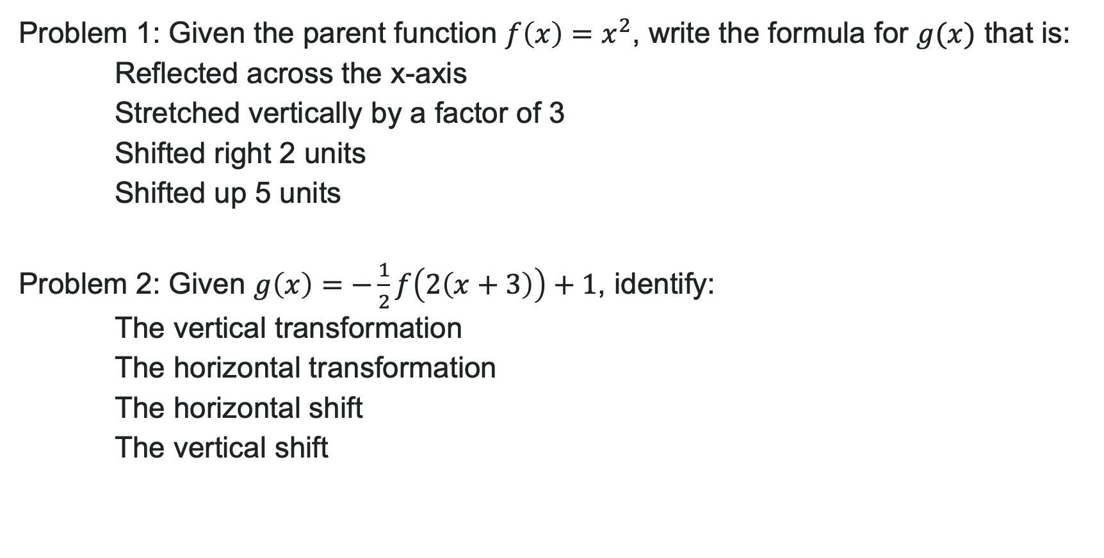
Try It: Writing Transformed Functions
Problem 1: Given the parent function $f\left(x\right)=x^{2}$, write the formula for $g(x)$ that is:
Reflected across the x-axis
Stretched vertically by a factor of 3
Shifted right 2 units
Shifted up 5 units
Problem 2: Given $g\left(x\right)=−\frac{1}{2}f\left(2\left(x+3\right)\right)+1$, identify:
The vertical transformation
The horizontal transformation
The horizontal shift
The vertical shift
Notes:
Answer 1: g(x) = -3(x - 2)^2 + 5 or using transformation notation: g(x) = -3f(x - 2) + 5 where a = -3, b = 1, h = 2, k = 5
Answer 2:
Vertical: Compressed by \frac{1}{2} and reflected across x-axis (a = -\frac{1}{2})
Horizontal: Compressed by \frac{1}{2} (b = 2)
Horizontal shift: Left 3 units (h = -3)
Vertical shift: Up 1 unit (k = 1)

Slide 34
Learning Goals: Inverse Functions
Deepen your understanding and form connections within these skills:
1 Use composition to check if two functions are inverses
2 Determine the domain and range of an inverse function, and restrict the domain of a function to make it one-to-one
3 Find or calculate the inverse of a function
4 Use the graph of a function to draw its inverse

Slide 35
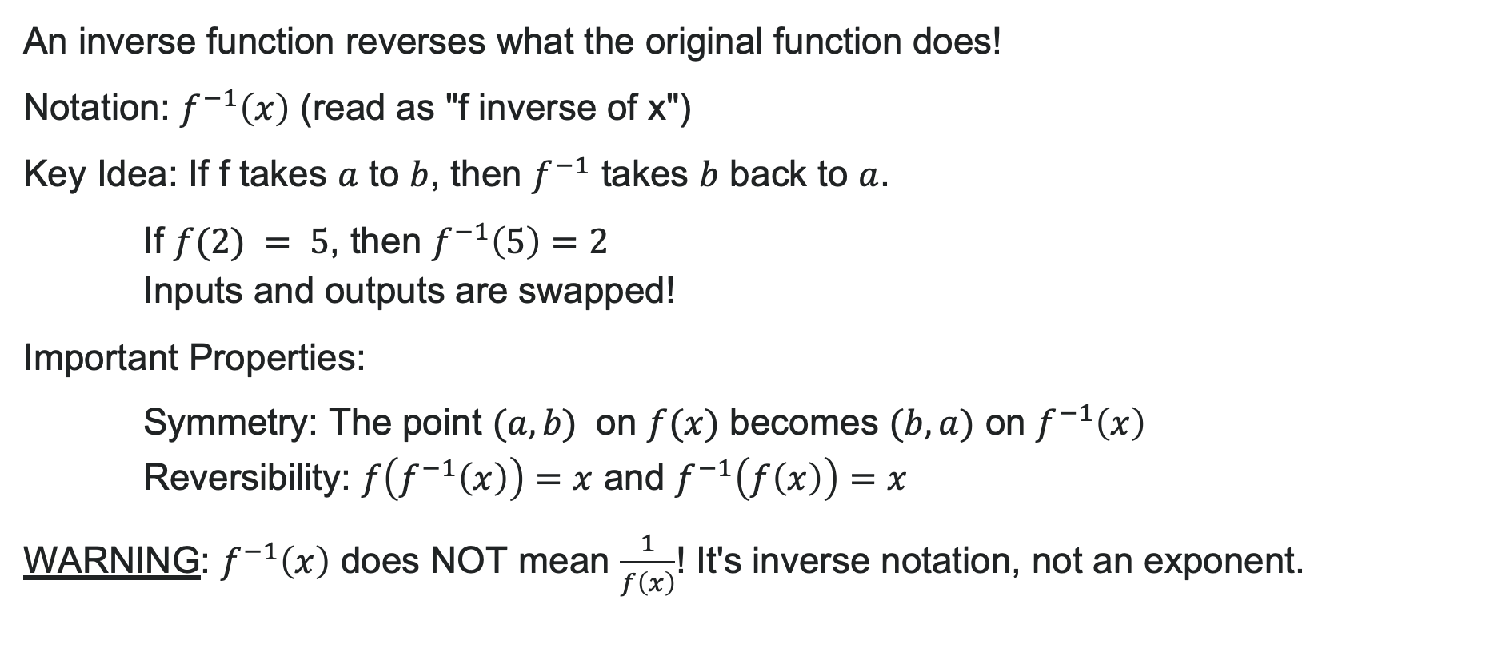
What is an Inverse Function?
An inverse function reverses what the original function does!
Notation: $f^{−1}\left(x\right)$ (read as "f inverse of x")
Key Idea: If f takes $a$ to $b$, then $f^{−1}$ takes $b$ back to $a$.
If $f(2) = 5$, then $f^{−1}\left(5\right)=2$
Inputs and outputs are swapped!
Important Properties:
Symmetry: The point $(a, b)$ on $f(x)$ becomes $(b, a)$ on $f^{−1}\left(x\right)$
Reversibility: $f\left(f^{−1}\left(x\right)\right)=x$ and $f^{−1}\left(f\left(x\right)\right)=x$
WARNING: $f^{−1}\left(x\right)$ does NOT mean $\frac{1}{f\left(x\right)}$! It's inverse notation, not an exponent.

Slide 36
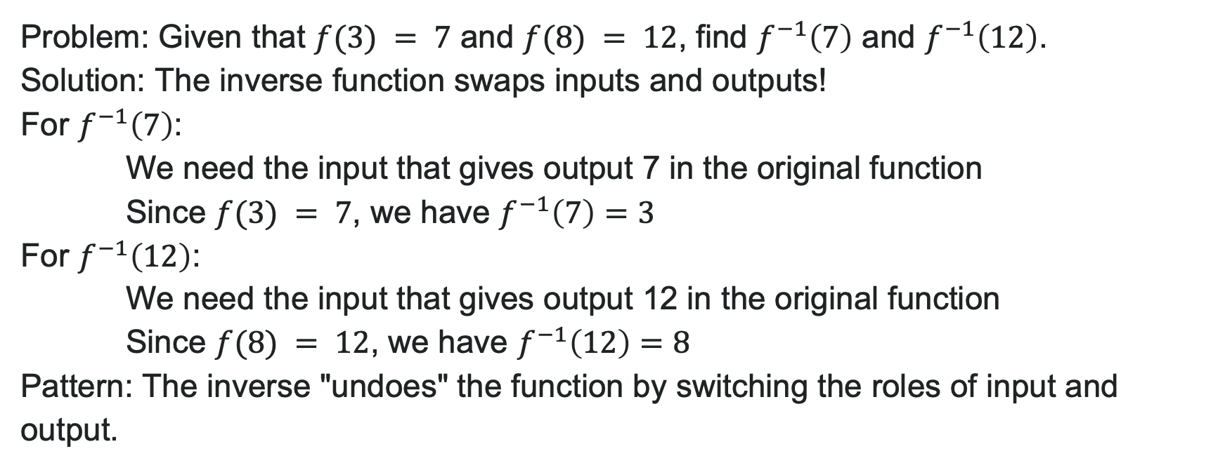
Example: Understanding Inverses
Problem: Given that $f(3) = 7$ and $f(8) = 12$, find $f^{−1}\left(7\right)$ and $f^{−1}\left(12\right)$.
Solution: The inverse function swaps inputs and outputs!
For $f^{−1}\left(7\right)$:
We need the input that gives output 7 in the original function
Since $f(3) = 7$, we have $f^{−1}\left(7\right)=3$
For $f^{−1}\left(12\right)$:
We need the input that gives output 12 in the original function
Since $f(8) = 12$, we have $f^{−1}\left(12\right)=8$
Pattern: The inverse "undoes" the function by switching the roles of input and output.

Slide 37
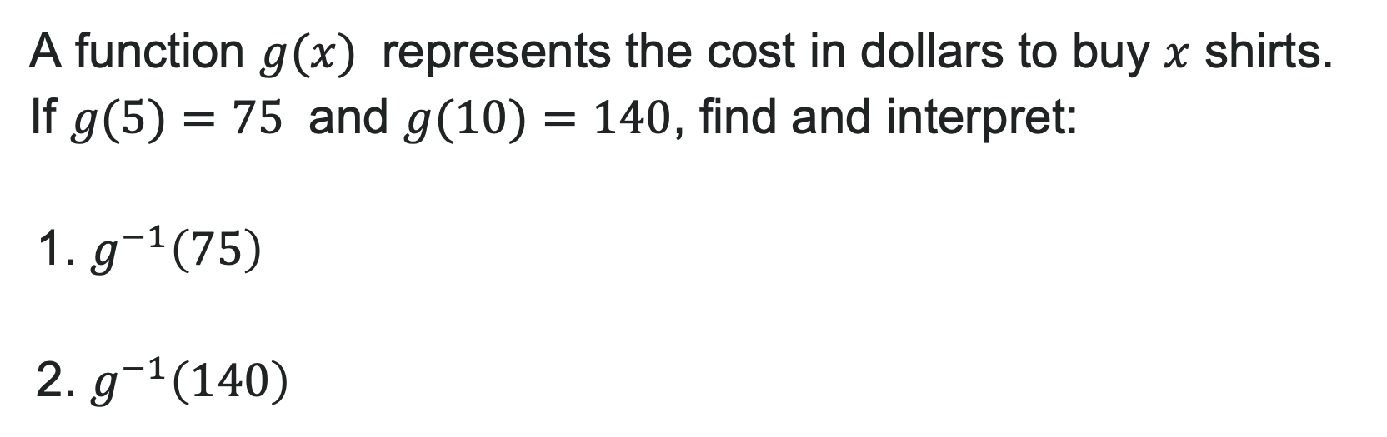
Try It: Inverse Values
A function $g(x)$ represents the cost in dollars to buy $x$ shirts. If $g(5)=75$ and $g(10)=140$, find and interpret:
1. $g^{−1}\left(75\right)$
2. $g^{−1}\left(140\right)$
Notes:
Answer 1: g^{-1}(75) = 5 (It costs $75 to buy 5 shirts, so if you spend $75, you can buy 5 shirts)
Answer 2: g^{-1}(140) = 10 (It costs $140 to buy 10 shirts, so if you spend $140, you can buy 10 shirts)

Slide 38

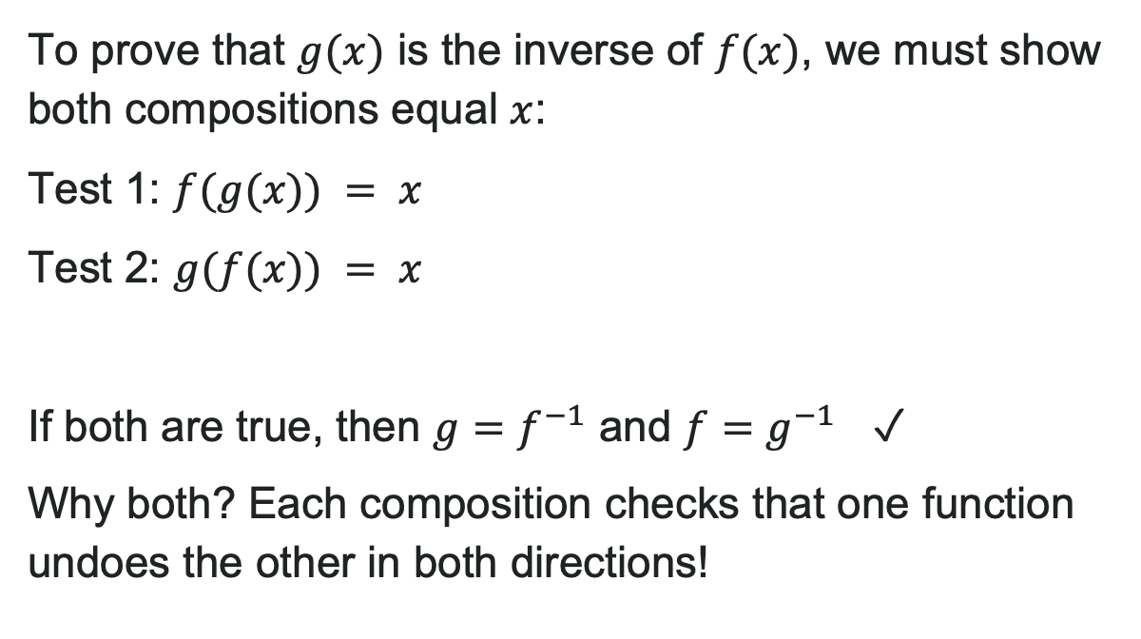
Verifying Inverse Functions
To prove that $g(x)$ is the inverse of $f(x)$, we must show both compositions equal $x$:
Test 1: $f(g(x)) = x$
Test 2: $g(f(x)) = x$
If both are true, then $g=f^{−1}$ and $f=g^{−1}$ ✓
Why both? Each composition checks that one function undoes the other in both directions!

Slide 39
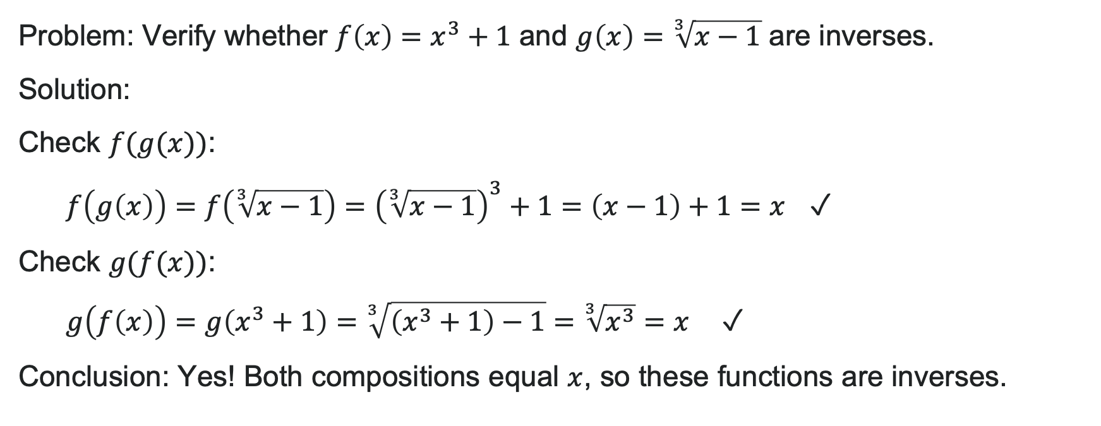
Example: Verifying Inverses
Problem: Verify whether $f\left(x\right)=x^{3}+1$ and $g\left(x\right)=\sqrt[3]{x−1}$ are inverses.
Solution:
Check $f(g(x))$:
$f\left(g\left(x\right)\right)=f\left(\sqrt[3]{x−1}\right)={\left(\sqrt[3]{x−1}\right)}^{3}+1=\left(x−1\right)+1=x$ ✓
Check $g(f(x))$:
$g\left(f\left(x\right)\right)=g\left(x^{3}+1\right)=\sqrt[3]{\left(x^{3}+1\right)−1}=\sqrt[3]{x^{3}}=x$ ✓
Conclusion: Yes! Both compositions equal $x$, so these functions are inverses.

Slide 40
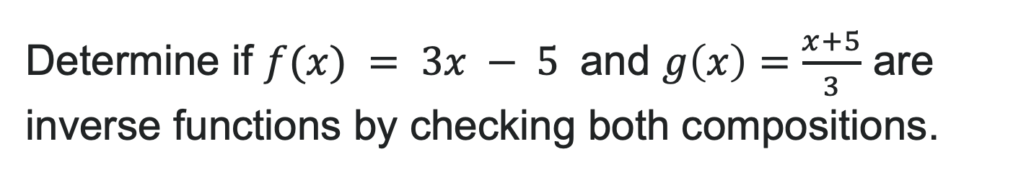
Try It: Verifying Inverses
Determine if $f(x) = 3x − 5$ and $g\left(x\right)=\frac{x+5}{3}$ are inverse functions by checking both compositions.
Notes:
Answer: Yes, they are inverses.
f(g(x)) = 3\left(\frac{x+5}{3}\right) - 5 = (x + 5) - 5 = x ✓
g(f(x)) = \frac{(3x - 5) + 5}{3} = \frac{3x}{3} = x ✓

Slide 41
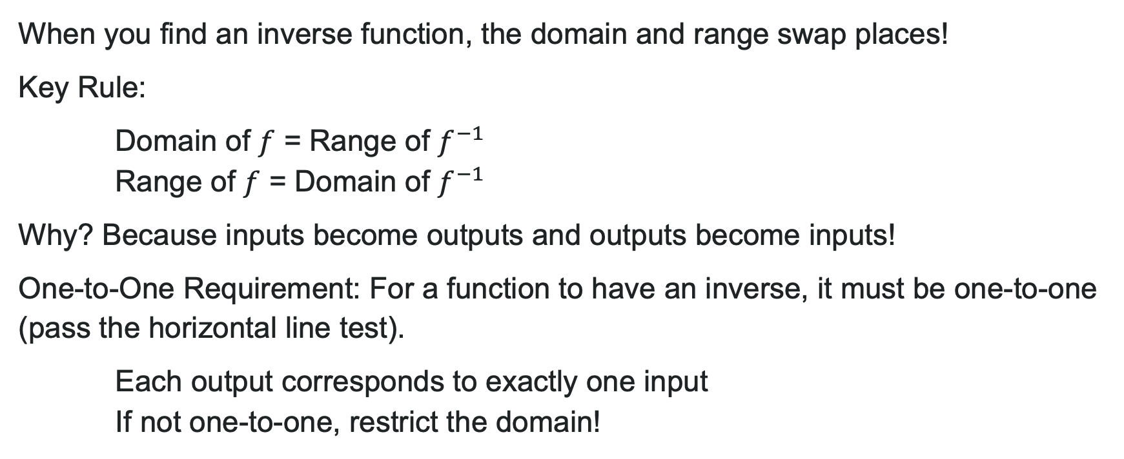
Domain and Range of Inverse Functions
When you find an inverse function, the domain and range swap places!
Key Rule:
Domain of $f$ = Range of $f^{−1}$
Range of $f$ = Domain of $f^{−1}$
Why? Because inputs become outputs and outputs become inputs!
One-to-One Requirement: For a function to have an inverse, it must be one-to-one (pass the horizontal line test).
Each output corresponds to exactly one input
If not one-to-one, restrict the domain!

Slide 42
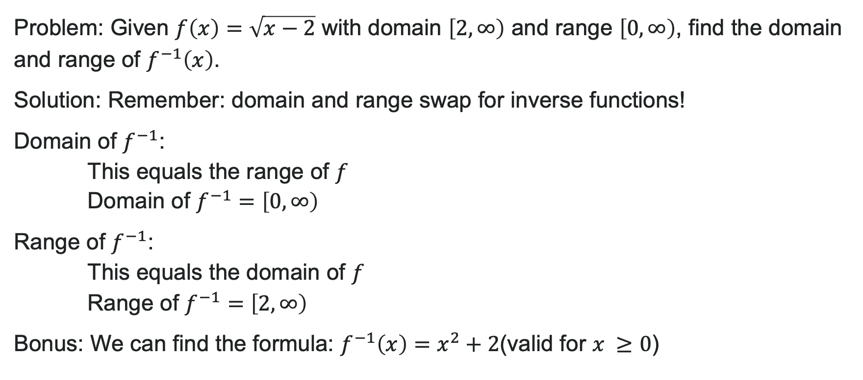
Example: Domain and Range of an Inverse
Problem: Given $f\left(x\right)=\sqrt{x−2}$ with domain $\left[2,∞\right)$ and range $\left[0,∞\right)$, find the domain and range of $f^{−1}\left(x\right)$.
Solution: Remember: domain and range swap for inverse functions!
Domain of $f^{−1}$:
This equals the range of $f$
Domain of $f^{−1}=\left[0,∞\right)$
Range of $f^{−1}$:
This equals the domain of $f$
Range of $f^{−1}=\left[2,∞\right)$
Bonus: We can find the formula: $f^{−1}\left(x\right)=x^{2}+2$(valid for $x ≥0$)

Slide 43
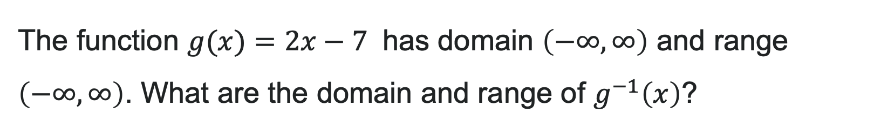
Try It: Domain and Range of Inverses
The function $g(x)=2x−7$ has domain $\left(−∞,∞\right)$ and range $\left(−∞,∞\right)$. What are the domain and range of $g^{−1}\left(x\right)$?
Notes:
Answer:
Domain of g^{-1} = Range of g = (-\infty, \infty)
Range of g^{-1} = Domain of g = (-\infty, \infty)

Slide 44
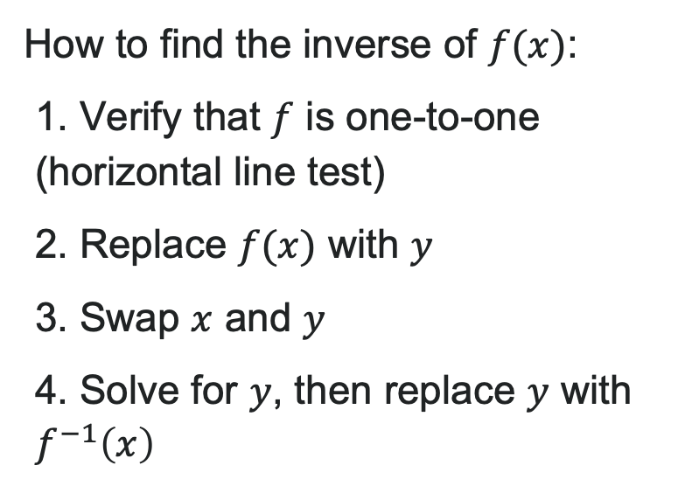
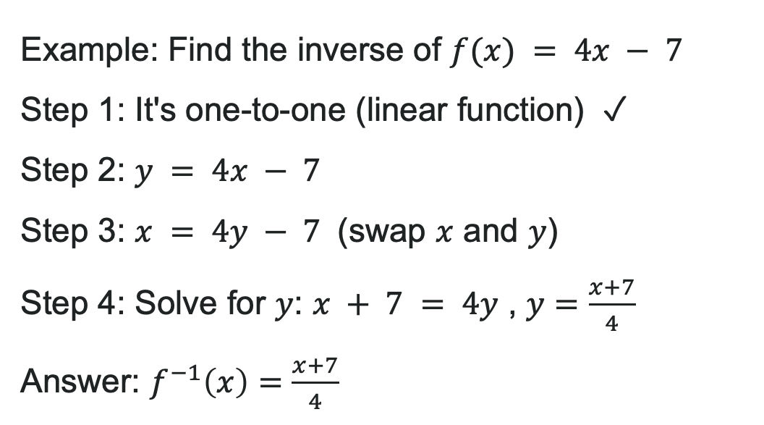
Finding Inverse Functions
How to find the inverse of $f(x)$:
1. Verify that $f$ is one-to-one (horizontal line test)
2. Replace $f(x)$ with $y$
3. Swap $x$ and $y$
4. Solve for $y$, then replace $y$ with $f^{−1}\left(x\right)$
Example: Find the inverse of $f(x) = 4x − 7$
Step 1: It's one-to-one (linear function) ✓
Step 2: $y = 4x − 7$
Step 3: $x = 4y − 7$ (swap $x$ and $y$)
Step 4: Solve for $y$: $x + 7 = 4y$ , $y=\frac{x+7}{4}$
Answer: $f^{−1}\left(x\right)=\frac{x+7}{4}$

Slide 45

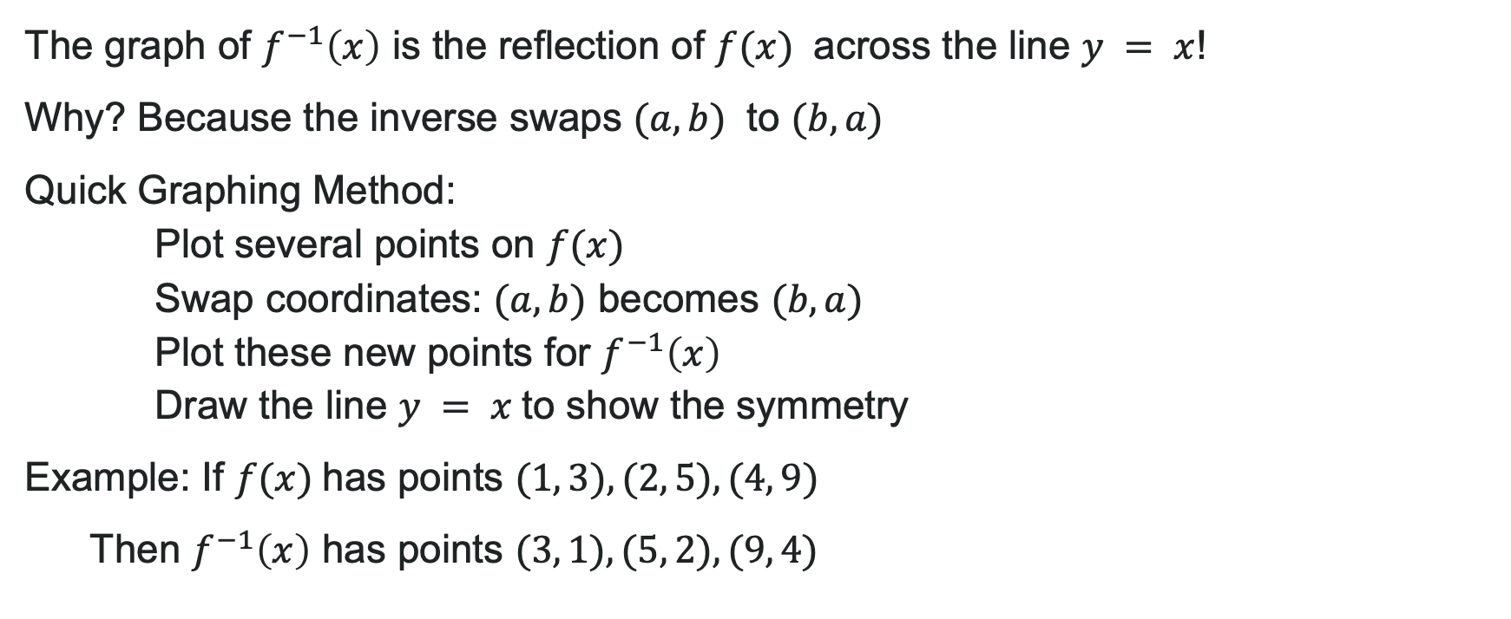
Graphing Inverse Functions
The graph of $f^{−1}\left(x\right)$ is the reflection of $f(x)$ across the line $y = x$!
Why? Because the inverse swaps $(a, b)$ to $(b, a)$
Quick Graphing Method:
Plot several points on $f(x)$
Swap coordinates: $(a, b)$ becomes $(b, a)$
Plot these new points for $f^{−1}\left(x\right)$
Draw the line $y = x$to show the symmetry
Example: If $f(x)$has points $(1, 3), (2, 5), (4, 9)$
Then $f^{−1}\left(x\right)$ has points $(3, 1), (5, 2), (9, 4)$

Slide 46
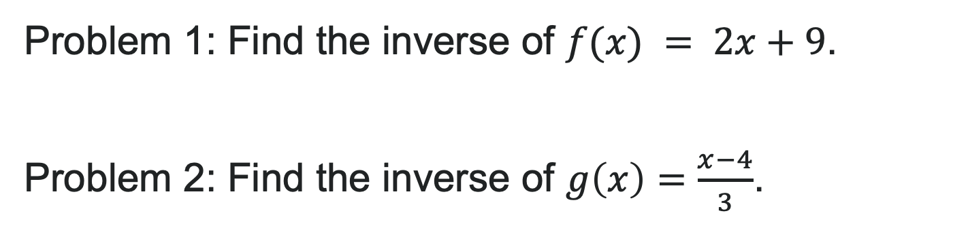
Try It: Finding an Inverse
Problem 1: Find the inverse of $f(x) = 2x+9$.
Problem 2: Find the inverse of $g\left(x\right)=\frac{x−4}{3}$.
Notes:
Answer:
Answer 1: f^{-1}(x) = \frac{x - 9}{2}
Step 1: y = 2x + 9
Step 2: x = 2y + 9 (swap)
Step 3: x - 9 = 2y
Step 4: y = \frac{x - 9}{2}
Answer 2: g^{-1}(x) = 3x + 4
Step 1: y = \frac{x - 4}{3}
Step 2: x = \frac{y - 4}{3} (swap)
Step 3: 3x = y - 4
Step 4: y = 3x + 4

Slide 47
Before we finish up…
2
Next steps…..
3
Reminders about student hours, upcoming deadlines, campus activities ….
1
Questions…..

Slide 48

Attributions
Illustrations are from Storyset
Authored by: Lumen Learning. License: CC BY: Attribution

