Slide 1

Precalculus
Module 16:
Triangle Trigonometry

Slide 2
Affirmations
I recognize that my math abilities continue to expand.
I am learning to enjoy the process of problem-solving.
My learning journey is unique and valuable.

Slide 3
Learning Goals: Right Triangle Trigonometry
Deepen your understanding and form connections within these skills:
1 Use right triangles to evaluate trigonometric functions
2 Use cofunctions of complementary angles
3 Use the deﬁnitions of trigonometric functions of any angle
4 Use right triangle trigonometry to solve applied problems

Slide 4
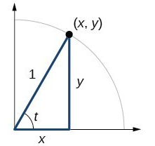
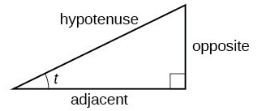
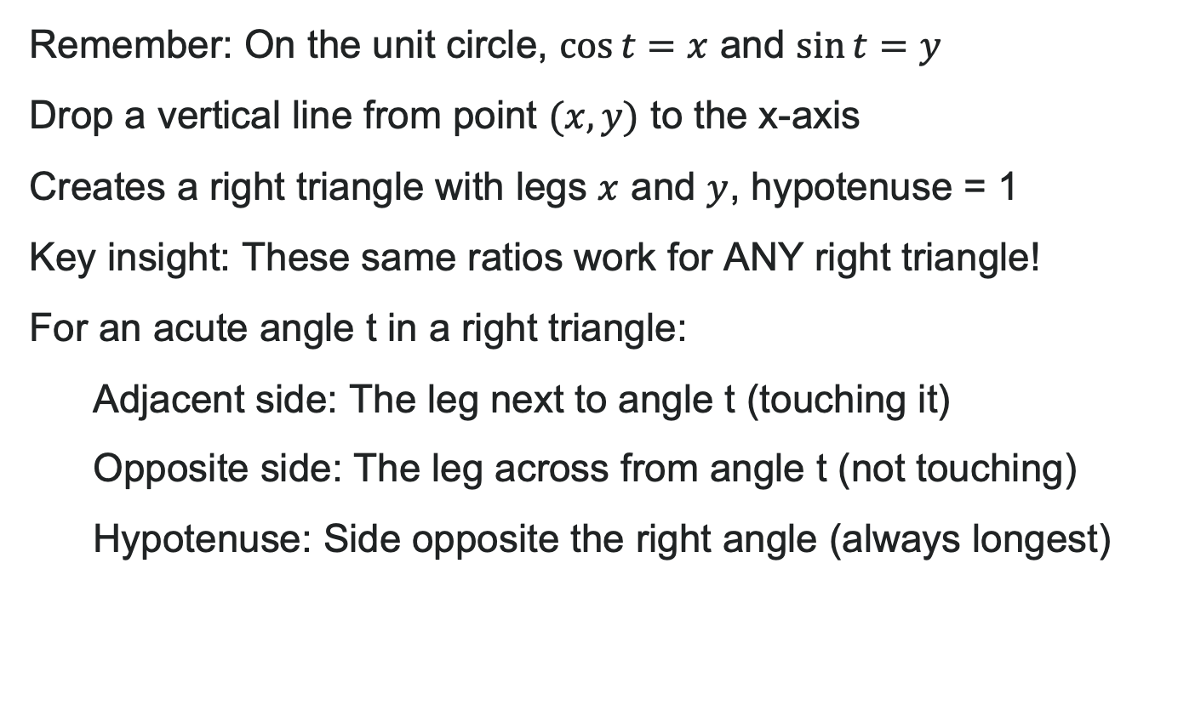
From Unit Circle to Right Triangle
Remember: On the unit circle, $\cos{t}=x$ and $\sin{t}=y$
Drop a vertical line from point $(x, y)$ to the x-axis
Creates a right triangle with legs $x$ and $y$, hypotenuse = 1
Key insight: These same ratios work for ANY right triangle!
For an acute angle t in a right triangle:
Adjacent side: The leg next to angle t (touching it)
Opposite side: The leg across from angle t (not touching)
Hypotenuse: Side opposite the right angle (always longest)

Slide 5


The Three Core Ratios (SOH-CAH-TOA)
Sine: $\sin\left(t\right)=\frac{\text{opposite}}{\text{hypotenuse}}$
Cosine: $\cos\left(t\right)=\frac{\text{adjacent}}{\text{hypotenuse}}$
Tangent: $\tan\left(t\right)=\frac{\text{opposite}}{\text{adjacent}}$
Mnemonic: SOH-CAH-TOA
Sine: Opposite/Hypotenuse
Cosine: Adjacent/Hypotenuse
Tangent: Opposite/Adjacent

Slide 6
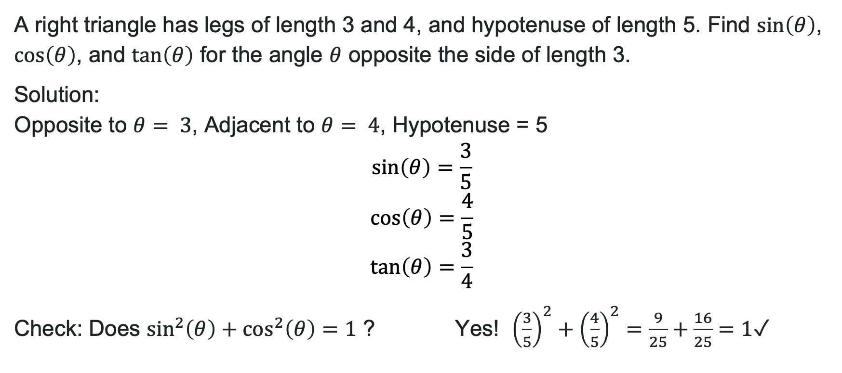
Example: Finding Sin, Cos, Tan
A right triangle has legs of length 3 and 4, and hypotenuse of length 5. Find $\sin\left(θ\right)$, $\cos\left(θ\right)$, and $\tan\left(θ\right)$ for the angle $θ$ opposite the side of length 3.
Solution: Opposite to $θ= 3$, Adjacent to $θ= 4$, Hypotenuse = 5
$$\sin\left(θ\right)=\frac{3}{5} \\ \cos\left(θ\right)=\frac{4}{5} \\ \tan\left(θ\right)=\frac{3}{4}$$
Check: Does $\sin^{2}\left(θ\right)+\cos^{2}\left(θ\right)=1$? Yes! ${\left(\frac{3}{5}\right)}^{2}+{\left(\frac{4}{5}\right)}^{2}=\frac{9}{25}+\frac{16}{25}=1$ ✓

Slide 7
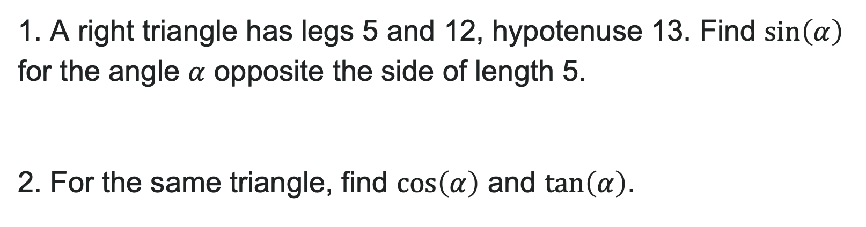
Try It: Practice Finding Ratios
1. A right triangle has legs 5 and 12, hypotenuse 13. Find $\sin\left(α\right)$ for the angle $α$ opposite the side of length 5.
2. For the same triangle, find $\cos\left(α\right)$ and $\tan\left(α\right)$.
Notes:
Answer:
\sin(\alpha) = \frac{5}{13}
\cos(\alpha) = \frac{12}{13}, \tan(\alpha) = \frac{5}{12}

Slide 8

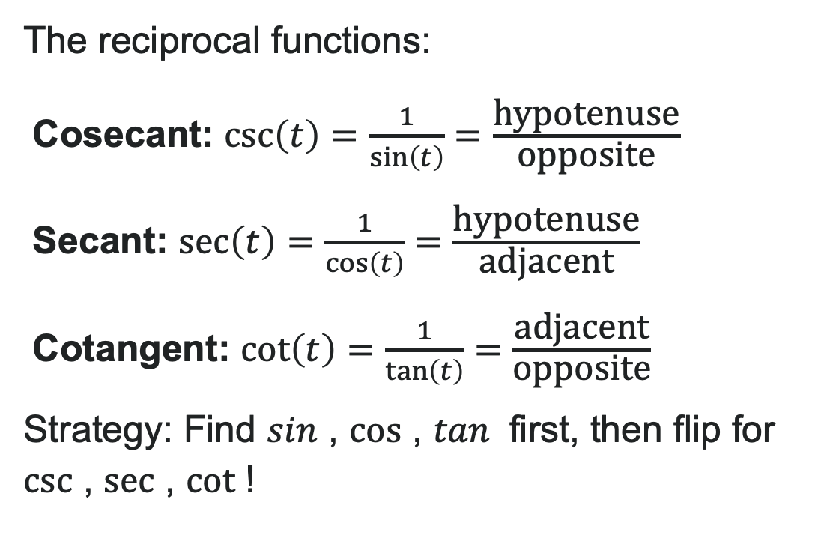
Beyond Sin, Cos, and Tan
The reciprocal functions:
Cosecant: $\csc\left(t\right)=\frac{1}{\sin\left(t\right)}=\frac{\text{hypotenuse}}{\text{opposite}}$
Secant: $\sec\left(t\right)=\frac{1}{\cos\left(t\right)}=\frac{\text{hypotenuse}}{\text{adjacent}}$
Cotangent: $\cot\left(t\right)=\frac{1}{\tan\left(t\right)}=\frac{\text{adjacent}}{\text{opposite}}$
Strategy: Find $sin$ , $cos$ , $tan⁡$ first, then flip for $csc$ , $sec$ , $cot$ !

Slide 9
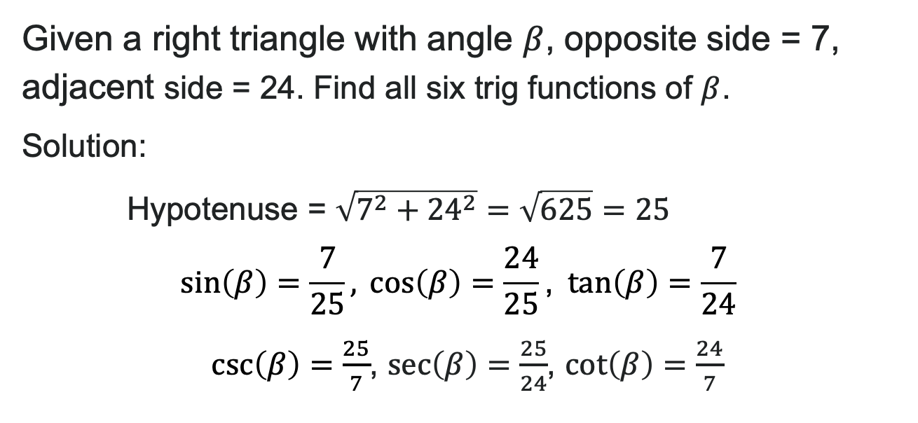
Example 2: Finding All Six Trig Functions
Given a right triangle with angle $β$, opposite side = 7, adjacent side = 24. Find all six trig functions of $β$.
Solution:
Hypotenuse = $\sqrt{7^{2}+{24}^{2}}=\sqrt{625}=25$
, $\sec\left(β\right)=\frac{25}{24}$, $\cot\left(β\right)=\frac{24}{7}$

Slide 10
Try It: Finding All Six Functions
A right triangle has opposite side = 8, adjacent side = 15. Find all six trigonometric functions of the angle.
Notes:
Answer: Hypotenuse = 17
\sin = \frac{8}{17}, \cos = \frac{15}{17}, \tan = \frac{8}{15}
\csc = \frac{17}{8}, \sec = \frac{17}{15}, \cot = \frac{15}{8}

Slide 11
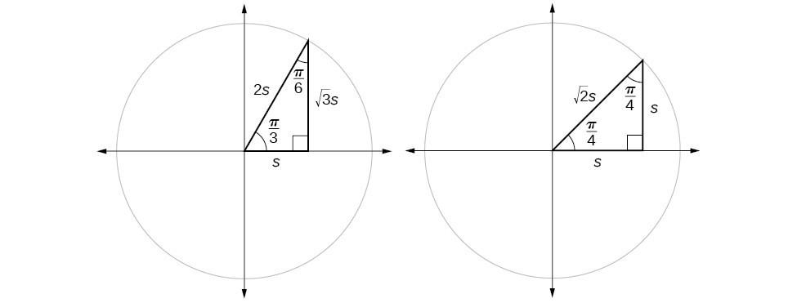
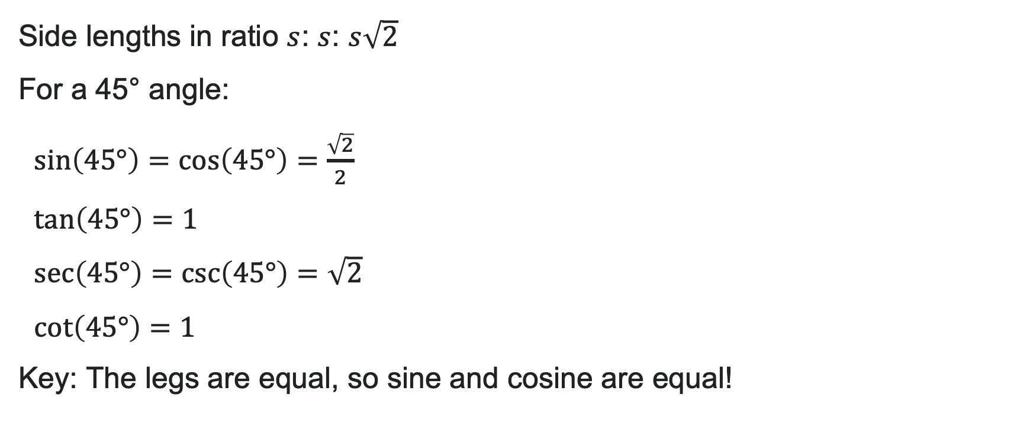
Special Angles: The 45-45-90 Triangle
Side lengths in ratio $s$: $s$: $s\sqrt{2}$
For a 45° angle:
$\sin\left(45°\right)=\cos\left(45°\right)=\frac{\sqrt{2}}{2}$
$\tan\left(45°\right)=1$
$\sec\left(45°\right)=\csc\left(45°\right)=\sqrt{2}$
$\cot\left(45°\right)=1$
Key: The legs are equal, so sine and cosine are equal!

Slide 12
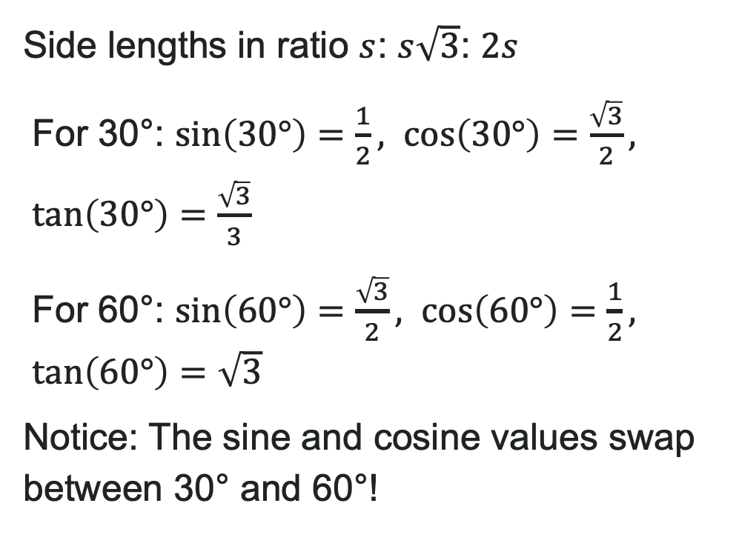
Special Angles: The 30-60-90 Triangle
Side lengths in ratio $s$: $s\sqrt{3}$: $2s$
For 30°: $\sin\left(30°\right)=\frac{1}{2}, \cos\left(30°\right)=\frac{\sqrt{3}}{2}, \tan\left(30°\right)=\frac{\sqrt{3}}{3}$
For 60°: $\sin\left(60°\right)=\frac{\sqrt{3}}{2}, \cos\left(60°\right)=\frac{1}{2}, \tan\left(60°\right)=\sqrt{3}$
Notice: The sine and cosine values swap between 30° and 60°!

Slide 13
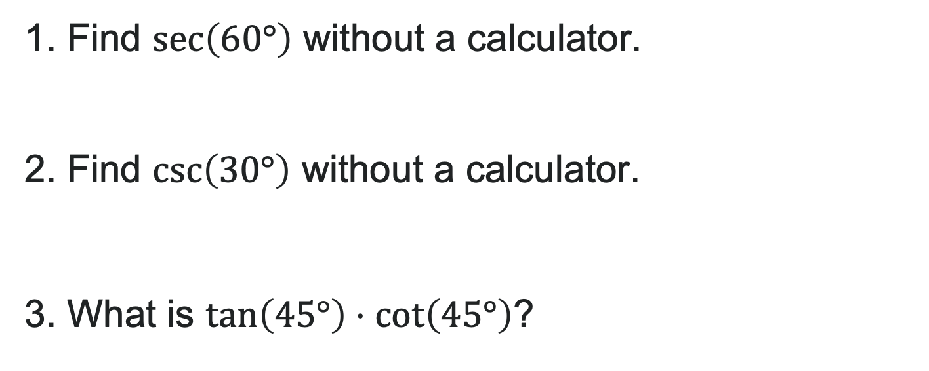
Try It: Special Angles
1. Find $\sec\left(60°\right)$ without a calculator.
2. Find $\csc\left(30°\right)$ without a calculator.
3. What is $\tan\left(45°\right)⋅\cot\left(45°\right)$?
Notes:
Answer:
\sec(60°) = 2
\csc(30°) = 2
\tan(45°) \cdot \cot(45°) = 1 \cdot 1 = 1

Slide 14
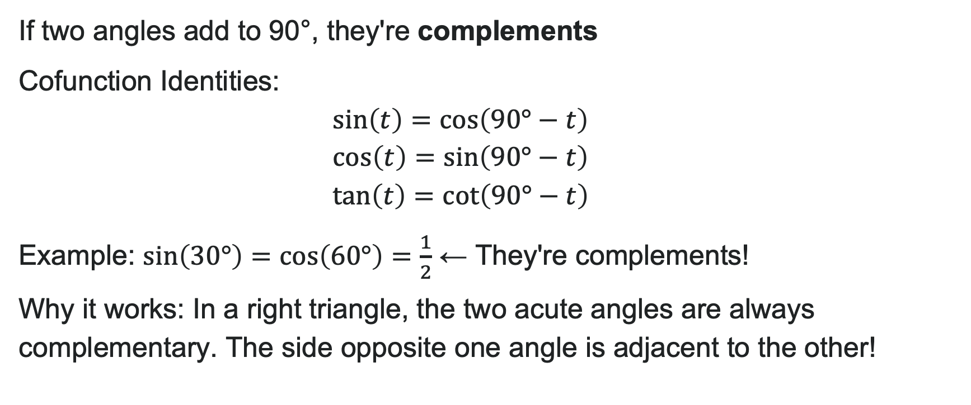
Complementary Angles
If two angles add to 90°, they're complements
Cofunction Identities:
Example: $\sin\left(30°\right)=\cos\left(60°\right)=\frac{1}{2}$ ← They're complements!
Why it works: In a right triangle, the two acute angles are always complementary. The side opposite one angle is adjacent to the other!

Slide 15

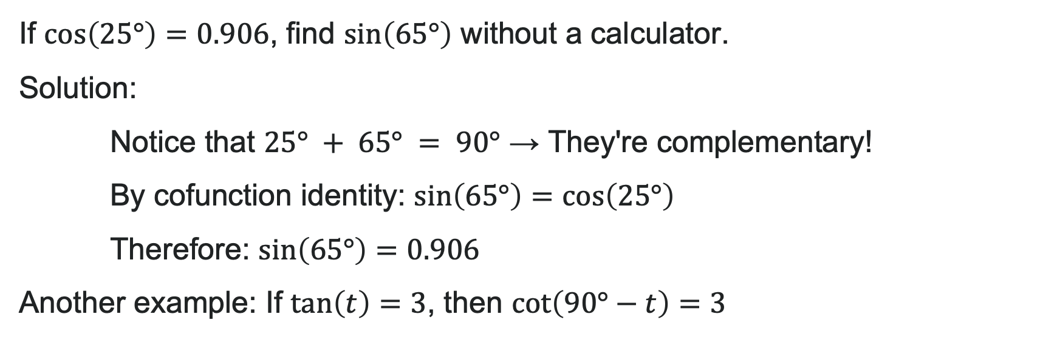
Example: Using Cofunctions
If $\cos\left(25°\right)=0.906$, find $\sin\left(65°\right)$ without a calculator.
Solution:
Notice that $25° + 65° = 90°$ → They're complementary!
By cofunction identity: $\sin\left(65°\right)=\cos\left(25°\right)$
Therefore: $\sin\left(65°\right)=0.906$
Another example: If $\tan\left(t\right)=3$, then $\cot\left(90°−t\right)=3$

Slide 16
How to: Solve for Unknown Sides
Given a right triangle, the length of one side, and the measure of one acute angle, find the remaining sides using the following steps:
For each side, select the trigonometric function that has the unknown side as either the numerator or the denominator. The known side will in turn be the denominator or the numerator.
Write an equation setting the function value of the known angle equal to the ratio of the corresponding sides.
Using the value of the trigonometric function and the known side length, solve for the missing side length.

Slide 17
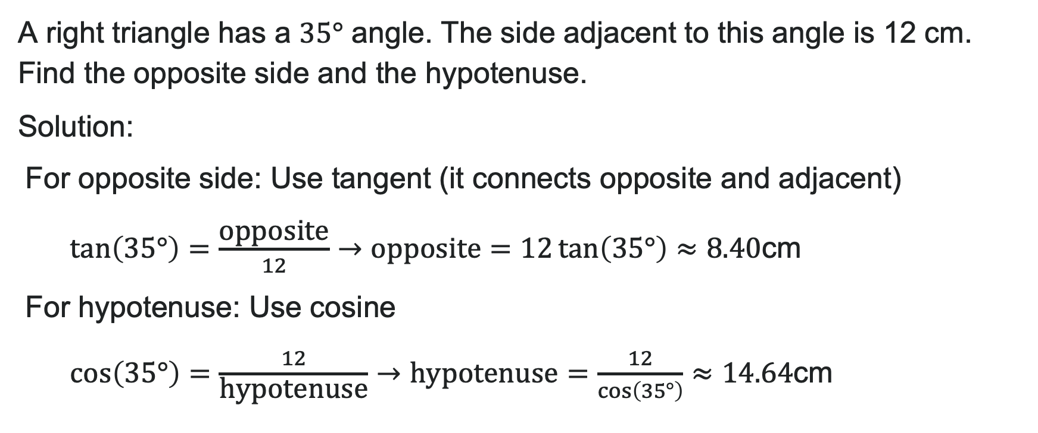
Example: Finding Unknown Sides
A right triangle has a $35°$ angle. The side adjacent to this angle is 12 cm. Find the opposite side and the hypotenuse.
Solution:
For opposite side: Use tangent (it connects opposite and adjacent)
$\tan\left(35°\right)=\frac{\text{opposite}}{12}→\text{opposite}=12\tan\left(35°\right)≈8.40$cm
For hypotenuse: Use cosine
$\cos\left(35°\right)=\frac{12}{\text{hypotenuse}}→\text{hypotenuse}=\frac{12}{\cos\left(35°\right)}≈14.64$cm

Slide 18
Try It: Solving for Unknown Sides
A right triangle has a 50° angle. The hypotenuse is 20 feet. Find the side opposite the 50° angle.
A right triangle has a 28° angle. The side opposite this angle is 9 meters. Find the adjacent side.
Notes:
Answer:
Use sine: \sin(50°) = \frac{\text{opposite}}{20} → \text{opposite} = 20 \sin(50°) \approx 15.32 feet
Use tangent: \tan(28°) = \frac{9}{\text{adjacent}} → \text{adjacent} = \frac{9}{\tan(28°)} \approx 16.92 meters

Slide 19
Learning Goals: Inverse Trigonometric Functions
Deepen your understanding and form connections within these skills:
1 Understand the domain restrictions on inverse sine, cosine, and tangent
2 Find the exact value of expressions involving the inverse sine, cosine, and tangent functions
3 Use a calculator to evaluate inverse trigonometric functions
4 Use inverse trigonometric functions to solve right triangles
5 Find exact values of composite functions with inverse trigonometric functions

Slide 20

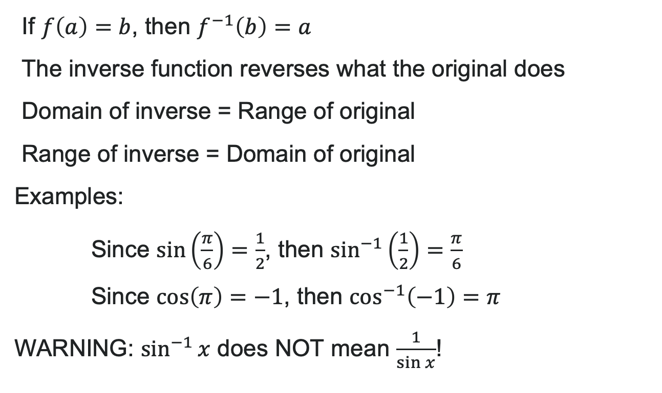
What Does "Inverse" Mean?
If $f\left(a\right)=b$, then $f^{−1}\left(b\right)=a$
The inverse function reverses what the original does
Domain of inverse = Range of original
Range of inverse = Domain of original
Examples:
Since $\sin\left(\frac{π}{6}\right)=\frac{1}{2}$, then $\sin^{−1}\left(\frac{1}{2}\right)=\frac{π}{6}$
Since $\cos\left(π\right)=−1$, then $\cos^{−1}\left(−1\right)=π$
WARNING: $\sin^{−1}{x}$ does NOT mean $\frac{1}{\sin{x}}$!

Slide 21
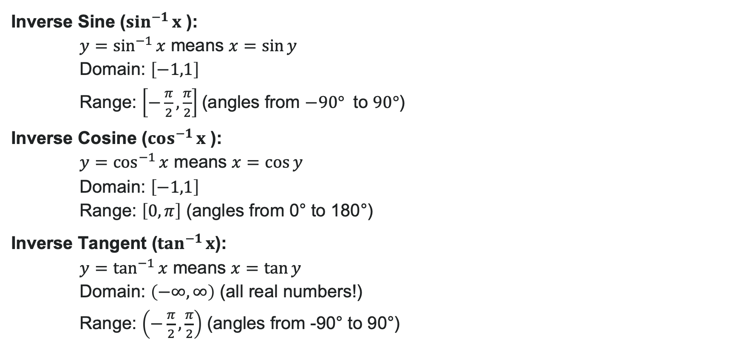
Inverse Sine, Cosine, & Tangent Functions
Inverse Sine ($\sin^{−1}{x}$ ):
$y=\sin^{−1}{x}$ means $x=\sin{y}$
Domain: $\left[−1,1\right]$
Range: $\left[−\frac{π}{2},\frac{π}{2}\right]$(angles from $−90°$ to $90°$)
Inverse Cosine ($\cos^{−1}{x}$ ):
$y=\cos^{−1}{x}$ means $x=\cos{y}$
Domain: $\left[−1,1\right]$
Range: $\left[0,π\right]$ (angles from 0° to 180°)
Inverse Tangent ($\tan^{−1}{x}$):
$y=\tan^{−1}{x}$ means $x=\tan{y}$
Domain: $\left(−∞,∞\right)$ (all real numbers!)
Range: $\left(−\frac{π}{2},\frac{π}{2}\right)$ (angles from -90° to 90°)

Slide 22
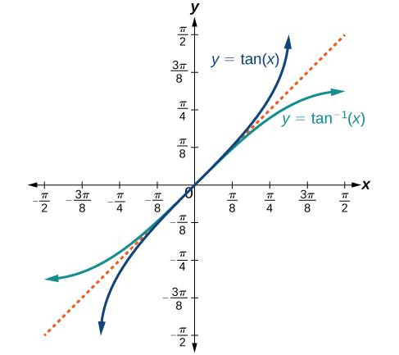
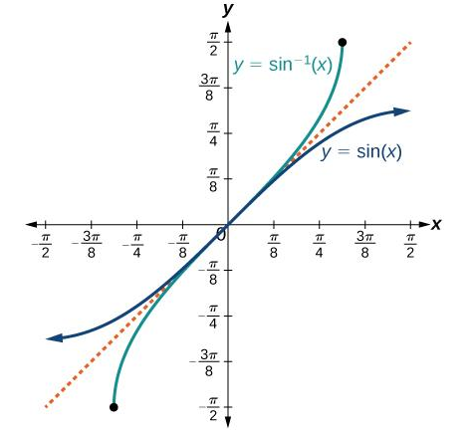
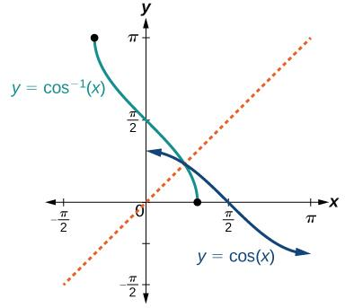
Inverse Sine, Cosine, and Tangent Functions Visualized

Slide 23
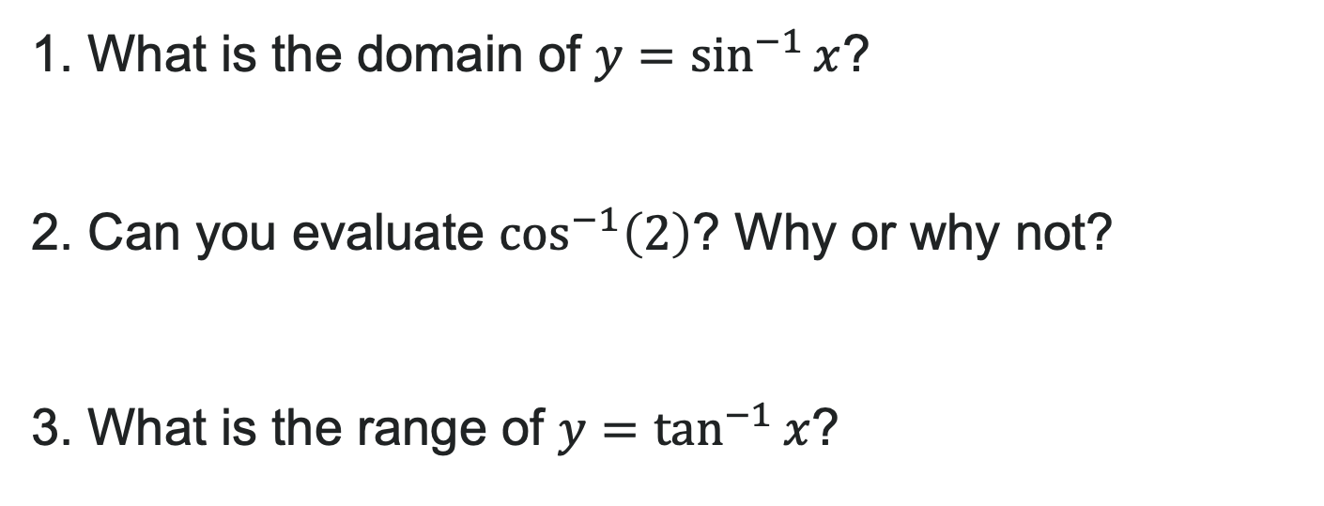
Try It: Domain and Range of Inverses
1. What is the domain of $y=\sin^{−1}{x}$?
2. Can you evaluate $\cos^{−1}\left(2\right)$? Why or why not?
3. What is the range of $y=\tan^{−1}{x}$?
Notes:
Answer:
[-1, 1]
No, because 2 is not in the domain [-1, 1] of \cos^{-1} x
\left(-\frac{\pi}{2}, \frac{\pi}{2}\right)

Slide 24
How to: Find Exact Values with Special Angles
Given a “special” input value, evaluate an inverse trigonometric function:
Find angle x for which the original trigonometric function has an output equal to the given input for the inverse trigonometric function.
If x is not in the defined range of the inverse, find another angle y that is in the defined range and has the same sine, cosine, or tangent as x, depending on which corresponds to the given inverse function.

Slide 25
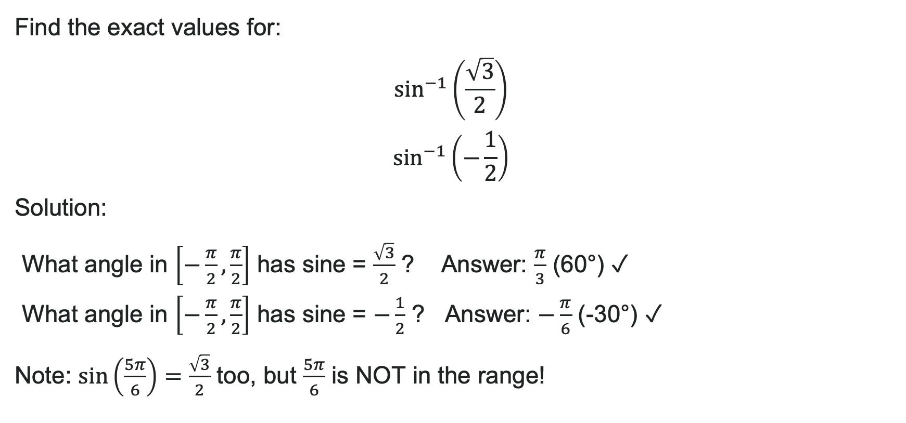
Example 1: Evaluating Inverse Sine
Find the exact values for:
Solution:
What angle in $\left[−\frac{π}{2},\frac{π}{2}\right]$ has sine = $\frac{\sqrt{3}}{2}$ ? Answer: $\frac{π}{3}$ (60°) ✓
What angle in $\left[−\frac{π}{2},\frac{π}{2}\right]$ has sine = $−\frac{1}{2}$ ? Answer: $−\frac{π}{6}$ (-30°) ✓
Note: $\sin\left(\frac{5π}{6}\right)=\frac{\sqrt{3}}{2}$ too, but $\frac{5π}{6}$ is NOT in the range!

Slide 26

Try It: Special Angle Inverses
1. $\sin^{−1}\left(0\right)$
2. $\cos^{−1}\left(−1\right)$
3. $\tan^{−1}\left(\sqrt{3}\right)$
Notes:
Answers:
0
\pi
\frac{\pi}{3}

Slide 27
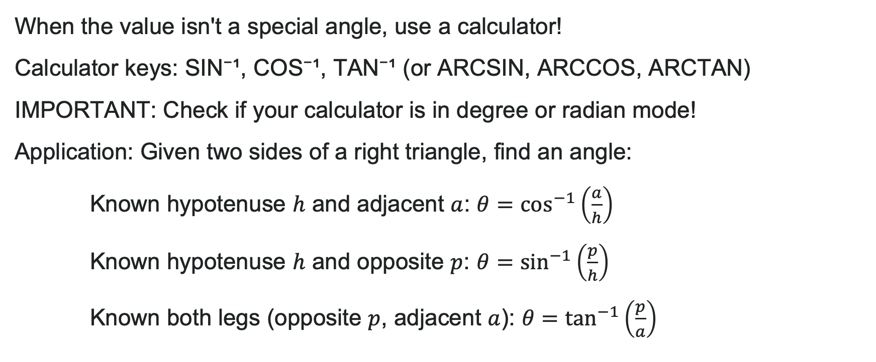
Finding Angles with a Calculator
When the value isn't a special angle, use a calculator!
Calculator keys: SIN⁻¹, COS⁻¹, TAN⁻¹ (or ARCSIN, ARCCOS, ARCTAN)
IMPORTANT: Check if your calculator is in degree or radian mode!
Application: Given two sides of a right triangle, find an angle:
Known hypotenuse $h$ and adjacent $a$: $θ=\cos^{−1}\left(\frac{a}{h}\right)$
Known hypotenuse $h$ and opposite $p$: $θ=\sin^{−1}\left(\frac{p}{h}\right)$
Known both legs (opposite $p$, adjacent $a$): $θ=\tan^{−1}\left(\frac{p}{a}\right)$

Slide 28
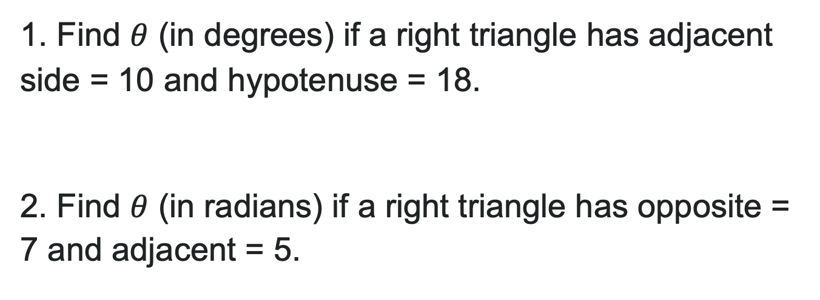
Try It: Calculator Practice
1. Find $θ$ (in degrees) if a right triangle has adjacent side = 10 and hypotenuse = 18.
2. Find $θ$ (in radians) if a right triangle has opposite = 7 and adjacent = 5.
Notes:
Answer:
\theta = \cos^{-1}\left(\frac{10}{18}\right) \approx 56.25°
\theta = \tan^{-1}\left(\frac{7}{5}\right) \approx 0.9505 radians

Slide 29

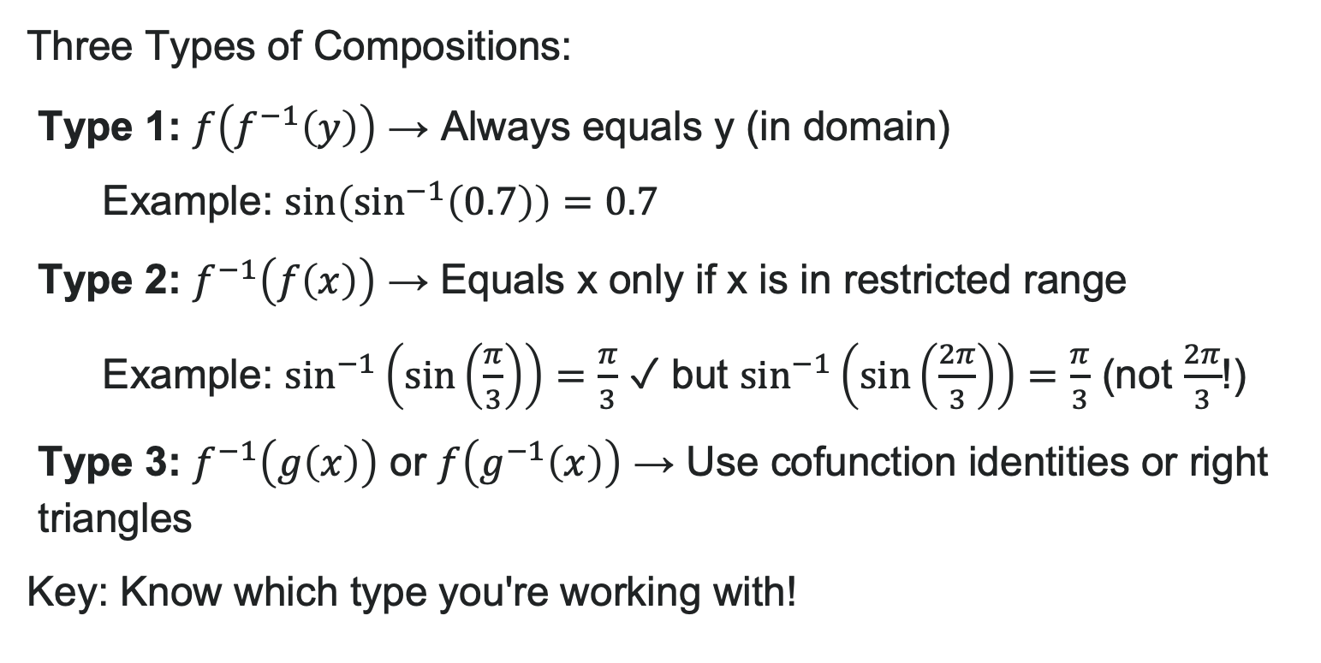
Composing Trig and Inverse Trig Functions
Three Types of Compositions:
Type 1: $f\left(f^{−1}\left(y\right)\right)$ → Always equals y (in domain)
Example: $\sin\left(\sin^{−1}\left(0.7\right)\right)=0.7$
Type 2: $f^{−1}\left(f\left(x\right)\right)$ → Equals x only if x is in restricted range
Example: $\sin^{−1}\left(\sin\left(\frac{π}{3}\right)\right)=\frac{π}{3}$ ✓ but $\sin^{−1}\left(\sin\left(\frac{2π}{3}\right)\right)=\frac{π}{3}$ (not $\frac{2π}{3}$!)
Type 3: $f^{−1}\left(g\left(x\right)\right)$ or $f\left(g^{−1}\left(x\right)\right)$ → Use cofunction identities or right triangles
Key: Know which type you're working with!

Slide 30

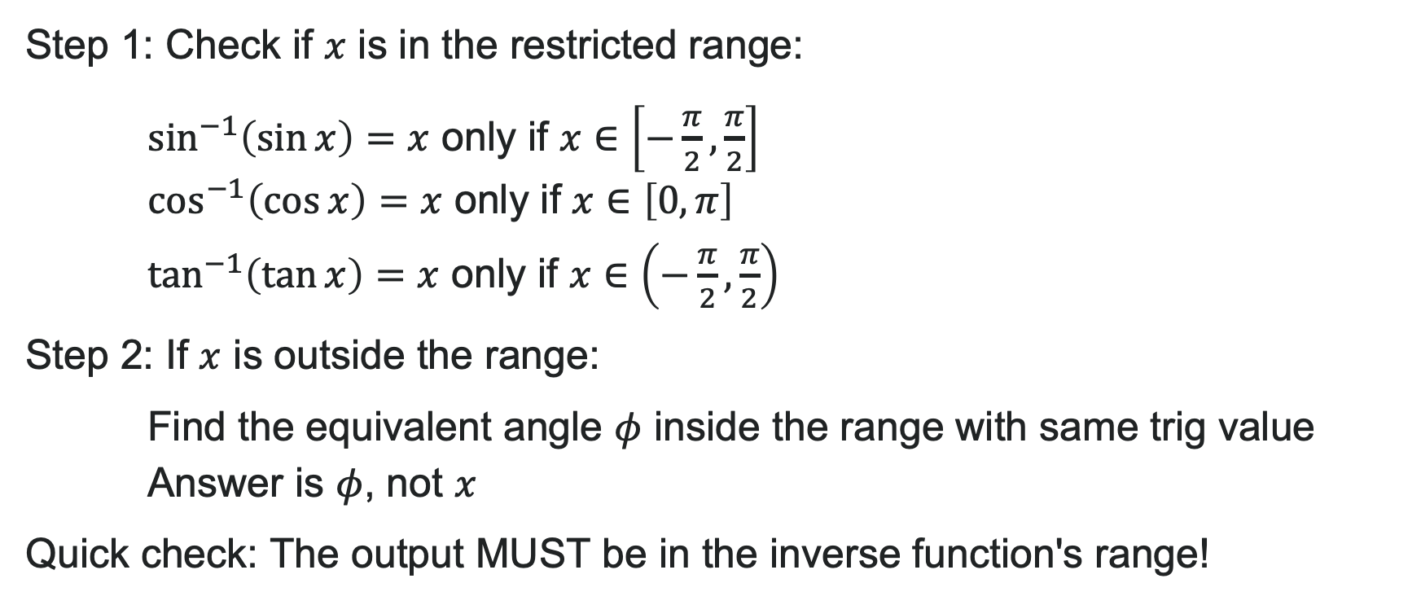
How to: Evaluate $f^{−1}\left(f\left(θ\right)\right)$
Step 1: Check if $x$ is in the restricted range:
$\sin^{−1}\left(\sin{x}\right)=x$ only if $x∈\left[−\frac{π}{2},\frac{π}{2}\right]$
$\cos^{−1}\left(\cos{x}\right)=x$ only if $x∈\left[0,π\right]$
$\tan^{−1}\left(\tan{x}\right)=x$ only if $x∈\left(−\frac{π}{2},\frac{π}{2}\right)$
Step 2: If $x$ is outside the range:
Find the equivalent angle $φ$ inside the range with same trig value
Answer is $φ$, not $x$
Quick check: The output MUST be in the inverse function's range!

Slide 31

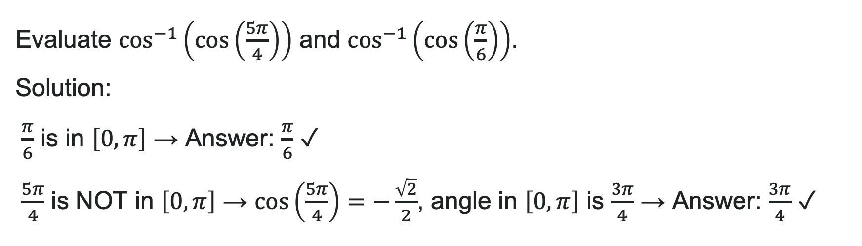
Example: Evaluating $\cos^{−1}\left(\cos{x}\right)$
Evaluate $\cos^{−1}\left(\cos\left(\frac{5π}{4}\right)\right)$ and $\cos^{−1}\left(\cos\left(\frac{π}{6}\right)\right)$.
Solution:
$\frac{π}{6}$ is in $\left[0,π\right]$ → Answer: $\frac{π}{6}$ ✓
$\frac{5π}{4}$ is NOT in $\left[0,π\right]$ → $\cos\left(\frac{5π}{4}\right)=−\frac{\sqrt{2}}{2}$, angle in $\left[0,π\right]$ is $\frac{3π}{4}$ → Answer: $\frac{3π}{4}$ ✓

Slide 32

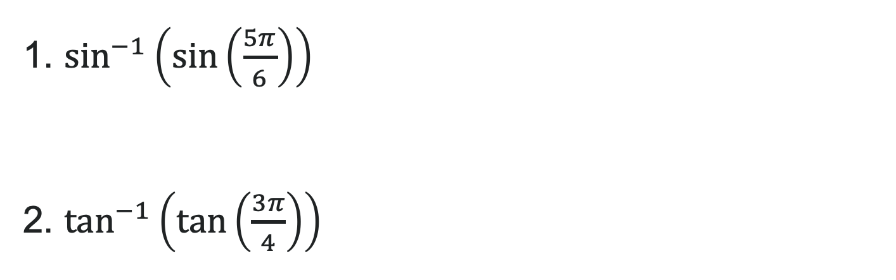
Try It: Evaluating $\cos^{−1}\left(\cos{x}\right)$
1. $\sin^{−1}\left(\sin\left(\frac{5π}{6}\right)\right)$
2. $\tan^{−1}\left(\tan\left(\frac{3π}{4}\right)\right)$
Notes:
Answer:
\frac{\pi}{6} (since \sin(\frac{5\pi}{6}) = \frac{1}{2} and \frac{\pi}{6} \in [-\frac{\pi}{2}, \frac{\pi}{2}])
-\frac{\pi}{4} (since \tan(\frac{3\pi}{4}) = -1 and -\frac{\pi}{4} \in (-\frac{\pi}{2}, \frac{\pi}{2}))

Slide 33

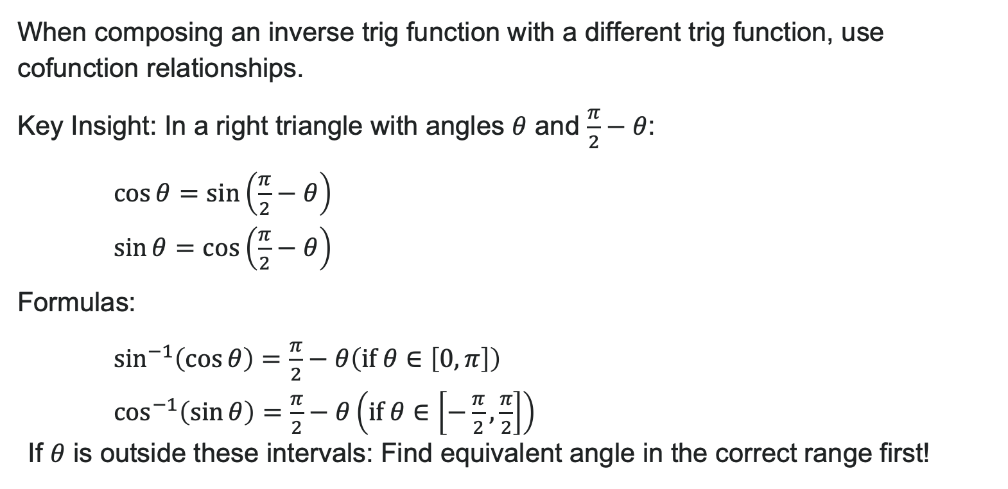
Compositions of the Form $f^{−1}\left(g\left(x\right)\right)$
When composing an inverse trig function with a different trig function, use cofunction relationships.
Key Insight: In a right triangle with angles $θ$ and $\frac{π}{2}−θ$:
$\cos{θ}=\sin\left(\frac{π}{2}−θ\right)$
$\sin{θ}=\cos\left(\frac{π}{2}−θ\right)$
Formulas:
$\sin^{−1}\left(\cos{θ}\right)=\frac{π}{2}−θ\left(\text{if} θ∈\left[0,π\right]\right)$
$\cos^{−1}\left(\sin{θ}\right)=\frac{π}{2}−θ\left(\text{if} θ∈\left[−\frac{π}{2},\frac{π}{2}\right]\right)$
If $θ$ is outside these intervals: Find equivalent angle in the correct range first!

Slide 34
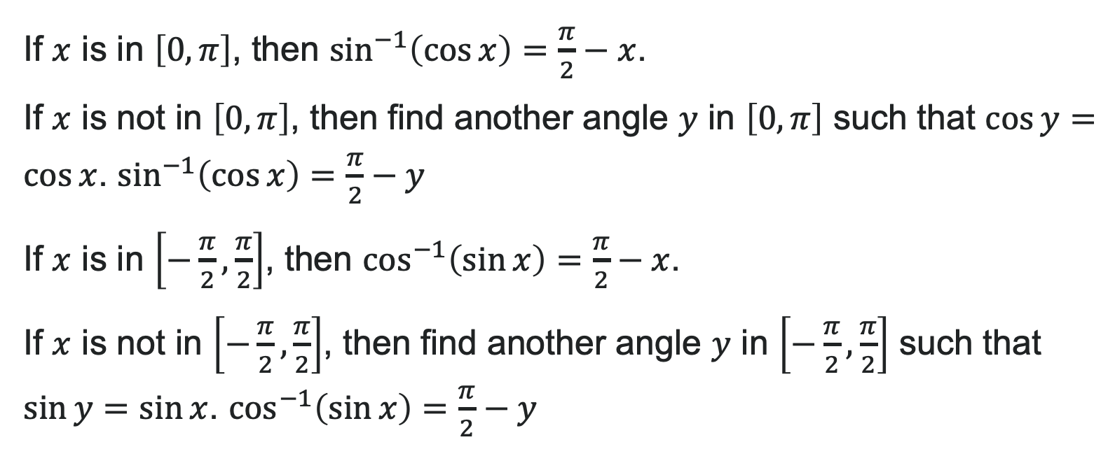
How to: Evaluate Cofunction Compositions
If $x$ is in $\left[0,π\right]$, then $\sin^{−1}\left(\cos{x}\right)=\frac{π}{2}−x$.
If $x$ is not in $\left[0,π\right]$, then find another angle $y$ in $\left[0,π\right]$ such that $\cos{y}=\cos{x}$. $\sin^{−1}\left(\cos{x}\right)=\frac{π}{2}−y$
If $x$ is in $\left[−\frac{π}{2},\frac{π}{2}\right]$, then $\cos^{−1}\left(\sin{x}\right)=\frac{π}{2}−x$.
If $x$ is not in $\left[−\frac{π}{2},\frac{π}{2}\right]$, then find another angle $y$ in $\left[−\frac{π}{2},\frac{π}{2}\right]$ such that $\sin{y}=\sin{x}$. $\cos^{−1}\left(\sin{x}\right)=\frac{π}{2}−y$

Slide 35

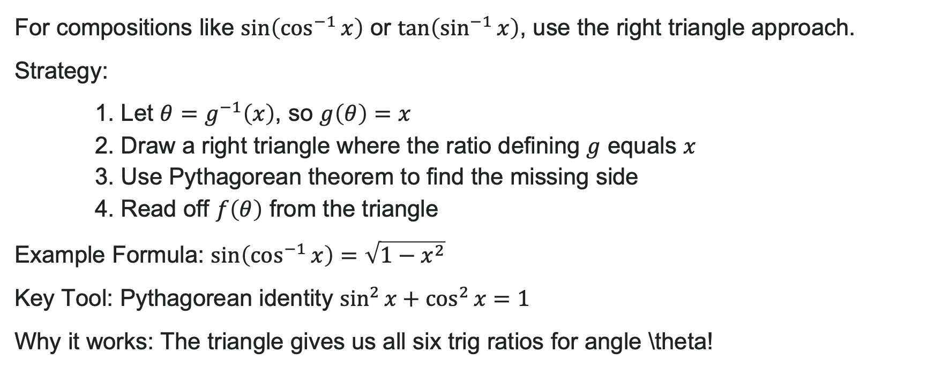
Compositions of the Form $f\left(g^{−1}\left(x\right)\right)$
For compositions like $\sin\left(\cos^{−1}{x}\right)$ or $\tan\left(\sin^{−1}{x}\right)$, use the right triangle approach.
Strategy:
1. Let $θ=g^{−1}\left(x\right)$, so $g\left(θ\right)=x$
2. Draw a right triangle where the ratio defining $g$ equals $x$
3. Use Pythagorean theorem to find the missing side
4. Read off $f\left(θ\right)$ from the triangle
Example Formula: $\sin\left(\cos^{−1}{x}\right)=\sqrt{1−x^{2}}$
Key Tool: Pythagorean identity $\sin^{2}{x}+\cos^{2}{x}=1$
Why it works: The triangle gives us all six trig ratios for angle \theta!

Slide 36
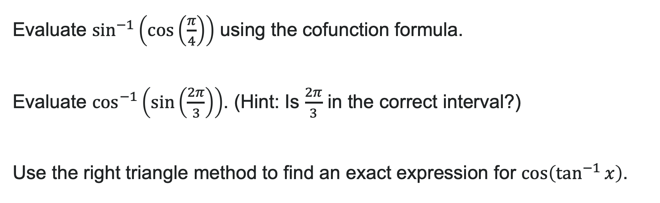
Try It: Cofunction and Triangle Compositions
Evaluate $\sin^{−1}\left(\cos\left(\frac{π}{4}\right)\right)$ using the cofunction formula.
Evaluate $\cos^{−1}\left(\sin\left(\frac{2π}{3}\right)\right)$. (Hint: Is $\frac{2π}{3}$ in the correct interval?)
Use the right triangle method to find an exact expression for $\cos\left(\tan^{−1}{x}\right)$.
Notes:
Answers:
Since \frac{\pi}{4} \in [0, \pi], use \sin^{-1}(\cos x) = \frac{\pi}{2} - x. Answer: \frac{\pi}{2} - \frac{\pi}{4} = \frac{\pi}{4}
\frac{2\pi}{3} \notin \left[-\frac{\pi}{2}, \frac{\pi}{2}\right]. Find equivalent angle: \sin\left(\frac{2\pi}{3}\right) = \frac{\sqrt{3}}{2} = \sin\left(\frac{\pi}{3}\right) where \frac{\pi}{3} \in \left[-\frac{\pi}{2}, \frac{\pi}{2}\right]. Answer: \frac{\pi}{2} - \frac{\pi}{3} = \frac{\pi}{6}
Let \theta = \tan^{-1} x, so \tan \theta = x = \frac{x}{1}. Triangle: opp = x, adj = 1, hyp = \sqrt{x^2 + 1}. Answer: \cos \theta = \frac{1}{\sqrt{x^2 + 1}} or \frac{\sqrt{x^2+1}}{x^2+1}

Slide 37
Learning Goals: Non-right Triangles with Law of Sines
Deepen your understanding and form connections within these skills:
1 Use the Law of Sines to solve oblique triangles
2 Find the area of an oblique triangle using the sine function
3 Solve applied problems using the Law of Sines

Slide 38
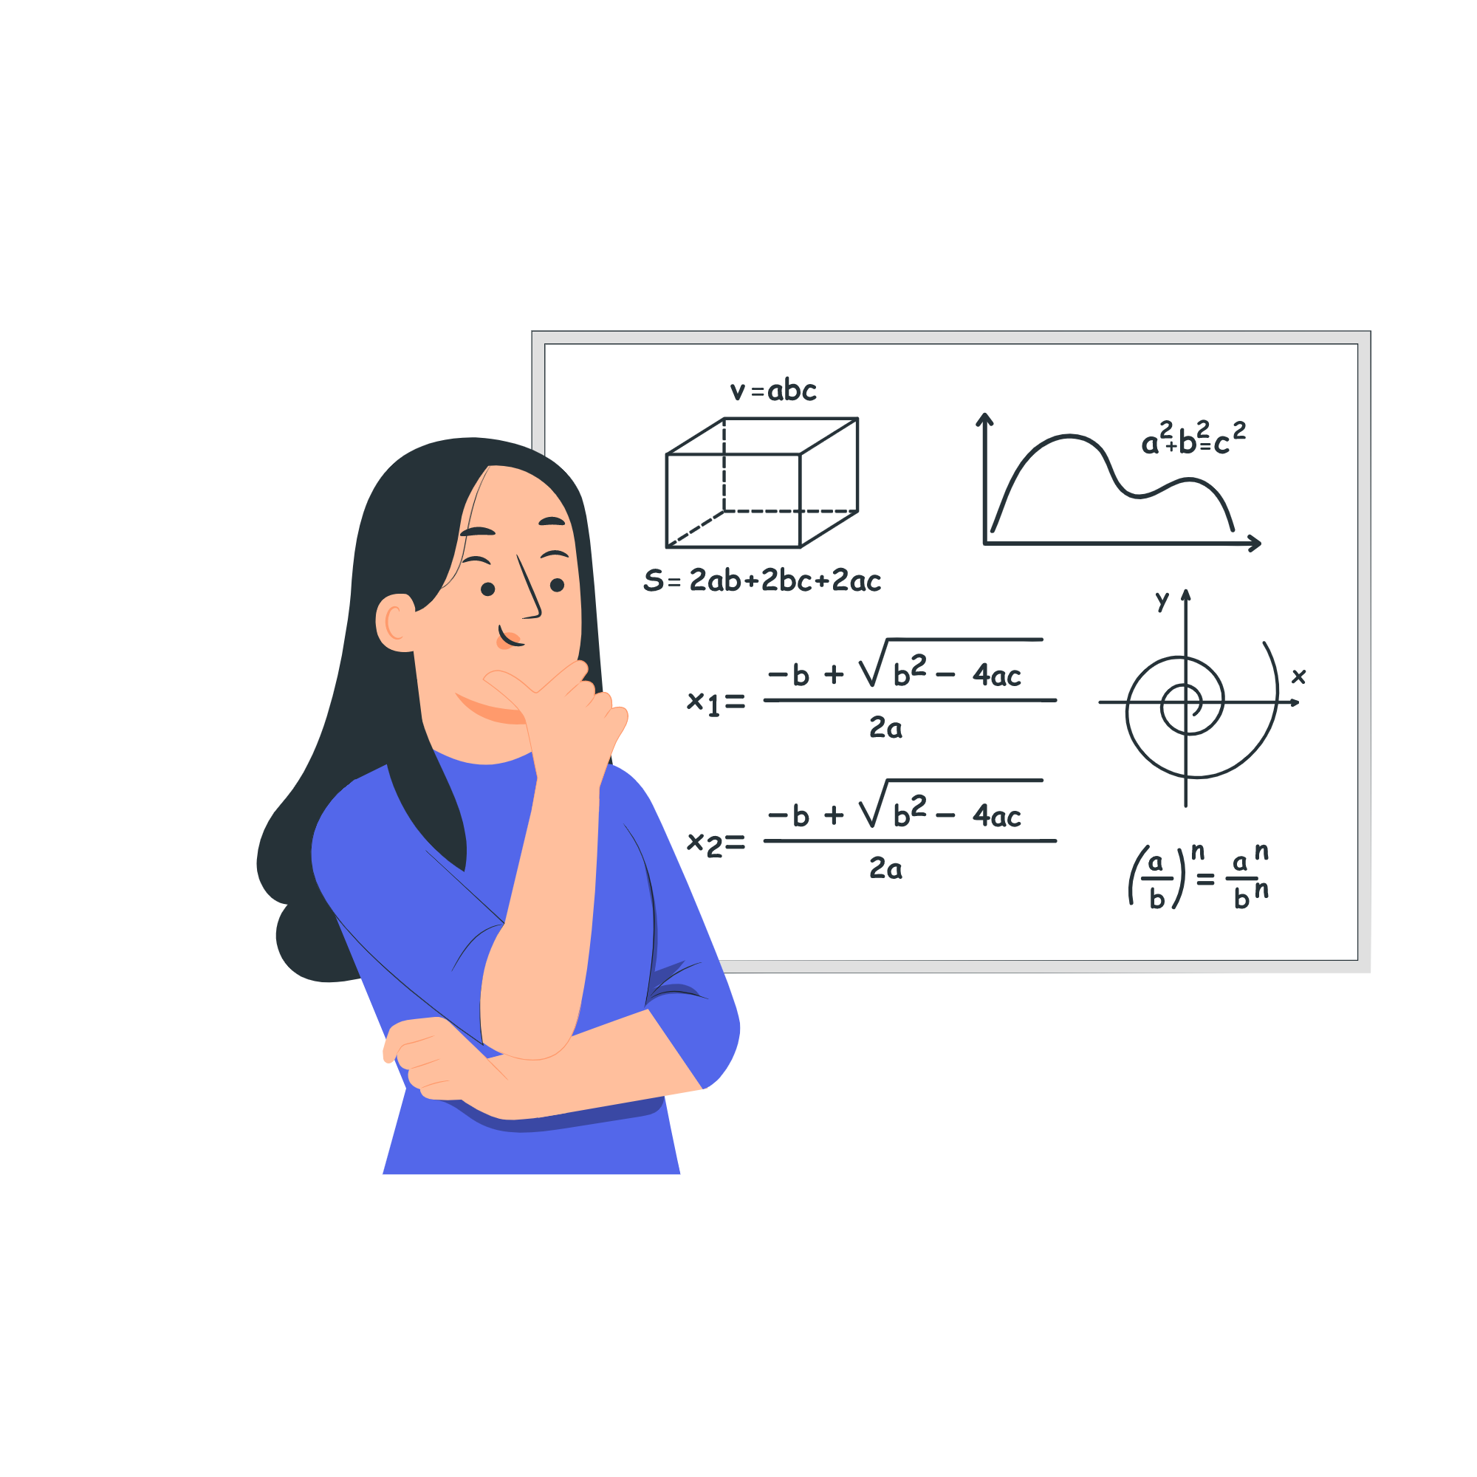
What is an Oblique Triangle?
Oblique triangle: Any triangle that is NOT a right triangle
Solving means finding all 3 angles AND all 3 sides
We need at least 3 values to start (including at least one side)
No dropping perpendiculars! We'll use proportions instead

Slide 39
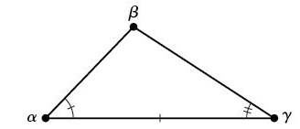
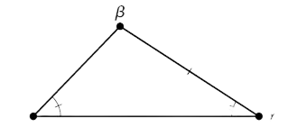
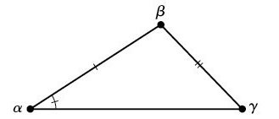
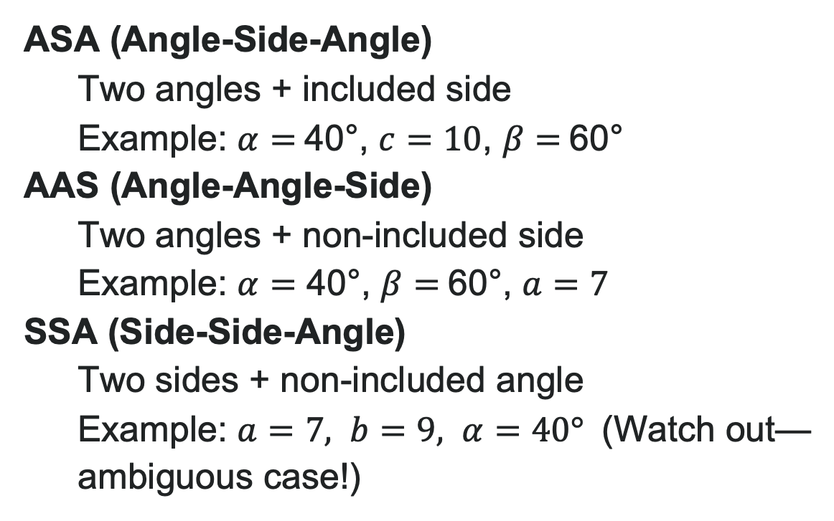
Three Main Cases for Law of Sines
ASA (Angle-Side-Angle)
Two angles + included side
Example: $α=$40°, $c=10$, $β=$60°
AAS (Angle-Angle-Side)
Two angles + non-included side
Example: $α=$ 40°, $β=$60°, $a=7$
SSA (Side-Side-Angle)
Two sides + non-included angle
Example: $a=7, b=9, α=40°$ (Watch out—ambiguous case!)

Slide 40
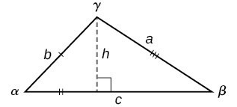
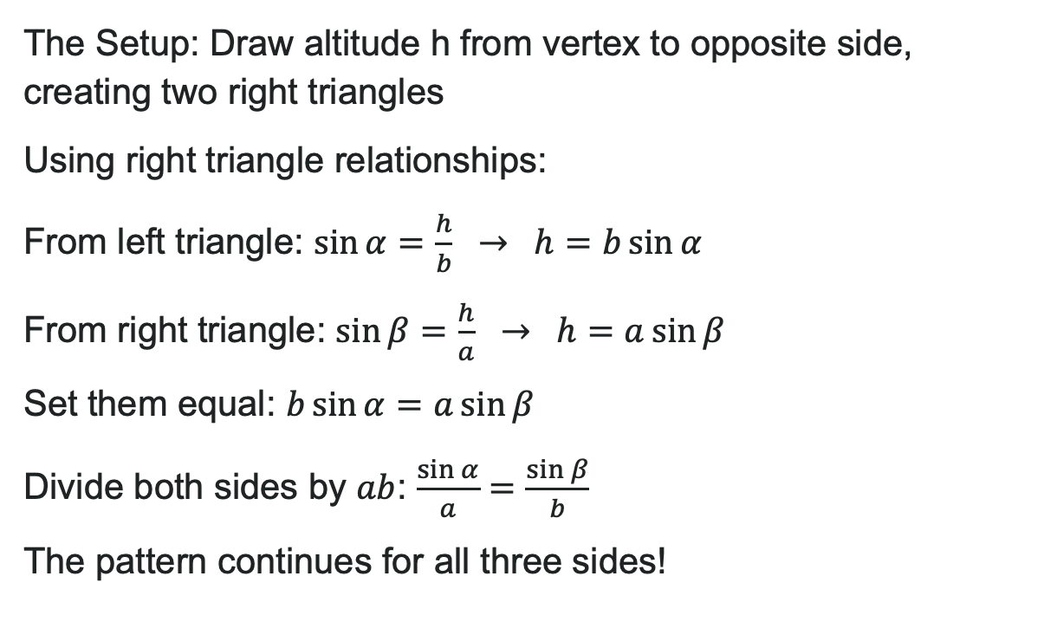
Where Does the Law of Sines Come From?
The Setup: Draw altitude h from vertex to opposite side, creating two right triangles
Using right triangle relationships:
From left triangle: $\sin{α}=\frac{h}{b} → h=b\sin{α}$
From right triangle: $\sin{β}=\frac{h}{a} → h=a\sin{β}$
Set them equal: $b\sin{α}=a\sin{β}$
Divide both sides by $ab$: $\frac{\sin{α}}{a}=\frac{\sin{β}}{b}$
The pattern continues for all three sides!

Slide 41

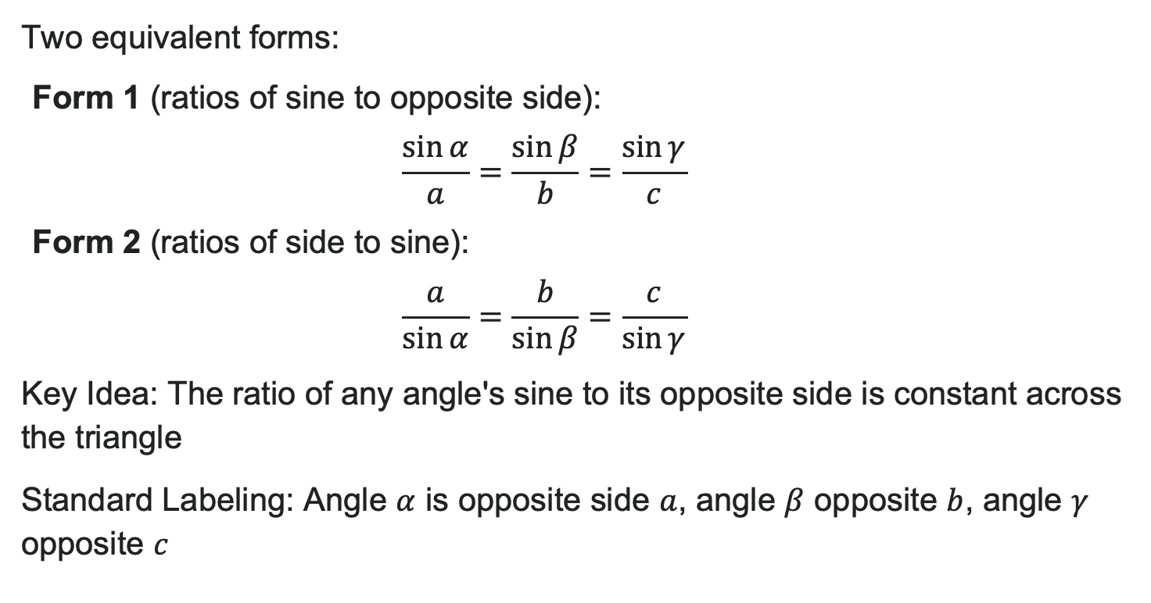
The Law of Sines
Two equivalent forms:
Form 1 (ratios of sine to opposite side):
$$\frac{\sin{α}}{a}=\frac{\sin{β}}{b}=\frac{\sin{γ}}{c}$$
Form 2 (ratios of side to sine):
$$\frac{a}{\sin{α}}=\frac{b}{\sin{β}}=\frac{c}{\sin{γ}}$$
Key Idea: The ratio of any angle's sine to its opposite side is constant across the triangle
Standard Labeling: Angle $α$ is opposite side $a$, angle $β$ opposite $b$, angle $γ$ opposite $c$

Slide 42
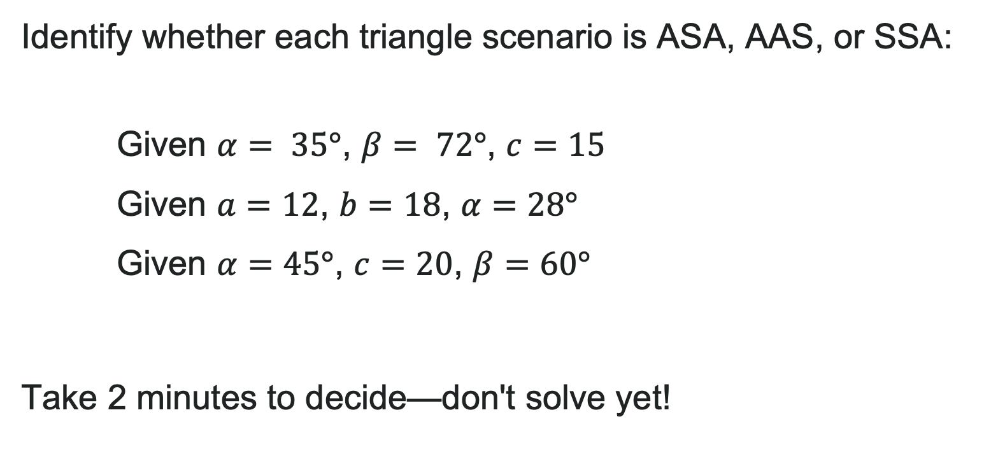
Try It: Identify the Case
Identify whether each triangle scenario is ASA, AAS, or SSA:
Given $α= 35°$, $β= 72°$, $c=15$
Given $a=12$, $b=18$, $α=28°$
Given $α=45°$, $c=20$, $β=60°$
Take 2 minutes to decide—don't solve yet!
Notes:
Answers:
AAS (two angles + non-included side)
SSA (two sides + non-included angle) - ambiguous case
ASA (two angles + included side)

Slide 43
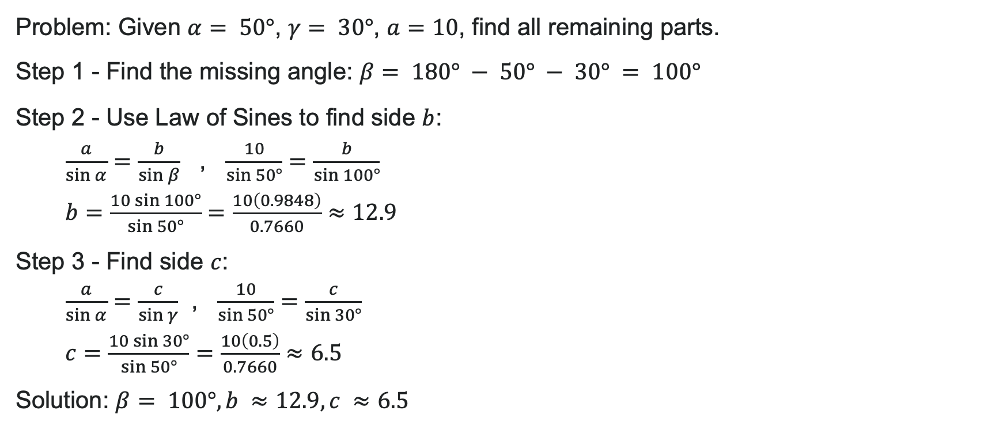
Example: AAS Case
Problem: Given $α= 50°$, $γ= 30°$, $a=10$, find all remaining parts.
Step 1 - Find the missing angle: $β= 180° − 50° − 30° = 100°$
Step 2 - Use Law of Sines to find side $b$:
$\frac{a}{\sin{α}}=\frac{b}{\sin{β}}$ , $\frac{10}{\sin{5}0°}=\frac{b}{\sin{1}00°}$
$b=\frac{10\sin{1}00°}{\sin{5}0°}=\frac{10\left(0.9848\right)}{0.7660}≈12.9$
Step 3 - Find side $c$:
$\frac{a}{\sin{α}}=\frac{c}{\sin{γ}}$ , $\frac{10}{\sin{5}0°}=\frac{c}{\sin{3}0°}$
$c=\frac{10\sin{3}0°}{\sin{5}0°}=\frac{10\left(0.5\right)}{0.7660}≈6.5$
Solution: $β= 100°, b ≈12.9, c ≈6.5$

Slide 44
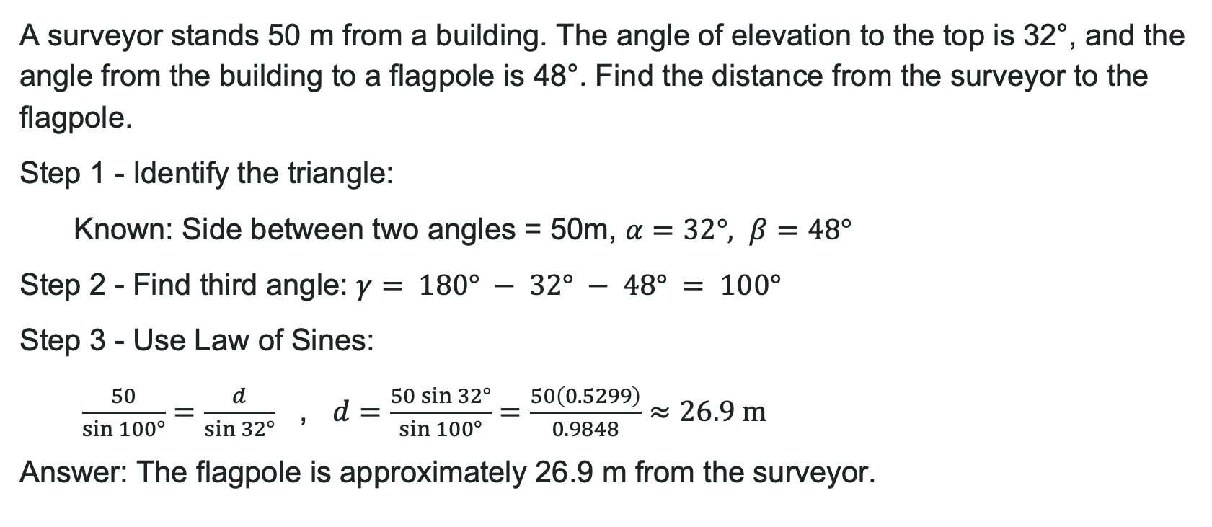
Example: ASA Case
A surveyor stands 50 m from a building. The angle of elevation to the top is 32°, and the angle from the building to a flagpole is 48°. Find the distance from the surveyor to the flagpole.
Step 1 - Identify the triangle:
Known: Side between two angles = 50m, $α=32°, β=48°$
Step 2 - Find third angle: $γ= 180° − 32° − 48° = 100°$
Step 3 - Use Law of Sines:
$\frac{50}{\sin{1}00°}=\frac{d}{\sin{3}2°}$ , $d=\frac{50\sin{3}2°}{\sin{1}00°}=\frac{50\left(0.5299\right)}{0.9848}≈26.9 \text{m}$
Answer: The flagpole is approximately 26.9 m from the surveyor.

Slide 45
Try It: Solve the Triangle
Given $β=42°, γ=78°, b=20$, find $α$, $a$, and $c$.
Notes:
Answer:
\alpha = 60°
a \approx 25.9
c \approx 29.3

Slide 46

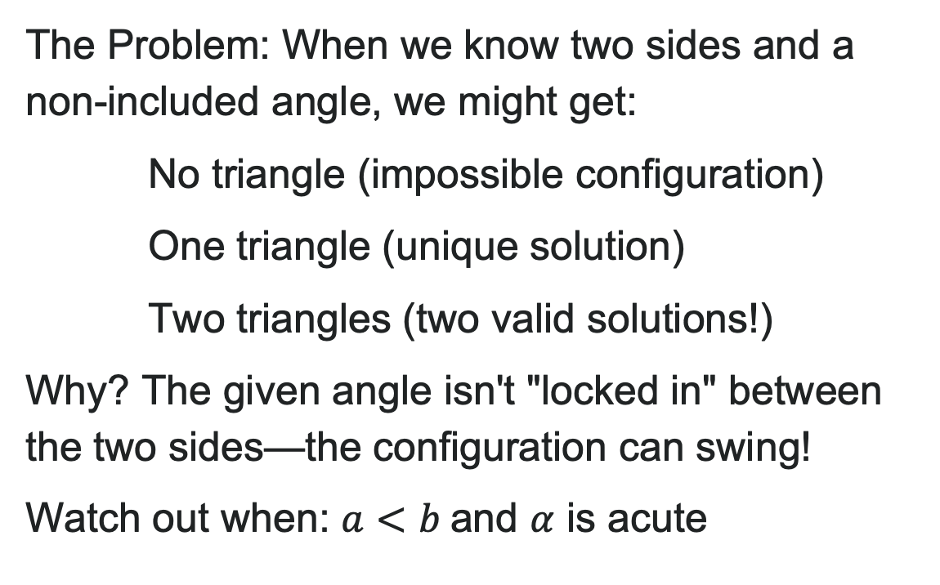
The Ambiguous Case (SSA)
The Problem: When we know two sides and a non-included angle, we might get:
No triangle (impossible configuration)
One triangle (unique solution)
Two triangles (two valid solutions!)
Why? The given angle isn't "locked in" between the two sides—the configuration can swing!
Watch out when: $a<b$and $α$ is acute

Slide 47
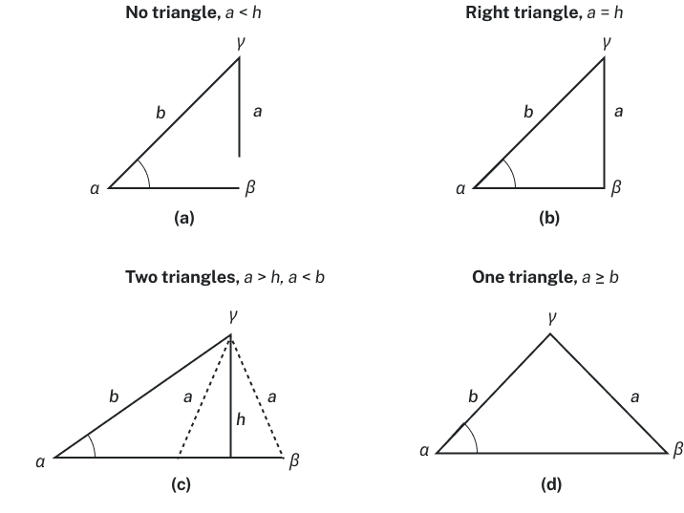

Four Possible SSA Outcomes
When solving SSA with sides $a$, $b$ and angle $α$:
1. No triangle: $a < h$ (where $h=b\sin{α}$) The side is too short to reach!
2. One right triangle: $a = h$ Forms exactly 90° at the opposite angle
3. Two triangles: $h < a < b$ The "ambiguous case"—two valid solutions!
4. One triangle: Long side "locks in" the configuration

Slide 48
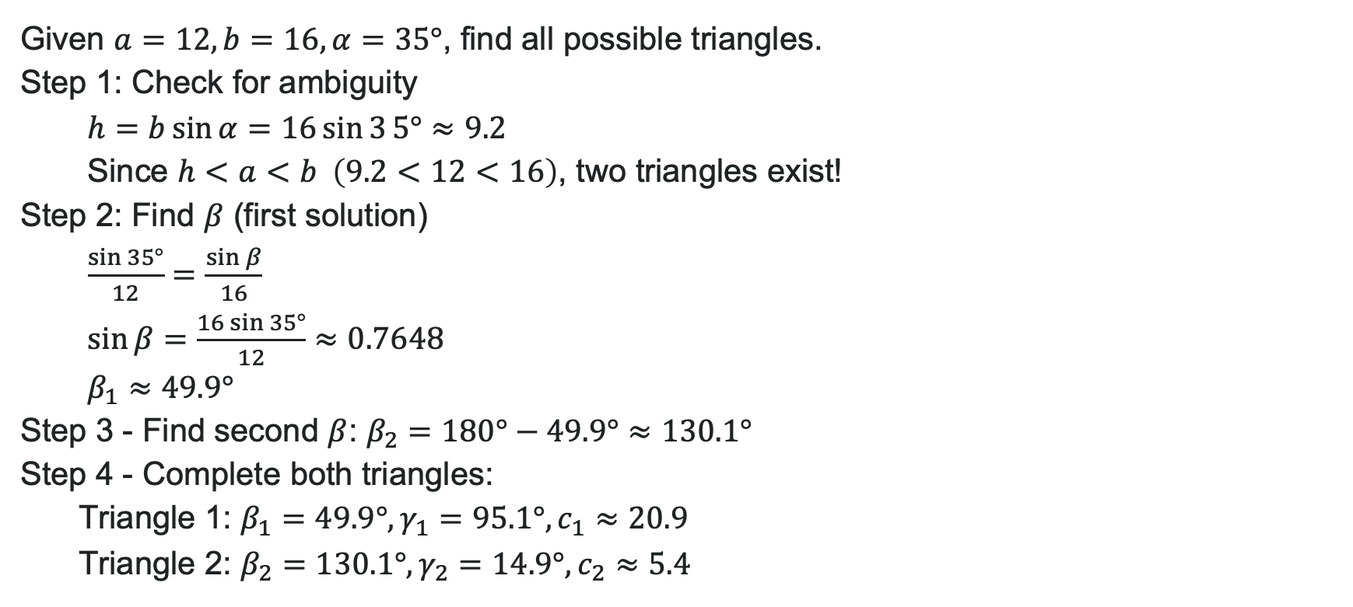
Example: The Ambiguous Case (SSA)
Given $a=12, b=16, α=35°$, find all possible triangles.
Step 1: Check for ambiguity
$h=b\sin{α}=16\sin{3}5°≈9.2$
Since $h<a<b \left(9.2<12<16\right)$, two triangles exist!
Step 2: Find $β$ (first solution)
$\frac{\sin{3}5°}{12}=\frac{\sin{β}}{16}$
$\sin{β}=\frac{16\sin{3}5°}{12}≈0.7648$
$β_{1}≈49.9°$
Step 3 - Find second $β$: $β_{2}=180°−49.9°≈130.1°$
Step 4 - Complete both triangles:
Triangle 1: $β_{1}=49.9°,γ_{1}=95.1°,c_{1}≈20.9$
Triangle 2: $β_{2}=130.1°,γ_{2}=14.9°,c_{2}≈5.4$

Slide 49
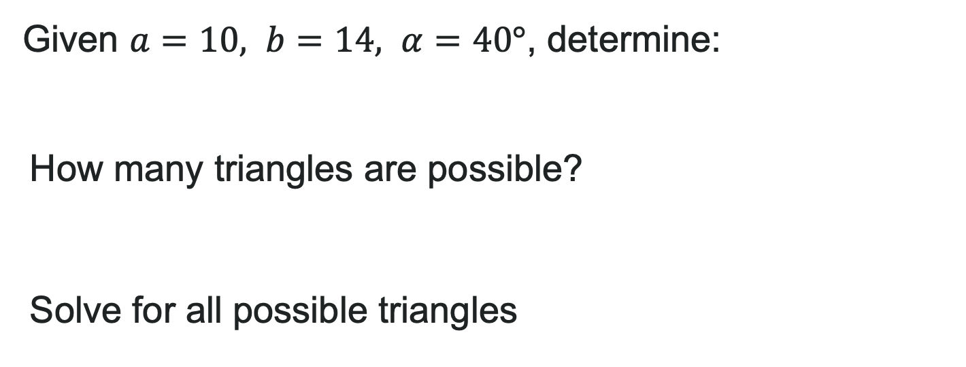
Try It: The Ambiguous Case
Given $a=10, b=14, α=40°$, determine:
How many triangles are possible?
Solve for all possible triangles
Notes:
Answer: Two triangles exist
Triangle 1: \beta_1 \approx 64.0°, \gamma_1 \approx 76.0°, c_1 \approx 15.1
Triangle 2: \beta_2 \approx 116.0°, \gamma_2 \approx 24.0°, c_2 \approx 6.3

Slide 50
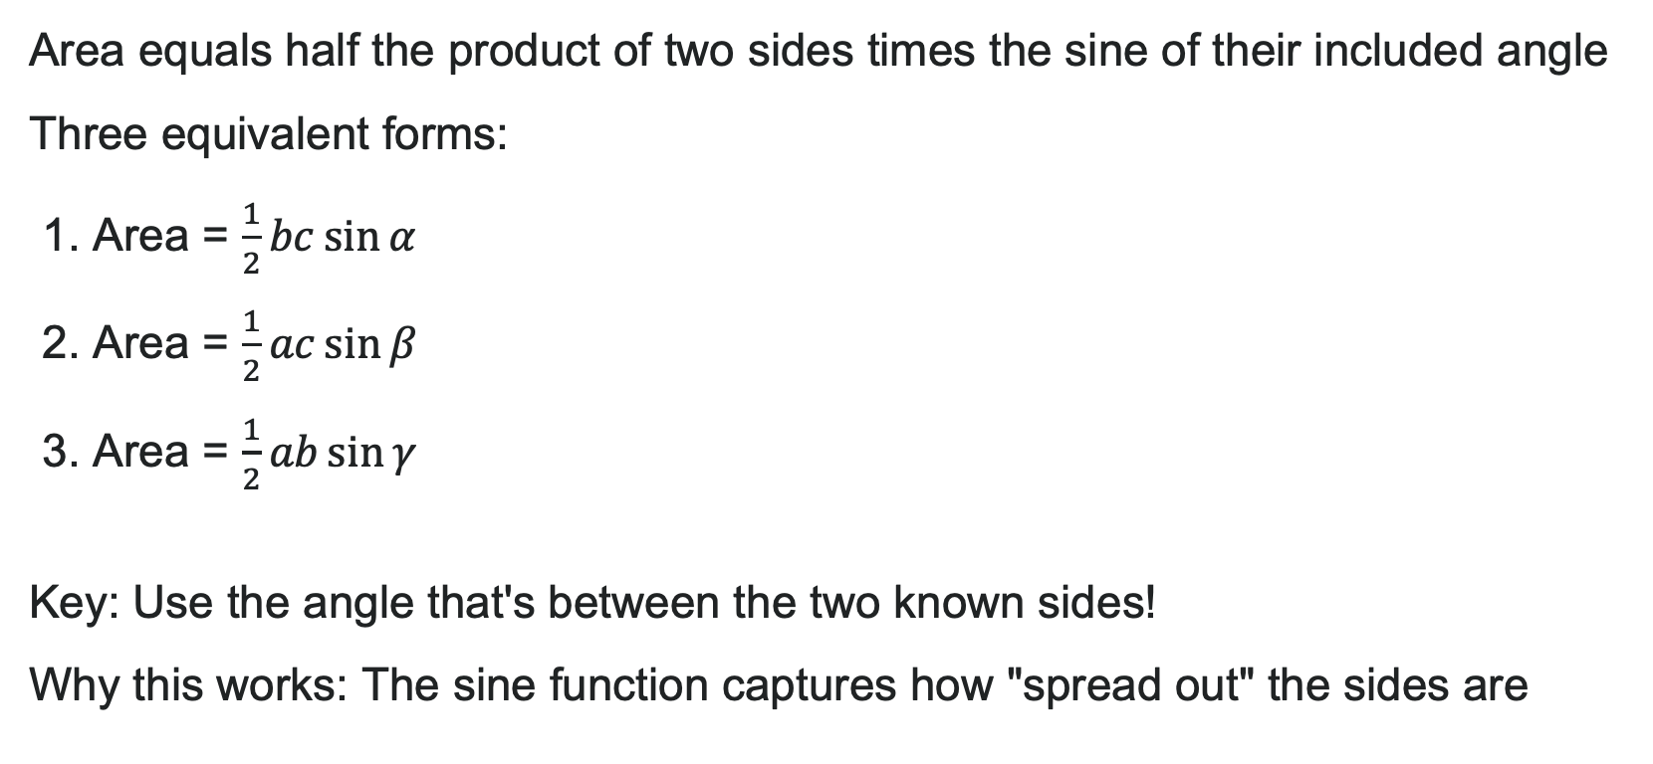
Area Formula for Oblique Triangles
Area equals half the product of two sides times the sine of their included angle
Three equivalent forms:
1. Area = $\frac{1}{2}bc\sin{α}$
2. Area = $\frac{1}{2}ac\sin{β}$
3. Area = $\frac{1}{2}ab\sin{γ}$
Key: Use the angle that's between the two known sides!
Why this works: The sine function captures how "spread out" the sides are

Slide 51

Example: Area of an Oblique Triangle
A triangular park has sides of 120 m and 150 m with an included angle of 48°. Find the area.
Solution:
Area = $\frac{1}{2}\left(120\right)\left(150\right)\sin{4}8°$
Area = $\frac{1}{2}\left(18000\right)\left(0.7431\right)$
Area = $9000\left(0.7431\right)$
Area $≈6688.4 {\text{m}}^{2}$
Interpretation: The park covers approximately 6688 square meters, or about 0.67 hectares.
Check: Does this make sense? If the angle were 90°, area would be 9000 m². Since $48°<90°$, our answer should be less.

Slide 52

Try It: Calculate the Area
1. Find the area of a triangle with $b=24, c=36, α=72°$
2. A triangular sail has sides 8 ft and 11 ft with an included angle of 105°. Find the area.
Notes:
Answer:
Area \approx 410.5 square units
Area \approx 42.4 square feet

Slide 53
Learning Goals: Non-right Triangles with Law of Cosines
Deepen your understanding and form connections within these skills:
1 Use the Law of Cosines to solve oblique triangles
2 Solve applied problems using the Law of Cosines
3 Use Heron’s formula to ﬁnd the area of a triangle

Slide 54

When the Law of Sines Fails
Recall: Law of Sines needs an angle-side opposite pair to get started
Two problematic cases:
SAS (Side-Angle-Side): We know two sides and the included angle
Example: $a=10, γ=65°, b=14$
The angle is trapped between the sides!
SSS (Side-Side-Side): We know all three sides, but no angles
Example: $a=8, b=11, c=13$
No angle-side pairs to work with!
The solution: We need a new tool → Law of Cosines

Slide 55


The Law of Cosines
The pattern: The square of any side equals the sum of squares of the other two sides minus twice their product times the cosine of the included angle.
Three equivalent forms:
1. $a^{2}=b^{2}+c^{2}−2bc\cos{α}$
2. $b^{2}=a^{2}+c^{2}−2ac\cos{β}$
3. $c^{2}=a^{2}+b^{2}−2ab\cos{γ}$
Memory trick: Like Pythagorean Theorem $\left(a^{2}=b^{2}+c^{2}\right)$, but subtract the "cosine correction term"
When $γ=90°:\cos{90°}=0$, so the formula reduces to $c^{2}=a^{2}+b^{2}$ ✓

Slide 56

Try It: Which Formula?
For each triangle, identify which Law of Cosines equation you'd use first:
1. Given $a=15, β=48°, c=22$, find $b$
2. Given $a=9, b=12, γ=73°$, find $c$
3. Given $a=7, b=10, c=8$, find any angle
Notes:
Answer:
b^2 = a^2 + c^2 - 2ac \cos \beta
c^2 = a^2 + b^2 - 2ab \cos \gamma
Any of the three; recommend starting with \cos \alpha = \frac{b^2 + c^2 - a^2}{2bc} (rearranged form)

Slide 57

Example: Finding the Third Side (SAS)
A pilot flies 50 miles on bearing N30°E, then turns and flies 80 miles on bearing N80°E. How far is the plane from its starting point?
Step 1 - Draw and identify:
The angle between the two paths is $80°−30°=50°$
Known: $a=80, b=50, γ=50°$ (included angle)
Find: $c$ (distance from start)
Step 2 - Apply Law of Cosines:
$c^{2}=a^{2}+b^{2}−2ab\cos{γ}$
$c^{2}={80}^{2}+{50}^{2}−2\left(80\right)\left(50\right)\cos{5}0°$
$c^{2}=6400+2500−8000\left(0.6428\right)$
$c^{2}=8900−5142.4=3757.6$
$c=\sqrt{3757.6}≈61.3 \text{miles}$
Answer: The plane is approximately 61.3 miles from its starting point.

Slide 58

Example: SAS in Action
Given $a=12, b=18, γ=42°$, find side $c$ and the remaining angles.
Step 1: Find side $c$ (Law of Cosines):
$c^{2}={12}^{2}+{18}^{2}−2\left(12\right)\left(18\right)\cos{4}2°$
$c^{2}=144+324−432\left(0.7431\right)=468−320.9=147.1$
$c ≈12.1$
Step 2: Find angle $α$ (Law of Sines is easier now):
$\frac{\sin{α}}{12}=\frac{\sin{4}2°}{12.1}$
$\sin{α}=\frac{12\sin{4}2°}{12.1}≈0.6635$
$α≈41.5°$
Step 3: Find angle $β$: $β= 180° − 42° − 41.5° = 96.5°$
Solution: $c≈12.1, α≈41.5°, β≈96.5°$

Slide 59
Try It: Solve a SAS Triangle
Two sides of a triangular garden are 30 ft and 45 ft, meeting at a 68° angle. Find the length of the third side and all angles.
Hint: Start with Law of Cosines, then use Law of Sines!
Notes:
Answer:
Third side c \approx 44.0 ft
\alpha \approx 40.5°
\beta \approx 71.5°

Slide 60

The Rearranged Formula
Problem: What if we know $a$, $b$, and $c$, but need to find the angles?
Solution: Rearrange the Law of Cosines to solve for cosine of the angle!
Original: $a^{2}=b^{2}+c^{2}−2bc\cos{α}$
Rearranged: $\cos{α}=\frac{b^{2}+c^{2}−a^{2}}{2bc}$
Similarly:
$\cos{β}=\frac{a^{2}+c^{2}−b^{2}}{2ac}$
$\cos{γ}=\frac{a^{2}+b^{2}−c^{2}}{2ab}$
Pro tip: Use $\cos^{−1}$ on your calculator to find the angle from its cosine value

Slide 61

Example: Solving a SSS Triangle
A surveyor measures the sides of a triangular plot as 120 m, 200 m, and 250 m. Find all three angles.
Step 1: Find largest angle first (opposite longest side $c = 250$)
$\cos{γ}=\frac{{120}^{2}+{200}^{2}−{250}^{2}}{2\left(120\right)\left(200\right)}$
$\cos{γ}=\frac{14400+40000−62500}{48000}=\frac{−8100}{48000}≈−0.1688$
$γ=\cos^{−1}\left(−0.1688\right)≈99.7°$
Step 2: Find second angle
$\cos{α}=\frac{{200}^{2}+{250}^{2}−{120}^{2}}{2\left(200\right)\left(250\right)}=\frac{88100}{100000}=0.881$
$α≈28.2°$
Step 3: Find third angle: $β= 180° − 99.7° − 28.2° = 52.1°$
Solution: $α≈28.2°, β≈52.1°, γ≈99.7°$
Note: Always find the largest angle first—if it's obtuse, you'll catch it immediately!

Slide 62

Try It: SSS Triangle
Find all three angles of a triangle with sides
$a=8, b=11, c=13$.
Hint: Find the largest angle first (opposite the longest side)!
Notes:
Answer:
\alpha \approx 37.6°
\beta \approx 57.9°
\gamma \approx 84.5°

Slide 63

Heron's Formula: Finding Area Without Angles
What if we only know the three sides and no angles?
Heron of Alexandria (1st century A.D.) discovered this elegant solution:
1. Calculate the semi-perimeter: $s=\frac{a+b+c}{2}$ (half the perimeter)
2. Apply Heron's Formula: Area = $\sqrt{s\left(s−a\right)\left(s−b\right)\left(s−c\right)}$
Why it works: Each factor $\left(s−a\right), \left(s−b\right), \left(s−c\right)$measures how much the semi-perimeter exceeds each side
When to use: Perfect for SSS triangles where you haven't found angles yet!

Slide 64

Example: Using Heron's Formula
A triangular park has sides of 85 m, 120 m, and 140 m. Find the area.
Step 1: Calculate semi-perimeter
$$s=\frac{85+120+140}{2}=\frac{345}{2}=172.5 \text{m}$$
Step 2: Calculate each difference
$s − a = 172.5 − 85 = 87.5$
$s − b = 172.5 − 120 = 52.5$
$s − c = 172.5 − 140 = 32.5$
Step 3: Apply Heron's Formula
Area = $\sqrt{172.5\left(87.5\right)\left(52.5\right)\left(32.5\right)}$
Area = $\sqrt{51,328,828.125}$
Area $≈7164.4 {\text{m}}^{2}$
Answer: The park has an area of approx. 7164 square meters, or about 0.72 hectares.

Slide 65
Try It: Heron's Formula
1. Find the area of a triangle with sides 9, 12, and 15.
2. A triangular sail has sides of 7 ft, 8 ft, and 10 ft. What is its area?
Notes:
Answer:
s = 18, Area = \sqrt{18 \cdot 9 \cdot 6 \cdot 3} = \sqrt{2916} = 54 square units
s = 12.5, Area \approx 27.8 square feet

Slide 66
Before we finish up…
2
Next steps…..
3
Reminders about student hours, upcoming deadlines, campus activities ….
1
Questions…..

