Slide 1

Precalculus
Module 15:
Trigonometric Identities and Equations

Slide 2
Affirmations
I am confident in the skills I’ve built as a student.
I offer encouragement and positivity to my peers.
I am learning how to study smarter, not harder.

Slide 3
Learning Goals: Simplifying Trigonometric Expressions With Identities
Deepen your understanding and form connections within these skills:
1 Verify the fundamental trigonometric identities
2 Simplify trigonometric expressions using algebra and the identities

Slide 4
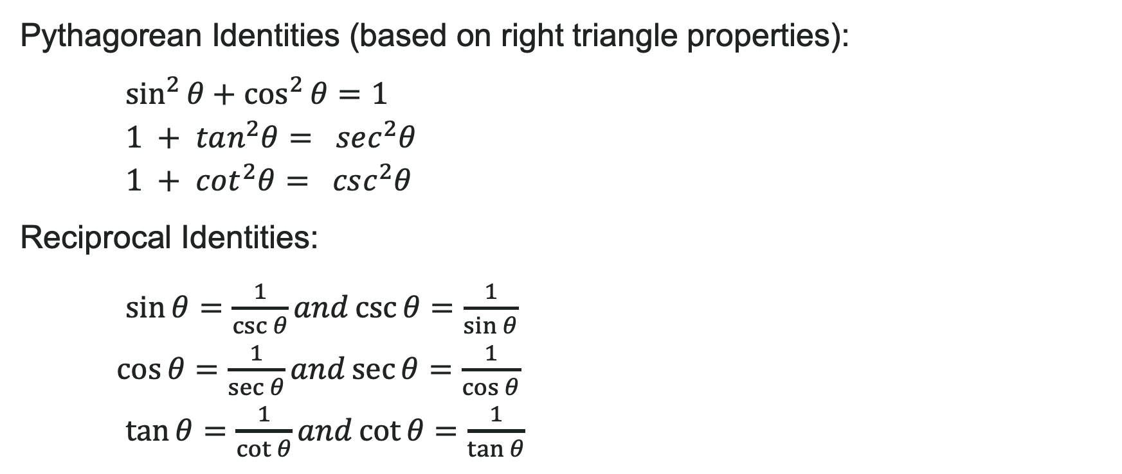
The Fundamental Identities (Part 1)
Pythagorean Identities (based on right triangle properties):
$\sin^{2}{θ}+\cos^{2}{θ}=1$
$1 + tan^{2}θ= sec^{2}θ$
$1 + cot^{2}θ= csc^{2}θ$
Reciprocal Identities:
$\sin{θ}=\frac{1}{\csc{θ}}and\csc{θ}=\frac{1}{\sin{θ}}$
$\cos{θ}=\frac{1}{\sec{θ}}and\sec{θ}=\frac{1}{\cos{θ}}$
$\tan{θ}=\frac{1}{\cot{θ}}and\cot{θ}=\frac{1}{\tan{θ}}$

Slide 5
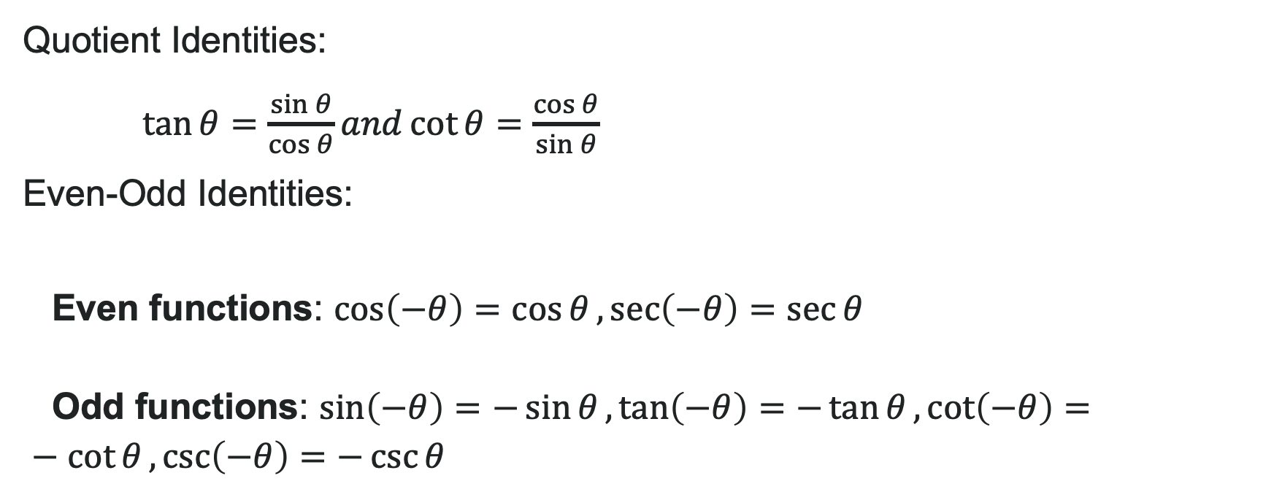
The Fundamental Identities (Part 2)
Quotient Identities:
$\tan{θ}=\frac{\sin{θ}}{\cos{θ}}and\cot{θ}=\frac{\cos{θ}}{\sin{θ}}$
Even-Odd Identities:
Even functions: $\cos\left(−θ\right)=\cos{θ},\sec\left(−θ\right)=\sec{θ}$
Odd functions: $\sin\left(−θ\right)=−\sin{θ},\tan\left(−θ\right)=−\tan{θ},\cot\left(−θ\right)=−\cot{θ},\csc\left(−θ\right)=−\csc{θ}$

Slide 6

How to: Verify Identities
Work on one side of the equation. It is usually better to start with the more complex side, as it is easier to simplify than to build.
Look for opportunities to factor expressions, square a binomial, or add fractions.
Noting which functions are in the final expression, look for opportunities to use the identities and make the proper substitutions.
If these steps do not yield the desired result, try converting all terms to sines and cosines.

Slide 7
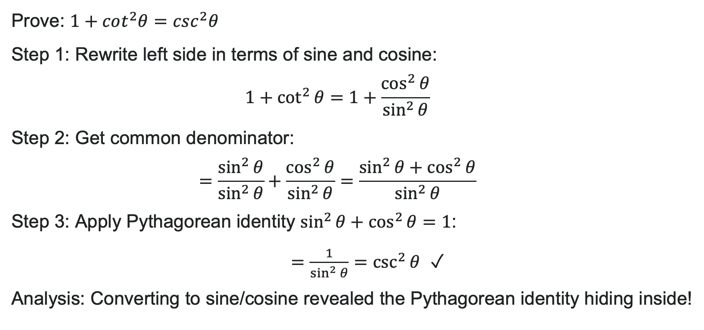
Example: Deriving a Pythagorean Identity
Prove: $1+cot^{2}θ=csc^{2}θ$
Step 1: Rewrite left side in terms of sine and cosine:
$1+\cot^{2}{θ}=1+\frac{\cos^{2}{θ}}{\sin^{2}{θ}}$
Step 2: Get common denominator:
$=\frac{\sin^{2}{θ}}{\sin^{2}{θ}}+\frac{\cos^{2}{θ}}{\sin^{2}{θ}}=\frac{\sin^{2}{θ}+\cos^{2}{θ}}{\sin^{2}{θ}}$
Step 3: Apply Pythagorean identity $\sin^{2}{θ}+\cos^{2}{θ}=1$:
$=\frac{1}{\sin^{2}{θ}}=\csc^{2}{θ}$ ✓
Analysis: Converting to sine/cosine revealed the Pythagorean identity hiding inside!

Slide 8

Try It: Verify the Identity
Verify the identity: $\tan{θ}\cos{θ}=\sin{θ}$
(Work on the left side)
Notes:
Answer: \tan\theta \cos\theta = \frac{\sin\theta}{\cos\theta} \cdot \cos\theta = \sin\theta ✓

Slide 9
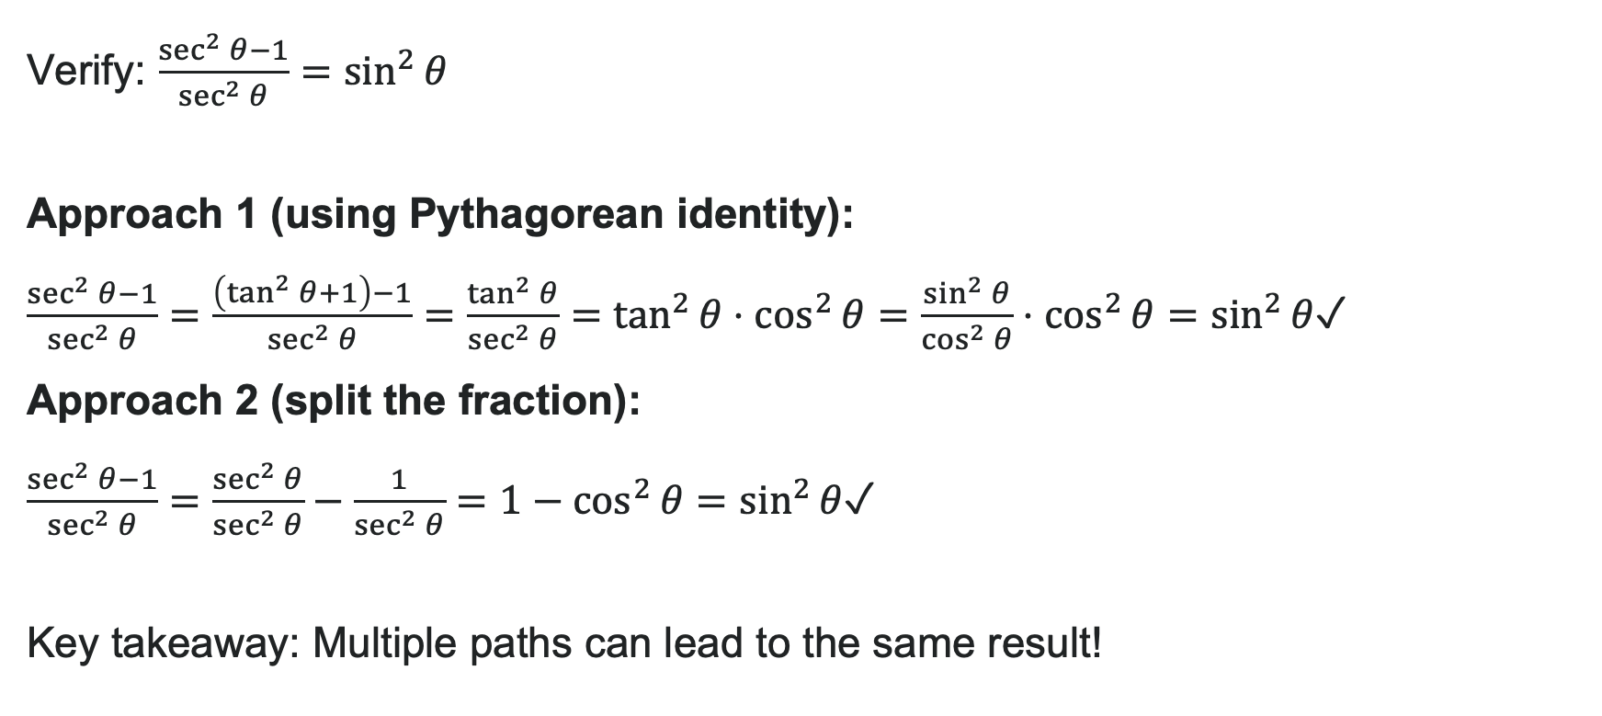
Example: Two Approaches to Verification
Verify: $\frac{\sec^{2}{θ}−1}{\sec^{2}{θ}}=\sin^{2}{θ}$
Approach 1 (using Pythagorean identity):
$\frac{\sec^{2}{θ}−1}{\sec^{2}{θ}}=\frac{\left(\tan^{2}{θ}+1\right)−1}{\sec^{2}{θ}}=\frac{\tan^{2}{θ}}{\sec^{2}{θ}}=\tan^{2}{θ}⋅\cos^{2}{θ}=\frac{\sin^{2}{θ}}{\cos^{2}{θ}}⋅\cos^{2}{θ}=\sin^{2}{θ}$✓
Approach 2 (split the fraction):
$\frac{\sec^{2}{θ}−1}{\sec^{2}{θ}}=\frac{\sec^{2}{θ}}{\sec^{2}{θ}}−\frac{1}{\sec^{2}{θ}}=1−\cos^{2}{θ}=\sin^{2}{θ}$✓
Key takeaway: Multiple paths can lead to the same result!

Slide 10

Try It: Verifying Identities
Verify the identity: $\csc{θ}\cos{θ}\tan{θ}=1$
Notes:
Answer: \csc\theta \cos\theta \tan\theta = \frac{1}{\sin\theta} \cdot \cos\theta \cdot \frac{\sin\theta}{\cos\theta} = \frac{\cos\theta \sin\theta}{\sin\theta \cos\theta} = 1 ✓

Slide 11
Learning Goals: Sum and Difference Identities
Deepen your understanding and form connections within these skills:
1 Use sum and difference formulas for sine, cosine, and tangent
2 Use sum and difference formulas to verify identities

Slide 12

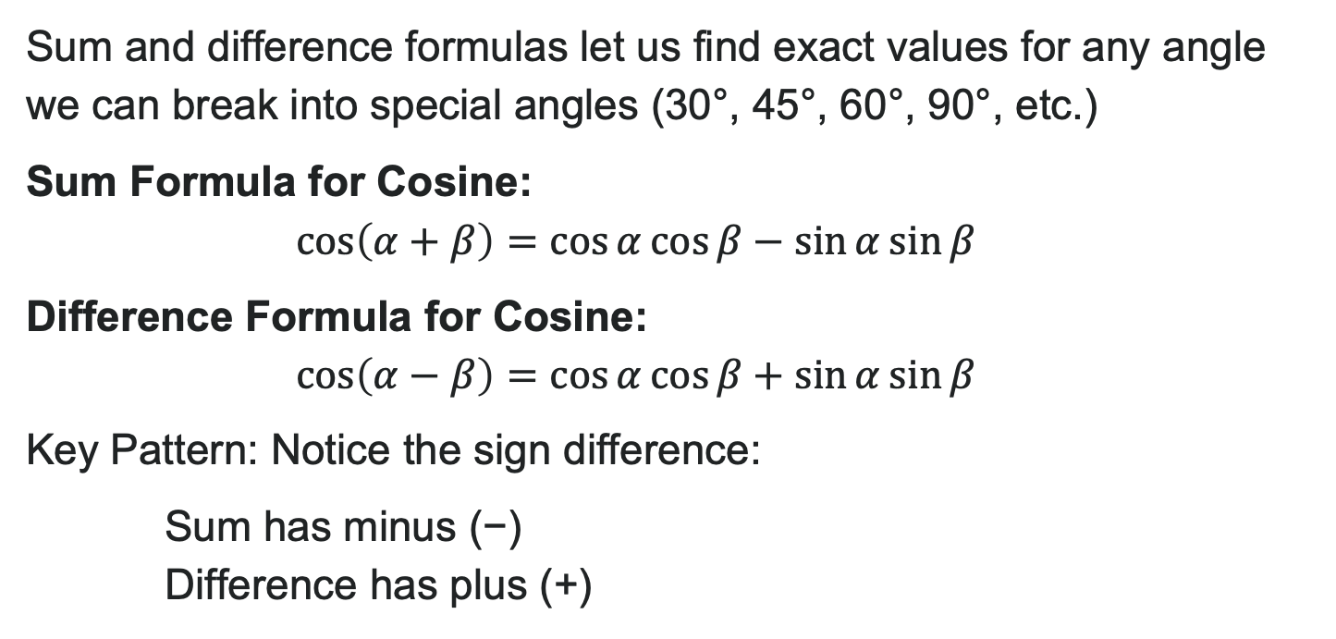
Sum and Difference Formulas for Cosine
Sum and difference formulas let us find exact values for any angle we can break into special angles (30°, 45°, 60°, 90°, etc.)
Sum Formula for Cosine:
$\cos\left(α+β\right)=\cos{α}\cos{β}−\sin{α}\sin{β}$
Difference Formula for Cosine:
$\cos\left(α−β\right)=\cos{α}\cos{β}+\sin{α}\sin{β}$
Key Pattern: Notice the sign difference:
Sum has minus (−)
Difference has plus (+)

Slide 13
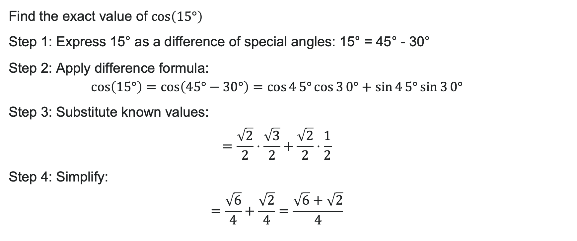
Example: Finding Exact Values with Cosine Difference
Find the exact value of $\cos\left(15°\right)$
Step 1: Express 15° as a difference of special angles: 15° = 45° - 30°
Step 2: Apply difference formula:
$$\cos\left(15°\right)=\cos\left(45°−30°\right)=\cos{4}5°\cos{3}0°+\sin{4}5°\sin{3}0°$$
Step 3: Substitute known values:
$$=\frac{\sqrt{2}}{2}⋅\frac{\sqrt{3}}{2}+\frac{\sqrt{2}}{2}⋅\frac{1}{2}$$
Step 4: Simplify:
$$=\frac{\sqrt{6}}{4}+\frac{\sqrt{2}}{4}=\frac{\sqrt{6}+\sqrt{2}}{4}$$

Slide 14
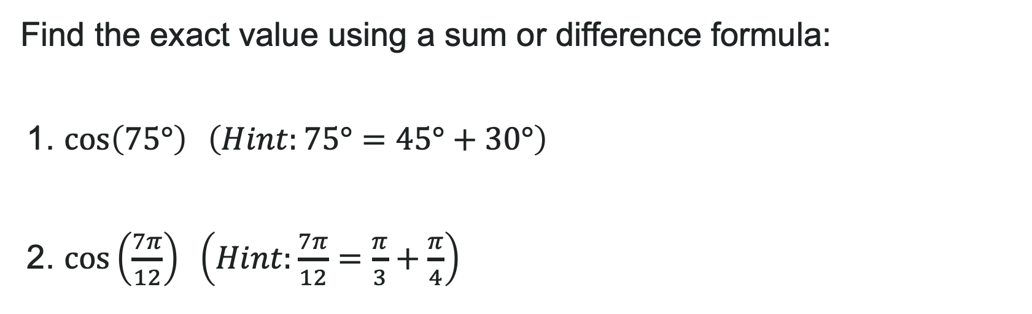
Try It: Using Cosine Sum and Difference Formulas
Find the exact value using a sum or difference formula:
1. $\cos\left(75°\right) \left(Hint:75°=45°+30°\right)$
2. $\cos\left(\frac{7π}{12}\right) \left(Hint:\frac{7π}{12}=\frac{π}{3}+\frac{π}{4}\right)$
Notes:
Answers:
1. \cos(75°) = \cos(45° + 30°) = \cos 45° \cos 30° - \sin 45° \sin 30° = \frac{\sqrt{2}}{2} \cdot \frac{\sqrt{3}}{2} - \frac{\sqrt{2}}{2} \cdot \frac{1}{2} = \frac{\sqrt{6} - \sqrt{2}}{4}
2. \cos\left(\frac{7\pi}{12}\right) = \cos\left(\frac{\pi}{3} + \frac{\pi}{4}\right) = \frac{1}{2} \cdot \frac{\sqrt{2}}{2} - \frac{\sqrt{3}}{2} \cdot \frac{\sqrt{2}}{2} = \frac{\sqrt{2} - \sqrt{6}}{4}

Slide 15
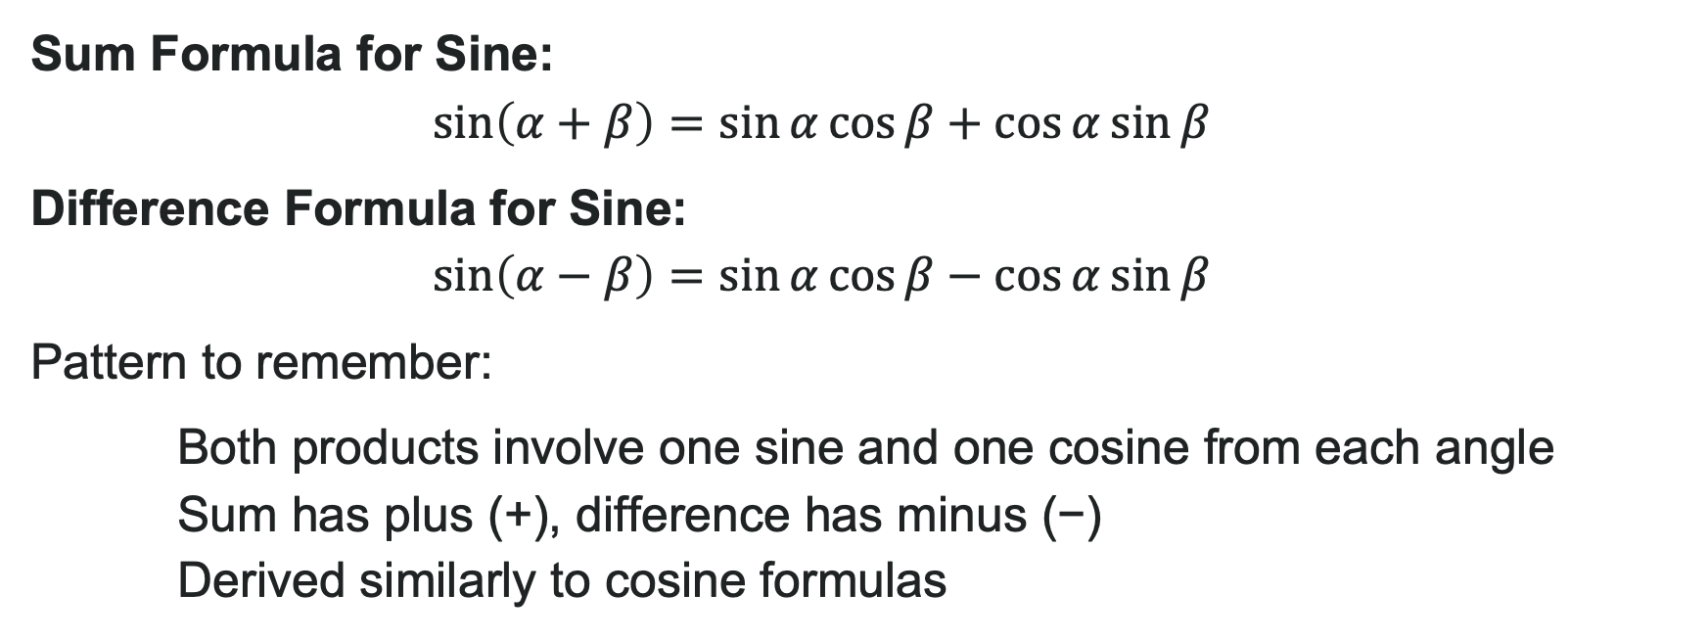
Sum and Difference Formulas for Sine
Sum Formula for Sine:
$$\sin\left(α+β\right)=\sin{α}\cos{β}+\cos{α}\sin{β}$$
Difference Formula for Sine:
$$\sin\left(α−β\right)=\sin{α}\cos{β}−\cos{α}\sin{β}$$
Pattern to remember:
Both products involve one sine and one cosine from each angle
Sum has plus (+), difference has minus (−)
Derived similarly to cosine formulas

Slide 16
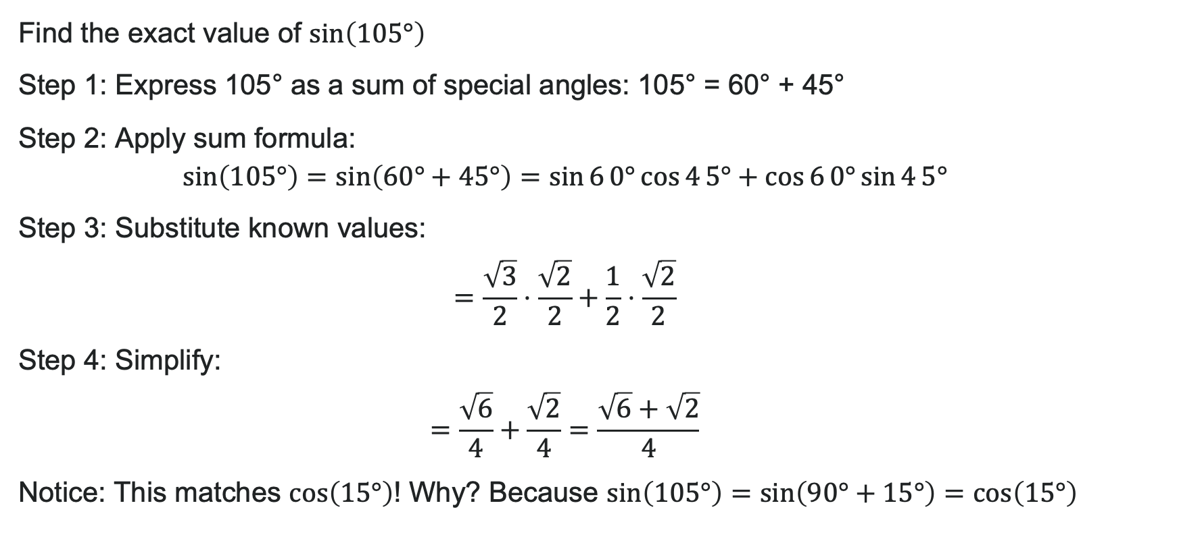
Example : Finding Exact Values with Sine Sum
Find the exact value of $\sin\left(105°\right)$
Step 1: Express 105° as a sum of special angles: 105° = 60° + 45°
Step 2: Apply sum formula:
$\sin\left(105°\right)=\sin\left(60°+45°\right)=\sin{6}0°\cos{4}5°+\cos{6}0°\sin{4}5°$
Step 3: Substitute known values:
$=\frac{\sqrt{3}}{2}⋅\frac{\sqrt{2}}{2}+\frac{1}{2}⋅\frac{\sqrt{2}}{2}$
Step 4: Simplify:
$=\frac{\sqrt{6}}{4}+\frac{\sqrt{2}}{4}=\frac{\sqrt{6}+\sqrt{2}}{4}$
Notice: This matches $\cos\left(15°\right)$! Why? Because $\sin\left(105°\right)=\sin\left(90°+15°\right)=\cos\left(15°\right)$

Slide 17
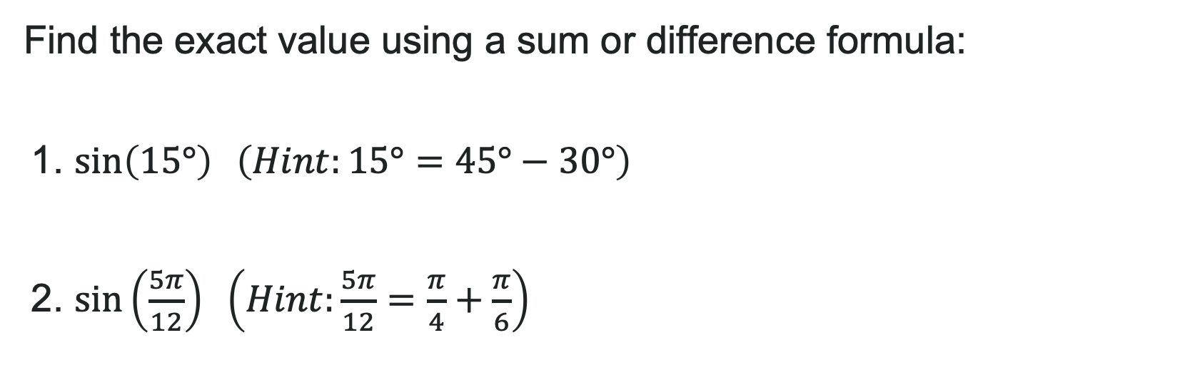
Try It: Using Sine Sum and Difference Formulas
Find the exact value using a sum or difference formula:
1. $\sin\left(15°\right) \left(Hint:15°=45°−30°\right)$
2. $\sin\left(\frac{5π}{12}\right) \left(Hint:\frac{5π}{12}=\frac{π}{4}+\frac{π}{6}\right)$
Notes:
Answers:
\sin(15°) = \sin(45° - 30°) = \sin 45° \cos 30° - \cos 45° \sin 30° = \frac{\sqrt{2}}{2} \cdot \frac{\sqrt{3}}{2} - \frac{\sqrt{2}}{2} \cdot \frac{1}{2} = \frac{\sqrt{6} - \sqrt{2}}{4}
\sin\left(\frac{5\pi}{12}\right) = \sin\left(\frac{\pi}{4} + \frac{\pi}{6}\right) = \frac{\sqrt{2}}{2} \cdot \frac{\sqrt{3}}{2} + \frac{\sqrt{2}}{2} \cdot \frac{1}{2} = \frac{\sqrt{6} + \sqrt{2}}{4}

Slide 18
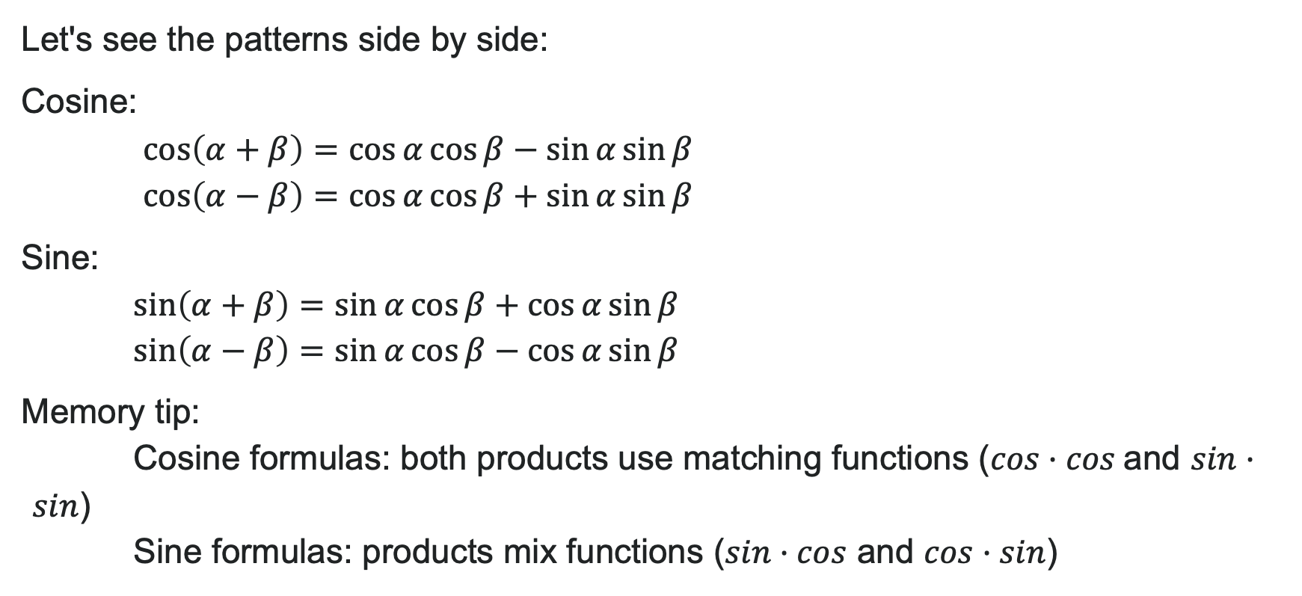
Comparing Sine and Cosine Formulas
Let's see the patterns side by side:
Cosine:
$\cos\left(α+β\right)=\cos{α}\cos{β}−\sin{α}\sin{β}$
$\cos\left(α−β\right)=\cos{α}\cos{β}+\sin{α}\sin{β}$
Sine:
$\sin\left(α+β\right)=\sin{α}\cos{β}+\cos{α}\sin{β}$
$\sin\left(α−β\right)=\sin{α}\cos{β}−\cos{α}\sin{β}$
Memory tip:
Cosine formulas: both products use matching functions ($cos·cos⁡$and $sin·sin$)
Sine formulas: products mix functions ($sin·cos$ and $cos·sin$)

Slide 19
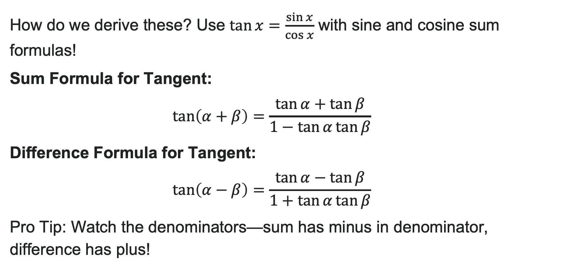
Sum and Difference Formulas for Tangent
How do we derive these? Use $\tan{x}=\frac{\sin{x}}{\cos{x}}$ with sine and cosine sum formulas!
Sum Formula for Tangent:
$\tan\left(α+β\right)=\frac{\tan{α}+\tan{β}}{1−\tan{α}\tan{β}}$
Difference Formula for Tangent:
$\tan\left(α−β\right)=\frac{\tan{α}−\tan{β}}{1+\tan{α}\tan{β}}$
Pro Tip: Watch the denominators—sum has minus in denominator, difference has plus!

Slide 20
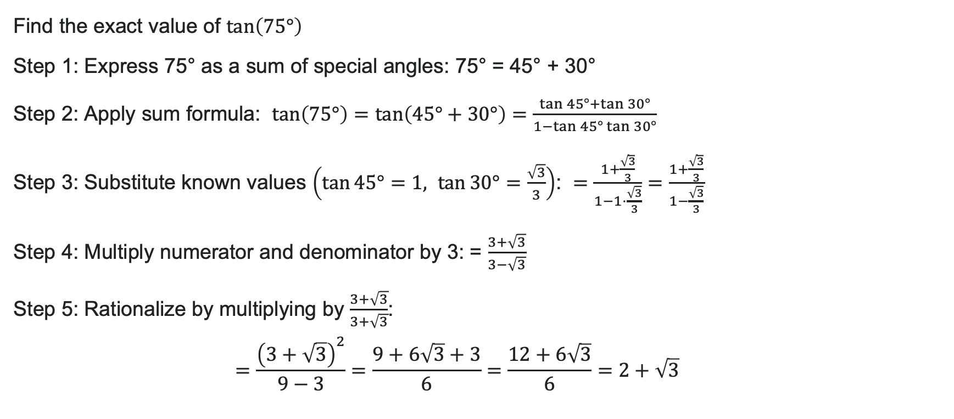
Example: Finding Exact Values with Tangent
Find the exact value of $\tan\left(75°\right)$
Step 1: Express 75° as a sum of special angles: 75° = 45° + 30°
Step 2: Apply sum formula: $\tan\left(75°\right)=\tan\left(45°+30°\right)=\frac{\tan{4}5°+\tan{3}0°}{1−\tan{4}5°\tan{3}0°}$
Step 3: Substitute known values $\left(\tan{45°}=1, \tan{30°}=\frac{\sqrt{3}}{3}\right)$: $=\frac{1+\frac{\sqrt{3}}{3}}{1−1⋅\frac{\sqrt{3}}{3}}=\frac{1+\frac{\sqrt{3}}{3}}{1−\frac{\sqrt{3}}{3}}$
Step 4: Multiply numerator and denominator by 3: = $\frac{3+\sqrt{3}}{3−\sqrt{3}}$
Step 5: Rationalize by multiplying by $\frac{3+\sqrt{3}}{3+\sqrt{3}}$:
$$=\frac{{\left(3+\sqrt{3}\right)}^{2}}{9−3}=\frac{9+6\sqrt{3}+3}{6}=\frac{12+6\sqrt{3}}{6}=2+\sqrt{3}$$

Slide 21

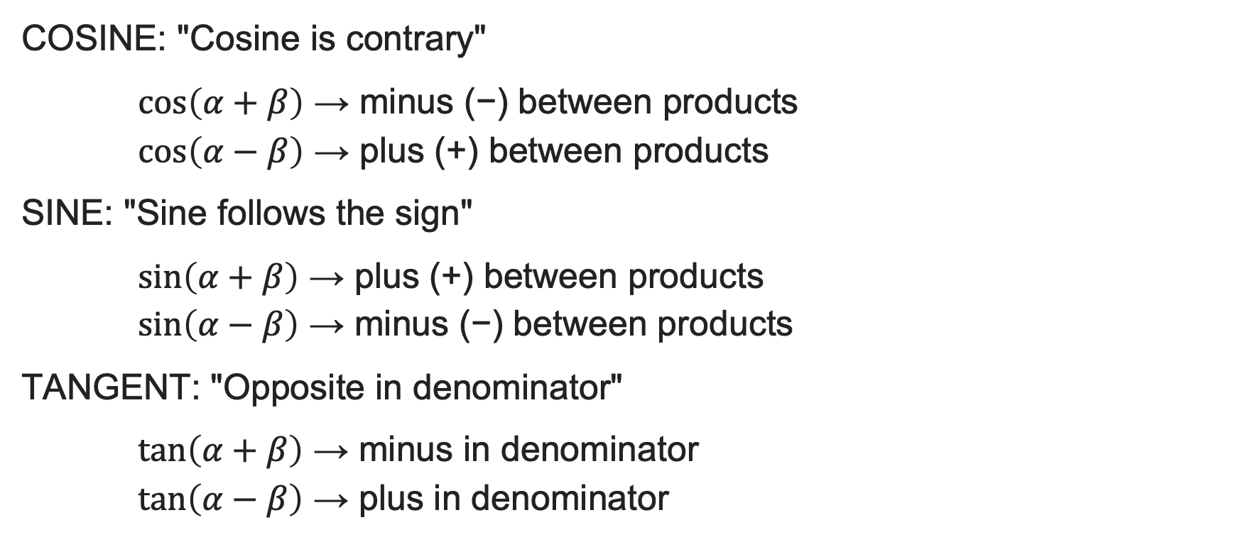
Quick Reference: Sign Patterns
COSINE: "Cosine is contrary"
$\cos\left(α+β\right)$ → minus (−) between products
$\cos\left(α−β\right)$ → plus (+) between products
SINE: "Sine follows the sign"
$\sin\left(α+β\right)$ → plus (+) between products
$\sin\left(α−β\right)$ → minus (−) between products
TANGENT: "Opposite in denominator"
$\tan\left(α+β\right)$ → minus in denominator
$\tan\left(α−β\right)$ → plus in denominator

Slide 22
Learning Goals: Double Angle, Half Angle, and Reduction Formulas
Deepen your understanding and form connections within these skills:
1 Use double-angle formulas to find exact values
2 Use double-angle formulas to verify identities
3 Use reduction formulas to simplify an expression
4 Use half-angle formulas to find exact values

Slide 23
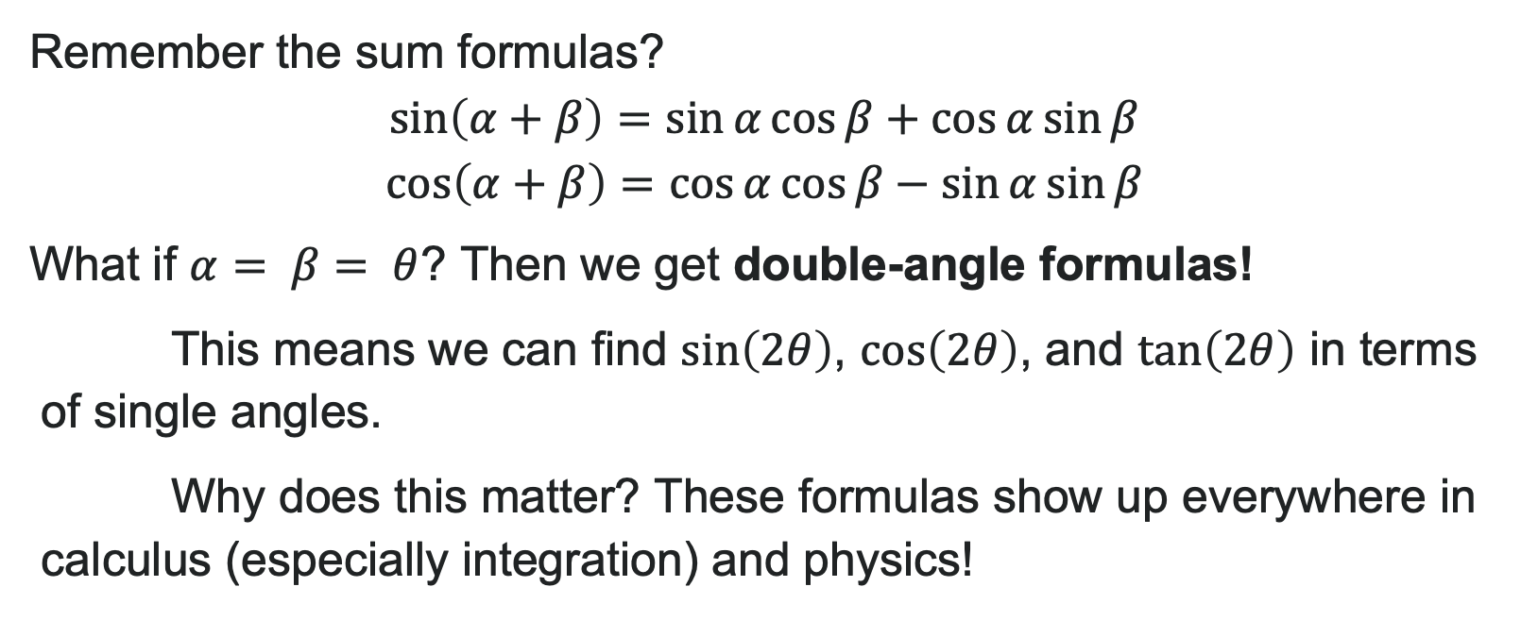
From Sum Formulas to Double-Angle Formulas
Remember the sum formulas?
What if $α= β= θ$? Then we get double-angle formulas!
This means we can find $\sin\left(2θ\right)$, $\cos\left(2θ\right)$, and $\tan\left(2θ\right)$ in terms of single angles.
Why does this matter? These formulas show up everywhere in calculus (especially integration) and physics!

Slide 24

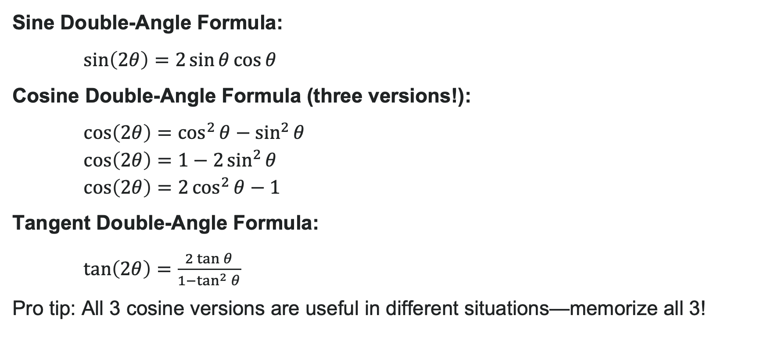
Double-Angle Formulas
Sine Double-Angle Formula:
$\sin\left(2θ\right)=2\sin{θ}\cos{θ}$
Cosine Double-Angle Formula (three versions!):
$\cos\left(2θ\right)=\cos^{2}{θ}−\sin^{2}{θ}$
$\cos\left(2θ\right)=1−2\sin^{2}{θ}$
$\cos\left(2θ\right)=2\cos^{2}{θ}−1$
Tangent Double-Angle Formula:
$\tan\left(2θ\right)=\frac{2\tan{θ}}{1−\tan^{2}{θ}}$
Pro tip: All 3 cosine versions are useful in different situations—memorize all 3!

Slide 25
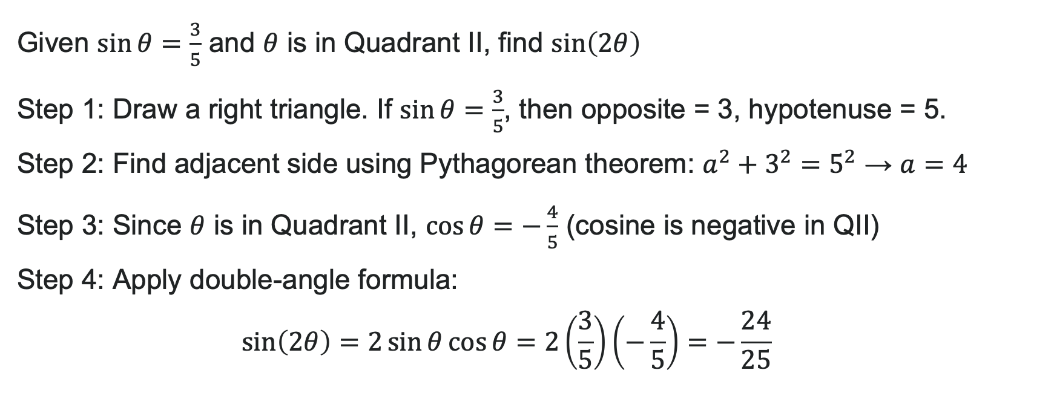
Example: Using Double-Angle Formula for Sine
Given $\sin{θ}=\frac{3}{5}$ and $θ$ is in Quadrant II, find $\sin\left(2θ\right)$
Step 1: Draw a right triangle. If $\sin{θ}=\frac{3}{5}$, then opposite = 3, hypotenuse = 5.
Step 2: Find adjacent side using Pythagorean theorem: $a^{2}+3^{2}=5^{2}$ → $a=4$
Step 3: Since $θ$ is in Quadrant II, $\cos{θ}=−\frac{4}{5}$ (cosine is negative in QII)
Step 4: Apply double-angle formula:
$$\sin\left(2θ\right)=2\sin{θ}\cos{θ}=2\left(\frac{3}{5}\right)\left(−\frac{4}{5}\right)=−\frac{24}{25}$$

Slide 26
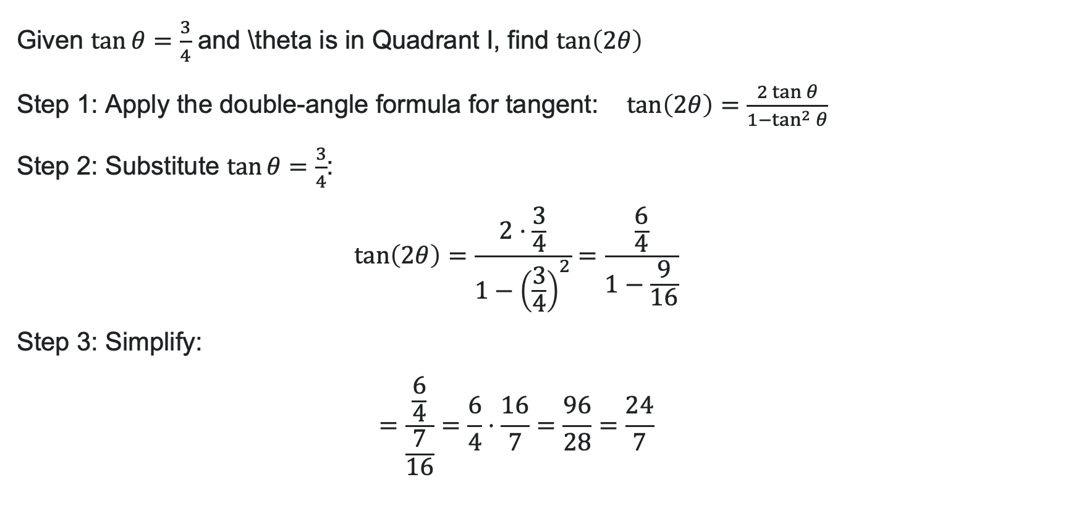
Example: Double-Angle Formula for Tangent
Given $\tan{θ}=\frac{3}{4}$ and \theta is in Quadrant I, find $\tan\left(2θ\right)$
Step 1: Apply the double-angle formula for tangent: $\tan\left(2θ\right)=\frac{2\tan{θ}}{1−\tan^{2}{θ}}$
Step 2: Substitute $\tan{θ}=\frac{3}{4}$:
$\tan\left(2θ\right)=\frac{2⋅\frac{3}{4}}{1−{\left(\frac{3}{4}\right)}^{2}}=\frac{\frac{6}{4}}{1−\frac{9}{16}}$
Step 3: Simplify:
$$=\frac{\frac{6}{4}}{\frac{7}{16}}=\frac{6}{4}⋅\frac{16}{7}=\frac{96}{28}=\frac{24}{7}$$

Slide 27
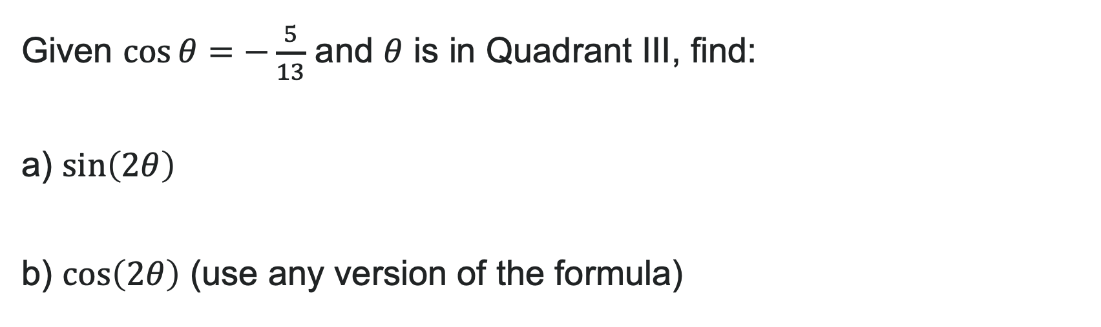
Try It: Double-Angle Formulas
Given $\cos{θ}=−\frac{5}{13}$ and $θ$ is in Quadrant III, find:
a) $\sin\left(2θ\right)$
b) $\cos\left(2θ\right)$ (use any version of the formula)
Notes:
Answer: Draw triangle: if \cos\theta = -\frac{5}{13}, adjacent = -5, hypotenuse = 13, so opposite = -12 (negative in QIII) Thus \sin\theta = -\frac{12}{13}, \cos\theta = -\frac{5}{13}
\sin(2\theta) = 2\sin\theta\cos\theta = 2\left(-\frac{12}{13}\right)\left(-\frac{5}{13}\right) = \frac{120}{169}
\cos(2\theta) = \cos^2\theta - \sin^2\theta = \left(-\frac{5}{13}\right)^2 - \left(-\frac{12}{13}\right)^2 = \frac{25}{169} - \frac{144}{169} = -\frac{119}{169}

Slide 28

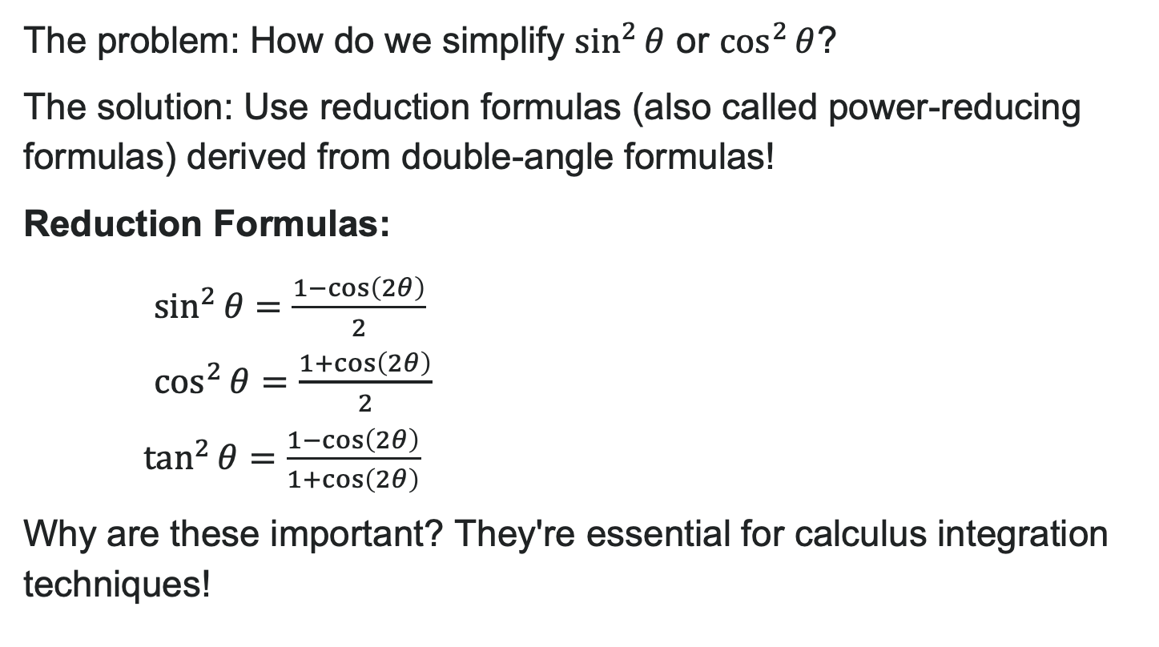
Reduction Formulas—Lowering Powers
The problem: How do we simplify $\sin^{2}{θ}$ or $\cos^{2}{θ}$?
The solution: Use reduction formulas (also called power-reducing formulas) derived from double-angle formulas!
Reduction Formulas:
$\sin^{2}{θ}=\frac{1−\cos\left(2θ\right)}{2}$
$\cos^{2}{θ}=\frac{1+\cos\left(2θ\right)}{2}$
$\tan^{2}{θ}=\frac{1−\cos\left(2θ\right)}{1+\cos\left(2θ\right)}$
Why are these important? They're essential for calculus integration techniques!

Slide 29

Try It: Reduction Formulas
Use reduction formulas to simplify:
1. $\sin^{2}\left(3x\right)$
2. $\cos^{2}\left(\frac{x}{2}\right)$
Notes:
Answer:
\sin^2(3x) = \frac{1 - \cos(2 \cdot 3x)}{2} = \frac{1 - \cos(6x)}{2}
\cos^2\left(\frac{x}{2}\right) = \frac{1 + \cos(2 \cdot \frac{x}{2})}{2} = \frac{1 + \cos x}{2}

Slide 30

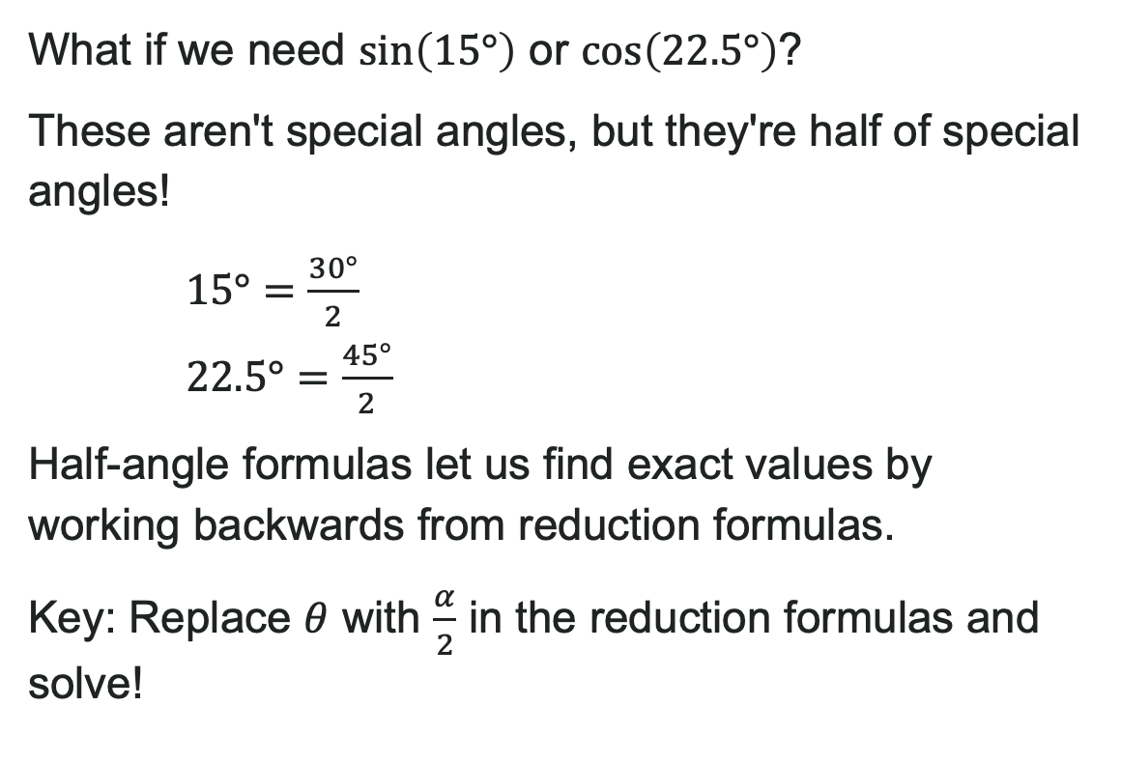
When Do We Need Half Angle Formulas?
What if we need $\sin\left(15°\right)$ or $\cos\left(22.5°\right)$?
These aren't special angles, but they're half of special angles!
$15°=\frac{30°}{2}$
$22.5°=\frac{45°}{2}$
Half-angle formulas let us find exact values by working backwards from reduction formulas.
Key: Replace $θ$ with $\frac{α}{2}$ in the reduction formulas and solve!

Slide 31
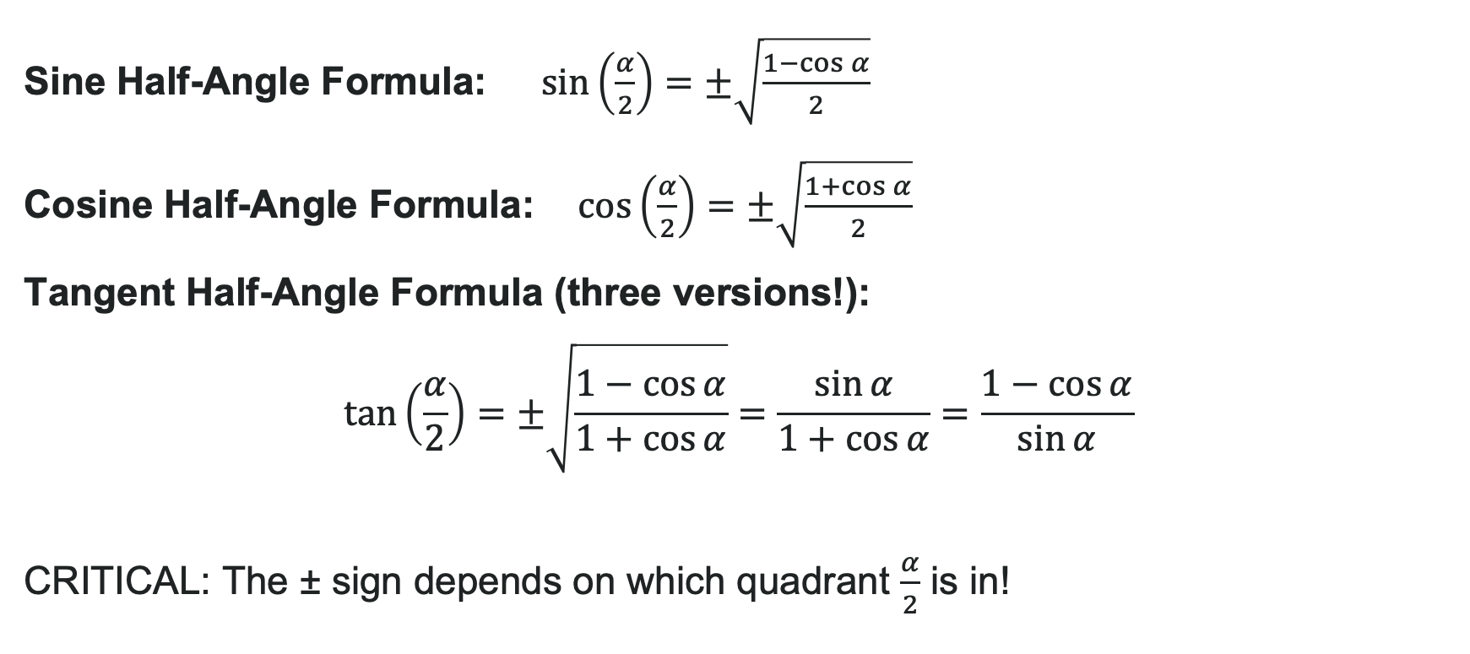
Half-Angle Formulas
Sine Half-Angle Formula: $\sin\left(\frac{α}{2}\right)=±\sqrt{\frac{1−\cos{α}}{2}}$
Cosine Half-Angle Formula: $\cos\left(\frac{α}{2}\right)=±\sqrt{\frac{1+\cos{α}}{2}}$
Tangent Half-Angle Formula (three versions!):
$$\tan\left(\frac{α}{2}\right)=±\sqrt{\frac{1−\cos{α}}{1+\cos{α}}}=\frac{\sin{α}}{1+\cos{α}}=\frac{1−\cos{α}}{\sin{α}}$$
CRITICAL: The ± sign depends on which quadrant $\frac{α}{2}$ is in!

Slide 32
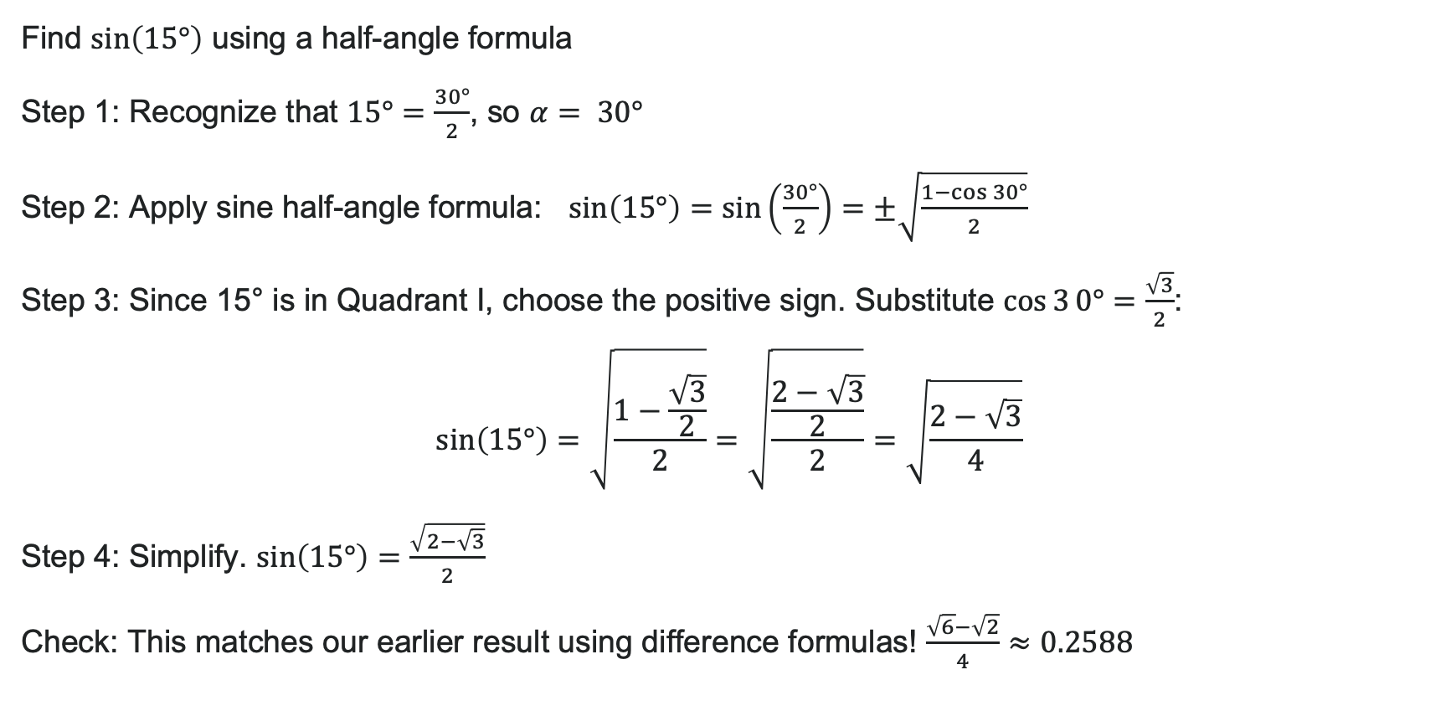
Example: Exact Value w/Half-Angle Formula
Find $\sin\left(15°\right)$ using a half-angle formula
Step 1: Recognize that $15°=\frac{30°}{2}$, so $α= 30°$
Step 2: Apply sine half-angle formula: $\sin\left(15°\right)=\sin\left(\frac{30°}{2}\right)=±\sqrt{\frac{1−\cos{3}0°}{2}}$
Step 3: Since 15° is in Quadrant I, choose the positive sign. Substitute $\cos{3}0°=\frac{\sqrt{3}}{2}$:
$\sin\left(15°\right)=\sqrt{\frac{1−\frac{\sqrt{3}}{2}}{2}}=\sqrt{\frac{\frac{2−\sqrt{3}}{2}}{2}}=\sqrt{\frac{2−\sqrt{3}}{4}}$
Step 4: Simplify. $\sin\left(15°\right)=\frac{\sqrt{2−\sqrt{3}}}{2}$
Check: This matches our earlier result using difference formulas! $\frac{\sqrt{6}−\sqrt{2}}{4}≈0.2588$

Slide 33

Try It: Using Half Angle Formulas
Find the exact value using a half-angle formula:
1. $\cos\left(22.5°\right)$
(Hint: $22.5°=\frac{45°}{2}$)
2. $\tan\left(\frac{π}{8}\right)$
(Hint: $\frac{π}{8}=\frac{\frac{π}{4}}{2}$)
Notes:
Answers:
\cos(22.5°) = \sqrt{\frac{1 + \cos 45°}{2}} = \sqrt{\frac{1 + \frac{\sqrt{2}}{2}}{2}} = \sqrt{\frac{2 + \sqrt{2}}{4}} = \frac{\sqrt{2 + \sqrt{2}}}{2} (positive since 22.5° is in QI)
\tan\left(\frac{\pi}{8}\right) = \frac{\sin\frac{\pi}{4}}{1 + \cos\frac{\pi}{4}} = \frac{\frac{\sqrt{2}}{2}}{1 + \frac{\sqrt{2}}{2}} = \frac{\sqrt{2}}{2 + \sqrt{2}} = \sqrt{2} - 1 (after rationalizing)

Slide 34
Learning Goals: Sum-to-Product and Product-to-Sum Formulas
Deepen your understanding and form connections within these skills:
1 Express products as sums
2 Express sums as products

Slide 35

Why Do We Need These Formulas?
Sometimes we need to convert between products and sums of trig functions.
Real-world applications:
Signal processing (audio engineering, telecommunications)
Physics (wave interference, harmonic analysis)
Calculus (integration of trig products)
The Big Idea: These formulas are derived from the sum and difference formulas we already know—just rearranged in clever ways!

Slide 36
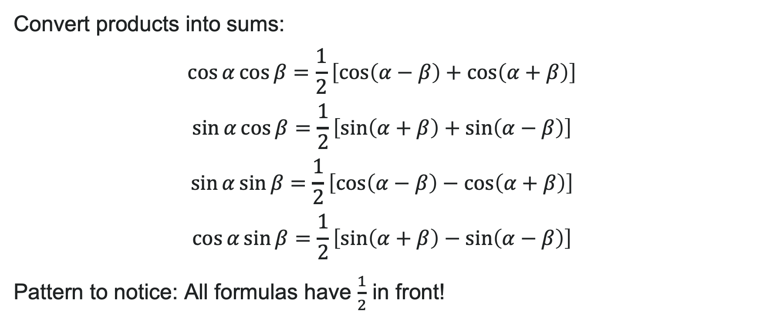
Product-to-Sum Formulas
Convert products into sums:
Pattern to notice: All formulas have $\frac{1}{2}$ in front!

Slide 37
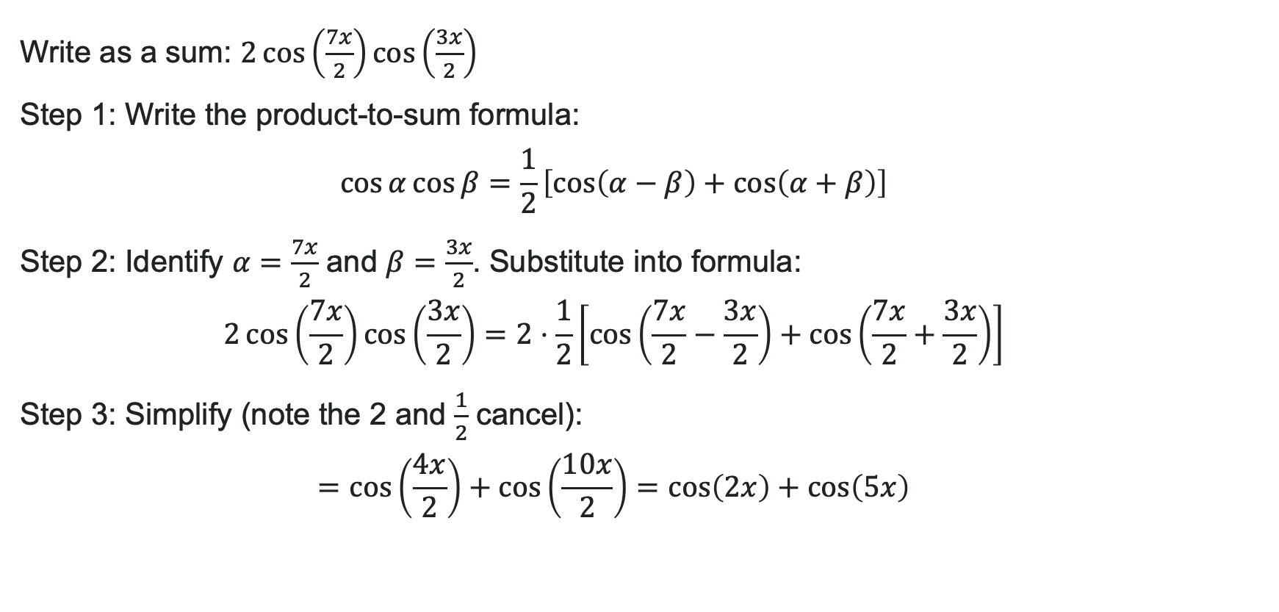
Example: Product-to-Sum for Cosine
Write as a sum: $2\cos\left(\frac{7x}{2}\right)\cos\left(\frac{3x}{2}\right)$
Step 1: Write the product-to-sum formula:
$\cos{α}\cos{β}=\frac{1}{2}\left[\cos\left(α−β\right)+\cos\left(α+β\right)\right]$
Step 2: Identify $α=\frac{7x}{2}$ and $β=\frac{3x}{2}$. Substitute into formula:
$2\cos\left(\frac{7x}{2}\right)\cos\left(\frac{3x}{2}\right)=2⋅\frac{1}{2}\left[\cos\left(\frac{7x}{2}−\frac{3x}{2}\right)+\cos\left(\frac{7x}{2}+\frac{3x}{2}\right)\right]$
Step 3: Simplify (note the 2 and $\frac{1}{2}$ cancel):
$$=\cos\left(\frac{4x}{2}\right)+\cos\left(\frac{10x}{2}\right)=\cos\left(2x\right)+\cos\left(5x\right)$$

Slide 38
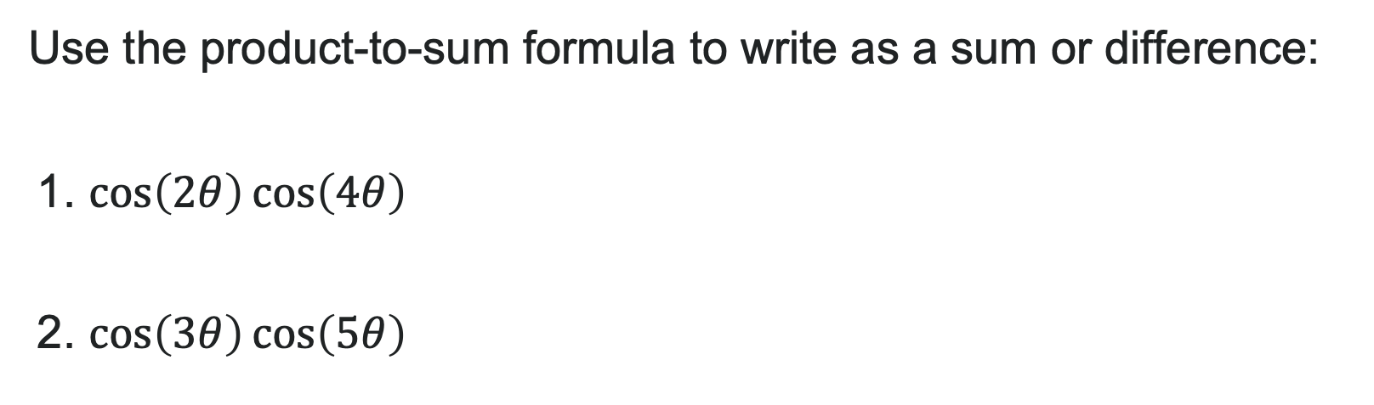
Try It: Product-to-Sum for Cosine
Use the product-to-sum formula to write as a sum or difference:
1. $\cos\left(2θ\right)\cos\left(4θ\right)$
2. $\cos\left(3θ\right)\cos\left(5θ\right)$
Notes:
Answer:
\cos(2\theta)\cos(4\theta) = \frac{1}{2}[\cos(2\theta - 4\theta) + \cos(2\theta + 4\theta)] = \frac{1}{2}[\cos(-2\theta) + \cos(6\theta)] = \frac{1}{2}[\cos(2\theta) + \cos(6\theta)]
\cos(3\theta)\cos(5\theta) = \frac{1}{2}[\cos(3\theta - 5\theta) + \cos(3\theta + 5\theta)] = \frac{1}{2}[\cos(-2\theta) + \cos(8\theta)] = \frac{1}{2}[\cos(2\theta) + \cos(8\theta)]

Slide 39
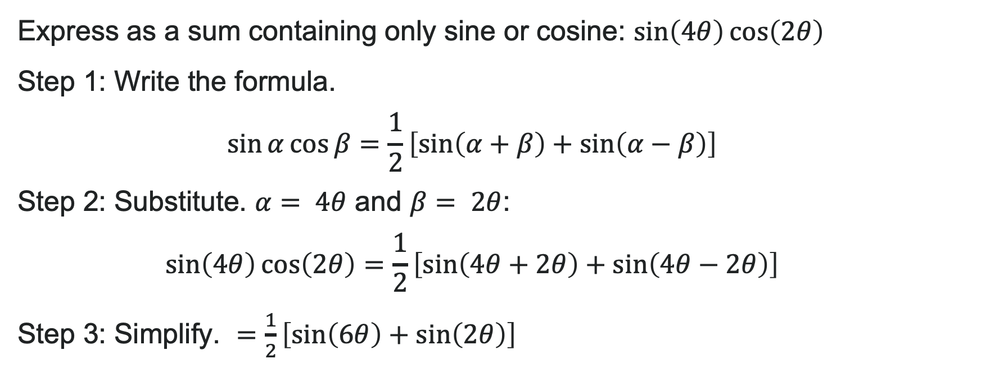
Example: Product-to-Sum for Sine and Cosine
Express as a sum containing only sine or cosine: $\sin\left(4θ\right)\cos\left(2θ\right)$
Step 1: Write the formula.
$\sin{α}\cos{β}=\frac{1}{2}\left[\sin\left(α+β\right)+\sin\left(α−β\right)\right]$
Step 2: Substitute. $α= 4θ$ and $β= 2θ$:
$\sin\left(4θ\right)\cos\left(2θ\right)=\frac{1}{2}\left[\sin\left(4θ+2θ\right)+\sin\left(4θ−2θ\right)\right]$
Step 3: Simplify. $=\frac{1}{2}\left[\sin\left(6θ\right)+\sin\left(2θ\right)\right]$

Slide 40
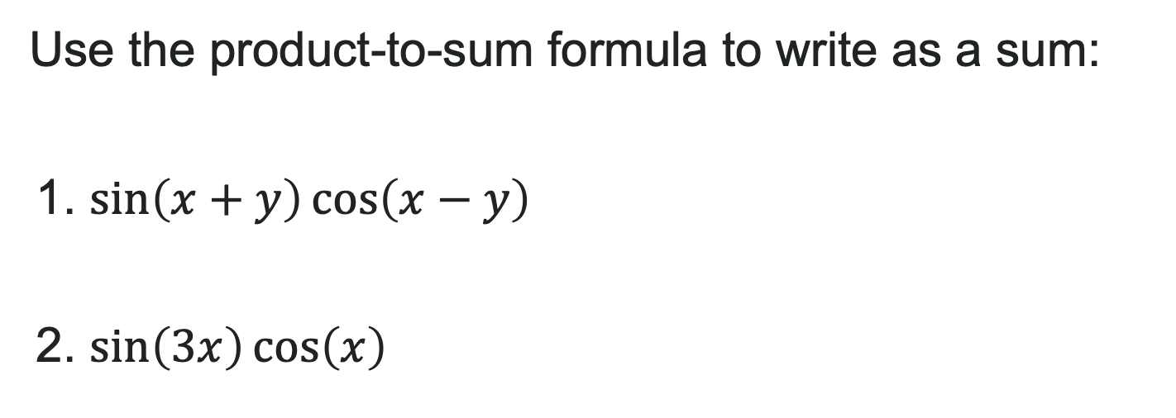
Try It: Product-to-Sum for Sine and Cosine
Use the product-to-sum formula to write as a sum:
1. $\sin\left(x+y\right)\cos\left(x−y\right)$
2. $\sin\left(3x\right)\cos\left(x\right)$
Notes:
Answer:
\sin(x + y)\cos(x - y) = \frac{1}{2}[\sin((x+y) + (x-y)) + \sin((x+y) - (x-y))] = \frac{1}{2}[\sin(2x) + \sin(2y)]
\sin(3x)\cos(x) = \frac{1}{2}[\sin(3x + x) + \sin(3x - x)] = \frac{1}{2}[\sin(4x) + \sin(2x)]

Slide 41
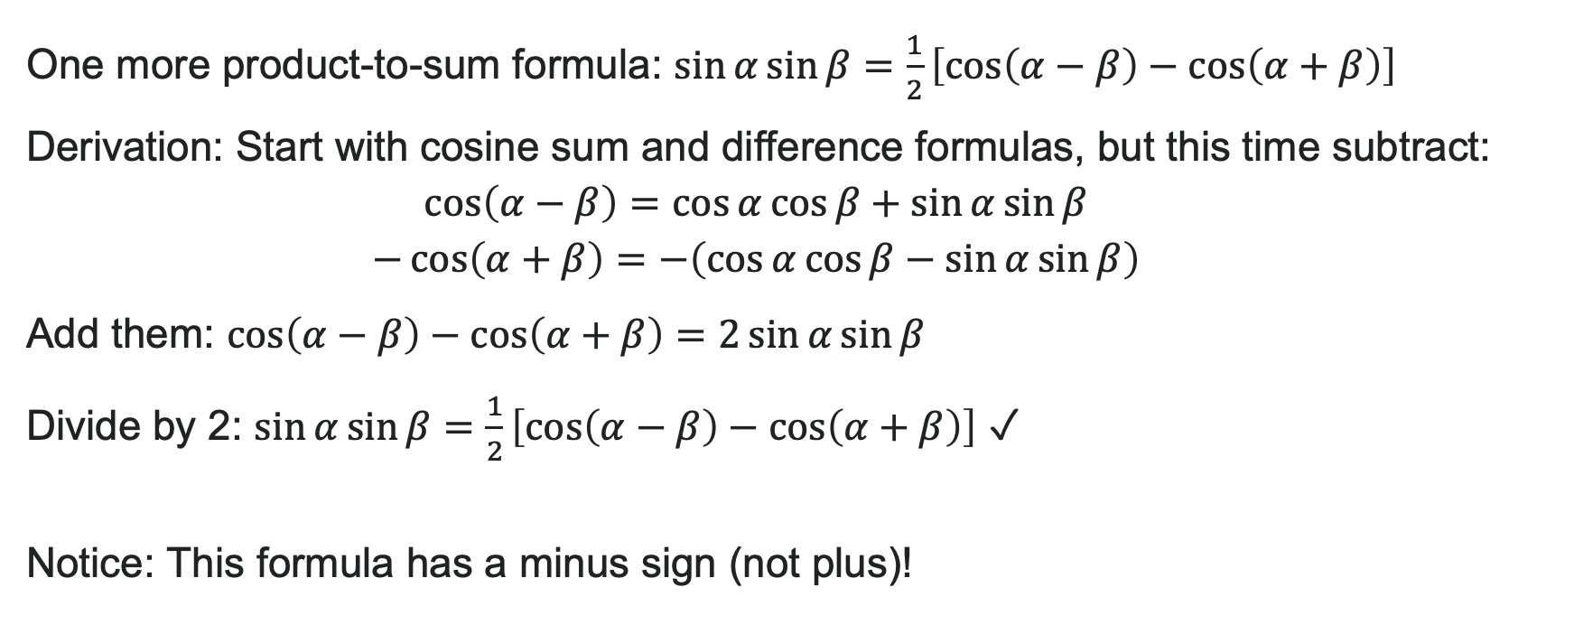
Product-to-Sum for Sine Times Sine
One more product-to-sum formula: $\sin{α}\sin{β}=\frac{1}{2}\left[\cos\left(α−β\right)−\cos\left(α+β\right)\right]$
Derivation: Start with cosine sum and difference formulas, but this time subtract:
Add them: $\cos\left(α−β\right)−\cos\left(α+β\right)=2\sin{α}\sin{β}$
Divide by 2: $\sin{α}\sin{β}=\frac{1}{2}\left[\cos\left(α−β\right)−\cos\left(α+β\right)\right]$ ✓
Notice: This formula has a minus sign (not plus)!

Slide 42
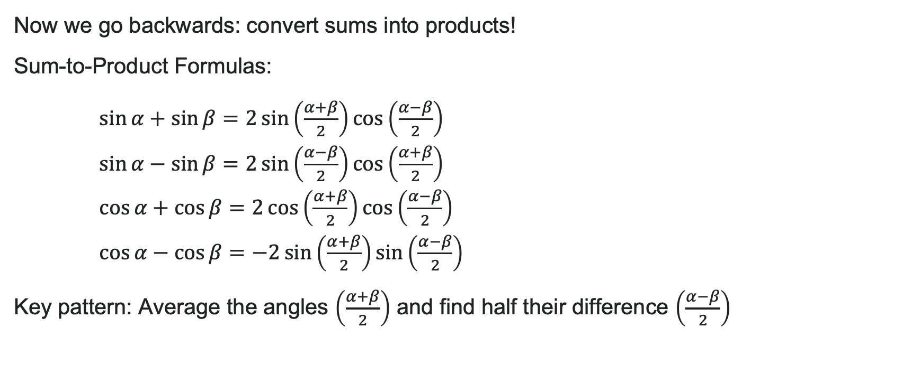
Sum-to-Product Formulas: The Reverse Process
Now we go backwards: convert sums into products!
Sum-to-Product Formulas:
$\sin{α}+\sin{β}=2\sin\left(\frac{α+β}{2}\right)\cos\left(\frac{α−β}{2}\right)$
$\sin{α}−\sin{β}=2\sin\left(\frac{α−β}{2}\right)\cos\left(\frac{α+β}{2}\right)$
$\cos{α}+\cos{β}=2\cos\left(\frac{α+β}{2}\right)\cos\left(\frac{α−β}{2}\right)$
$\cos{α}−\cos{β}=−2\sin\left(\frac{α+β}{2}\right)\sin\left(\frac{α−β}{2}\right)$
Key pattern: Average the angles $\left(\frac{α+β}{2}\right)$ and find half their difference $\left(\frac{α−β}{2}\right)$

Slide 43
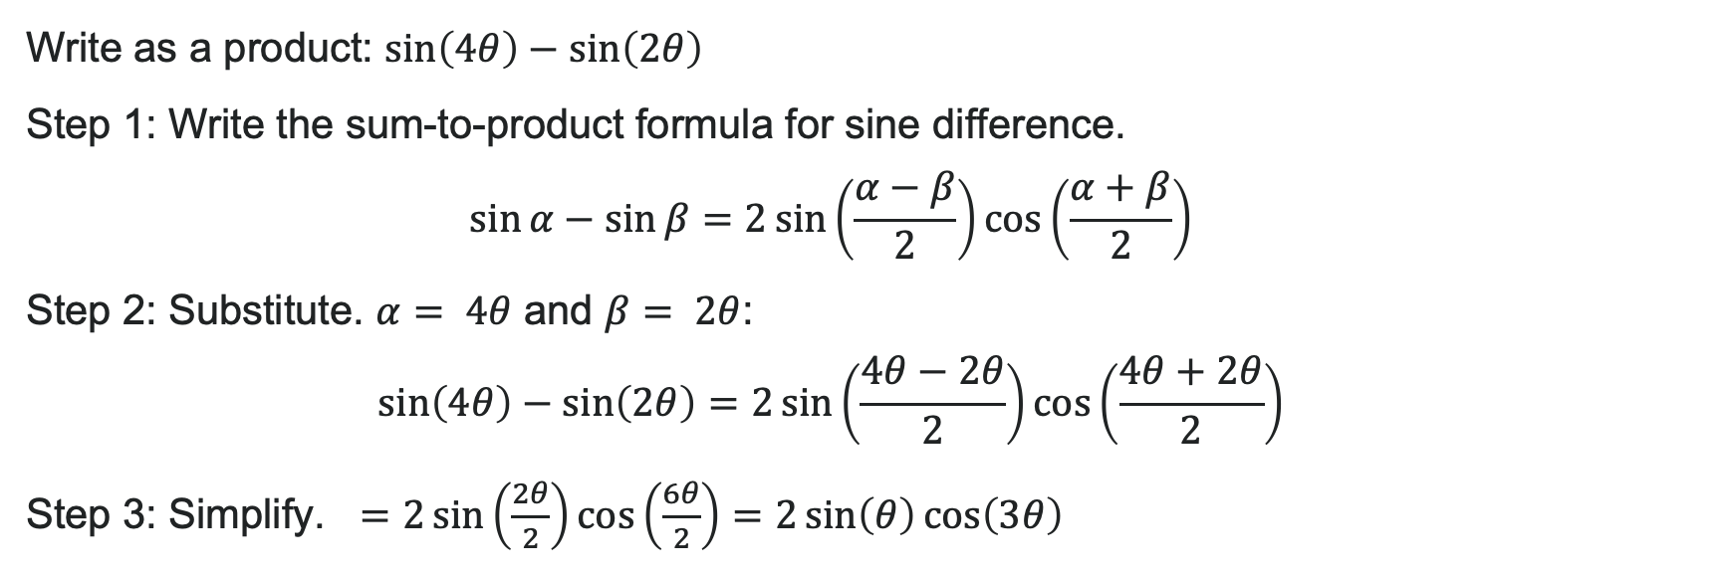
Example: Sum-to-Product for Sine Difference
Write as a product: $\sin\left(4θ\right)−\sin\left(2θ\right)$
Step 1: Write the sum-to-product formula for sine difference.
$\sin{α}−\sin{β}=2\sin\left(\frac{α−β}{2}\right)\cos\left(\frac{α+β}{2}\right)$
Step 2: Substitute. $α= 4θ$ and $β= 2θ$:
$\sin\left(4θ\right)−\sin\left(2θ\right)=2\sin\left(\frac{4θ−2θ}{2}\right)\cos\left(\frac{4θ+2θ}{2}\right)$
Step 3: Simplify. $=2\sin\left(\frac{2θ}{2}\right)\cos\left(\frac{6θ}{2}\right)=2\sin\left(θ\right)\cos\left(3θ\right)$

Slide 44
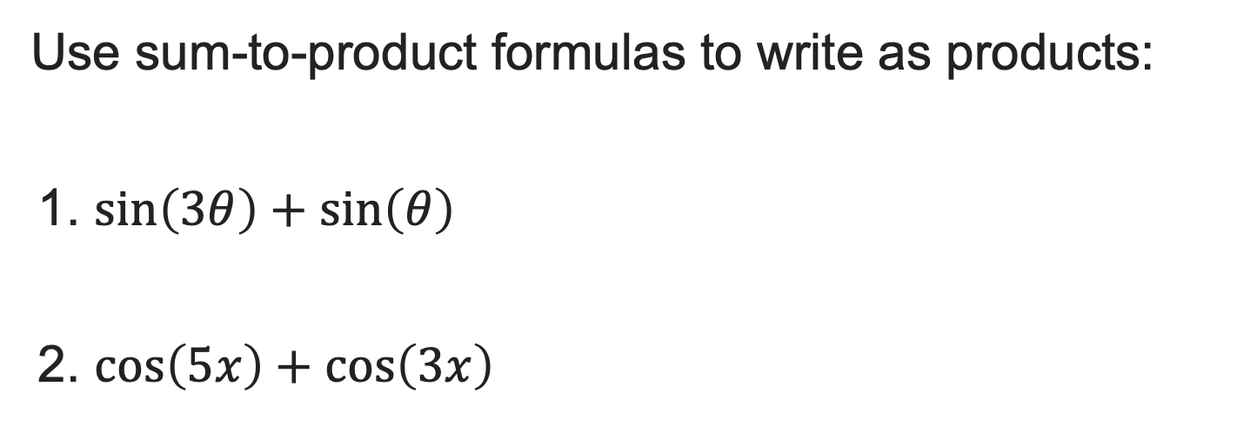
Try It: Sum-to-Product Formulas
Use sum-to-product formulas to write as products:
1. $\sin\left(3θ\right)+\sin\left(θ\right)$
2. $\cos\left(5x\right)+\cos\left(3x\right)$
Notes:
Answers:
\sin(3\theta) + \sin(\theta) = 2\sin\left(\frac{3\theta + \theta}{2}\right)\cos\left(\frac{3\theta - \theta}{2}\right) = 2\sin(2\theta)\cos(\theta)
\cos(5x) + \cos(3x) = 2\cos\left(\frac{5x + 3x}{2}\right)\cos\left(\frac{5x - 3x}{2}\right) = 2\cos(4x)\cos(x)

Slide 45
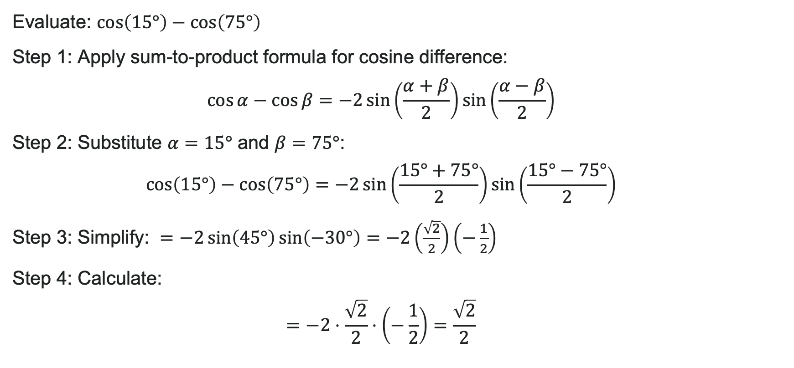
Example: Evaluating with Sum-to-Product
Evaluate: $\cos\left(15°\right)−\cos\left(75°\right)$
Step 1: Apply sum-to-product formula for cosine difference:
$\cos{α}−\cos{β}=−2\sin\left(\frac{α+β}{2}\right)\sin\left(\frac{α−β}{2}\right)$
Step 2: Substitute $α=15°$ and $β=75°$:
$\cos\left(15°\right)−\cos\left(75°\right)=−2\sin\left(\frac{15°+75°}{2}\right)\sin\left(\frac{15°−75°}{2}\right)$
Step 3: Simplify: $=−2\sin\left(45°\right)\sin\left(−30°\right)=−2\left(\frac{\sqrt{2}}{2}\right)\left(−\frac{1}{2}\right)$
Step 4: Calculate:
$$=−2⋅\frac{\sqrt{2}}{2}⋅\left(−\frac{1}{2}\right)=\frac{\sqrt{2}}{2}$$

Slide 46
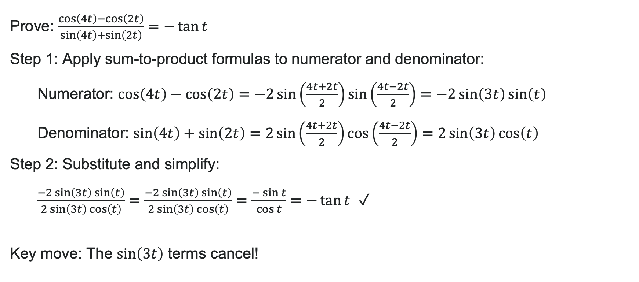
Example: Verifying an Identity
Prove: $\frac{\cos\left(4t\right)−\cos\left(2t\right)}{\sin\left(4t\right)+\sin\left(2t\right)}=−\tan{t}$
Step 1: Apply sum-to-product formulas to numerator and denominator:
Numerator: $\cos\left(4t\right)−\cos\left(2t\right)=−2\sin\left(\frac{4t+2t}{2}\right)\sin\left(\frac{4t−2t}{2}\right)=−2\sin\left(3t\right)\sin\left(t\right)$
Denominator: $\sin\left(4t\right)+\sin\left(2t\right)=2\sin\left(\frac{4t+2t}{2}\right)\cos\left(\frac{4t−2t}{2}\right)=2\sin\left(3t\right)\cos\left(t\right)$
Step 2: Substitute and simplify:
$\frac{−2\sin\left(3t\right)\sin\left(t\right)}{2\sin\left(3t\right)\cos\left(t\right)}=\frac{−2\sin\left(3t\right)\sin\left(t\right)}{2\sin\left(3t\right)\cos\left(t\right)}=\frac{−\sin{t}}{\cos{t}}=−\tan{t}$ ✓
Key move: The $\sin\left(3t\right)$ terms cancel!

Slide 47
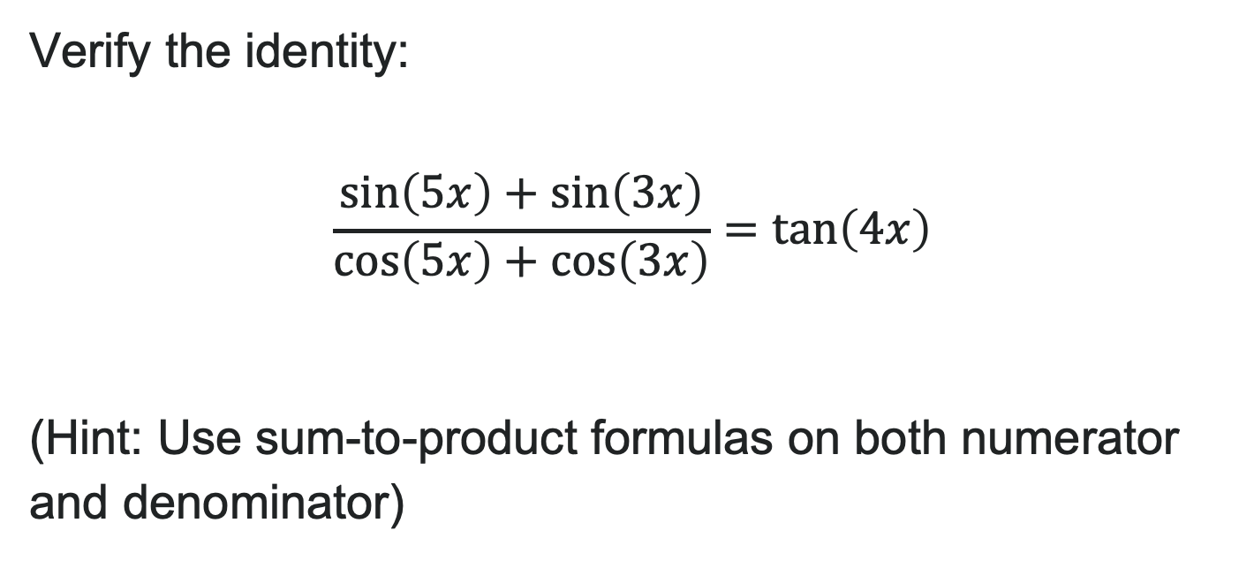
Try It: Verify the Trig Identity
Verify the identity:
$$\frac{\sin\left(5x\right)+\sin\left(3x\right)}{\cos\left(5x\right)+\cos\left(3x\right)}=\tan\left(4x\right)$$
(Hint: Use sum-to-product formulas on both numerator and denominator)
Notes:
Answer: Numerator: \sin(5x) + \sin(3x) = 2\sin(4x)\cos(x) Denominator: \cos(5x) + \cos(3x) = 2\cos(4x)\cos(x) Therefore: \frac{2\sin(4x)\cos(x)}{2\cos(4x)\cos(x)} = \frac{\sin(4x)}{\cos(4x)} = \tan(4x) ✓

Slide 48
Learning Goals: Solving Trigonometric Equations
Deepen your understanding and form connections within these skills:
1 Solve equations involving a single trigonometric function
2 Solve trigonometric equations that involve factoring
3 Solve trigonometric equations using fundamental identities
4 Solve trigonometric equations with multiple angles

Slide 49

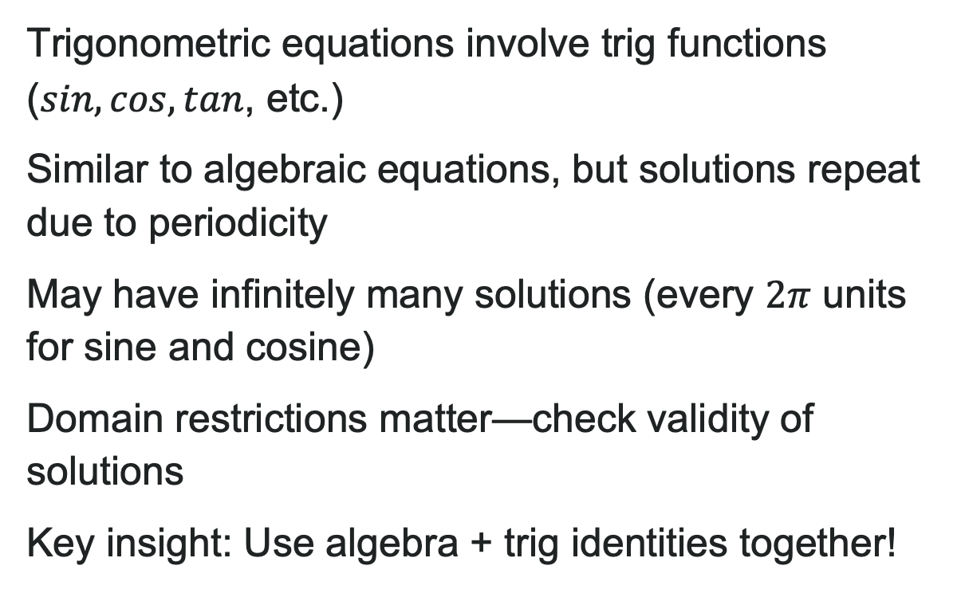
What Are Trigonometric Equations?
Trigonometric equations involve trig functions ($sin, cos, tan$, etc.)
Similar to algebraic equations, but solutions repeat due to periodicity
May have infinitely many solutions (every $2π$ units for sine and cosine)
Domain restrictions matter—check validity of solutions
Key insight: Use algebra + trig identities together!

Slide 50
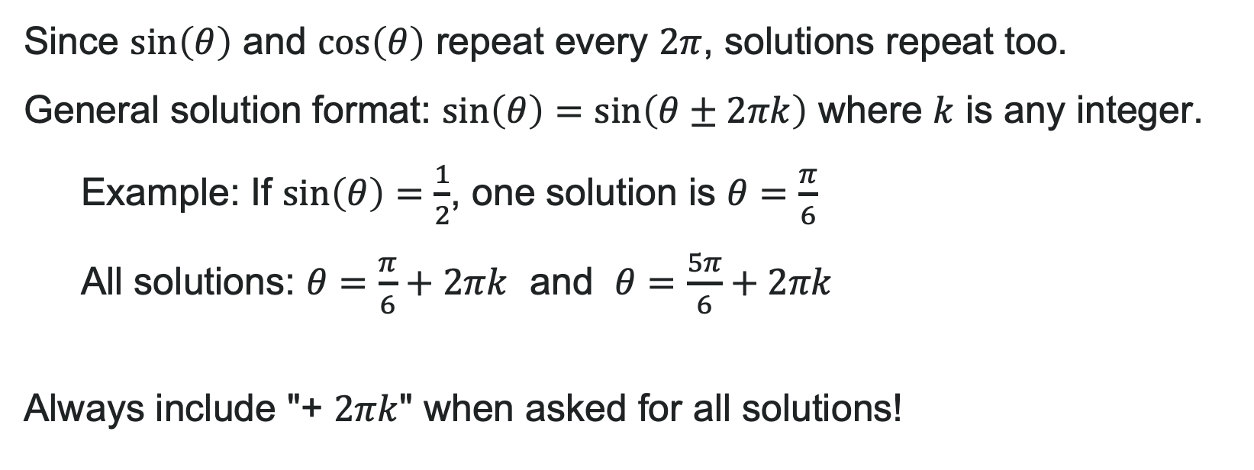
The Periodic Property
Since $\sin\left(θ\right)$ and $\cos\left(θ\right)$ repeat every $2π$, solutions repeat too.
General solution format: $\sin\left(θ\right)=\sin\left(θ±2πk\right)$ where $k$ is any integer.
Example: If $\sin\left(θ\right)=\frac{1}{2}$, one solution is $θ=\frac{π}{6}$
All solutions: $θ=\frac{π}{6}+2πk$ and $θ=\frac{5π}{6}+2πk$
Always include "+ $2πk$" when asked for all solutions!

Slide 51

Try It: Using the Periodic Property
Find all solutions to $\cos\left(θ\right)=−\frac{\sqrt{2}}{2}$ on the interval $\left[0,2π\right)$.
Notes:
Answer: \theta = \frac{3\pi}{4}, \frac{5\pi}{4}

Slide 52
How To: Solve Trigonometric Equations
Look for patterns: Difference of squares? Factoring opportunity?
Substitute: Replace trig expression with a variable (like u)
Solve algebraically: Treat it like any algebra equation
Substitute back: Put the trig function back in
Solve for the angle: Use unit circle or calculator
This is the same process you use for algebraic equations—trig is just another layer!

Slide 53


Example: Linear Equation (Single Function)
Solve $2\sin\left(x\right)−1=0$ on $\left[0,2π\right)$
Solution:
Step 1: Isolate the trig function:
$2\sin\left(x\right)=1$
$\sin\left(x\right)=\frac{1}{2}$
Step 2: Find angles from the unit circle:
Where is sine equal to $\frac{1}{2}$ ?
$x=\frac{π}{6}$ and $x=\frac{5π}{6}$
Final Answer: $x=\frac{π}{6},\frac{5π}{6}$

Slide 54
Try It: Solve Trigonometric Equations
Solve $3\cos\left(x\right)+2=0$ on $\left[0,2π\right)$.
Notes:
Answer: x = \frac{2\pi}{3}, \frac{4\pi}{3}

Slide 55
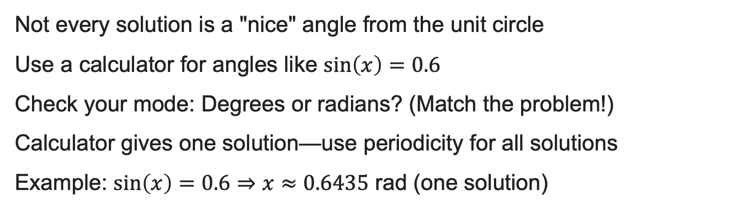
Using a Calculator to Solve Trig Equations
Not every solution is a "nice" angle from the unit circle
Use a calculator for angles like $\sin\left(x\right)=0.6$
Check your mode: Degrees or radians? (Match the problem!)
Calculator gives one solution—use periodicity for all solutions
Example: $\sin\left(x\right)=0.6⇒x≈0.6435$ rad (one solution)

Slide 56
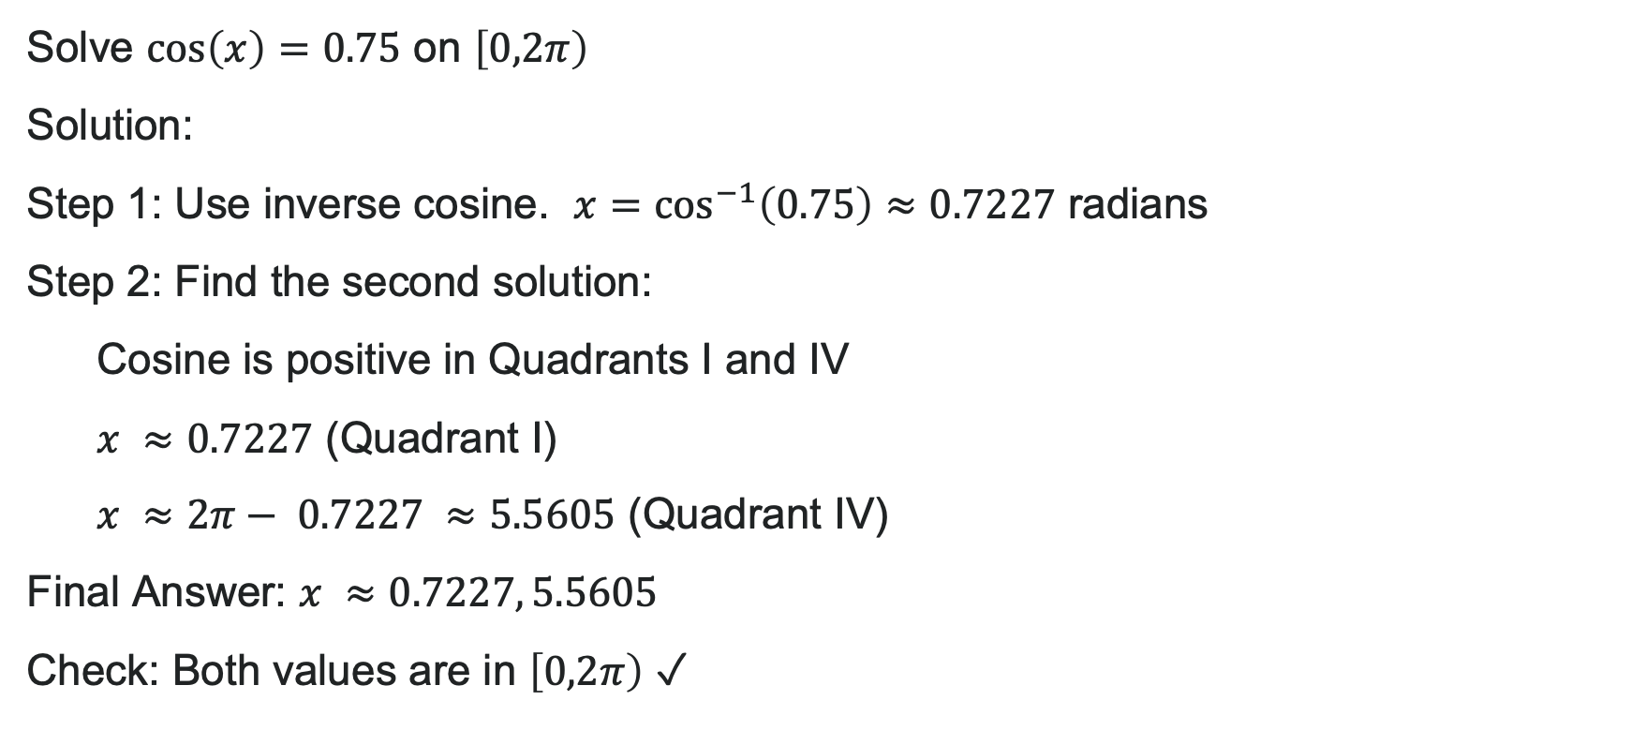
Example: Using a Calculator
Solve $\cos\left(x\right)=0.75$ on $\left[0,2π\right)$
Solution:
Step 1: Use inverse cosine. $x=\cos^{−1}\left(0.75\right)≈0.7227$ radians
Step 2: Find the second solution:
Cosine is positive in Quadrants I and IV
$x ≈0.7227$ (Quadrant I)
$x ≈2π− 0.7227 ≈5.5605$ (Quadrant IV)
Final Answer: $x ≈0.7227, 5.5605$
Check: Both values are in $\left[0,2π\right)$ ✓

Slide 57
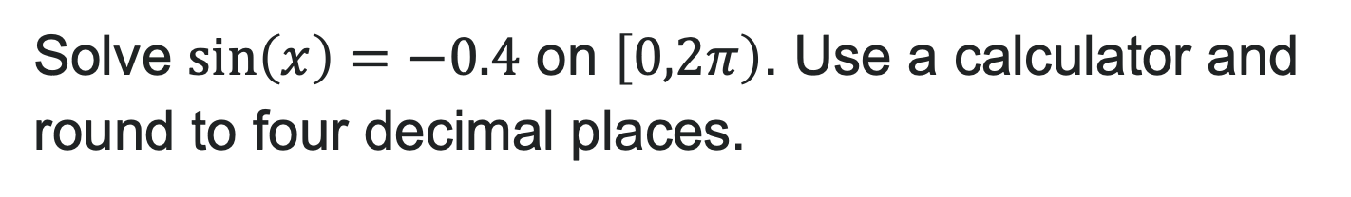
Try It: Use a Calculator
Solve $\sin\left(x\right)=−0.4$ on $\left[0,2π\right)$. Use a calculator and round to four decimal places.
Notes:
Answer: x \approx 3.5536, 5.8712

Slide 58

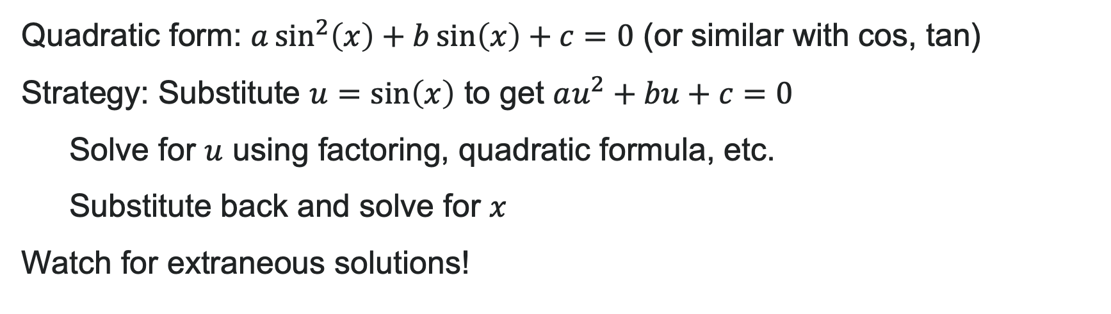
Quadratic Trigonometric Equations
Quadratic form: $a\sin^{2}\left(x\right)+b\sin\left(x\right)+c=0$ (or similar with cos, tan)
Strategy: Substitute $u=\sin\left(x\right)$ to get $au^{2}+bu+c=0$
  Solve for $u$ using factoring, quadratic formula, etc.
  Substitute back and solve for $x$
Watch for extraneous solutions!

Slide 59
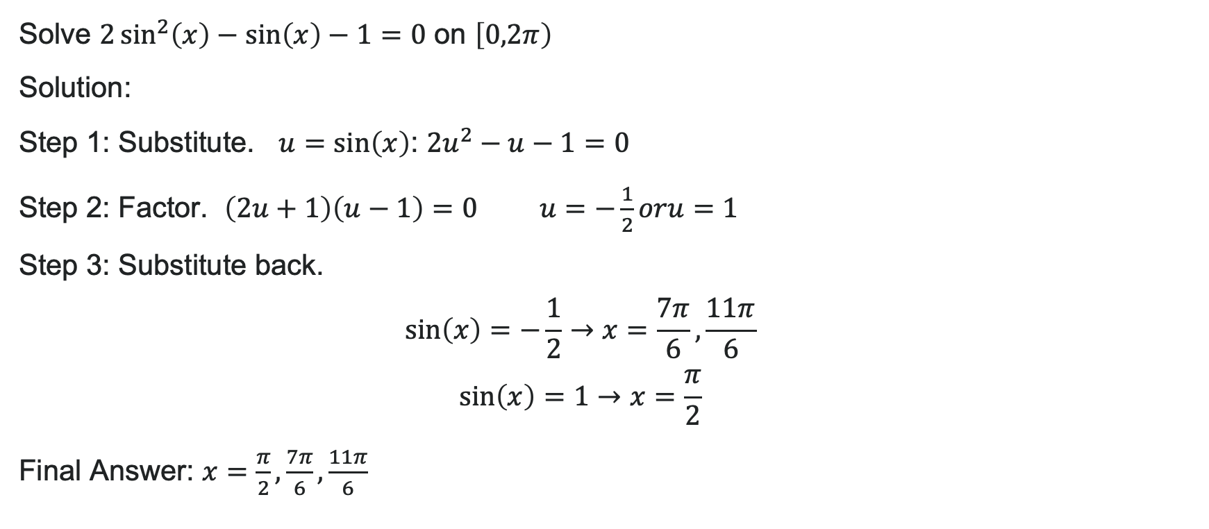
Example: Quadratic Form
Solve $2\sin^{2}\left(x\right)−\sin\left(x\right)−1=0$ on $\left[0,2π\right)$
Solution:
Step 1: Substitute. $u=\sin\left(x\right)$: $2u^{2}−u−1=0$
Step 2: Factor. $\left(2u+1\right)\left(u−1\right)=0$ $u=−\frac{1}{2}oru=1$
Step 3: Substitute back.
Final Answer: $x=\frac{π}{2},\frac{7π}{6},\frac{11π}{6}$

Slide 60
Try It: Quadratic Trigonometric Equations
Solve $\cos^{2}\left(x\right)−\cos\left(x\right)=0$ on $\left[0,2π\right)$
Notes:
Answer: x = 0, \frac{\pi}{2}, \frac{3\pi}{2}

Slide 61
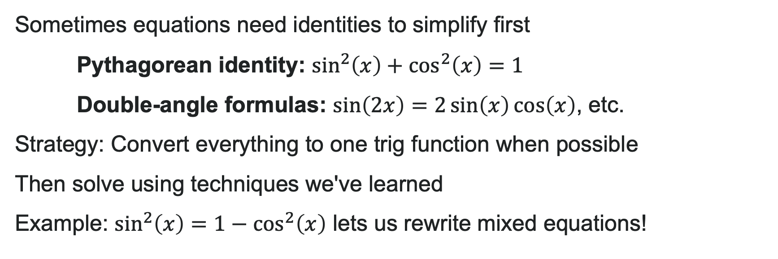
Using Identities to Simplify
Sometimes equations need identities to simplify first
Pythagorean identity: $\sin^{2}\left(x\right)+\cos^{2}\left(x\right)=1$
Double-angle formulas: $\sin\left(2x\right)=2\sin\left(x\right)\cos\left(x\right)$, etc.
Strategy: Convert everything to one trig function when possible
Then solve using techniques we've learned
Example: $\sin^{2}\left(x\right)=1−\cos^{2}\left(x\right)$ lets us rewrite mixed equations!

Slide 62
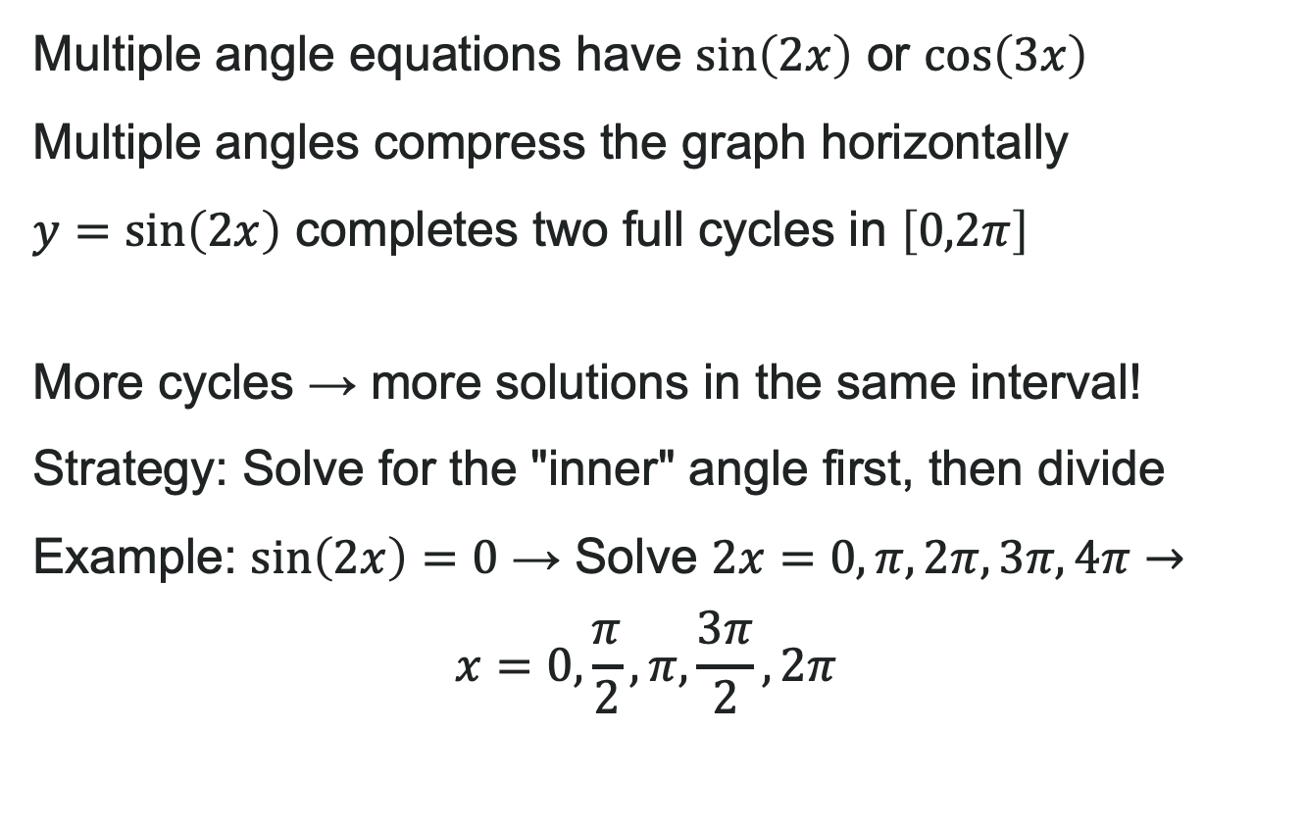
Multiple Angle Equations
Multiple angle equations have $\sin\left(2x\right)$ or $\cos\left(3x\right)$
Multiple angles compress the graph horizontally
$y=\sin\left(2x\right)$ completes two full cycles in $\left[0,2π\right]$
More cycles → more solutions in the same interval!
Strategy: Solve for the "inner" angle first, then divide
Example: $\sin\left(2x\right)=0$ → Solve $2x=0,π,2π,3π,4π→$
$$x=0,\frac{π}{2},π,\frac{3π}{2},2π$$

Slide 63

Try It: Multiple Angles
Solve $\cos\left(2x\right)=\frac{1}{2}$ on $\left[0,2π\right)$
Notes:
Answer: x = \frac{\pi}{6}, \frac{5\pi}{6}, \frac{7\pi}{6}, \frac{11\pi}{6}
(Hint: Solve 2x = \frac{\pi}{3}, \frac{5\pi}{3}, \frac{7\pi}{3}, \frac{11\pi}{3}, then divide by 2):

Slide 64
Learning Goals: Modeling with Trigonometric Equations
Deepen your understanding and form connections within these skills:
1 Determine the amplitude and period of a periodic context
2 Model periodic behavior with sinusoidal functions
3 Write both a sine and cosine function to model the same periodic behavior

Slide 65
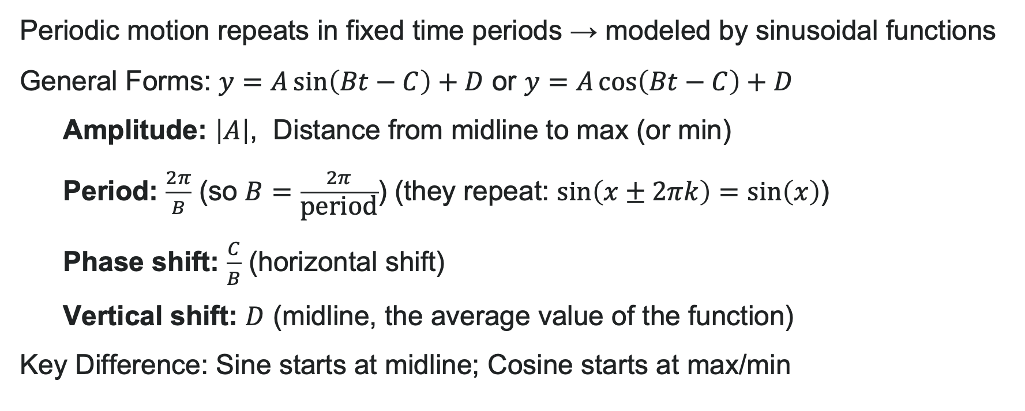
Modeling Periodic Behavior
Periodic motion repeats in fixed time periods → modeled by sinusoidal functions
General Forms: $y=A\sin\left(Bt−C\right)+D$ or $y=A\cos\left(Bt−C\right)+D$
  Amplitude: $\left|A\right|$, Distance from midline to max (or min)
  Period: $\frac{2π}{B}$ (so $B=\frac{2π}{\text{period}}$) (they repeat: $\sin\left(x±2πk\right)=\sin\left(x\right)$)
  Phase shift: $\frac{C}{B}$ (horizontal shift)
  Vertical shift: $D$ (midline, the average value of the function)
Key Difference: Sine starts at midline; Cosine starts at max/min

Slide 66
Try It: Periodic General Form
A function has a maximum value of 18 and a minimum value of 6. The function repeats every 10 units. Find:
The amplitude
The midline (vertical shift)
The value of B
Notes:
Answers:
Amplitude = \frac{18-6}{2} = 6
Midline = \frac{18+6}{2} = 12
B = \frac{2\pi}{10} = \frac{\pi}{5}

Slide 67
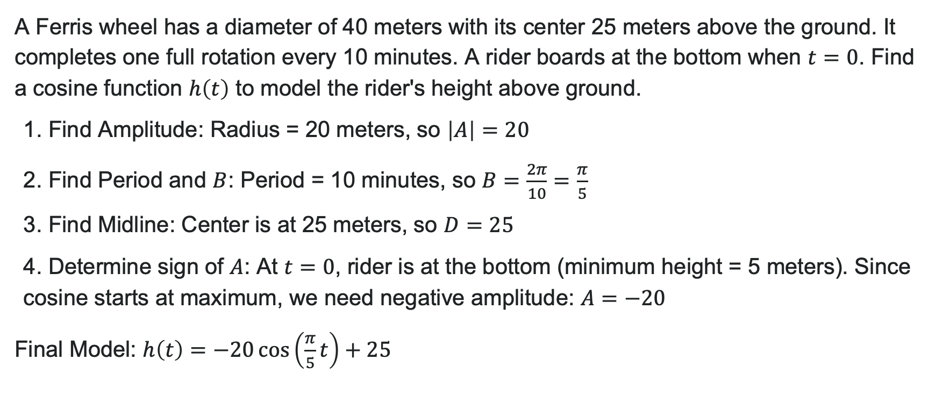
Example: Ferris Wheel Height
A Ferris wheel has a diameter of 40 meters with its center 25 meters above the ground. It completes one full rotation every 10 minutes. A rider boards at the bottom when $t=0$. Find a cosine function $h\left(t\right)$ to model the rider's height above ground.
1. Find Amplitude: Radius = 20 meters, so $\left|A\right|=20$
2. Find Period and $B$: Period = 10 minutes, so $B=\frac{2π}{10}=\frac{π}{5}$
3. Find Midline: Center is at 25 meters, so $D=25$
4. Determine sign of $A$: At $t=0$, rider is at the bottom (minimum height = 5 meters). Since cosine starts at maximum, we need negative amplitude: $A=−20$
Final Model: $h\left(t\right)=−20\cos\left(\frac{π}{5}t\right)+25$
Notes:
Verification:
At t = 0: h(0) = -20(1) + 25 = 5 meters ✓ (bottom)
At t = 5: h(5) = -20\cos(\pi) + 25 = -20(-1) + 25 = 45 meters ✓ (top)

Slide 68
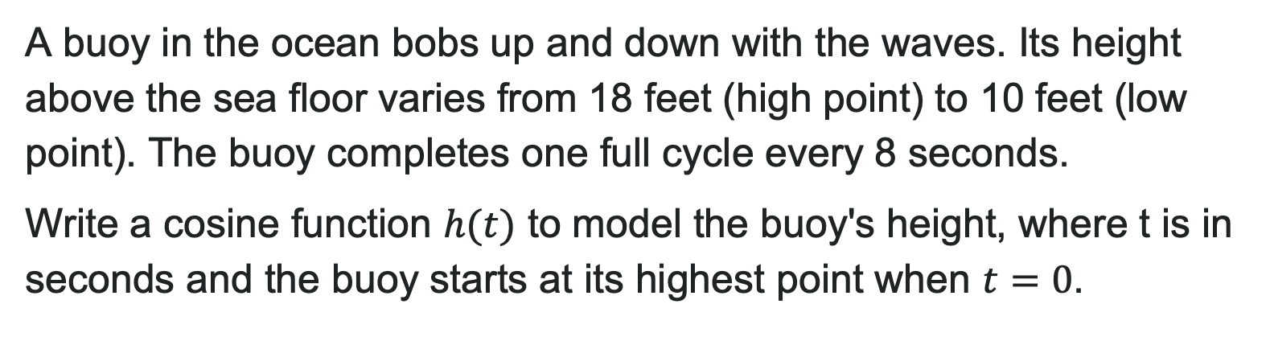
Try It: Modeling Periodic Behavior
A buoy in the ocean bobs up and down with the waves. Its height above the sea floor varies from 18 feet (high point) to 10 feet (low point). The buoy completes one full cycle every 8 seconds.
Write a cosine function $h(t)$ to model the buoy's height, where t is in seconds and the buoy starts at its highest point when $t=0$.
Notes:
Answer: h(t) = 4\cos(\frac{\pi}{4}t) + 14
(Amplitude = 4, Period = 8 so B = \frac{\pi}{4}, Midline = 14, starts at max so positive cosine)

Slide 69

Sine vs. Cosine—Which to Use?
Both sine and cosine model the same periodic behavior!
Key difference: Where they start at $t=0$
  Cosine starts at maximum (or minimum with negative $A$)
  Sine starts at the midline, crossing upward
Strategy: Pick the function that matches your starting point
They're related: $\cos\left(x\right)=\sin\left(x+\frac{π}{2}\right)and\sin\left(x\right)=\cos\left(x−\frac{π}{2}\right)$
Pro tip: Choose whichever makes your math simpler!

Slide 70

Try It: Sine vs. Cosine
The average monthly rainfall in a tropical region varies from 2 inches (minimum in February, month 2) to 14 inches (maximum in August, month 8). The pattern repeats annually. Let $m$ represent the month number (1-12).
Write both a cosine function and a sine function to model rainfall $R(m)$.
Notes:
Answers:
Amplitude = 6, Midline = 8, B = \frac{\pi}{6} (period = 12)
Cosine: R(m) = -6\cos(\frac{\pi}{6}(m - 2)) + 8 (min at m=2)
Sine: R(m) = 6\sin(\frac{\pi}{6}(m - 5)) + 8 (adjusted for max at m=8)

Slide 71


Simple Harmonic Motion
Harmonic motion involves a restoring force (like a spring pulling back)
Simple harmonic motion: Assumes motion continues forever (no friction)
Displacement from equilibrium: $d=a\cos\left(ωt\right)$ or $d=a\sin\left(ωt\right)$
Parameters:
  $\left|a\right|=$ maximum displacement (amplitude)
  Period = $\frac{2π}{ω}$
  Frequency = $\frac{ω}{2π}$ (cycles per unit time)

Slide 72

Example: Vibrating Guitar String
A guitar string vibrates with displacement $d=0.8\sin\left(880πt\right)$ mm, where $t$ is in seconds. Find:
1. Maximum displacement: $|a|=0.8$ mm
2. Period: $\frac{2π}{ω}=\frac{2π}{880π}=\frac{1}{440}$ seconds
3. Frequency: $\frac{ω}{2π}=\frac{880π}{2π}=440$ Hz (A note!)
4. When does it first reach $d=0.4$ mm (while increasing)?
Solving for $t$:
seconds

Slide 73

Try It: Mass on a Spring
A mass on a spring oscillates with position $y=15\cos\left(4πt\right)$ cm, where $t$ is in seconds. Find:
1. amplitude
2. period
3. frequency
4. position at $t=0.5$ seconds
Notes:
Answers:
Amplitude = 15 cm
Period = \frac{2\pi}{4\pi} = 0.5 seconds
Frequency = \frac{4\pi}{2\pi} = 2 cycles per second
At t = 0.5: y = 15\cos(2\pi) = 15 cm

Slide 74

Damped Harmonic Motion
Real springs and pendulums don't oscillate forever—friction dampens them
Damped harmonic motion: Energy decreases over time
Model: $f\left(t\right)=ae^{−ct}\sin\left(ωt\right)$ or $f\left(t\right)=ae^{−ct}\cos\left(ωt\right)$
Parameters:
  $c$ = damping constant (larger c = faster decay)
  $a$ = initial displacement
  Period still = $\frac{2π}{ω}$
Watch this! The amplitude envelope $ae^{−ct}$ decreases exponentially

Slide 75

Example: Damped Motion
A pendulum is released from 20 cm displacement. It has a natural frequency of 0.75 cycles per second and a damping constant of $c=0.4$. Write the damped motion equation.
Solution:
Find $ω$: Frequency = $\frac{ω}{2π}=0.75→ω=1.5π$
Initial displacement $a=20$ cm
At $t=0$, displacement is at maximum, so use cosine
Model: $d\left(t\right)=20e^{−0.4t}\cos\left(1.5πt\right)$
What happens? After 5 seconds: $d\left(5\right)=20e^{−2}\cos\left(7.5π\right)≈20\left(0.135\right)\left(−1\right)≈−2.7$ cm
(Amplitude has decayed to about 13.5% of original!)

Slide 76

Try It: Damped Motion
A shock absorber on a car compresses 8 cm initially and oscillates with damping constant 0.6. The period of oscillation is 1.5 seconds.
Write a damped harmonic motion equation using the form $y=ae^{−ct}\cos\left(ωt\right)$.
Notes:
Answer: First find \omega: Period = \frac{2\pi}{\omega} = 1.5 → \omega = \frac{4\pi}{3}
Function: y = 8e^{-0.6t}\cos(\frac{4\pi}{3}t)

Slide 77


Bounding Curves
Some functions have varying amplitude (rises and falls multiple times)
Example: $f\left(x\right)=\cos\left(x\right)\cos\left(10x\right)$ oscillates inside a "bounding envelope"
Bounding curves: $y=\cos\left(x\right)$ and $y=−\cos\left(x\right)$ trace the high/low points
The fast oscillation $\left(\cos\left(10x\right)\right)$ happens inside the slow envelope $\left(\cos\left(x\right)\right)$
This creates a wave pattern that looks like it "breathes"!
Real applications:
  AM radio signal modulation
  Beat frequencies in music
  Interference patterns in physics

Slide 78

Try It: Bounding Curves
An object vibrates in damped harmonic motion. Initially displaced 12 cm, after 5 seconds the amplitude has decreased to 4 cm.
Find the damping constant $c$.
(Hint: What fraction of the original amplitude remains?)
Notes:
Answer: Amplitude ratio = \frac{4}{12} = \frac{1}{3}
Set up: e^{-5c} = \frac{1}{3}
e^{5c} = 3
5c = \ln(3)
c = \frac{\ln(3)}{5} \approx 0.220 per second

Slide 79
Before we finish up…
2
Next steps…..
3
Reminders about student hours, upcoming deadlines, campus activities ….
1
Questions…..

