Slide 1

Precalculus
Module 12:
Probability and Counting Theory

Slide 2
Affirmations
I am consistent, capable, and committed to my goals.
I grow through the questions I ask.
I improve my math confidence each time I practice.

Slide 3
Learning Goals: Counting Principles
Deepen your understanding and form connections within these skills:
1 Solve counting problems using the Addition and Multiplication Principles
2 Solve counting problems using permutations and combinations
3 Solve counting problems using permutations involving n non-distinct objects

Slide 4

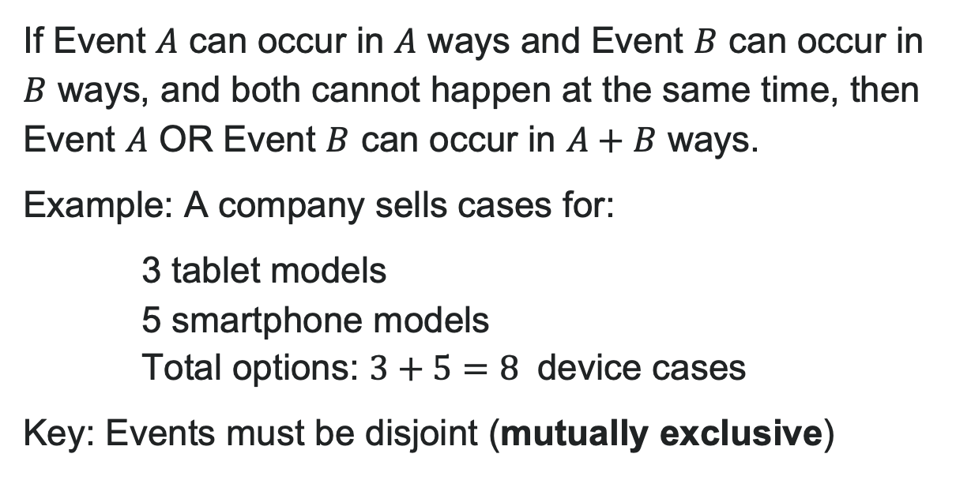
Addition Principle (Mutually Exclusive Events)
If Event $A$ can occur in $A$ ways and Event $B$ can occur in $B$ ways, and both cannot happen at the same time, then Event $A$ OR Event $B$ can occur in $A+B$ ways.
Example: A company sells cases for:
3 tablet models
5 smartphone models
Total options: $3+5=8$ device cases
Key: Events must be disjoint (mutually exclusive)

Slide 5
Try It: Addition Principle
A bakery offers breakfast pastries:
5 types of muffins
6 types of donuts
A customer will choose either a muffin OR a donut (not both).
How many different pastry choices does the customer have?
Notes:
Answer: 11 choices (using Addition Principle: 5 + 6 = 11)

Slide 6

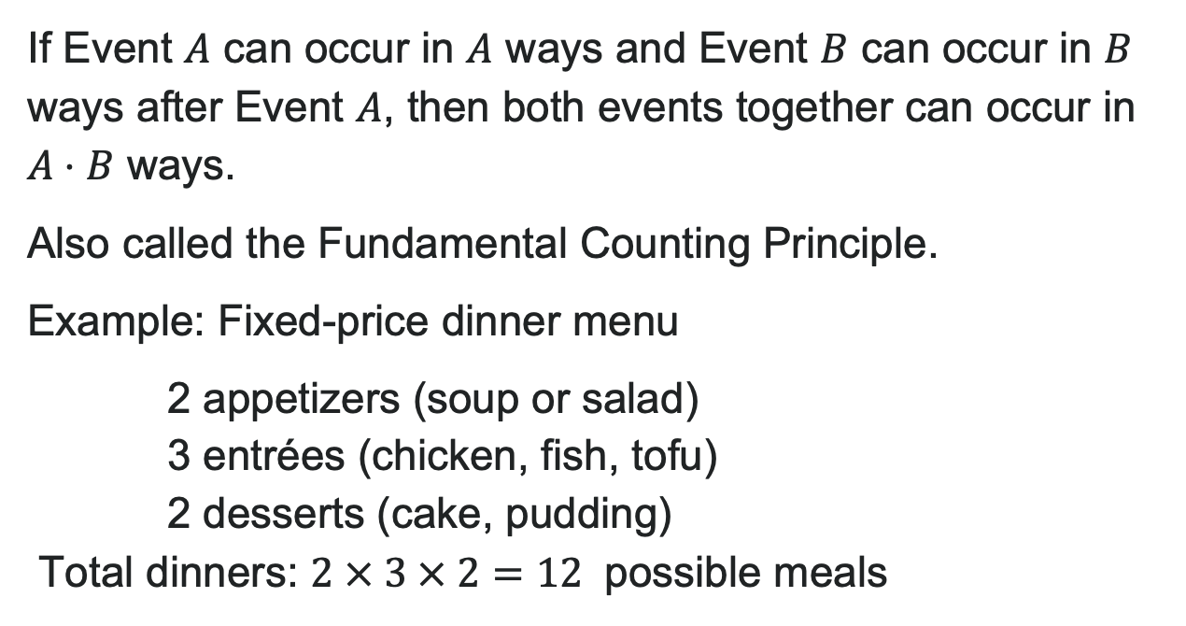
Multiplication Principle (Sequential Choices)
If Event $A$ can occur in $A$ ways and Event $B$ can occur in $B$ ways after Event $A$, then both events together can occur in $A⋅B$ ways.
Also called the Fundamental Counting Principle.
Example: Fixed-price dinner menu
2 appetizers (soup or salad)
3 entrées (chicken, fish, tofu)
2 desserts (cake, pudding)
Total dinners: $2 × 3 × 2=12$ possible meals

Slide 7
Try It: Multiplication Principle
A sandwich shop offers lunch combos:
5 types of sandwiches
3 types of chips
4 types of drinks
How many different lunch combos can be ordered?
Notes:
Answer: 60 combos
Calculation: 5 \times 3 \times 4 = 60

Slide 8
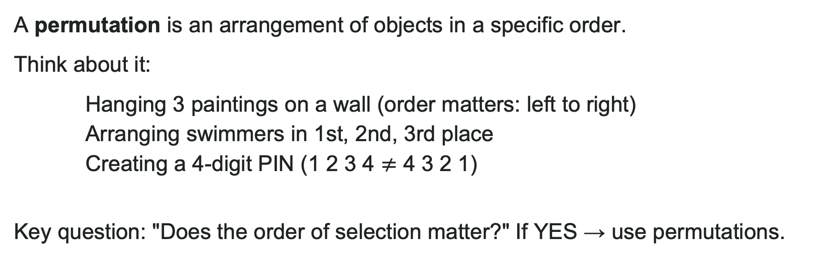
Permutations: When Order Matters
A permutation is an arrangement of objects in a specific order.
Think about it:
Hanging 3 paintings on a wall (order matters: left to right)
Arranging swimmers in 1st, 2nd, 3rd place
Creating a 4-digit PIN (1 2 3 4 $≠$ 4 3 2 1)
Key question: "Does the order of selection matter?" If YES → use permutations.

Slide 9
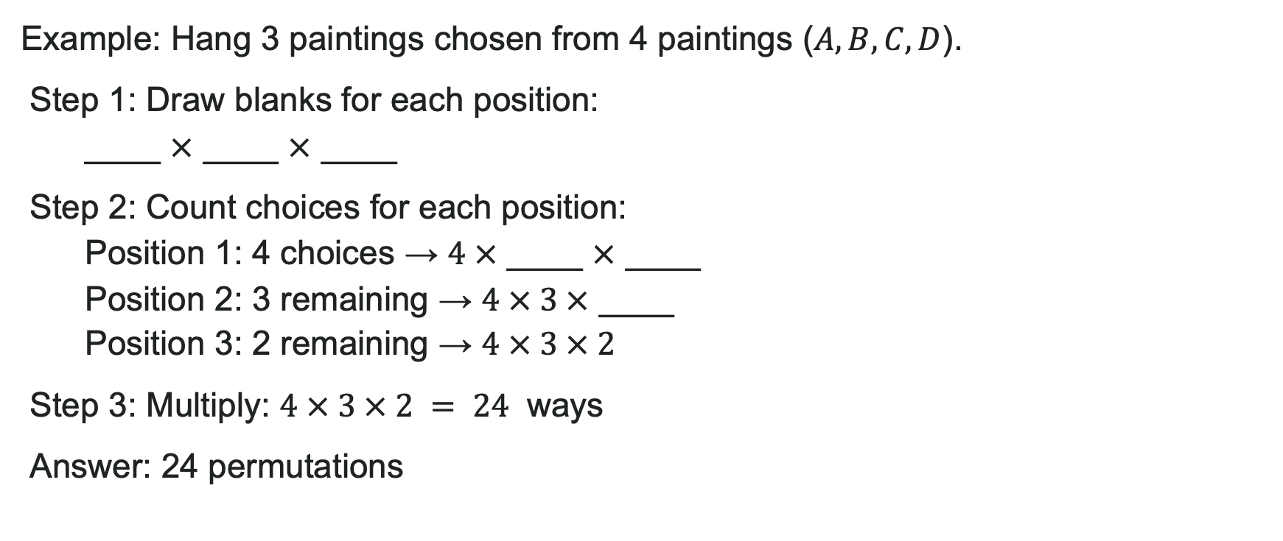
Permutations Using Multiplication Principle
Example: Hang 3 paintings chosen from 4 paintings ($A, B, C, D$).
Step 1: Draw blanks for each position:
____ $×$ ____ $×$ ____
Step 2: Count choices for each position:
Position 1: 4 choices → $4 ×$ ____ $×$ ____
Position 2: 3 remaining → $4 × 3 ×$ ____
Position 3: 2 remaining → $4 × 3 × 2$
Step 3: Multiply: $4 × 3 × 2 = 24$ ways
Answer: 24 permutations

Slide 10
Try It: Permutation
A teacher is arranging 5 students in a row for a photo. How many different arrangements are possible?
Notes:
Answer: 120 arrangements
Calculation: 5! = 5 \times 4 \times 3 \times 2 \times 1 = 120

Slide 11
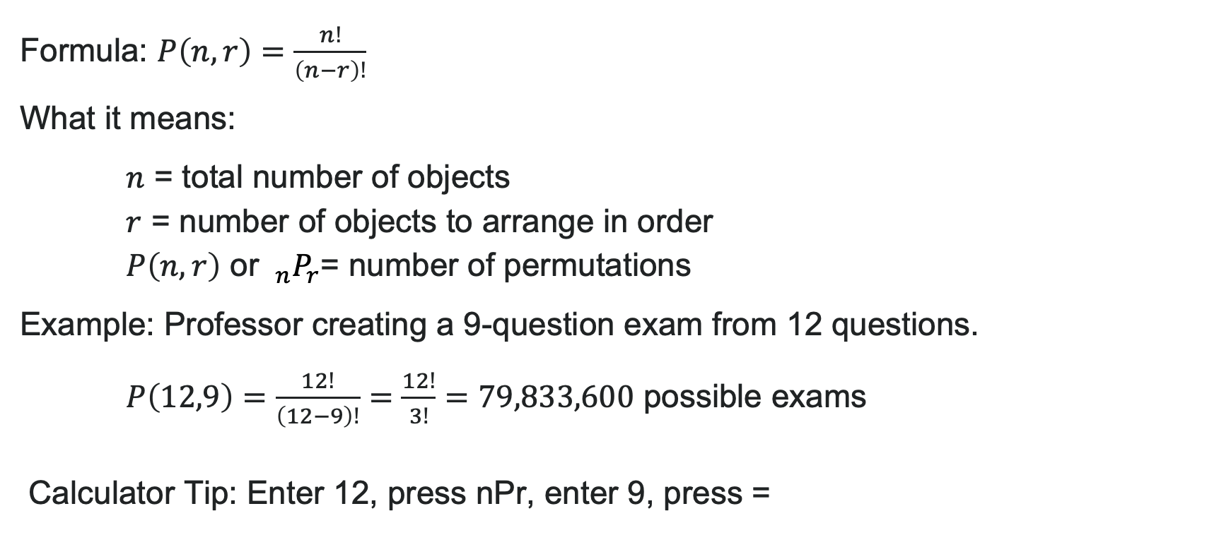
Permutation Formula
Formula: $P\left(n,r\right)=\frac{n!}{\left(n−r\right)!}$
What it means:
$n$ = total number of objects
$r$ = number of objects to arrange in order
$P\left(n,r\right)$ or $_{n}P_{r}$= number of permutations
Example: Professor creating a 9-question exam from 12 questions.
$P\left(12,9\right)=\frac{12!}{\left(12−9\right)!}=\frac{12!}{3!}=79,833,600$ possible exams
Calculator Tip: Enter 12, press nPr, enter 9, press =

Slide 12
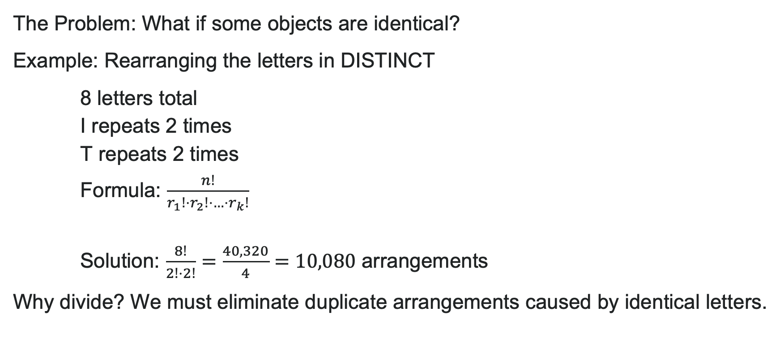
Permutations of Non-Distinct Objects
The Problem: What if some objects are identical?
Example: Rearranging the letters in DISTINCT
8 letters total
I repeats 2 times
T repeats 2 times
Formula: $\frac{n!}{r_{1}!⋅r_{2}!⋅…⋅r_{k}!}$
Solution: $\frac{8!}{2!⋅2!}=\frac{40,320}{4}=10,080$ arrangements
Why divide? We must eliminate duplicate arrangements caused by identical letters.

Slide 13
Try It: Permutations of Non-Distinct Objects
How many ways can you rearrange the letters in the word MISSISSIPPI?
Notes:
Answer: 34,650 arrangements
Calculation: 11 letters total; M(1), I(4), S(4), P(2)
\frac{11!}{1! \cdot 4! \cdot 4! \cdot 2!} = \frac{39,916,800}{1,152} = 34,650

Slide 14
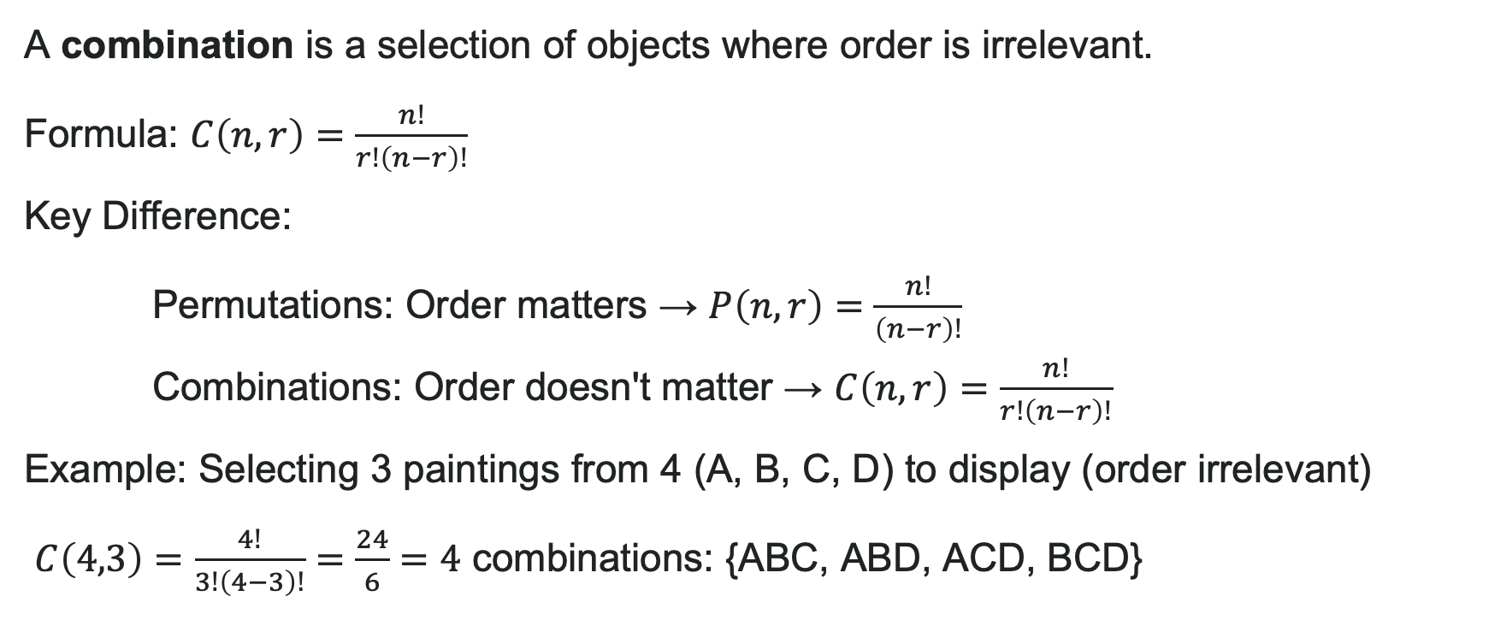
Combinations: When Order Doesn't Matter
A combination is a selection of objects where order is irrelevant.
Formula: $C\left(n,r\right)=\frac{n!}{r!\left(n−r\right)!}$
Key Difference:
Permutations: Order matters → $P\left(n,r\right)=\frac{n!}{\left(n−r\right)!}$
Combinations: Order doesn't matter → $C\left(n,r\right)=\frac{n!}{r!\left(n−r\right)!}$
Example: Selecting 3 paintings from 4 (A, B, C, D) to display (order irrelevant)
$C\left(4,3\right)=\frac{4!}{3!\left(4−3\right)!}=\frac{24}{6}=4$ combinations: {ABC, ABD, ACD, BCD}

Slide 15
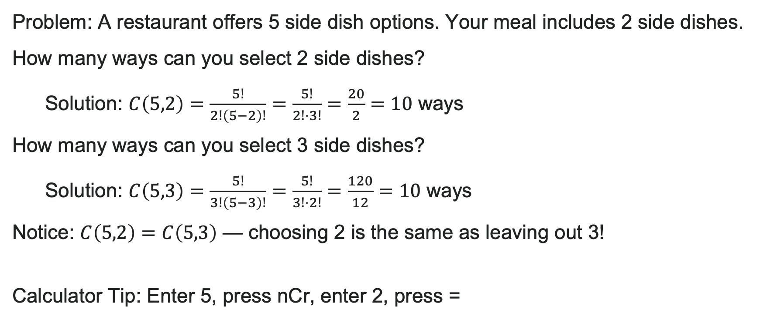
Example: Side Dish Combinations
Problem: A restaurant offers 5 side dish options. Your meal includes 2 side dishes.
How many ways can you select 2 side dishes?
Solution: $C\left(5,2\right)=\frac{5!}{2!\left(5−2\right)!}=\frac{5!}{2!⋅3!}=\frac{20}{2}=10$ ways
How many ways can you select 3 side dishes?
Solution: $C\left(5,3\right)=\frac{5!}{3!\left(5−3\right)!}=\frac{5!}{3!⋅2!}=\frac{120}{12}=10$ ways
Notice: $C\left(5,2\right)=C\left(5,3\right)$ — choosing 2 is the same as leaving out 3!
Calculator Tip: Enter 5, press nCr, enter 2, press =

Slide 16
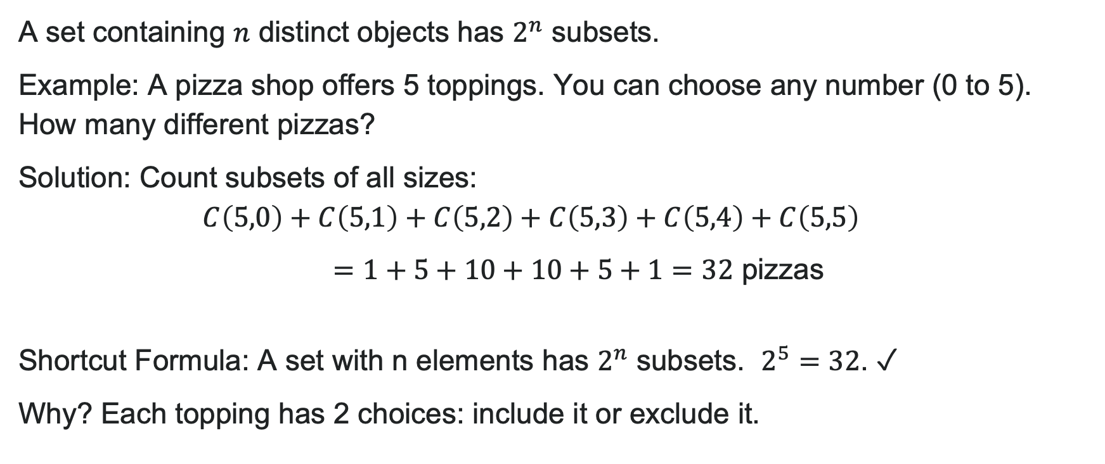
Subsets of a Set
A set containing $n$ distinct objects has $2^{n}$ subsets.
Example: A pizza shop offers 5 toppings. You can choose any number (0 to 5). How many different pizzas?
Solution: Count subsets of all sizes:
pizzas
Shortcut Formula: A set with n elements has $2^{n}$ subsets. $2^{5}=32$. ✓
Why? Each topping has 2 choices: include it or exclude it.

Slide 17
Try It: Subsets of a Set
A social media app offers 4 optional notification settings:
Comments, Likes, Messages, Friend Requests
You can enable any combination of these notifications (or disable them all).
How many different notification configurations are possible?
Notes:
Answer: 16 different configurations
Calculation: 2^4 = 16

Slide 18
Learning Goals: Binomial Theorem
Deepen your understanding and form connections within these skills:
1 Use the Binomial Theorem to expand a binomial
2 Use the Binomial Theorem to find a specified term of a binomial expansion

Slide 19
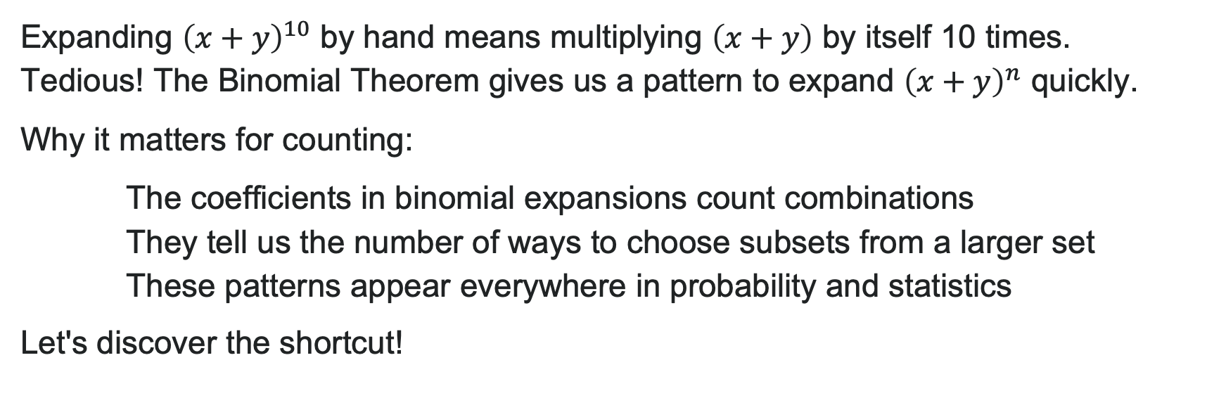
Introduction to Binomial Theorem
Expanding ${\left(x+y\right)}^{10}$ by hand means multiplying $\left(x+y\right)$ by itself 10 times. Tedious! The Binomial Theorem gives us a pattern to expand ${\left(x+y\right)}^{n}$ quickly.
Why it matters for counting:
The coefficients in binomial expansions count combinations
They tell us the number of ways to choose subsets from a larger set
These patterns appear everywhere in probability and statistics
Let's discover the shortcut!

Slide 20
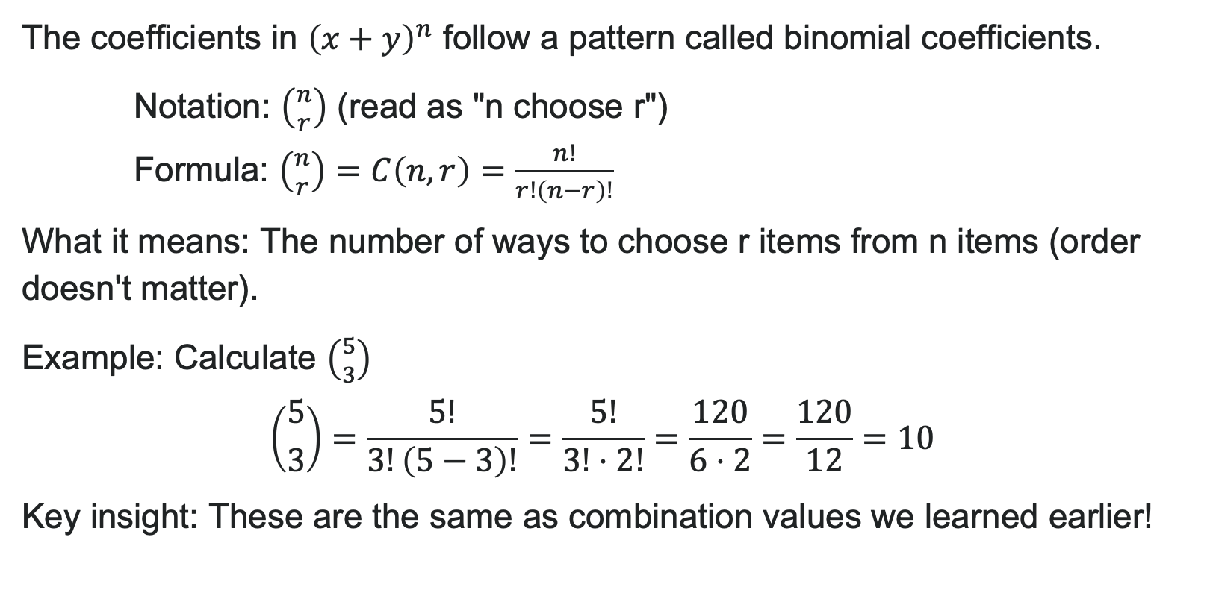
Binomial Coefficients
The coefficients in ${\left(x+y\right)}^{n}$ follow a pattern called binomial coefficients.
Notation: $\left({n \atop r}\right)$ (read as "n choose r")
Formula: $\left({n \atop r}\right)=C\left(n,r\right)=\frac{n!}{r!\left(n−r\right)!}$
What it means: The number of ways to choose r items from n items (order doesn't matter).
Example: Calculate $\left({5 \atop 3}\right)$
$\left({5 \atop 3}\right)=\frac{5!}{3!\left(5−3\right)!}=\frac{5!}{3!⋅2!}=\frac{120}{6⋅2}=\frac{120}{12}=10$
Key insight: These are the same as combination values we learned earlier!

Slide 21
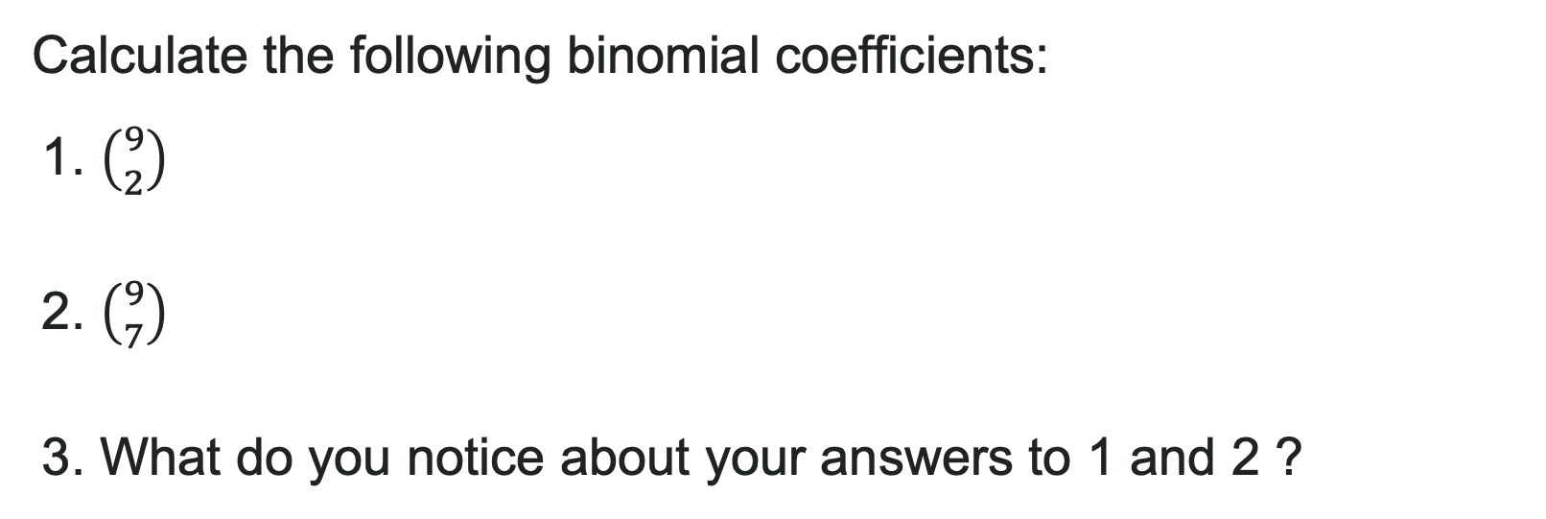
Try It: Binomial Coefficients
Calculate the following binomial coefficients:
1. $\left({9 \atop 2}\right)$
2. $\left({9 \atop 7}\right)$
3. What do you notice about your answers to 1 and 2 ?
Notes:
Answer:
\binom{9}{2} = \frac{9!}{2! \cdot 7!} = \frac{9 \times 8}{2 \times 1} = \frac{72}{2} = 36
\binom{9}{7} = \frac{9!}{7! \cdot 2!} = \frac{9 \times 8}{2 \times 1} = \frac{72}{2} = 36
They're equal! This demonstrates the symmetry property: \binom{n}{r} = \binom{n}{n-r} Choosing 2 items from 9 is the same as leaving out 7 items.

Slide 22


Binomial Theorem
The Binomial Theorem is a formula that can be used to expand any binomial.
The Formula: ${\left(x+y\right)}^{n}=\sum_{k=0}^{n}{\left({n \atop k}\right)}x^{n−k}y^{k}$
Expanded form: ${\left(x+y\right)}^{n}=x^{n}+\left({n \atop 1}\right)x^{n−1}y+\left({n \atop 2}\right)x^{n−2}y^{2}+⋯+\left({n \atop n−1}\right)xy^{n−1}+y^{n}$
What it means:
$n$ = the power you're raising the binomial to
$k$ = the term number (starts at 0, goes to n)
$\left({n \atop k}\right)$ = the coefficient for each term
Powers of $x$ decrease; powers of $y$ increase
This works for ANY binomial raised to ANY power!

Slide 23

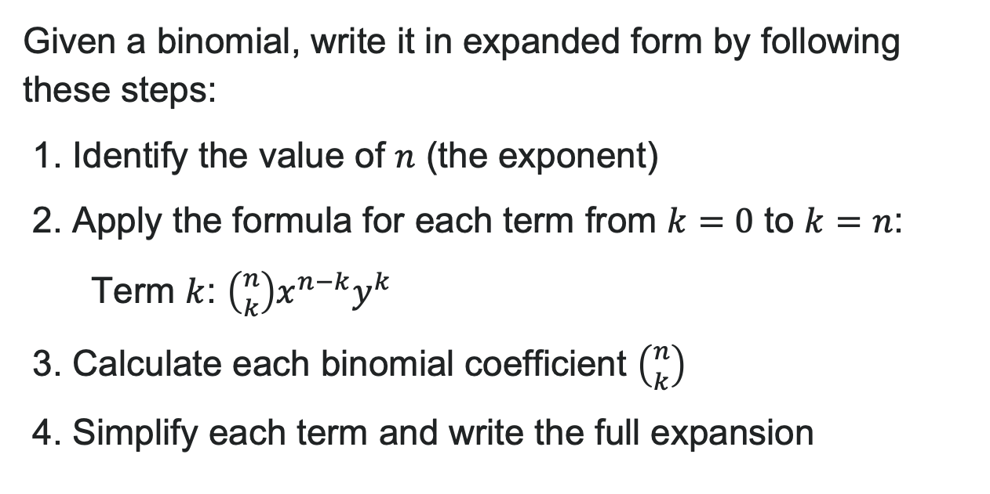
How to: Use the Binomial Theorem
Given a binomial, write it in expanded form by following these steps:
1. Identify the value of $n$ (the exponent)
2. Apply the formula for each term from $k=0$ to $k=n$:
Term $k$: $\left({n \atop k}\right)x^{n−k}y^{k}$
3. Calculate each binomial coefficient $\left({n \atop k}\right)$
4. Simplify each term and write the full expansion

Slide 24
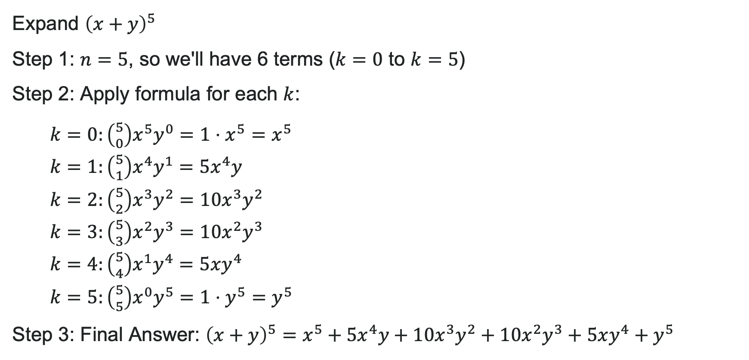
Example: Simple Expansion
Expand ${\left(x+y\right)}^{5}$
Step 1: $n=5$, so we'll have 6 terms ($k=0$ to $k=5$)
Step 2: Apply formula for each $k$:
$k=0:\left({5 \atop 0}\right)x^{5}y^{0}=1⋅x^{5}=x^{5}$
$k=1:\left({5 \atop 1}\right)x^{4}y^{1}=5x^{4}y$
$k=2:\left({5 \atop 2}\right)x^{3}y^{2}=10x^{3}y^{2}$
$k=3:\left({5 \atop 3}\right)x^{2}y^{3}=10x^{2}y^{3}$
$k=4:\left({5 \atop 4}\right)x^{1}y^{4}=5xy^{4}$
$k=5:\left({5 \atop 5}\right)x^{0}y^{5}=1⋅y^{5}=y^{5}$
Step 3: Final Answer: ${\left(x+y\right)}^{5}=x^{5}+5x^{4}y+10x^{3}y^{2}+10x^{2}y^{3}+5xy^{4}+y^{5}$
Check: Coefficients match Row 5 of Pascal's Triangle: 1, 5, 10, 10, 5, 1 ✓

Slide 25
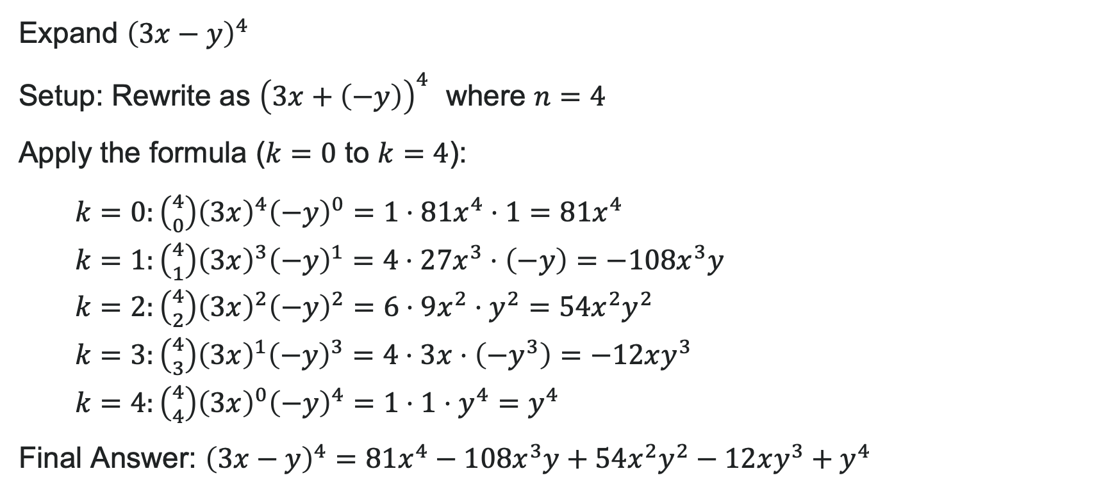
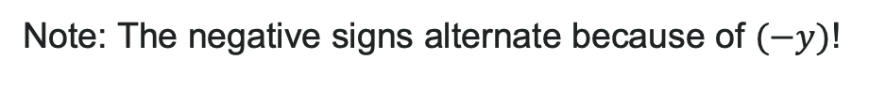
Example: Coefficients and Subtraction
Expand ${\left(3x−y\right)}^{4}$
Setup: Rewrite as ${\left(3x+\left(−y\right)\right)}^{4}$ where $n=4$
Apply the formula ($k=0$ to $k=4$):
$k=0:\left({4 \atop 0}\right){\left(3x\right)}^{4}{\left(−y\right)}^{0}=1⋅81x^{4}⋅1=81x^{4}$
$k=1:\left({4 \atop 1}\right){\left(3x\right)}^{3}{\left(−y\right)}^{1}=4⋅27x^{3}⋅\left(−y\right)=−108x^{3}y$
$k=2:\left({4 \atop 2}\right){\left(3x\right)}^{2}{\left(−y\right)}^{2}=6⋅9x^{2}⋅y^{2}=54x^{2}y^{2}$
$k=3:\left({4 \atop 3}\right){\left(3x\right)}^{1}{\left(−y\right)}^{3}=4⋅3x⋅\left(−y^{3}\right)=−12xy^{3}$
$k=4:\left({4 \atop 4}\right){\left(3x\right)}^{0}{\left(−y\right)}^{4}=1⋅1⋅y^{4}=y^{4}$
Final Answer: ${\left(3x−y\right)}^{4}=81x^{4}−108x^{3}y+54x^{2}y^{2}−12xy^{3}+y^{4}$
Note: The negative signs alternate because of $(−y)$!

Slide 26
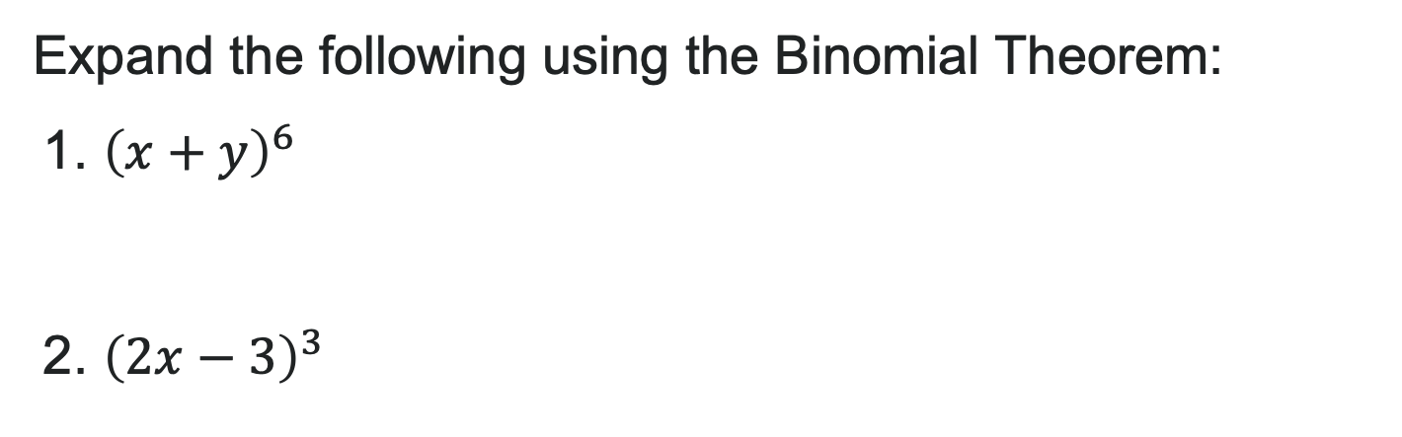
Try It: Binomial Theorem
Expand the following using the Binomial Theorem:
1. ${\left(x+y\right)}^{6}$
2. ${\left(2x−3\right)}^{3}$
Notes:
Answer:
(x + y)^6 = x^6 + 6x^5y + 15x^4y^2 + 20x^3y^3 + 15x^2y^4 + 6xy^5 + y^6
Coefficients from Row 6 of Pascal's Triangle: 1, 6, 15, 20, 15, 6, 1
(2x - 3)^3 = (2x)^3 + 3(2x)^2(-3) + 3(2x)(-3)^2 + (-3)^3
= 8x^3 + 3(4x^2)(-3) + 3(2x)(9) + (-27)
= 8x^3 - 36x^2 + 54x - 27

Slide 27
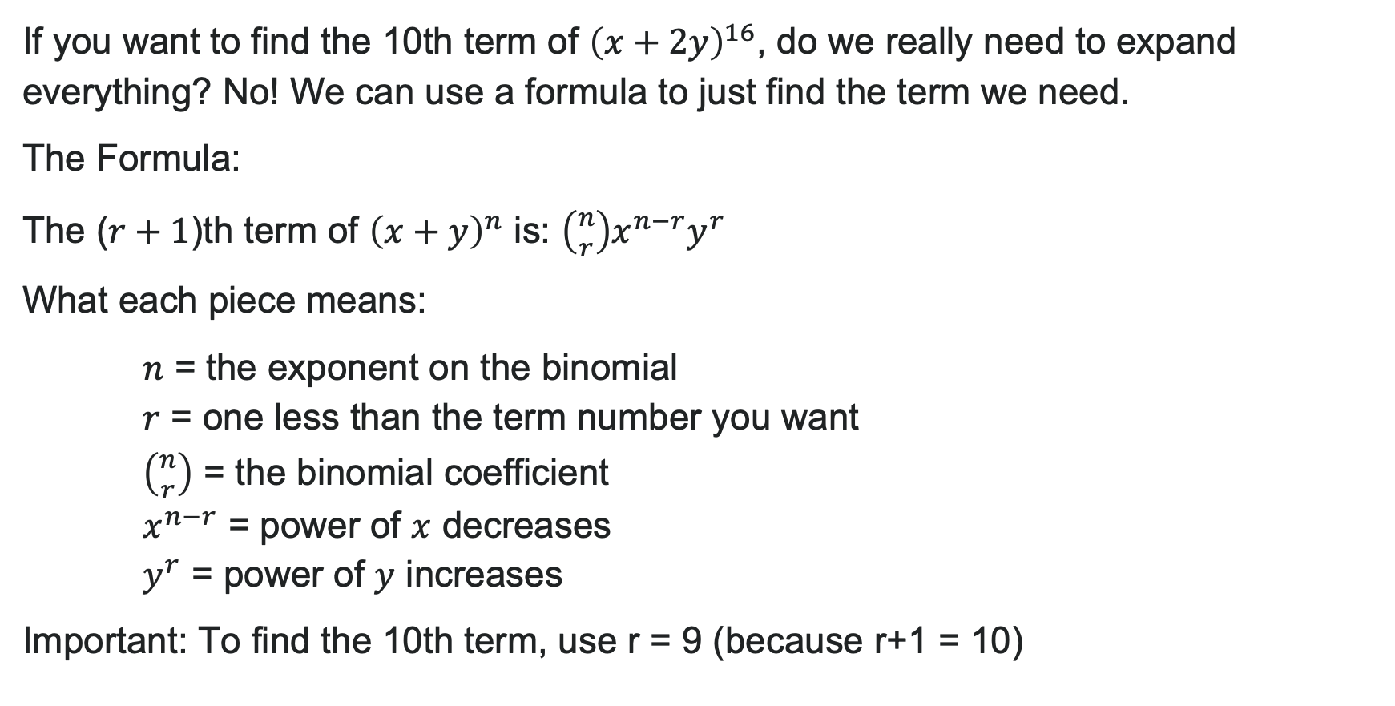
Finding a Single Term
If you want to find the 10th term of ${\left(x+2y\right)}^{16}$, do we really need to expand everything? No! We can use a formula to just find the term we need.
The Formula:
The ($r+1$)th term of ${\left(x+y\right)}^{n}$ is: $\left({n \atop r}\right)x^{n−r}y^{r}$
What each piece means:
$n$ = the exponent on the binomial
$r$ = one less than the term number you want
$\left({n \atop r}\right)$ = the binomial coefficient
$x^{n−r}$ = power of $x$ decreases
$y^{r}$ = power of $y$ increases
Important: To find the 10th term, use r = 9 (because r+1 = 10)

Slide 28

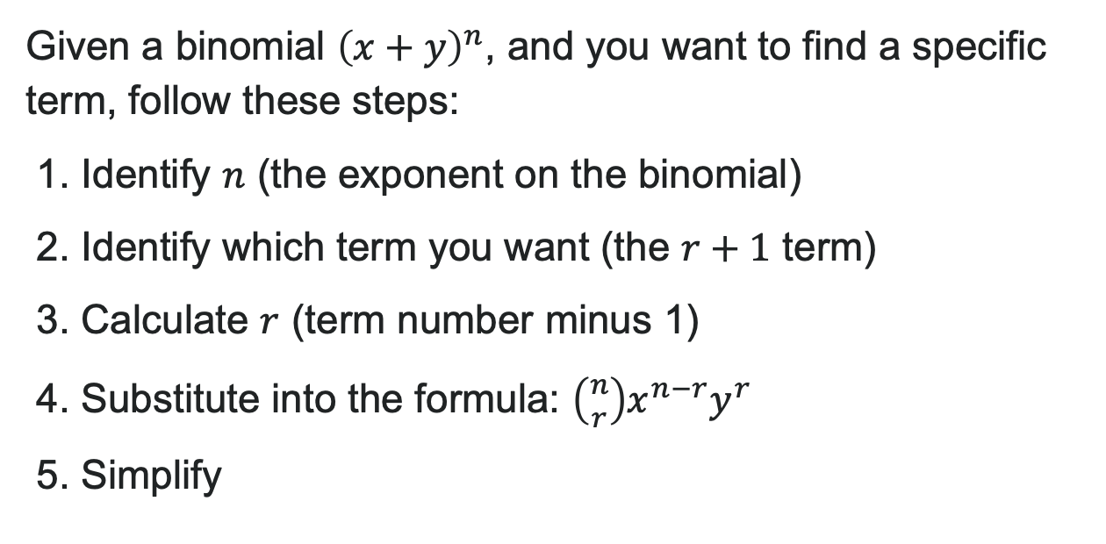
How to: Find a Single Term
Given a binomial ${\left(x+y\right)}^{n}$, and you want to find a specific term, follow these steps:
1. Identify $n$ (the exponent on the binomial)
2. Identify which term you want (the $r+1$ term)
3. Calculate $r$ (term number minus 1)
4. Substitute into the formula: $\left({n \atop r}\right)x^{n−r}y^{r}$
5. Simplify

Slide 29
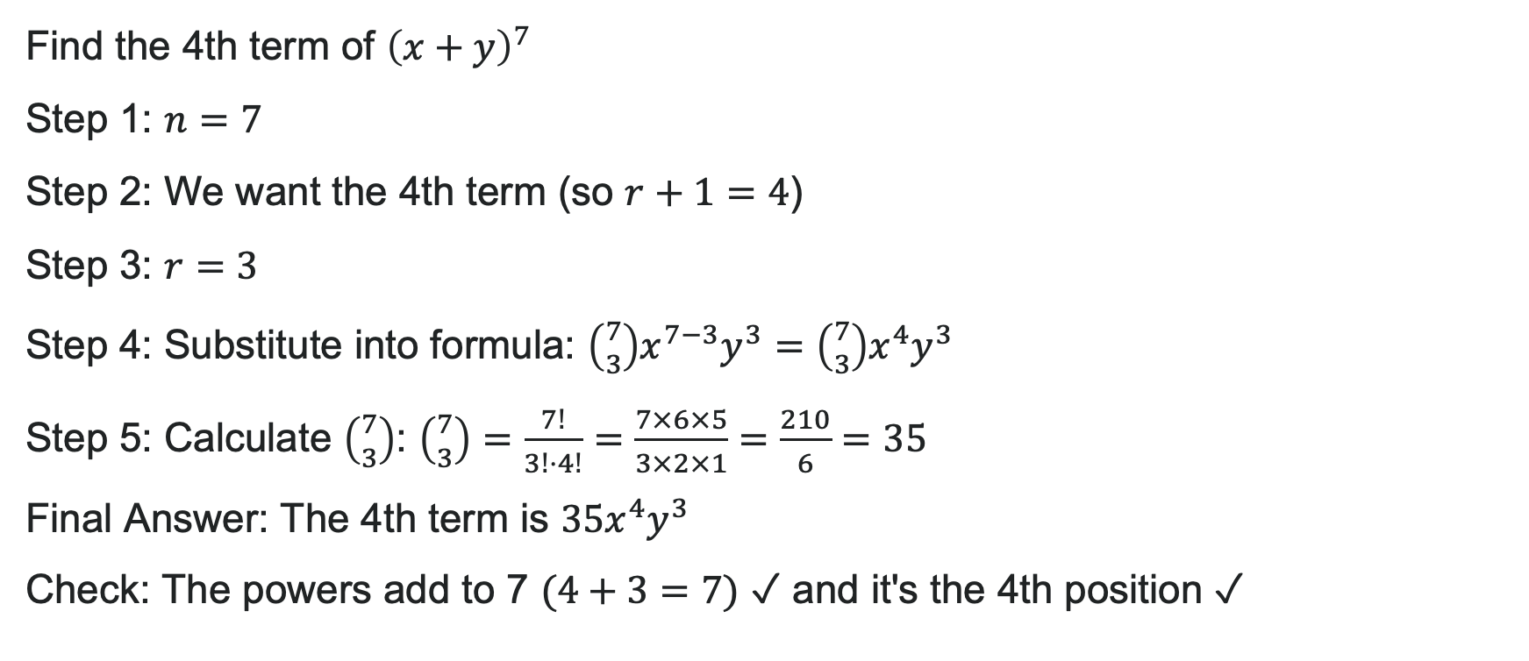
Example: Finding the 4th Term
Find the 4th term of ${\left(x+y\right)}^{7}$
Step 1: $n=7$
Step 2: We want the 4th term (so $r+1=4$)
Step 3: $r=3$
Step 4: Substitute into formula: $\left({7 \atop 3}\right)x^{7−3}y^{3}=\left({7 \atop 3}\right)x^{4}y^{3}$
Step 5: Calculate $\left({7 \atop 3}\right)$: $\left({7 \atop 3}\right)=\frac{7!}{3!⋅4!}=\frac{7×6×5}{3×2×1}=\frac{210}{6}=35$
Final Answer: The 4th term is $35x^{4}y^{3}$
Check: The powers add to 7 $(4+3=7)$ ✓ and it's the 4th position ✓

Slide 30
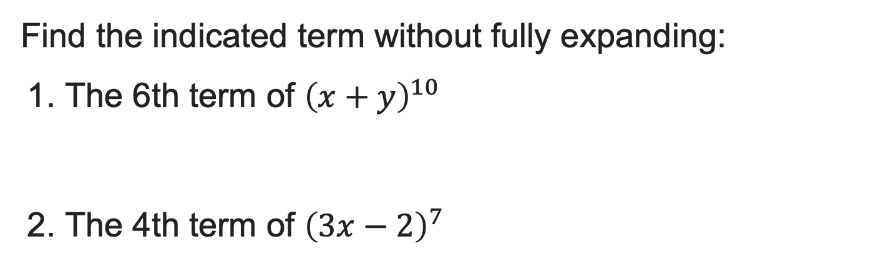
Try It: Find a Single Term
Find the indicated term without fully expanding:
1. The 6th term of ${\left(x+y\right)}^{10}$
2. The 4th term of ${\left(3x−2\right)}^{7}$
Notes:
Answer:
The 6th term (r+1=6, so r=5):
\binom{10}{5} x^{10-5} y^5 = \binom{10}{5} x^5 y^5
\binom{10}{5} = \frac{10!}{5! \cdot 5!} = 252
Answer: 252x^5y^5
The 4th term (r+1=4, so r=3), rewrite as (3x + (-2))^7:
\binom{7}{3} (3x)^{7-3} (-2)^3 = \binom{7}{3} (3x)^4 (-2)^3
\binom{7}{3} = 35, (3x)^4 = 81x^4, (-2)^3 = -8
35 \times 81x^4 \times (-8) = -22{,}680x^4
Answer: -22,680x^4

Slide 31
Learning Goals: Probability
Deepen your understanding and form connections within these skills:
1 Compute probabilities of equally likely outcomes
2 Compute probabilities of the union of two events
3 Use the complement rule to find probabilities
4 Compute probability using counting theory

Slide 32
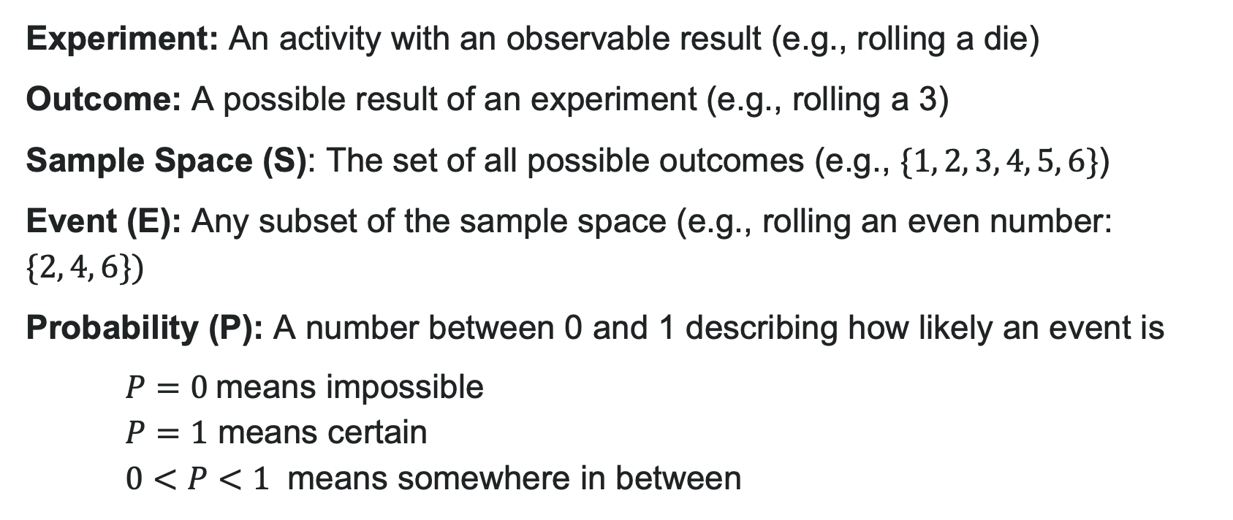
Key Probability Vocabulary
Experiment: An activity with an observable result (e.g., rolling a die)
Outcome: A possible result of an experiment (e.g., rolling a 3)
Sample Space (S): The set of all possible outcomes (e.g., $\{1, 2, 3, 4, 5, 6\}$)
Event (E): Any subset of the sample space (e.g., rolling an even number: $\{2, 4, 6\})$
Probability (P): A number between 0 and 1 describing how likely an event is
$P=0$means impossible
$P=1$ means certain
$0<P<1$ means somewhere in between

Slide 33
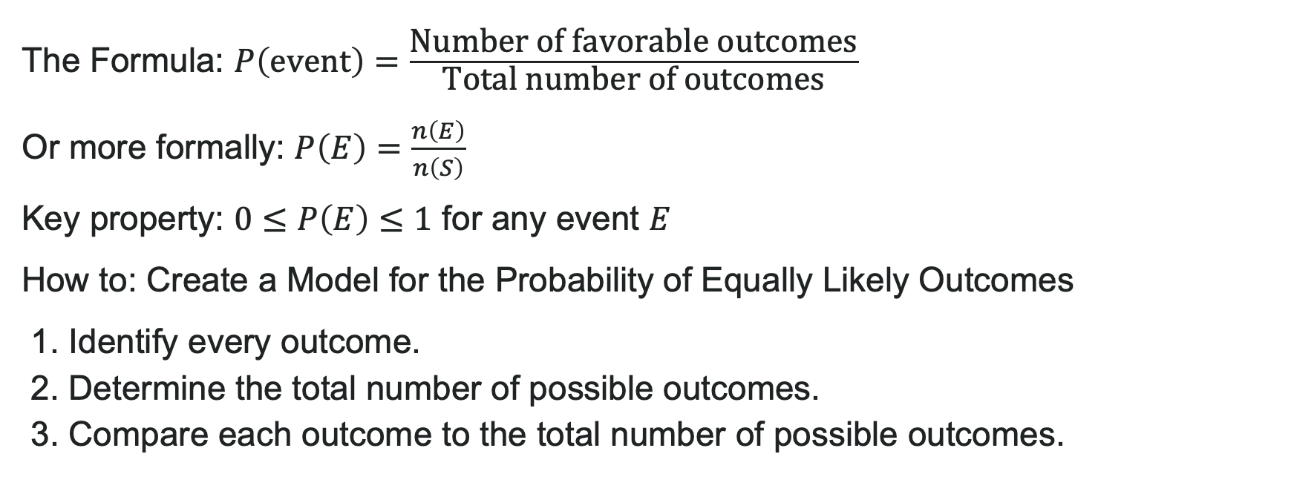
Probability of Equally Likely Outcomes
The Formula: $P\left(\text{event}\right)=\frac{\text{Number} \text{of} \text{favorable} \text{outcomes}}{\text{Total} \text{number} \text{of} \text{outcomes}}$
Or more formally: $P\left(E\right)=\frac{n\left(E\right)}{n\left(S\right)}$
Key property: $0≤P\left(E\right)≤1$ for any event $E$
How to: Create a Model for the Probability of Equally Likely Outcomes
1. Identify every outcome.
2. Determine the total number of possible outcomes.
3. Compare each outcome to the total number of possible outcomes.

Slide 34
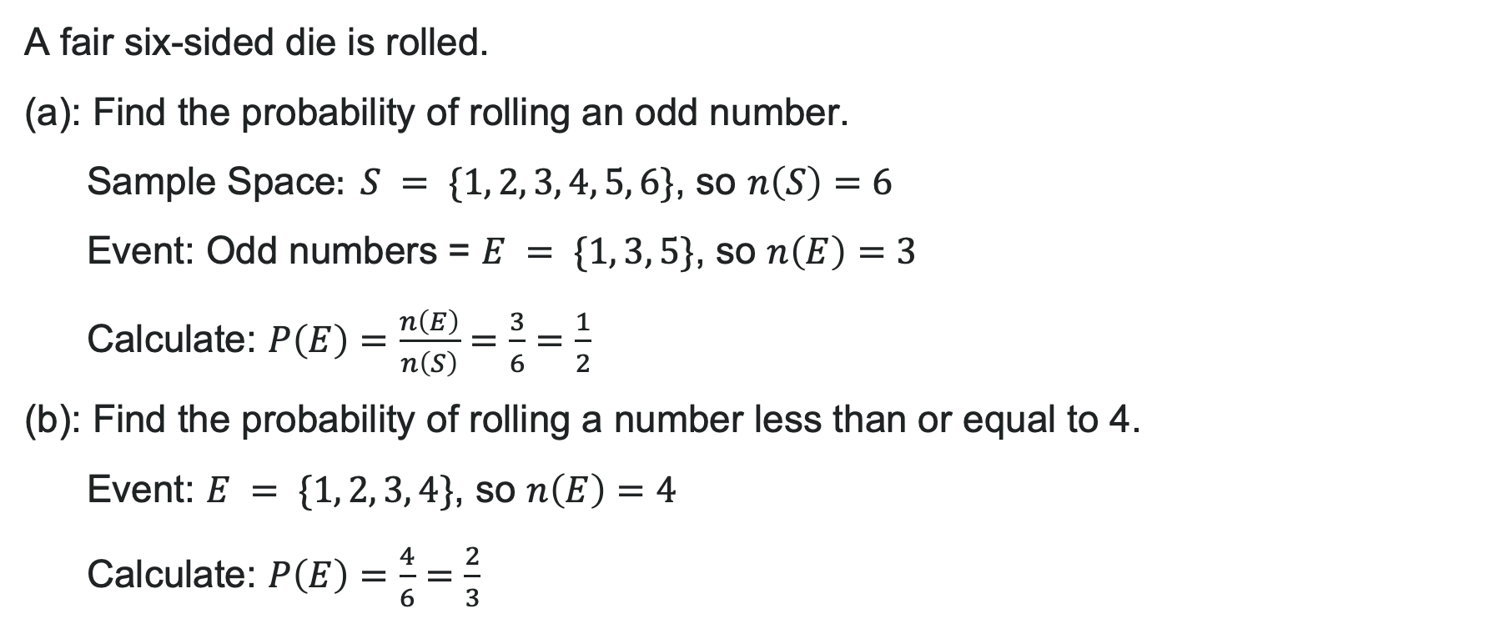
Example: Rolling a Die
A fair six-sided die is rolled.
(a): Find the probability of rolling an odd number.
Sample Space$: S = \{1, 2, 3, 4, 5, 6\}$, so $n\left(S\right)=6$
Event: Odd numbers = $E = \{1, 3, 5\}$, so $n\left(E\right)=3$
Calculate: $P\left(E\right)=\frac{n\left(E\right)}{n\left(S\right)}=\frac{3}{6}=\frac{1}{2}$
(b): Find the probability of rolling a number less than or equal to 4.
Event: $E = \{1, 2, 3, 4\}$, so $n\left(E\right)=4$
Calculate: $P\left(E\right)=\frac{4}{6}=\frac{2}{3}$
Interpretation: There's a 50% chance of rolling odd, and about 67% chance of rolling $≤4$.

Slide 35
Try It: Basic Probability
A bag contains 5 red marbles, 3 blue marbles, and 2 green marbles. You randomly select one marble.
What is the probability of selecting a red marble?
What is the probability of selecting a blue or green marble?
Notes:
Answer:
P(\text{red}) = \frac{5}{10} = \frac{1}{2}
P(\text{blue or green}) = \frac{3 + 2}{10} = \frac{5}{10} = \frac{1}{2}

Slide 36

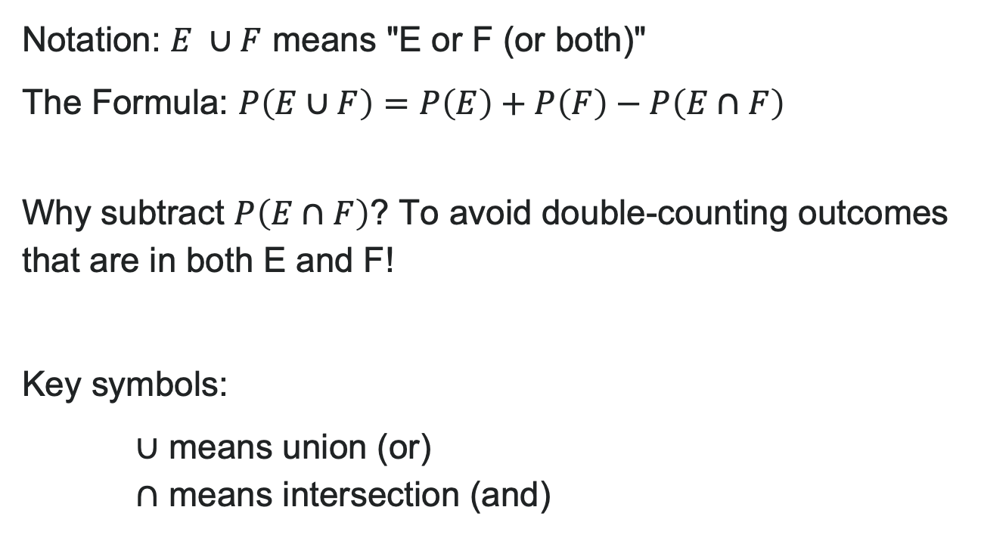
Probability of "A OR B" (Union)
Notation: $E ∪F$ means "E or F (or both)"
The Formula: $P\left(E∪F\right)=P\left(E\right)+P\left(F\right)−P\left(E∩F\right)$
Why subtract $P\left(E∩F\right)$? To avoid double-counting outcomes that are in both E and F!
Key symbols:
$∪$ means union (or)
$∩$ means intersection (and)

Slide 37
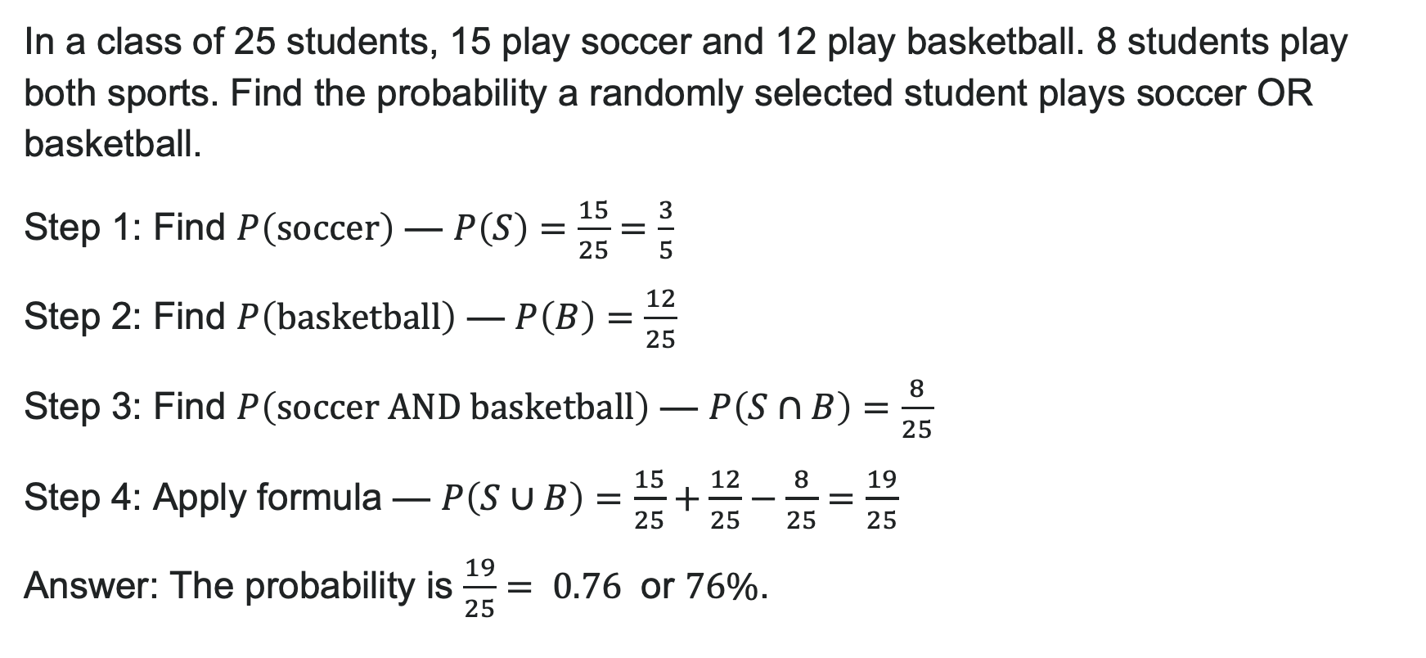
Example: Union with Overlap
In a class of 25 students, 15 play soccer and 12 play basketball. 8 students play both sports. Find the probability a randomly selected student plays soccer OR basketball.
Step 1: Find $P\left(\text{soccer}\right)$ — $P\left(S\right)=\frac{15}{25}=\frac{3}{5}$
Step 2: Find $P\left(\text{basketball}\right)$ — $P\left(B\right)=\frac{12}{25}$
Step 3: Find $P\left(\text{soccer} \text{AND} \text{basketball}\right)$ — $P\left(S∩B\right)=\frac{8}{25}$
Step 4: Apply formula — $P\left(S∪B\right)=\frac{15}{25}+\frac{12}{25}−\frac{8}{25}=\frac{19}{25}$
Answer: The probability is $\frac{19}{25}= 0.76$ or $76\%$.

Slide 38
Try It: Union of Events
A bag contains 20 marbles: 8 are red, 7 are blue, and 5 are both red and blue striped. The rest are green. Find the probability of randomly selecting a marble that is red OR blue (including striped ones).
Notes:
Answer:
Red (including striped): 8
Blue (including striped): 7
Striped (counted in both): 5
P(\text{red or blue}) = \frac{8}{20} + \frac{7}{20} - \frac{5}{20} = \frac{10}{20} = \frac{1}{2}

Slide 39
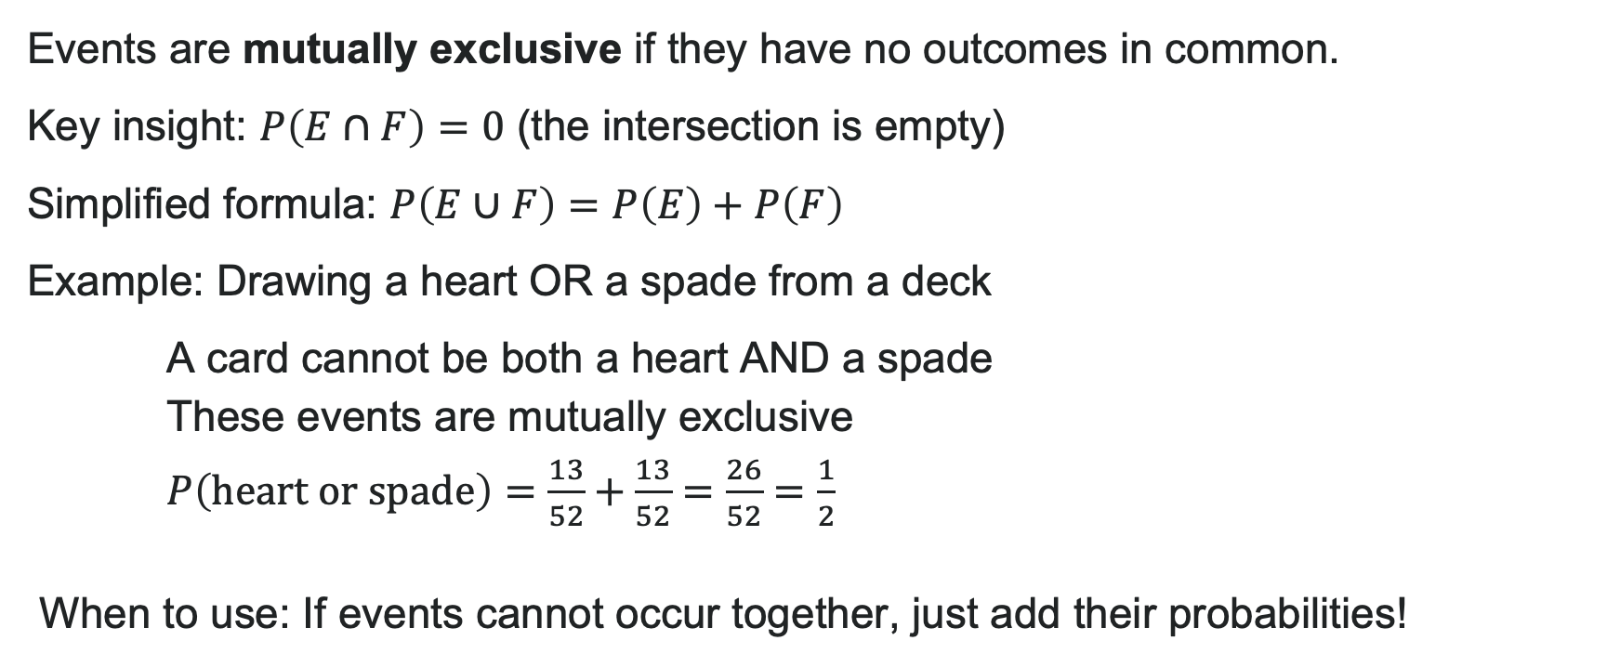
Probability of Mutually Exclusive Events
Events are mutually exclusive if they have no outcomes in common.
Key insight: $P\left(E∩F\right)=0$ (the intersection is empty)
Simplified formula: $P\left(E∪F\right)=P\left(E\right)+P\left(F\right)$
Example: Drawing a heart OR a spade from a deck
A card cannot be both a heart AND a spade
These events are mutually exclusive
$P\left(\text{heart} \text{or} \text{spade}\right)=\frac{13}{52}+\frac{13}{52}=\frac{26}{52}=\frac{1}{2}$
When to use: If events cannot occur together, just add their probabilities!

Slide 40
Try It: Mutually Exclusive Events
A spinner has 12 equal sections: 4 red, 3 blue, 2 yellow, and 3 green. Find the probability of spinning yellow OR green.
Notes:
Answer: Yellow and green are mutually exclusive (a section can't be both colors).
P(\text{yellow}) = \frac{2}{12}
P(\text{green}) = \frac{3}{12}
P(\text{yellow or green}) = \frac{2}{12} + \frac{3}{12} = \frac{5}{12}

Slide 41
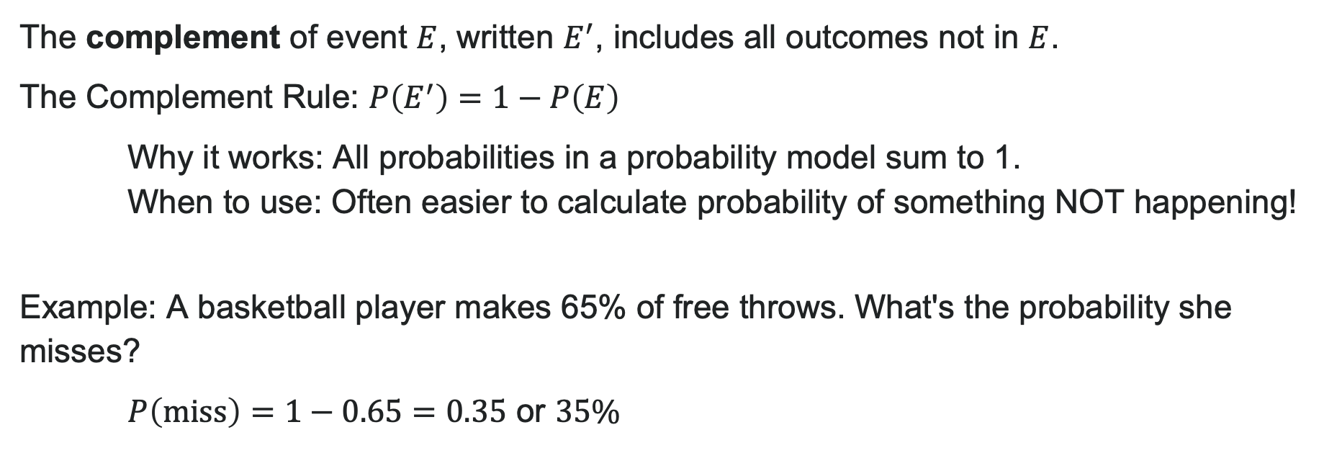
The Complement Rule
The complement of event $E$, written $E^{′}$, includes all outcomes not in $E$.
The Complement Rule: $P\left(E^{′}\right)=1−P\left(E\right)$
Why it works: All probabilities in a probability model sum to 1.
When to use: Often easier to calculate probability of something NOT happening!
Example: A basketball player makes 65% of free throws. What's the probability she misses?
$P\left(\text{miss}\right)=1−0.65=0.35$ or $35\%$

Slide 42
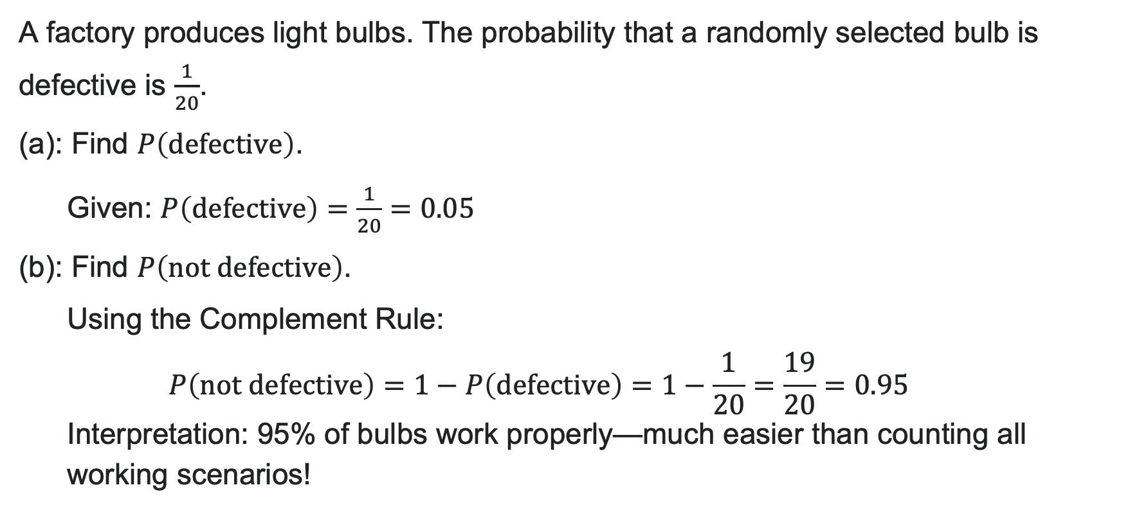
Example: Using the Complement Rule
A factory produces light bulbs. The probability that a randomly selected bulb is defective is $\frac{1}{20}$.
(a): Find $P\left(\text{defective}\right)$.
Given: $P\left(\text{defective}\right)=\frac{1}{20}=0.05$
(b): Find $P\left(\text{not} \text{defective}\right)$.
Using the Complement Rule: $$P\left(\text{not} \text{defective}\right)=1−P\left(\text{defective}\right)=1−\frac{1}{20}=\frac{19}{20}=0.95$$ Interpretation: 95% of bulbs work properly—much easier than counting all working scenarios!

Slide 43
Try It: The Complement Rule
The weather forecast says there's a 30% chance of rain tomorrow. What is the probability it will NOT rain?
Notes:
Answer: P(\text{rain}) = 0.30
P(\text{no rain}) = 1 - 0.30 = 0.70 or 70%

Slide 44
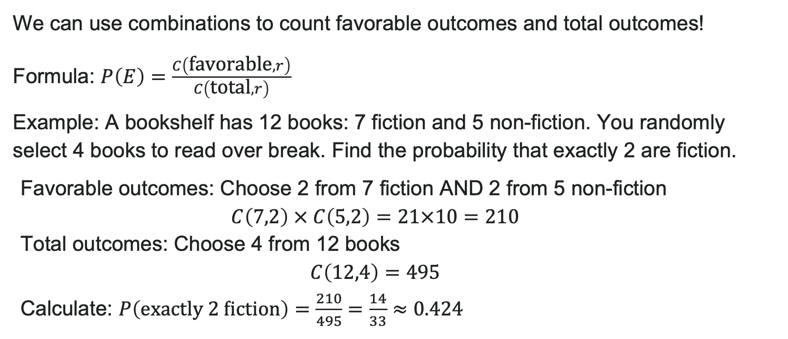
Probability Using Counting Theory
We can use combinations to count favorable outcomes and total outcomes!
Formula: $P\left(E\right)=\frac{C\left(\text{favorable},r\right)}{C\left(\text{total},r\right)}$
Example: A bookshelf has 12 books: 7 fiction and 5 non-fiction. You randomly select 4 books to read over break. Find the probability that exactly 2 are fiction.
Favorable outcomes: Choose 2 from 7 fiction AND 2 from 5 non-fiction
$C\left(7,2\right) × C\left(5,2\right)=21×10=210$
Total outcomes: Choose 4 from 12 books
$C\left(12,4\right)=495$
Calculate: $P\left(\text{exactly}\text{ 2 }\text{fiction}\right)=\frac{210}{495}=\frac{14}{33}≈0.424$
Interpretation: About 42% chance of selecting exactly 2 fiction books.

Slide 45
Try It: Counting & Probability
A poker hand of 5 cards is dealt from a standard 52-card deck.
What is the probability that all 5 cards are spades?
What is the probability that exactly 3 cards are hearts?
Notes:
Answer:
a) Choose 5 from 13 spades: C(13, 5) = 1,287
Choose 5 from 52 total: C(52, 5) = 2,598,960
P(\text{all spades}) = \frac{1,287}{2,598,960} \approx 0.000495
b) Choose 3 from 13 hearts: C(13, 3) = 286
Choose 2 from 39 non-hearts: C(39, 2) = 741
Both: 286 \times 741 = 211,926 ways
P(\text{exactly 3 hearts}) = \frac{211,926}{2,598,960} \approx 0.0815

Slide 46
Before we finish up…
2
Next steps…..
3
Reminders about student hours, upcoming deadlines, campus activities ….
1
Questions…..

Slide 47

Attributions
Illustrations are from Storyset
Authored by: Lumen Learning. License: CC BY: Attribution

