Slide 1

Precalculus
Module 11:
Sequences

Slide 2
Affirmations
I am patient with myself as I work through tough problems.
I break big tasks into small, manageable steps.
I am proud of the resilience I show in my learning.

Slide 3
Learning Goals: Sequences and Their Notations
Deepen your understanding and form connections within these skills:
1 Expand sequences defined by explicit and recursive formulas
2 Write the explicit formula for a given sequence

Slide 4
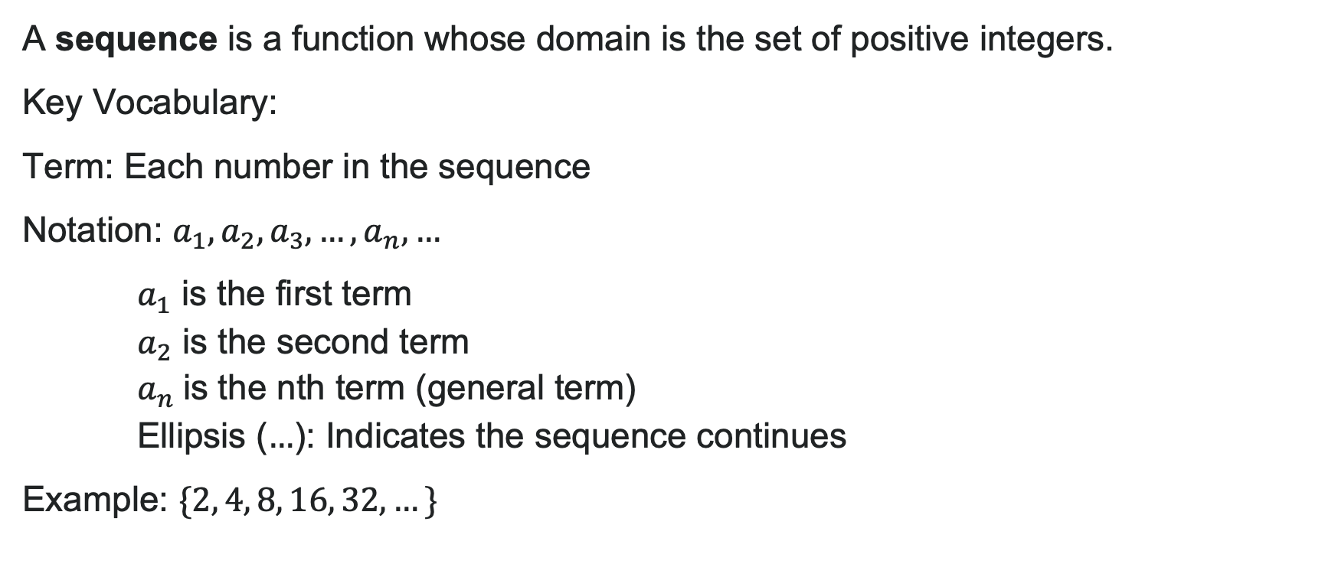
What is a Sequence?
A sequence is a function whose domain is the set of positive integers.
Key Vocabulary:
Term: Each number in the sequence
Notation: $a_{1},a_{2},a_{3},…,a_{n},…$
$a_{1}$ is the first term
$a_{2}$ is the second term
$a_{n}$is the nth term (general term)
Ellipsis ($…$): Indicates the sequence continues
Example: $\{2, 4, 8, 16, 32, …\}$

Slide 5

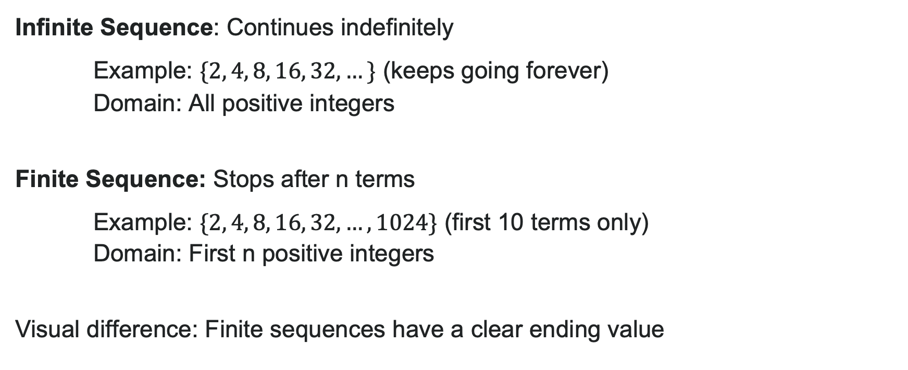
Finite vs. Infinite Sequences
Infinite Sequence: Continues indefinitely
Example: $\{2, 4, 8, 16, 32, …\}$ (keeps going forever)
Domain: All positive integers
Finite Sequence: Stops after n terms
Example: $\{2, 4, 8, 16, 32, …, 1024\}$ (first 10 terms only)
Domain: First n positive integers
Visual difference: Finite sequences have a clear ending value

Slide 6
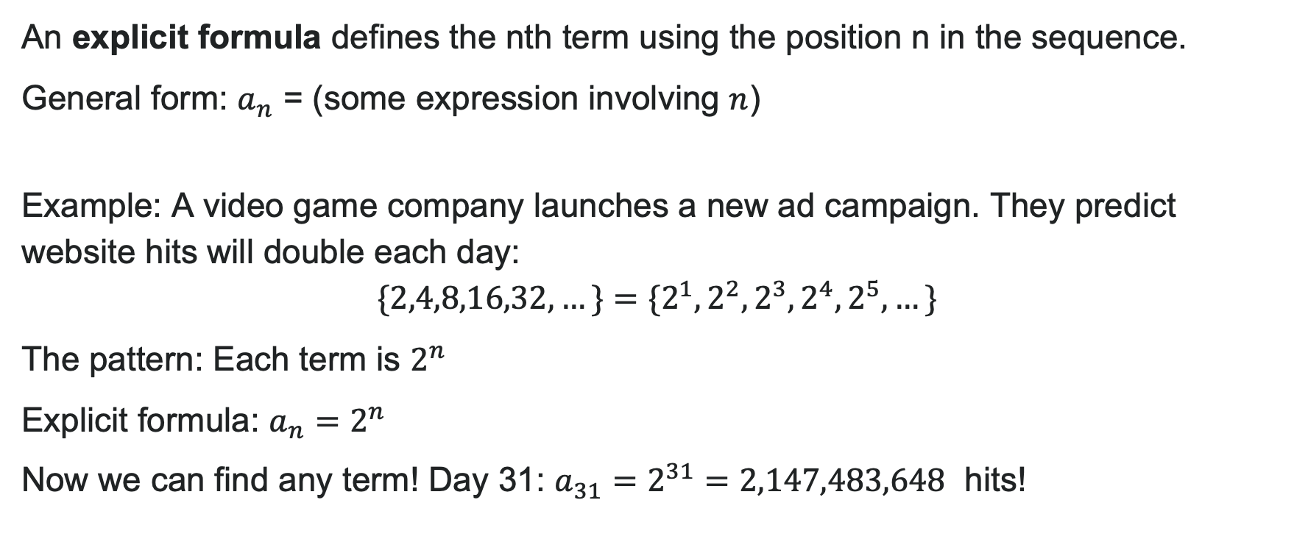
Explicit Formulas
An explicit formula defines the nth term using the position n in the sequence.
General form: $a_{n}$ = (some expression involving $n$)
Example: A video game company launches a new ad campaign. They predict website hits will double each day:
$\{2,4,8,16,32,…\}=\{2^{1},2^{2},2^{3},2^{4},2^{5},…\}$
The pattern: Each term is $2^{n}$
Explicit formula: $a_{n}=2^{n}$
Now we can find any term! Day 31: $a_{31}=2^{31}=2,147,483,648$ hits!

Slide 7
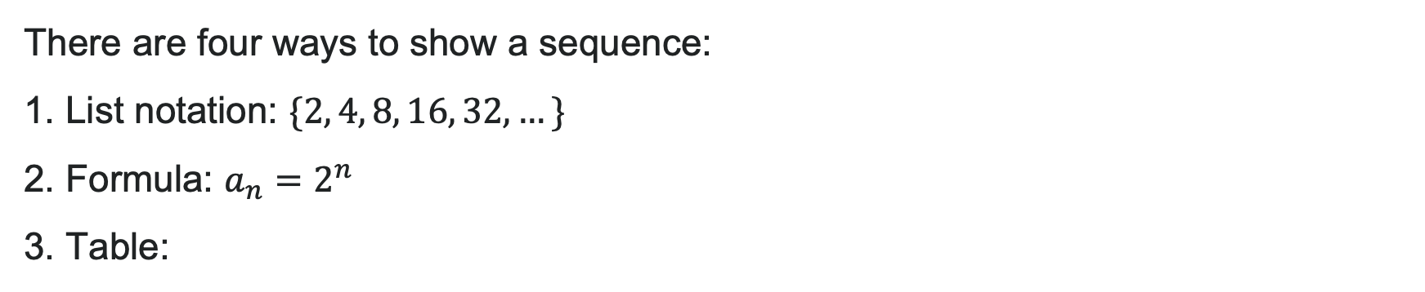
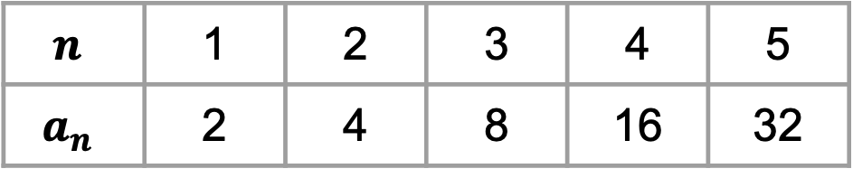
Representing Sequences
There are four ways to show a sequence:
1. List notation: $\{2, 4, 8, 16, 32, …\}$
2. Formula: $a_{n}=2^{n}$
3. Table:
$$n$$ | 1 | 2 | 3 | 4 | 5
$$a_{n}$$ | 2 | 4 | 8 | 16 | 32
4. Graph: Discrete points (not continuous!)

Slide 8

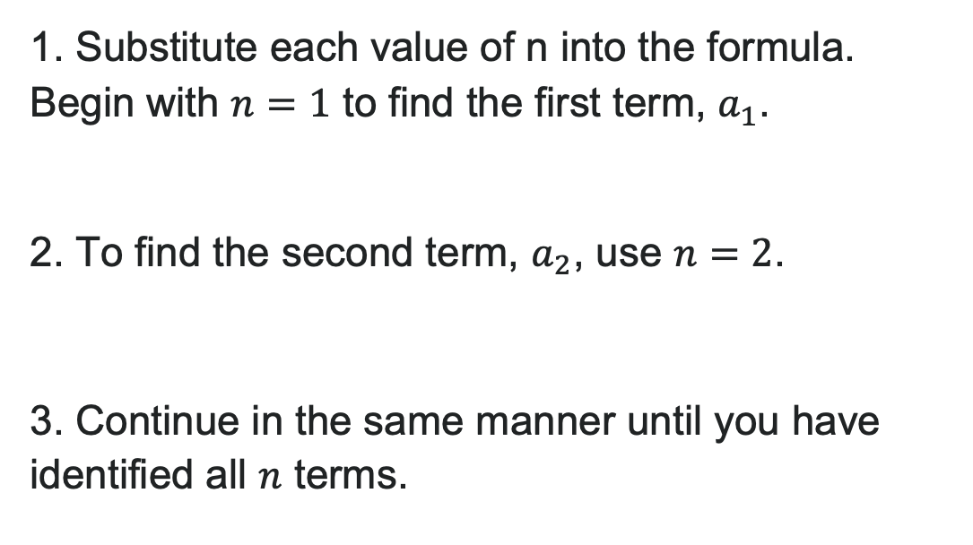
How To: Use an Explicit Formula
1. Substitute each value of n into the formula. Begin with $n=1$ to find the first term, $a_{1}$.
2. To find the second term, $a_{2}$, use $n=2$.
3. Continue in the same manner until you have identified all $n$ terms.

Slide 9

Try It: Using an Explicit Formula
Write the first five terms of the sequence:
$$a_{n}=2n^{2}−5$$
Notes:
Answer:
n = 1: a_1 = 2(1)^2 - 5 = 2 - 5 = -3
n = 2: a_2 = 2(2)^2 - 5 = 8 - 5 = 3
n = 3: a_3 = 2(3)^2 - 5 = 18 - 5 = 13
n = 4: a_4 = 2(4)^2 - 5 = 32 - 5 = 27
n = 5: a_5 = 2(5)^2 - 5 = 50 - 5 = 45
First five terms: \{-3, 3, 13, 27, 45\}

Slide 10
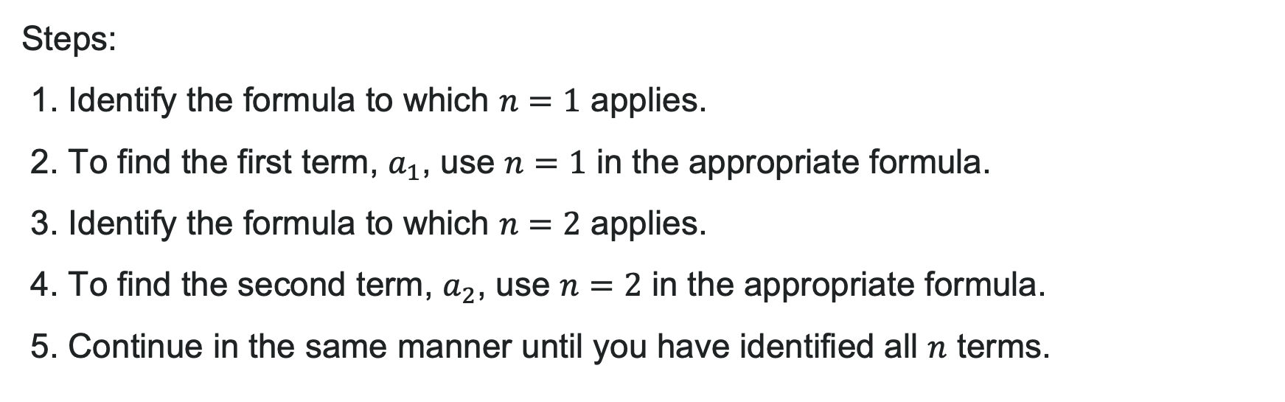
How to: Evaluate Piecewise Sequences
Steps:
1. Identify the formula to which $n=1$ applies.
2. To find the first term, $a_{1}$, use $n=1$ in the appropriate formula.
3. Identify the formula to which $n=2$ applies.
4. To find the second term, $a_{2}$, use $n=2$ in the appropriate formula.
5. Continue in the same manner until you have identified all $n$ terms.

Slide 11

Finding Explicit Formulas
Given a sequence, how do we find the formula?
Strategy: Look for patterns!
Are terms increasing or decreasing?
Is there a common difference (arithmetic)?
Is there a common ratio (geometric)?
What patterns exist in numerators? Denominators? Exponents?
Key: Test your formula with the given terms to verify!

Slide 12

Try It: Find the Formula
Write an explicit formula for the nth term:
$$\{e^{4},e^{5},e^{6},e^{7},e^{8},…\}$$
Notes:
Answer:
Pattern: Powers of e starting at 4
When n = 1, exponent is 4
When n = 2, exponent is 5
Exponent pattern: n + 3
Formula: a_n = e^{n+3}

Slide 13
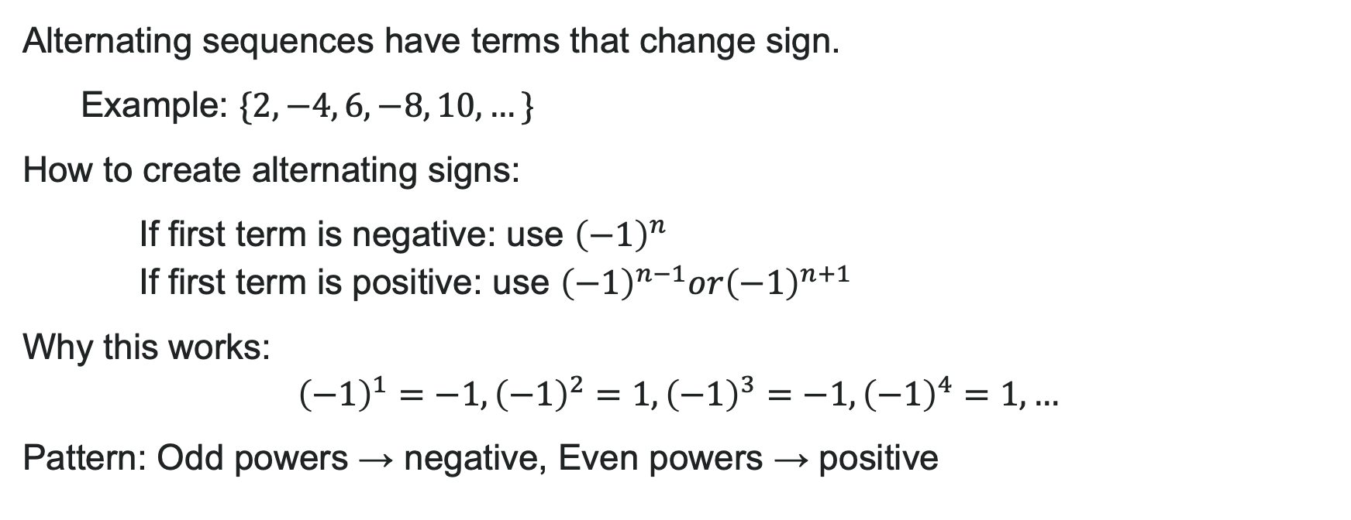
Alternating Sequences
Alternating sequences have terms that change sign.
Example: $\{2, −4, 6, −8, 10, …\}$
How to create alternating signs:
If first term is negative: use ${\left(−1\right)}^{n}$
If first term is positive: use ${\left(−1\right)}^{n−1}or{\left(−1\right)}^{n+1}$
Why this works:
${\left(−1\right)}^{1}=−1,{\left(−1\right)}^{2}=1,{\left(−1\right)}^{3}=−1,{\left(−1\right)}^{4}=1,…$
Pattern: Odd powers → negative, Even powers → positive

Slide 14

Example: Alternating Sequence
Write the first five terms: $a_{n}=\frac{{\left(−1\right)}^{n}n^{2}}{n+1}$
Solution:
$n=1:a_{1}=\frac{{\left(−1\right)}^{1}{\left(1\right)}^{2}}{1+1}=\frac{−1}{2}=−\frac{1}{2}$
$n=2:a_{2}=\frac{{\left(−1\right)}^{2}{\left(2\right)}^{2}}{2+1}=\frac{4}{3}$
$n=3:a_{3}=\frac{{\left(−1\right)}^{3}{\left(3\right)}^{2}}{3+1}=\frac{−9}{4}=−\frac{9}{4}$
$n=4:a_{4}=\frac{{\left(−1\right)}^{4}{\left(4\right)}^{2}}{4+1}=\frac{16}{5}$
$n=5:a_{5}=\frac{{\left(−1\right)}^{5}{\left(5\right)}^{2}}{5+1}=\frac{−25}{6}=−\frac{25}{6}$
First five terms: $\left\{−\frac{1}{2},\frac{4}{3},−\frac{9}{4},\frac{16}{5},−\frac{25}{6}\right\}$

Slide 15
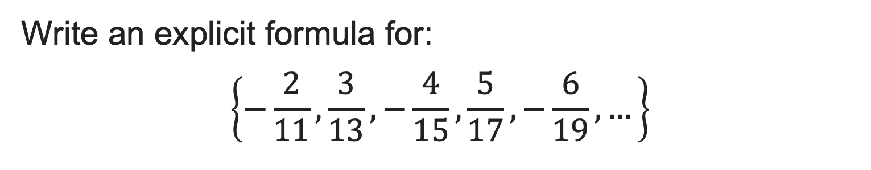
Try It: Alternating Formula
Write an explicit formula for:
$$\left\{−\frac{2}{11},\frac{3}{13},−\frac{4}{15},\frac{5}{17},−\frac{6}{19},…\right\}$$
Notes:
Answer:
Sign pattern: First term negative → use (-1)^n
Numerator pattern: 2, 3, 4, 5, 6, ... → n + 1
Denominator pattern: 11, 13, 15, 17, 19, ... → 2n + 9
Formula: a_n = \frac{(-1)^n(n+1)}{2n+9}

Slide 16
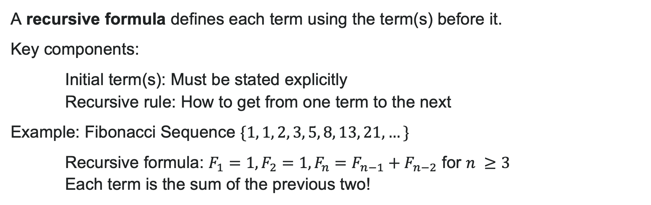
Recursive Formulas
A recursive formula defines each term using the term(s) before it.
Key components:
Initial term(s): Must be stated explicitly
Recursive rule: How to get from one term to the next
Example: Fibonacci Sequence $\{1, 1, 2, 3, 5, 8, 13, 21, …\}$
Recursive formula: $F_{1}=1,F_{2}=1,F_{n}=F_{n−1}+F_{n−2}$ for $n ≥3$
Each term is the sum of the previous two!

Slide 17
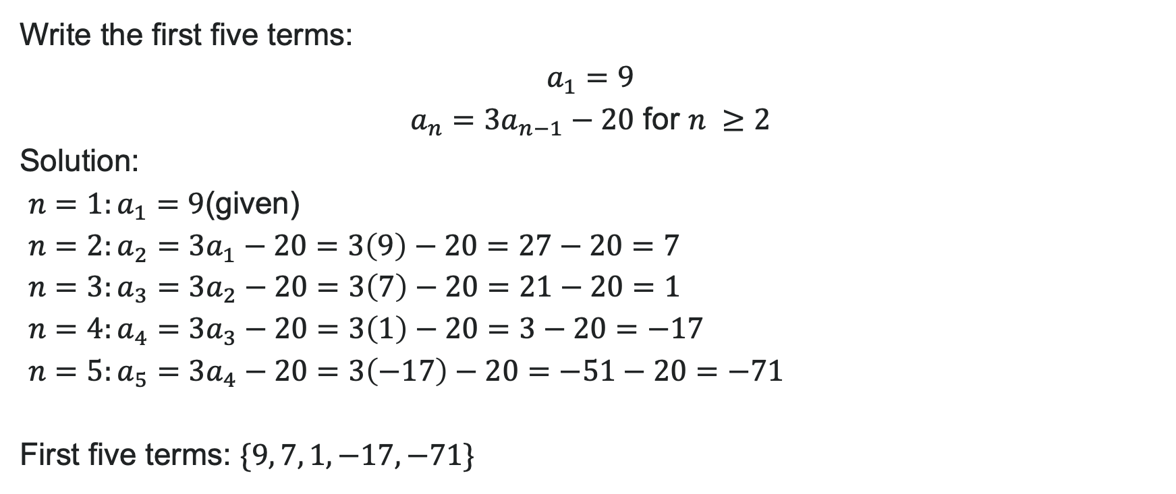
Example: Recursive Formulas
Write the first five terms:
for $n ≥2$
Solution:
$n=1:a_{1}=9$(given)
$n=2:a_{2}=3a_{1}−20=3\left(9\right)−20=27−20=7$
$n=3:a_{3}=3a_{2}−20=3\left(7\right)−20=21−20=1$
$n=4:a_{4}=3a_{3}−20=3\left(1\right)−20=3−20=−17$
$n=5:a_{5}=3a_{4}−20=3\left(−17\right)−20=−51−20=−71$
First five terms: $\{9, 7, 1, −17, −71\}$
Notice: You must calculate terms in order—you can't skip ahead!

Slide 18
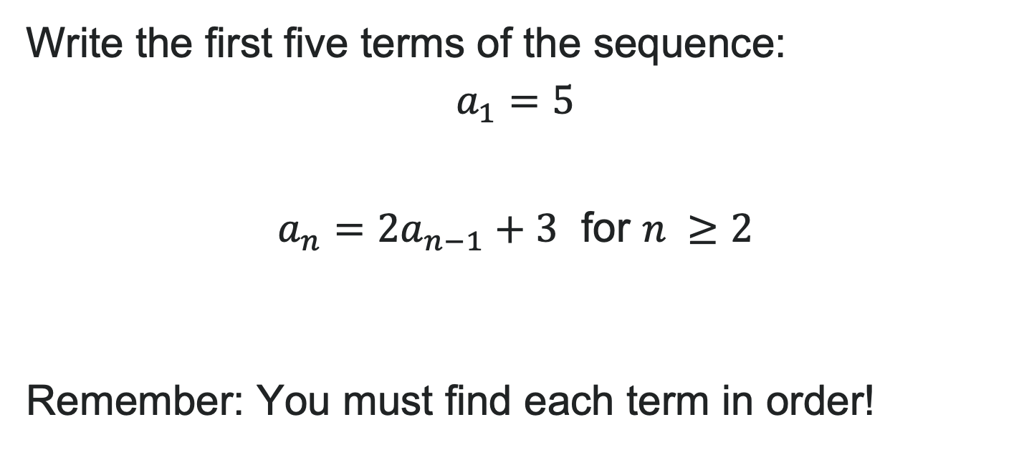
Try It: Recursive Formulas
Write the first five terms of the sequence:
$$a_{1}=5$$
$a_{n}=2a_{n−1}+3$ for $n ≥2$
Remember: You must find each term in order!
Notes:
Answer:
n = 1: a_1 = 5 (given)
n = 2: a_2 = 2a_1 + 3 = 2(5) + 3 = 10 + 3 = 13
n = 3: a_3 = 2a_2 + 3 = 2(13) + 3 = 26 + 3 = 29
n = 4: a_4 = 2a_3 + 3 = 2(29) + 3 = 58 + 3 = 61
n = 5: a_5 = 2a_4 + 3 = 2(61) + 3 = 122 + 3 = 125
First five terms: \{5, 13, 29, 61, 125\}

Slide 19
Learning Goals: Arithmetic Sequences
Deepen your understanding and form connections within these skills:
1 Find the common difference for an arithmetic sequence
2 Write the formula for an arithmetic sequence
3 Use arithmetic sequences to solve realistic scenarios

Slide 20
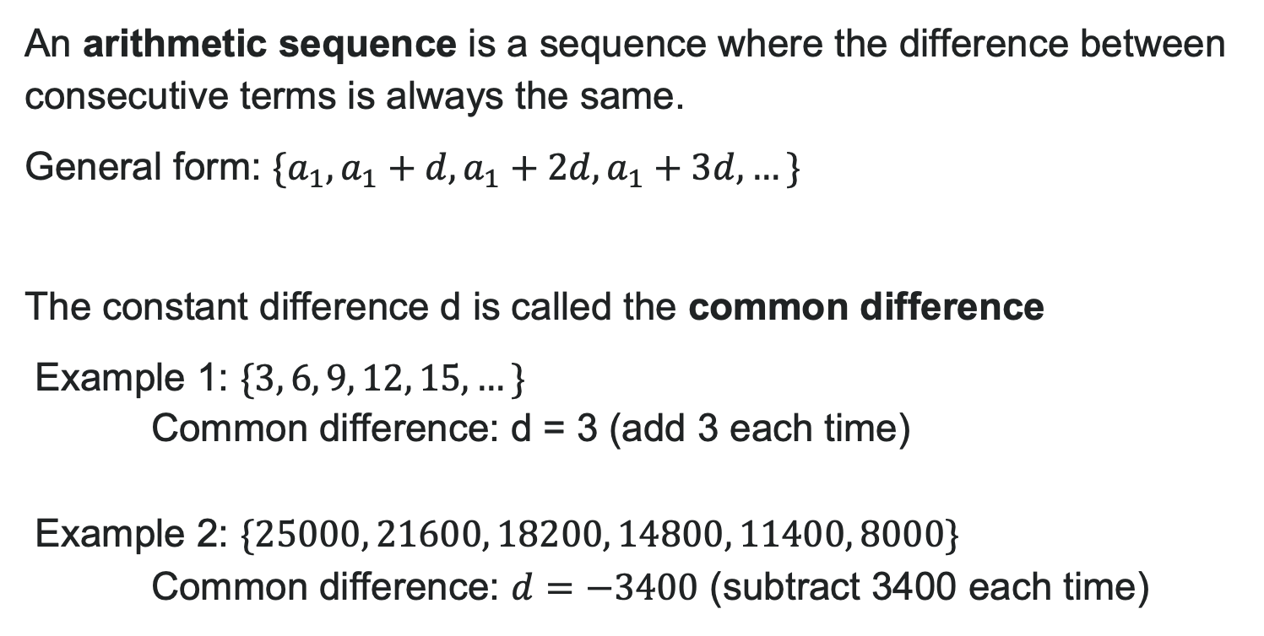
What is an Arithmetic Sequence?
An arithmetic sequence is a sequence where the difference between consecutive terms is always the same.
General form: $\{a_{1},a_{1}+d,a_{1}+2d,a_{1}+3d,…\}$
The constant difference d is called the common difference
Example 1: $\{3, 6, 9, 12, 15, …\}$
Common difference: d = 3 (add 3 each time)
Example 2: $\{25000, 21600, 18200, 14800, 11400, 8000\}$
Common difference: $d=−3400$ (subtract 3400 each time)

Slide 21

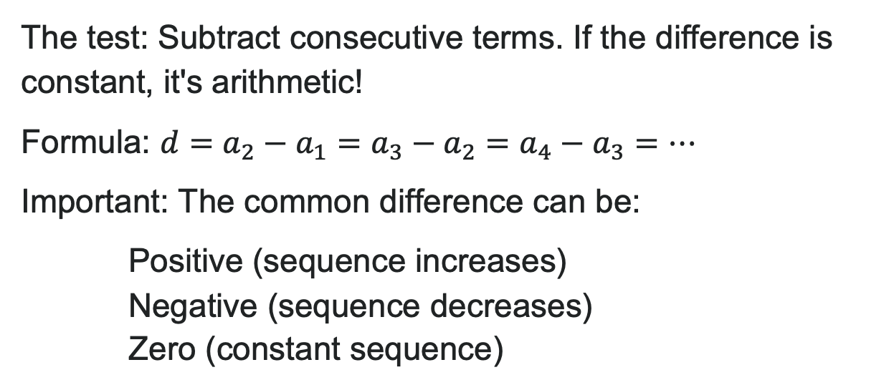
Identifying Arithmetic Sequences
The test: Subtract consecutive terms. If the difference is constant, it's arithmetic!
Formula: $d=a_{2}−a_{1}=a_{3}−a_{2}=a_{4}−a_{3}=…$
Important: The common difference can be:
Positive (sequence increases)
Negative (sequence decreases)
Zero (constant sequence)

Slide 22
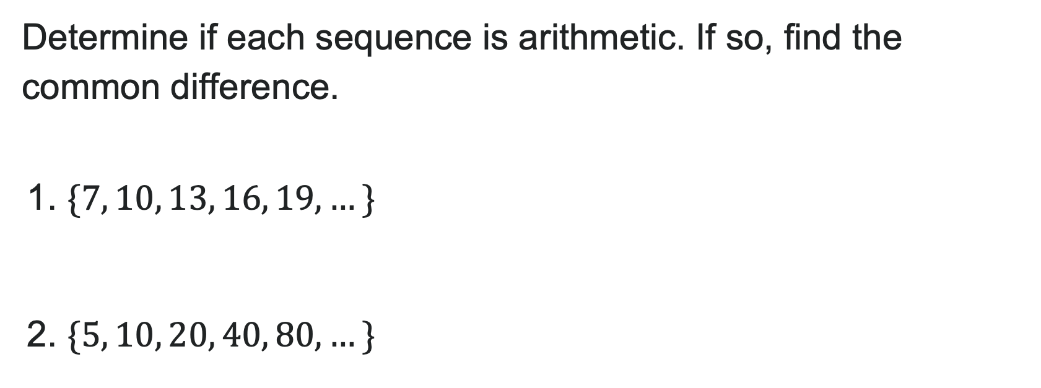
Try It: Common Difference
Determine if each sequence is arithmetic. If so, find the common difference.
1. $\{7, 10, 13, 16, 19, …\}$
2. $\{5, 10, 20, 40, 80, …\}$
Notes:
Answer:
1) 10 - 7 = 3, 13 - 10 = 3, 16 - 13 = 3, 19 - 16 = 3
Arithmetic with d = 3
2) 10 - 5 = 5, 20 - 10 = 10, 40 - 20 = 20, 80 - 40 = 40
NOT arithmetic (no common difference)

Slide 23
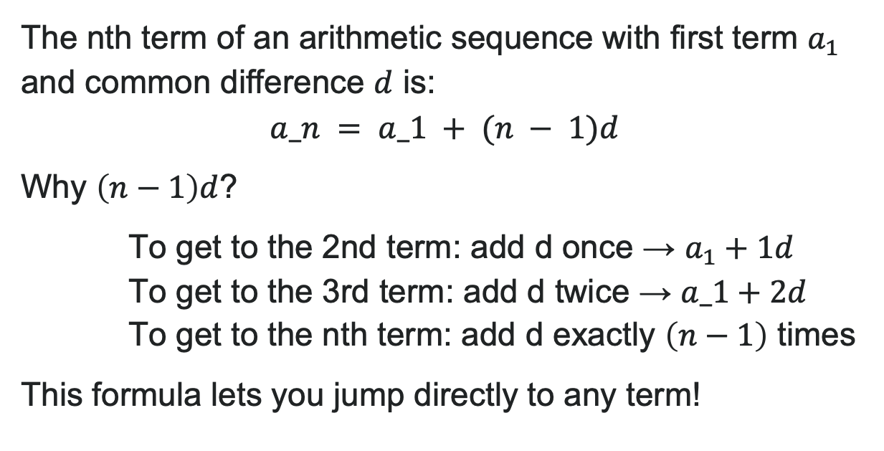
General Term of an Arithmetic Sequence
The nth term of an arithmetic sequence with first term $a_{1}$ and common difference $d$ is:
$$a_n = a_1 + (n − 1)d$$
Why $\left(n−1\right)d$?
To get to the 2nd term: add d once → $a_{1}+1d$
To get to the 3rd term: add d twice → $a_1+2d$
To get to the nth term: add d exactly $\left(n−1\right)$ times
This formula lets you jump directly to any term!

Slide 24


Example: Using the nth term
Write the first five terms of the arithmetic sequence with $a_{1}=17$ and $d=−3$.
Solution: Using $a_{n}=a_{1}+\left(n−1\right)d=17+\left(n−1\right)\left(−3\right)$
$a_{1}=17$
$a_{2}=17+\left(1\right)\left(−3\right)=17−3=14$
$a_{3}=17+\left(2\right)\left(−3\right)=17−6=11$
$a_{4}=17+\left(3\right)\left(−3\right)=17−9=8$
$a_5 = 17 + (4)(−3) = 17 − 12 = 5$
First five terms: $\{17, 14, 11, 8, 5\}$

Slide 25
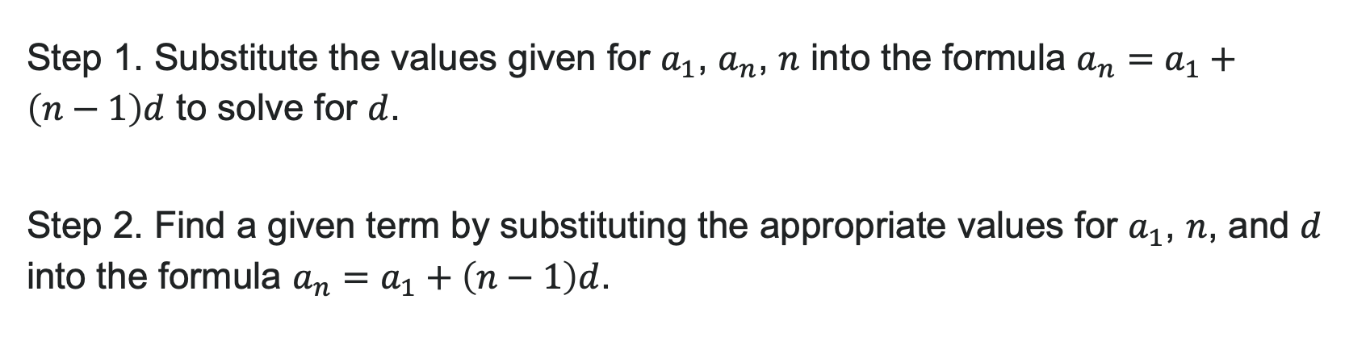
How to: Find a Given Term in an Arithmetic Sequence
Step 1. Substitute the values given for $a_{1}$, $a_{n}$, $n$ into the formula $a_{n}=a_{1}+\left(n−1\right)d$ to solve for $d$.
Step 2. Find a given term by substituting the appropriate values for $a_{1}$, $n$, and $d$ into the formula $a_{n}=a_{1}+\left(n−1\right)d$.

Slide 26
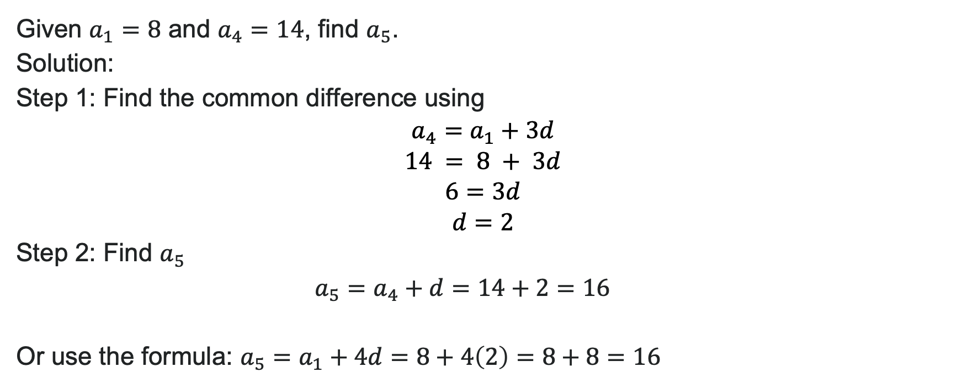
Example: Finding a Specific Term
Given $a_{1}=8$ and $a_{4}=14$, find $a_{5}$.
Solution:
Step 1: Find the common difference using
$$a_{4}=a_{1}+3d \\ 14 = 8 + 3d \\ 6=3d \\ d=2$$
Step 2: Find $a_{5}$
$$a_{5}=a_{4}+d=14+2=16$$
Or use the formula: $a_{5}=a_{1}+4d=8+4\left(2\right)=8+8=16$

Slide 27

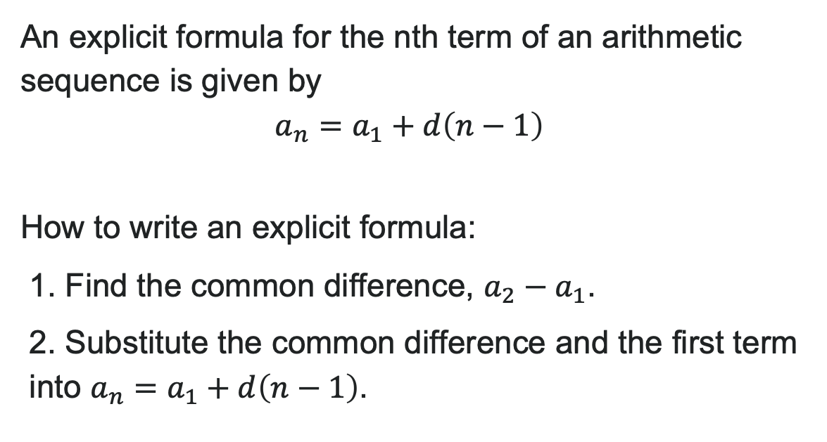
Explicit Formulas for Arithmetic Sequences
An explicit formula for the nth term of an arithmetic sequence is given by
$$a_{n}=a_{1}+d\left(n−1\right)$$
How to write an explicit formula:
1. Find the common difference, $a_{2}−a_{1}$.
2. Substitute the common difference and the first term into $a_{n}=a_{1}+d\left(n−1\right)$.

Slide 28

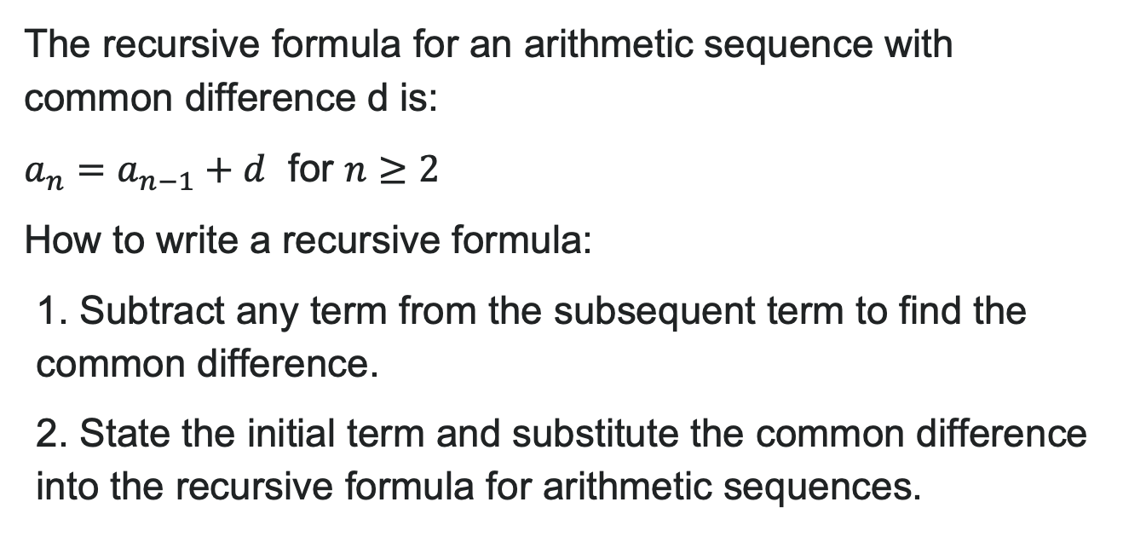
Recursive Formulas for Arithmetic Sequences
The recursive formula for an arithmetic sequence with common difference d is:
$a_{n}=a_{n−1}+d$ for $n≥2$
How to write a recursive formula:
1. Subtract any term from the subsequent term to find the common difference.
2. State the initial term and substitute the common difference into the recursive formula for arithmetic sequences.

Slide 29
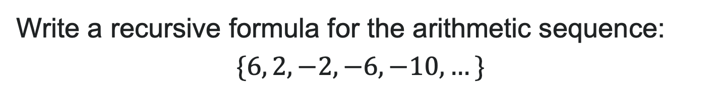
Try It: Recursive Formulas for Arithmetic Sequences
Write a recursive formula for the arithmetic sequence:
$$\{6, 2, −2, −6, −10, …\}$$
Notes:
Answer:
Step 1: Find common difference:
d = 2 - 6 = -4
Step 2: Write recursive formula:
a_1 = 6
a_n = a_{n-1} - 4 for n \geq 2
(or equivalently: a_n = a_{n-1} + (-4))
Verify:
a_2 = a_1 - 4 = 6 - 4 = 2 ✓
a_3 = a_2 - 4 = 2 - 4 = -2 ✓

Slide 30
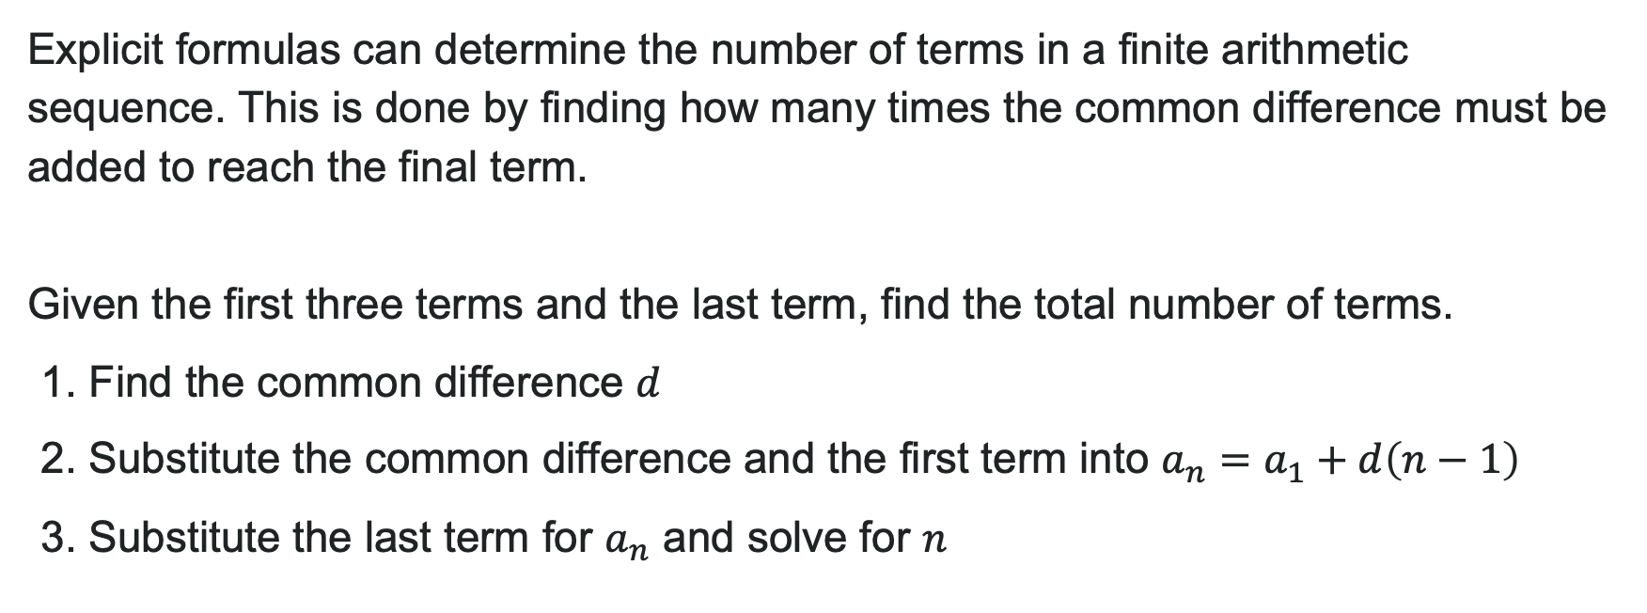
Finding the Number of Terms
Explicit formulas can determine the number of terms in a finite arithmetic sequence. This is done by finding how many times the common difference must be added to reach the final term.
Given the first three terms and the last term, find the total number of terms.
1. Find the common difference $d$
2. Substitute the common difference and the first term into $a_{n}=a_{1}+d\left(n−1\right)$
3. Substitute the last term for $a_{n}$ and solve for $n$

Slide 31
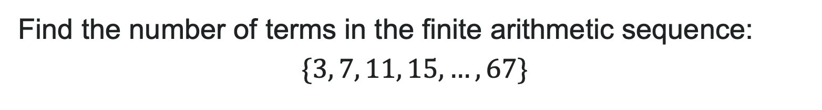
Try It: Number of Terms in an Arithmetic Sequence
Find the number of terms in the finite arithmetic sequence:
$$\{3, 7, 11, 15, …, 67\}$$
Notes:
Answer:
Step 1: Find d:
d = 7 - 3 = 4
Step 2: Write formula:
a_n = a_1 + d(n - 1)
a_n = 3 + 4(n - 1)
a_n = 3 + 4n - 4
a_n = 4n - 1
Step 3: Substitute last term and solve:
67 = 4n - 1
68 = 4n
n = 17
There are 17 terms in the sequence.

Slide 32
Learning Goals: Geometric Sequences
Deepen your understanding and form connections within these skills:
1 Find the common ratio for a geometric sequence
2 Write the formula for a geometric sequence
3 Use geometric sequences to solve realistic scenarios

Slide 33

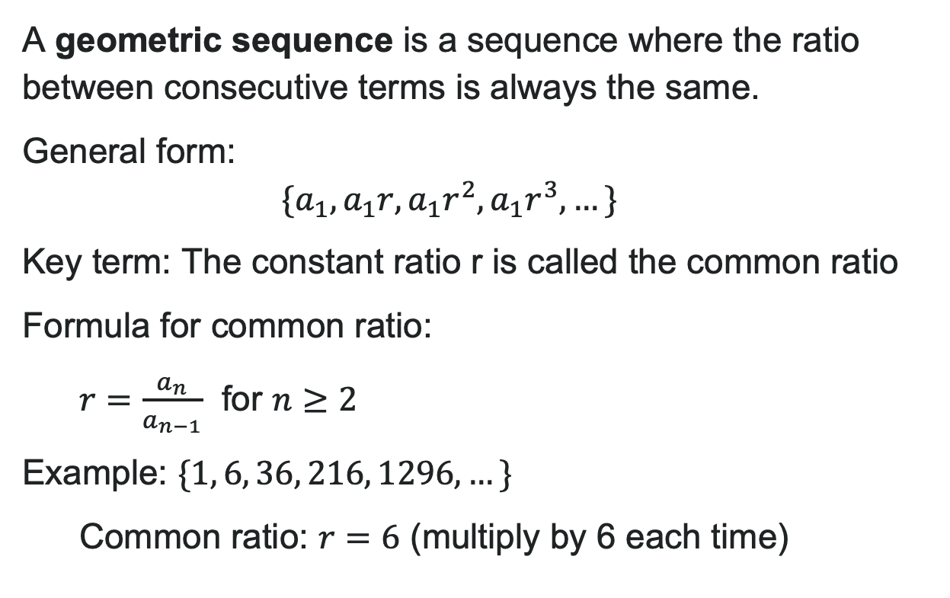
What is a Geometric Sequence?
A geometric sequence is a sequence where the ratio between consecutive terms is always the same.
General form:
$$\{a_{1},a_{1}r,a_{1}r^{2},a_{1}r^{3},…\}$$
Key term: The constant ratio r is called the common ratio
Formula for common ratio:
$r=\frac{a_{n}}{a_{n−1}}$ for $n≥2$
Example: $\{1, 6, 36, 216, 1296, …\}$
Common ratio: $r=6$ (multiply by 6 each time)

Slide 34
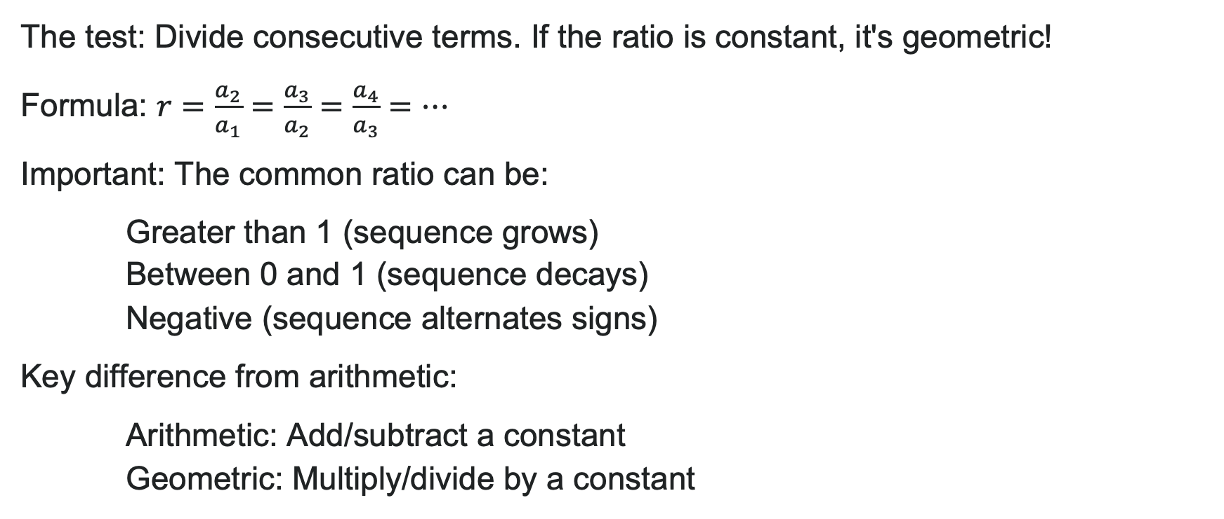
Identifying Geometric Sequences
The test: Divide consecutive terms. If the ratio is constant, it's geometric!
Formula: $r=\frac{a_{2}}{a_{1}}=\frac{a_{3}}{a_{2}}=\frac{a_{4}}{a_{3}}=…$
Important: The common ratio can be:
Greater than 1 (sequence grows)
Between 0 and 1 (sequence decays)
Negative (sequence alternates signs)
Key difference from arithmetic:
Arithmetic: Add/subtract a constant
Geometric: Multiply/divide by a constant

Slide 35
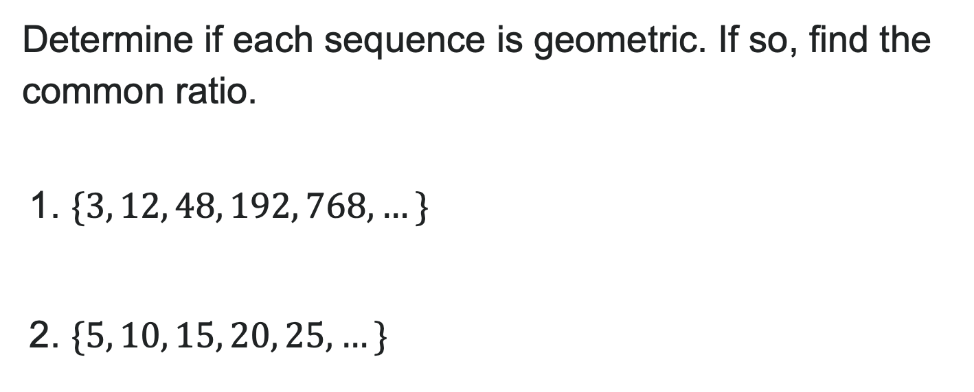
Try It: Common Ratio
Determine if each sequence is geometric. If so, find the common ratio.
1. $\{3, 12, 48, 192, 768, …\}$
2. $\{5, 10, 15, 20, 25, …\}$
Notes:
Answers:
1) \frac{12}{3} = 4, \frac{48}{12} = 4, \frac{192}{48} = 4, \frac{768}{192} = 4
Geometric with r = 4
2) \frac{10}{5} = 2, \frac{15}{10} = 1.5, \frac{20}{15} = 1.33...
NOT geometric (this is arithmetic with d = 5)

Slide 36
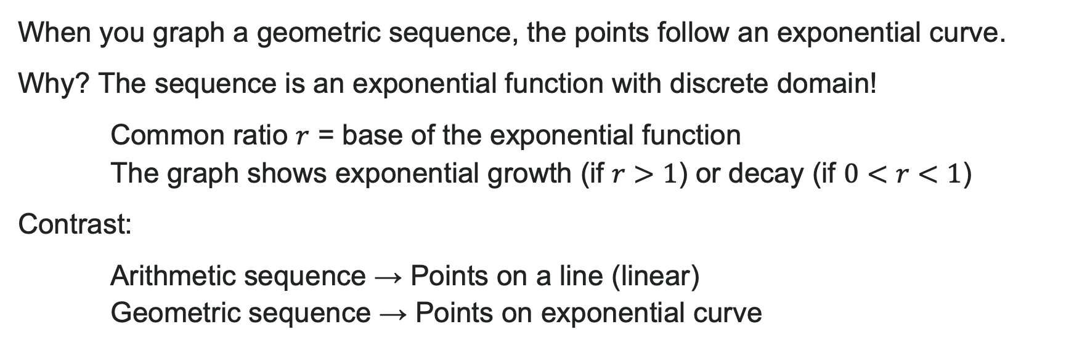
Graphs of Geometric Sequences
When you graph a geometric sequence, the points follow an exponential curve.
Why? The sequence is an exponential function with discrete domain!
Common ratio $r$ = base of the exponential function
The graph shows exponential growth (if $r>1$) or decay (if $0<r<1$)
Contrast:
Arithmetic sequence → Points on a line (linear)
Geometric sequence → Points on exponential curve

Slide 37
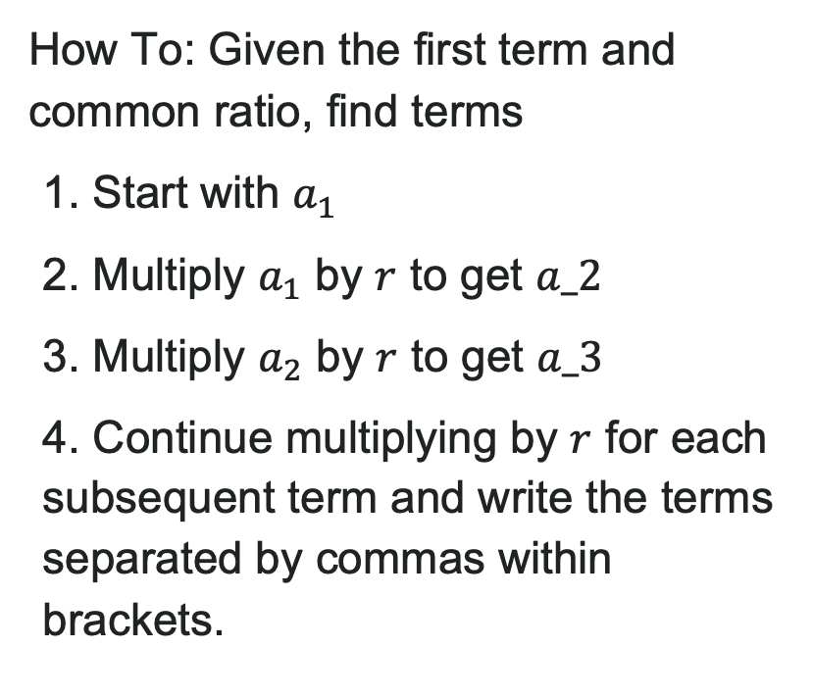
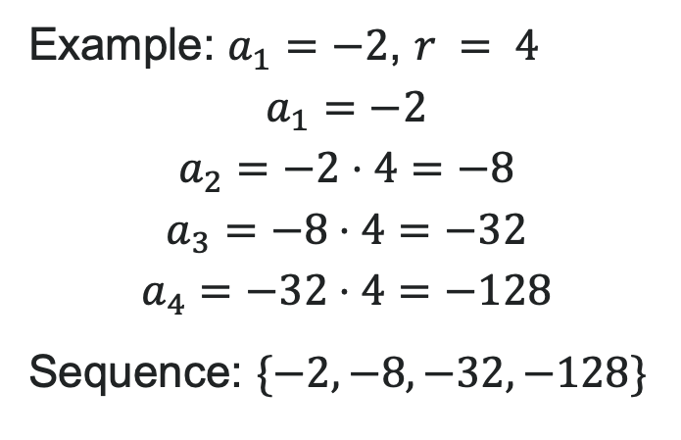
Writing Terms of Geometric Sequences
How To: Given the first term and common ratio, find terms
1. Start with $a_{1}$
2. Multiply $a_{1}$ by $r$ to get $a_2$
3. Multiply $a_{2}$ by $r$ to get $a_3$
4. Continue multiplying by $r$ for each subsequent term and write the terms separated by commas within brackets.
Example: $a_{1}=−2$, $r = 4$
$$a_{1}=−2$$
Sequence: $\{−2, −8, −32, −128\}$

Slide 38
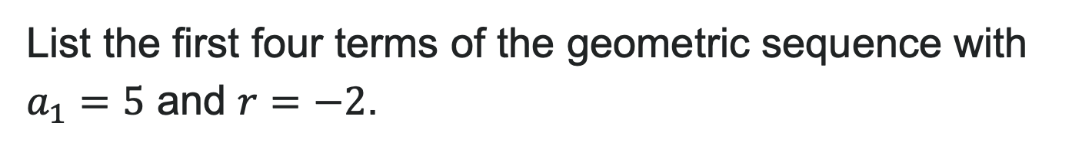
Try It: Write the Terms of a Geometric Sequence
List the first four terms of the geometric sequence with $a_{1}=5$ and $r=−2$.
Notes:
Answer:
a_1 = 5
a_2 = 5 \cdot (-2) = -10
a_3 = -10 \cdot (-2) = 20
a_4 = 20 \cdot (-2) = -40
First four terms: \{5, -10, 20, -40\}

Slide 39
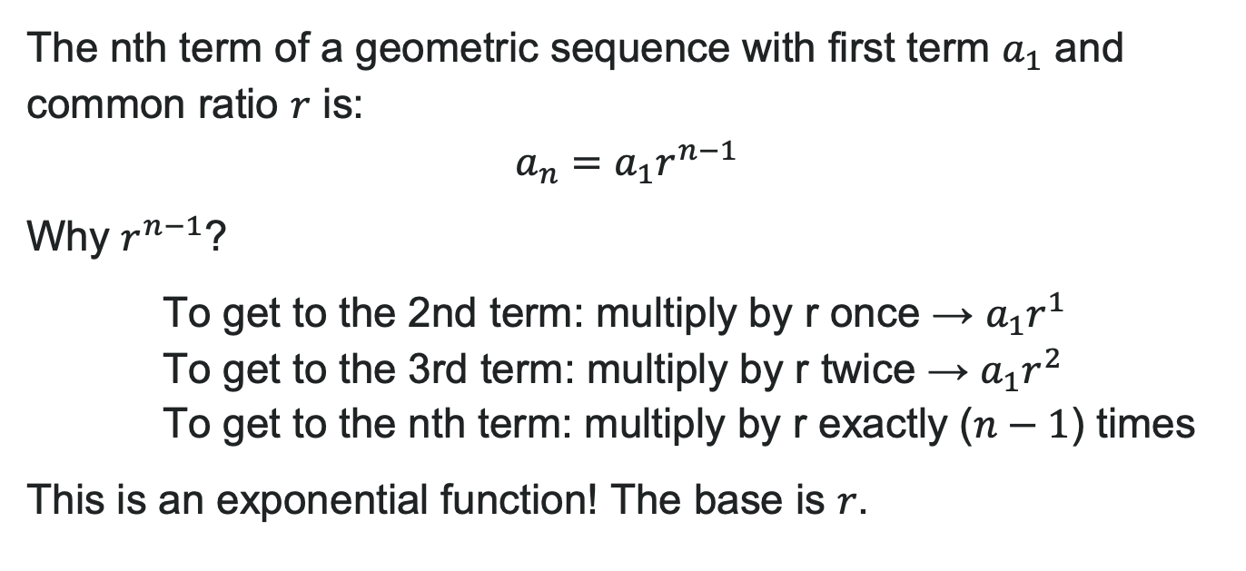
Explicit Formula for a Geometric Sequence
The nth term of a geometric sequence with first term $a_{1}$ and common ratio $r$ is:
$a_{n}=a_{1}r^{n−1}$
Why $r^{n−1}$?
To get to the 2nd term: multiply by r once → $a_{1}r^{1}$
To get to the 3rd term: multiply by r twice → $a_{1}r^{2}$
To get to the nth term: multiply by r exactly ($n−1$) times
This is an exponential function! The base is $r$.

Slide 40
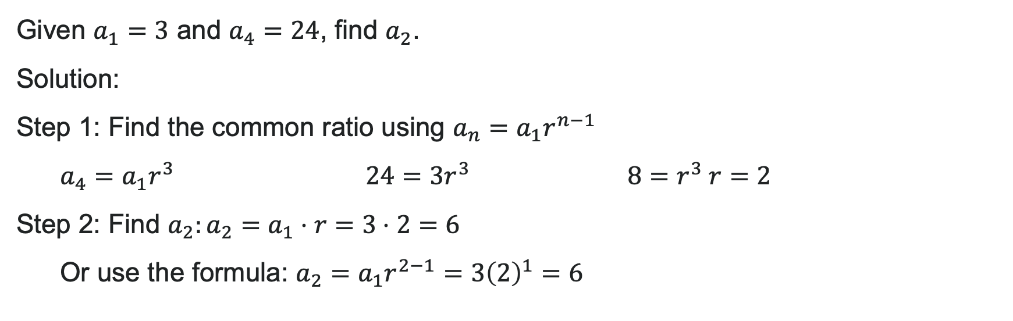
Example: Using the Explicit Formula for Geometric Sequences
Given $a_{1}=3$ and $a_{4}=24$, find $a_{2}$.
Solution:
Step 1: Find the common ratio using $a_{n}=a_{1}r^{n−1}$
$a_{4}=a_{1}r^{3}$ $24=3r^{3}$ $8=r^{3} r=2$
Step 2: Find $a_{2}:a_{2}=a_{1}⋅r=3⋅2=6$
Or use the formula: $a_{2}=a_{1}r^{2−1}=3{\left(2\right)}^{1}=6$

Slide 41

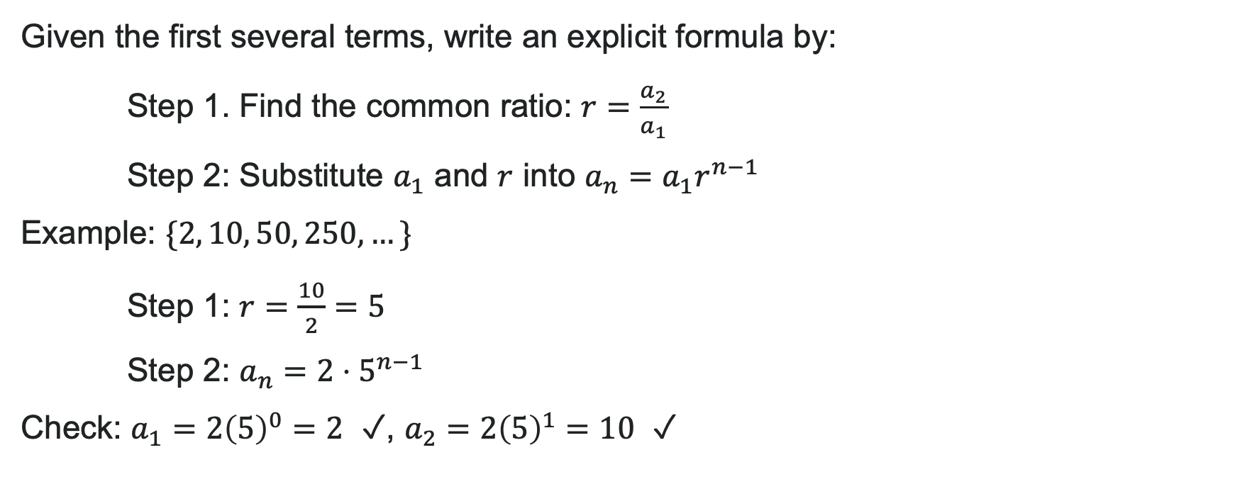
How to: Write Explicit Formulas for Geometric Sequences
Given the first several terms, write an explicit formula by:
Step 1. Find the common ratio: $r=\frac{a_{2}}{a_{1}}$
Step 2: Substitute $a_{1}$ and $r$ into $a_{n}=a_{1}r^{n−1}$
Example: $\{2, 10, 50, 250, …\}$
Step 1: $r=\frac{10}{2}=5$
Step 2: $a_{n}=2⋅5^{n−1}$
Check: $a_{1}=2{\left(5\right)}^{0}=2$ ✓, $a_{2}=2{\left(5\right)}^{1}=10$ ✓

Slide 42
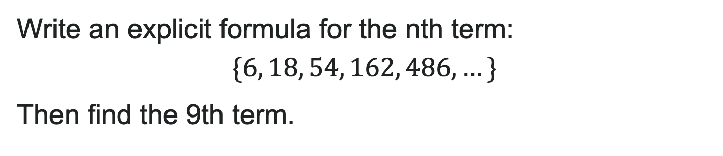
Try It: Write an Explicit Formula for a Geometric Sequence
Write an explicit formula for the nth term:
$\{6, 18, 54, 162, 486, …\}$
Then find the 9th term.
Notes:
Answer:
Step 1: Find r:
r = \frac{18}{6} = 3
Step 2: Write formula:
a_n = 6 \cdot 3^{n-1}
Step 3: Find 9th term:
a_9 = 6 \cdot 3^{9-1} = 6 \cdot 3^8 = 6 \cdot 6561 = 39,366

Slide 43
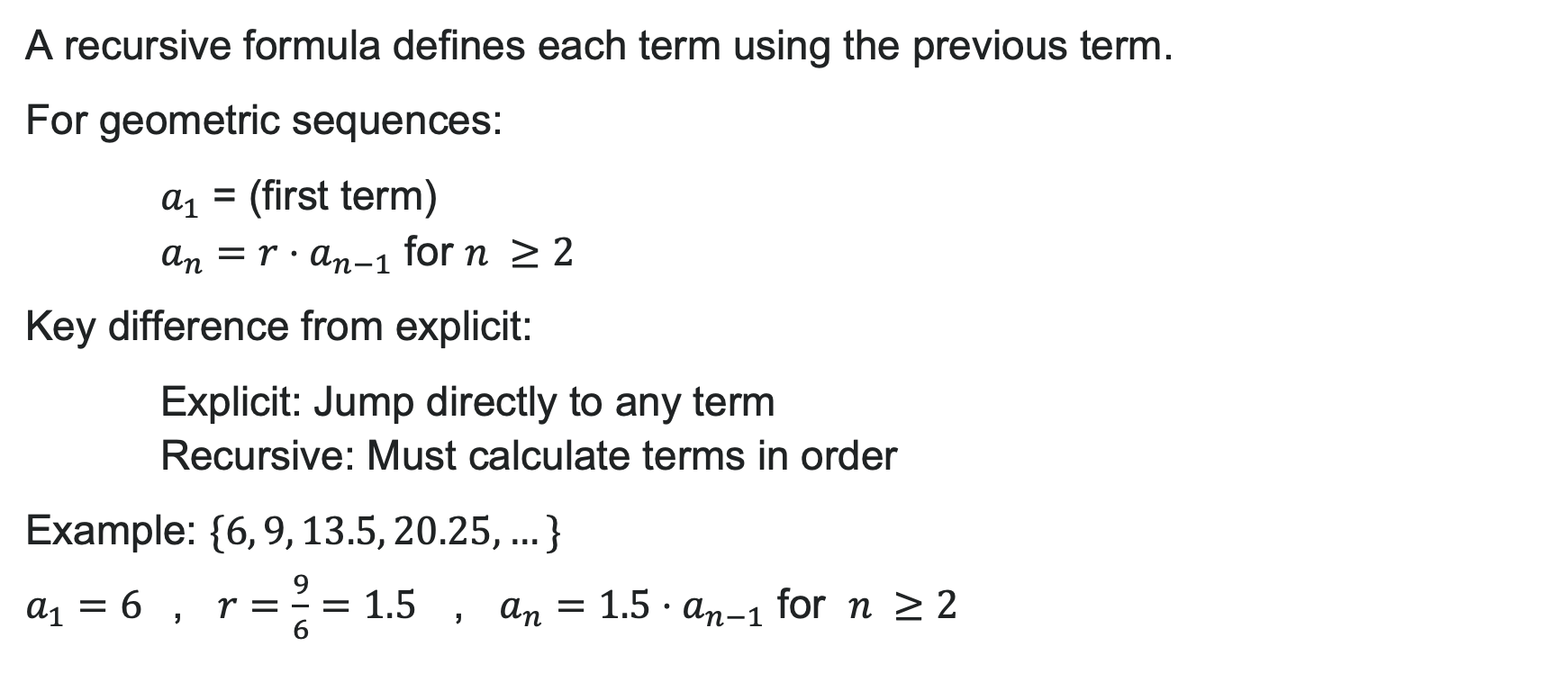
Recursive Formula for Geometric Sequences
A recursive formula defines each term using the previous term.
For geometric sequences:
$a_{1}$ = (first term)
$a_{n}=r⋅a_{n−1}$ for $n ≥2$
Key difference from explicit:
Explicit: Jump directly to any term
Recursive: Must calculate terms in order
Example:
, $r=\frac{9}{6}=1.5$ , $a_{n}=1.5⋅a_{n−1}$ for $n ≥2$

Slide 44
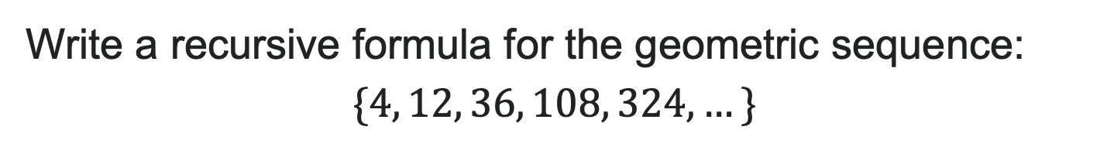
Try It: Recursive Formulas for a Geometric Sequence
Write a recursive formula for the geometric sequence:
$$\{4, 12, 36, 108, 324, …\}$$
Notes:
Answer:

Slide 45
Learning Goals: Series and Their Notations
Deepen your understanding and form connections within these skills:
1 Use summation notation to represent a series
2 Use the formula for the sum of the ﬁrst n terms of an arithmetic series
3 Use the formula for the sum of the ﬁrst n terms of a geometric series
4 Use the formula for the sum of an inﬁnite geometric series
5 Solve word problems involving series

Slide 46
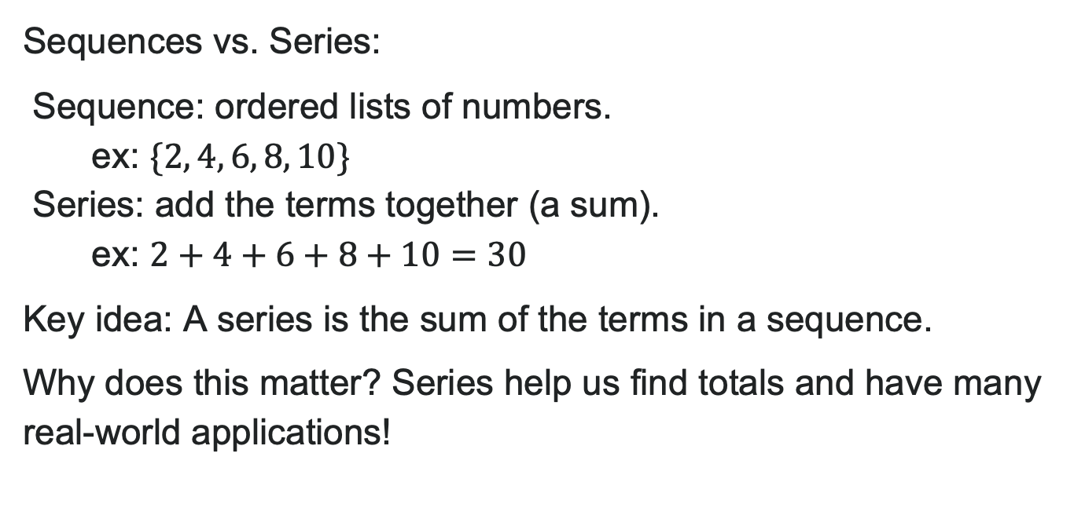
From Sequences to Series
Sequences vs. Series:
Sequence: ordered lists of numbers.
  ex: $\{2, 4, 6, 8, 10\}$
Series: add the terms together (a sum).
  ex: $2+4+6+8+10=30$
Key idea: A series is the sum of the terms in a sequence.
Why does this matter? Series help us find totals and have many real-world applications!

Slide 47

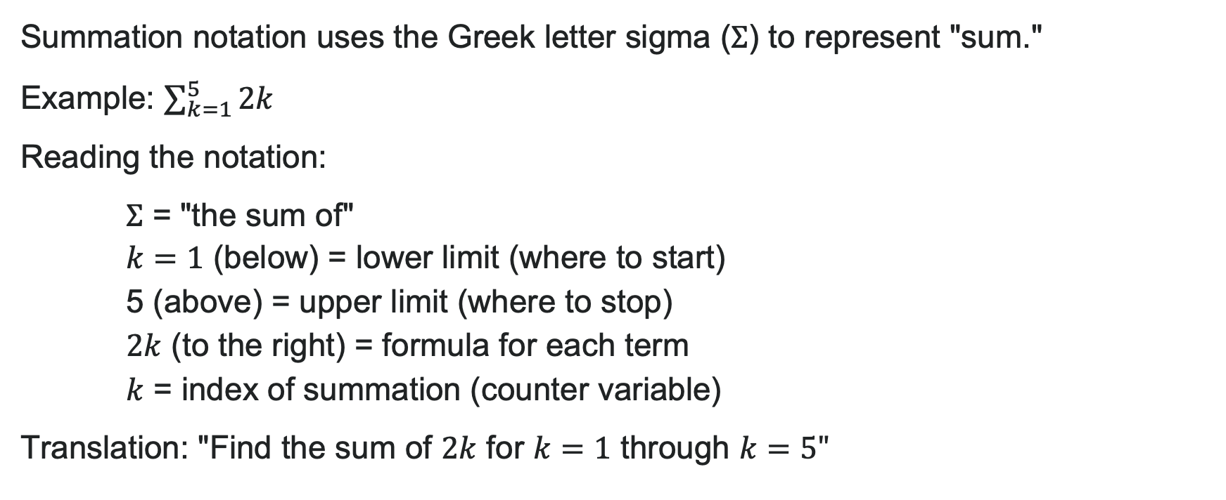
Summation Notation (Sigma Notation)
Summation notation uses the Greek letter sigma ($Σ$) to represent "sum."
Example: $\sum_{k=1}^{5}{2k}$
Reading the notation:
$Σ$ = "the sum of"
$k=1$ (below) = lower limit (where to start)
5 (above) = upper limit (where to stop)
$2k$ (to the right) = formula for each term
$k$ = index of summation (counter variable)
Translation: "Find the sum of $2k$ for $k=1$ through $k=5"$

Slide 48
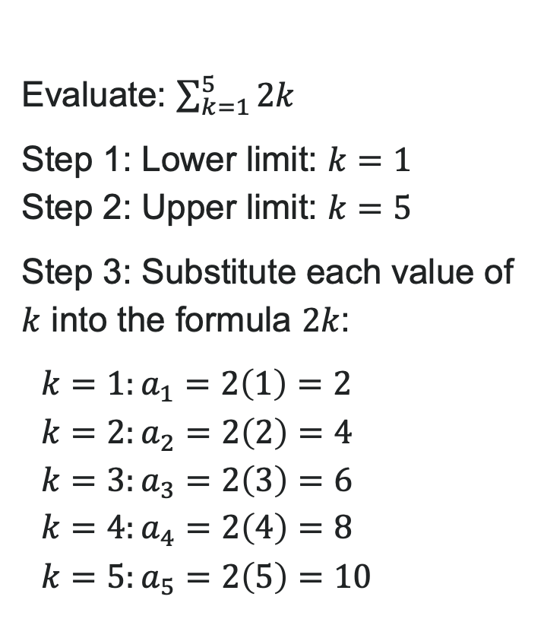
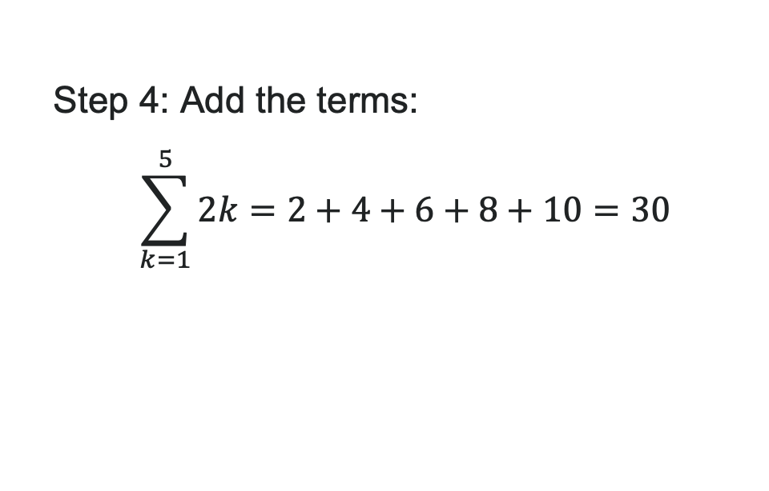
Evaluate a Series
Evaluate: $\sum_{k=1}^{5}{2k}$
Step 1: Lower limit: $k=1$
Step 2: Upper limit: $k=5$
Step 3: Substitute each value of $k$ into the formula $2k$:
$k=1:a_{1}=2\left(1\right)=2$
$k=2:a_{2}=2\left(2\right)=4$
$k=3:a_{3}=2\left(3\right)=6$
$k=4:a_{4}=2\left(4\right)=8$
$k=5:a_{5}=2\left(5\right)=10$
Steps:
1. Identify the lower limit of summation.
2. Identify the upper limit of summation.
3. Substitute each value of k from the lower limit to the upper limit into the formula.
4. Add to find the sum.
Step 4: Add the terms:
$$\sum_{k=1}^{5}{2k}=2+4+6+8+10=30$$

Slide 49
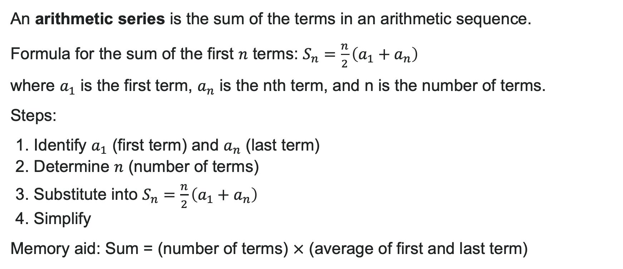
Arithmetic Series
An arithmetic series is the sum of the terms in an arithmetic sequence.
Formula for the sum of the first $n$ terms: $S_{n}=\frac{n}{2}\left(a_{1}+a_{n}\right)$
where $a_{1}$ is the first term, $a_{n}$ is the nth term, and n is the number of terms.
Steps:
1. Identify $a_{1}$ (first term) and $a_{n}$ (last term)
2. Determine $n$ (number of terms)
3. Substitute into $S_{n}=\frac{n}{2}\left(a_{1}+a_{n}\right)$
4. Simplify
Memory aid: Sum = (number of terms) $×$ (average of first and last term)

Slide 50
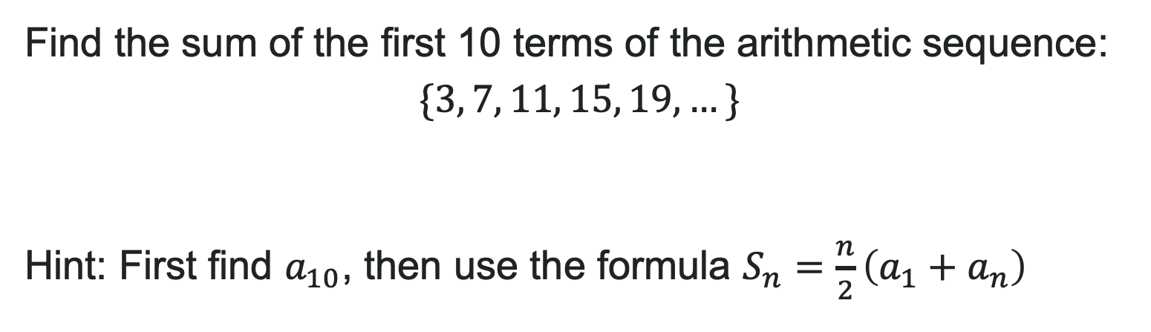
Try It: Arithmetic Series
Find the sum of the first 10 terms of the arithmetic sequence:
$$\{3, 7, 11, 15, 19, …\}$$
Hint: First find $a_{10}$, then use the formula $S_{n}=\frac{n}{2}\left(a_{1}+a_{n}\right)$
Notes:
Answer:
Step 1: Identify a_1 = 3
Step 2: Find a_{10} using a_n = a_1 + (n-1)d
d = 7 - 3 = 4
a_{10} = 3 + (10-1)(4) = 3 + 36 = 39
Step 3: n = 10 terms
Step 4: Use formula:
S_{10} = \frac{10}{2}(3 + 39) = 5(42) = 210
The sum is 210.

Slide 51
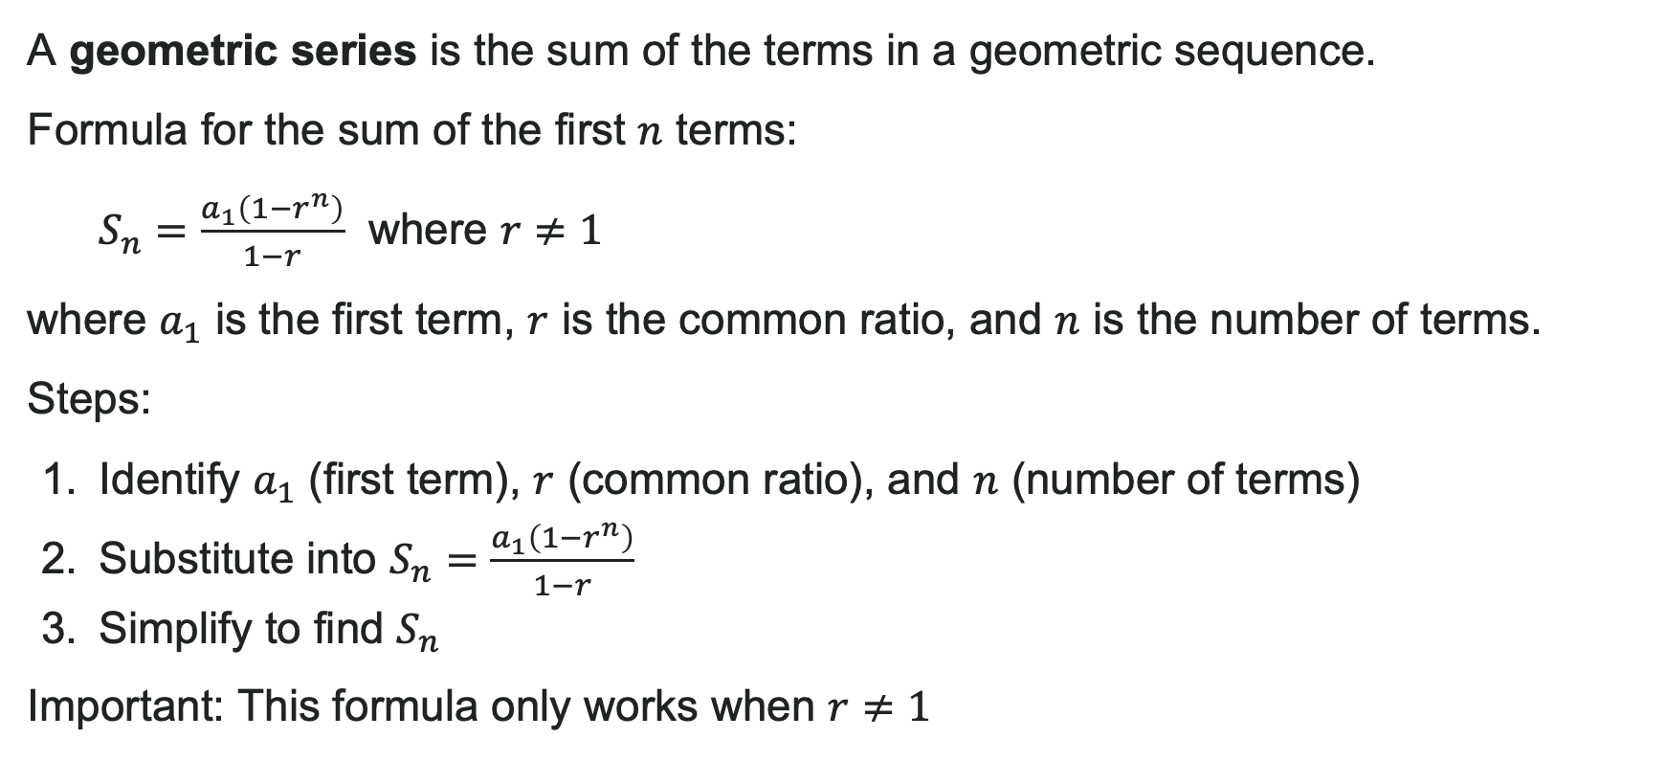
Geometric Series
A geometric series is the sum of the terms in a geometric sequence.
Formula for the sum of the first $n$ terms:
$S_{n}=\frac{a_{1}\left(1−r^{n}\right)}{1−r}$ where $r≠1$
where $a_{1}$ is the first term, $r$ is the common ratio, and $n$ is the number of terms.
Steps:
Identify $a_{1}$ (first term), $r$ (common ratio), and $n$ (number of terms)
Substitute into $S_{n}=\frac{a_{1}\left(1−r^{n}\right)}{1−r}$
Simplify to find $S_{n}$
Important: This formula only works when $r≠1$

Slide 52
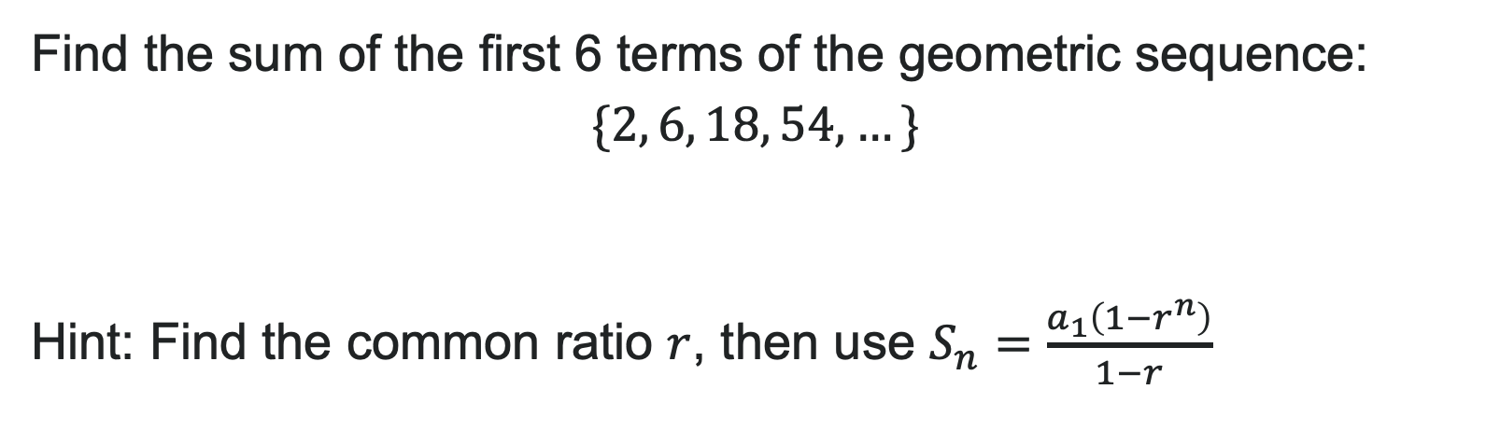
Try It: Geometric Series
Find the sum of the first 6 terms of the geometric sequence:
$$\{2, 6, 18, 54, …\}$$
Hint: Find the common ratio $r$, then use $S_{n}=\frac{a_{1}\left(1−r^{n}\right)}{1−r}$
Notes:
Answer:
Step 1: Identify values
a_1 = 2
r = \frac{6}{2} = 3
n = 6
Step 2: Substitute into formula:
S_6 = \frac{2(1 - 3^6)}{1 - 3}
Step 3: Simplify:
S_6 = \frac{2(1 - 729)}{-2}
S_6 = \frac{2(-728)}{-2}
S_6 = \frac{-1456}{-2}
S_6 = 728
The sum is 728.

Slide 53
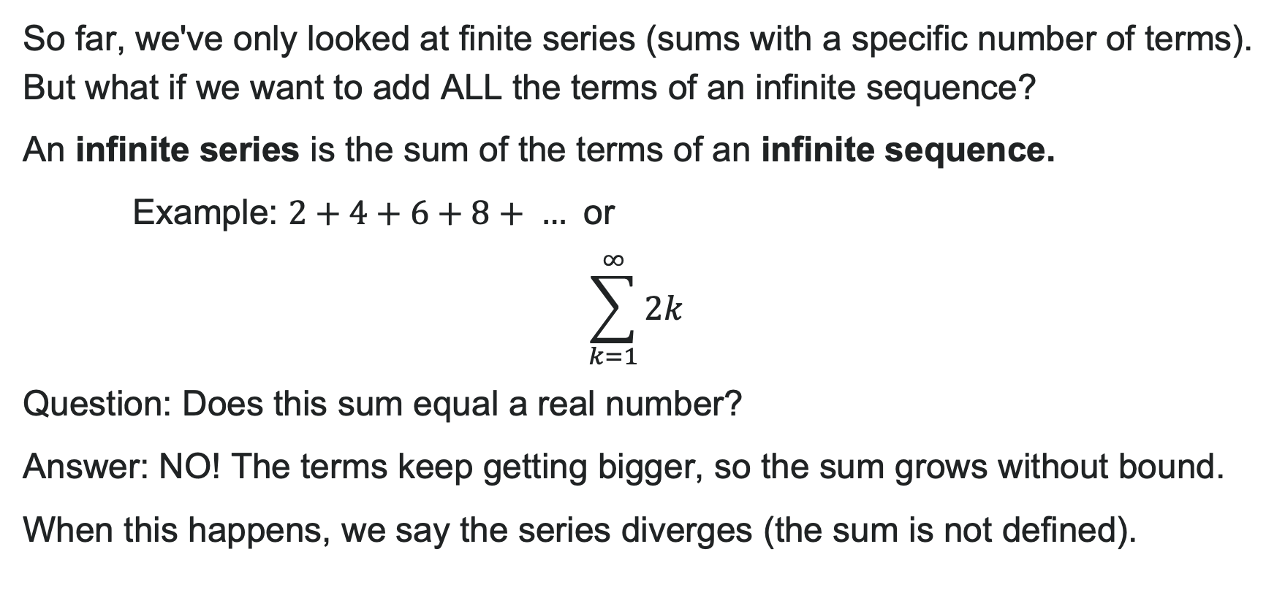
Infinite Series
So far, we've only looked at finite series (sums with a specific number of terms). But what if we want to add ALL the terms of an infinite sequence?
An infinite series is the sum of the terms of an infinite sequence.
Example: $2+4+6+8+ …$ or
$$\sum_{k=1}^{∞}{2k}$$
Question: Does this sum equal a real number?
Answer: NO! The terms keep getting bigger, so the sum grows without bound.
When this happens, we say the series diverges (the sum is not defined).

Slide 54
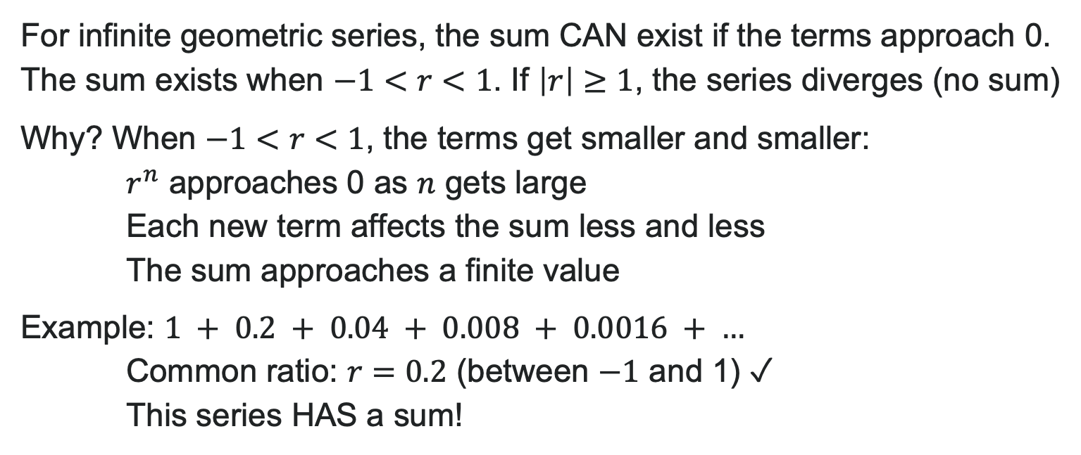
When Does an Infinite Arithmetic Series Have a Sum?
For infinite geometric series, the sum CAN exist if the terms approach 0. The sum exists when $−1<r<1$. If $\left|r\right|≥1$, the series diverges (no sum)
Why? When $−1<r<1$, the terms get smaller and smaller:
$r^{n}$ approaches 0 as $n$ gets large
Each new term affects the sum less and less
The sum approaches a finite value
Example: $1 + 0.2 + 0.04 + 0.008 + 0.0016 + …$
Common ratio: $r=0.2$ (between $−1$ and 1) ✓
This series HAS a sum!

Slide 55
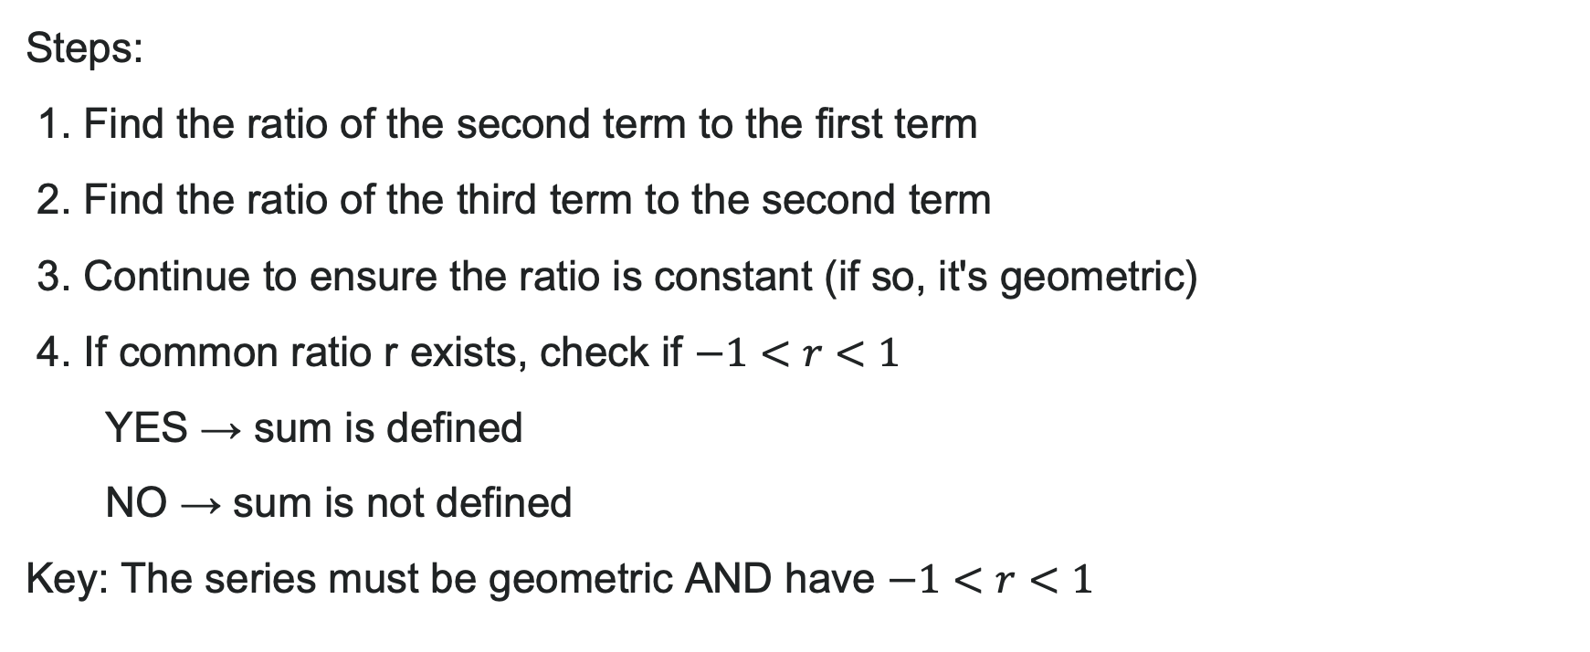
How to: Determine if Sum Exists
Steps:
1. Find the ratio of the second term to the first term
2. Find the ratio of the third term to the second term
3. Continue to ensure the ratio is constant (if so, it's geometric)
4. If common ratio r exists, check if $−1<r<1$
  YES → sum is defined
  NO → sum is not defined
Key: The series must be geometric AND have $−1<r<1$

Slide 56
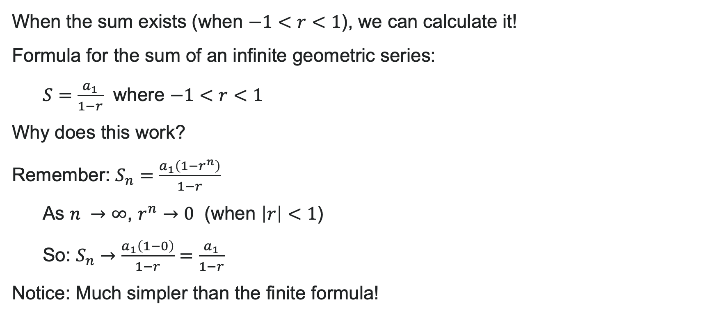
Finding the Actual Sum
When the sum exists (when $−1<r<1$), we can calculate it!
Formula for the sum of an infinite geometric series:
$S=\frac{a_{1}}{1−r}$ where $−1<r<1$
Why does this work?
Remember: $S_{n}=\frac{a_{1}\left(1−r^{n}\right)}{1−r}$
As $n →∞$, $r^{n}→0$ (when $\left|r\right|<1$)
So: $S_{n}→\frac{a_{1}\left(1−0\right)}{1−r}=\frac{a_{1}}{1−r}$
Notice: Much simpler than the finite formula!

Slide 57


How To: Find the Infinite Sum
Given an infinite geometric series, find its sum by:
1. Identify $a_{1}$ and $r$
2. Confirm that $−1<r<1$ (if not, sum doesn't exist!)
3. Substitute into the formula: $S=\frac{a_{1}}{1−r}$
4. Simplify to find $S$
Important: Always check the condition in Step 2 first!

Slide 58

Try It!
Find the sum of the infinite geometric series (if it exists):
$$\sum_{k=1}^{∞}{6}⋅{\left(\frac{2}{3}\right)}^{k}$$
Notes:
Answer:
Step 1: Identify values
First term when k=1: a_1 = 6 \cdot (\frac{2}{3})^1 = 6 \cdot \frac{2}{3} = 4
Common ratio: r = \frac{2}{3}
Step 2: Check condition
-1 < \frac{2}{3} < 1 ✓ Sum exists!
Step 3: Use formula:
S = \frac{a_1}{1 - r} = \frac{4}{1 - \frac{2}{3}}
Step 4: Simplify:
S = \frac{4}{\frac{1}{3}} = 4 \cdot 3 = 12
The sum is 12.

Slide 59
Before we finish up…
2
Next steps…..
3
Reminders about student hours, upcoming deadlines, campus activities ….
1
Questions…..

Slide 60

Attributions
Illustrations are from Storyset
Authored by: Lumen Learning. License: CC BY: Attribution

