Slide 1

Precalculus
Module 1:
Introduction to Functions

Slide 2
Affirmations
I am disciplined and organized in my studies.
I am not afraid to make mistakes—they’re part of learning.
Math is a skill I can develop with practice.

Slide 3

Learning Goals: Functions and Function Notation
Deepen your understanding and form connections within these skills:
1 Understand what a function is and use the vertical line test to check if a graph shows a function
2 Use function notation $f(x)$ and evaluate functions
3 Recognize the graphs of common functions

Slide 4
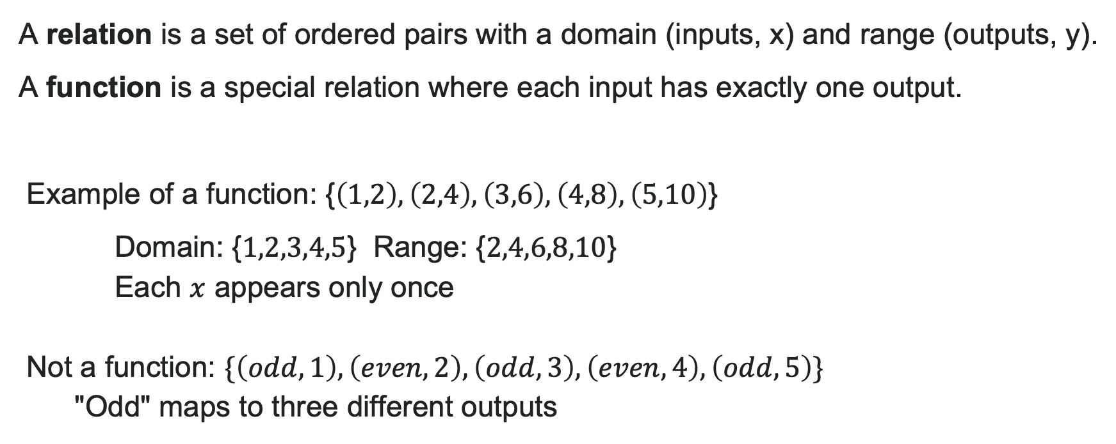
Determining Relation vs. Function
A relation is a set of ordered pairs with a domain (inputs, x) and range (outputs, y).
A function is a special relation where each input has exactly one output.
Example of a function: {$\left(1,2\right),\left(2,4\right),\left(3,6\right),\left(4,8\right),\left(5,10\right)$}
Domain: {$1,2,3,4,5$} Range: {$2,4,6,8,10$}
Each $x$ appears only once
Not a function: $\{\left(odd,1\right),\left(even,2\right),\left(odd,3\right),\left(even,4\right),\left(odd,5\right)\}$
"Odd" maps to three different outputs

Slide 5

Example: Is It a Function?
Menu: Plain donut $1.49, Jelly donut $1.99, Chocolate donut $1.99
Question: Is price a function of item? Is item a function of price?
Solution:
Price of item? YES – each item has exactly one price
Item of price? NO – $1.99 corresponds to two items
Key takeaway: Direction matters! Check if each input produces only one output.

Slide 6
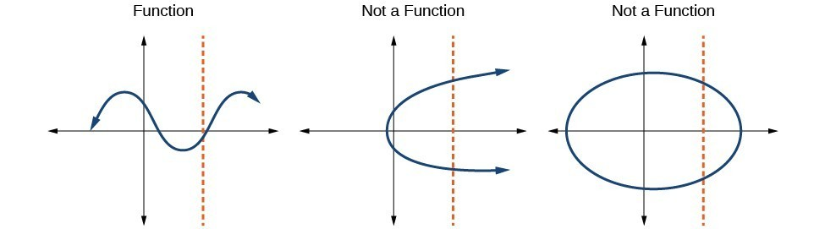
The Vertical Line Test
The vertical line test determines if a graph represents a function.
If ANY vertical line intersects the graph MORE THAN ONCE, it's NOT a function.
Why? Multiple intersections mean one input produces multiple outputs.

Slide 7
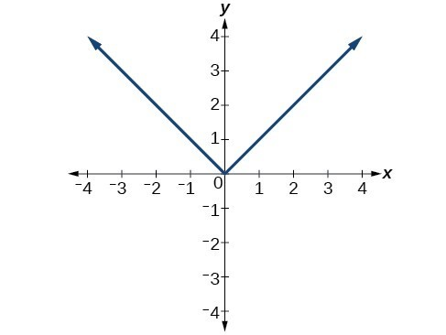
Try It: Vertical Line Test
Does $y=\left|x\right|$ pass the test?
Notes:
Answer: YES – any vertical line crosses once.

Slide 8

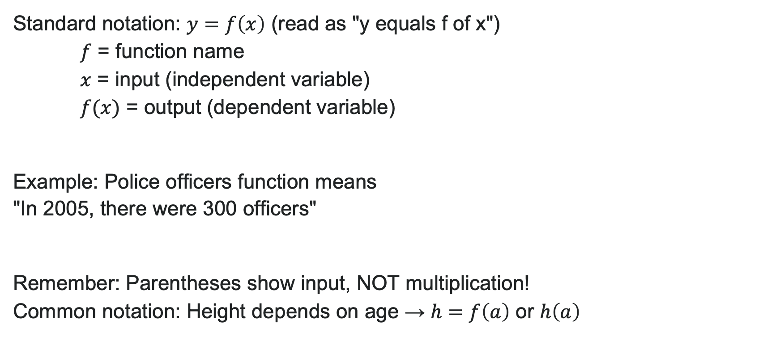
Function Notation
Standard notation: $y=f\left(x\right)$ (read as "y equals f of x")
$f$ = function name
$x$ = input (independent variable)
$f(x)$ = output (dependent variable)
Example: Police officers function means "In 2005, there were 300 officers"
Remember: Parentheses show input, NOT multiplication!
Common notation: Height depends on age → $h=f\left(a\right)$ or $h\left(a\right)$

Slide 9
Evaluating vs. Solving Functions
Evaluating: You know the input → find the output
Put a number into the function machine, get one result out
Strategy: Substitute the given value into the function and simplify
Always gives ONE answer
Solving: You know the output → find the input(s)
Working backwards—what went into the machine?
Strategy: Set the function equal to the given output and solve the equation
Can give MULTIPLE answers

Slide 10
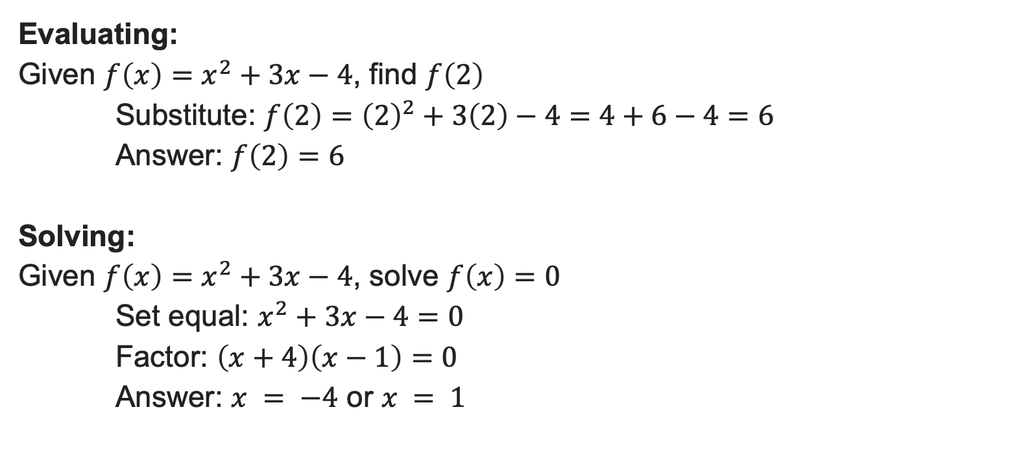
Examples: Evaluating and Solving
Evaluating:
Given $f\left(x\right)=x^{2}+3x−4$, find $f\left(2\right)$
Substitute: $f\left(2\right)={\left(2\right)}^{2}+3\left(2\right)−4=4+6−4=6$
Answer: $f\left(2\right)=6$
Solving:
Given $f\left(x\right)=x^{2}+3x−4$, solve $f\left(x\right)=0$
Set equal: $x^{2}+3x−4=0$
Factor: $\left(x+4\right)\left(x−1\right)=0$
Answer: $x = −4$ or $x = 1$

Slide 11
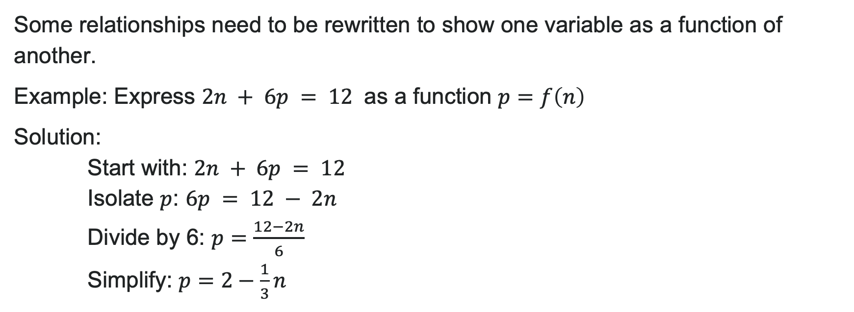

Evaluating Functions Expressed in Formulas
Some relationships need to be rewritten to show one variable as a function of another.
Example: Express $2n + 6p = 12$ as a function $p=f\left(n\right)$
Solution:
Start with: $2n + 6p = 12$
Isolate $p$: $6p = 12 − 2n$
Divide by 6: $p=\frac{12−2n}{6}$
Simplify: $p=2−\frac{1}{3}n$
Function form: $p=f\left(n\right)=2−\frac{1}{3}n$

Slide 12

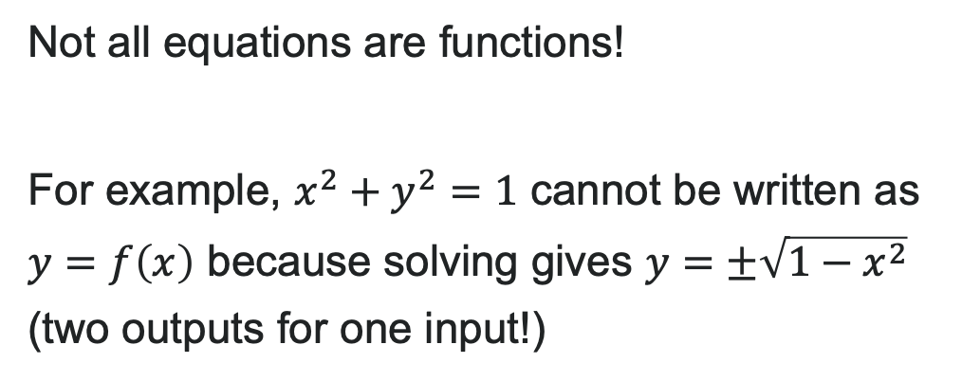
Pro Tip:
Not all equations are functions!
For example, $x^{2}+y^{2}=1$ cannot be written as $y=f\left(x\right)$ because solving gives $y=±\sqrt{1−x^{2}}$ (two outputs for one input!)

Slide 13

Try It: Evaluate and Solve Functions
Given $g\left(m\right)=\sqrt{m−4}$:
Evaluate $g\left(5\right)$
Solve $g\left(m\right)=2$
Notes:
Answer: a) g(5) = \sqrt{5-4} = 1
b) \sqrt{m-4} = 2 → m-4 = 4 → m = 8

Slide 14
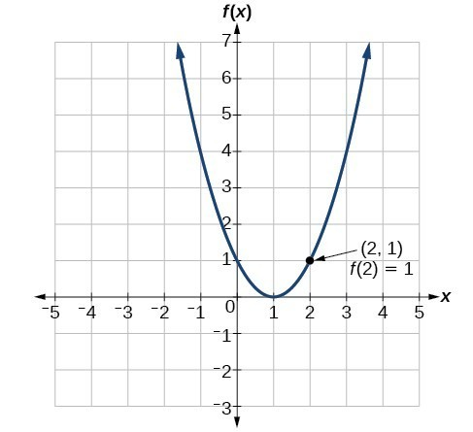
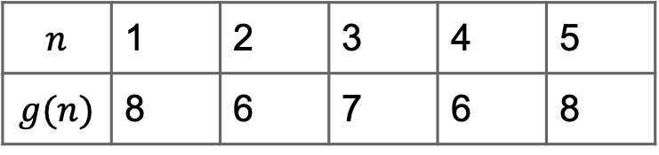
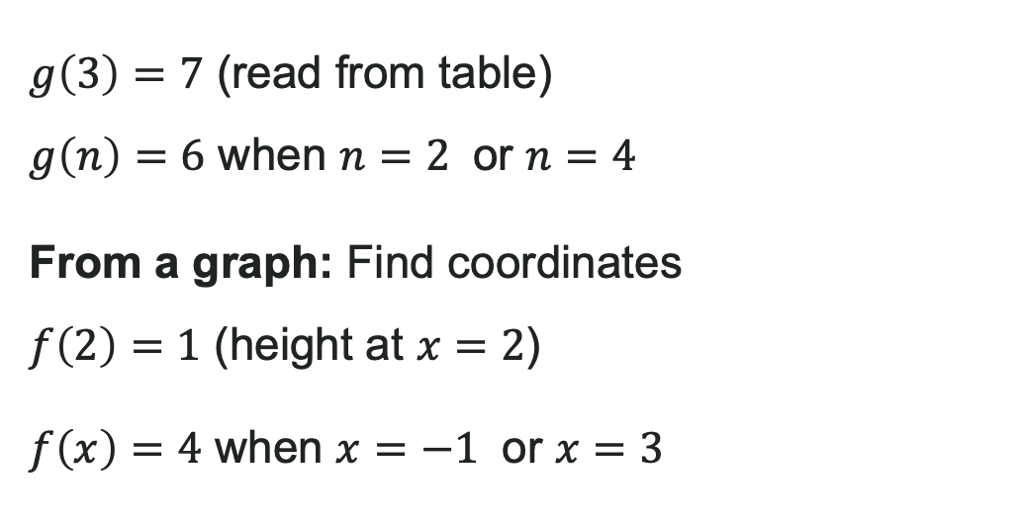
Evaluating from Tables and Graphs
From a table: Read directly
$$n$$ | 1 | 2 | 3 | 4 | 5
$$g(n)$$ | 8 | 6 | 7 | 6 | 8
$g\left(3\right)=7$ (read from table)
$g\left(n\right)=6$ when $n=2$ or $n=4$
From a graph: Find coordinates
$f\left(2\right)=1$ (height at $x=2$)
$f\left(x\right)=4$ when $x=−1$ or $x=3$

Slide 15
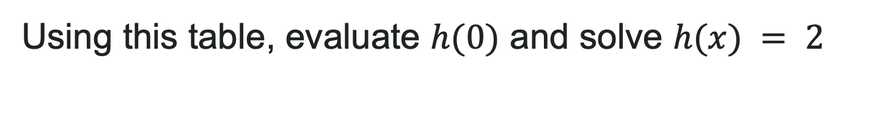
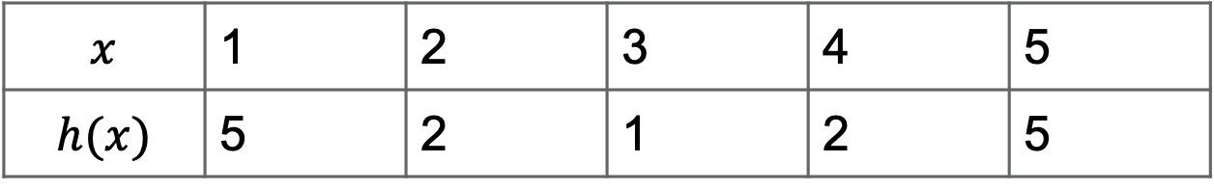
Try It: Evaluating from a Table
Using this table, evaluate $h(0)$ and solve $h(x) = 2$
$$x$$ | 1 | 2 | 3 | 4 | 5
$$h(x)$$ | 5 | 2 | 1 | 2 | 5
Notes:
Answer: Eval: h(0) = 1 Solve: h(x) = 2 when x = -1 or x = 1

Slide 16
Learning Goals: Domain and Range
Deepen your understanding and form connections within these skills:
1 Find the domain of a function by looking at its equation
2 Find the domain of a function by look at its graph
3 Sketch graphs of piecewise functions

Slide 17
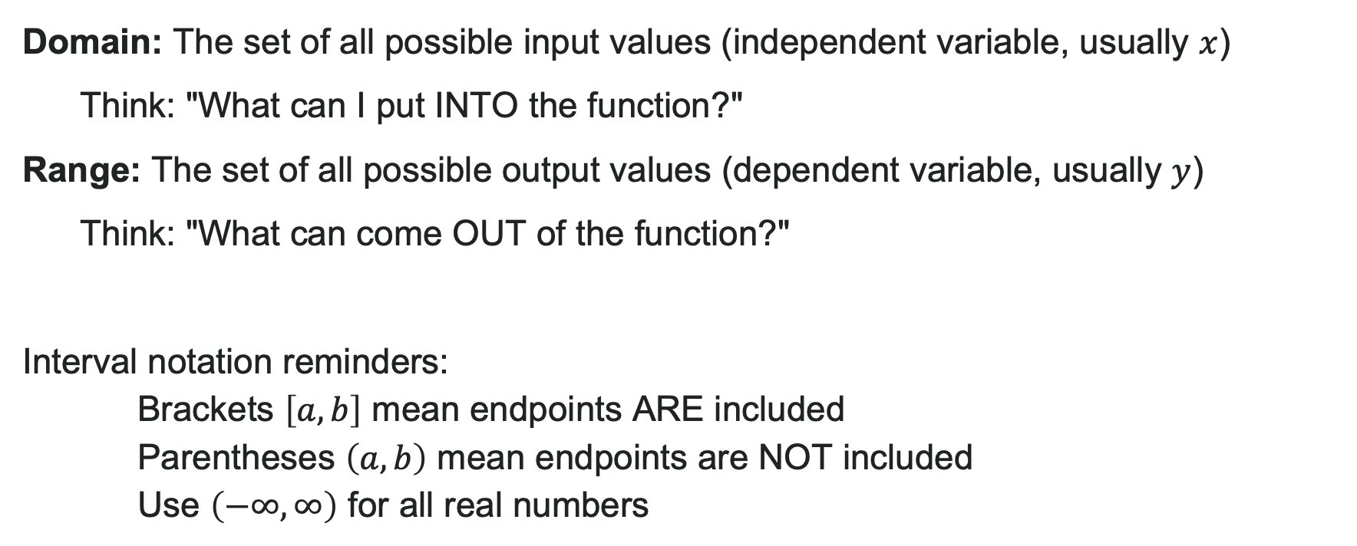
What Are Domain and Range?
Domain: The set of all possible input values (independent variable, usually $x$)
Think: "What can I put INTO the function?"
Range: The set of all possible output values (dependent variable, usually $y$)
Think: "What can come OUT of the function?"
Interval notation reminders:
Brackets $\left[a,b\right]$ mean endpoints ARE included
Parentheses $\left(a,b\right)$ mean endpoints are NOT included
Use $\left(−∞,∞\right)$ for all real numbers

Slide 18
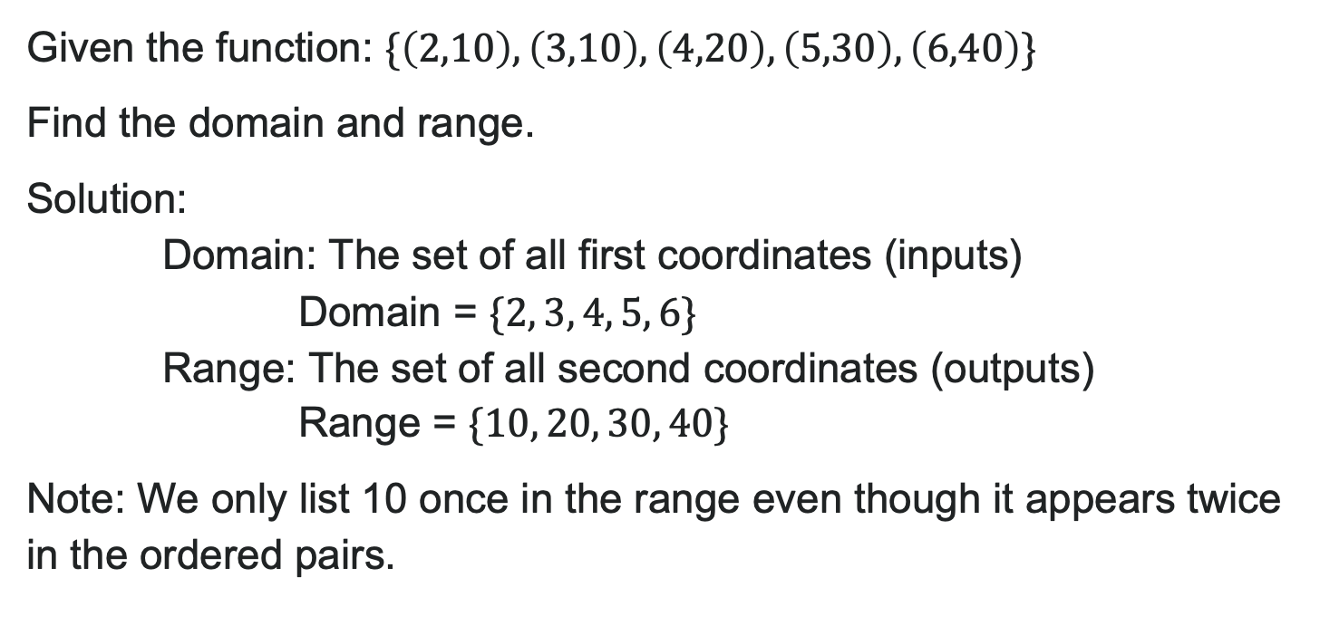
Example: Finding Domain and Range
Given the function: $\{\left(2,10\right),\left(3,10\right),\left(4,20\right),\left(5,30\right),\left(6,40\right)\}$
Find the domain and range.
Solution:
Domain: The set of all first coordinates (inputs)
Domain = $\{2, 3, 4, 5, 6\}$
Range: The set of all second coordinates (outputs)
Range = $\{10, 20, 30, 40\}$
Note: We only list 10 once in the range even though it appears twice in the ordered pairs.

Slide 19
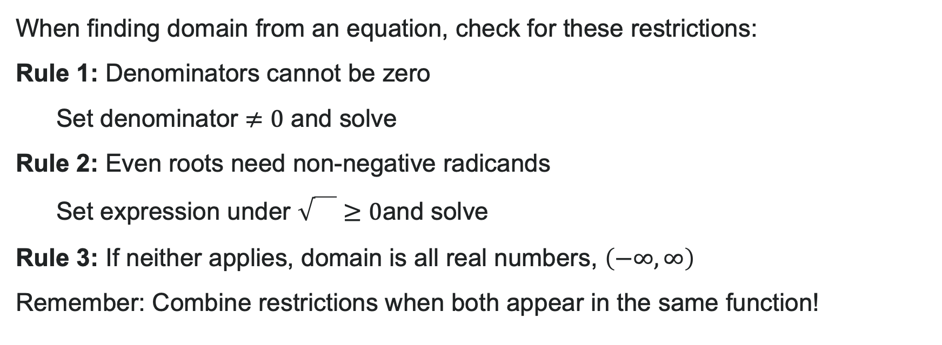
Finding Domain from Equations
When finding domain from an equation, check for these restrictions:
Rule 1: Denominators cannot be zero
Set denominator $≠0$ and solve
Rule 2: Even roots need non-negative radicands
Set expression under $\sqrt{}≥0$and solve
Rule 3: If neither applies, domain is all real numbers, $\left(−∞,∞\right)$
Remember: Combine restrictions when both appear in the same function!

Slide 20
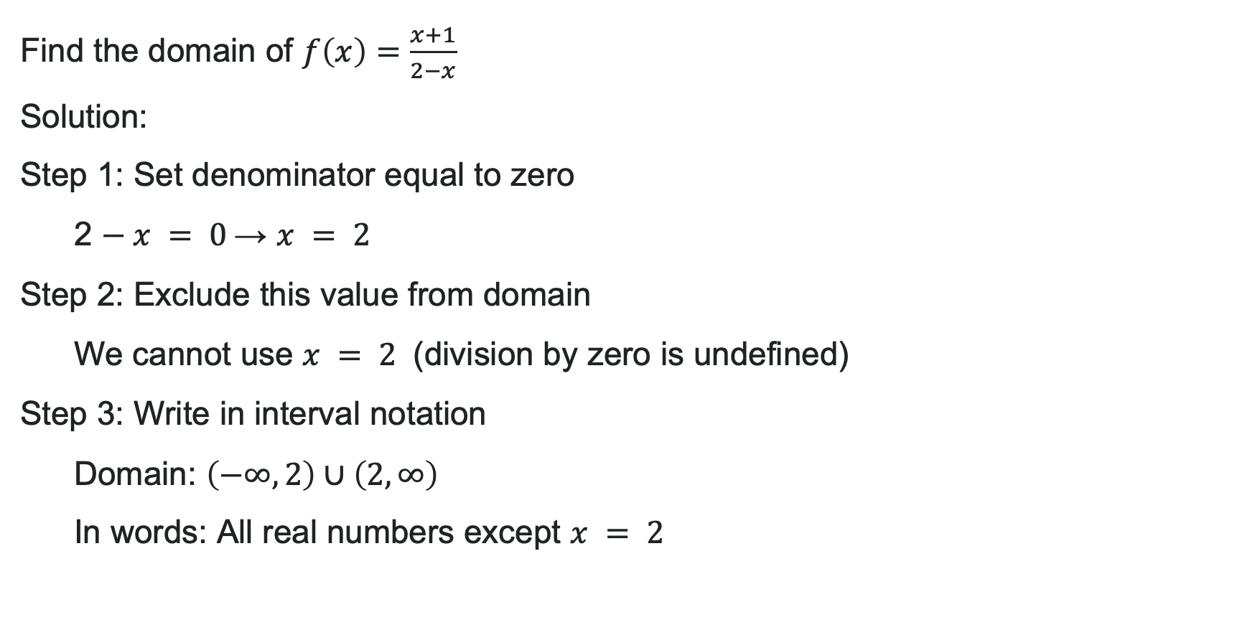
Example: Function with a Fraction
Find the domain of $f\left(x\right)=\frac{x+1}{2−x}$
Solution:
Step 1: Set denominator equal to zero
2 $− x = 0$→ $x = 2$
Step 2: Exclude this value from domain
We cannot use $x = 2$ (division by zero is undefined)
Step 3: Write in interval notation
Domain: $\left(−∞,2\right)∪\left(2,∞\right)$
In words: All real numbers except $x = 2$

Slide 21
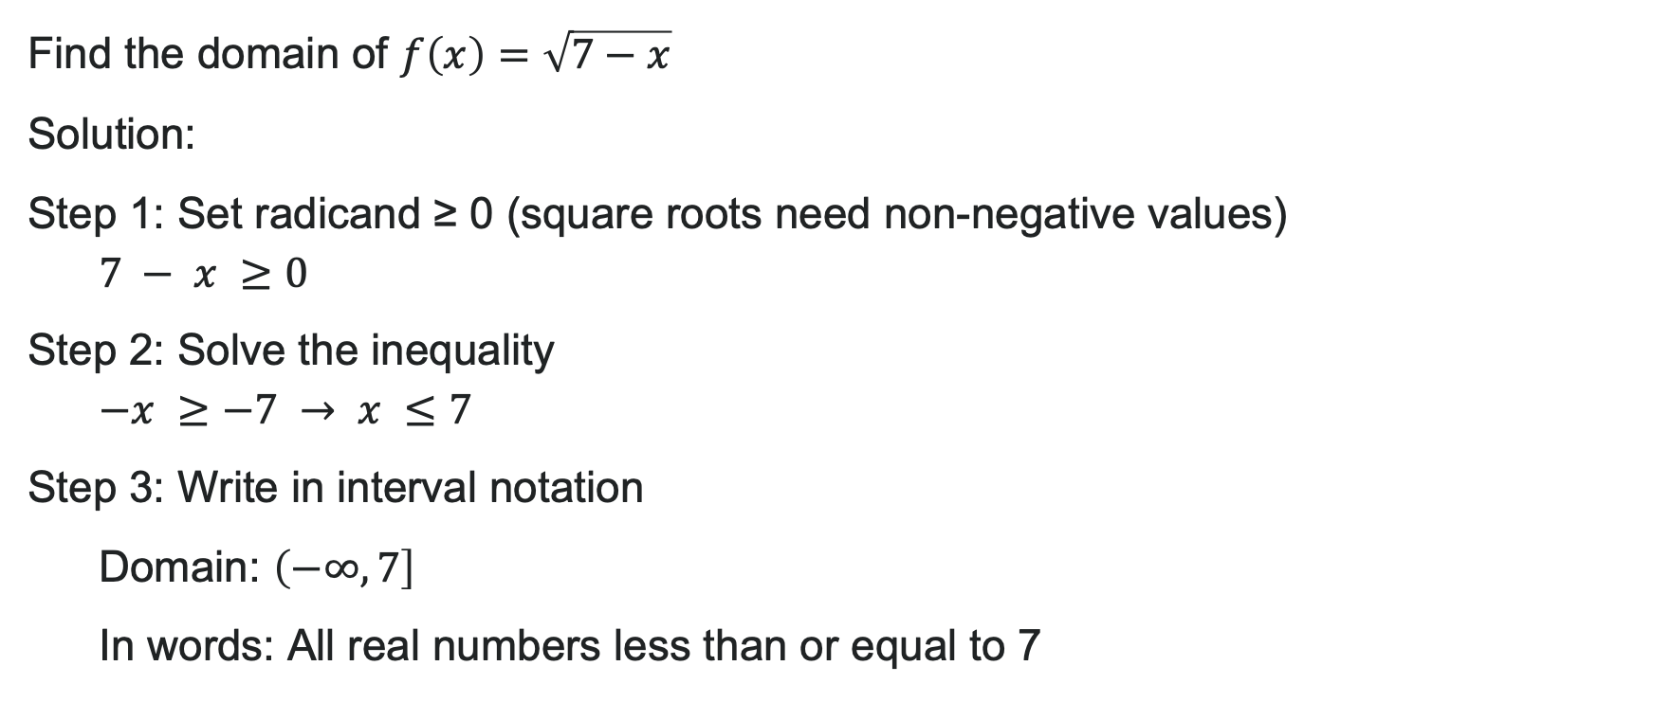
Example: Function with a Square Root
Find the domain of $f\left(x\right)=\sqrt{7−x}$
Solution:
Step 1: Set radicand ≥ 0 (square roots need non-negative values)
$$7 − x ≥0$$
Step 2: Solve the inequality
$$−x ≥−7 → x ≤7$$
Step 3: Write in interval notation
Domain: $\left(−∞,7\right]$
In words: All real numbers less than or equal to 7

Slide 22
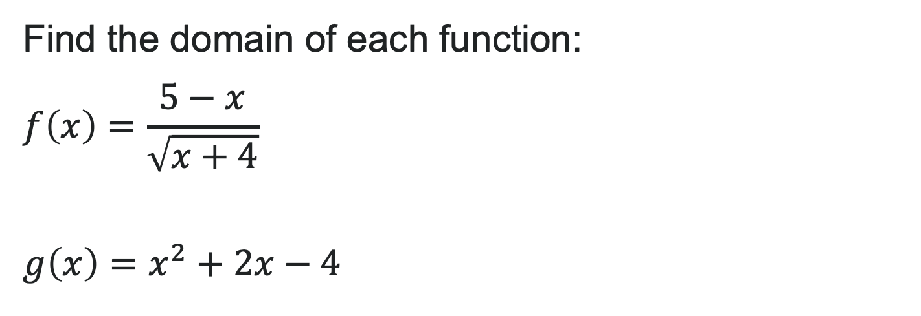
Try It: Finding Domain
Find the domain of each function:
$$f\left(x\right)=\frac{5−x}{\sqrt{x+4}}$$
$$g\left(x\right)=x^{2}+2x−4$$
Notes:
a) f(x) = \frac{5-x}{\sqrt{x+4}}
Step 1: The numerator has a square root: 5 - x \geq 0 → x \leq 5
Step 2: The denominator has a square root that cannot equal zero: x + 4 > 0 → x > -4
Step 3: Combine both restrictions: x > -4 AND x \leq 5
Answer: Domain = (-4, 5]
b) g(x) = x^2 + 2x - 4
This is a polynomial with no denominators or even roots.
Answer: Domain = (-\infty, \infty) (all real numbers)

Slide 23
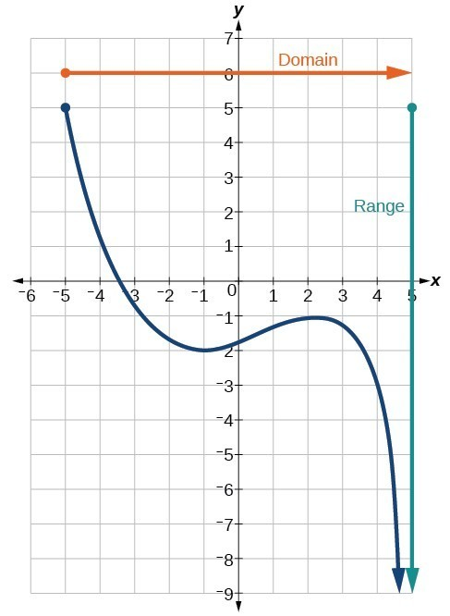
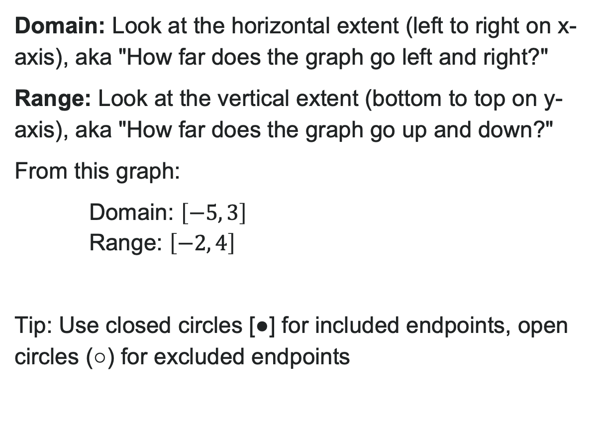
Domain and Range from Graphs
Domain: Look at the horizontal extent (left to right on x-axis), aka "How far does the graph go left and right?"
Range: Look at the vertical extent (bottom to top on y-axis), aka "How far does the graph go up and down?"
From this graph:
Domain: $\left[−5, 3\right]$
Range: $\left[−2, 4\right]$
Tip: Use closed circles [●] for included endpoints, open circles (○) for excluded endpoints

Slide 24
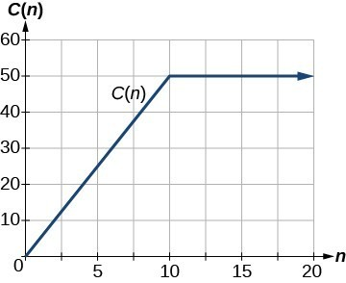
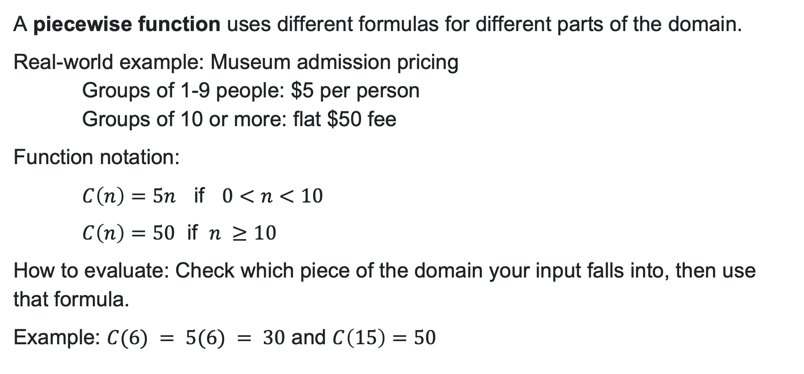
Piecewise Functions
A piecewise function uses different formulas for different parts of the domain.
Real-world example: Museum admission pricing
Groups of 1-9 people: $5 per person
Groups of 10 or more: flat $50 fee
Function notation:
$C\left(n\right)=5n$ if $0<n<10$
$C\left(n\right)=50$ if $n ≥10$
How to evaluate: Check which piece of the domain your input falls into, then use that formula.
Example: $C(6) = 5(6) = 30$ and $C\left(15\right)=50$

Slide 25
Learning Goals: Rates of Change and Behaviors of Graphs
Deepen your understanding and form connections within these skills:
1 Find the average rate of change
2 Use a graph to see where a function is going up, going down, or staying flat
3 Use a graph to identify the highest and lowest points

Slide 26
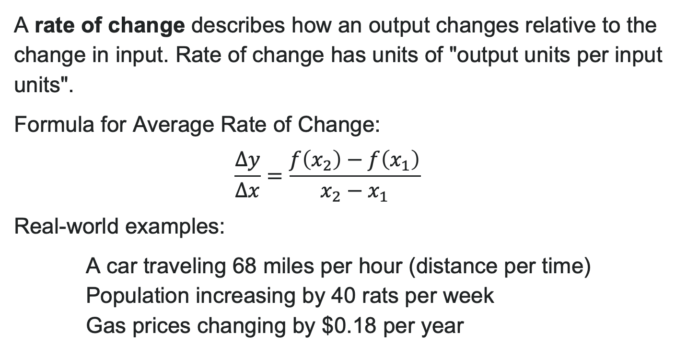
What is Rate of Change?
A rate of change describes how an output changes relative to the change in input. Rate of change has units of "output units per input units".
Formula for Average Rate of Change:
$$\frac{Δy}{Δx}=\frac{f\left(x_{2}\right)−f\left(x_{1}\right)}{x_{2}−x_{1}}$$
Real-world examples:
A car traveling 68 miles per hour (distance per time)
Population increasing by 40 rats per week
Gas prices changing by $0.18 per year

Slide 27
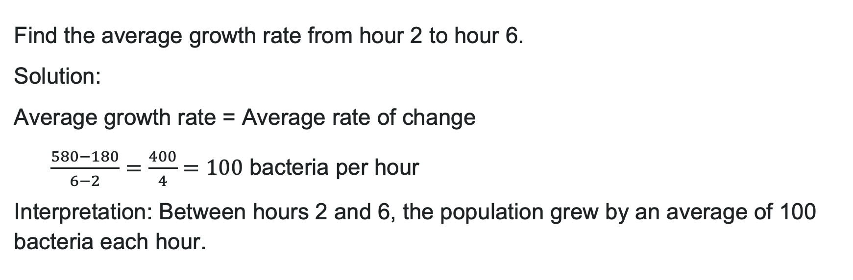
Example: Bacteria Growth
A bacteria colony's population is measured:
Time (hours) | 0 | 2 | 4 | 6
Population | 100 | 180 | 320 | 580
Find the average growth rate from hour 2 to hour 6.
Solution:
Average growth rate = Average rate of change
$\frac{580−180}{6−2}=\frac{400}{4}=100$ bacteria per hour
Interpretation: Between hours 2 and 6, the population grew by an average of 100 bacteria each hour.

Slide 28
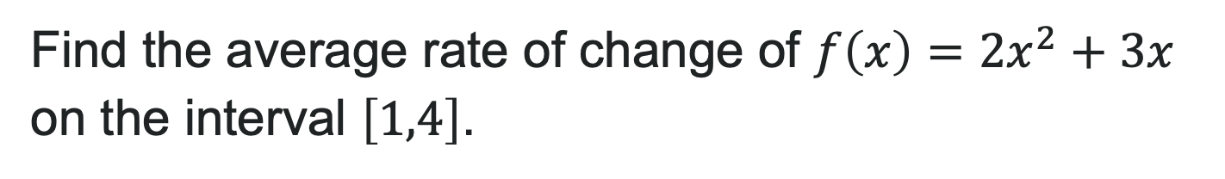
Try It: Average Rate of Change
Find the average rate of change of $f\left(x\right)=2x^{2}+3x$ on the interval $\left[1,4\right]$.
Notes:
Answer: f(1) = 2(1)^2 + 3(1) = 2 + 3 = 5 f(4) = 2(4)^2 + 3(4) = 32 + 12 = 44
Average rate of change = \frac{f(4) - f(1)}{4 - 1} = \frac{44 - 5}{3} = \frac{39}{3} = 13

Slide 29
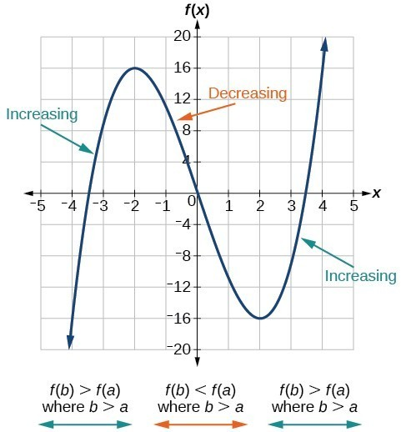
Increasing and Decreasing Functions
A function is increasing on an interval if the function values increase as the input values increase within that interval.
A function is decreasing on an interval if the function values decrease as the input values increase over that interval.
Connection to rate of change:
Average rate of change of an increasing function is positive
Average rate of change of a decreasing function is negative

Slide 30

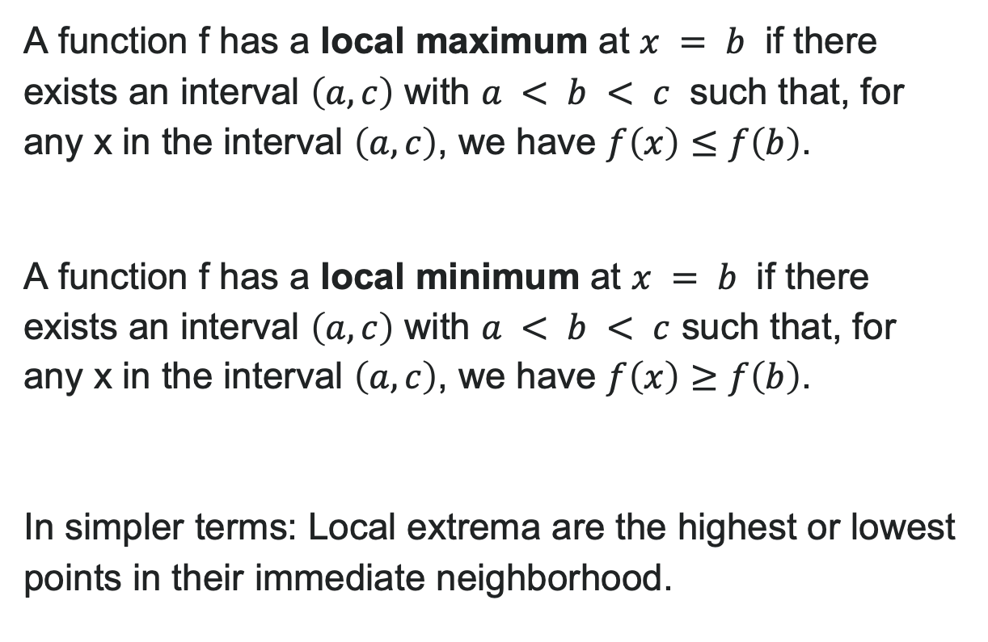
Local Maxima and Minima (Extrema)
A function f has a local maximum at $x = b$ if there exists an interval $\left(a,c\right)$ with $a < b < c$ such that, for any x in the interval $\left(a,c\right)$, we have $f\left(x\right)≤f\left(b\right)$.
A function f has a local minimum at $x = b$ if there exists an interval $\left(a,c\right)$ with $a < b < c$ such that, for any x in the interval $\left(a,c\right)$, we have $f\left(x\right)≥f\left(b\right)$.
In simpler terms: Local extrema are the highest or lowest points in their immediate neighborhood.

Slide 31
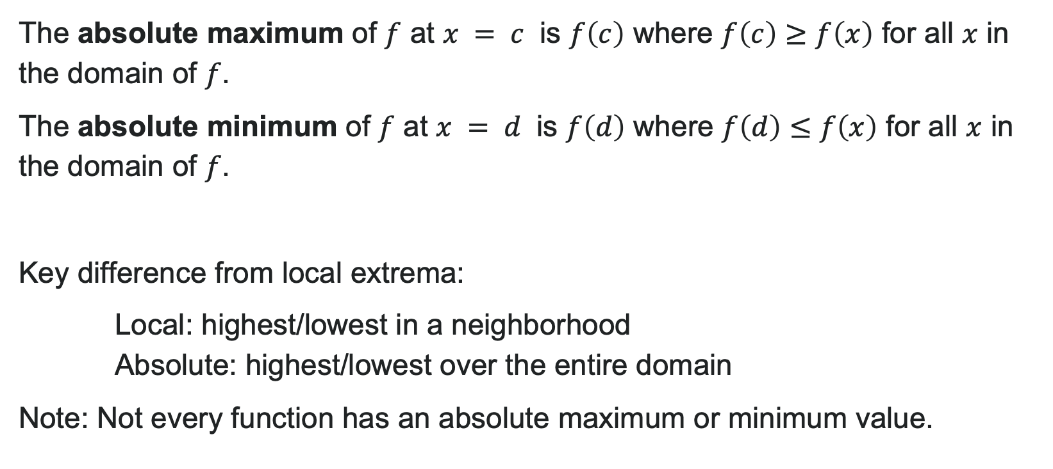
Absolute Maximum and Minimum
The absolute maximum of $f$ at $x = c$ is $f\left(c\right)$ where $f\left(c\right)≥f\left(x\right)$ for all $x$ in the domain of $f$.
The absolute minimum of $f$ at $x = d$ is $f\left(d\right)$ where $f\left(d\right)≤f\left(x\right)$ for all $x$ in the domain of $f$.
Key difference from local extrema:
Local: highest/lowest in a neighborhood
Absolute: highest/lowest over the entire domain
Note: Not every function has an absolute maximum or minimum value.

Slide 32
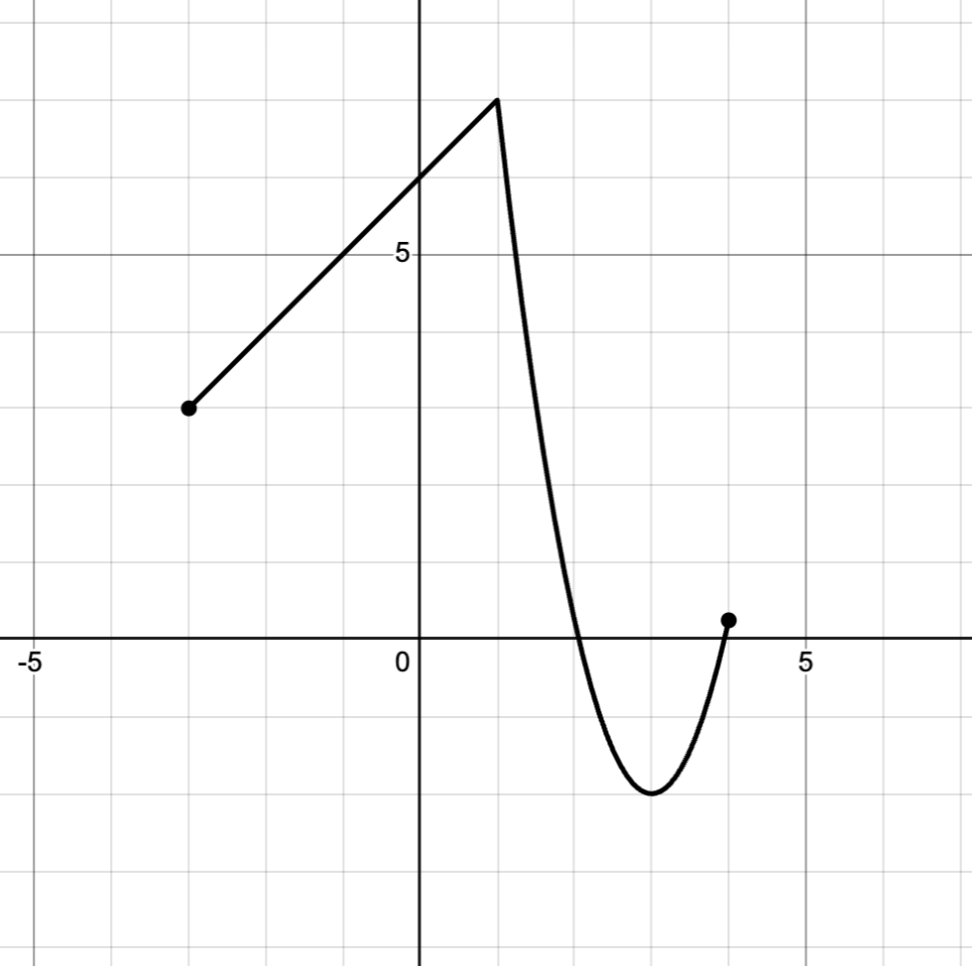
Try It: Absolute Extrema
Use the graph below to identify:
a) The absolute maximum value and where it occurs
b) The absolute minimum value and where it occurs
Notes:
Answer: a) The absolute maximum is 7, and it occurs at x = 1
b) The absolute minimum is -2, and it occurs at x = 3

Slide 33
Before we finish up…
2
Next steps…..
3
Reminders about student hours, upcoming deadlines, campus activities ….
1
Questions…..

Slide 34

Attributions
Illustrations are from Storyset
Authored by: Lumen Learning. License: CC BY: Attribution

